Slide 1
Snowmass 2013: a look back, and a view forward
J. Campbell, J. Huston
for K. Hatakeyama, F. Petriello

Slide 2
QCD and the Strong Force
…our charge was fairly broad
…and a lot of interaction with the EWK group
Joey Huston
Michigan State University
for the QCD conveners
John Campbell, Ken Hatakeyama, Frank Petriello
Note: 2020
comments in
black
I think the division into more focused sub-groups is probably a better idea. There
certainly has been more interest expressed than in 2013. Maybe because of zoom.

Slide 3
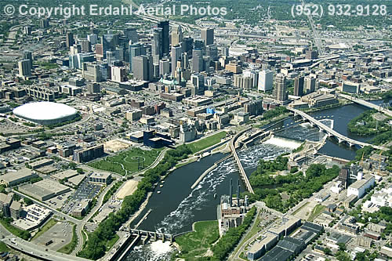
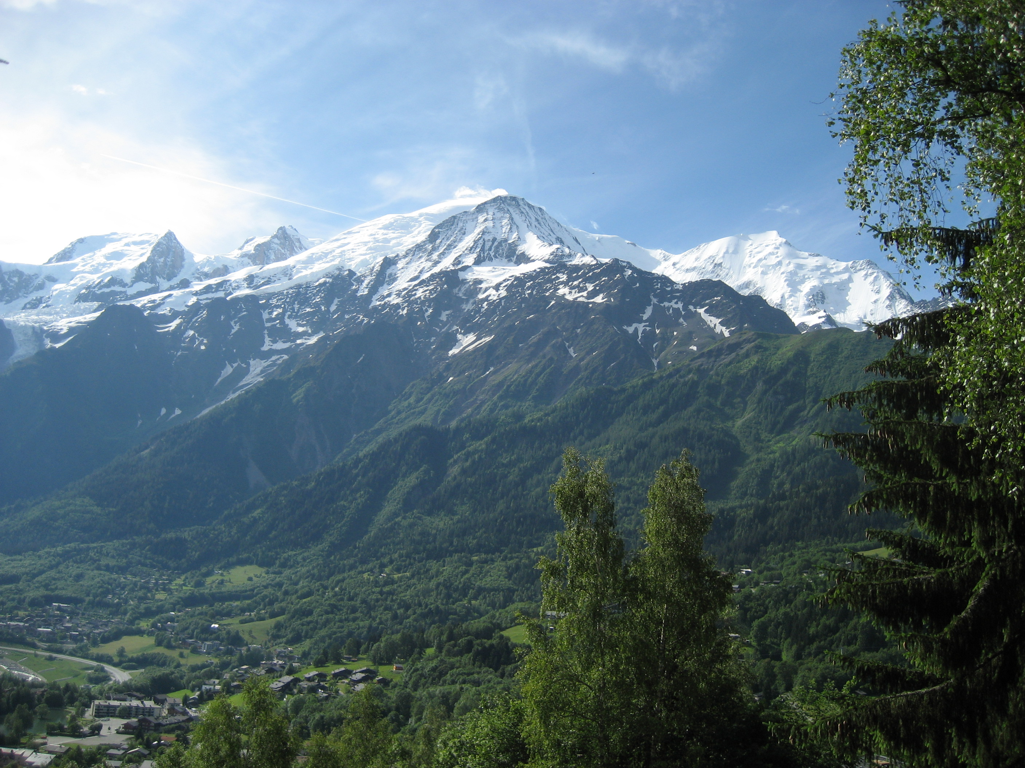
Snow-Houches
There was a lot of cross-talk and collaboration between the Snowmass process and Les Houches
Note that both were spread out over roughly a year
+

Slide 4
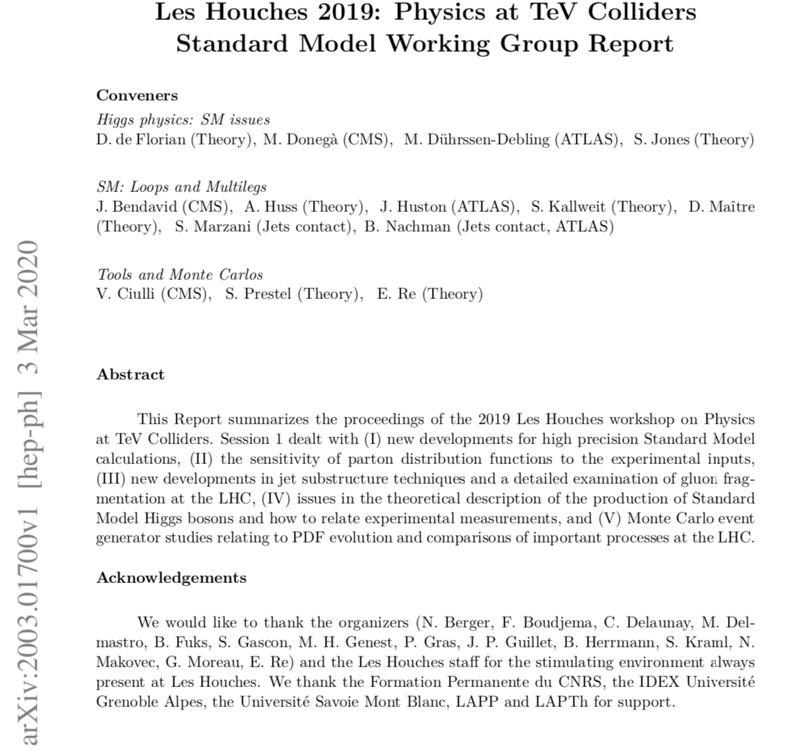

Slide 5
2013 Charge
The charge for the QCD group (like every other group) is to determine the
current state of the art
what is likely/priority for the next 5 years?
what is likely/priority for longer time scale (20 years)?
Of course a) is the easiest, b) is less so and parts of c) are in the realm of pure speculation
We have broken down each question into a series of more definite sub-issues that should be addressed. For each issue, we include a discussion of the current status and outlook, some possible projects, and overlap/synergy with the other physics groups.

Slide 6
Question 1a
What are the prospects for future higher order calculations at NLO and matched with parton showers? What subtleties remain to be understood for precision measurements?
By now this is a well-understood field. Any reasonable cross section can be calculated automatically, and interfaced with a parton shower. One example of state-of-the-art is gg->Higgs +1,2 and 3 jets at NLO. Speed is still an issue, though, for states this complex.
There are still issues with matching and merging that one has to be careful about
…and with giving too much phase space to the parton shower; see for example the first attempt to include HH at NLO in Powheg
Recoil scheme seems to be the key to reach NLL accuracy; going beyond? NLO?
We now can also include NLO EW corrections in an automatic way, crucial for high p_{T} processes at the LHC, and even more so for a 33 or 100 TeV collider
The frontier now is interfacing NNLO predictions with parton showers; state of the art is 2->1; want 2->2

Slide 7
Precision
First of all, remember the damn fixed-order calculations
This is the first line of precision
There are still a number of issues to be tackled when using these precise matrix elements in a parton shower Monte Carlo
matching/merging: the introduction of resummation scales
PDFs: first of all, remember not to use the damn leading order PDFs
even at NLO or higher, there are still issues between the evolution that happens in the parton shower (non-collinear) and the normal PDF DGLAP evolution (collinear)
precision
See Stefan Prestel in Les Houches 2019

Slide 8
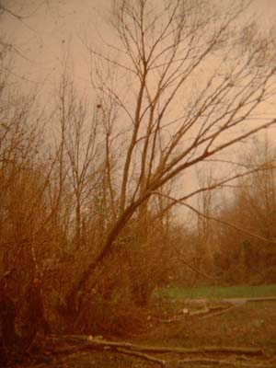
Question 1b
Once we have the NLO and NNLO calculations, how do we (experimentalists) use them?
If a theoretical calculation is done, but it can not be used by any experimentalists, does it make a sound? Or create a citation?
We need public programs and/or public ntuples
Often-times, the program is too complex to be run by non-authors
Old(er) approach: ROOT ntuples
works well for NLO calculations, i.e. Blackhat+Sherpa, gosam, etc
maybe too bulky for NNLO (100 TB)
work in progress to allow for more compact storage; see D. Maitre in Les Houches 2019
New approach: applFast; only full
application so far is for jets in DIS;
need for more NNLO 2->2; ultimate
goal is for programs like NNLOJET to
be made public->see LH 2019

Slide 9
Question 1c
Survey of the importance of EWK corrections. Do we need an EWK wishlist similar to the now-defunct NLO QCD one
Where are combined QCD-EWK corrections important?
EWK corrections important for many of the kinematic regions at the LHC, both current and to be expected with 4000 fb⁻¹
it’s what Kalanand Mishra in 2013 called “the Sudakov Zone”
Even more so for 33 or 100 TeV
QCD and EWK corrections can be of equal importance
See later discussion of Les Houches wishlist

Slide 10
Question 1d
The frontier for NNLO is 2->2 processes
What processes do we need calculated?
What is the timescale?
To date, most NNLO calculations are 2->1 (W/Z/Higgs)
Multiple NNLO calculations containing colorless final states (diphoton production, W+Higgs production) have recently been completed
Several partonic channels contributing to tt at NNLO have been completed and full result is expected soon
Work is proceeding on dijets, W/Z+jet, Higgs+jet
Work is finished on basically all 2->2 processes
2->3 is the new frontier; 2 years away?

Slide 11
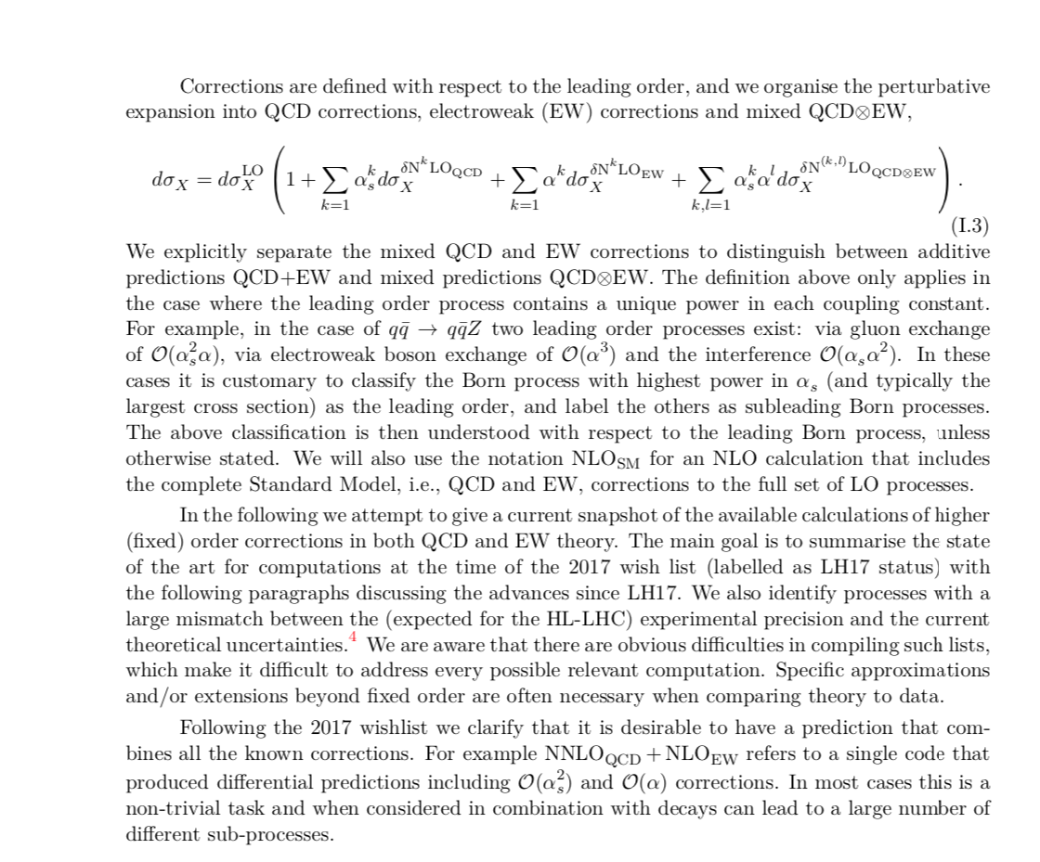
Les Houches wishlist
One of big remaining
uncertainties, especially
for predictions that have
large higher order
QCD corrections

Slide 12
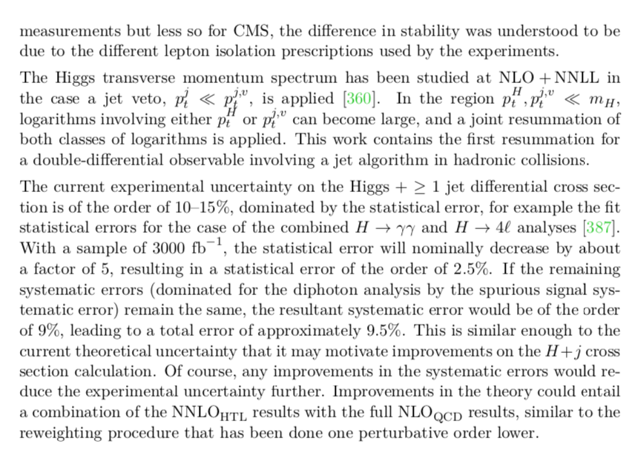
Status and Desired
example for H+1jet
more work needed on
experimental motivations

Slide 13
Question 2a
Can jet analyses be repeated with different (infra-red safe) jet algorithms and/or jet sizes?
Both major LHC experiments are using the antikT algorithm (which is good) but different jet sizes (which is bad). Physics analyses can be automated to the extent that there is no reason not to carry them out with several jet sizes and/or several jet algorithms. Each algorithm/size may illustrate different aspects of the underlying physics.
Both ATLAS and CMS carry out inclusive jet measurements with two different R sizes
Recently, CMS has published inclusive jet cross sections over a very wide range of R

Slide 14
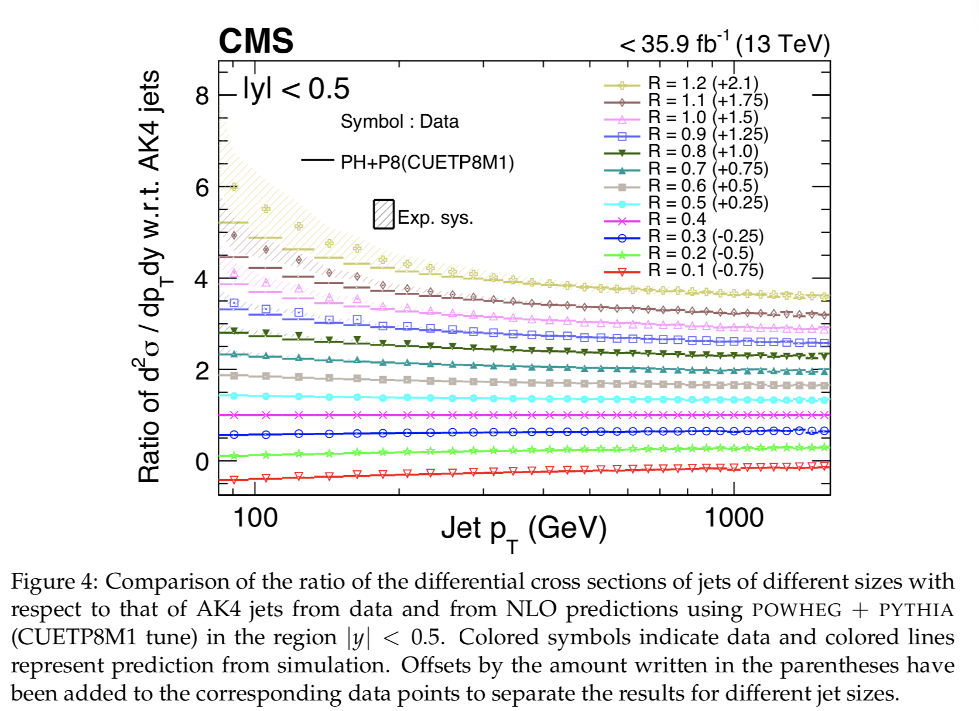
arXiv:2005.05159
useful for
understanding
of both
perturbative and
non-perturbative
corrections

Slide 15
Jet cross sections at the LHC and the quest for higher precision: arXiv:1905.12563
NNLO describes jet shape essentially as well as parton shower, i.e. it describes the R-dependence of cross sections very well
NNLO has a better normalization than ME+PS predictions (NLO), but shapes of differential distributions well-described by NNLO, i.e. parton showers have little effect on inclusive distributions
(naïve) NNLO estimates of the scale uncertainty can dramatically underestimate the scale uncertainties for small R (~0.4)

Slide 16
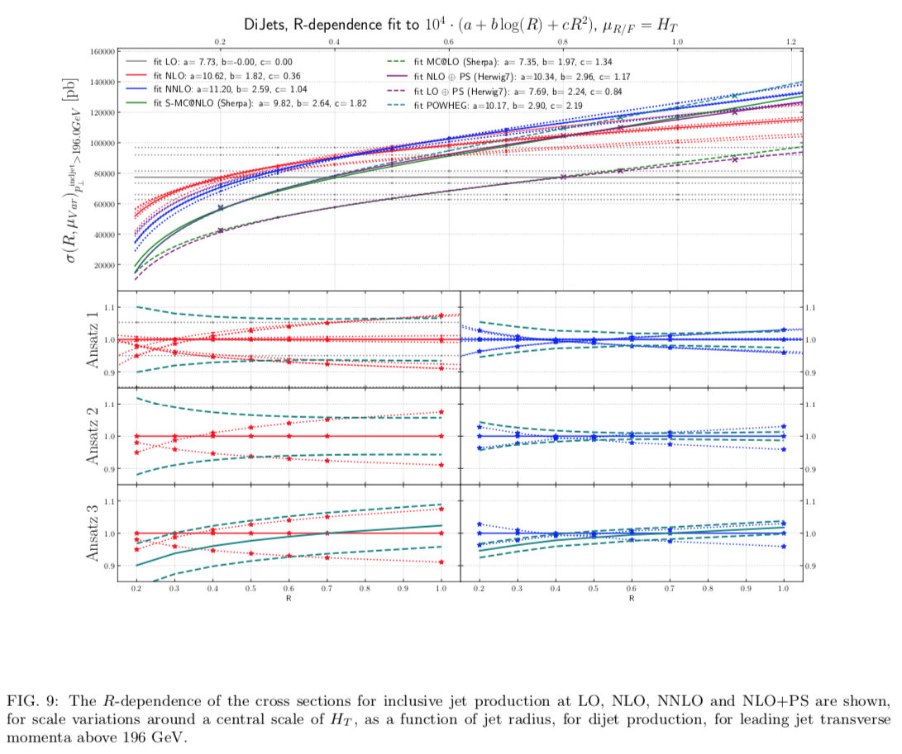
scale uncertainty
crosses zero around
R=0.4
better estimate of
uncertainty through
treating the process
as a production of a
large R jet and the
subsequent
fragmentation of
that jet into a small
R jet
see also
discussion in
arXiv:1602.01110

Slide 17
Question 2b
Can jet substructure, in particular for boosted systems, be put to wider use in other physics analyses?
There has been a great deal of attention given to jet substructure, especially for boosted systems. These tools can also be put to use for most physics analyses, again to try to understand the underlying physics better.
Yes, it has become a widely popular tool
Not universally applied yet, but in a large number of measurements

Slide 18
Question 2c
At what future luminosities might existing jet algorithms cease to be robust? What techniques may be introduced to stabilize them?
The antikT algorithm, and the accompanying techniques, have worked well at the LHC,even with current luminosities resulting in >=30 additional events per crossing. Studies need to be carried out to see at what pileup rates, existing jet algorithms may cease to be robust, and better clustering techniques may need to be developed.
We have experience now with high pileup conditions and many studies have been conducted to scale up to higher pileup conditions, with jet area subtraction techniques

Slide 19
Question 2d
Can particle flow techniques be taken advantage of in future jet algorithms?
Both ATLAS and CMS have used particle flow techniques to improve the jet energy scale determination. Such techniques are considered as crucial for future linear collider experiments, and it may be that new jet algorithms can be developed to take advantage of the commensurate granular resolution inherent in such techiques.
Both ATLAS and CMS use particle-flow jet reconstruction as their primary method. leading to high precision for jet energy measurements

Slide 20
Question 2e
Can event shapes such as jettiness be useful in future measurements, and should the experimental collaborations study their implementation at the LHC?
There has already been some work by ATLAS and CMS, but this is an area that needs to be developed further
It has been developed further
There has been an explosion of both experimental and theoretical work, that allows a better understanding of interesting (and non-interesting) final states

Slide 21
Question 3a
What impact will LHC data have on PDFs?
How can the precision of global PDFs be improved?
There has been a great deal of work on understanding PDF predictions and uncertainties at the LHC, in particular by the PDF4LHC working group.
The DIS data, including both HERA and fixed target are the dominant ‘deciders’ in global fits. Collider cross sections, however, are often directly sensitive to the gluon distribution in a way that DIS data is not. As the statistical and systematic errors improve, the use of LHC data in global fits will accelerate. It is crucial that correlated systematic error information be published for all of this data.

Slide 22
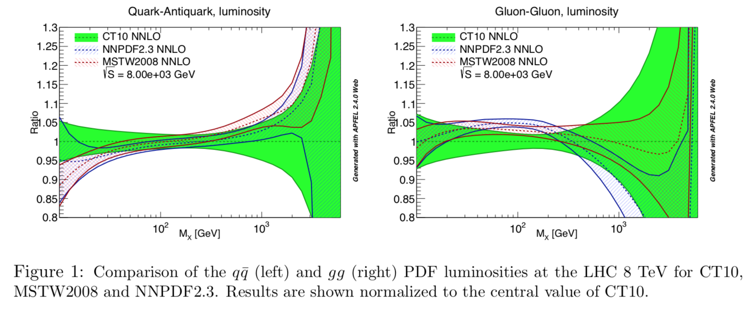
Situation going into Snowmass 13

Slide 23
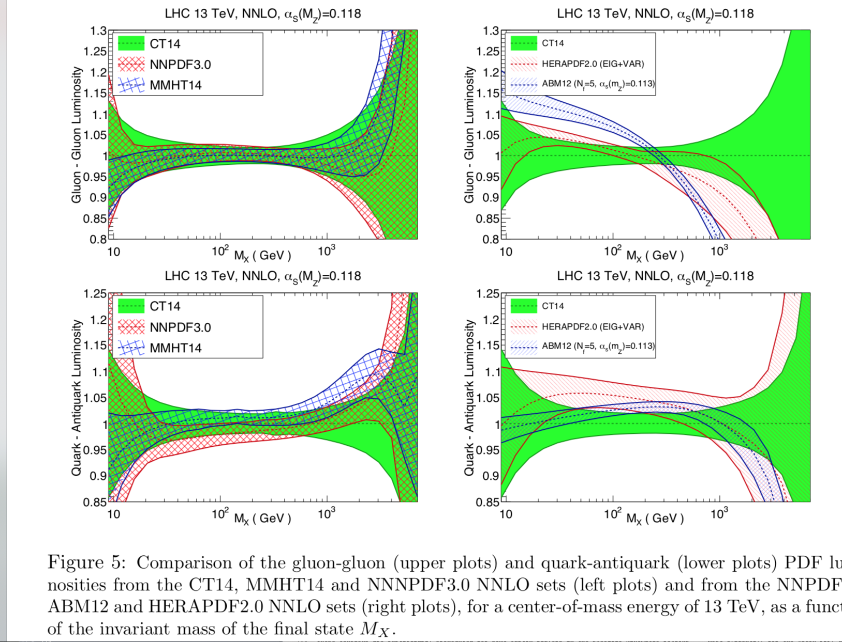
Afterwards

Slide 24
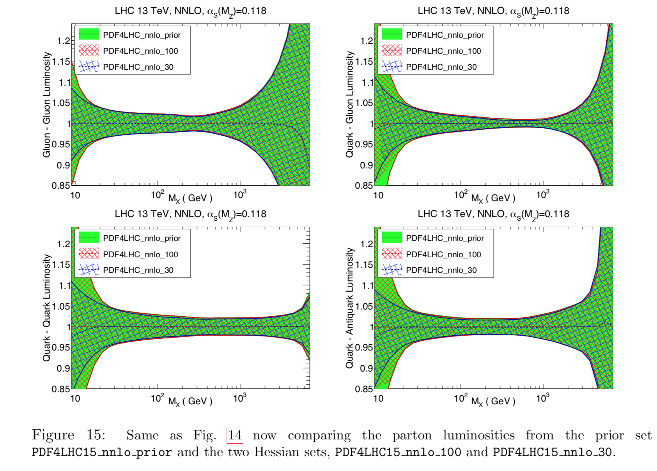
PDF4LHC15 combination
NB:
PDF4LHC_30
imposed a
rapidity cut of
of +/-5 in these
plots; the
others did not,
resulting in a
somewhat
different
uncertainty
range at very
low mass

Slide 25
…but very little LHC data in previous plots
…much more in CT18

Slide 26
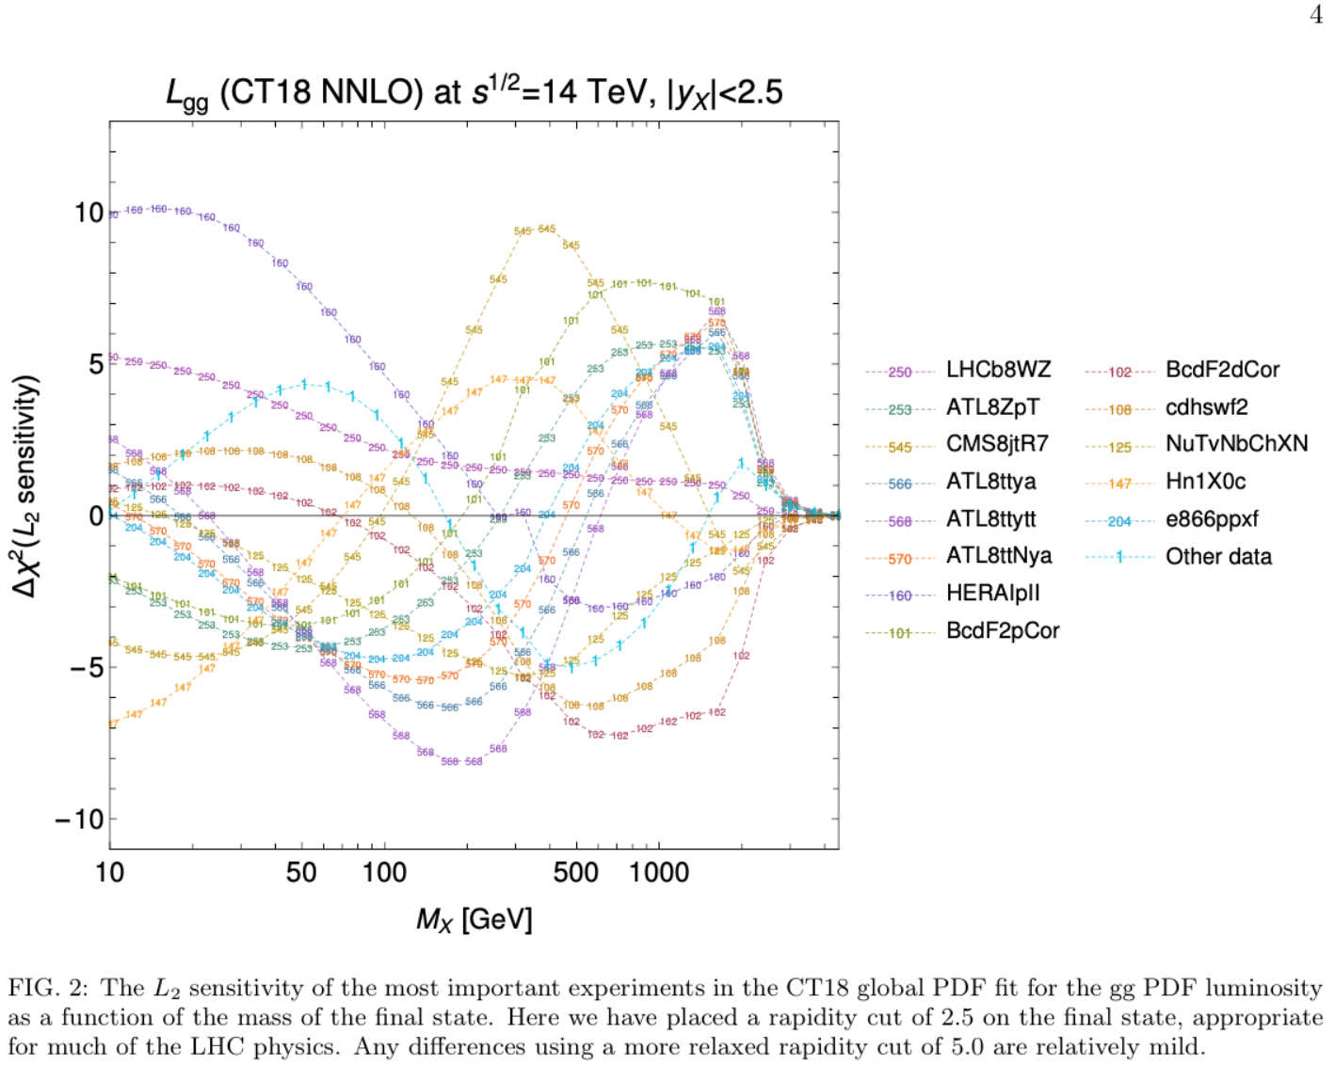
more data does not
necessarily mean that
PDF error bars decrease, if
some data sets are in
tension with each other
L2 sensitivity calculated
before fit

Slide 27
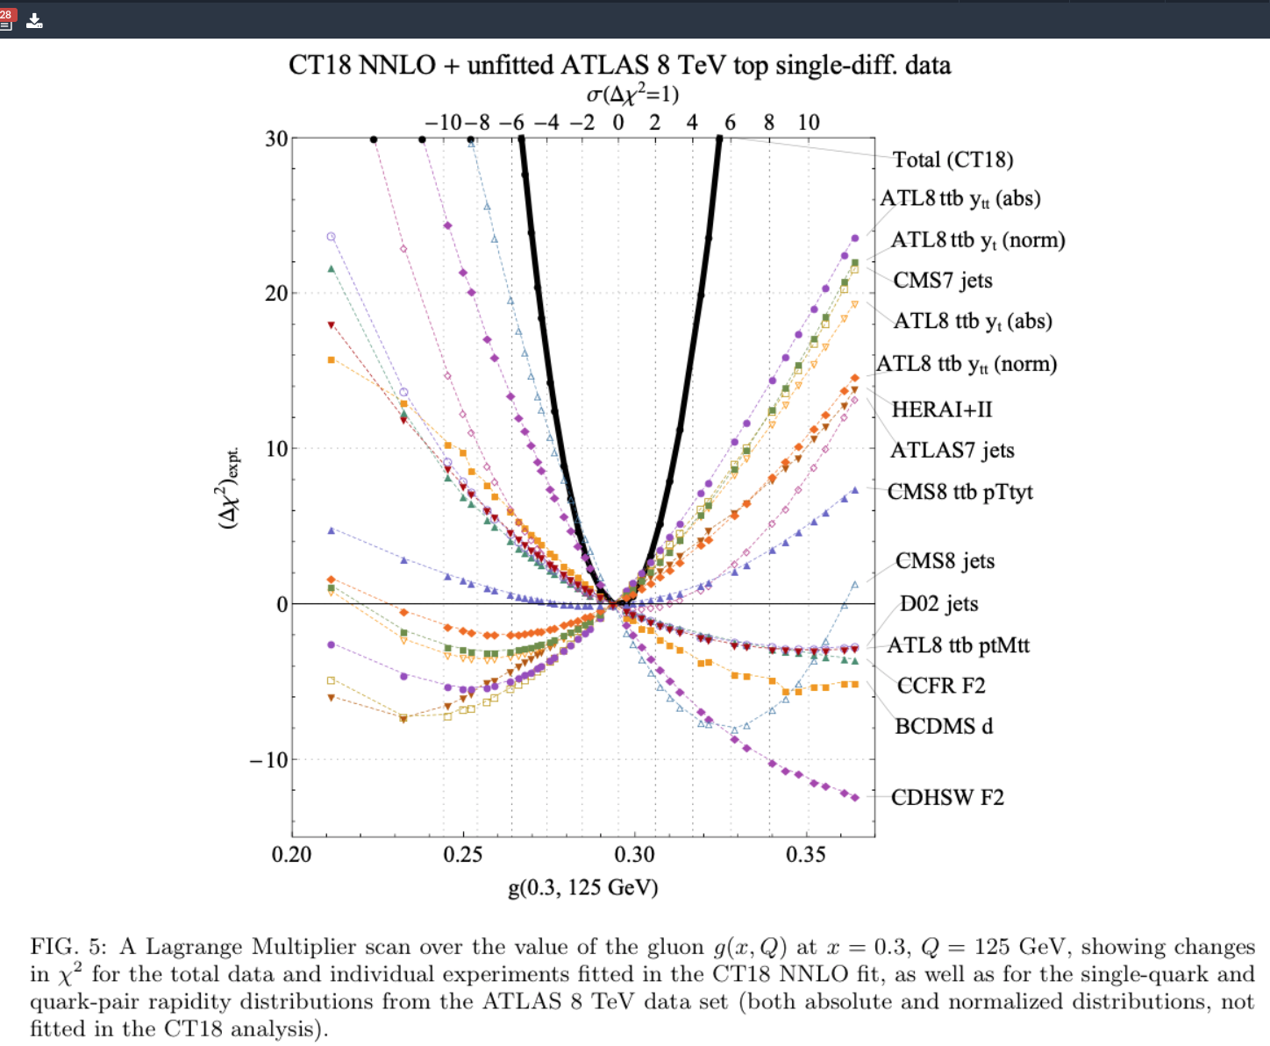
Lagrange Mutiplier studies after the fit
Note the tension,
for example,
between CMS
7 and 8 TeV jets

Slide 28
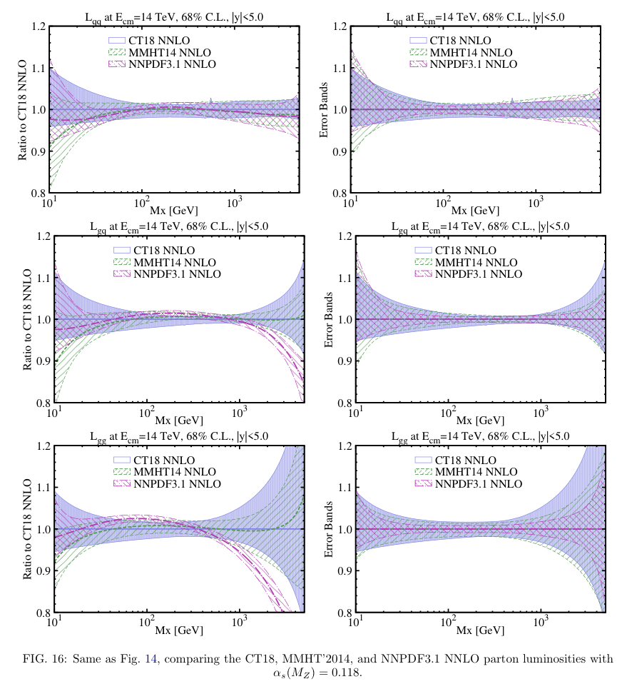
PDF uncertainty still one of
main uncertainties for gg->H
MMHT and NNPDF will be
coming out with new
PDF sets containing
similar amount of LHC
data as CT18
are commencing a
benchmark study similar
to PDF4LHC13 that will
involve a combination
will be reported on in
Future Snowmass meetings

Slide 29
Question 3b
How much better might an eLHC constrain PDFs? Is the improved precision necessary?
Now we’re talking more about an EIC (in the proton-proton mode)
Good tie-in to heavy ion physics
The LHC probes PDFs in ranges outside of direct investigation possible in HERA. This will become even more true with higher running energies for the LHC, or a possible successor. An eLHC will serve to directly determine PDFs in this new kinematic regime.
The information provided will be superior to that determined by the inclusion of collider data in the PDF fits, but it should be investigated how necessary that increased precision might be.

Slide 30
Question 3b+
What are the prospects for improving the theoretical description of PDFs?
How important is a good knowledge of the photon PDF?
What does having a negative gluon imply?
(That you’re starting at too low of a scale)
The ultimate accuracy may require NNNLO PDFs, but that is certainly in the future
One thing that is clear is that lattice determination of PDFs will become increasingly important
For example, including QED corrections in the evolution, or even moving beyond NNLO. (See Durham EWK workshop for discussion of QED effects in PDFs.)
Photon PDFs are now common-place, and the photon distribution is well-determined
…as is QED evolution
Frontier is EW evolution, and W/Z PDFs

Slide 31
Question 3c
What are the prospects for improved measurements of α_{s} at the LHC and future colliders?
And from lattice gauge theory
Measuring α_{s}, and its running, is one of the most fundamental of QCD tests
…and along with PDFs is one of the main uncertainties for gg->H

Slide 32
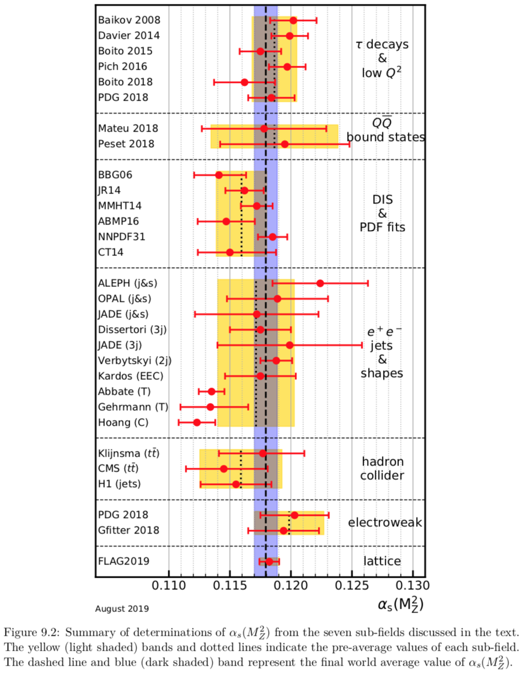
JH, with Klaus Rabbertz and Giulia
Zanderighi α_{s}=0.1179+/-0.001
For the first time, the uncertainties for
lattice and non-lattice determinations
agree with each other, both in central
value and uncertainty
There can be a lot more determinations
from the LHC; difficult to compete with
lattice precision

Slide 33
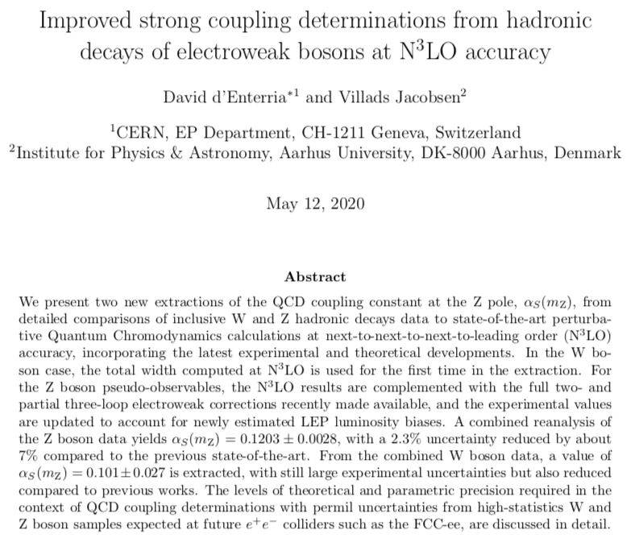
…for example

Slide 34
Question 6
How hampered are we by our limited understanding of non-perturbative physics?
Of course, there has been a great deal of progress in the last 7 years, but I think that ATLAS and CMS still have different assumptions about non-perturbative corrections, and it would be useful to understand why systematic uncertainties from this source seem to be different.
This includes both effects such as jet fragmentation as well as the multiple parton interactions that make up the bulk of the underlying event. Another issue is the definition of kinematic quantities that have been treated in a classical sense to date, but for which increased precision requires a better theoretical basis; perhaps foremost among these is the measurement of the top mass to both the current precision and to the improved precision that will be possible with further LHC running and at future machines.

Slide 35
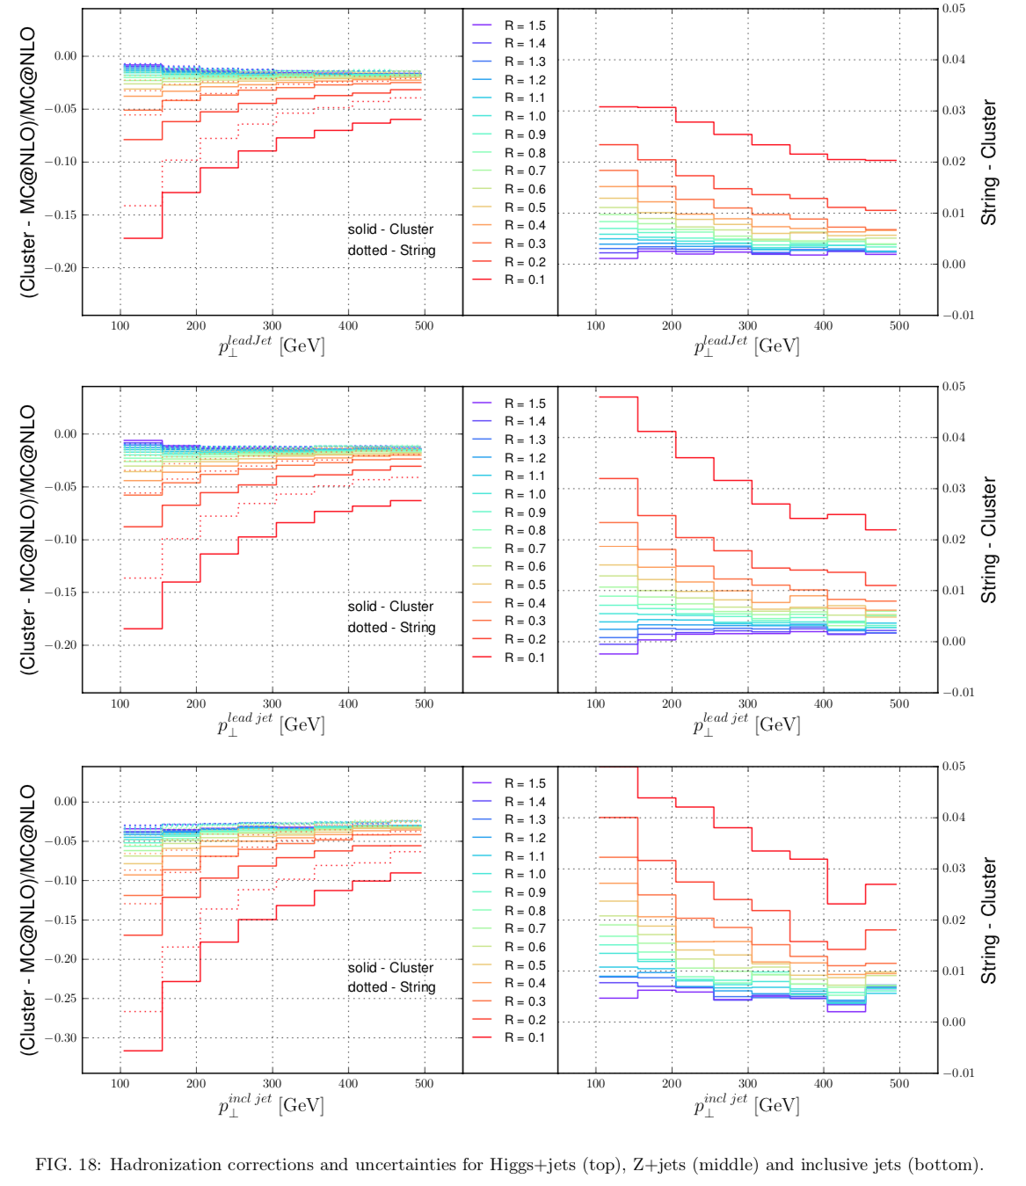

Slide 36
Summary
There were more questions, but I’ll stop here
The charge of the 2013 QCD group was quite large, the number of people quite small, and there were no explicit sub-groups per se
We think it’s a good idea to have the kinds of sub-groups that we’ve seen in the organization, and we’re also impressed by the number of people who have connected, including the number of Europeans
If nothing else, video technology has improved a great deal in the last 7-8 years
It’s also a good idea to have regular meetings, at least once a month

Slide 37
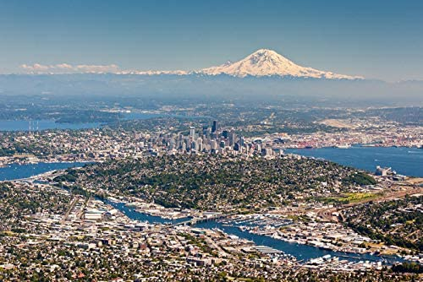
Snow-Houches
Many of these issues have been/will be addressed in the Les Houches workshops which have taken place since 1999
We will try to coordinate some of the common work between the two
At least, there’s a damn mountain this time
+
==Snow-Houches, the sequel

Slide 38
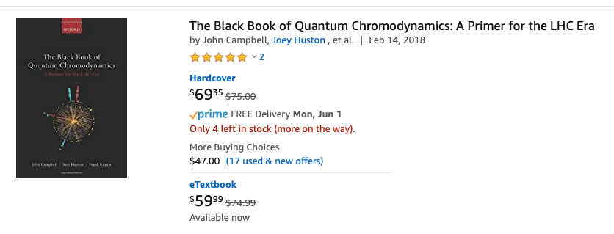
One book to rule them all

