Slide 1
Interesting Quantum R&D Activities
Jim Kowalkowski
SCD Projects Meeting
06/25/2020

Slide 2
Fermilab Quantum Institute – reminders of structure
https://quantum.fnal.gov/
Two aspects
Quantum Science Program: algorithms, theory, controls (networks)
Quantum Technology Program: sensors, devices, systems
We are mainly involved in the science program, but work directly with the technology group
Many small QuantISED grants are active now
Adam Lyon: Large-scale (HPC) open quantum systems simulations (w/ANL)
Gabe Perdue: Machine learning and optimization (w/ORNL)
Gustavo Cancelo: Controls (w/UChicago)
Alex Macridin: Spin systems with VQE (FNAL theory group)
Panagiotis: Quantum networking (Caltech, Northwestern)
Steve Mrenna and I are part of the projects that Gabe and Adam run

Slide 3
Some of the key initiatives
National Quantum Institute call
Fermilab put in a proposal focused on SRF-based qubit systems, QIS, algorithms, and material science led by Anna Grassellino, partnered with NASA and many universities
Panagiotis, AlexM, AdamL, myself included and many others from Tech Division and theory
Five are in the running, probably three will make it (FNAL/NASA, ORNL/LANL, UofC/ANL, LBNL/Sandia, Brookhaven/others)
Steve Mrenna included on the ORNL-led proposal for HEP theory
Partnerships with industry
Rigetti: CRADA is still in the works for linking to HEPCloud to to connect HEP to quantum resources. Several SCD folks involved (Burt, Tony, Andrew, Adam, Farrukh).
IBM: We are part of the IBMQ network through ORNL
Google
Honeywell and AWS Braket are in the works

Slide 4
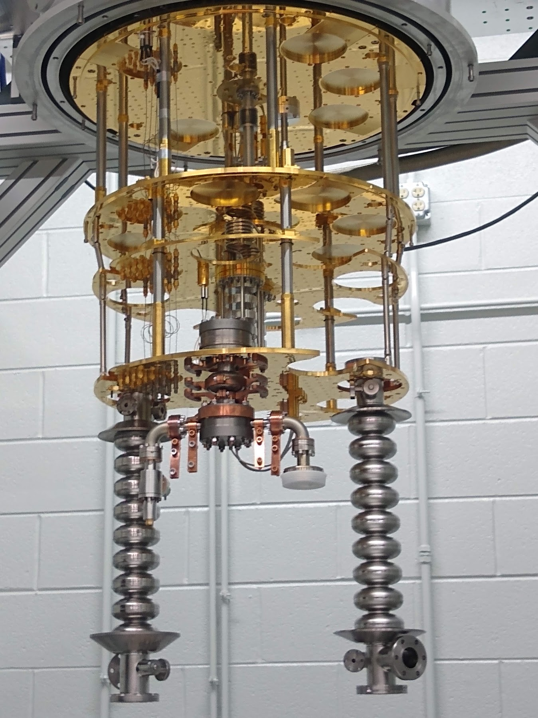
What’s exciting and interesting?
We can run quantum circuits that
Find valid solutions to difficult optimization problems on Dwave and IBMQ
Do classification tasks on Google’s Sycamore chip using SVMs
Show results from Rabi model using Rigetti device and VQE
Running a program is similar to running a physics experiment.
Superconducting qubits have short coherence times (10s of microseconds), are noisy (very limited in kinds of gate sequences that can be executed and measured), and can only handle the smallest toy problems.
The system we (FNAL) are constructing from SRF cavities will be interesting
Very long conherence times and very high fidelity expected,
qudit capabilities (2^10 levels possible)
Adam and I are working to help develop simulation capabilities with Eric Holland
Current systems can solve (small) problems using hybrid algorithms and variational methods (VQE, QAOA)

Slide 5
Many other areas involving quantum
There are many other aspect of the quantum science program. I’ve only touched on a few here.
Examples:
Sensors for axion detection (Aaron Chou, Daniel Bowring)
Cryo electronics and ASICs (Farah Fahim, Davide Braga)
Quantum Computing device development with SRF (Eric Holland)

