Slide 1
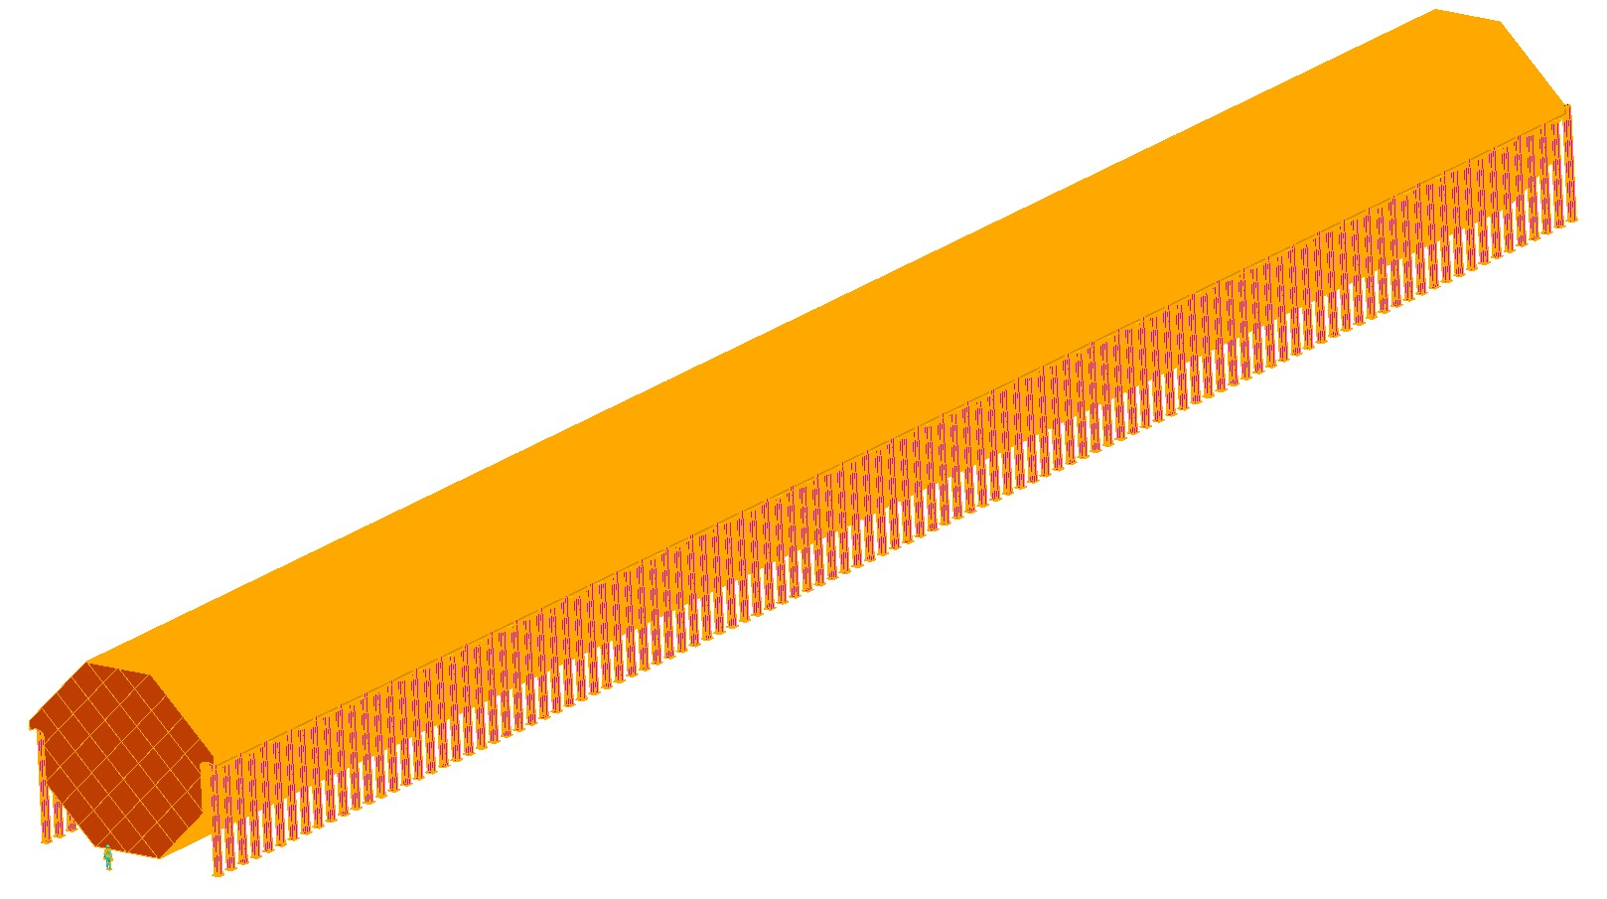
MINOS-MIND Simulation Meeting
Technology & Engineering
Motivation and Goals

Slide 2
M&G
This is really an “outreach” service meeting for our MINOS colleagues
Thanks
To date, the NF detector (MIND) simulations have used a rather “idealized” detector model
We (MIND) claim to be able to measure some things to a precision of better than 0.01% (muon charge)
Next round of simulation for MIND must include realistic detector
Field
Scintillator response
Etc +?
From this meeting we hope
Gain some additional insight regarding how detailed (B) needs to be in next round
Explore other detector and simulation issues (given MINOS’ experience) that need to be addressed

