Slide 1
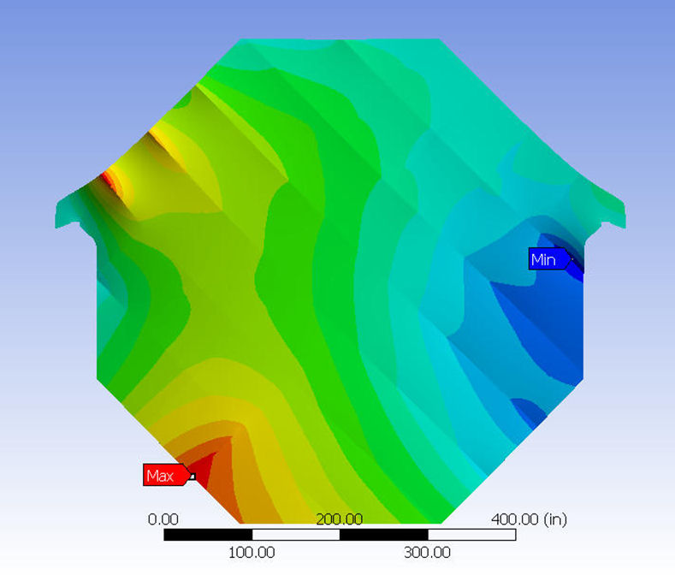
Magnetized Iron Neutrino Detector MIND
Technology & Engineering

Slide 2
Outline
Basic concept
Technology choices
Engineering details
Where we are & where we are headed
R&D requirements
Costing
Conclusions

Slide 3
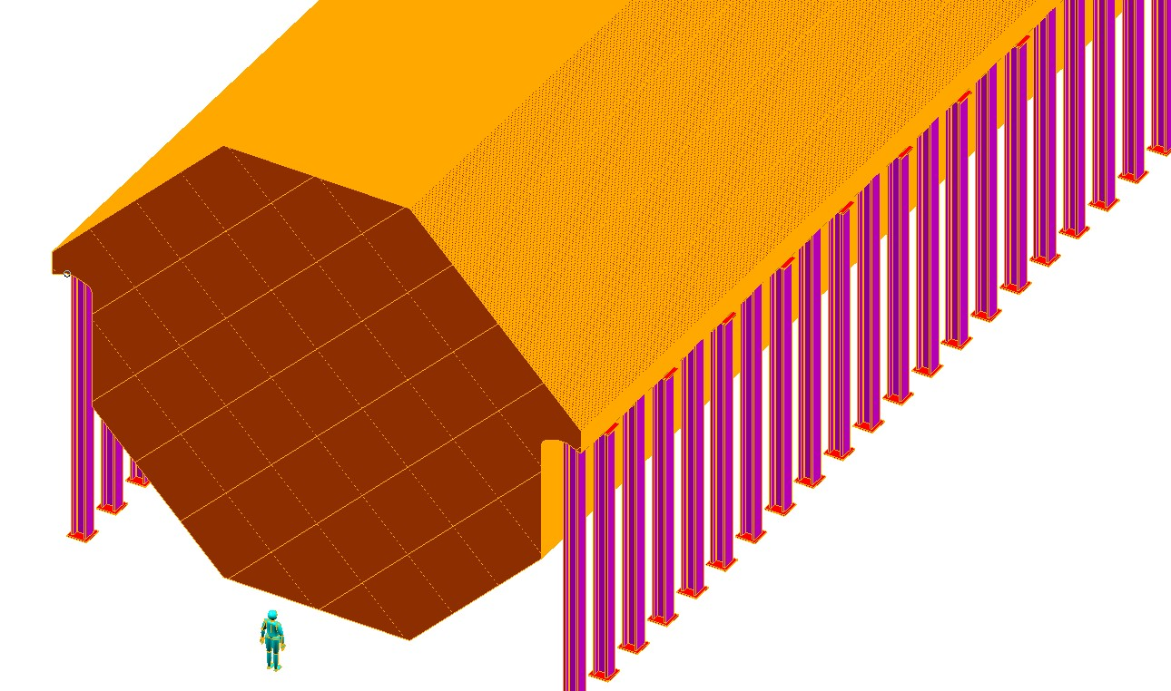
Basic Concept
MIND is an iron and scintillator sampling calorimeter which is essentially a larger version of the MINOS detector (20X)

Slide 4
Draw from MINOS’
Follow the MINOS Assembly Approach

Slide 5
14m X 14m X 3cm Fe plate
Initial calculations indicated “hanging” stresses too large
Detailed plate design + ANSYS analysis
OK

Slide 6
Side-View Detail
Support Beam

Slide 7
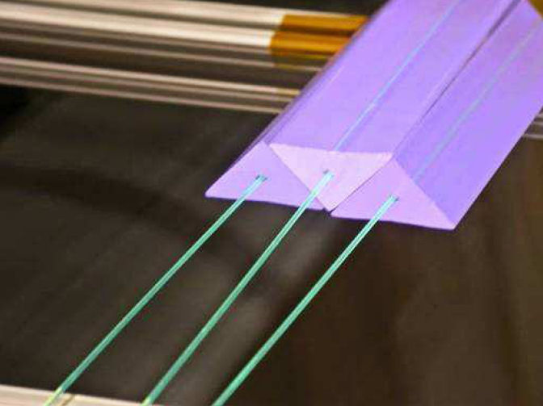
Readout planes
X + Y views of scintillator extrusions between each plate (MINOS alternated, X or Y)
Wavelength shifting fiber readout
Solid-state photon detector (SiPM)

Slide 8
Engineering Details Fe Plates
Two plate models were developed
One with 2m strips
One with 3m & 2m strips
Two layer (1.5 cm thick each), cross-strip design
Plug welded mosaic
Both yielded acceptable performance
Stresses
Buckling
Deformations

Slide 9
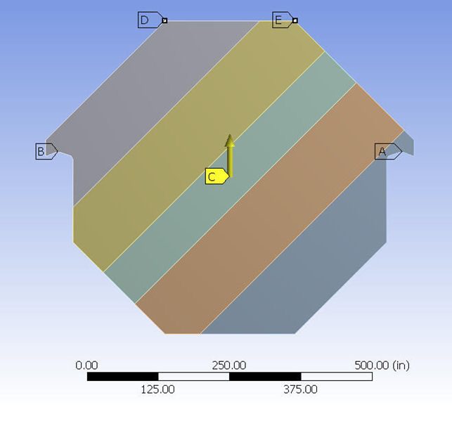
Fe Plate Designs
2m strip
2m & 3m strip

Slide 10
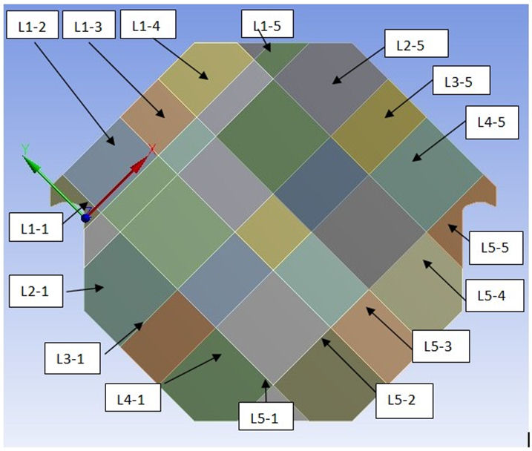
3D Plate Design

Slide 11
Plate deflections

Slide 12
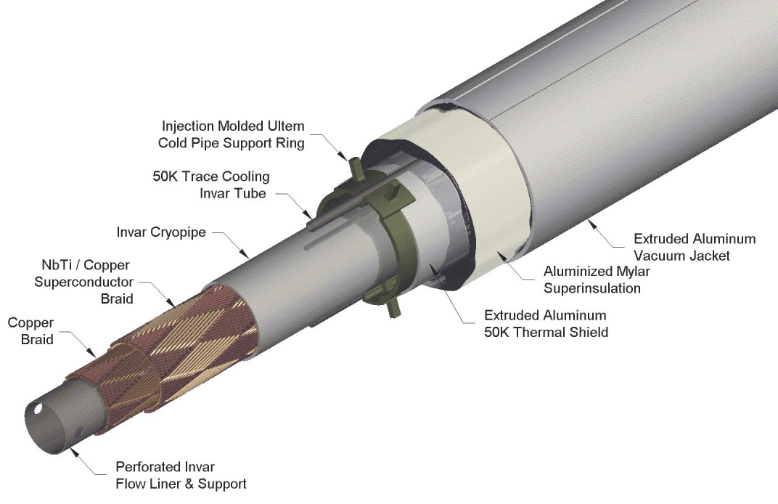
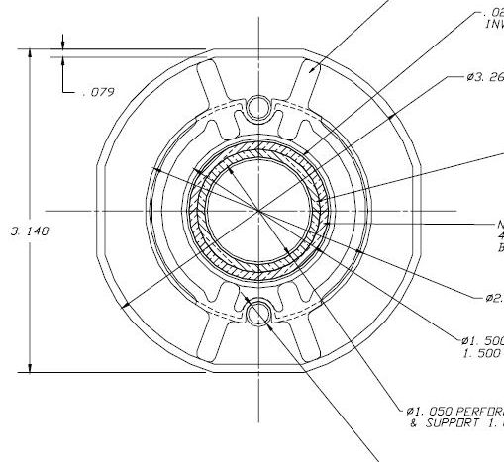
Engineering Details Magnetization
Baseline is to use the superconducting transmission line (STL) developed/prototyped for the VLHC
100kA-turn
80 mm diameter
100mm hole
Average ρ ≈ 0.5g/cm³

Slide 13
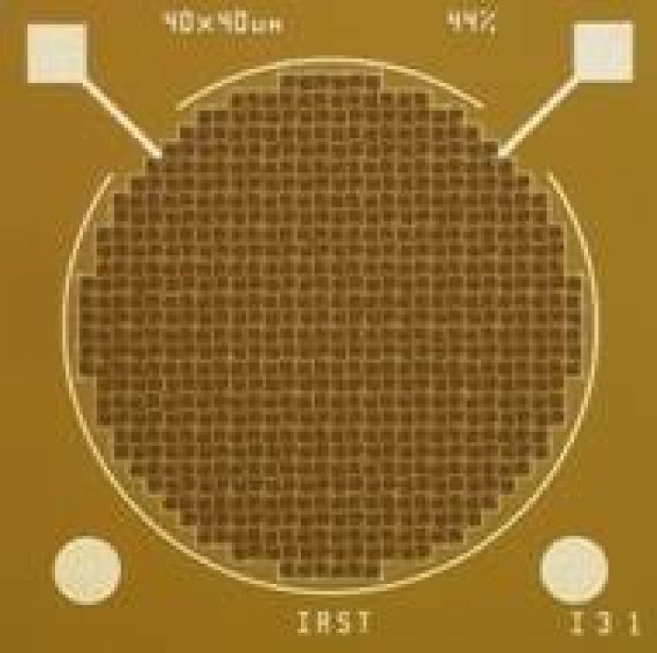
Photo-detector & Electronics
Silicon avalanche photodiode operating in Geiger mode
SiPM, MPPC, MRS, etc
Aggressive, world-wide R&D
Readout Electronics
Front-end chip on SiPM
ASIC back-end

Slide 14
R&D requirements
Steel
None, mature technology.
Magnetization
Investigate STL with multiple superconductor loops within the STL cryostat
Smaller external excitation current
Photodetectors
None
On-going world-wide activities deemed sufficient for now
Scintillator
Advanced and mature technology, however:
Need to specify final shape
Impact on production & cost
Engineer detector plane mechanics
Fiber
Co-extrude with scintillator (good, but not essential)
Develop 2nd vendor with university participation

Slide 15
Costing
Plan to use CERN costing model, but already have detailed template from MINOS
Steel
Cavern
Scintillator
As built costs for surface building from Noνa
Plus updated fiber cost for very-large quantity

Slide 16
MINOS Costing Model

Slide 17
It is Always better to be Lucky Than Smart
MINOS Production

Slide 18
Conclusions
Although the size (100kT) of MIND is daunting, the detector technology and engineering is mature
5 kT prototype (MINOS)
Mature technologies with little or no required R&D
Steel and magnetization
Scintillator
Extruded scintillator technology significantly advanced since the time of MINOS production

Slide 19
Conclusions II
Required R&D is limited and well-specified
Iteration on the superconducting transmission line design of the VLHC
Photon detector
Take wait and see approach for now
Scintillator
Details of extrusion shape
Study large-scale production issues
Co-extrusion of commercial fiber and bulk scintillator
Not a requirement – cost issue

Slide 20
END

