Slide 1
Snowmass 2021
Accelerator Frontier
Geneeral Topical Group Conveners Meeting
May 27 2020
Steve Gourlay (LBNL)
Tor Raubenheimer (SLAC)
Vladimir Shiltsev (FNAL)

Slide 2
Agenda
Group Reports AF1 – AF7 :
  One rep/group
  Few slides
  ~5 min/group
General Discussion:
  From AF conveners
  From EF liaisons (Meenakshi)
  Q&A
  AOB

Slide 3
Accelerator Frontier Update (05/27/20)
All Topical Group Convener slots filled
DPB announcement – sent early May, also via US PAS, EPS-AG and IEEE
LoI template distributed and solicitations are being sent out
First three received (GF), dozens in the works (that we know of), more to come…
All Topical Groups had at least one meeting.
We think of AF own meetings and conferences as well as using various other opportunities: eg these GARD-ABP Workshops !, Neutrino 2020 (June 22-July 2), EF Workshop (July 9-10), HB2020 (Oct 5-9), etc
SOME 30 NOMINATED for the SNOWMASS YOUNG
(students and postdocs, early career)

Slide 4
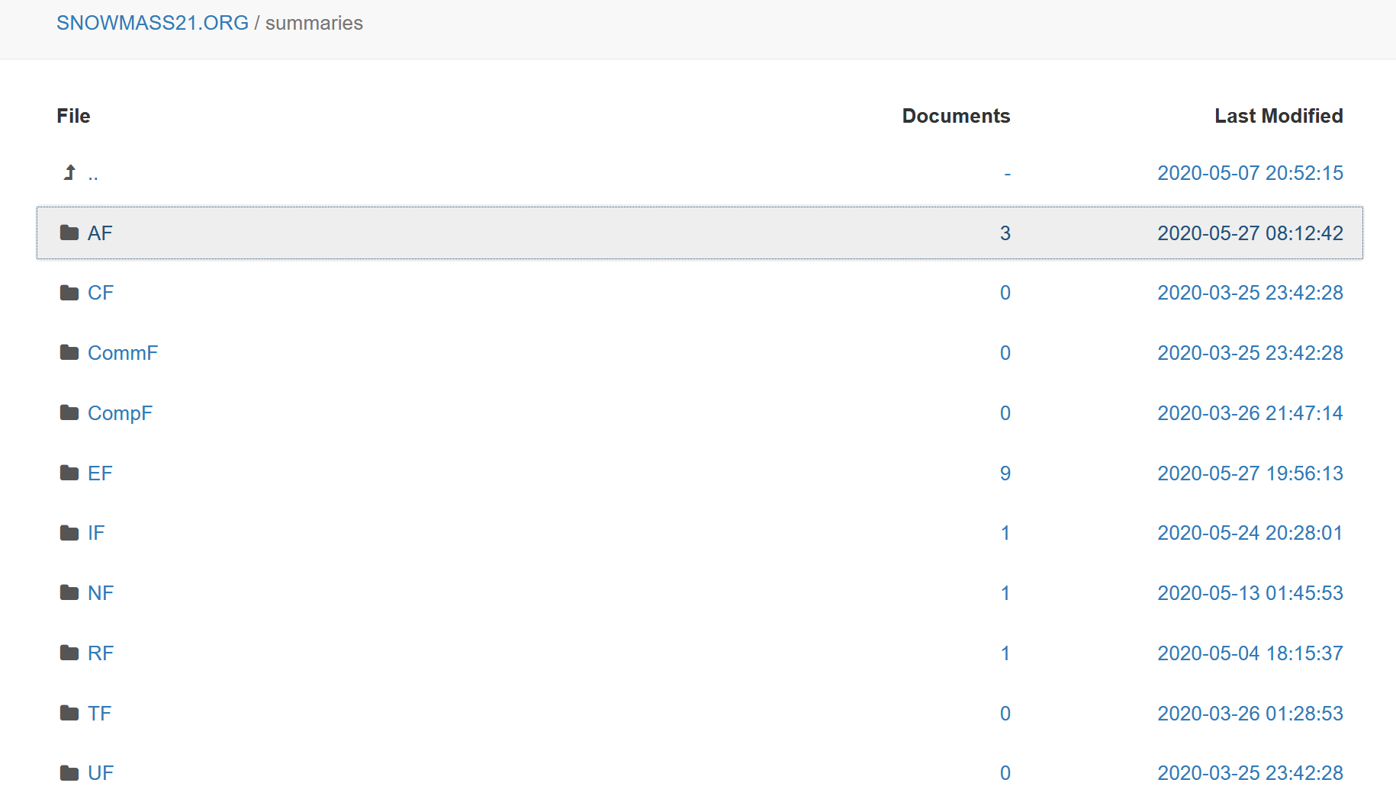
LoIs

Slide 5
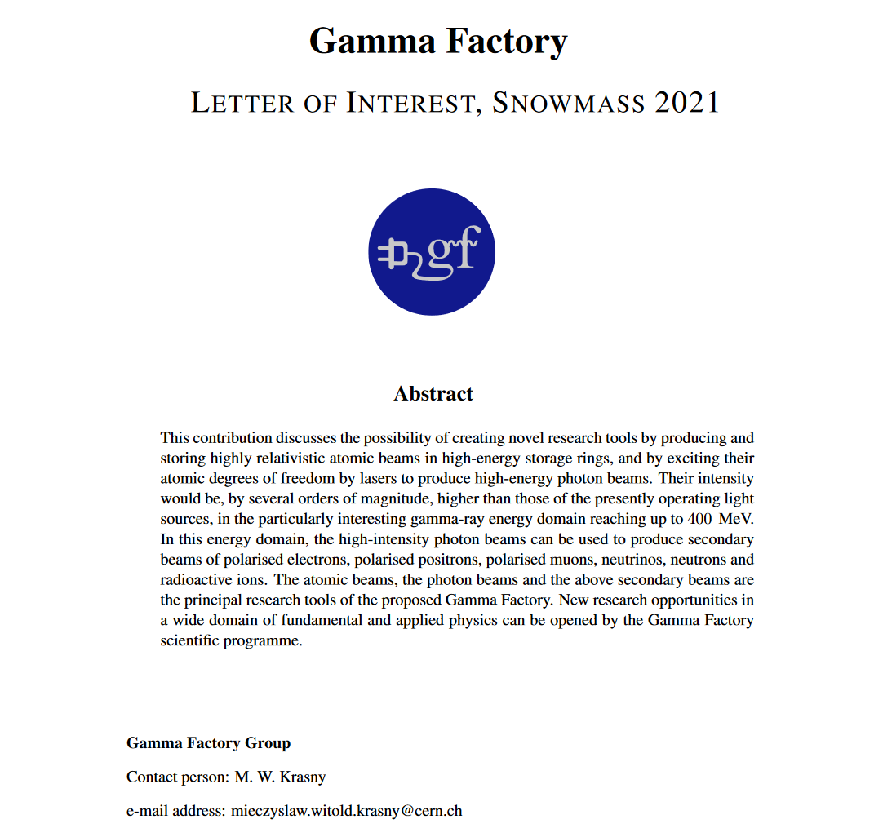
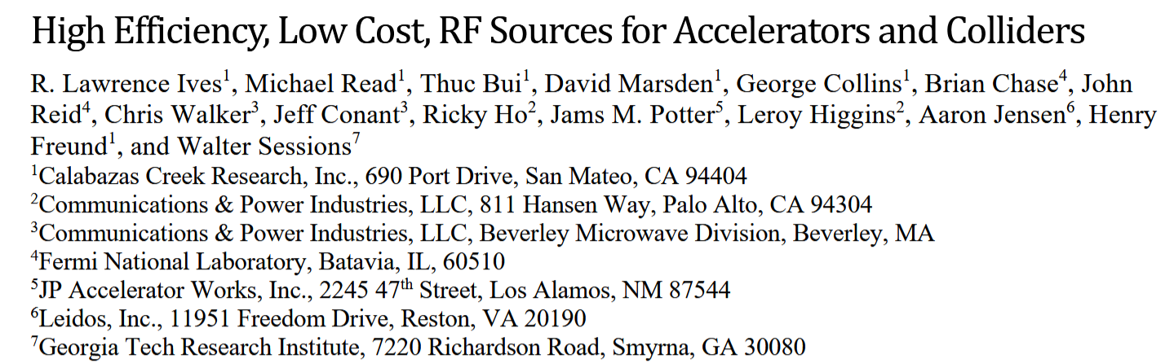
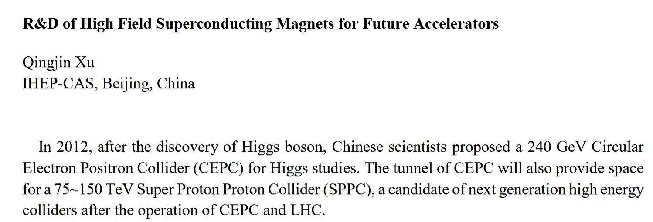
First AF LoIs
https://www.snowmass21.org/docs/files/summaries/AF/SNOWMASS21-AF-TOPIC0-001.pdf

Slide 6
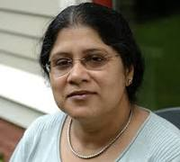
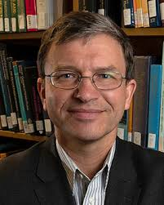
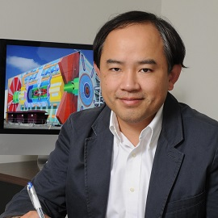
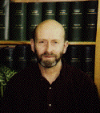
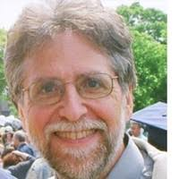
Liaisons
AF to Enertgy FrontierF (EF to AF)
  Meenakshi Narain(Brown), Dmitri Denisov (BNL)
AF to Theory Frontier : LianTan Wang (U Chicago)
AF to Instrumentation Frontier:
  Andy White (UT Austin)
AF to Rare-Processes: Robert Bernsten (FNAL)
Looking for “AF to CF” and “AF to Public Engagement “

Slide 7
Let’s
Make Snowmass
Great Again!

Slide 8
Back up slides

Slide 9
Accelerator Frontier “Challenges”
How can existing accelerator facilities be upgraded or extended to serve new particle physics experiments and a broader physics base?
What are the next accelerators for particle and nuclear physics on a 10 to 20-year time scale?
What are the most efficient Higgs and electroweak factories that can start operation by the end of the LHC program ~2040?
What are the most efficient options for a beyond-LHC energy-frontier discovery collider facility by 2050/60?
What are the 20-year goals and expectations for core accelerator technologies such as RF, magnets, particle sources and targets?
Are there coherent long-term physics and infrastructure scenarios?
Can ERLs, muon accelerators, wake-field and other advanced technologies deliver on a promise of sustainable and financially feasible next-generation particle physics facilities, i.e. by ~2040?
What are the accelerator technology and accelerator science gaps needed to be overcome to realize such facilities?
https://snowmass21.org/accelerator/start

Slide 10
The Snowmass process
Long-term planning exercise for the particle-physics community.
“Develop community long-term physics aspirations.”
“Communicate opportunities for discovery in particle-physics to broader community and to the (US) government.”
(Young-Kee Kim, DPF Chair, Town-Hall Meeting, 2020 April APS meeting)
Physics-driven effort.
Covers all areas of particle physics and facilitates cross-cutting.
Develop overarching physics studies.
Global effort.
Input from non-US community is essential.
Input from recent international studies, for example HL-LHC, European Strategy Particle Physics Update (ESPPU), future colliders etc.

Slide 11
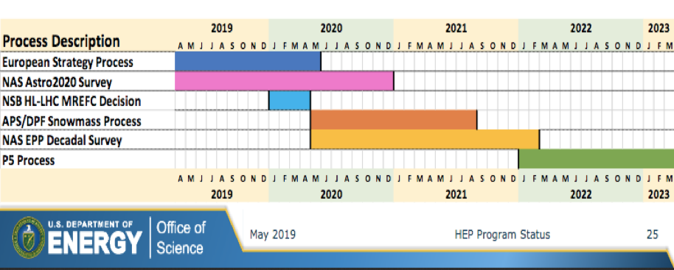
International Timeline
Snowmass Final Report: Fall 2021
NAS (National Academy of Sciences) Decadal Survey Report: end 2020 or very early 2022
Snowmass 2021 results will be used as input to the next P5 (2022)

Slide 12
Snowmass 2021 Timeline
We are ahead of the curve compared to Snowmass 2013
Today
11/19 | 12/19 | 1/20 | 2/20 | 3/20 | 4/20 | 5/20 | 6/20 | 7/20 | 8/20 | 9/20 | 10/20
Preparation
Letters of Interest
Contributed Papers
(Continued…)
Planning Meeting
Nov 4-6, 2020 (Fermilab)
Summer Study
July 11-20, 2021 (UW Seattle)
Snowmass
Report
11/20 | 12/20 | 1/21 | 2/21 | 3/21 | 4/21 | 5/21 | 6/21 | 7/21 | 8/21 | 9/21 | 10/21
Contributed Papers

Slide 13
Past Snowmass and P5
Snowmass 2013: new successful model
  Energy Frontier
  Intensity Frontier
  Cosmic Frontier
  Cross-cutting groups: Facilities, Instrumentation, Computing, Theory, Communication.
Report: https://www.slac.stanford.edu/econf/C1307292/
P5 (2014): identified five scientific drivers
  Use the Higgs boson as a new tool for discovery.
  Pursue the physics associated with neutrino masses.
  Identify the new physics of dark matter.
  Understand cosmic acceleration: dark energy and inflation.
  Explore the unknown: new particles, interaction, and physical principles.
Report: https://www.usparticlephysics.org

Slide 14
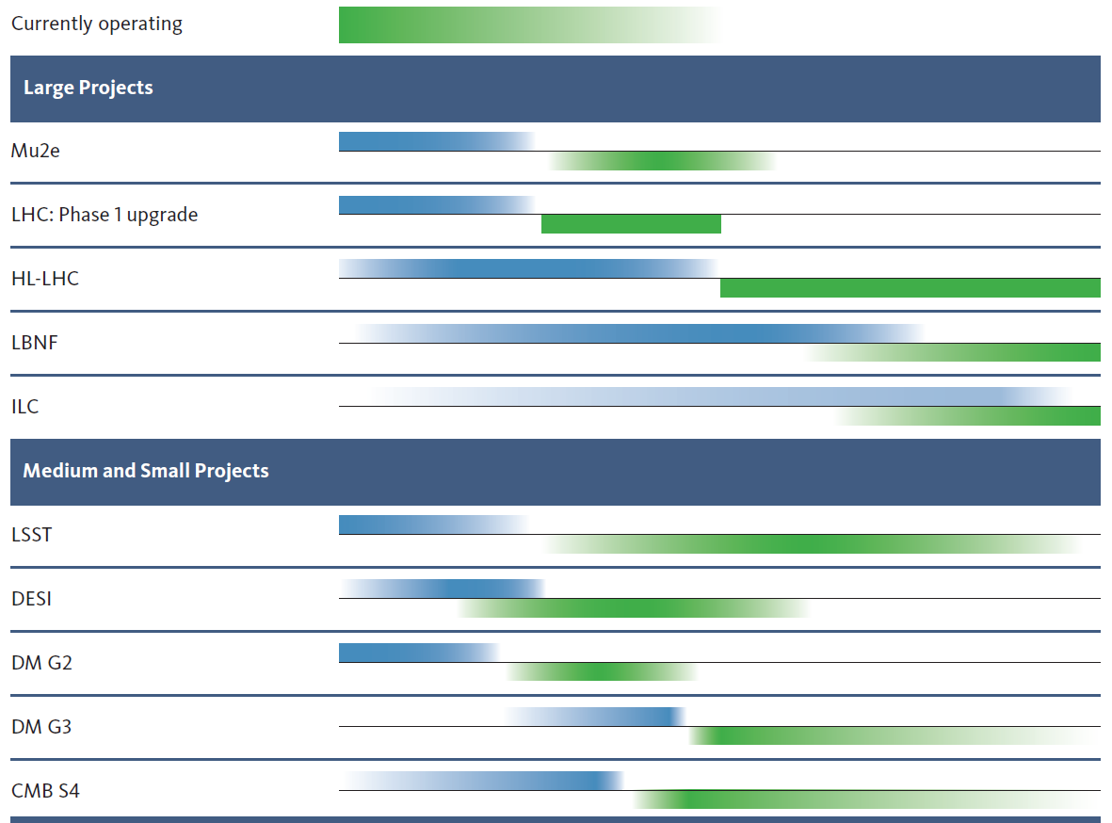
P5 2014 has been very successful !!
10 year plan
Scientific Drivers
HEP Science Output
[>$200M]
The Unknown (U.S.)
construction
operation
Higgs as a tool
The Unknown
(Europe)
Neutrino (U.S.)
LBNF/DUNE (and PIP-II)
LBNF/DUNE & PIP-II schedules advanced
[<$200M]
Cosmic Acceleration (U.S.)
Dark Matter (U.S.)
Cosmic Acceleration (U.S.)
(SuperCDMS, LZ, ADMX)
We are here
Construction
Expected Physics

Slide 15
Snowmass 2021: leading to the next P5
Ten Frontiers (with Liaisons in between).
Energy Frontier
Frontiers in Neutrino Physics
Rare Processes & Precision Measurements
Cosmic Frontier
Theory Frontier
Underground Facilities
Accelerator Frontier
Instrumentation Frontier
Computational Frontier
Community Engagement Frontier
Wiki: https://snowmass21.org/start

Slide 16
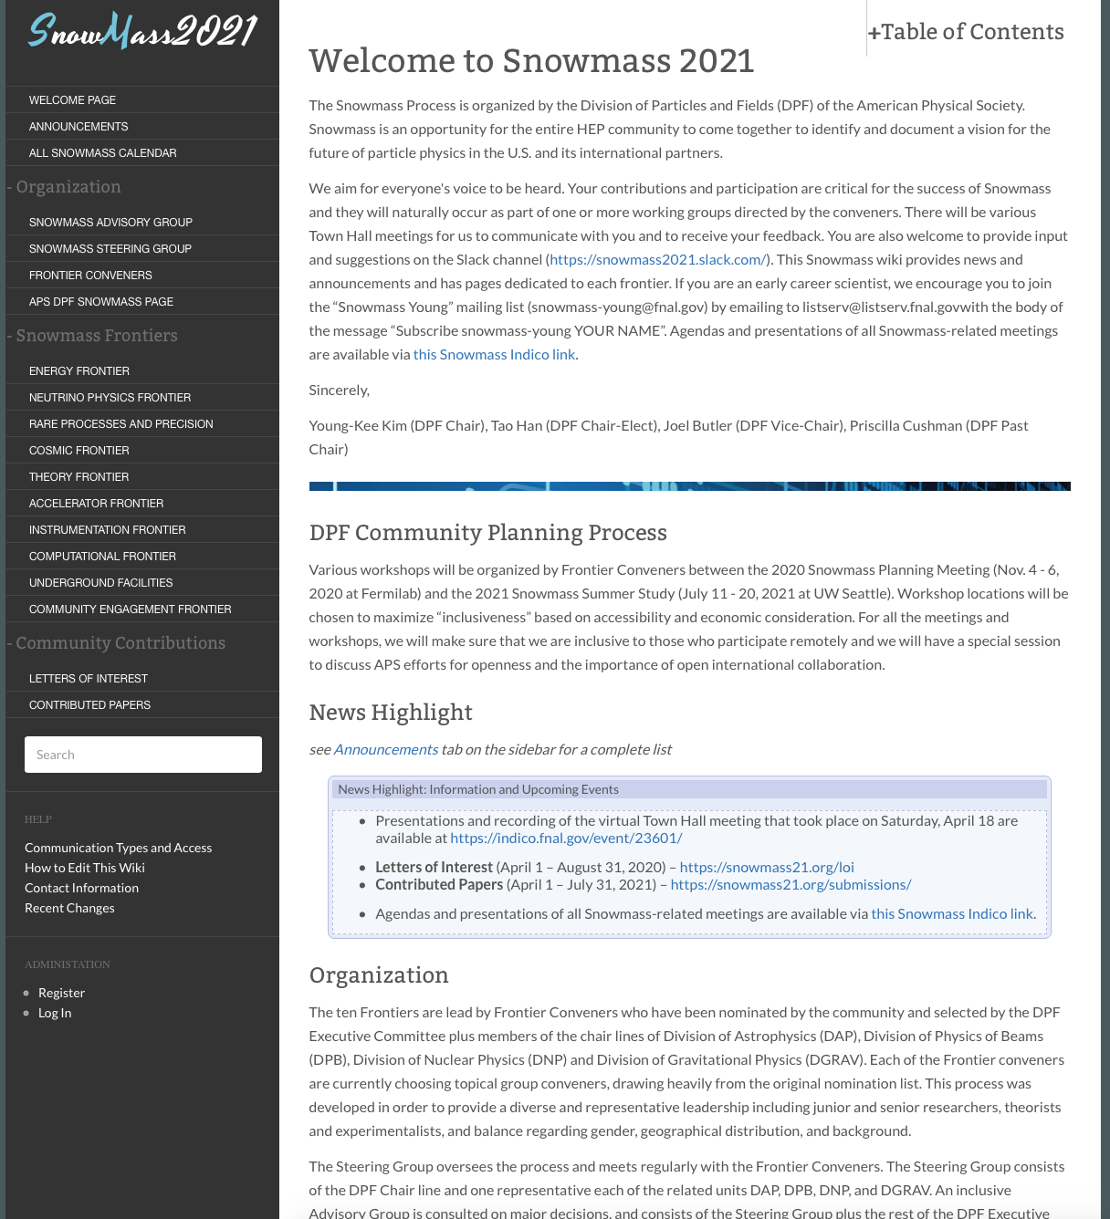
Wiki: https://snowmass21.org/start
→

Slide 17
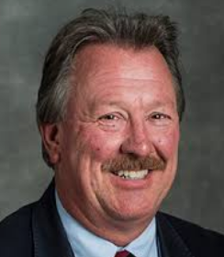

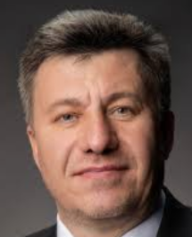
Accelerator Frontier Conveners
Steve Gourlay (LBNL)
Tor Raubenheimer (SLAC)
Vladimir Shiltsev (FNAL)
Topical Group |  | Topical Group co-Conveners
AF01 | Beam Phys & Accel. Education | Z. Huang (Stanford) | M. Bei (GSI) | S. Lund (MSU)
AF02 | Accelerators for Neutrinos | J. Galambos (ORNL) | B. Zwaska (FNAL) | G. Arduini (CERN)
AF03 | Accelerators for EW/Higgs | M. Ross (SLAC) | Q. Qin (IHEP, Beijing) | Georg Hoffstaetter (Cornell)
AF04 | Multi-TeV Colliders | M. Palmer (BNL) | A. Valishev (FNAL) | N. Pastrone (INFN, Torino)
AF05 | Accelerators for PBC and Rare Processes | E. Prebys (UC Davis) | M. Lamont (CERN) | Richard Milner (MIT)
AF06 | Advanced Accelerator Concepts | C. Geddes (LBNL) | M. Hogan (SLAC) | P. Musumeci (UCLA) | R. Assmann (DESY)
AF07 | Accelerator Technology R&D
 | Sub-group RF | E. Nanny (SLAC) | S. Posen (FNAL) | H. Weise (DESY)
 | Sub-Group Magnets | G. Sabbi (LBNL) | S. Zlobin (FNAL) | S. Izquierdo Bermudez (CERN)
 | Sub-Group Targets/Sources | C. Barbier (ORNL) | Y. Sun (ANL) | Frederique Pellemoine (FNAL)

Slide 18
Topical Group Activities
All AF Topical Groups (TG) have:
wiki pages and Indico sites for their meetings
mailing lists (will have)
Everybody’s contribution and participation are vital to the Snowmass process!
How to engage:
Contact the AF1-7 conveners and join the AF1-7 activities (join meetings, discussion).
Bring existing studies and/or new ideas and projects to investigate.
Write a Letter of Interest (LOI): 2 pages, briefly what you want to work on (the AF conveners and the TG conveners will facilitate the process).
  This can be done as individuals, user groups or collaborations
  We invite collaborations & initiatives to submit (one or multiple) LOIs with a set of open questions and how to get new users involved in the studies.
Various user groups are providing documents with contact informations, available studies, available tools, etc

Slide 19
Snowmass Young (I)
From: Sara Simon <smsimon@umich.edu>
Subject: Solicitation for Snowmass Young Representatives
Date: April 7, 2020 at 1:33:09 PM EDT
To: snowmass@fnal.gov, snowmass-young@fnal.gov, snowmasconveners@listserv.fnal.gov
Dear Colleagues,
As part of the Snowmass 2021 process, we are soliciting nominations for representatives for Snowmass Young. The Snowmass 2021 process will develop a long-term strategic plan, so the voices of early career members are critically important and we want them to be heard.
These representatives will have the opportunity to shape how early career members are included in the Snowmass process. This could include finding ways to get early career members engaged with the working groups, incorporating career development opportunities into events, surveying early career members as was done for Snowmass 2013, and integrating other items of interest to early career members into the events.
Nominations can be made by anyone, but nominees should be early career members (e.g. grad students, postdocs, etc.). Nominees need not be APS members to participate in the process. Nominations can include self-nominations and will be open until May 22, 2020 through the google form below:
https://forms.gle/Xpd4jW3Y6oxcXxmD7
Nominees will be reviewed and selected to ensure that the group is representative of the field. More details about the responsibilities and Snowmass process are included below. Please circulate this broadly.
Sincerely, Sara M. Simon & Fernanda Psihas 2019 DPF Executive Committee Early Career Member

Slide 20
Snowmass Young (II)
(from Snowmass wiki) - If you are an early career scientist, we encourage you to join the “Snowmass Young” mailing list (snowmass-young@fnal.gov) by emailing to listserv@listserv.fnal.gov with the body of the message “Subscribe snowmass-young YOUR NAME”.
NOMINATE!
https://docs.google.com/forms/d/e/1FAIpQLScA9zuSNeYTQsWbPtxJ2mdXME01MymoB5DJRzLAi3aM_bG9_w/viewform

Slide 21
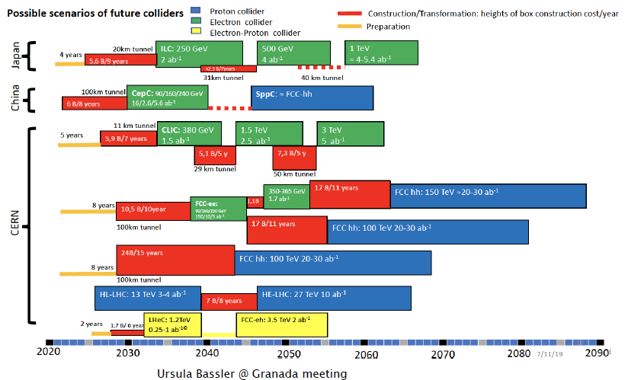
Future Collider Scenarios & Timelines

Slide 22
Future Colliders Scenarios
ESG studies, comparing various options, are detailed in the briefing book
Snowmass21 will expand on these studies and add other collider scenarios, e.g.
muon collider, Electron-Ion Collider, other c.o.m. (if needed)....
Our goal is to:
  Identify “Focus Questions” and the “Scientific Merits” of the various collider options.
  Develop a global picture and a future roadmap.
  Compile existing studies [start from ESG briefing book and confirm with Accelerator Frontier].
  Add new studies and information.
  For pp future colliders, HL-LHC will serve as a critical baseline. HL-LHC results may be revisited if deemed necessary.

Slide 23
AF: Engaging early career members of the community
The Snowmass process thrives on the participation of young people and offers an ideal environment for young people to get involved and promote their own initiatives.
We strongly encourage young members of the community to get involved!
To all senior members: get your students and postdocs involved!
Snowmass Young: forum of early career members.
Nominations for representatives solicited (closed on May 11).
Nominees: early career members (e.g. graduate students, postdocs).
Coordinated by:
  Sara M. Simons (2020 DPF ECEarly Career Member)
  Fernanda Psihas (2019 DPF EC Committee Early Career Member)

Slide 24
Liaisons among Frontiers and Projects
They will provide high-level and bi-directional communication b/w Frontiers.
They will be people with interests in both communities.
Official Liaisons:
  Neutrino Physics Frontier: TBD
  Rare Processes and Precision: Robert Bersntein (FNAL)
  Cosmic Frontier: n/a
  Theory Frontier: Liantao Wang (Chicago)
  Energy Frontier: Dmitri Denisov (BNL), Meenakshi Narain (Brown)
  Computational Frontier: TBD
  Instrumentation Frontier: Andy White (UTA)
In addition to official Liaison we foresee ‘Link People’
  Provide a more technical link between AF2-AF6 and established teams/projects
  They will be people who are embedded in both communities based on their personal interests.

Slide 25
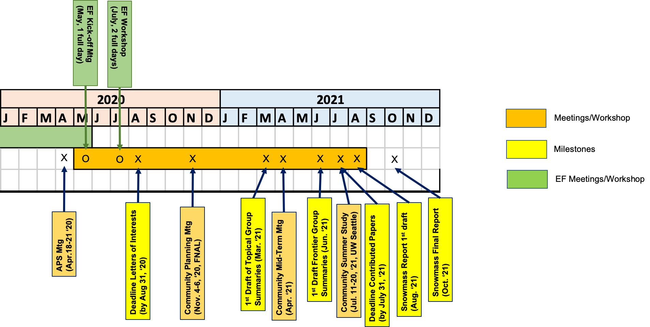
Accelerator Frontier Planning
Two AF community meetings to be arranged before the LoI deadline and in preparation for the Nov 4-6, 2020 Snowmass Planning Meeting:
  AF Kick-off meeting ??
  EF workshop July 9-10 with common sessions with Accel Frontier
More workshops will follows
EF meeting
↘
Today→

Slide 26
EF Meeting and July Workshop
Kick-off Meeting: Today Thursday May 21, 2020 (full day).
  Review of existing studies, and plans to engage communities.
    Goal is to lay out our plans, strategy, activities, discuss the organisation of the EF group and TGs, how to communicate within the community.
    Summaries of studies that can be considered as stepping stones for TG activities (e.g. surveys of previous or international studies, e.g. ESG results, Yellow Reports etc.) as well as overviews of ideas for studies that can be carried out for Snowmass 2021.
    Present plans for and use of letters of intents and contributed papers within the EF group, and the strategy for MC production.
EF Workshop: July 9-10, 2020 (two full days)
  First opportunity for the community to present ideas, plans, and results if already available.
  Plans to have dedicated joint sessions with other Frontiers, and common session between TGs.

Slide 27
“Letters of Interest” and “Contributed Papers”
Letters of Interest (LOI)
(submission period: April 1, 2020 – August 31, 2020)
“They allow Snowmass conveners to see what proposals to expect and to encourage the community to begin studying them. They will help conveners to prepare the Snowmass Planning Meeting that will take place on November 4 - 6, 2020 at Fermilab. Letters should give brief descriptions of the proposal and cite the relevant papers to study. Instructions for submitting letters are available at
https://snowmass21.org/loi.
Authors of the letters are encouraged to submit a full write-up for their work as a contributed paper.”
Very brief (two pages).
Uploaded by Authors through Snowmass 2021 Wiki.
Index of submitted LOI available on the Snowmass 2021 Wiki.
Could represent existing work (cite) or new ideas.
Will help the EF conveners plan the work of the Frontier (including liaisons with other Frontiers: avoid duplication/build synergy).
If further developed in the context of the Snowmass 2021 exercise could lead to a Contributed Paper.

Slide 28
“Letters of Interest” and “Contributed Papers”
Contributed Papers
(submission period: April 1, 2020 – July 31, 2021)
“Contributed papers will be part of the Snowmass proceedings. They may include white papers on specific scientific areas, technical articles presenting new results on relevant physics topics, and reasoned expressions of physics priorities, including those related to community involvement. These papers and discussions throughout the Snowmass process will help shape the long-term strategy of particle physics in the U.S. Contributed papers will remain part of the permanent record of Snowmass 2021. Instructions for submitting contributed papers are available at
https://snowmass21.org/submissions/”
More extensive studies.
May include white papers, scientific/technical articles, etc.
Can but do not have to be related to a given LOI.
Submitted by Authors following instructions given on Snowmass 2021 Wiki page (submit to arXiv, send email to M. Peskin with subject “Contribution to Snowmass 2021”, etc.)
Will be part of the official Snowmass 2021 records..

Slide 29
Inputs from Collaborations
We need to start receiving inputs from International Collaborations
  Plans for analyses, MC samples, framework availability and how to share them with the Snowmass community, contact people etc.
  Letters of Interests
Following slides show three contributions received by EF so far – as an example, more are expected from other collaborations
Those contributions will be made available to the whole Snowmass community soon

