Slide 1
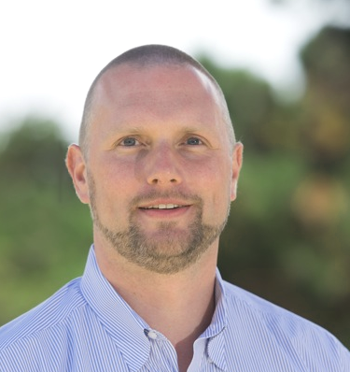
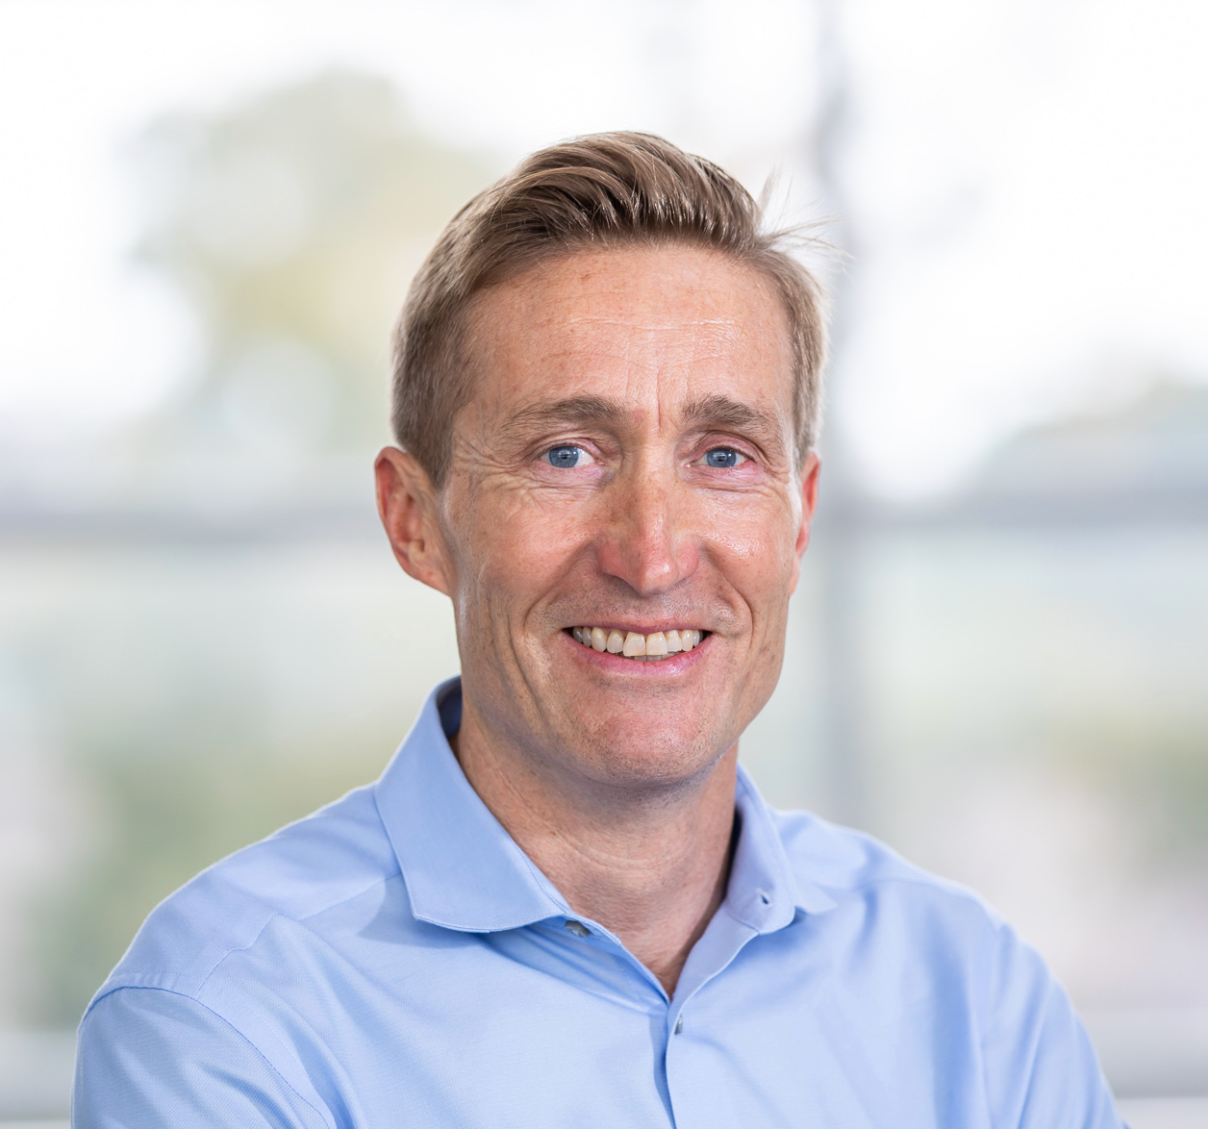
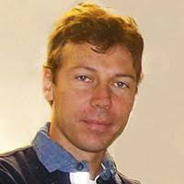
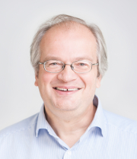
Accelerator Frontier 6: Advanced Accelerator Concepts
AF6 “goal”:
Assess potential for new accelerator technologies to revolutionize cost and capability of future accelerators for frontier High Energy Physics
Capacity for orders of magnitude higher acceleration gradient than conventional systems enabling new types of high energy colliders including energies at/beyond TeV.
Generation of beams with unprecedented parameters (ultrahigh brightness), enabling novel intermediate applications
Identify challenges and capability gaps that new acceleration methods could address
AF6 Conveners
Cameron Geddes
Lawrence Berkeley
National Lab
cgrgeddes@lbl.gov
Mark Hogan
SLAC National
Accelerator Lab
hogan@slac.stanford.edu
Pietro Musumeci
University of California,
Los Angeles
musumeci@physics.ucla.edu
Ralph Assmann
Deutsches Elektronen-
Sychrotron
ralph.assmann@desy.de

Slide 2
AF6 LOIs Status and Plans
Invitations planned to mailing lists of conferences:
AAC list - US and international
EAAC, EuroNNAC lists - Europe
LPAW list - Europe and Asia
LOIs to date:
Gamma factory
LOI solicitation topics/plans: Address path to colliders and intermediate applications such as photon sources (e.g. FELs, MeV gamma rays…)
Technologies including Address path to collider performance, including
PWFA – System concepts & luminosity
LWFA – Particle injectors - low emittance
Hybrid – Positron generation & transport
Proton-driven plasma accelerators – Efficient acceleration
Crystal / nanostructure accelerators – ‘Staging’ of modules to TeV-class energy
High frequency metal and dielectric structures – Beam manipulation / cooling / focusing
Dielectric laser-driven accelerators – Polarization transport
High efficiency lasers and drivers – Diagnostic techniques

Slide 3
AF6 Meetings and Conferences
Conveners meetings biweekly
Advanced Accelerator Conferences (all postponed):
AAC 2020 - discussions with organizers started on potential focus sessions
Linac 2020
High Gradient Workshop 2020
AF6 Liaisons and PoCs
Drive accelerator needs from physics frontiers, ground in accelerator designs
Energy Frontier - specific for AF6, outreach started
Computational Frontier
Coordination among accelerator frontiers
US Accelerator Test Facilities Council – discussions started
Started outreach to other groups- will include LaserNetUS, ICFA advanced concepts panel, EuPRAXIA, AWAKE, ALEGRO, AChip
AF6 AOB
Snowmass Young nominations submitted including Brendan O’Shea, Mike Litos, Spencer Gessner, Marlene Turner

