Slide 1
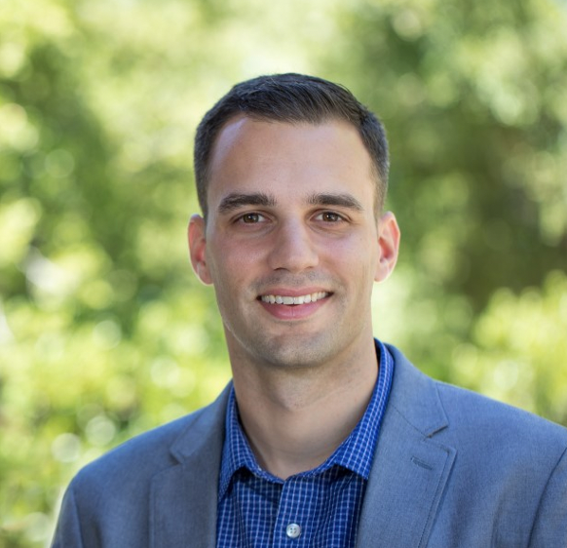
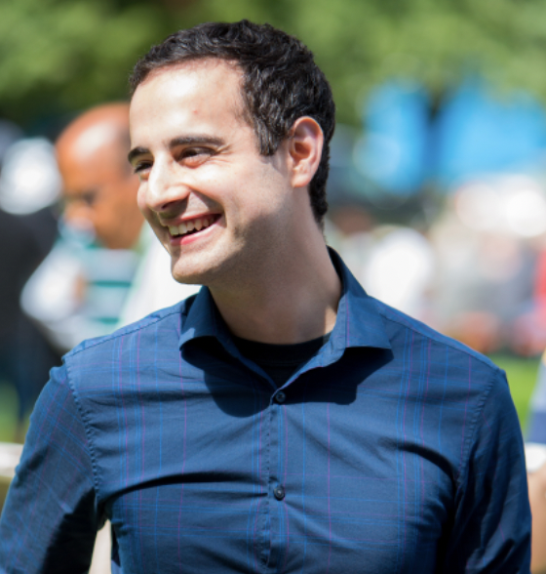
Accelerator Frontier 7: Accelerator Technology R&D
RF Subtopical Group
RF acceleration – primarily divided into SRF and NCRF, plus consideration for regions of overlap, e.g. RF sources
Soliciting from existing email lists, including TTC, NCRF high gradient workshop, CLIC, Advanced Accelerator Concepts workshop, GARD RF Roadmap preparation group
Planning to have 2 zoom kickoff meetings on June 22, timed ~12 hours apart to accommodate colleagues in North America, Asia, and Europe regions – information + Q&A
AF7 - RF Conveners
Emilio Nanni
SLAC
nanni@slac.stanford.edu
Sam Posen
Fermilab
sposen@fnal.gov
Hans Weise
DESY
hans.weise@desy.de

Slide 2
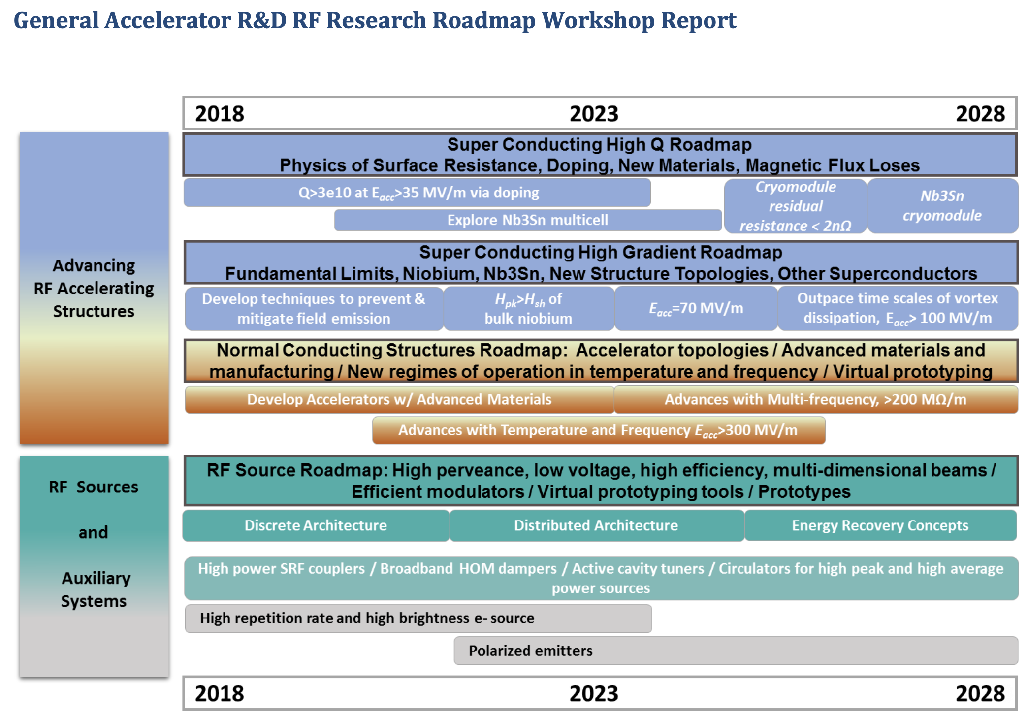
GARD RF Acceleration R&D Roadmap

Slide 3
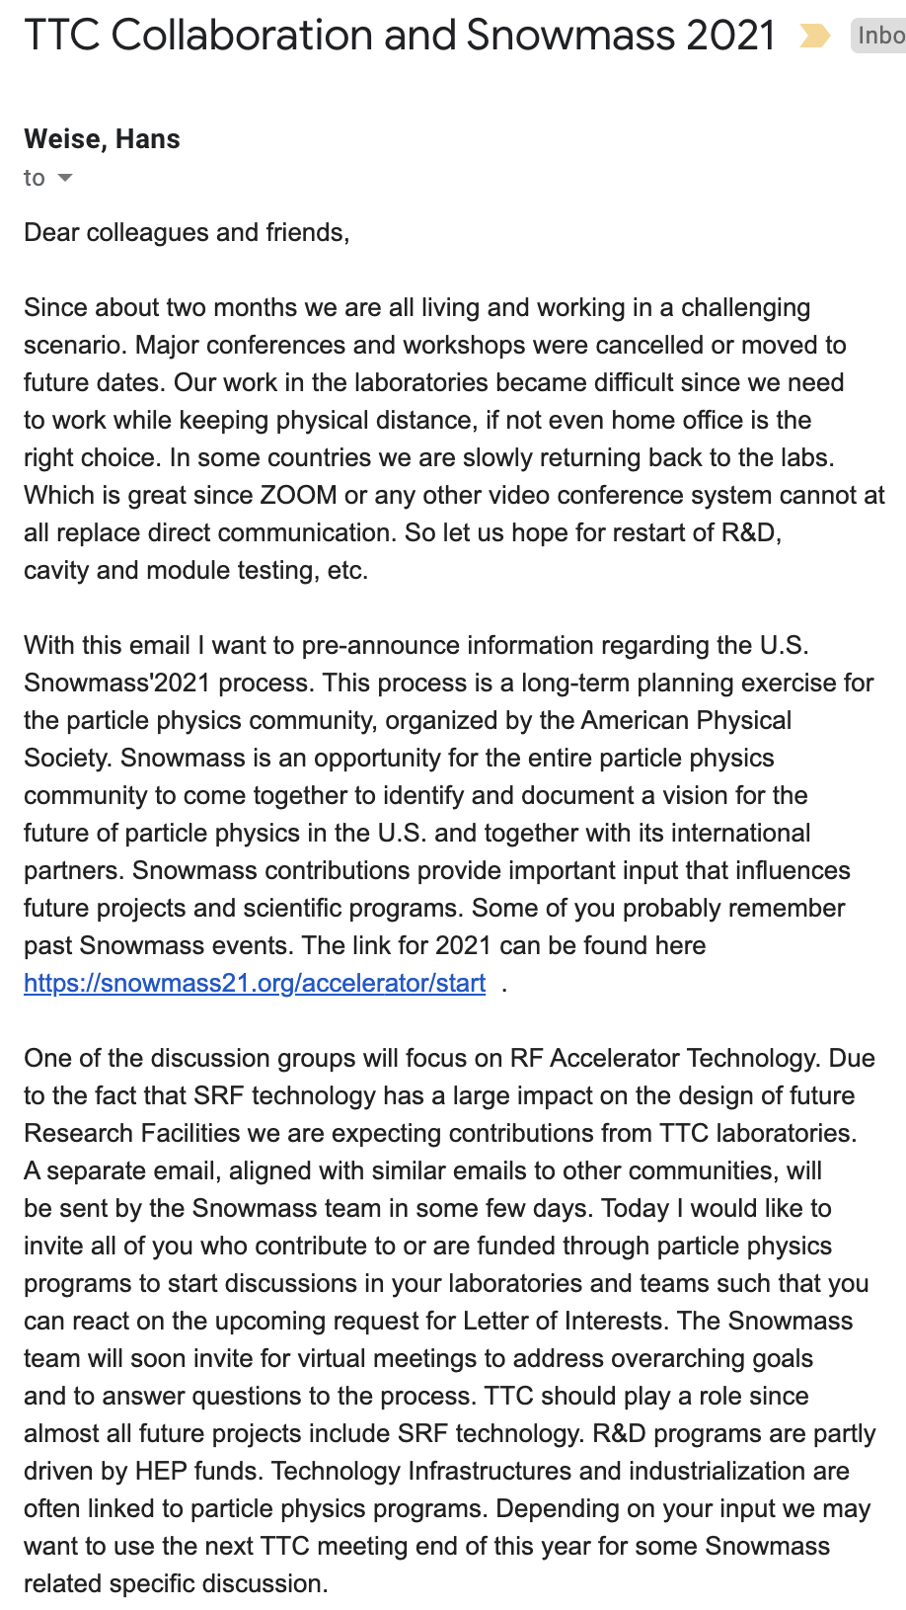

Slide 4
AF7 - RF Meetings and Conferences
Kickoff meetings before LOI deadline – Two on June 22 for time zone accommodation
Booster upgrade/replacement at Fermilab discussions
TTC Meeting 2021
CLIC Meeting 2021
High Gradient Workshop 2021
AF7 - RF Liaisons & POCs
Need more work on liaisons to other WGs and projects
Please connect with us! Would be helpful to discuss best ways to join input

