Slide 2
Author: Esther Salaman
Journal: Listener Date: 1955

Slide 3
A Theory of Everything
Determine the smallest building blocks of the universe.
Work out the forces that make the universe tick and do they have a single origin?
Figure out how the universe came into existence and how it will end.
How does everything hang together?

Slide 4
A Theory of Everything
Determine the smallest building blocks of the universe.
Work out the forces that make the universe tick and do they have a single origin?
Figure out how the universe came into existence and how it will end.
How does everything hang together?
What do I mean by
everything?

Slide 5
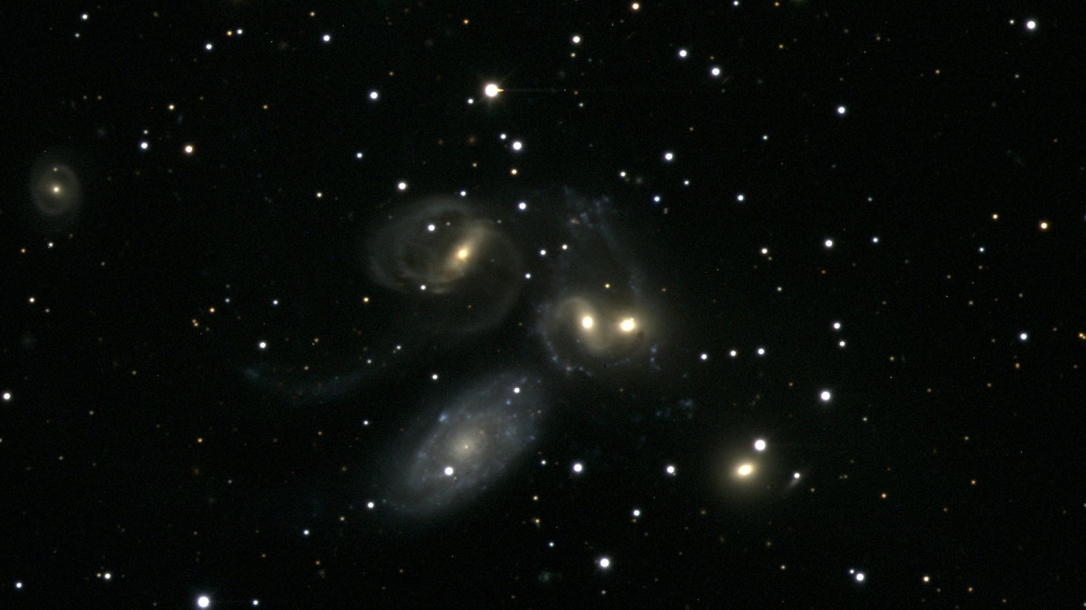
Notes:
Stephan’s Quintet.

Slide 6
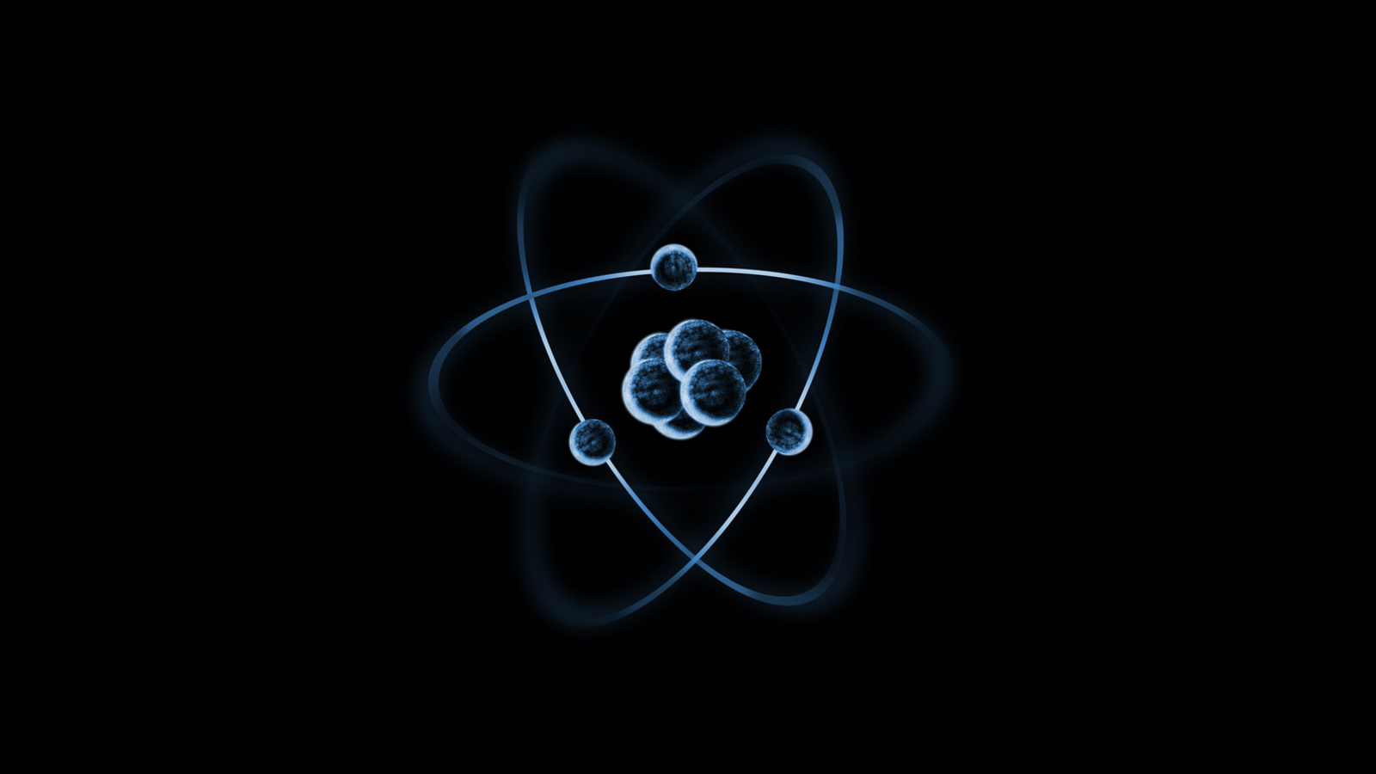

Slide 7
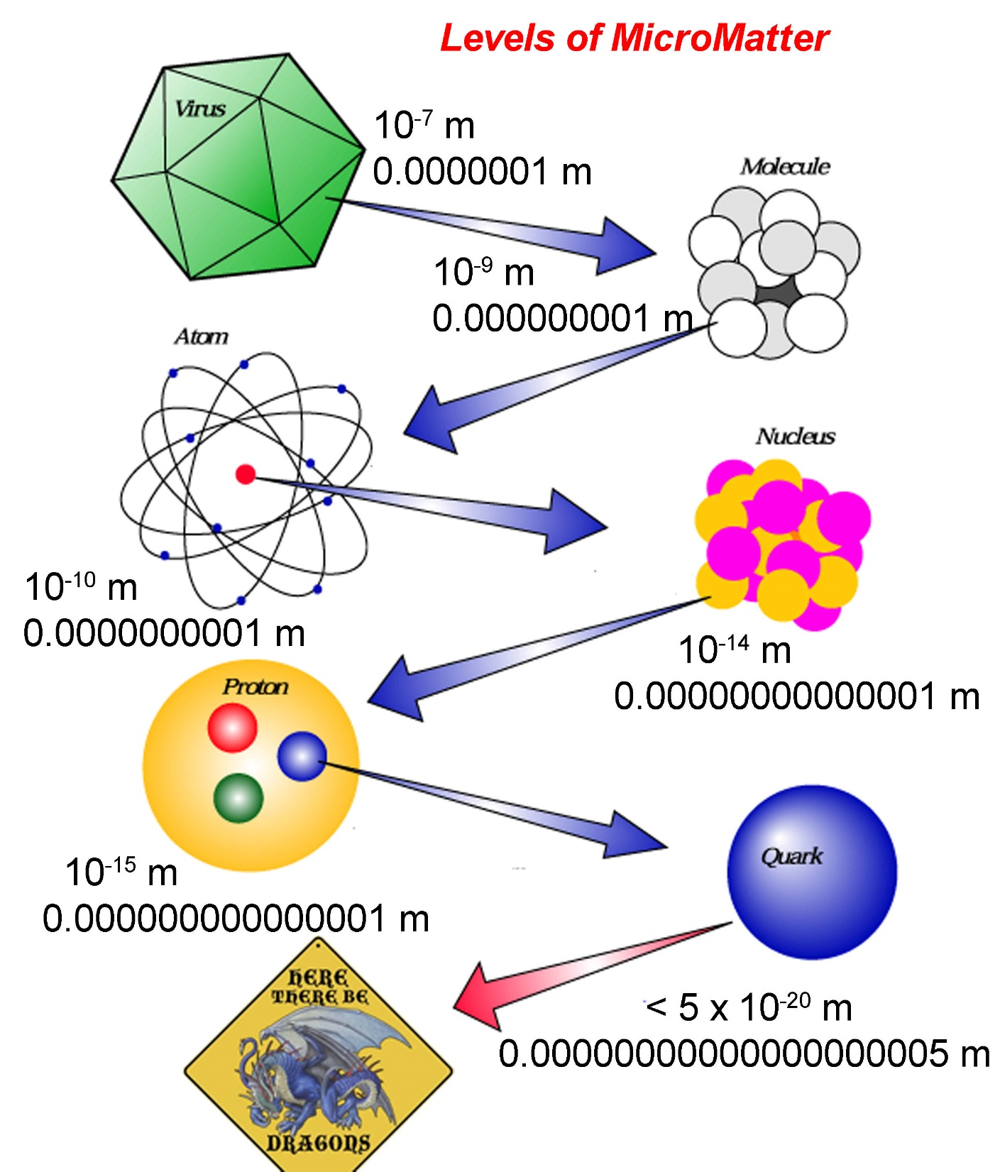
Remember the Journey
Big things are built from smaller things.
Those smaller things are governed by laws that we’ve discovered.
The journey has been long.

Slide 8
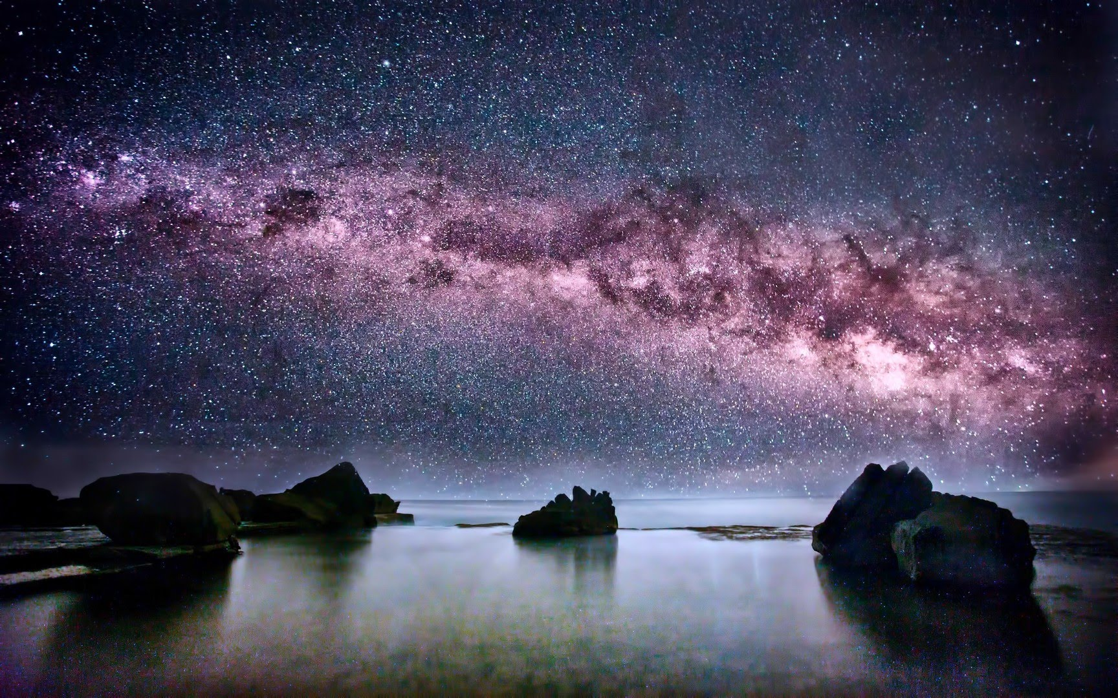
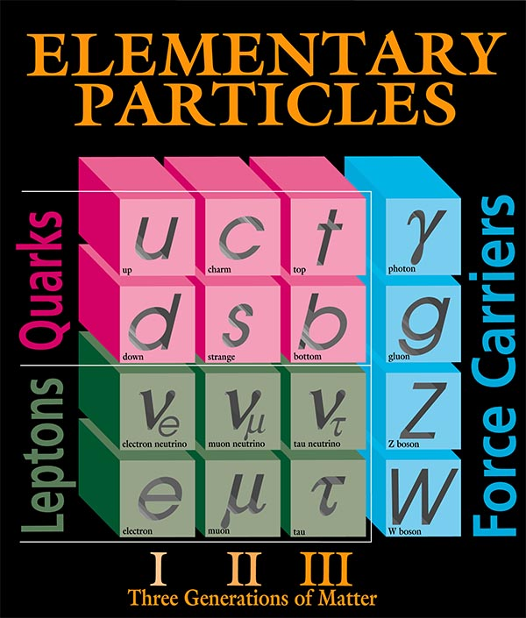

Slide 13
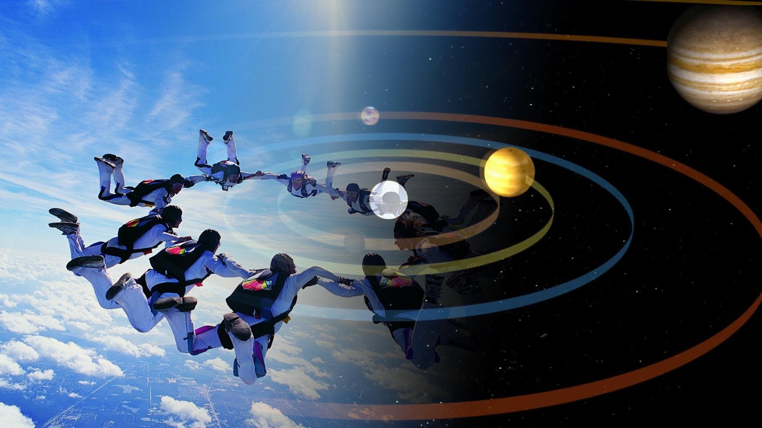

Slide 14
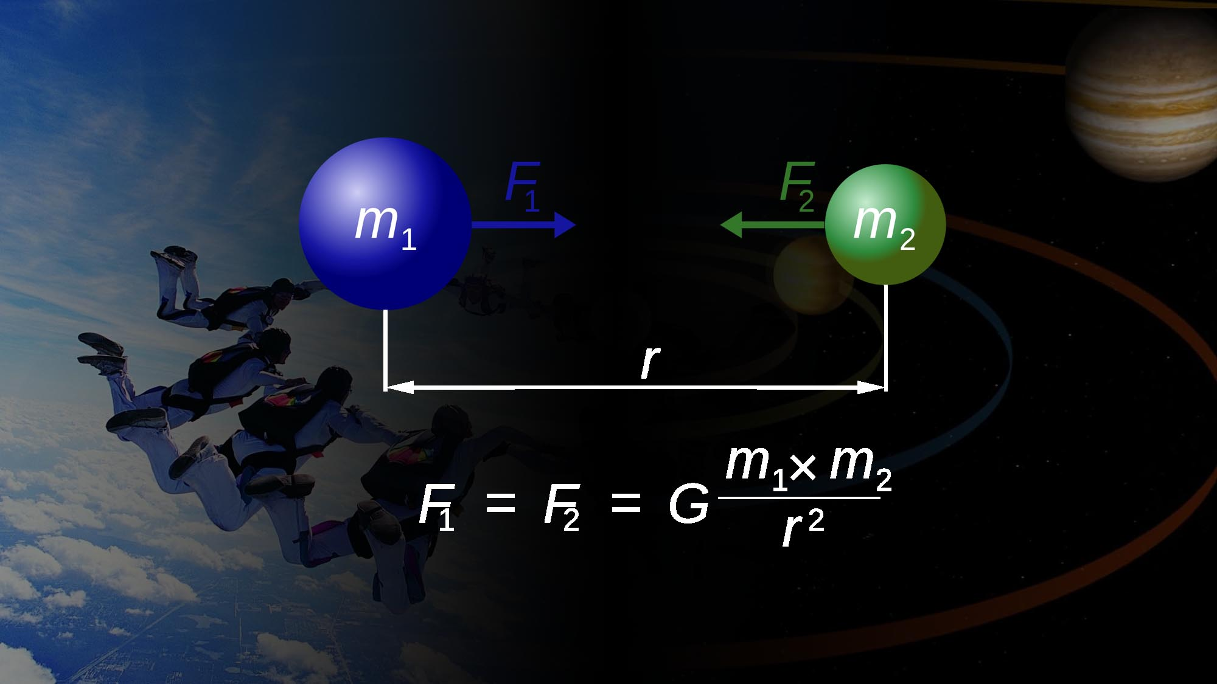

Slide 15
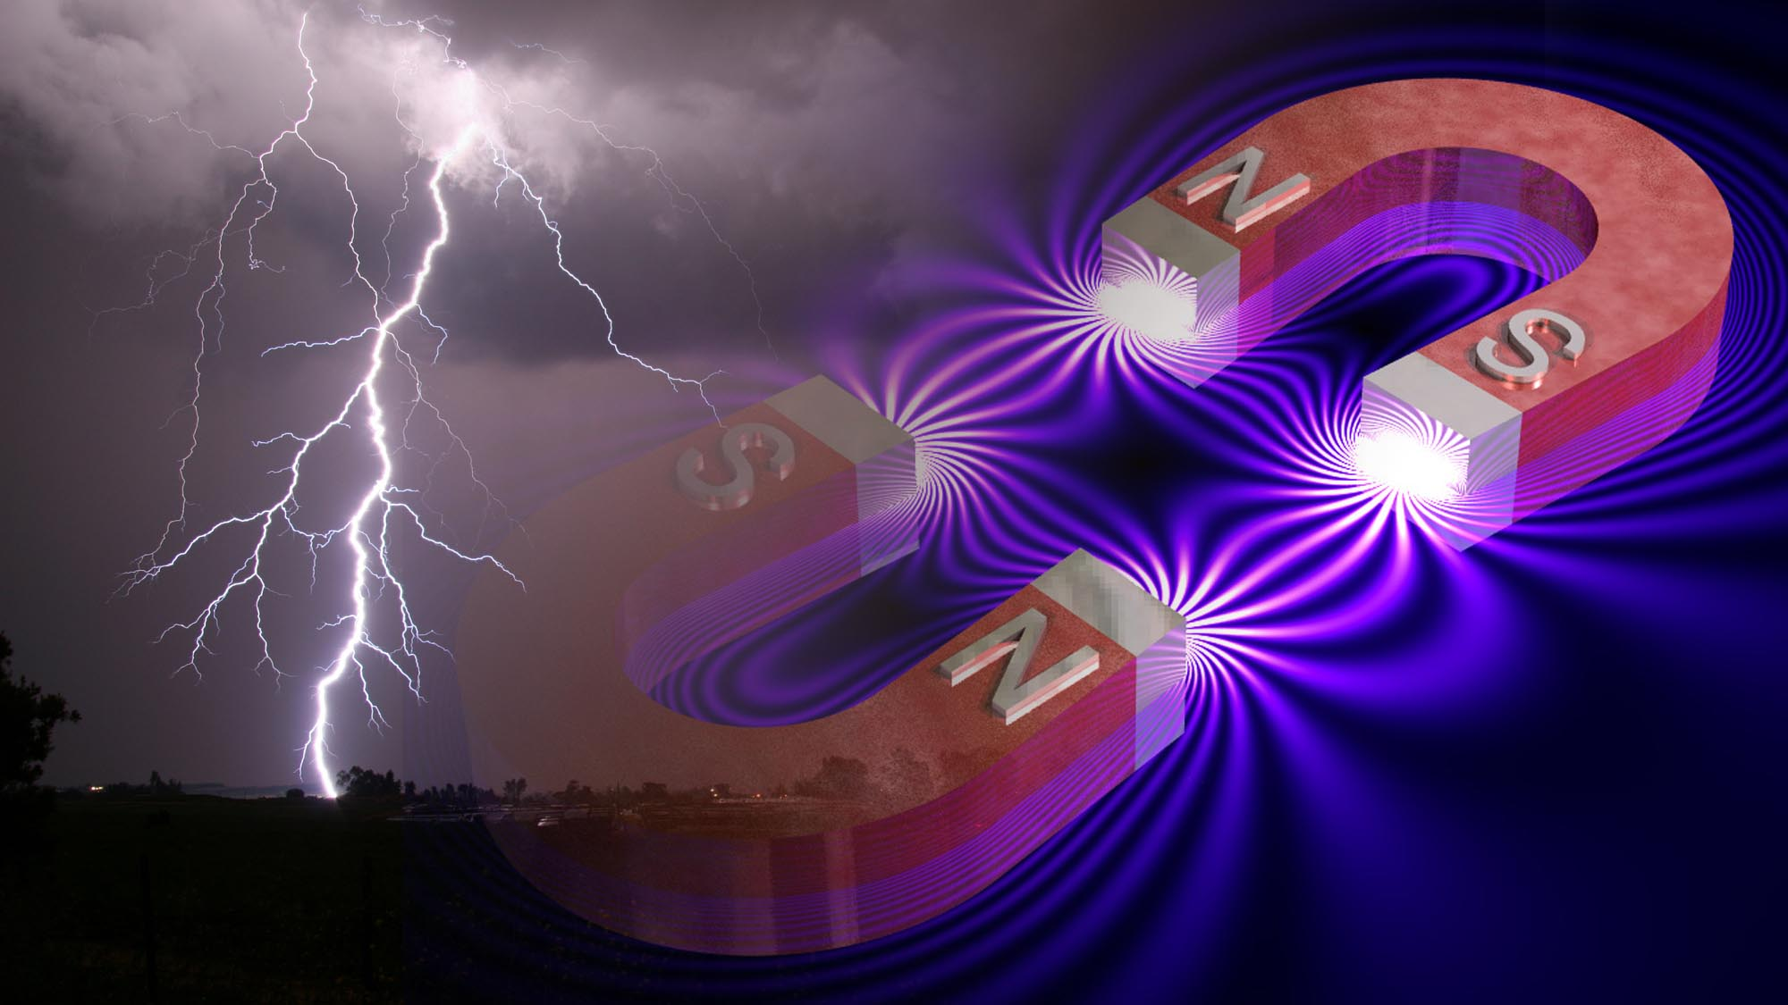

Slide 17
1960

Slide 18
2020

Slide 19
Future?

Slide 21
The Standard Model is our best theory for ordinary matter.
Simplest form of the SM, predicts fundamental particles have zero mass.
Fundamental particles do have mass (e.g. m(top quark) = 183 × m(proton)
In 1964, Peter Higgs and others postulated a field which gives all particles their mass.
This field permeates the universe.
If this field exists, a particle must exist (Higgs boson).

Slide 22
Higgs Field
Higgs Field
Higgs Field
Higgs Field
Higgs Field
Higgsless World
Higgs Field
photon
particle
Higgs Field
Higgs Field
Higgs Field
Higgs Field

Slide 24
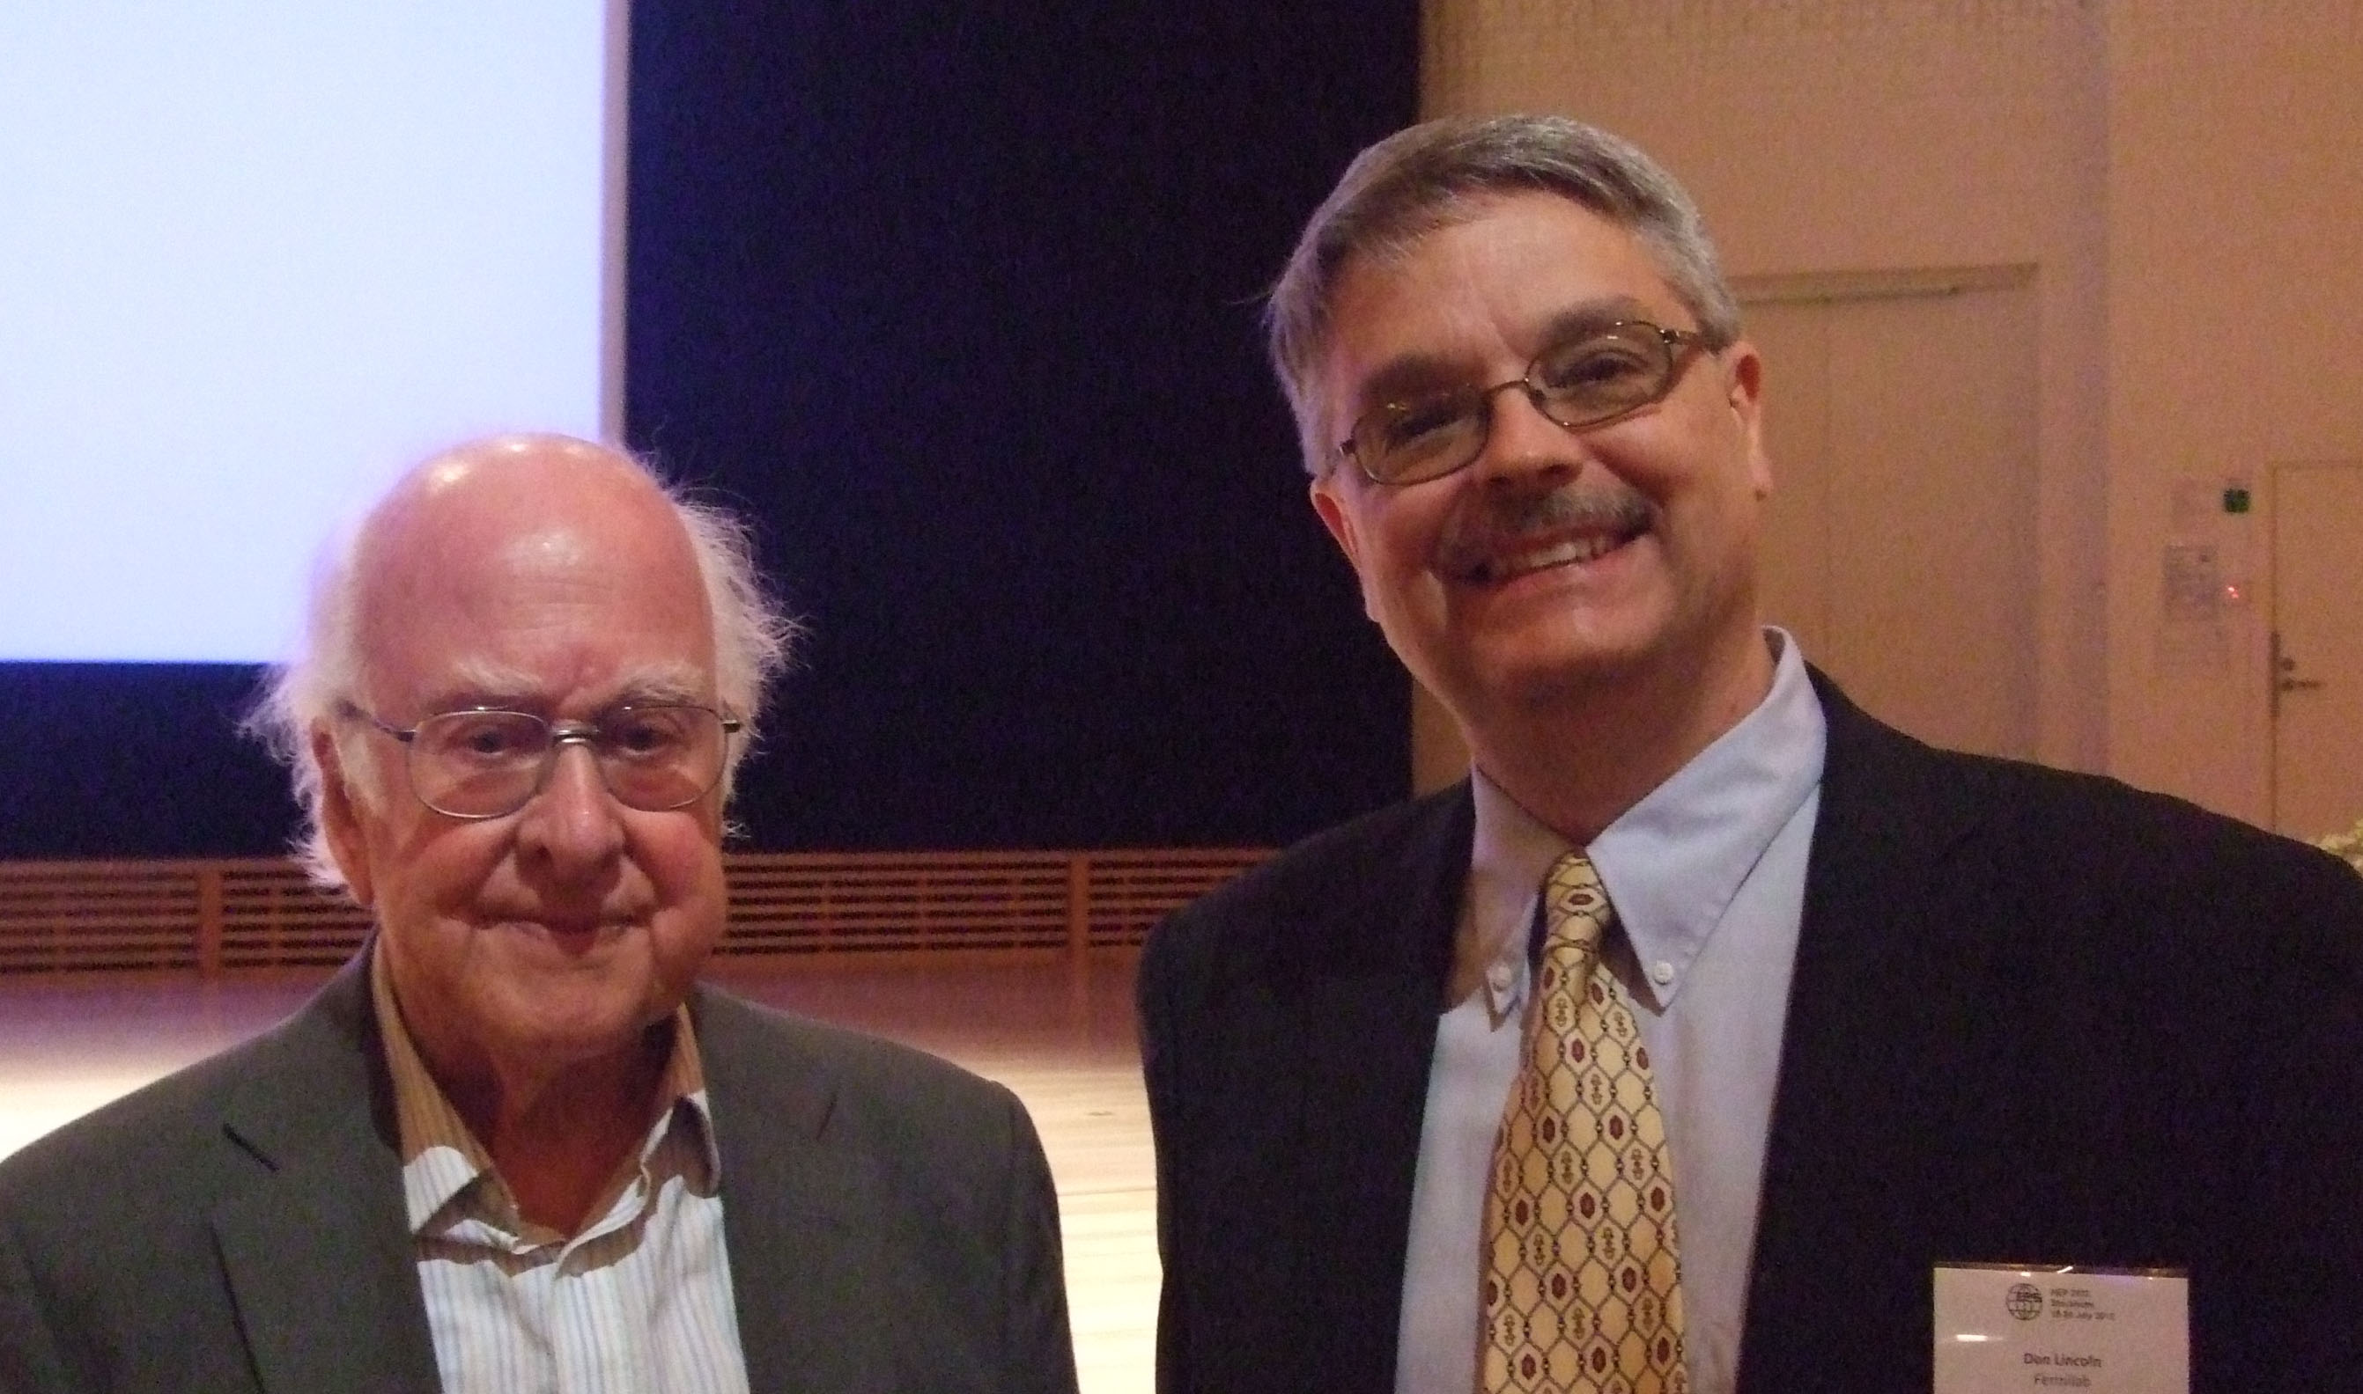
July 2013

Slide 25
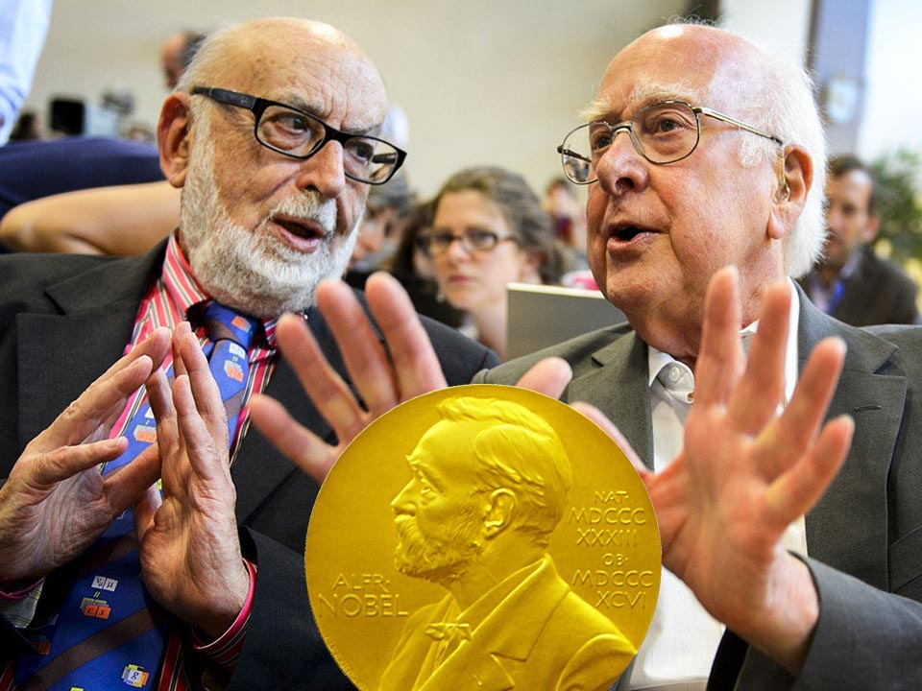
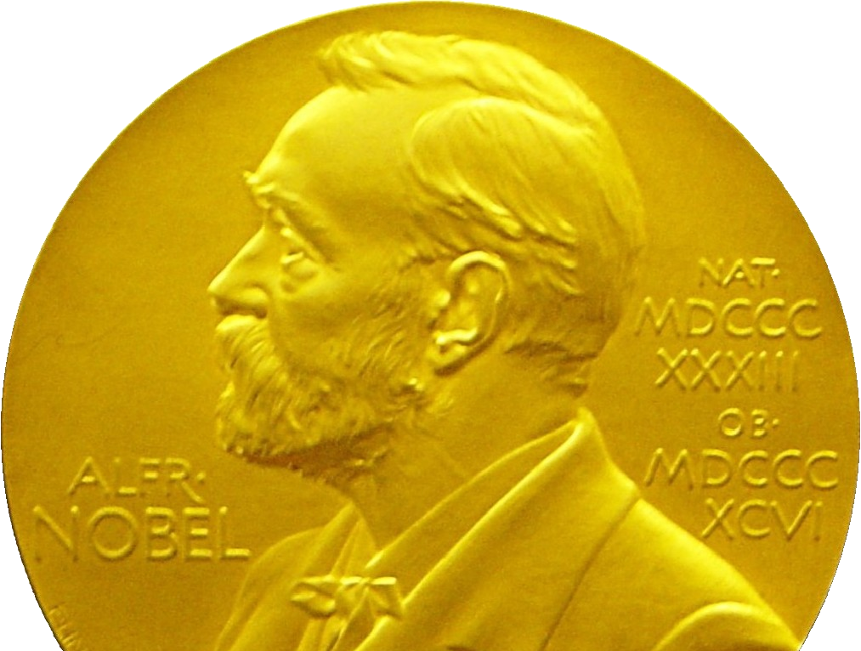
October 2013

Slide 27
But….

Slide 28
Is the Standard Model
a
Theory of Everything?

Slide 29
Candidate Theory of Everything

Slide 30
Candidate Theory of Everything
Candidate Theory of Everything

Slide 31
Things the Standard Model Doesn’t Explain
Why four forces?
Why quarks?
Why leptons?
Why a Higgs field?
Why three generations?

Slide 32
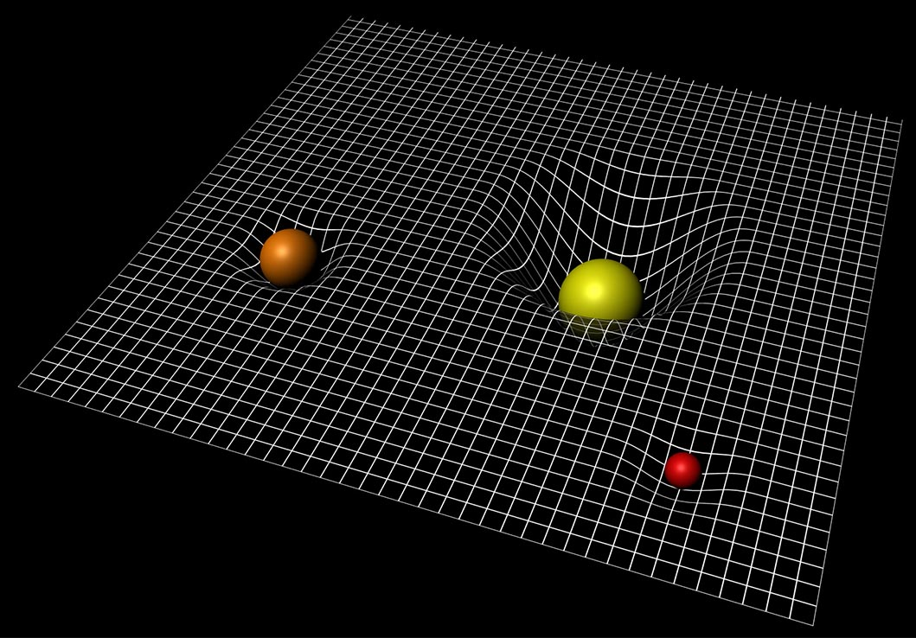
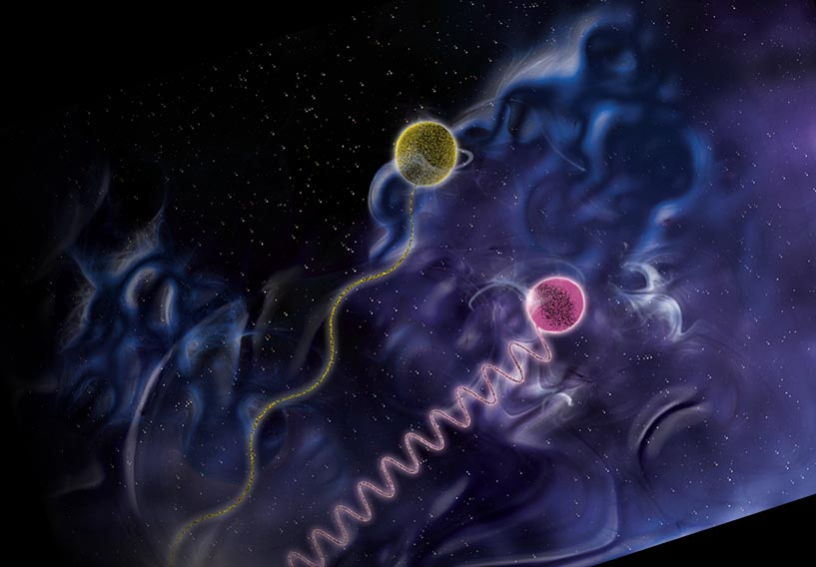
Things the Standard Model Doesn’t Explain

Slide 33
Connections: Known and Imagined
Key
Gravity
Standard
Model
Higgs
Electroweak
Quantized
E&M
General
relativity
Quantum
mechanics
Strong
Force
Spacetime
geometry
Special
relativity
E&M
Weak
force
Newtonian
gravity
Nuclear
physics
Mesons
&
baryons
chemistry
light
Celestial
gravity
Terrestrial
gravity
electricity
magnetism

Slide 34
Connections: Known and Imagined
Key
TOE
GUT
Gravity
Standard
Model
Quantum
gravity
Higgs
Electroweak
Speculative
Quantized
E&M
General
relativity
Quantum
mechanics
Strong
Force
Spacetime
geometry
Special
relativity
E&M
Weak
force
Newtonian
gravity
Nuclear
physics
Mesons
&
baryons
chemistry
light
Celestial
gravity
Terrestrial
gravity
electricity
magnetism

Slide 35
Connections: Known and Imagined
Key
TOE
GUT
Gravity
?
?
?
Standard
Model
Quantum
gravity
Higgs
Electroweak
?
Speculative
?
?
Quantized
E&M
General
relativity
Quantum
mechanics
Strong
Force
Spacetime
geometry
Special
relativity
E&M
Weak
force
Newtonian
gravity
Nuclear
physics
Mesons
&
baryons
chemistry
light
Celestial
gravity
Terrestrial
gravity
electricity
magnetism

Slide 36
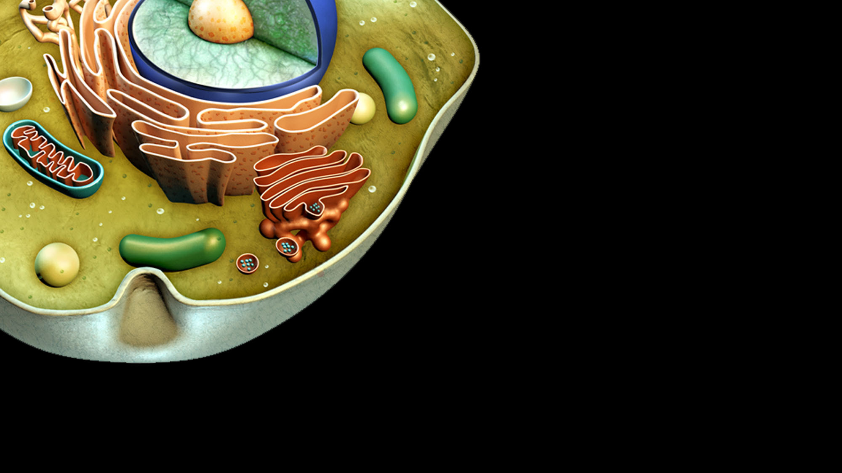

Slide 37
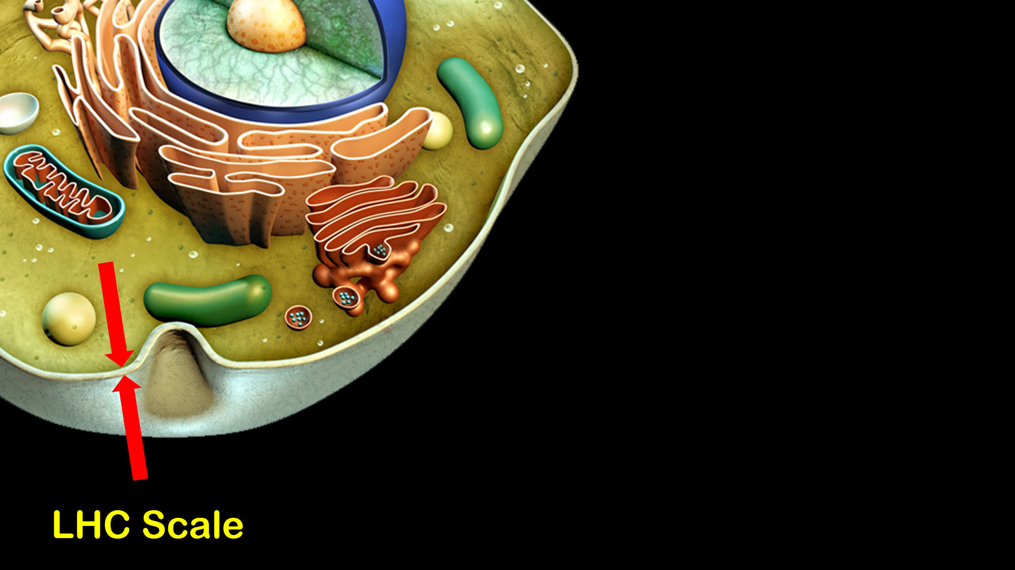

Slide 38
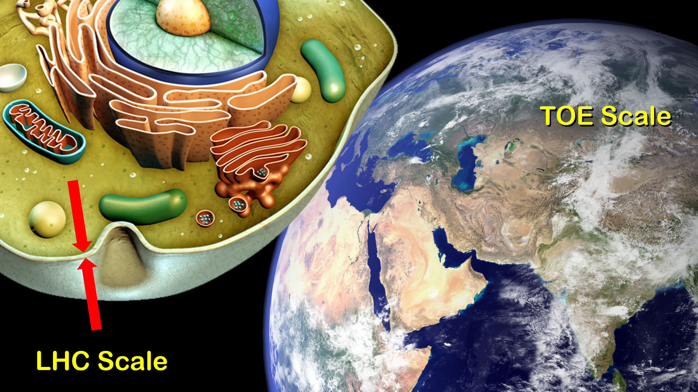

Slide 39
Currently Accessible Scale ∼ 10⁴ GeV TOE Scale ∼ 10¹⁹ GeV
Fifteen orders of magnitude! (proton to human scale)

Slide 41
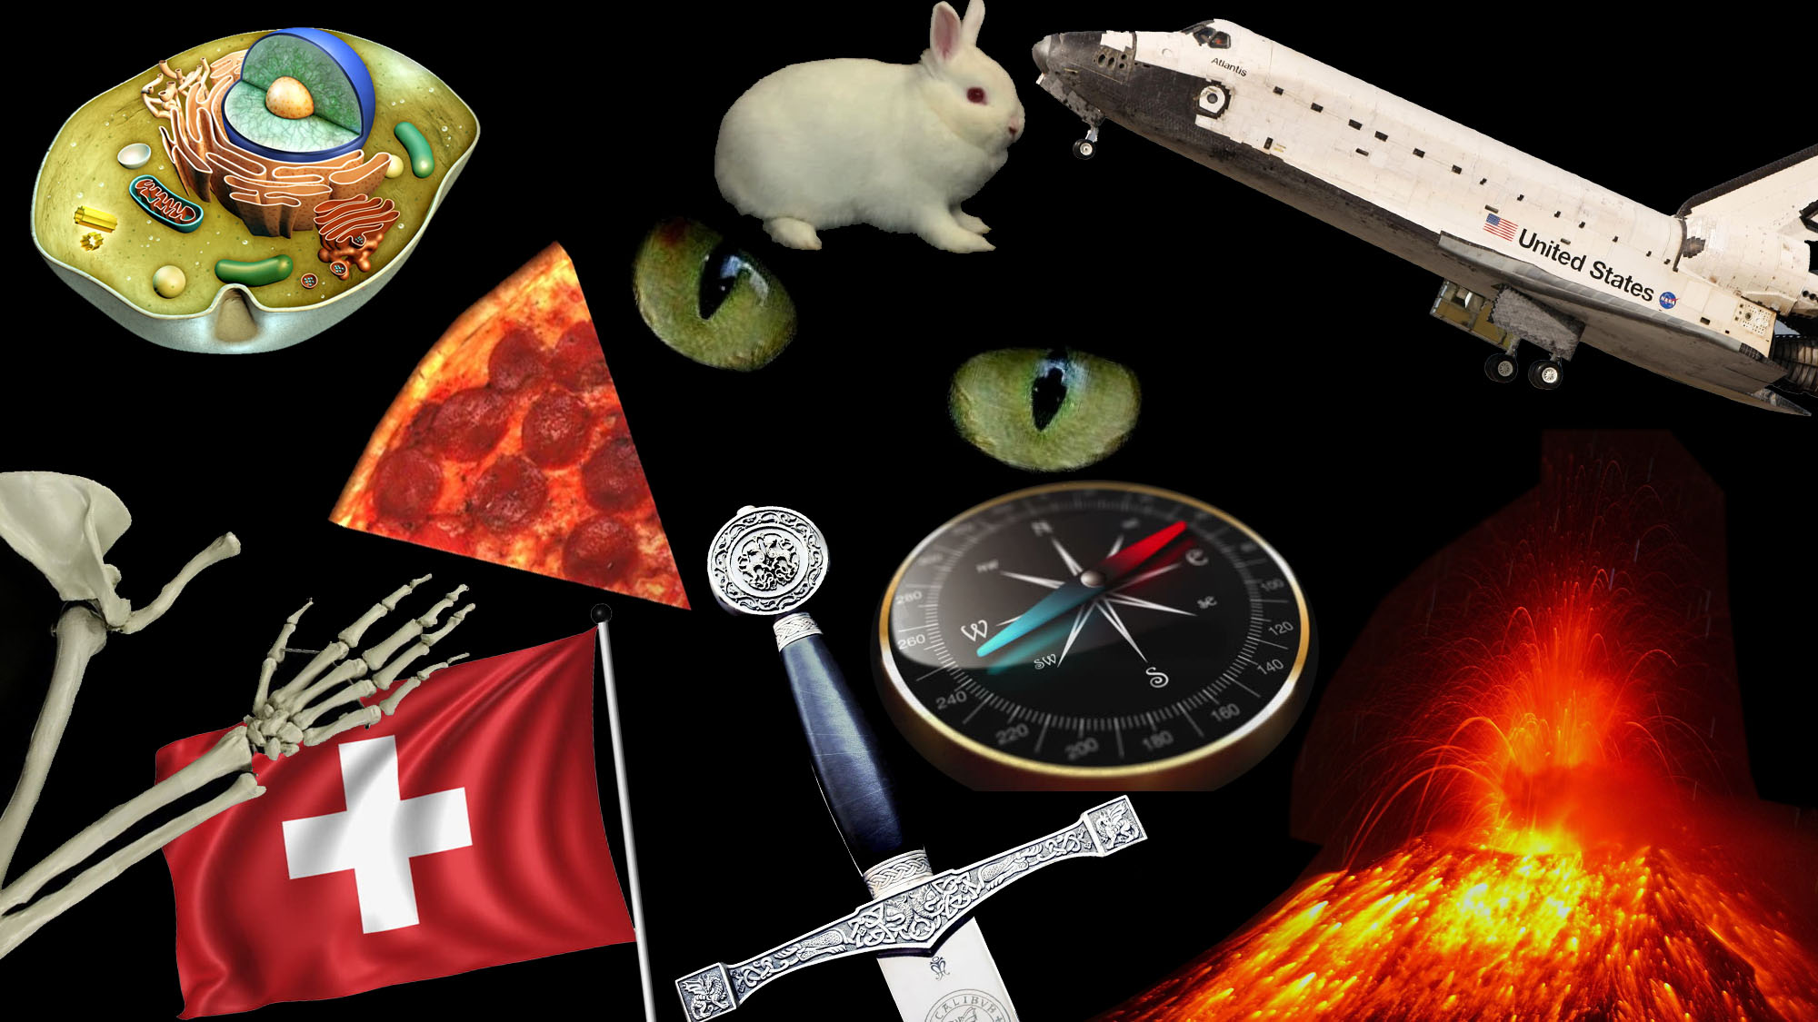

Slide 42
Generations
Connections: Known and Imagined
Key
TOE
GUT
Dark
matter
Gravity
?
?
?
Dark
energy
Standard
Model
Quantum
gravity
Higgs
Electroweak
?
Matter
antimatter
asymmetry
Speculative
?
?
Quantized
E&M
General
relativity
Inflation
Unknown
Quantum
mechanics
Strong
Force
Spacetime
geometry
Special
relativity
E&M
Weak
force
Newtonian
gravity
Nuclear
physics
Mesons
&
baryons
chemistry
light
Celestial
gravity
Terrestrial
gravity
electricity
magnetism

Slide 45
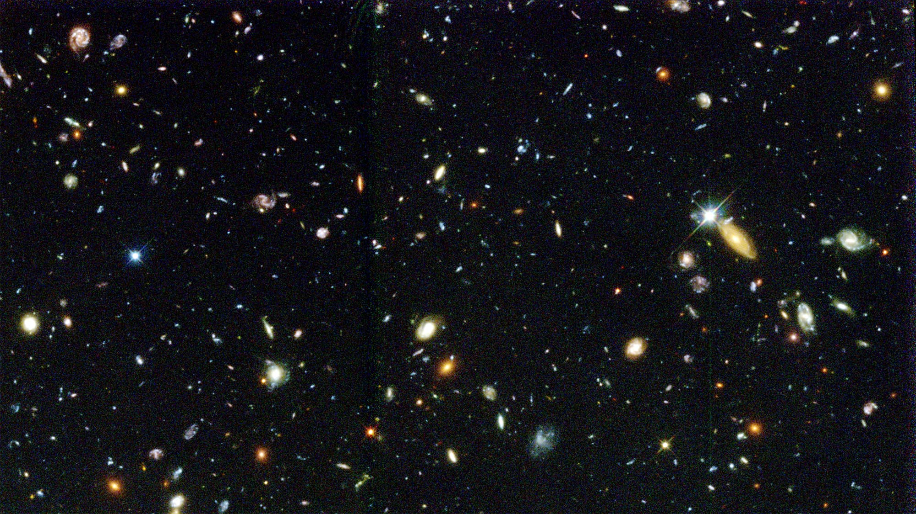

Slide 46
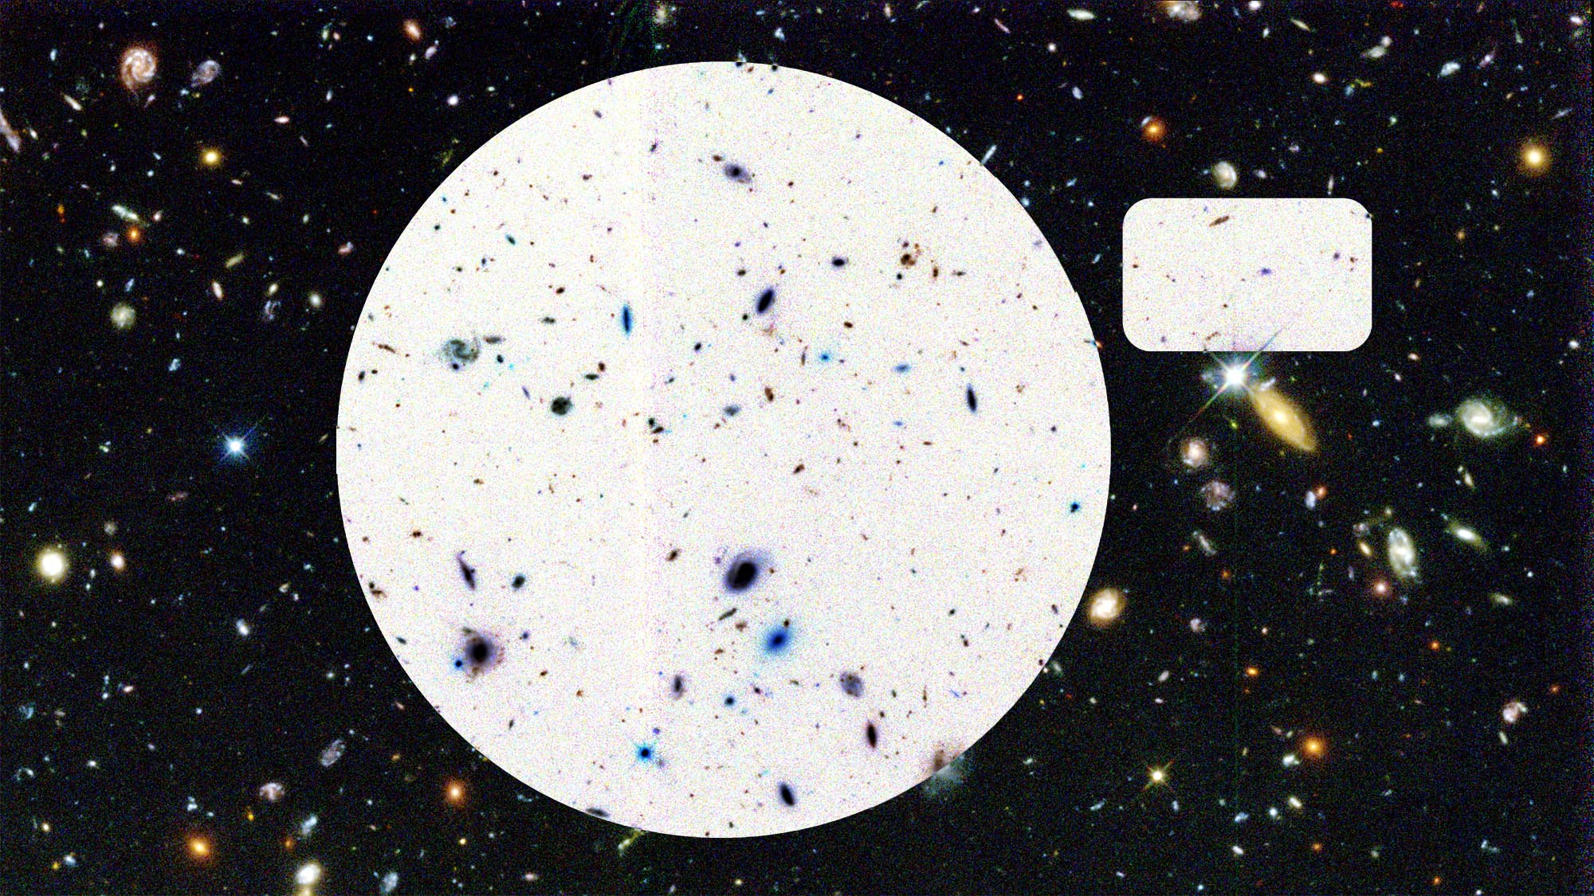
Heavy Elements
0.03%

Slide 47
Stars
0.5%

Slide 48
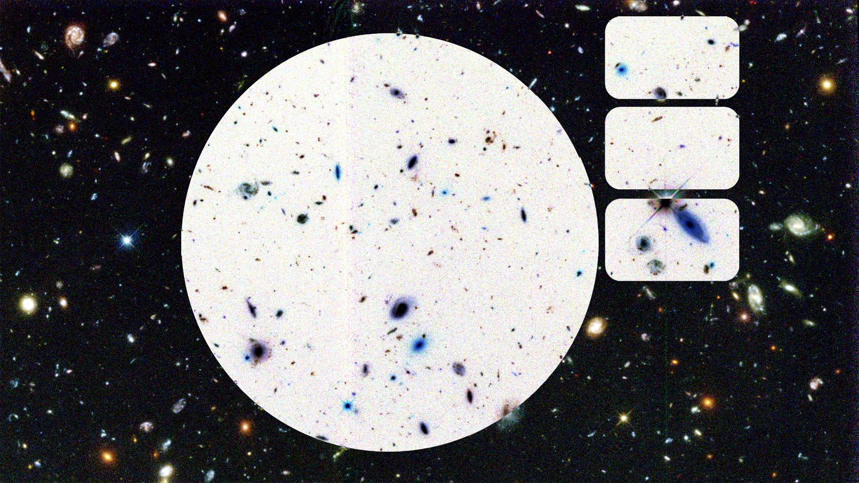
Neutrinos
0.3%
Stars
0.5%
Gas Clouds
4%

Slide 49
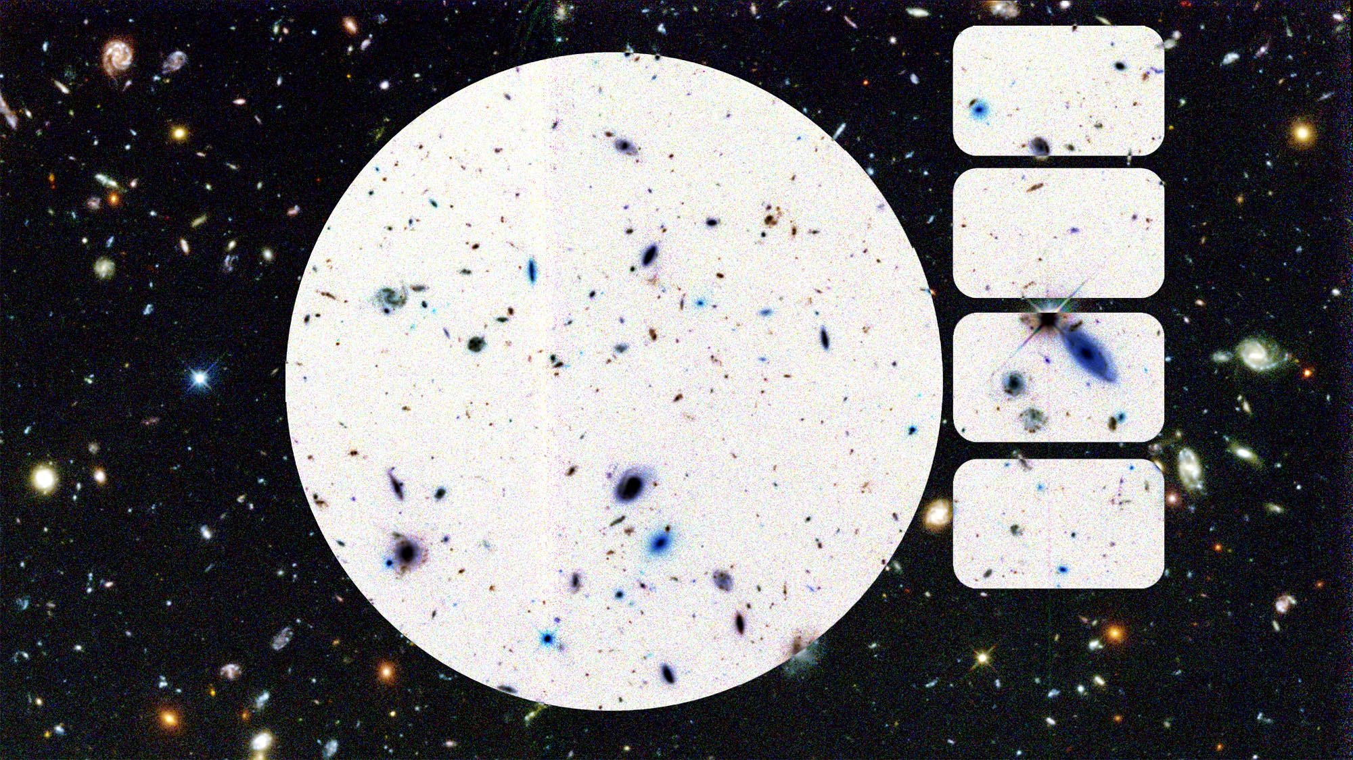
Neutrinos
0.3%
Stars
0.5%
Gas Clouds
4%
Dark Matter
27%

Slide 50
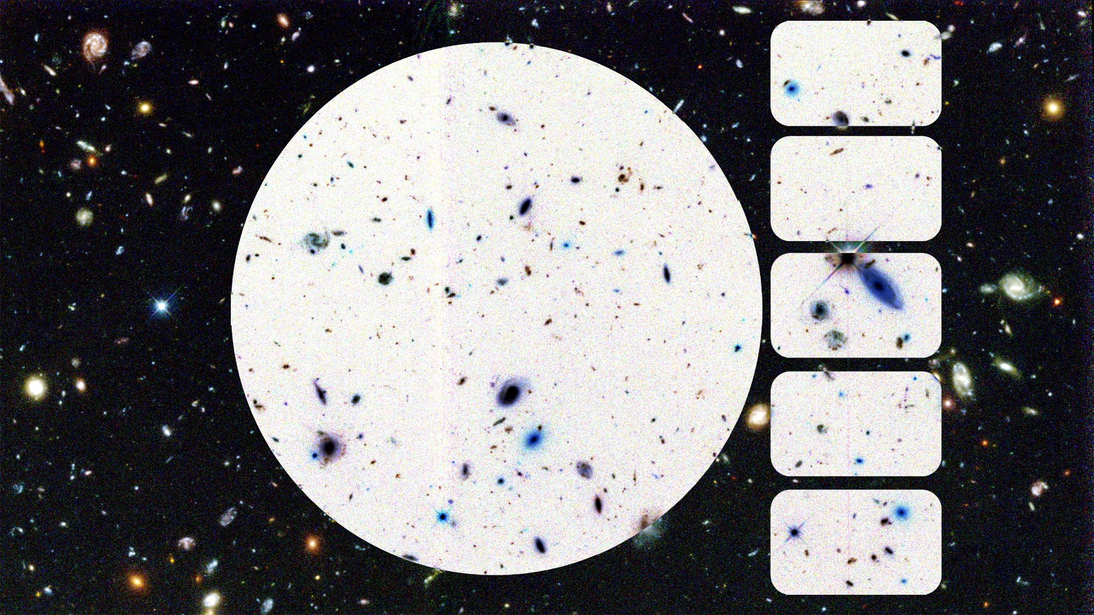
Neutrinos
0.3%
Stars
0.5%
Gas Clouds
4%
Dark Matter
27%
Dark Energy
68%

Slide 51
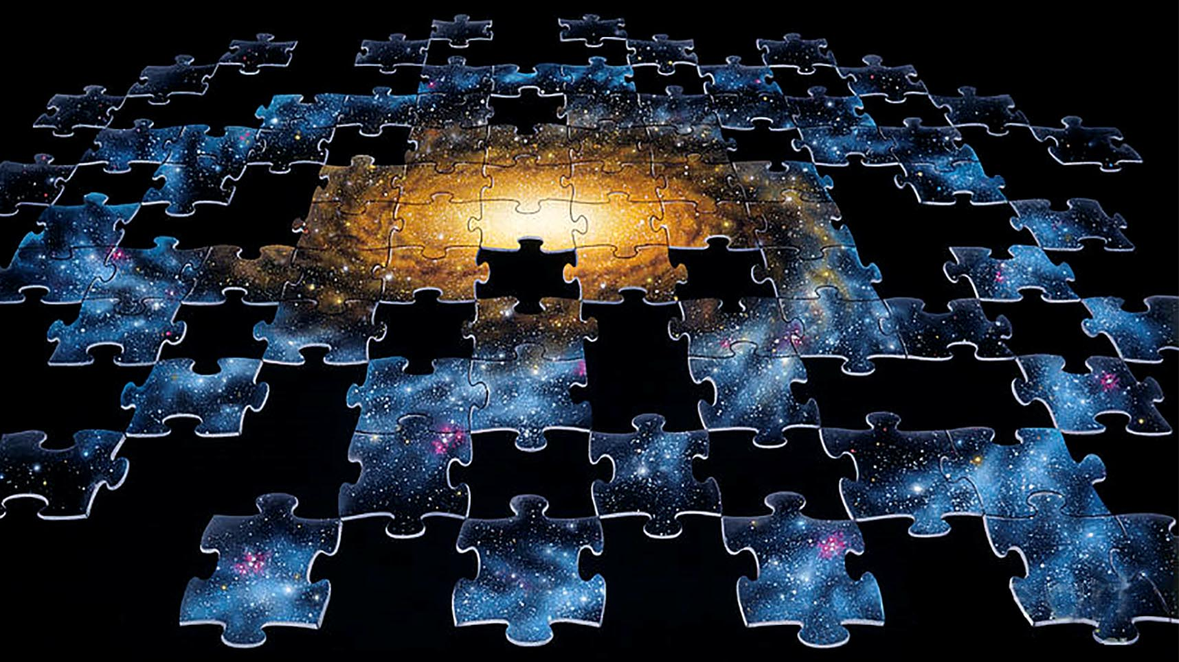

Slide 52
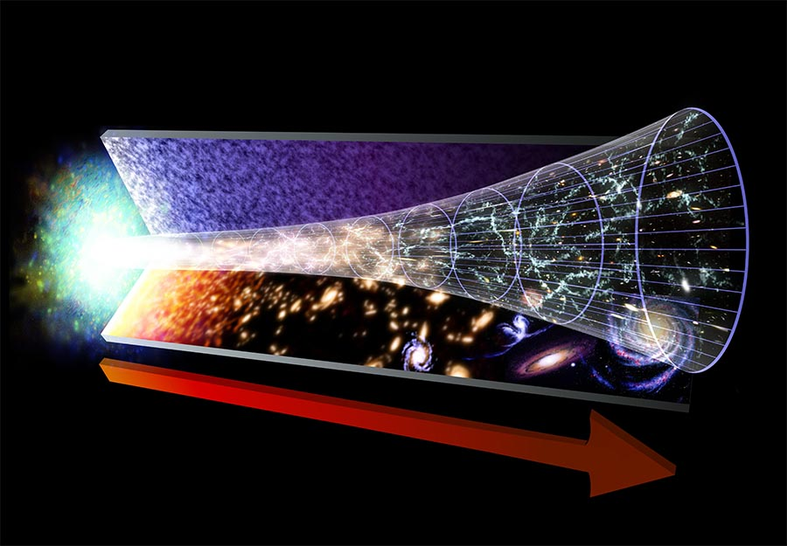
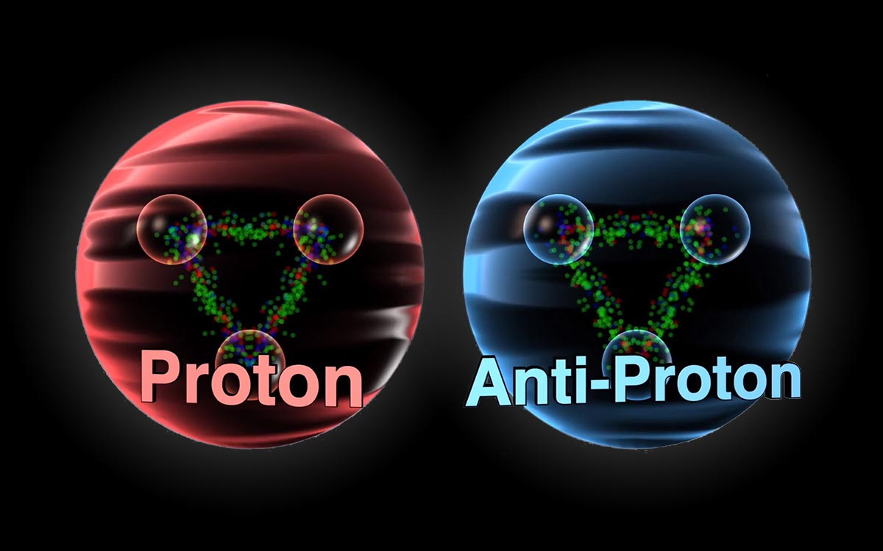
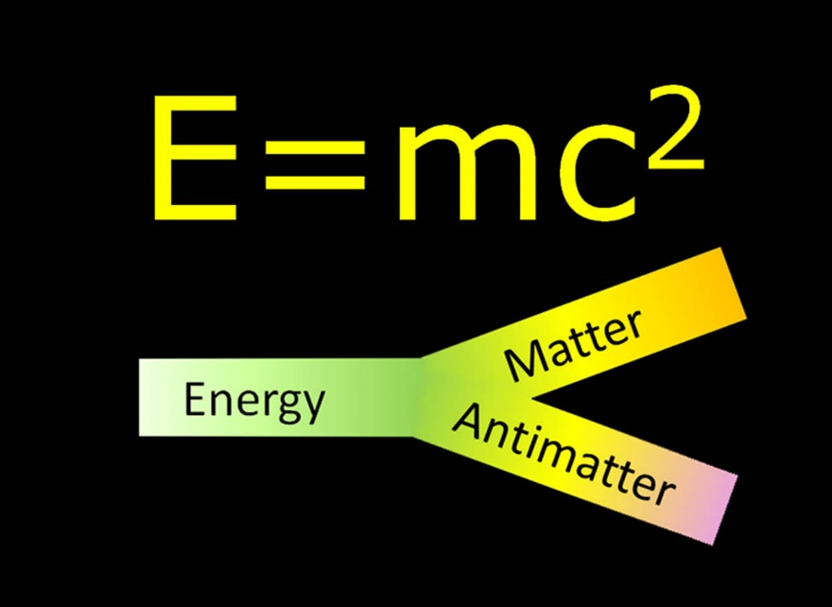
Where did the antimatter go?

Slide 54
The Big Bang: What started it?
Was there a “before?”

Slide 55
The Large Hadron Collider

Slide 56
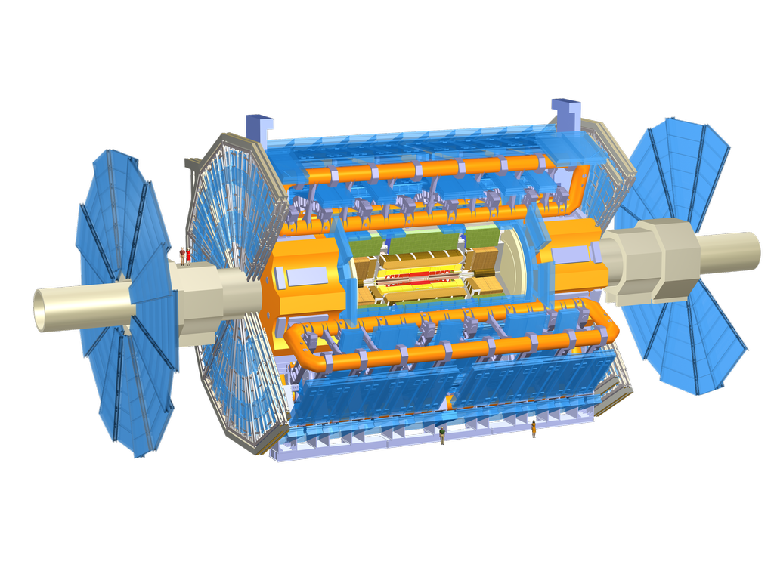
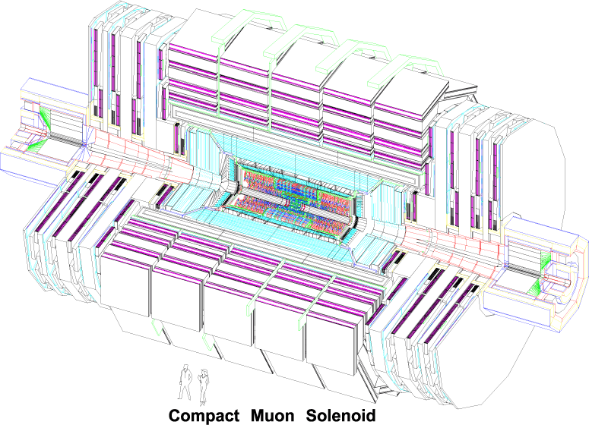
Two LHC Experiments

Slide 57
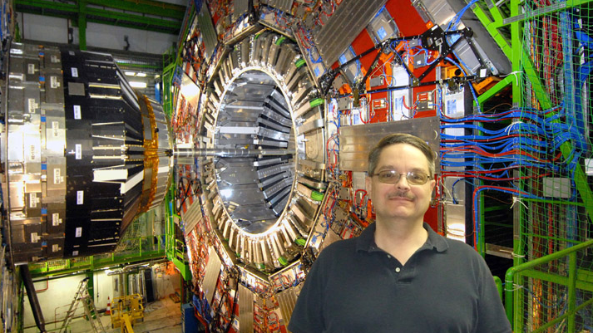

Slide 59
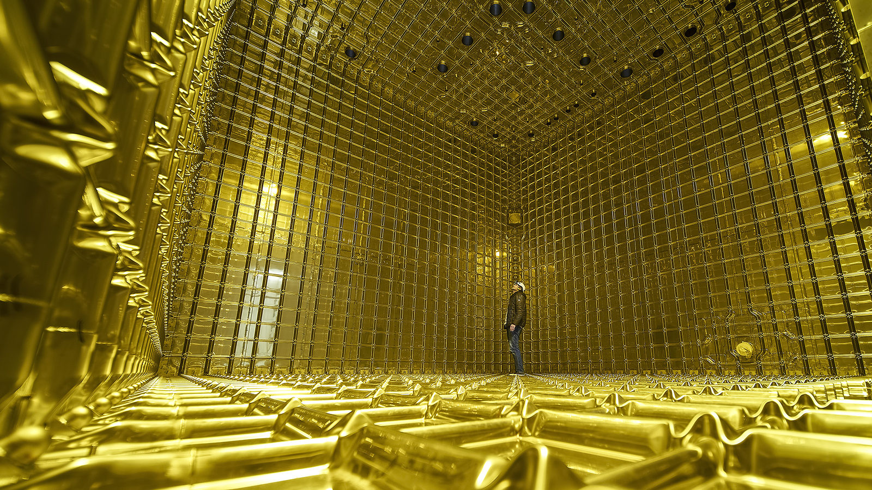

Slide 60
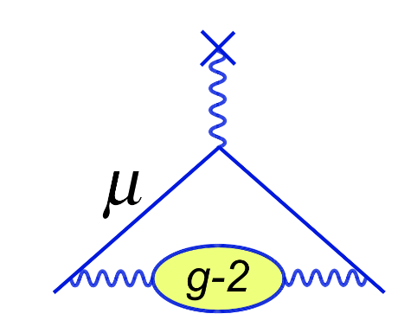
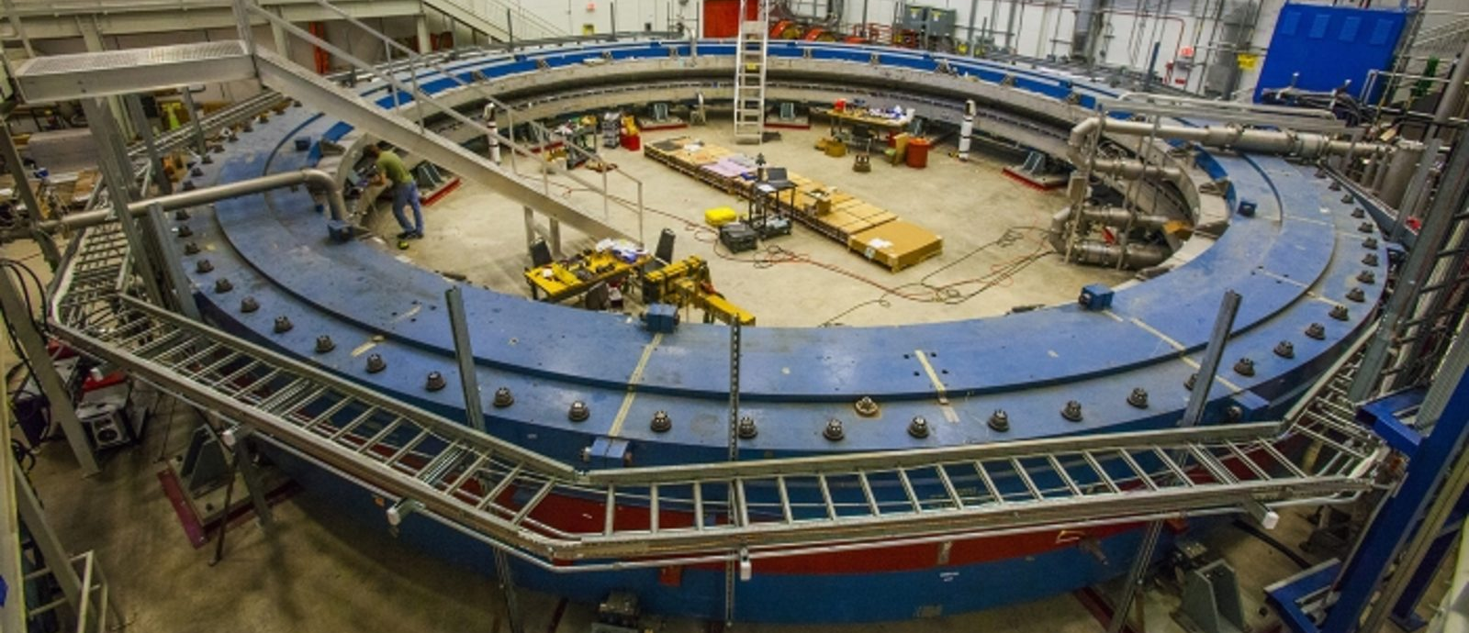
First beam: May 31, 2017
First result: Fall 2020

Slide 64
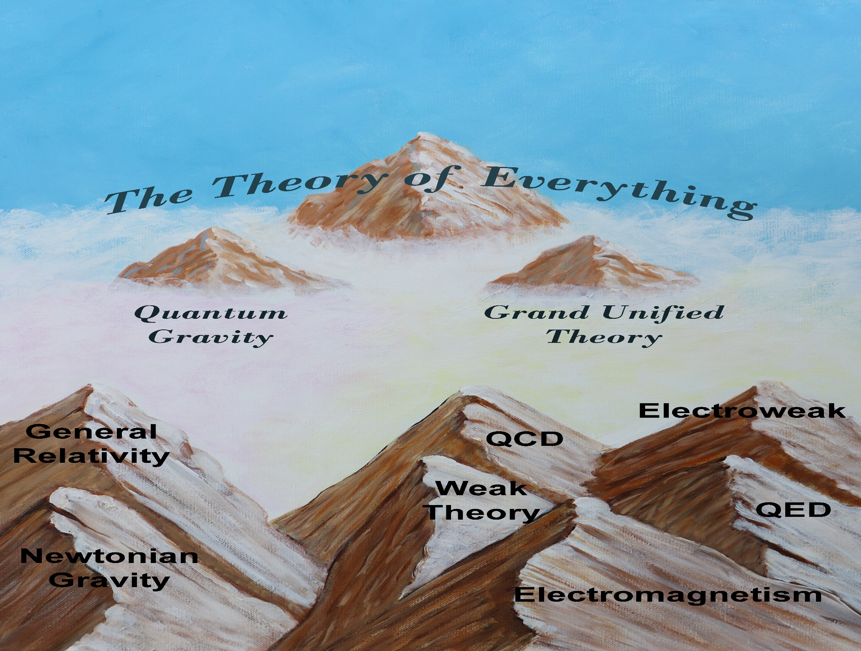

Slide 65
Perspective
Unification is a slow process
~ 1680 – Newton merged celestial & terrestrial gravity
~ 1880 – Maxwell merged electricity & magnetism
~ 1970 – Higgs and many others merged E&M & weak force
Many experiments are ongoing, looking for clues
Particle accelerators are exploring high energy and high precision
Dark matter experiments deep underground
Extraordinary telescopes look far away and back in time.
Fermilab is a leader in all of these efforts
LHC, neutrinos (lots!), g-2 Mu2e, COUPP, DES, Holometer

Slide 67
http://www.facebook.com/Dr.Don.Lincoln

Slide 68
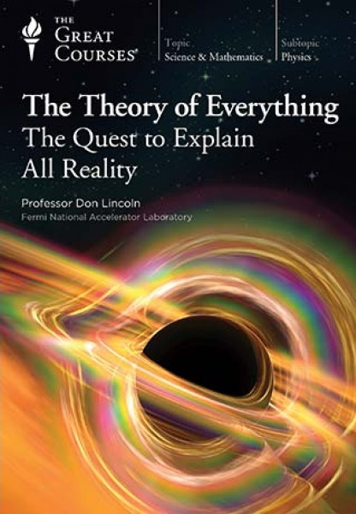
…Professor Lincoln’s 24 lectures teach you
what we know, and what we don’t, about a
theory of everything.
Highly recommended.

Slide 69
This true tale of the largest particle accelerator in history is better reading than fiction…
…the book is a fast read brimming with personality.
…Lincoln makes the discovery of minuscule particles sound like so much fun that any high schooler with a passing interest in general science may be in danger of full conversion to professional theoretical physics.
- Foreword Reviews
Follow the LHC and Don Lincoln on
Facebook at
http://www.facebook.com/Dr.Don.Lincoln

Slide 71
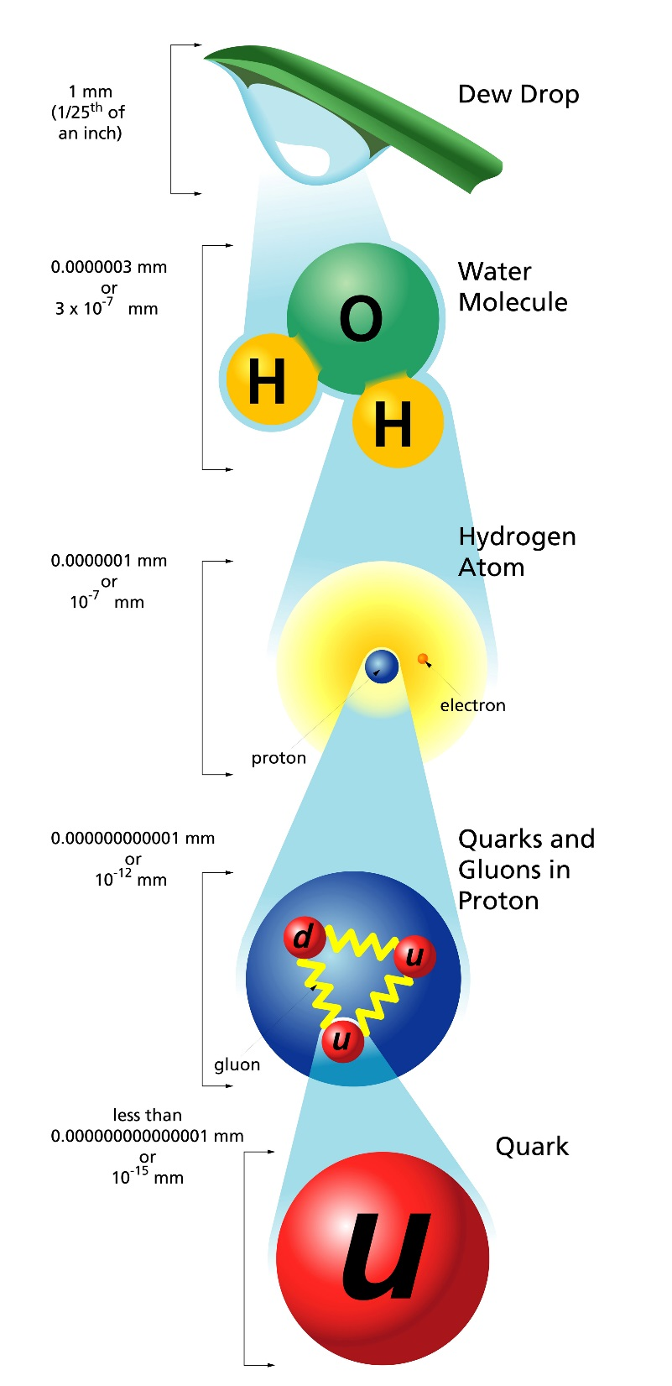

Slide 72
History
LHC started operations 2010 (7 TeV)
Increased energy 2012 (8 TeV)
Higgs discovery 2012
Higgs Nobel 2013
Shutdown 2012, Resumed operations 2015
13 TeV (increase of 63%)
Operating at nearly design specifications in 2016

Slide 73
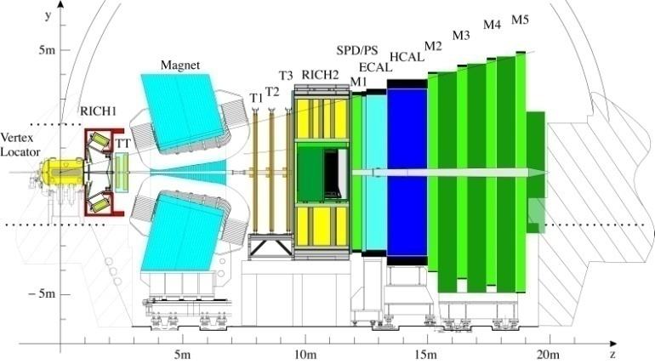
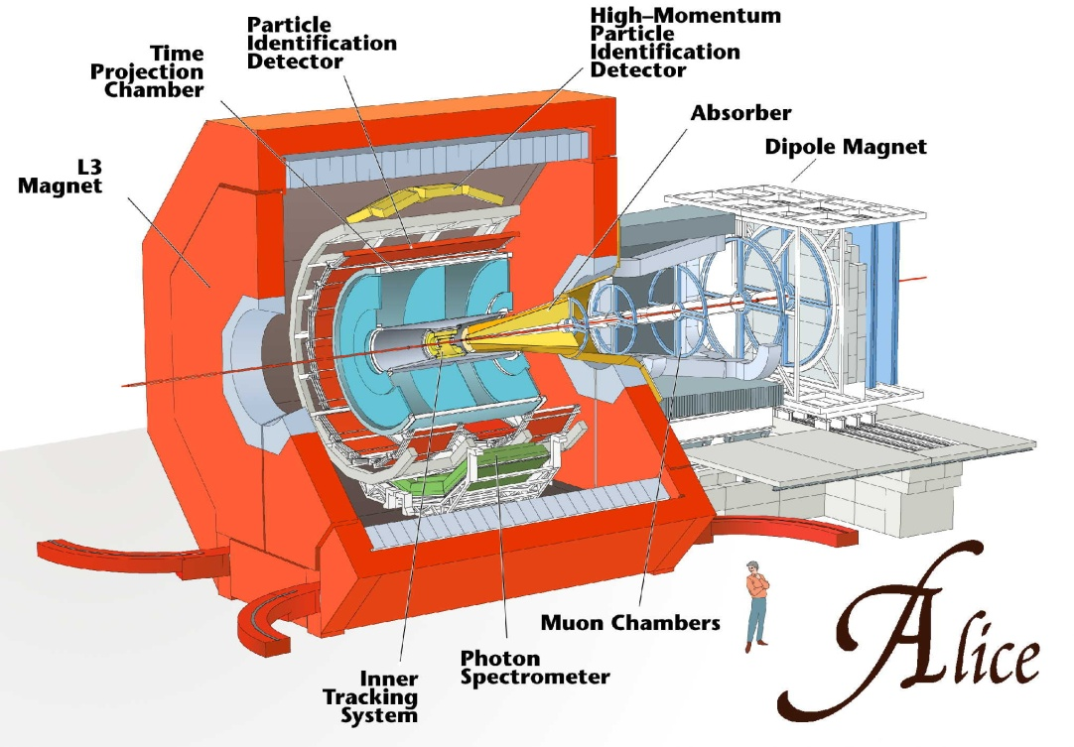
LHC Experiments

Slide 74
LHC Capabilities
The LHC is the highest energy particle accelerator ever constructed.
Fully 13 TRILLION electron volts of energy
$≈$20 – 50 collisions each times the beams cross (or much more)
$≈$1,000,000,000 collisions/second
Generate temperatures 100,000 hotter than the center of the sun!
These temperatures were last common in the universe a tenth of a trillionth of a second after the Big Bang!

Slide 76
Top 5 LHC Facts
Velocity of protons 99.9999991% speed of light! (will circle Earth 7 times per second)
Energy in the beams is 300 MJ (would melt 1 ton of copper)
Energy in the magnets 11 GJ (would melt 18 tons of gold)
The vacuum in the accelerator is ten times better than the surface of the moon!
The temperature inside the magnets is 1.9 K (-450 °F, -271 °C, colder than space between galaxies)

Slide 77
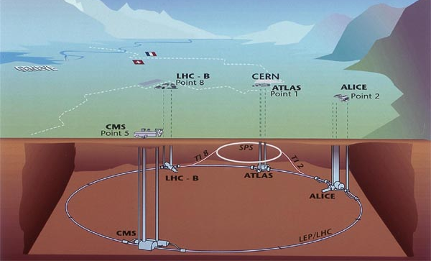
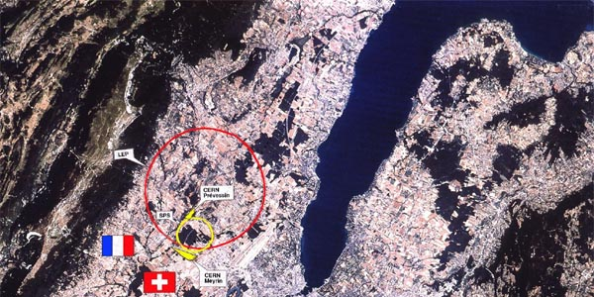
LHC
LHC

Slide 78
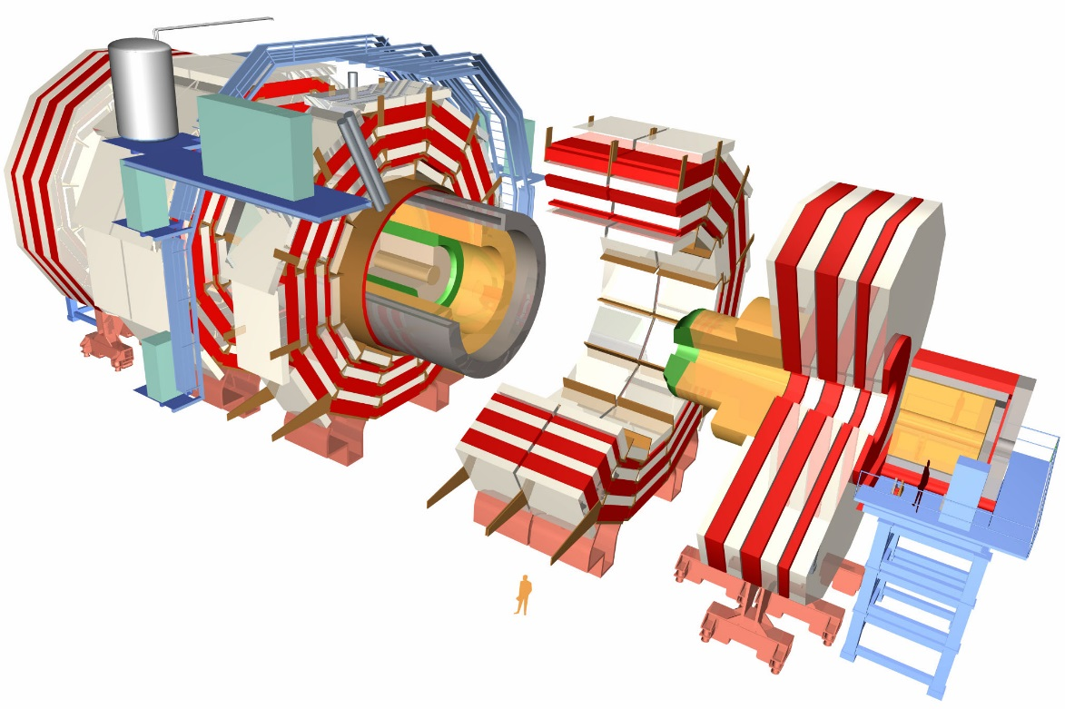
3,000 scientists
CMS
38 countries
183 institutes

