Slide 1
SIST Project: ProtoDUNE Workflow Development and Analysis
Lisa Paton
SIST 5 minutes, 5 slides 2020
3-June-2020

Slide 2
DUNE
The Deep Underground Neutrino Experiment (DUNE)
Will use 70,000 tons of Liquid Argon
MicroBooNE uses 170 tons
An International collaboration
1000 scientists
180 Universities and Laboratories
30 Countries
Will take place in the Long-Baseline Neutrino Facility
Between Fermilab and Stanford Underground Research Facility in South Dakota (800 miles)

Slide 3
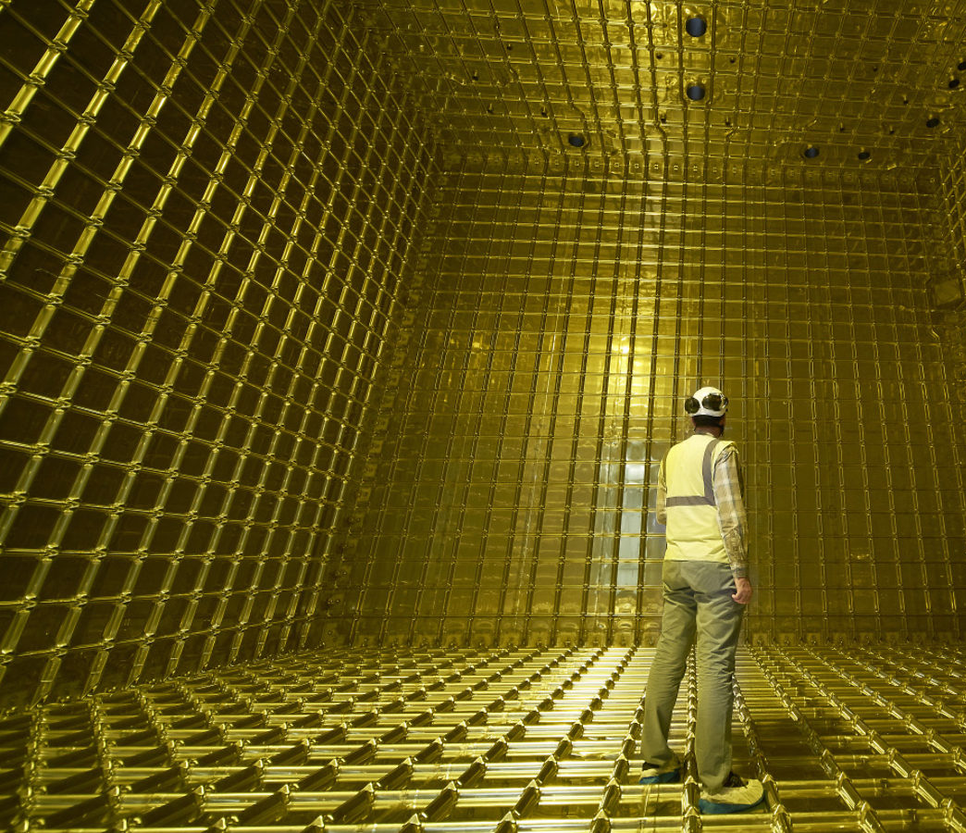
ProtoDUNE
Large scale prototypes of DUNE at CERN
Single Phase
Liquid Argon Only
Ran for six weeks in 2018
Dual Phase
Liquid Argon and Gas
In most recent ProtoDUNE Simulation, more memory was needed than in previous runs
High memory consumption is resource intensive

Slide 4
MC Memory Consumption
ProtoDUNE SP Production 2
ProtoDUNE SP Production 3
Job count vs Memory
Job count vs Memory
6/2/2020
Lisa Paton | SIST 5 minutes, 5 slides 2020

Slide 5
My Project
Neutrino Interaction generation
Modify the existing ProtoDUNE (single phase) simulation workflow
Incorporate recently designed changes to reduce overall memory consumption
Test these changes on a large scale
How can we consume less memory?
Split Geant4 into two stages (shown to the right)
This reduces how many subdetectors are in memory at the same time
Geant4 Sim Stage1
Geant4 Sim Stage2
Geant4 Sim Stage2
Electronics Simulation
Event Reconstruction

