Slide 1
DUNE’s Potential to Search for Neutrinoless Double Beta Decay
Elise Chavez
Supervisor: Joseph Zennamo
5 Minute 5 Slide
03 June 2020

Slide 2
Neutrinoless Double Beta Decay
Occurs when a nucleus has two neutrons decay into two protons but only emits two electrons
Xe(136, 54) $→$ Ba(136 , 56) + 2e⁻ + 2.459 MeV (136-atomic number, 54/56-proton number, 2.459-energy released)

Slide 3
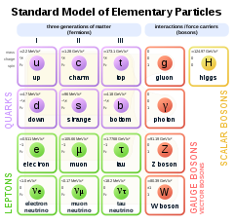
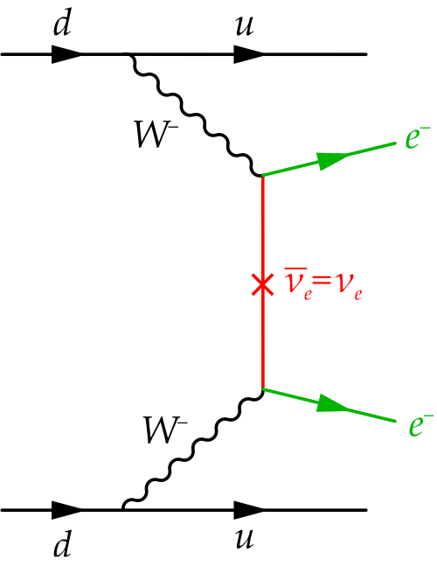
Neutrinoless Double Beta Decay
Forbidden by the standard Model
Violates lepton number
For this to occur, the neutrino must
be a majorana particle
Means the neutrino is the same as
its anti-particle
One of the pieces to the
matter/anti-matter asymmetry
puzzle

Slide 4
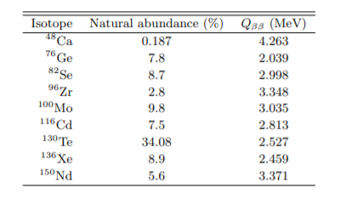
Difficult Search $→$ Try Using DUNE
Physicists have been searching for 0$νββ$ since about the 1960s
Led to the 0$νββ$decay half-life $T_{1/2}^{0ν}$ limit being improved by several orders of magnitude (for Xenon it is ~${10}^{27}$years, or ~10^16 ages of the universe)
Need specific isotopes
Nuclear physics dictates that only
certain nuclei can decay through
0$νββ$ decay
For TPCs, Xenon is typically used
Ultra-rare decay, so we need a big detector
DUNE is a really big detector $→$ dope the liquid Ar with Xe
For comparison, XO200 is only 2kg of Xe

Slide 5
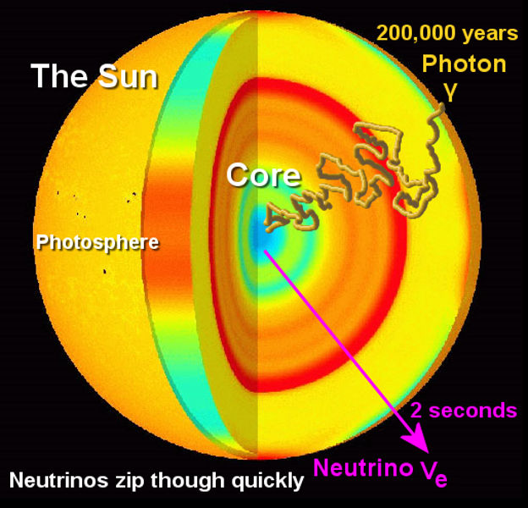
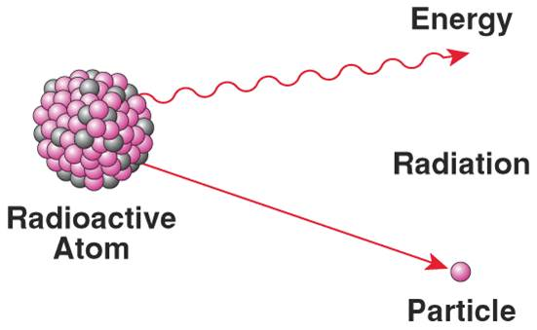
Strategy and Goals for this Project
Model the backgrounds for 0$νββ$within the LArTPC to determine the feasibility of a search
Environmental radioactive decays
Solar neutrinos
Spallation caused by Cosmic Muons
Any other sources of background
to be determined
Lower DUNE’s capabilities to < 5 MeV
Determine whether the signal can
be separated from this background
What can we expect to see in
this type of search using DUNE
0$νββ$ $→$ 2 energetic e⁻ vs. background $→$ 1 energetic e⁻

Slide 6
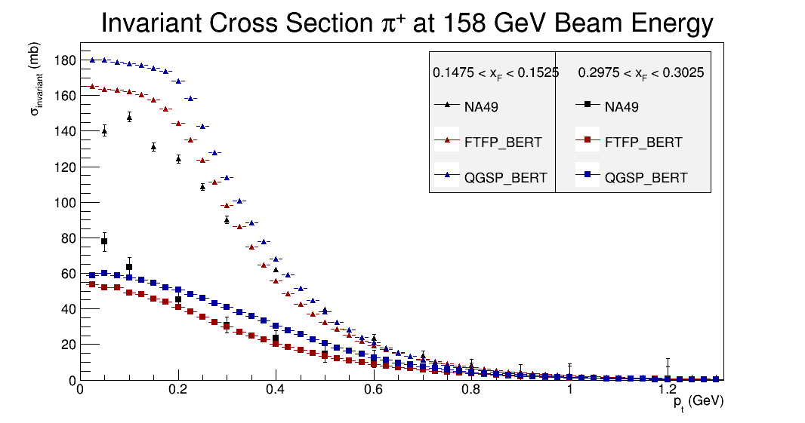
What I hope to Learn
Radioactive decay and more about general nuclear physics
Determining which decays are important
How to model these decays
Coding and simulating within the DUNE framework
Different than what I am used to,
CMS, NOvA (similar but not the same)
Become better at analysis in an experimental context
Learn from my supervisor, and his post-doc
Physics, Fermilab, DUNE, etc

Slide 7
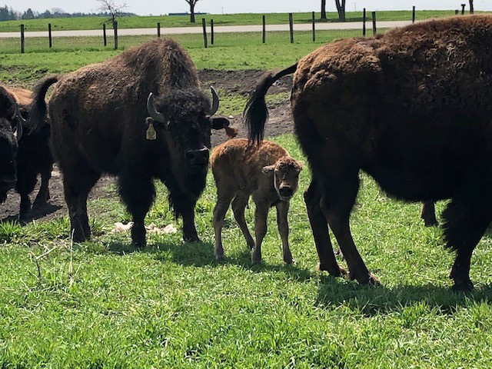
Thank you!

