Slide 1
Tolerances of the APA frames
Inspection results
Tolerances of components
Tolerances on assembly

Slide 2
Forty nine points are surveyed Note: Coordinate system is fit to P1, P6, P12, and P17
y
x

Slide 3
Summary of results
 | Result | Limit | units
Overall flatness | 1.9 | 11 | mm
Overall bow | -1.1 | 11 | mm
Overall twist | -0.2 | 2 | mm/m
Twist Zone 1 | 0.2 | 2 | mm/m
Twist Zone 2 | 0.2 | 2 | mm/m
Twist Zone 3 | -0.1 | 2 | mm/m
Twist Zone 4 | -0.8 | 2 | mm/m
Twist Zone 5 | -0.3 | 2 | mm/m
Fold - front side
Foot tube | 0.6 | 1.2 | mm
Rib 1 | 0.5 | 1.2 | mm
Rib 2 | 0.7 | 1.2 | mm
Rib 3 | 0.5 | 1.2 | mm
Rib 4 | 0.5 | 1.2 | mm
Head tube | 0.2 | 1.2 | mm
Max. x dev. | -1.9
Max. y dev. | -1.1
Minimum Envelope | 2299.88
Notes:
Board mounting features are within 0.5mm except for one foot tube hole at a y deviation of -1.1.
2) Features in middle tube are shifted ~1.4mm in the minus x direction.

Slide 4
PD slot alignment
As planned dedicated fixturing will better control the x and y position of the middle tube.
Suggested tolerance is 2mm positional tolerance in three dimensions

Slide 5
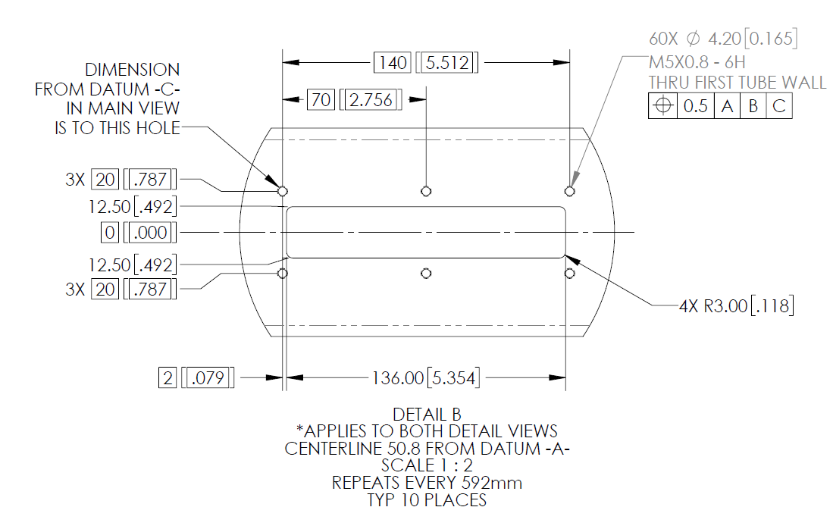
Tolerances of components - Side tubes
Tolerance of PD holes to side tube Datums is a true position of 0.5mm

Slide 6
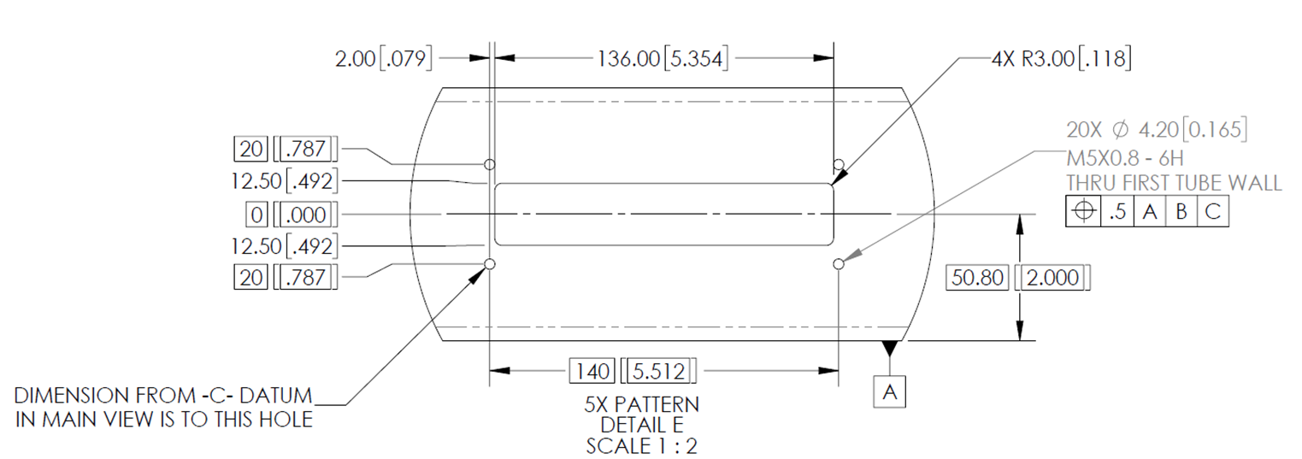
Tolerances of components - middle tubes
Tolerance of PD holes to middle tube Datums is a true position of 0.5mm

Slide 7
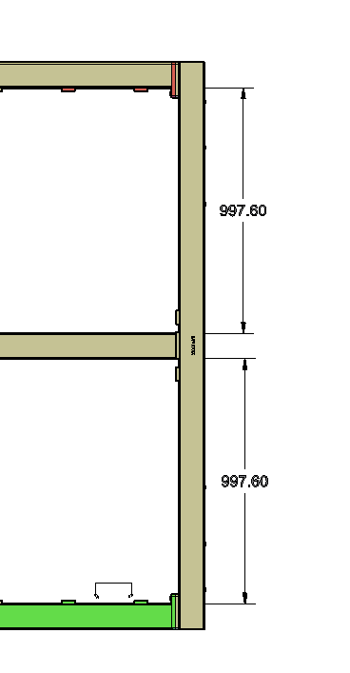
Tolerances on assembly – tube to tube
+/- 2mm
+/- 2mm

Slide 8
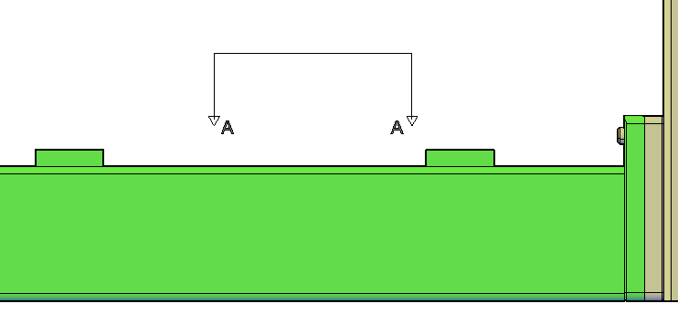
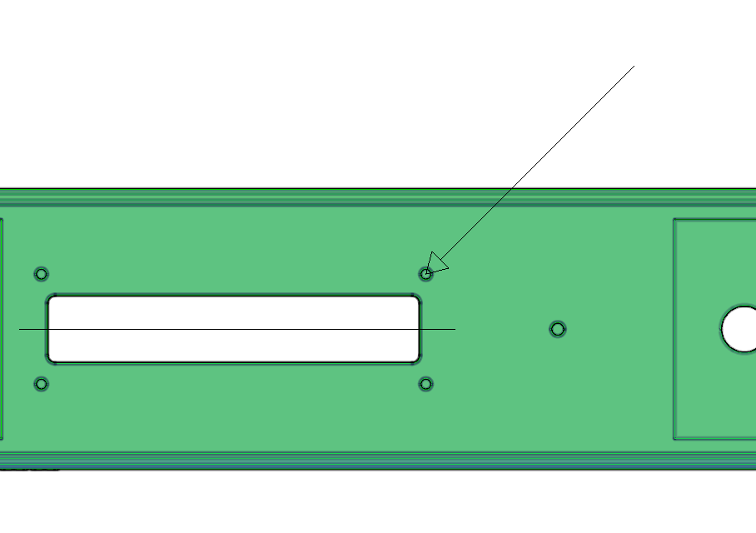
Tolerances on assembly
4.0 A B C
Section A-A
Datum A,B, and C are establish for best fit to P1, P6,P12, and P17 (see page 2)
Should consider a gage for checking pattern and or checking PD insertion after railes are installed

Slide 9
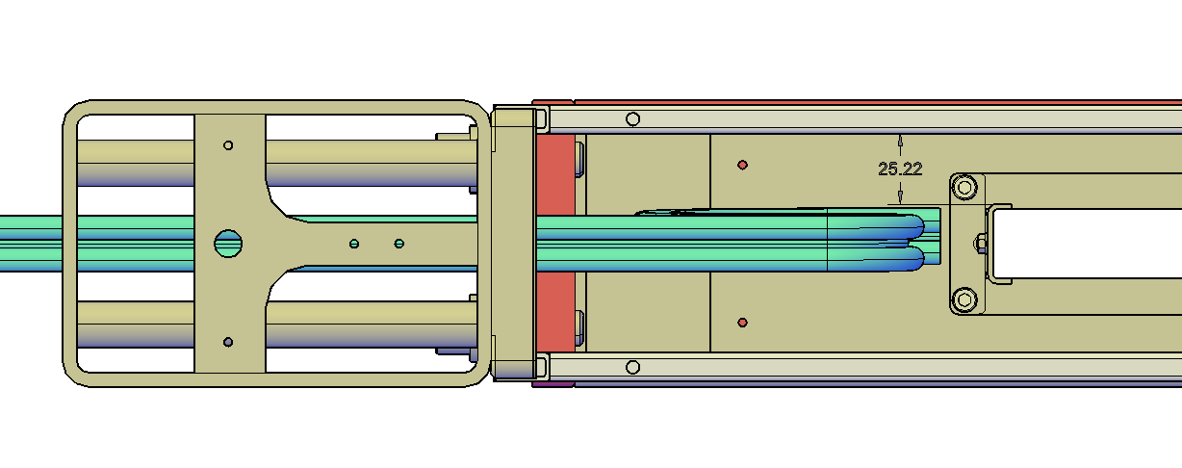
PD slot alignment
Interface to mesh panels – How much space is needed to pass cables over rails?

