Slide 1
Electroweak Precision Measurements at FCC-ee
requirements on theory and experiments
SNOWMASS EF04 – Alain.Blondel@cern.ch

Slide 2
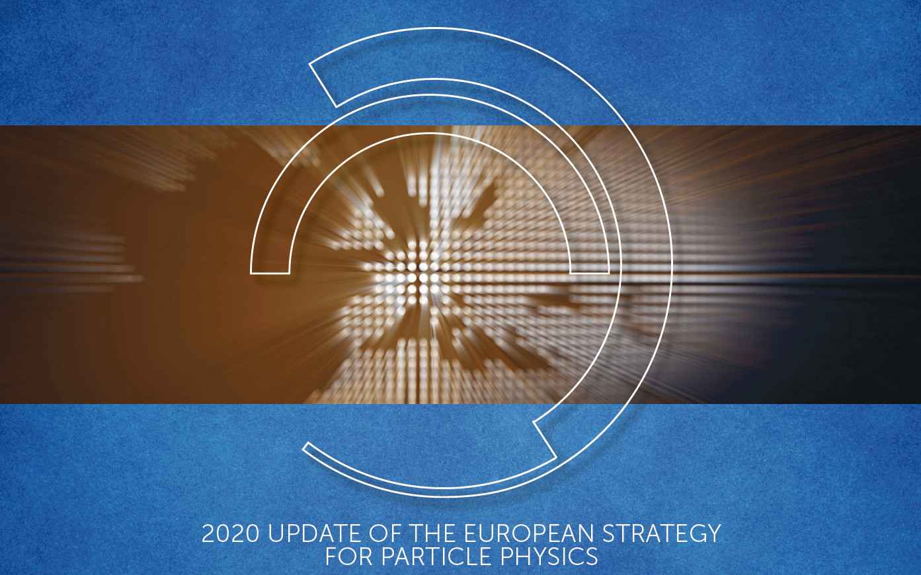
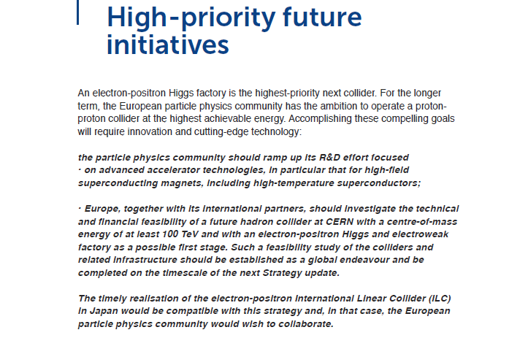
HOT NEWS
Preamble

Slide 3
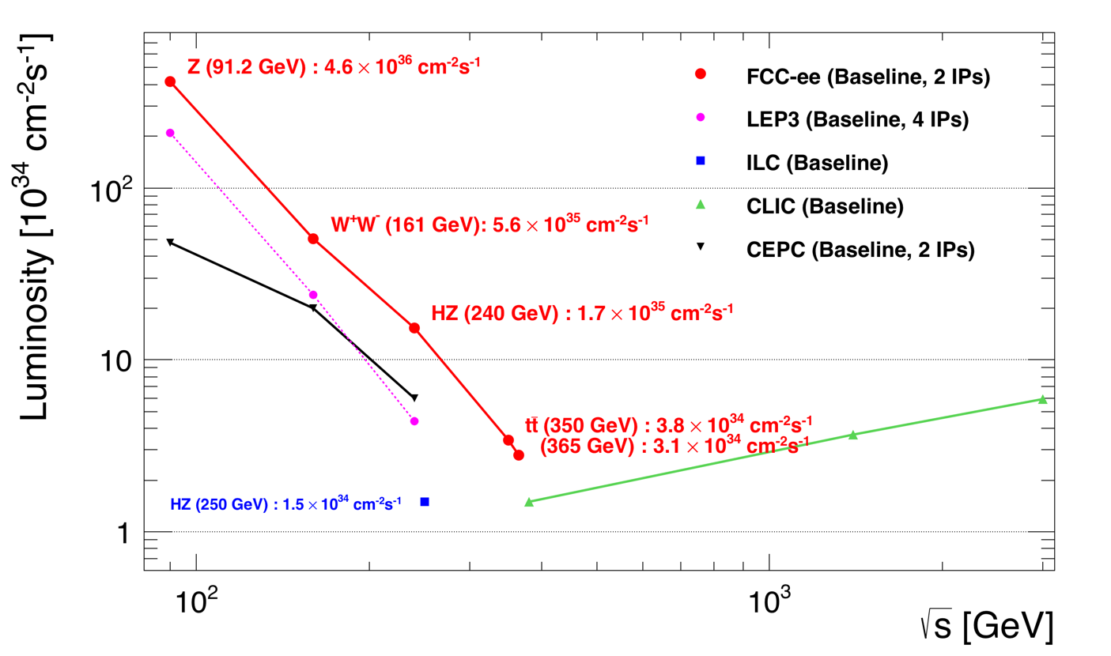
Z WW HZ tt
FCC-ee
LEPx10⁵!
4 expts
➔ x1.7
Event statistics :
E_{CM} errors:
Z peak E_{cm} = 91 GeV 5 10¹² e+e- → Z
WW threshold E_{cm} = 161 GeV 10⁸ e+e- → WW
ZH threshold E_{cm} = 240 GeV 10⁶ e+e- → ZH
‾tt threshold E_{cm} = 350 GeV 10⁶ e+e- →‾tt
H(optional) E_{cm} = 125 GeV 10⁴ e+e- →‾H
LEP x 10⁵
LEP x 2.10³
Never done
Never done
Never done
100 keV
300 keV
2 MeV
5MeV
<1 MeV
Great energy range for the heavy particles of the Standard Model.
Complementarity with hadron colliders (LHC, FCC-hh) and also with linear colliders

Slide 4
CAVEATs
In 20 minutes this presentation can only be a first presentation.
I will concentrate on the Z-factory part of the program, which comes first
and is most demanding.
3. I will concentrate on the approach to experimental errors and on the
goals for the TFDR that we should deliver around 2025
4. There are plenty of opportunities for all in Snowmass to participate in this adventure
either
-- towards the detector requirements and design (there are 2-4 detectors on FCC-ee!)
-- the theory calculations
-- the new physics sensitivity and interpretation of the results

Slide 5
Motivation for the precision measurements and associated precision calculations
1. Given that the SM is complete with the Higgs discovery, how do we find out: -- if the Higgs boson is exactly what is foreseen by the standard model? -- where/what are the new physics phenomena that must be present to explain:
baryon asymmetry
dark matter,
neutrino masses (and other mysteries we don’t understand) 2. A powerful and broadly efficient methods is to perform precision measurements -- many observables contain sensitivity to new phenomena, either by loops, direct long distance propagator effects, or mixing with SM coupled particles. (in addition to a great program of direct searches for feebly coupled particles)
-- are there any more weakly coupled particles?
The top quark effect at LEP was 10σ! (➔ there is *not* another t-b quark system)
any SU(2)-violating effect will appear strongly regardless of mass scale
-- is there mixing ? in particular active-sterile neutrino mixing ( ibid )
-- high mass SM coupled SU(2)-respecting → (ex: Z’ or degenerate SuSy) → EFT analysis
Emphasis on different observables depending on the question asked.
«T»
«ν»
«S»

Slide 6
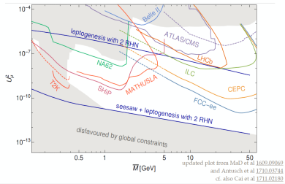
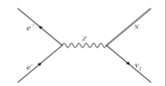
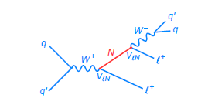
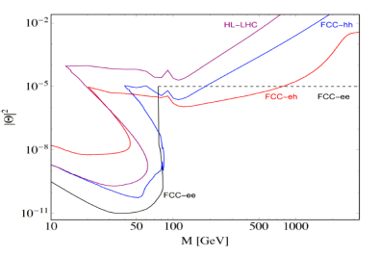
Heavy neutrinos
FCC-ee Z
+
or$l$±ν
(*)
-
FCC-hh
tau life-time and branching ratios
FCC-ee
-- EWPO, G_{F}, τ , N_{v}: sensitivity 10⁻⁵ up to v. high Masses
-- high sensitivity to single N(→ $l2$± W) in Z decay
FCC-hh
-- production in W-> $l1$± + N(→ $l2$± W) (LNV+LFV)
with initial and final lepton charge and flavour
FCC e-p
-- production in CC e± p → X N(→ $l$±W) high mass
ee-hh/ep complementarity:
indirect/direct discovery + studies of FNV and LFV!
Detached
vertices
Massive neutrino mechanisms for generating the matter-antimatter asymmetry in the Universe should be a central consideration in the selection and design of future colliders. (neutrino town meeting report to ESPP)

Slide 7
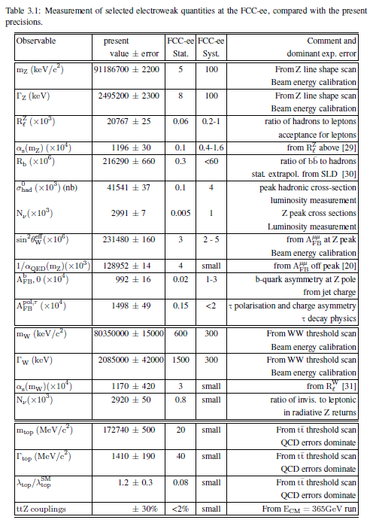
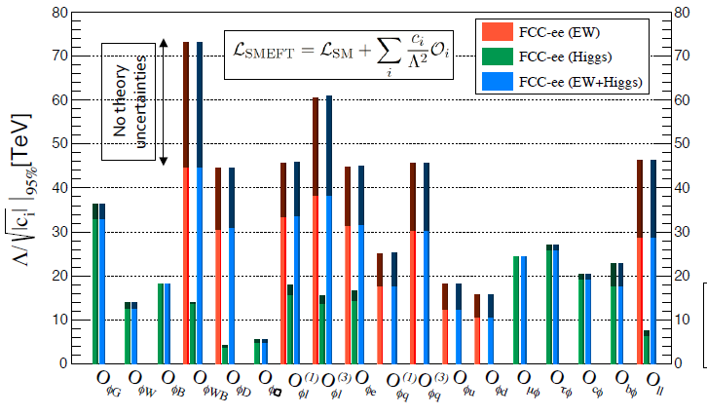
Pecision EW measurements:
is the SM complete?
-^- EFT D6 operators (some assumptions)
-^- Higgs and EWPOs are complementary
-^- top quark mass and couplings essential!
(the 100km circumference is optimal for this)
<-- many systematics are preliminary
and should improve with more work.
<-- tau b and c observables still to be added
<-- complemented by high energy FCC-hh
Theory work is critical and initiated
table as of CDR end of 2018

Slide 8
Systematic errors
-- a common mistake that was often made in ‘studies’ in the past is to underestimate the creativity of a 100% dedicated team to deconstruct a delicate systematic errors problem .
➔ systematic uncertainties were grossly overestimated
example: in the 1986 LEP yellow report Z mass (width) errors were given as 50(20) MeV
In reality the total final errors were 2 (2) MeV. (i.e. close to the statistical ones)
As a consequence we argued in the 1988 yellow report (polarization at LEP) that we should have longitudinal polarization to measure ALR (and sin²θ^{eff}_{W} to +- 0.00035) (spin rotators etc..) because we could not measure sin²θ^{eff}_{W} better than +- 0.0008 (syst) otherwise.
(final LEP: +-0.00016 without longitudinal polarization) (CERN 86-02, 88-06)
- This conservative behaviour can have considerable consequences on detector design or on
the running plan e.g. (to scan or not to scan, longitudinal polarization or not…etc.)
Unless otherwise specified we would advocate the use of statistical errors (with appropriate
selection efficiencies and background subtractions) as the best way to assess the
physics potential of a facility.
It is however important to concentrate on finding the potential ‘show stoppers’
or ‘stumbling blocks’, to guide the detector R&D and detector requirements , and
Strong support for theoretical calculations will be needed if the program is to be successful

Slide 9
courtesy J. De Blas
The main change comes from full use of the power of the Z width measurement
NB the relation between m_{Z} and Γ_{ee} is not affected by uncertainty on α_{QED} (m_{Z})

Slide 10
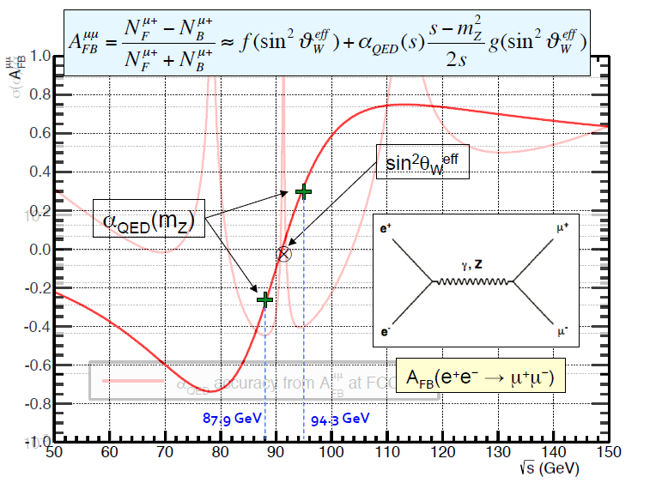
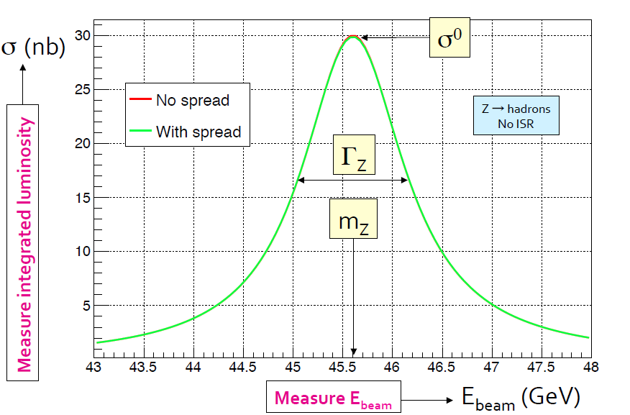
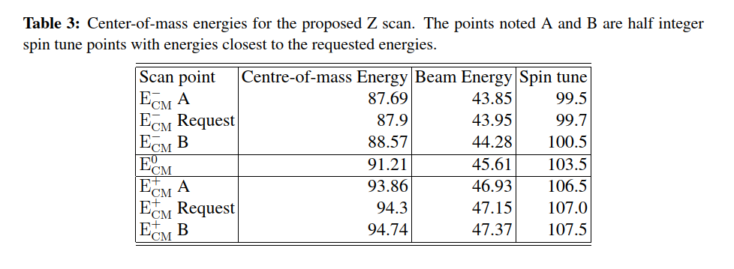
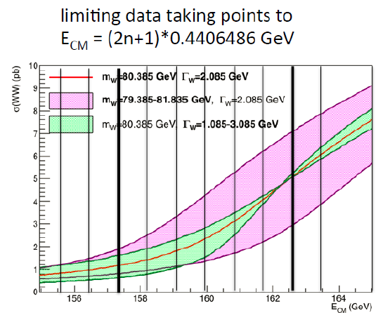
Z Line shape and W threshold

Slide 11
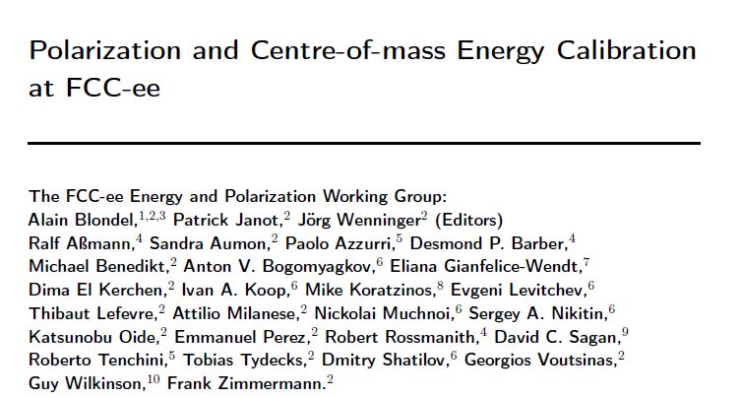
FCC-ee beam polarization and
centre-of-mass energy calibration
arXiv:1909.12245

Slide 12
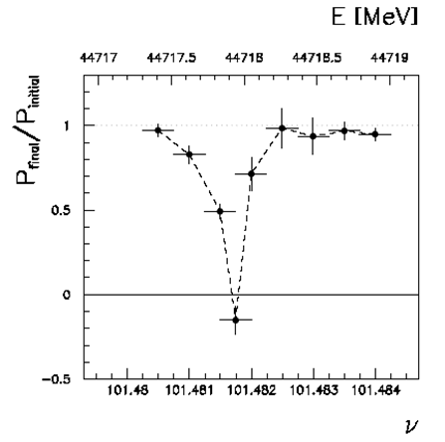
Beam Polarization can provide two main ingredients to Physics Measurements
Transverse beam polarization provides beam energy calibration
by resonant depolarization
→ low level of polarization is required (~10% is sufficient)
→ at Z & W pair threshold comes naturally σ_{E} ∝ E²/√ρ
→ at Z use of asymmetric wigglers at beginning of fills since polarization time is otherwise very long (250h→ ~1h)
→ could be used also at ee → H(126)
→ use ‘single’ non-colliding bunches and calibrate continuously
during physics fills to avoid issues encountered at LEP
→ Compton polarimeter for both e+ and e-
→ should calibrate at energies corresponding to half-integer spin tune
→ must be complemented by analysis of «average E_beam» to E_CM relationship
For beam energies higher than ~90 GeV can use ee → Z γ or ee → WW events
to calibrate E_{CM} at ±1-5 MeV level: m_{H} (5 MeV) and m_{top} (20 MeV) measts

Slide 13
Beam Polarization can provide two main ingredients to Physics Measurements
2. Longitudinal beam polarization provides chiral e+e- system
-- High level of polarization is required (>40% )
-- Must compare with natural e+e- polarization due to chiral couplings of electrons (15%)
or with final state polarization analysis for CC weak decays (100% polarized) (tau and top)
-- Physics case for Z peak is very well studied and motivated: A_{LR} = A_{e} , A_{FB}^{Pol}(f) etc… (CERN Y.R. 88-06)
figure of merit is L.P² --> must not lose more than a factor ~10 in lumi.
self calibrating polarization measurement requires controlled e+ and e- polarization
at high statistics A_{FB}^{Pol} = A_{e} plays the role of A_{LR} (Tenchini)
-- enhance Higgs cross section (by up to ~30%)
top quark couplings? final state analysis does as well (Janot arXiv:1503.01325)
enhance signal, subtract/monitor backgrounds, for ee→WW , ee →H
-- requires High polarization level and often both e- and e+ polarization
➔ not interesting If loss of luminosity is too high
-- Obtaining high level of polarization in high luminosity collisions is delicate in top-up mode
DECIDED to FOCUS ON TRANSERSE POLARIZATION FOR ENERGY CALIBRATION
As far as we could check, there is no physics that can be done with longitudinal polarization
that cannot be done without, given enough luminosity

Slide 14
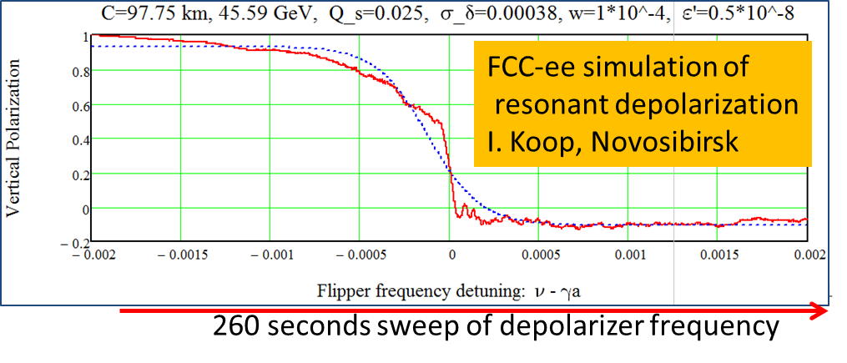
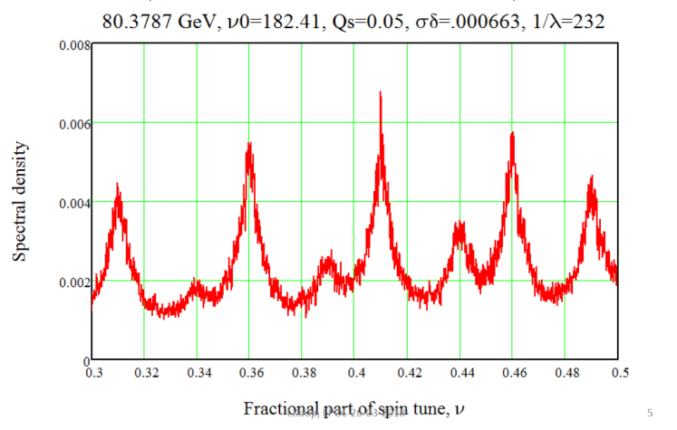
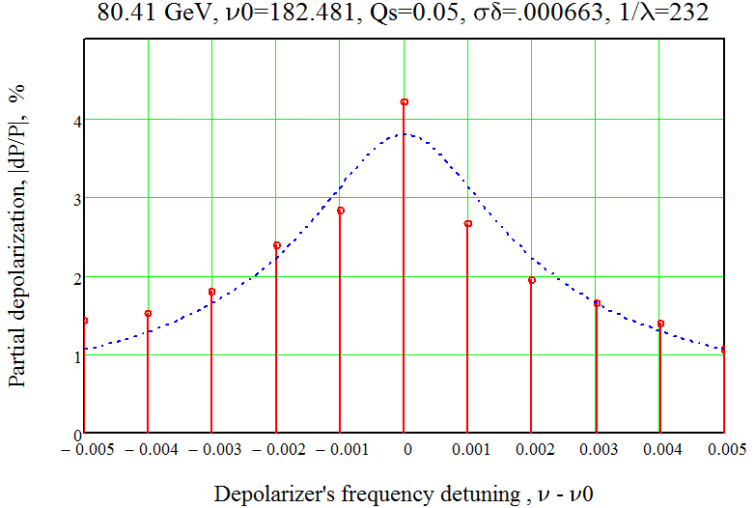
LEP
long sweep works well at the Z. Several depolarizations needed: eliminate Qs side band and 0.5 ambiguity
Less well at the W: the Qs side bands are much more excited because of energy spread, need iterations with
smaller and smaller sweeps – work in progress. see I. Koop presentation.
← Fourier analysis shows the
side band situation at W.
FCC-W
spectrometer ±1σ/s
First attempt at ‘LEP’
multiple sweep
technique →

Slide 15
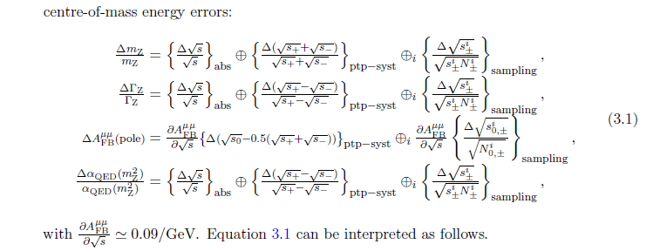
statistical precision at the Z
Three categories:
Absolute dominate for Z and W mass)
Point-to-point dominate for Γ_{Z} & A_{FB}^{μμ} (peak and off-peak)
Due to sampling – turns out to be negligible for 1meast /(15 min= 1000s) → 10⁴ measts

Slide 16
4

Slide 17
with the improved systematic error evaluation

Slide 18
Next steps
These studies were aimed at evaluating ‘possible uncertainties’ based on experience (LEP, SLD)
Generally quite conservative and assuming detector somewhat improved wrt LEP/SLD/ILD/CLIC
but not designed specifically for the FCC-ee statistics and exp. conditions
Next:
1. start from statistical errors as precision reference (rather than starting from LEP/SLD)
2. attempt to indentify the places were detector design esp. construction, or theory, can/will be the limiting factor.
3. identify places where further input requires full simulation results
4. work towards systematics match statistics
IMPORTANT : this is a start and a template, not definitive answers.
An important message already is that «resolution» is not all that matters, we need to address
such as alignment, calibration and stability issues.
The next 5 years will be dedicated to solving the many ‘challenges’ that FCC-ee
presents to the detector builders.
Anybody with knowledge, competence or interest on these issues should manifest themselves

Slide 21
Next steps
We are at the start of a new step, the FCC-ee Technical and Financial design study
The emphasis will be placed on the detector design in order to bring the systematics
at the same level of statistical errors, or identify the stumbling blocks.
At the same time the organization of the theoretical effort towards the same goal
will continue
An LOI for Snowmass is being prepared to be submitted next week with specific
«case studies» being proposed.

Slide 22
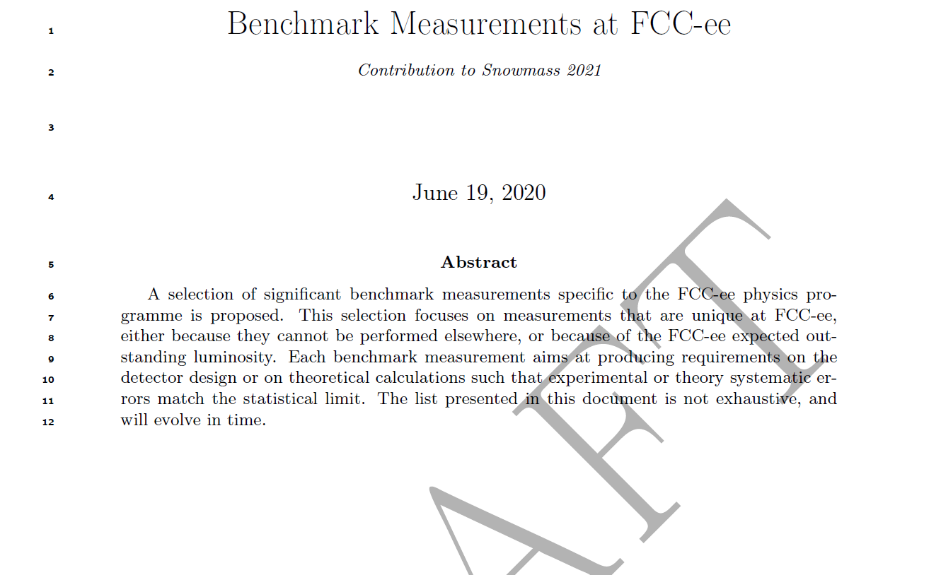

Slide 23
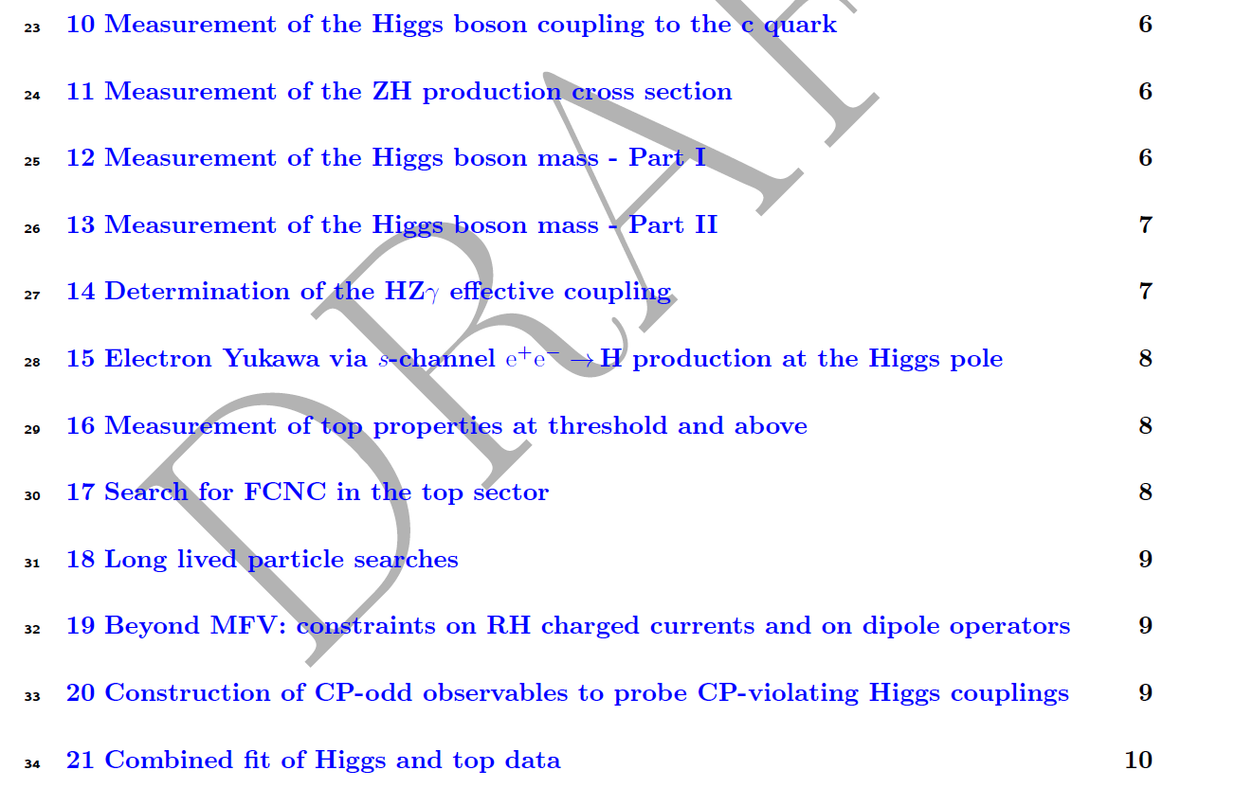

Slide 25
SPARES

Slide 26
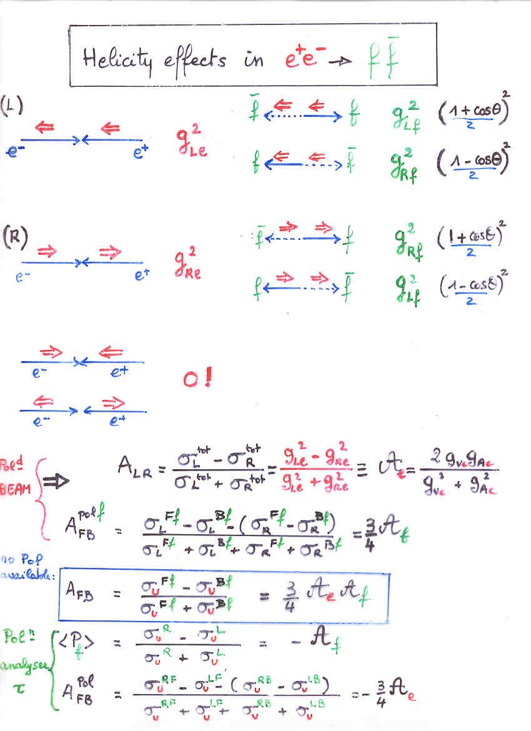
Polarization effects and left-right coupling asymmetries
This is very old stuff →
(see e.g. A. B.
Beam Polarization in e+e- annihilation,
http://cds.cern.ch/record/252128 ,
1993 pp 30-32)
the main points are
-- with beam helicity the quantity
A_{LR} can be measured with full statistics
of hadrons
-- need both e+ and e- polarization flip
to constrain the otherwise limiting error
on the beam polarization
ΔA_{e} /A_{e} = 5 10⁻⁴ for ILC
-- without beam helicity
the variation of tau polarization
with polar angle allows a determination
of the electron coupling asymmetry
with 1.7 10¹¹ tau pairs the τ→πν and ρν allow
ΔA_{e} /A_{e} = 10⁻⁴ for FCC-ee

Slide 27
This was very well shown by R. Tenchini at the FCC meeting in Amsterdam
and at the FCC CDR presentation at CERN https://indico.cern.ch/event/789349/
NB this is a relative precision of ΔA_{e} /A_{e} = 10⁻⁴
(the purely statistical error is about three times smaller)

Slide 29
The magic formula appears in the LEP EW paper on the Z pole arXiv:hep-ex/0509008v3
the most extensive publication is the ALEPH tau polarization paper
arXiv:hep-ex/0104038v1 20 Apr 2001
It is evident that a combined analysis of τ→πν and ρν is essentially limited (for the angular
distribution) by the MC statistics and other data-controlable quantities.
Nevertheless, a dedicated simulation and analysis of this essential channel should be foreseen
in the next years to evaluate the requirements on detector to achive this precision.
(geometry precision and hermiticity to photons and charged tracks)

Slide 30
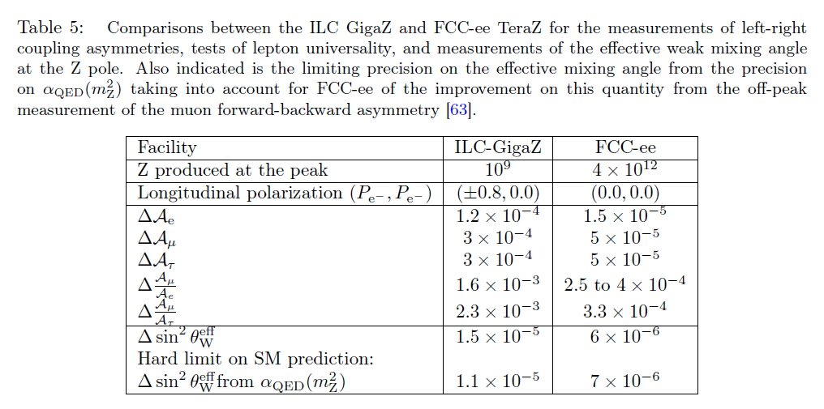
this table produced for arXiv:1906.02693v1 (FCC-ee your questions asked)
will be extended to include the other results that follow.

Slide 31
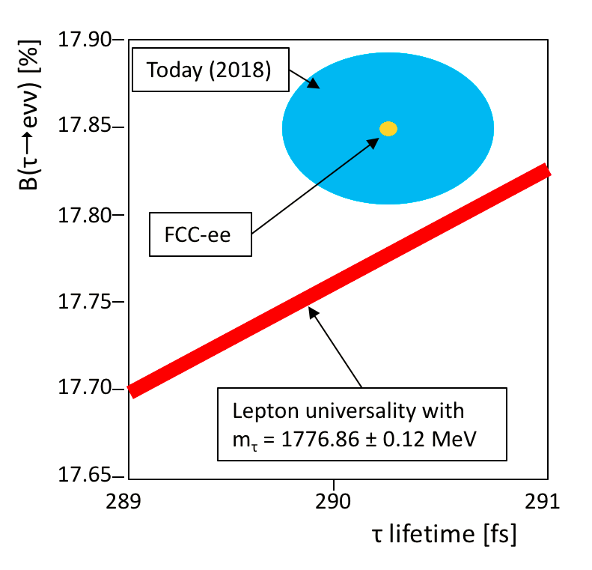
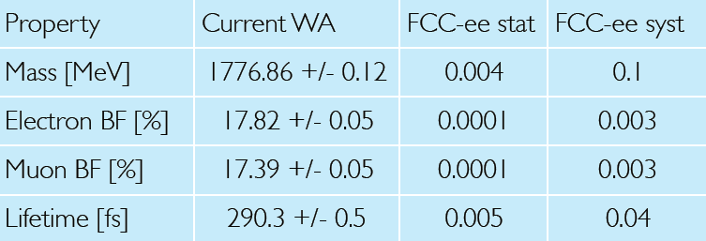
τ physics
Improve Lepton flavour violation sensitivity by 3 orders of magnitude
tau branching ratios are a good test of Universality
of the α - ν_{α} CC coupling α= e μ τ
➔ sensitive to light-heavy neutrino mixing
(Can someone re-measure the tau mass better?)
and many more….
«systematics will be at least this good»
probably much better → to be studied further!

Slide 32
τ physics

