Slide 1
Neutrino Town Hall Meeting
Patrick Huber, Kate Scholberg, Elizabeth Worcester
Neutrino Frontier Conveners
07/17/20
This meeting is conducted according to the community guidelines to be found here https://snowmass21.org/cpcg/start

Slide 2
SNOWMASS*
SNOWMASS is a community planning event organized by the Division of Particles and Fields (DPF) of the American Physical Society
Frequency is about once every 7-10 years, effectively making this a decadal planning exercise
It is year-long process which will end with a report to P5
The goal is to formulate a “vision for the future of particle physics in the U.S. and its international partners”
International participation and contribution are explicitly desired.
*The name is historic and relates to the place where some earlier instances, when we still could travel, took place, Snowmass, CO.

Slide 3
Particle Physics Project Priorization Panel (P5)
P5 is a temporary sub-panel of the High-Energy Physics Advisory Panel (HEPAP).
HEPAP was jointly chartered by DOE and NSF in 2000 and operates under the rules of Federal Advisory Committee Act (FACA)
There is an expectation that DOE and NSF will closely stick to HEPAP recommendations and thus, also P5 recommendations.
P5 has direct and lasting impact on federal funding levels
P5 deliberates for about 1 year and the SNOWMASS report is crucial input, other input includes: Long-range plan for nuclear science, Decadal Survey on Astronomy and Astrophysics, HEPAP Accelerator R&D sub-panel report
SNOWMASS = Your opportunity to provide input

Slide 4
SNOWMASS Advisory Group
Full list of names at snowmass21.org

Slide 5
Ten Frontiers
Energy
Neutrino
Rare Processes and Precision Measurement
Cosmic
Theory
Accelerator
Instrumentation
Computational
Underground
Community Engagement
Each frontier has three conveners and there are liasions as appropriate

Slide 6
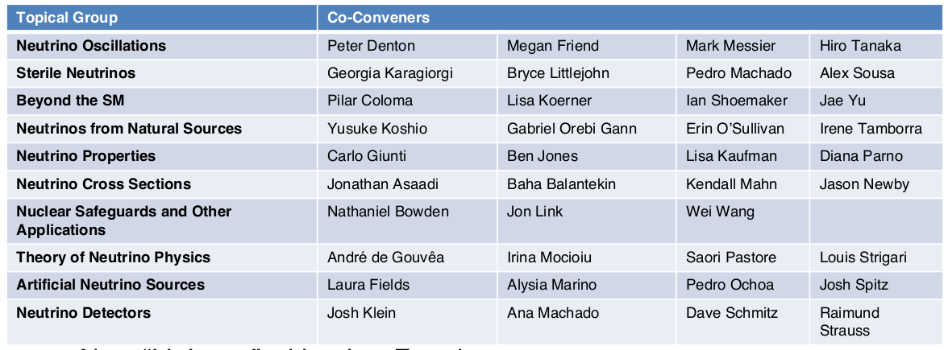
Co-conveners
Neutrino
Frontier

Slide 7
Written Input
Letters of Interest (LOI)
2 pages (!), due August 30
Purpose is to facilitate planning by conveners and topical conveners
Not a prerequisite for a contribution
Cross cuts will be handled appropriately
Contributions
Any length, but executive summary strongly encouraged for longer ones.
Final versions due by July 31, 2021
Submission to arXiv first
Will be part of the overall SNOWMASS output

Slide 8
Where to find information
Snowmass21.org starting point for all searches
Calendar:
snowmass21.org/meetings/start
Slides etc.
indico.fnal.gov/category/1098/
Mailing list (for announcements)
snowmass-neutrino-frontier@fnal.gov
Slack channel (for discussions)
snowmass21.slack.com
#neutrinos

Slide 9
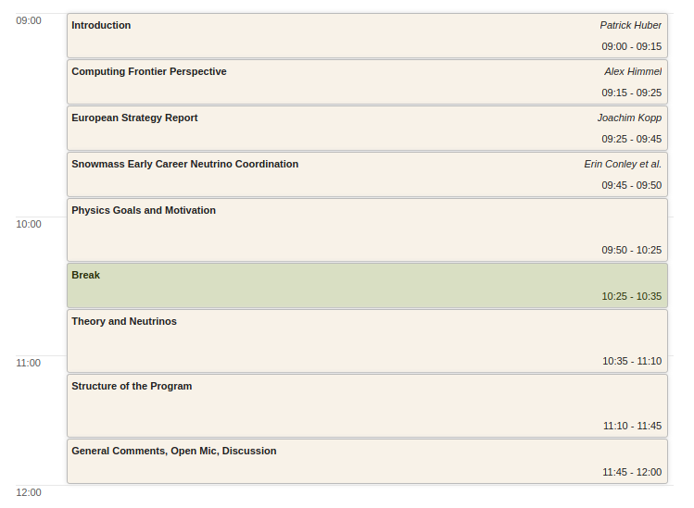
Plan for
Today

Slide 10
Panelists
Physics Goals
Andre de Gouvea
Chris Marshall
Josh Spitz
Lindley Winslow
Moderator:
Physics Goals
Andre de Gouvea
Chris Marshall
Josh Spitz
Lindley Winslow
Moderator:
Physics Goals
Andre de Gouvea
Chris Marshall
Josh Spitz
Lindley Winslow
Moderator:
Elizabeth Worcester
Theory of Neutrinos
Alex Friedland
Carlo Giunti
Irene Tamborra
Jessica Taylor
Moderator:
Patrick Huber
Structure of Program
Jonathan Asaadi
Ryan Patterson
Elisa Resconi
Grayson Rich
Moderator:
Kate Scholberg
Note takers: Cindy Lin and Louis Strigari
Thanks to all the panelists and note takers!

Slide 11
Physics Goals and Motivation
How are the limitations of existing neutrino sources and detectors affecting our physics reach?
What kinds of new physics searches should we prioritize, especially considering that there are no decisive hints regarding what lies beyond the standard model from other fundamental physics experiments?
What can neutrino physics do for other fields of science and technology?
Theory and Neutrinos
What is the theory motivation to go beyond the current program?
How can theorists best support the experimental program?

Slide 12
Structure of the Program
How do we maintain the necessary breadth of physics, including smaller experiments, auxiliary measurements, and activities within larger projects?
How can we ensure that experimental and theoretical efforts have enough resources to pursue questions of significant interest, even if those questions cross the boundaries of Frontiers or funding umbrellas?

Slide 13
Questions from the community
Physics:
Masoom Singh: What new awaits the young neutrino physicists, when we have already entered the precision era?
Theory:
Ratul Swarno: How close are we in uncovering the physics behind WIMPS and other dark matter/energy candidates. Much thanks!
Structure of the program:
Scott Shaw: Do you foresee a convergence of neutrino detection and dark matter detection resources, or are the two areas headed in different directions?

Slide 14
Questions from the community
Structure of the program, continued:
Adam Bernstein: What importance do the conveners attach to cross-disciplinary research efforts with activities outside of fundamental research, such as accelerator development, advanced photosensors, neutrino detection for nonprolferation, and similar applied research ?
Alan Stone: What are the major obstacles for broadening the scientific understanding and participation in high energy neutrino physics?
Sunny Seo: The Covid-19 has been globally affecting people's life/health and economy.
It has changed our daily life a lot and we still do not know when it will be under-control. Therefore, I just wonder what is the impact of Covid-19 on science in USA. Is there any possibility that USA funding agency stop funding big projects ? Or, oppositely, the government stimulates science even more ? In any case, I think some sort of good options and/or proactive strategies are needed in the neutrino field in the era of Covid-19 and the following economic crisis.

