Slide 1
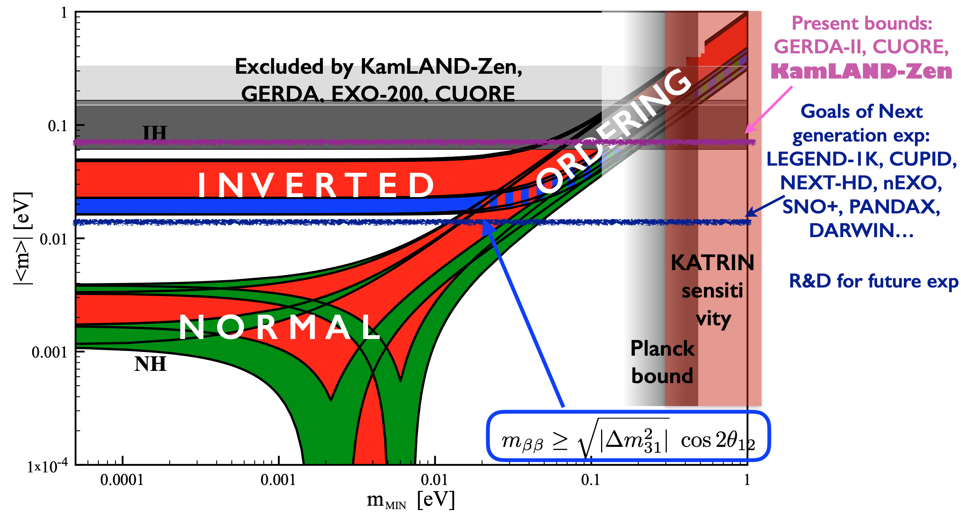
Understanding whether neutrinos have a Majorana
component is an essential question that needs to
be answered in order to truly understand neutrinos
in context of the Standard Model. Also impacts ideas
such as the See-Saw model and Leptogenesis.
Currently, in the US this effort is under the
purview of DOE/NP and NSF/NP. It is a major
part of the 2015 NSAC Long Range Plan, but
support is expressly not allowed under HEP.
“Support for LHCb research or studies of neutrinoless double beta decay is not provided under this research area.”
(DOE HEP FY20 FOA DE-FOA-0002181)
This policy made some sense when experiments were rather small scale. No
longer the case.
We should be thinking about
moving well-beyond the existing
program to answer this critical question.
Expertise from both the HEP and NP communities will be required. Thus, the viability of the old system needs to be reconsidered by P5. A joint HEP-NP effort may be required to be effective.
S.Pascoli, July 15 Neutrino Properties Workshop

