Slide 1
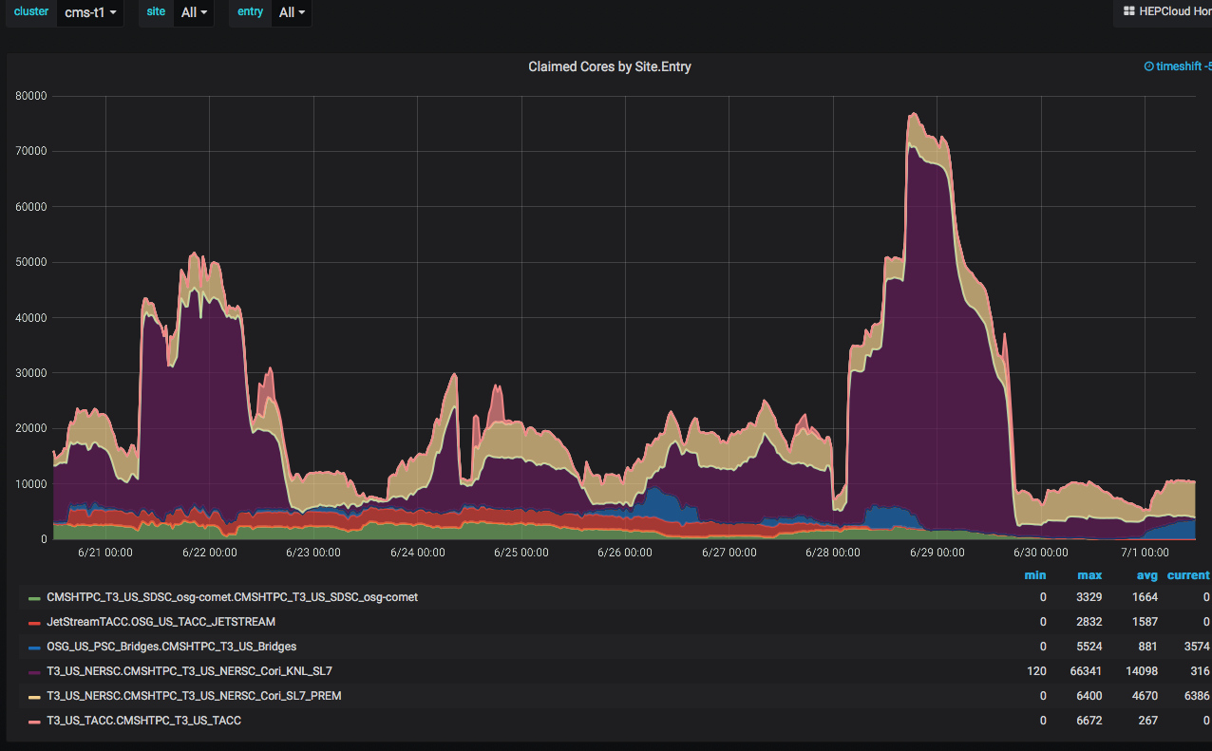
Operations Highlights June 2020

Slide 2
Operations highlights June 2020
Record number of claimed cores for CMS @ NERSC (77000)
End of XSEDE allocation year as of June 30, 2020
  Used significant amounts of all the quotas.
TACC-Jetstream resource will not be used starting July 1 2020.
Also have begun commissioning CMS running on new TACC system “Frontera”

