Slide 1
Kickoff Meeting: Snowmass Group AF7-RF
June 22, 2020
Emilio Nanni
Sam Posen
Hans Weise

Slide 2
Agenda
20 minutes: overview of Snowmass, RF acceleration R&D subtropical group, upcoming activities
Remaining time: Q&A

Slide 3
Snowmass
Snowmass is a long-term planning exercise for the particle physics community, organized by the American Physical Society (APS)
Opportunity for the entire particle physics community to come together to identify and document a vision for the future of particle physics in the U.S. and together with its international partners
Contributions provide important input that influences future projects and scientific programs.

Slide 4
Snowmass 2021 Organization
10 Frontiers
  Energy Frontier
  Neutrino Physics Frontier
  Rare Processes and Precision
  Cosmic Frontier
  Theory Frontier
  Accelerator Frontier
  Instrumentation Frontier
  Computational Frontier
  Underground Facilities
  Community Engagement Frontier

Slide 5
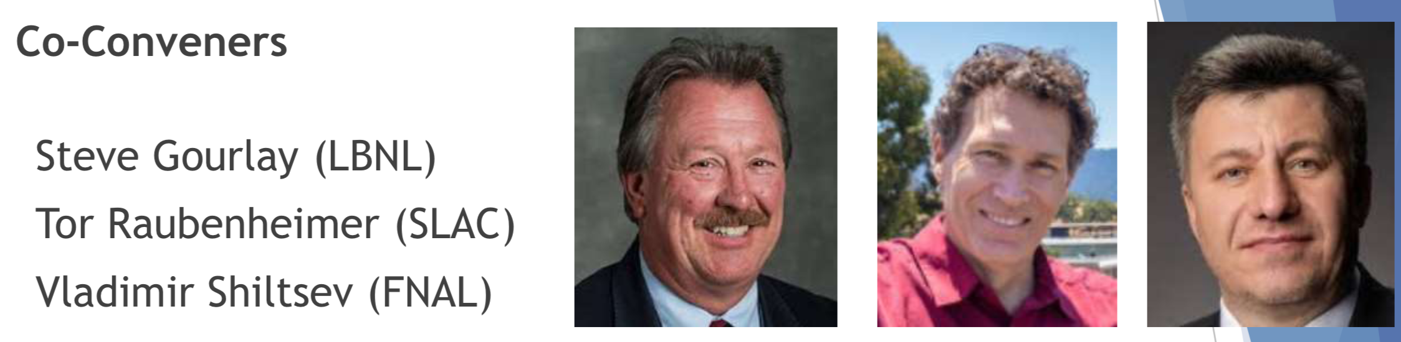
Snowmass Accelerator Frontier Organization
Frontier Conveners
Topical Group | Group Co-Conveners
AF1. Beam Physics and Education | Z. Huang (Stanford) | M. Bei (GSI) | S. Lund (MSU)
AF2. Accelerators for Neutrinos | J. Galambos (ORNL) | B. Zwaska (FNAL) | G. Arduini (CERN)
AF3. Accelerators for EW/Higgs | M. Ross (SLAC) | A. Seryi (JLAB) | Q. Qin (IHEP, Beijing)
AF4. Multi-TeV Colliders | M. Palmer (BNL) | A. Valishev (FNAL) | N. Pastrone (INFN, Torino)
AF5. Accelerators for PBC and Rare Processes | E. Prebys (UC Davis) | M. Lamont (CERN) | Richard Milner (MIT)
AF6. Advanced Accelerator Concepts | C. Geddes (LBNL) | M. Hogan (SLAC) | P. Musumeci (UCLA) | R. Assmann (DESY)
AF7. Accelerator Technology R&D
Sub-group RF | E. Nanni (SLAC) | S. Posen (FNAL) | H. Weise (DESY)
Sub-Group Magnets | G. Sabbi (LBNL) | S. Zlobin (FNAL) | S. Izquierdo Bermudez (CERN)
Sub-group Targets/Sources | Charlotte Barbier (ORNL) | Yin-E Sun (ANL) | Frederique Pellemoine (MSU/FNAL)

Slide 6
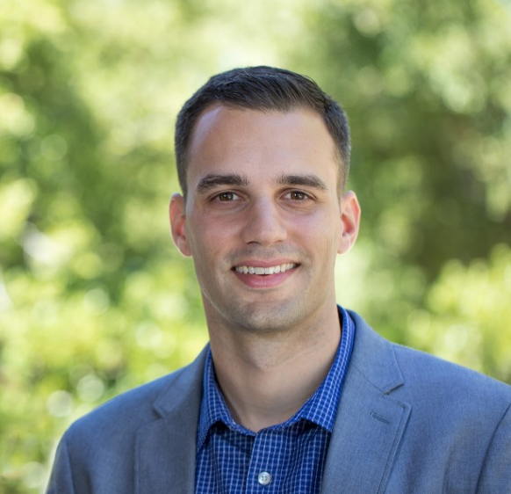
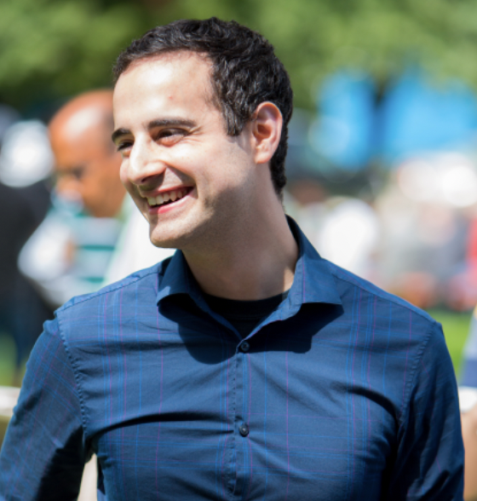
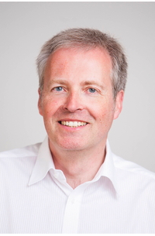
Accelerator Frontier 7: Accelerator Technology R&D
RF Subtopical Group
Accelerator Technology is the enabling foundation for accelerator-based HEP.
RF acceleration – primarily divided into SRF and NCRF, plus consideration for regions of overlap, e.g. RF sources
AF7 - RF Conveners
Emilio Nanni
SLAC
nanni@slac.stanford.edu
Sam Posen
Fermilab
sposen@fnal.gov
Hans Weise
DESY
hans.weise@desy.de

Slide 7
Snowmass Submissions
Snowmass submissions will take the form of Contributed Papers, such as white papers on specific scientific areas, with a maximum length of 10 pages each, due July 31, 2021
Contributed papers are typically expected to be preceded by Letters of Interest (LoI), with a maximum length of 2 pages each, due August 31, 2020
We encourage submission of LoI from members of the RF Acceleration community to the Snowmass process – your help is critical for generating a large and diverse pool of ideas

Slide 8
Letters of Interest (LOIs)
“Abstracts” for future Contributed Papers
Allow Snowmass conveners to see what proposals are coming and to encourage the community to begin studying them
Should give brief descriptions of the proposal and cite the relevant papers to study
Not funding proposals, they are intended to help conveners to prepare for the Snowmass Planning Meeting November 4-6, 2020 at Fermilab
Aid in the development of agendas for future meetings and workshop planning
There is no limit to the number of co-authors and collaborative efforts are welcome

Slide 9
Timeline Leading up to Snowmass
LOI submission period: April 1, 2020 – August 31, 2020
Contributed paper submission period: April 1, 2020 – July 31, 2021
Planning meeting at Fermilab (possibly remote instead?) November 4 - 6, 2020
Snowmass Summer Study at the University of Washington, Seattle, July 11 - 20, 2021

Slide 10
Impact of Submissions
Snowmass is our opportunity to inform the community on R&D opportunities in our field
DOE’s P5 will follow Snowmass and utilize this information to lay out a decadal vision
  Accelerator Subpanel deliberations during the last P5 made a significant impact on resources for R&D
First AF7 Sub-group RF Submission: “High Efficiency, Low Cost, RF Sources for Accelerators and Colliders” Iveset al.
https://snowmass21.org/loi

Slide 11
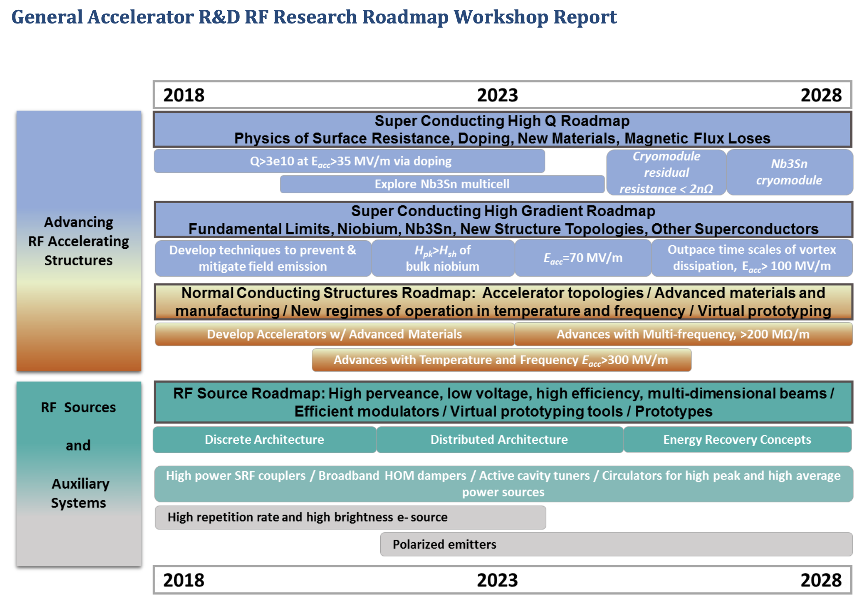
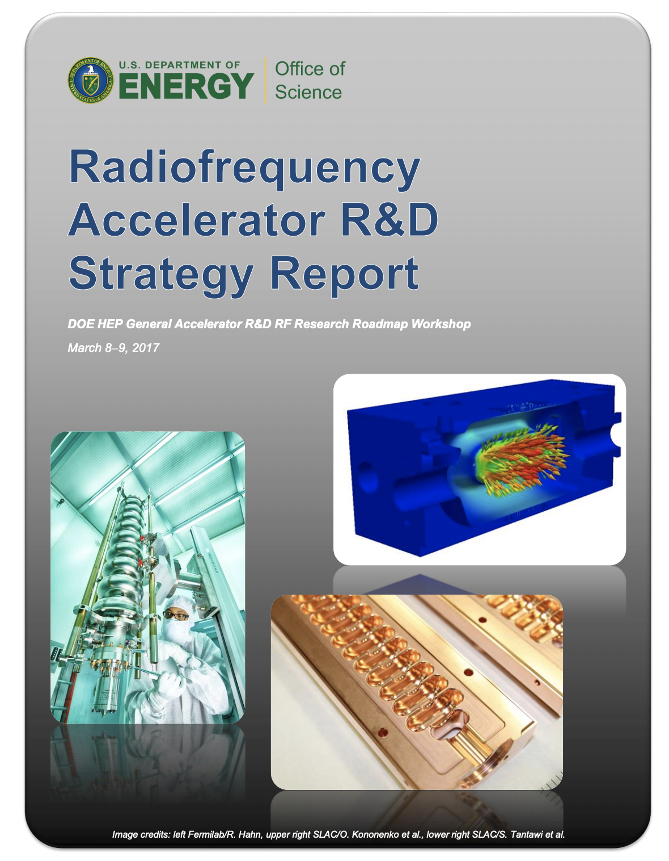
GARD RF Acceleration R&D Roadmap
Structure discussion around DOE RF Accelerator Roadmap
In addition explore new or overlooked concepts/topics

Slide 12
Broad Community Involvement
International participation/input is strongly encouraged
Awareness of International Activities:
  European Strategy for Particle Physics
    Strategy recommendations :
    https://indico.cern.ch/event/924500/contributions/3884837/subcontributions/308163/attachments/2060582/3456333/CERN-ESU-013.pdf
    Deliberation document :
    https://indico.cern.ch/event/924500/contributions/3884837/subcontributions/308163/attachments/2060582/3456338/CERN-ESU-014.pdf

Slide 13
AF7 - RF Meetings and Conferences
Planning for a series of ~monthly zoom meetings
Overviews of the field / strategy reports
  First meeting July 2nd 11 am CT / 9 am PT; Jamie Rosenzweig “State of Accelerator: R&D/GARD Update on P5 GARD subpanel recommendations”
  Planned future topics include GARD roadmap, plans in Europe, plans in Asia
Considering possible satellite meetings at related workshops:
  TTC Meeting 2021
  CLIC Meeting 2021
  High Gradient Workshop 2021

Slide 14
Resources
Snowmass website, including upload for LOIs and contributed papers – https://snowmass21.org/start
Slack Channel – https://snowmass2021.slack.com/
Snowmass 2013 proceedings – https://www.slac.stanford.edu/econf/C1307292/

Slide 15
Questions / Discussion Topics
Questions on LOIs?
What LOIs are you considering?
Is there a topic you would like to see an LOI on?
Who or what would you like to hear from for summer seminars ?
When should we have a fall meeting to discuss LOIs?
What national / international roadmaps and projects should we be aware of?

