Slide 1
Report from Energy Frontier –
Instrumentation Frontier Liaisons
Caterina Vernieri (SLAC), Maxim Titov (CEA Saclay)
Snowmass Instrumentation Frontier Kickoff Workshop, June 19, 2020

Slide 2
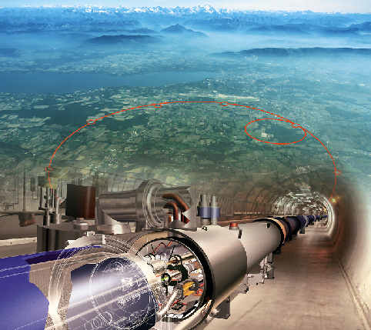
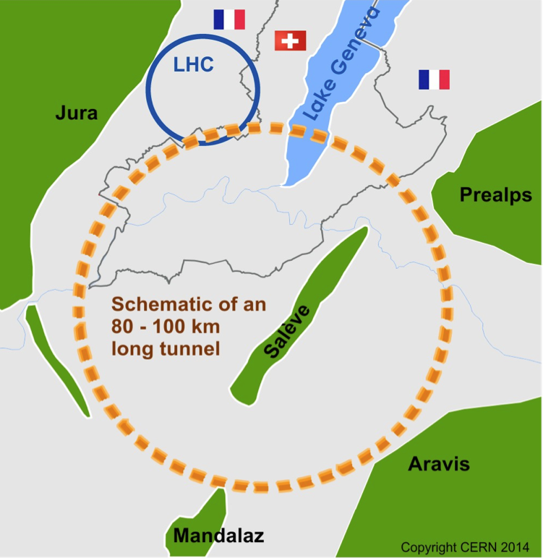
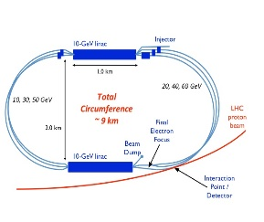
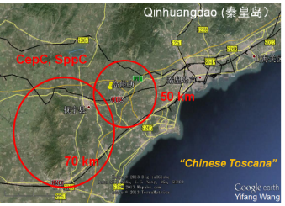
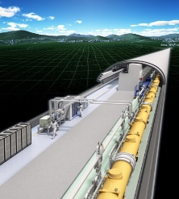
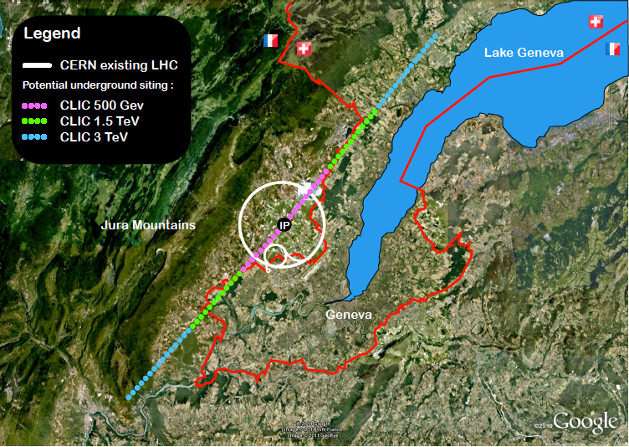
European Strategy Update Particle Physics: EF & IF
HL / HE-LHC
LHeC
CepC:
ILC
FCC - pp
FCC - ee
CLIC
The ESPPU is a scientific deliberation process, recommending the scientific priorities for the future of the field. Derived from above,
this update recommends:
Ramping up R&D efforts for advanced accelerator technologies
An electron-positron Higgs factory is the
highest priority after the LHC
Europe should undertake a feasibility study
for a next-generation hadron collider
Personal remark:
ILC is the most advanced in terms of
technology, maturity, cost and preparations in
international negotiations, based on TDR
CepC, FCC-ee, CLIC are based on CDR
Two major drivers for the Energy - Instrumentation Frontier:
- Detector R&Ds towards future hadron colliders: (HL-LHC) / HE-LHC, SppC, FCC-hh
- Detector R&Ds towards future lepton colliders: e+e- Higgs Factory

Slide 3
Future Challenges: Technology-Oriented / Generic R&Ds
Originally: ”Cell” approach, oriented to select LHC/HL-LHC detector technologies – CERN DRDC program (90’s) and CERN R&D White Paper Program:
→ Successful approach to streamline effort/resources, handle new techniques and common
components to on-going detector engineering developments or production.
→ CERN strategic R&D program (>2019) - CERN-OPEN-2018-006, https://cds.cern.ch/record/2649646
Active transversal CERN-R&D collaborations nowadays:
RD42 – Diamond detectors
RD50 – Silicon radiation hard devices
RD51 – Micro-Pattern Gaseous Detectors
RD53 – Pixel readout ASIC for ATLAS and CMS (in 65 nm)
Over a past few decades, many generic R&D studies applicable to any LC Detector Concept:
http://www.linearcollider.org/physics-detectors/working-group-detector-rd-liaison
Whenever possible, R&D is not only pursued with respect to one specific detector concept for
ILC (ILC, SiD) and CLIC (CLICdp), but in the context of world-wide R&D collaborations:
- CALICE: High Granularity Electromagnetic and Hadronic Calorimeters (since 2001 for ILC)
- LCTPC: Time- Projection Chamber for a Future Linear Collider
- FCAL: Very Forward Calorimetry for Future Linear Colliders
2019: US – CPAD Report “New Technologies for Discovery”:
DPF Coordinating Panel for Advanced Detectors, arXiv: 1908.00194 (2019)
2020 US - BRN Report (under preparation)
also look at emerging technologies: e.g. quantum sensors, superconducting photon detectors, etc ...

Slide 4
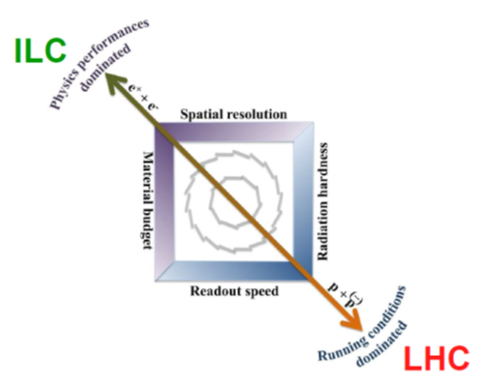
Si-Vertex and Tracking Detectors
Hadron vs Lepton
Colliders:
Major challenges:
pp: radiation hardness, speed; e+e-: granularity, material budget
Sensor-type options (can be thinned to become flexible):
Hadron colliders: hybrid pixel detectors (planar and 3D-sensors); HV/HR-CMOS for outer pixel layers for HL/LHC; LGADs for ps-timing
Lepton Colliders: CMOS (since 1998 for ILC) , DEFPET, Chronopix, SoI, FPCCD, 3D-IC (Global Foundries, LAPIX, TJas,…)
Hadron Colliders: Fast Readout /
Radiation Hardness:
Readout in 65 nm technology
(RD53 – ATLAS/CMS ASICs)
Small pixels down to 50 x 50 μm²
Output bandwidth 10 Gbit/s
Lepton Colliders: Low-Mass Trackers
CMOS: STAR HFT, ALICE ITS, CBM
DEPFET: Belle II
mostly pp Colliders
mostly e+e- Colliders
Development of large-area CMOS
MAPS (up-to the full wafer size)
using stitching technology

Slide 5
Gaseous Detectors for Tracking / Muon Systems
Primary choice for large-area coverage with low material-budget (+ dE/dx measurement):
« paradigm shift » from Wire/Drift Chamber → TPC, RPC → Micro-Pattern Gaseous Detectors
HL-LHC: Tracking (ALICE TPC); Muon Systems: RPC, CSC, MDT, TGC and ultimately MPGD;
Future Hadron Colliders: FCC-hh muon system area ~ 1000 m², particle fluxes ~O(10kHz/cm²) are
comparable with HL-LHC → should be OK for current MPGDs technologies;
Future Lepton Colliders: Tracking (Drift Chamber – FCC-ee, CepC; TPC – ILC, CepC), Calorimetry (ILC, CepC)
Many HL-LHC
upgrades emerged
from R&D studies
within the
CERN-RD51
Collaboration
TPC R&D for
ILC / (CePC)
is coordinated by
LCTPC
Collaboration

Slide 6
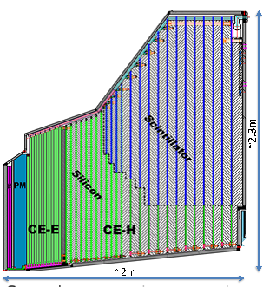
Calorimetry @ Hadron / Lepton Colliders
Main Calorimetry concepts & techniques:
Noble Liquid (intrinsic radiation hard, 3D imaging,
good timing resolution, finely segmented readout)
→ reference design for FCC-hh, also for FCC-ee
Homogeneous crystals (ultimate resolution)
→ CMS CALO based on PbWO₄
Particle Flow Calorimetry (5D imaging)
→ ILC/CLIC concepts, CMS HGCAL
Scintillator-based (cost-effective, mod. rad.-hard)
→ rad-hard crystals (LYSO, BaF₂ crystal scintillators,
YAG, GAGG);
→ LHCb ECAL upgrade (shashlyk, spagetti-type);
→ FCC-hh hadronic barrel similar to ATLAS Tile Calo;
Dual-readout calorimetry (simultaneous detection
of Cherenkov and scintillation light enables measur.
EM fraction of hadron shower event-by-event)
→ Dual-fibre readout calorimeter for FCC-ee
SiPMs are mostly used in HEP Calorimetry
→ SiPMs readout of plastic scintillators, crystals,
dual-readout calorimeters;
→ Challenge: cold operation at -30C to keep
radiation damage under control
CALICE: highly segmented / imaging
calorimeters (PFLOW is a LC-driven effort)
A long-standing concept for the ILC:
CMS HGCAL for HL-LHC
(600 m² Si ECAL/HCAL, 500 m² Sci. + SiPM HCAL)
CMS
HGCAL
ILC:
Sci-AHCAL
Combined beam-test of CMS HGCAL +CALICE AHCAL:

Slide 7
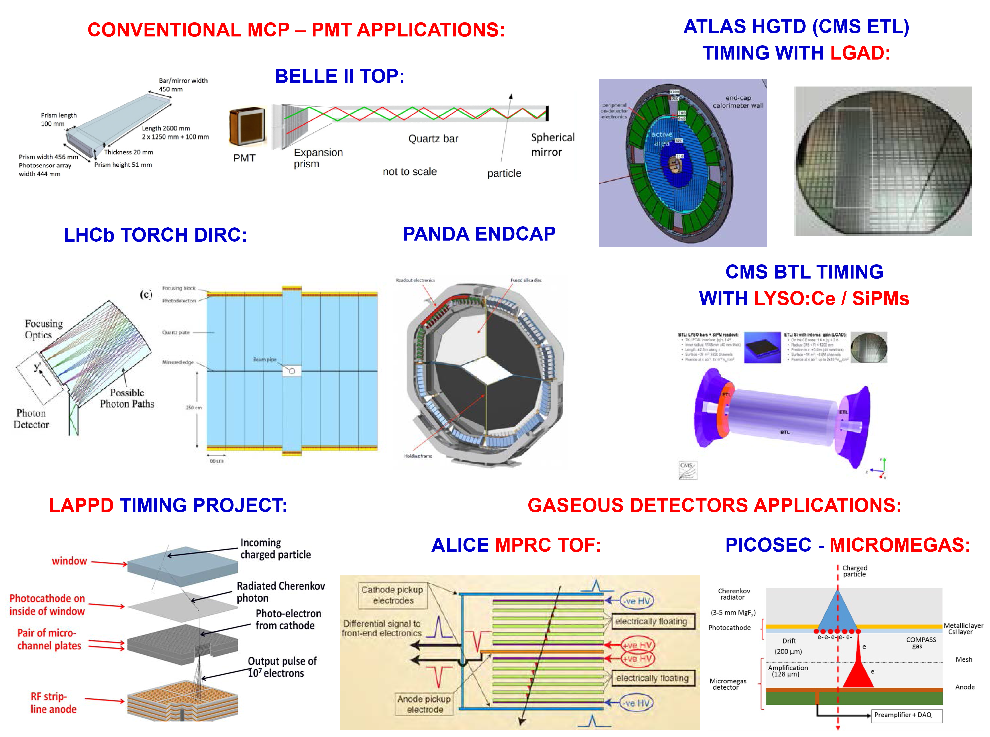
TIMING Detectors with a few 10’s of picosecond resolution
Hadron Colliders:
4D pattern recognition for HL-LHC
pile-up rejection: tracking ~O(10’s) μm
& timing detectors ~O(10’s) ps
→ ATLAS HGTD, CMS ETL (LGAD)
→ CMS BTL (LYSO +SiPM)
ps-timing reconstruction in calorimetry
(resolve develop. of hadron showers,
triangulate H → γγ prim. vertices)
→ CMS HGCAL (Si & Sci.+SiPMs)
TOF and TOP (RICH DIRC) PID
→ both at hadron/lepton colliders
Future challenges:
Radiation hardness: LGAD-sensors
3D-trench Si sensors, …
Large-scale applications → system aspects of timing det. (e.g. clock distr.)
“5D reconstruction”: space-points / ps-timing are available at
each point along the track →
LHCb EoI for LS4 is of general interest across experiments;
LAPPD → large-area ps- PID/TOF for hadron/lepton colliders
(intended as a direct replacement for PMTs)
Incom Inc. company started to produce LAPPDs with RF-strip
readout (US provisional patent) → cost still has to be controlled

Slide 8
Trigger, DAQ and Electronics
Lepton Colliders will run without trigger
Hadron Colliders (HL-LHC): Progressive replacement of the complex multi-stage trigger systems by a new architecture: single-level hardware trigger + final online selection
→ LHCb and ALICE will be triggerless after Phase-I Upgrade (no hardware trigger)
→ offline-like reconstruction is increasingly possible in online triggering systems, with further
reduction in the offline data volume without loss of physics performance.
Integration of significant intelligence at the sensor level (e.g. local track-segment finders):
GPUs are gaining a lot of popularity as co-processors due to the success of Machine Learning and „Artificial Intelligence“
Bringing the modern algorithmic advances from the field of machine learning from offline applications to online operations and trigger systems
Alternatives to VCSEL optical data-transmission – key to the modern HEP experiments
→ WDM technology, free-space optical links, wireless technology integration at 60 GHz

Slide 9
Summary and Outlook
This talk presents a snapshot of the R&D instrumentation challenges
and needs for the Energy Frontier
It is intended to initiate discussion → comments / suggestions are welcome!

