Slide 1
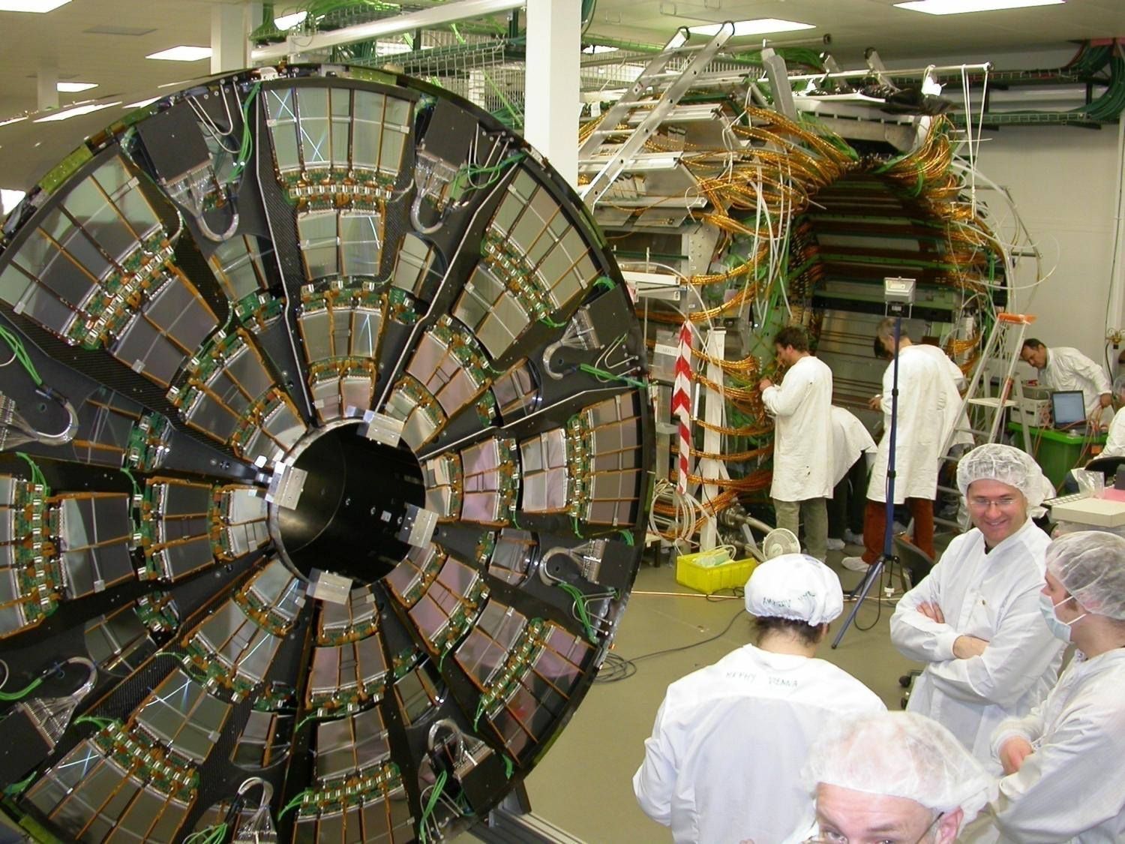

Silicon Detectors
Frank Hartmann

Slide 2
Historical aspects – Why use silicon?
Since 50ies large crystals for energy measurements
Need for fast and precise position measurements
  80ies charm quark tagging
  Late 80ies LEP experiments, vertex tracker
  90ies in hadron machines FERMILAB
  Today in all LHC experiments
Where are silicon sensors better suited than gas detectors?
Fast ~O(10ns); Precise O(5µm); very good energy resolution ~O(eV)
Take home
Silicon detectors gives momentum & vertexing,
which gives
b tagging
lifetimes
mixing background suppression
…… and a lot of great physics!
  Why wasn’t silicon used earlier?
    Needed micro-lithography technology ⇒ cost
    Small signal size (need low noise amplifiers)
    Needed read-out electronics miniaturization
      (transistors, ICs)

Slide 3
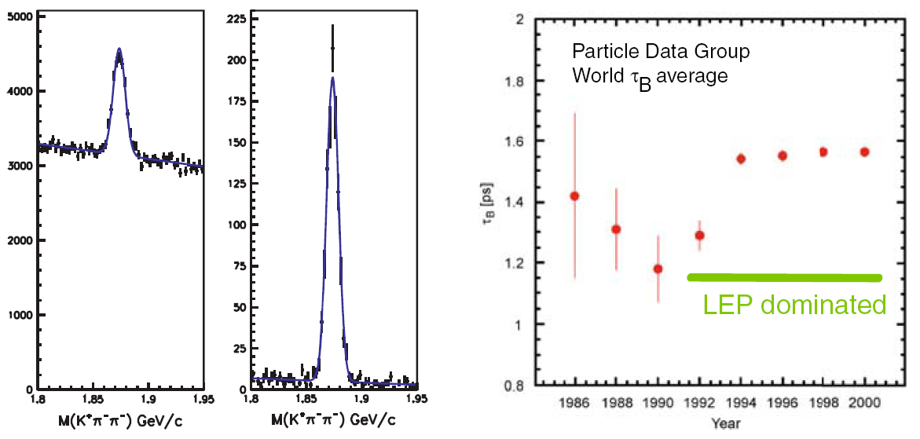
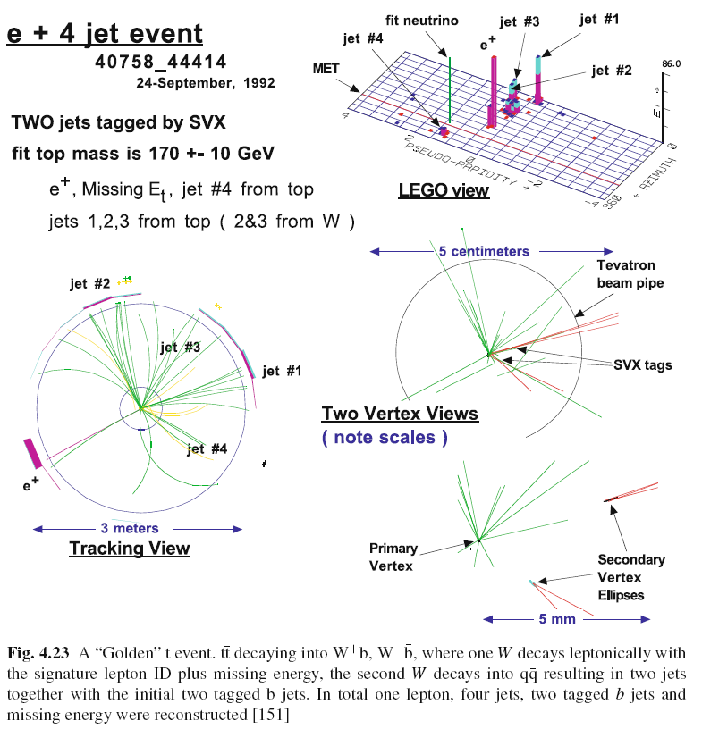
Historical aspects II – Why use silicon?
In the post era of the Z and W discovery, after the observation of Jets at UA1 and UA2 at CERN, John Ellis visioned at a HEP conference at Lake Tahoe, California in 1983 “To proceed with high energy particle physics, one has to tag the flavour of the quarks!”
Background reduction
CDF; top quark discovery
LEP
10 cm
200 collisions / 40M/s
Resolution to resolve this

Slide 4
Content
Material Properties – ‘get the numbers’
Detector Structures – strips, pads and pixel
- workhorse
What can go wrong – rushed examples
Performance – very short
Radiation – very brief
More Detector Concepts
Detector systems
What can go wrong – rushed examples
Today
Tomorrow
Homework – learn about signal formation
Shockley-Ramo

Slide 5
Material Properties

Slide 6
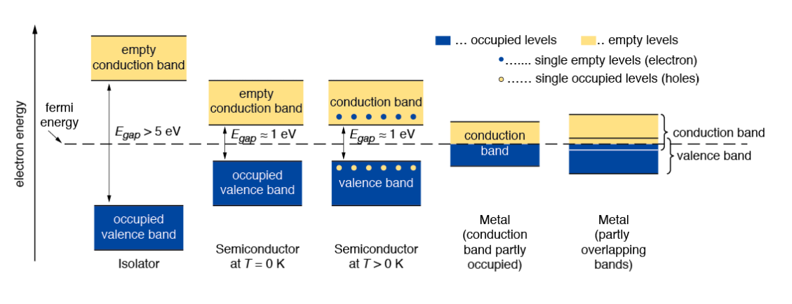
Material Properties
Energy bands: isolator–semiconductor–metal
In an isolated atom the electrons have only discrete energy levels. In solid state material the atomic levels merge to energy bands. In metals the conduction and the valence band overlap, whereas in isolators and semiconductors these levels are separated by an energy gap (band gap). In isolators this gap is large.
Notes:
Ask the question: What is the difference between insulator and semi-conductor?
Nothing fundamental thus the gap size. Mind diamonds ran under semi-conductor sensors but are insulators.

Slide 7
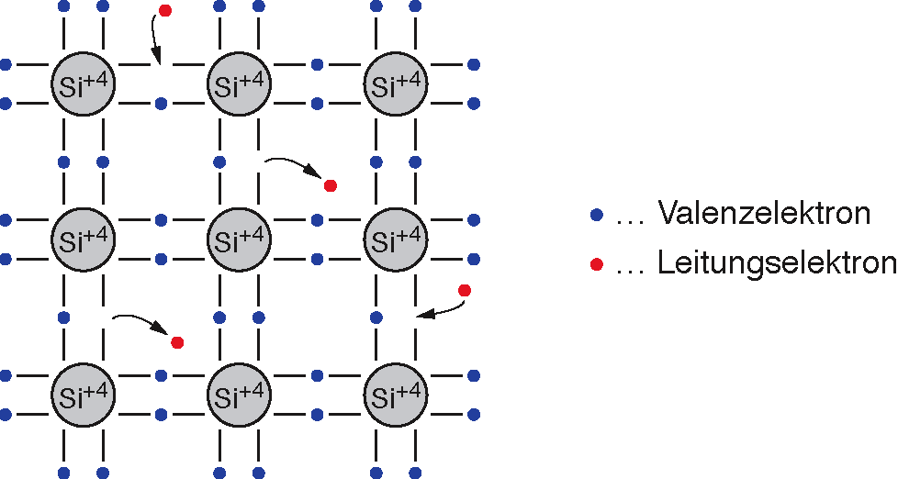
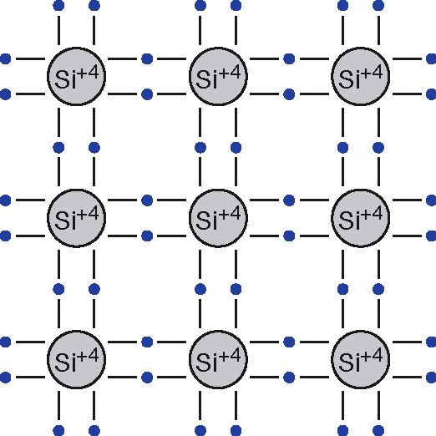
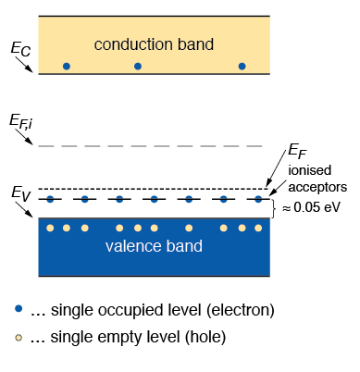
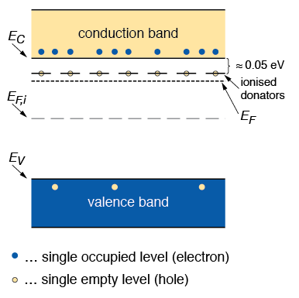
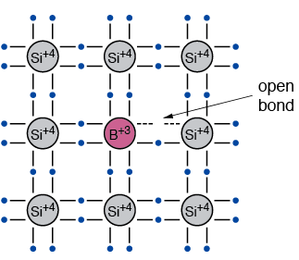
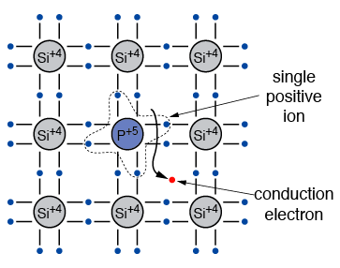
Intrinsic
T > 0 K
T = 0 K
Valence electron
Conduction electron
@ RT Approximately 1.45·10¹⁰ cm⁻³ intrinsic carieres with 10²² Atoms/cm³ about 1 in 10¹² silicon atoms is ionised
Extrinisic = doped
p-Doping - acceptor
n-Doping - donor
Typical doping concentrations for Si detectors are ≈10¹² atoms/cm³
(10¹⁴ und 10¹⁸ atoms/cm³ for CMOS elements)

Slide 8
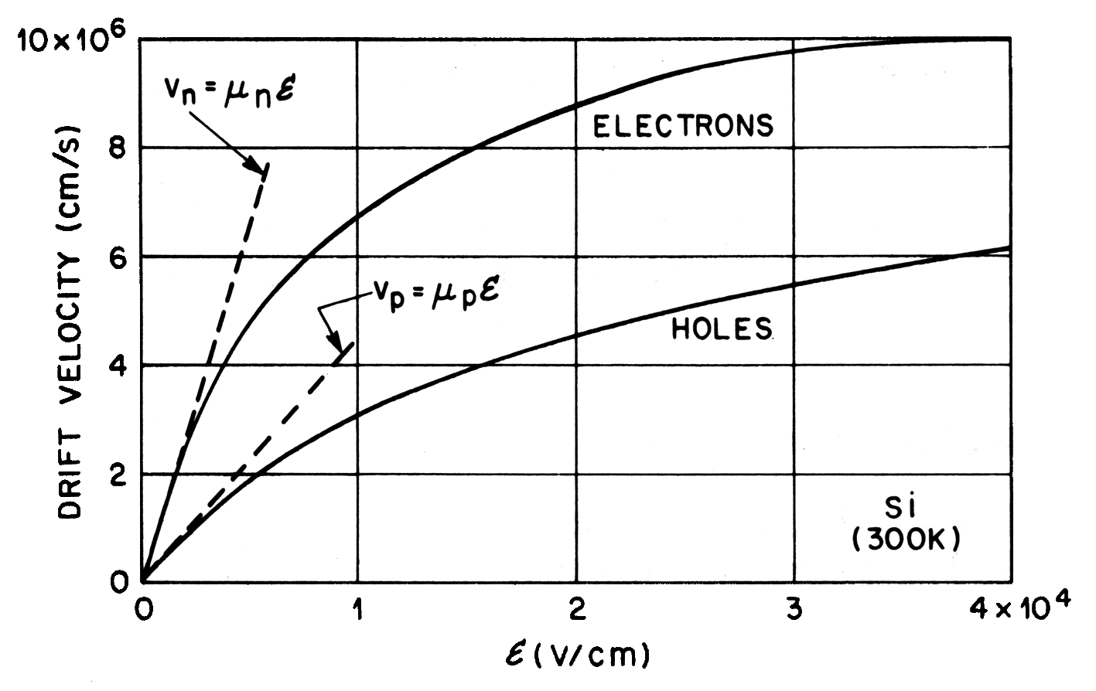
Material Properties
Drift velocity and mobility
Take Home
e 3 times faster then h
Drift velocity v
For electrons: and for holes:
Mobility μ
For electrons: and for holes:
µ_{n}(Si, 300 K) ≈ 1450 cm²/Vs
µ_{p}(Si, 300 K) ≈ 450 cm²/Vs
e … electron charge
ε … external electric field
m_{n} , m_{p} …effective mass of e⁻ and holes
τ_{n} , τ_{p} …mean free time between collisions
for e⁻ and holes
Delphi
CMS
Source: S.M. Sze, Semiconductor Devices , J. Wiley & Sons, 1985
Notes:
Hier: Speed
∴μυ also dependent on doping but pretty much constant for values we care
\mu electrons starts to decrease at E16 and holes at E17 and less then for electrons

Slide 9
Constructing a Detector
Estimate Signal to Noise Ratio SNR in an intrinsic silicon detector
Let’s make a simple calculation for silicon: Mean ionization energy I₀ = 3.62 eV, mean energy loss per flight path of a mip (minimum ionizing particle) dE/dx = 3.87 MeV/cm (rf. Bethe)
Assuming a detector with a thickness of d = 300 µm and an area of A = 1 cm².
➔ Signal of a mip in such a detector:
➔ Intrinsic charge carrier in the same volume (T = 300 K):
➔ Number of thermal created e–h⁺-pairs is four orders of magnitude larger than signal!!!
Charge carrier have to be removed!
➔ Depletion zone in reverse biased pn junction
Notes:
Hier: density – large energy deposition
Could be achieved by cool down but technically non-elegant method and difficult for large volume
BTW, mean not MPV

Slide 10
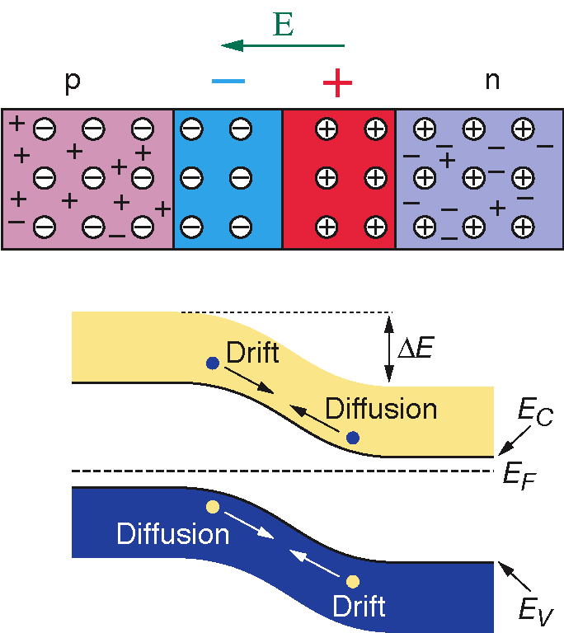
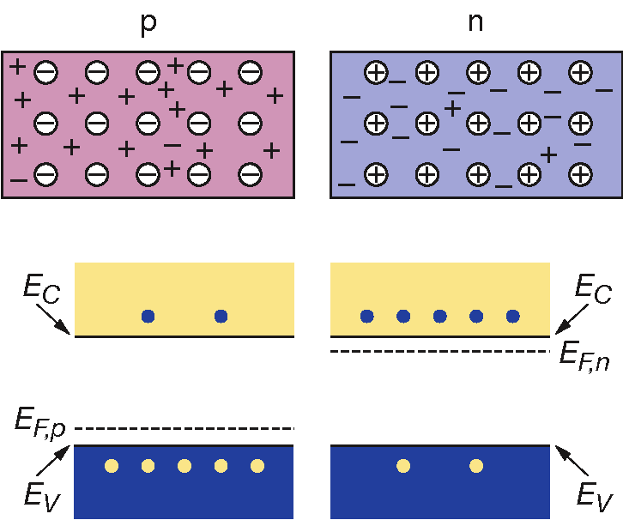

The p-n Junction
Creating a p-n junction
At the interface of an n-type and p-type semiconductor the difference in the fermi levels cause diffusion of surplus carries to the other material until thermal equilibrium is reached. At this point the fermi level is equal. The remaining ions create a space charge and an electric field stopping further diffusion.
The stable space charge region is free of charge carriers and is called the depletion zone.
Voltage
Notes:
Ask students how many free charges we have in the depleted volumes
And where does the space charge comes from?

Slide 11
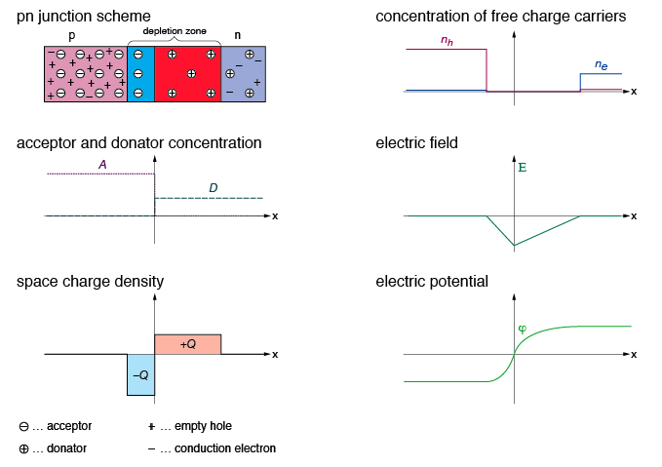


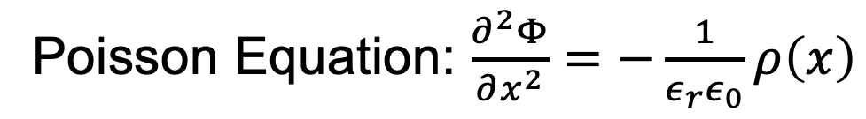
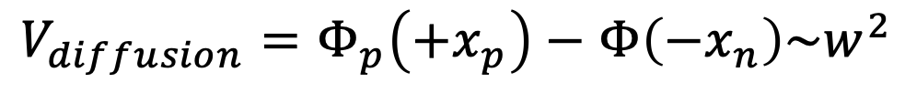
Take home:
Fields completely defined by doping concentration (& voltage)
The p-n Junction
Electrical characteristics
Poisson Equation: $\frac{∂^{2}Φ}{∂x^{2}}=−\frac{1}{ε_{r}ε_{0}}ρ\left(x\right)$
ρ (charge density) is constant in (+/-) depletion zones
$$E\left(x\right)\sim x$$
$$Φ\left(x\right)\sim x^{2}$$
$$V_{diffusion}=Φ_{p}\left(+x_{p}\right)−Φ\left(−x_{n}\right)\sim w^{2}$$
w=width of depletion zone
Notes:
Mind p (doped zone) has a negative space charge!! And vice versa!
Mind to think if \rho mean resistivity or density. It means density charge density on this slide
V_{diffusion} is ~O(mV), w ~O(µm)

Slide 12
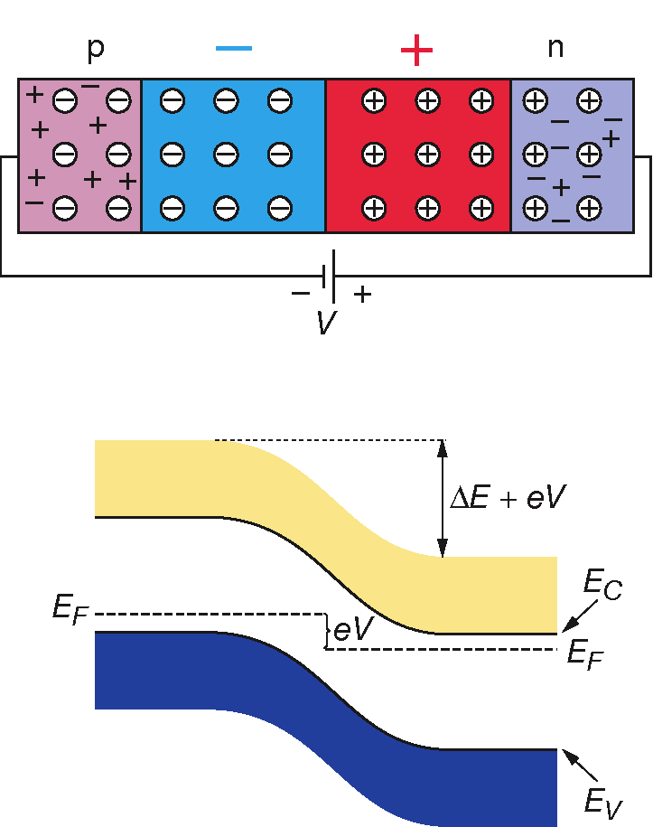
The p-n Junction
Operation with reverse bias
Take home:
Fields and potentials completely defined by doping concentration & voltage
p-n junction with reverse bias
Applying an external voltage V with the cathode to p and the anode to n e- and holes are pulled out of the depletion zone. The depletion zone becomes larger.
➔ That’s the way we operate our semiconductor detector!
Notes:
It’s dynamic!!!

Slide 13
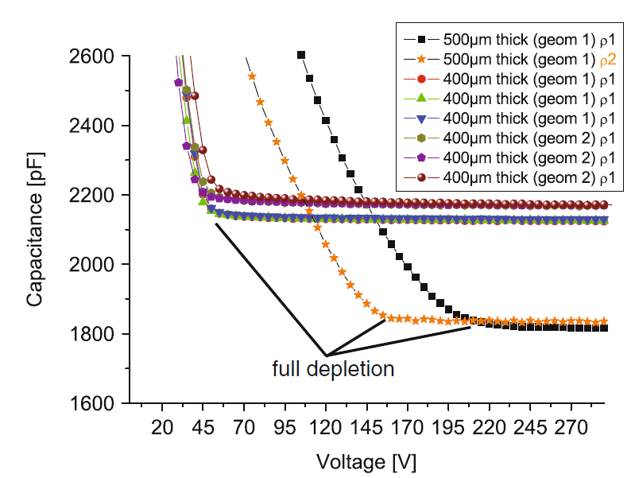
Detector Characteristics
Capacitance and Depletion Voltage of a detector
Depletion voltage V_{FD} is the minimum voltage at which the bulk of the sensor is fully depleted. The operating voltage is usually chosen to be higher (overdepletion).
- High resistivity material (i.e. low doping) requires low depletion voltage.
For a typical Si p-n junction (N_{a} >> N_{d} >> n_{i}) the detector capacitance is given as:
ρ … specific resistivity of the bulk
μ … mobility of majority charge carrier
V … bias voltage
A … detector surface
D … detector thickness
Measured detector capacitance as a function of the bias voltage, CMS strip detector:
Notes:
Depletion voltage the main topic these days, becoming an academic concept in the HL-LHC case
CV also reflects the doping profile; meaning ‘features’ hint to strange things; e.g. interfaces or changes due to radiation.
Look a the CVs shown here; after radiation you wish for something that nice and clear.
Plattenkondensator C=epsilon A/d

Slide 14
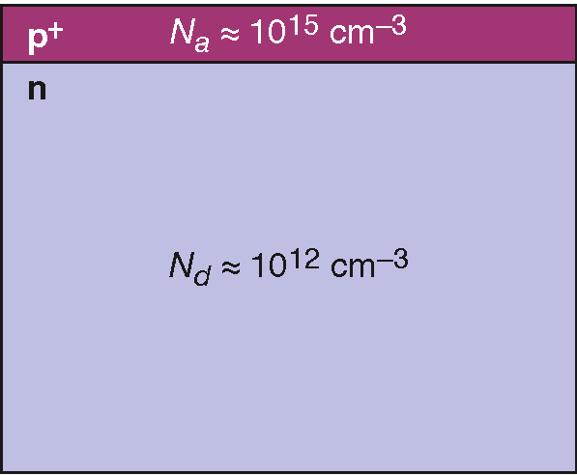
The p-n Junction
Width of the depletion zone
Example of a typical p⁺-n junction in a silicon detector:
Effective doping concentration N_{a} = 10¹⁵ cm^{–3} in p+ region and N_{d} = 10¹² cm^{–3} in n bulk.
Without external voltage:
  W_{p} = 0.02 µm
  W_{n} = 23 µm
  1 µm
  300 µm
Applying a reverse bias voltage of 100 V:
  W_{p} = 0.4 µm
  W_{n} = 363 µm
p⁺n junction
Width of depletion zone in n bulk:
V … External voltage
ρ … specific resistivity
… mobility of majority charge carriers
N_{eff} …effective doping concentration
with
Notes:
In sensors, p thin but far reaching
N BULK of volume thus bulk doping …

Slide 15
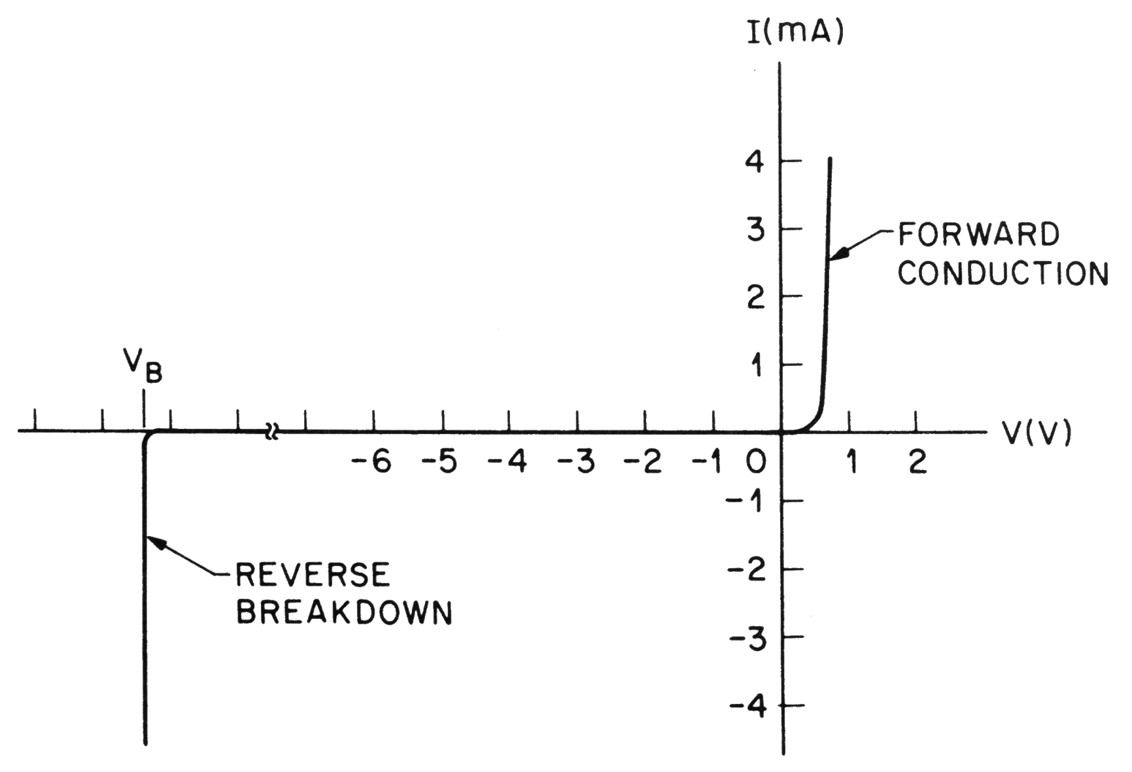
The p-n Junction
Current-voltage characteristics
Typical current-voltage of a p-n junction (diode): exponential current increase in forward bias, small saturation in reverse bias.
Operation mode
S.M. Sze, Semiconductor Devices , J. Wiley & Sons, 1985
Notes:
We come back to breakdown regime with SIPMs

Slide 16
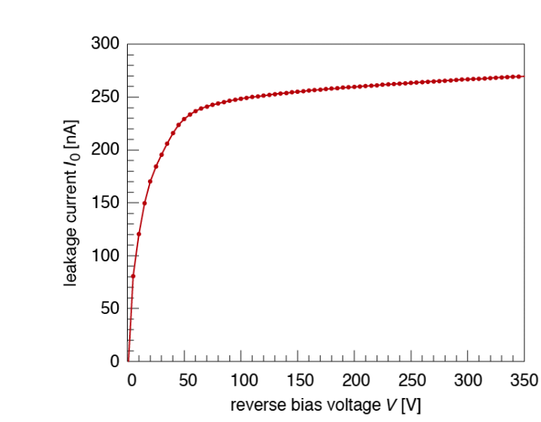
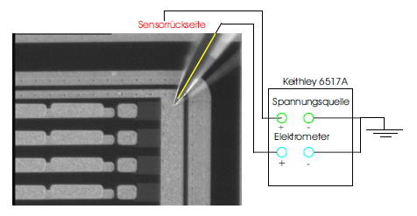
Detector Characteristics
Leakage Current
A silicon detector is operated with reverse bias,
hence reverse saturation current is relevant (leakage current).
This current is dominated by thermally generated e⁻h⁺ pair (totally dominated by defects).
Due to the applied electric field they cannot recombine and are separated.
The drift of the e⁻ and h⁺ to the electrodes causes the leakage current.
Backplane
Voltage source
Amp meter
Measured detector leakage current, CMS strip detector (measurement at room temperature):
Notes:
Forget about random walk as you read in text books (in a depleted sensors is only ONE zone)
You do not really care unless you cannot supply it – power; thermal runaway!

Slide 17
Detector Structures

Slide 18
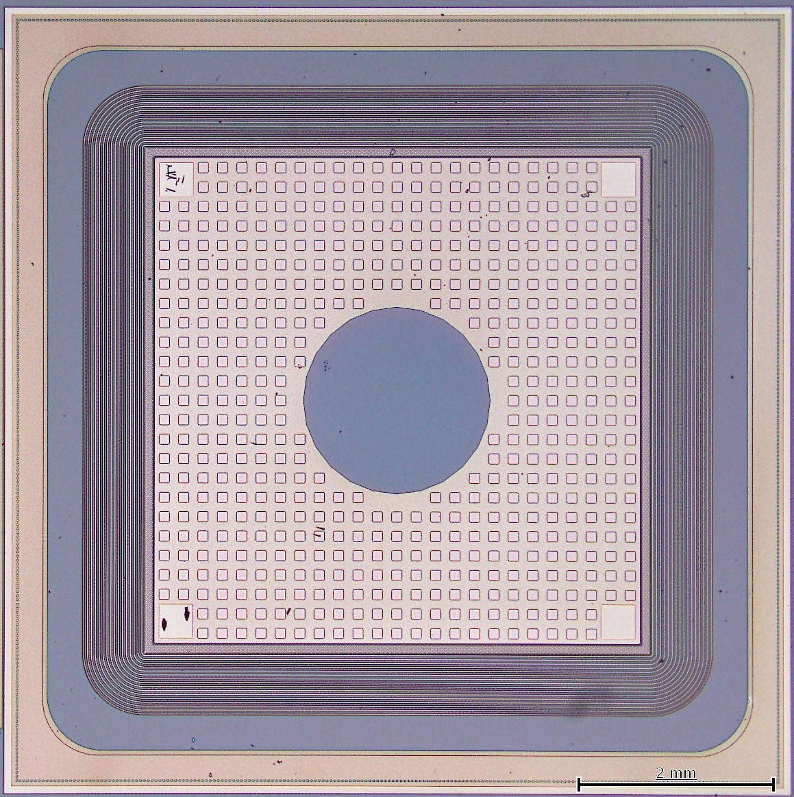
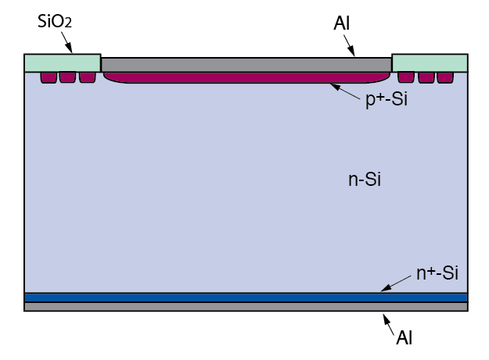
Pad Detector
The most simple detector is a large surface diode with guard ring(s).

Slide 19
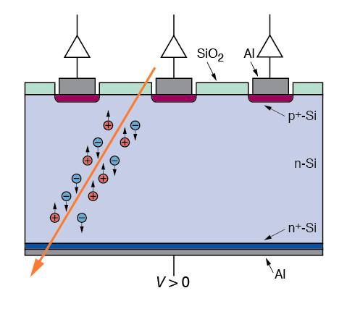
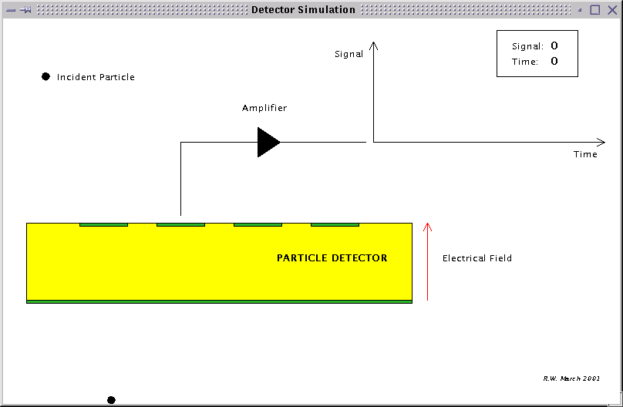
Microstrip Detector
DC coupled strip detector
Traversing charged particles create e⁻h⁺ pairs in the depletion zone (about 30.000 pairs in 300μm thickness). These charges drift to the electrodes.
The drift (current) creates the signal which is amplified by an amplifier connected to each strip.
A typical n-type Si strip detector:
p⁺n junction:
N_{a} ≈ 10¹⁵ cm⁻³, N_{d} ≈ 1 - 5·10¹² cm⁻³
n-type bulk: ρ > 2 kΩcm
➔ thickness 300 µm
Operating voltage < 100 - 600 V .
n⁺ layer on backplane to improve ohmic contact
Aluminum metallization
Notes:
Question: why a deep difussion – all edges, cuts interfaces have defects – increase distance of defects to active volume – deep diffusion; guard ring; active edge

Slide 20
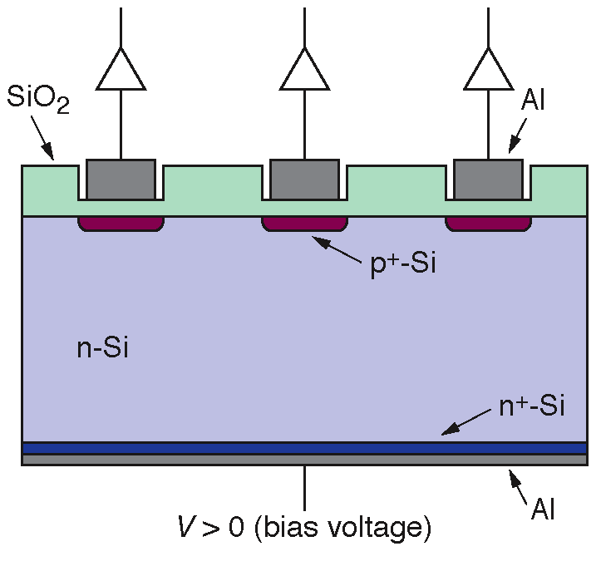
Microstrip Detector
AC coupled strip detector
AC coupling blocks leakage current towards the amplifier.
AC coupled strip detector:
Integration of coupling capacitances
in standard planar process.
Deposition of SiO₂ with a thickness of 100 - 200 nm between p+ and aluminum strip
Depending on oxide thickness and strip width the capacitances are in the range of 8–32 pF/cm.
Problems are shorts through the dielectric (pinholes). Usually avoided by a second layer of Si₃N₄.
However, the dielectric cuts the bias connection to the strips!
Several methods to connect the bias voltage:
polysilicon resistor, punch through bias, FOXFET bias.

Slide 21
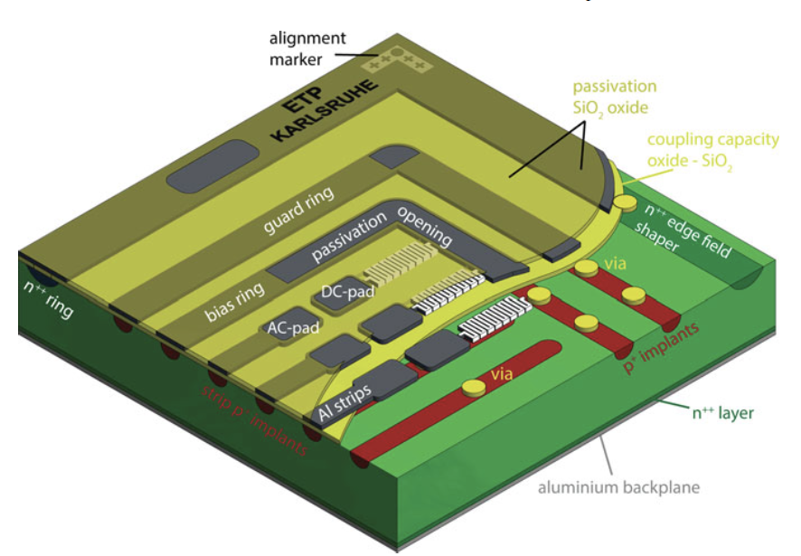
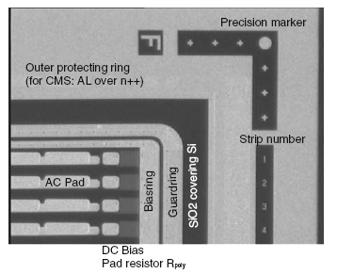
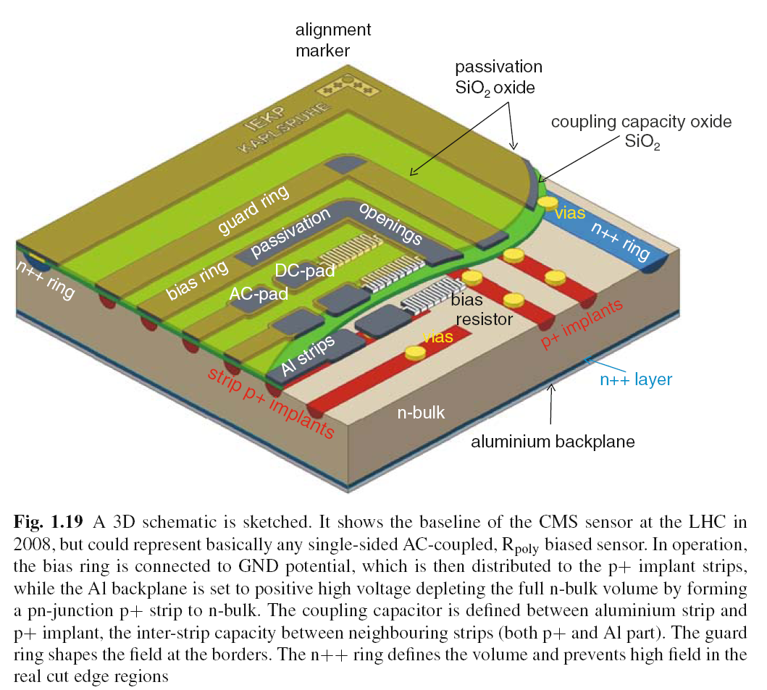
Microstrip Detector a real life case - p-in-n

Slide 22
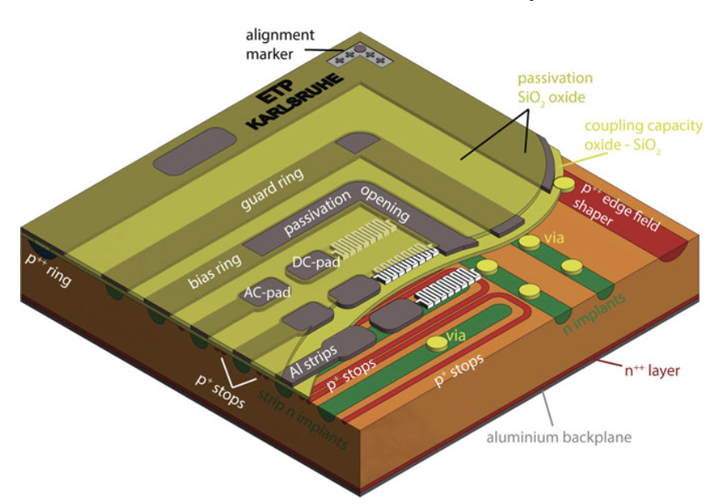
n-in-p sensor (for Phase 2 aka HL-LHC)
Invert everything
... and add channel isolation (here p-stops)

Slide 23
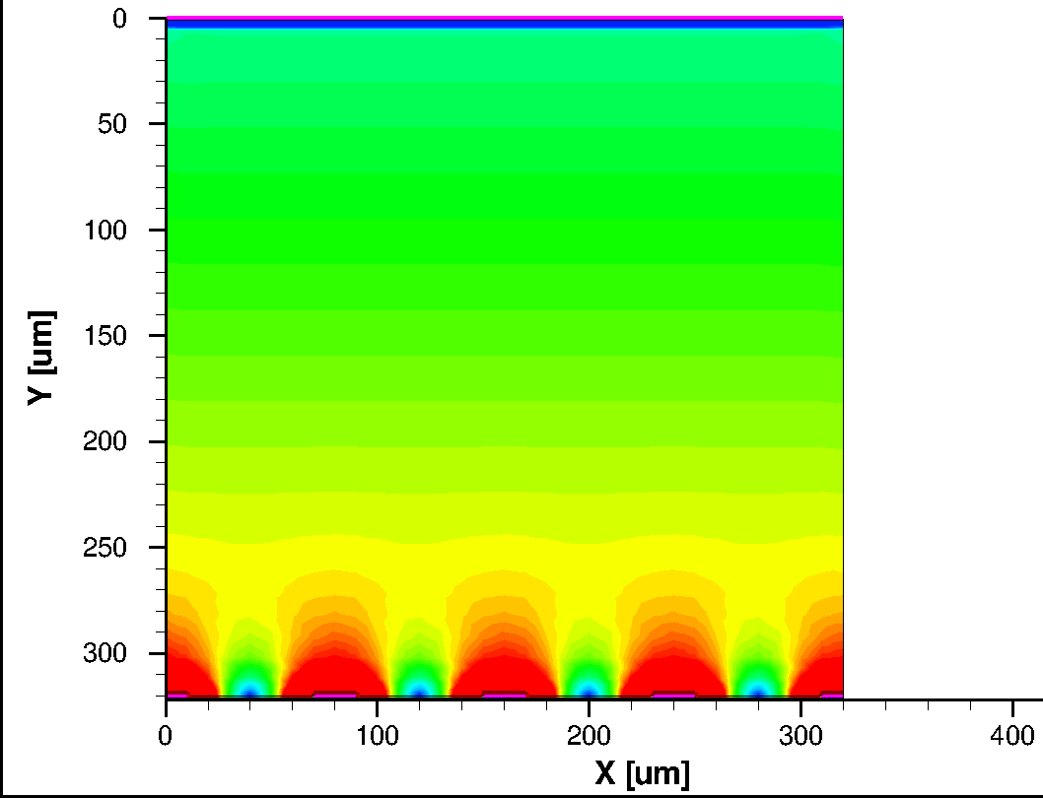
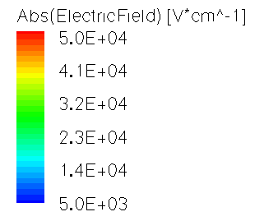
Electrical Field Configuration of a Strip Sensor p-in-n

Slide 24
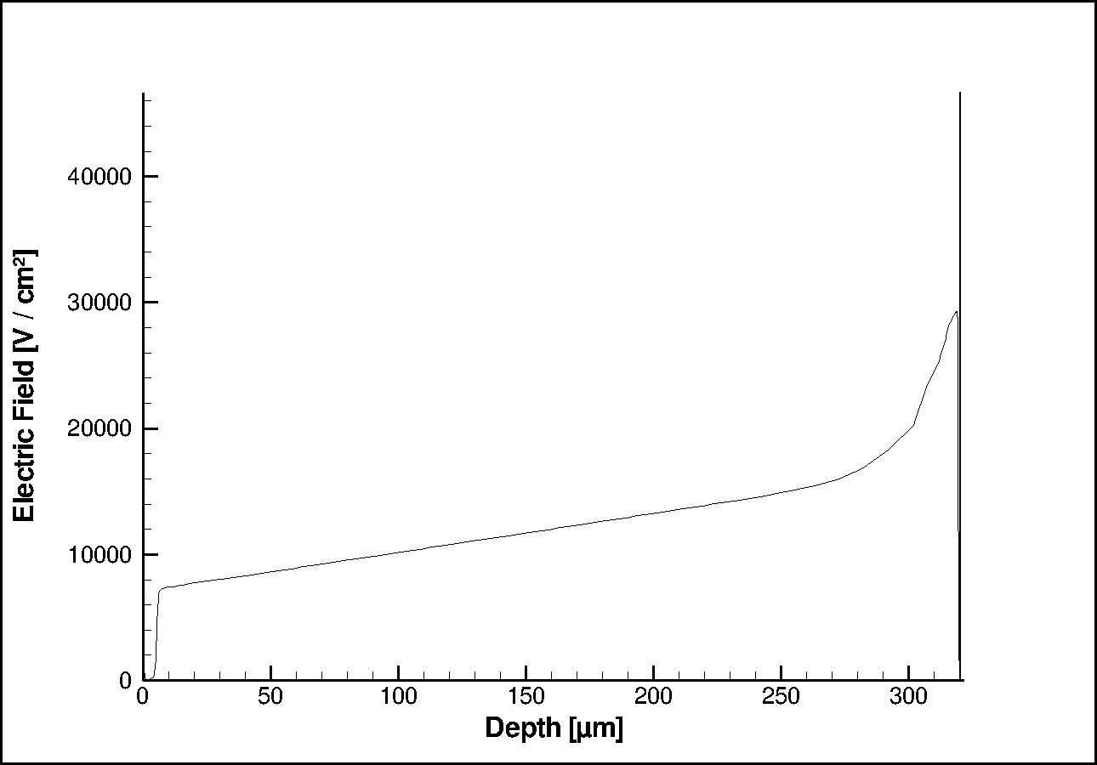
Electrical Field across a Strip
Increase near strip electrode
Electrical Field [ V/cm]
Linear

Slide 25
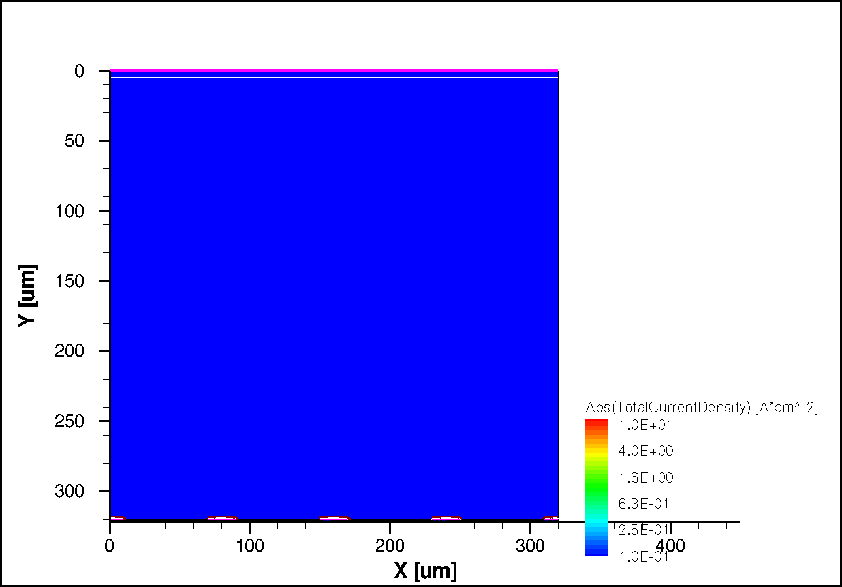
Simulated Current Density
Ionizing particle with 45º angle t=0 s
p-in-n
|Absolute values|
Simulation Thomas.Eichhorn

Slide 26
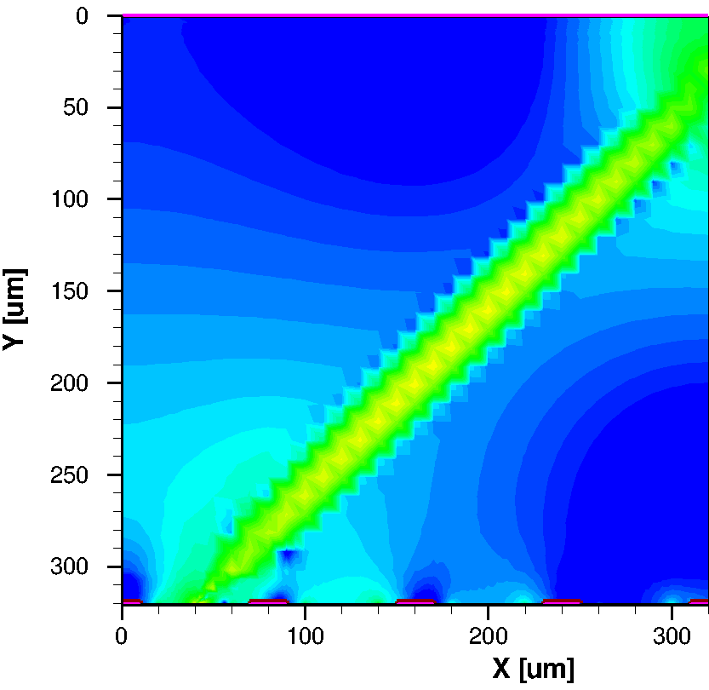
2.2. Simulated Current Density
Ionizing particle with 45º angle t=1 ns
1ns

Slide 27
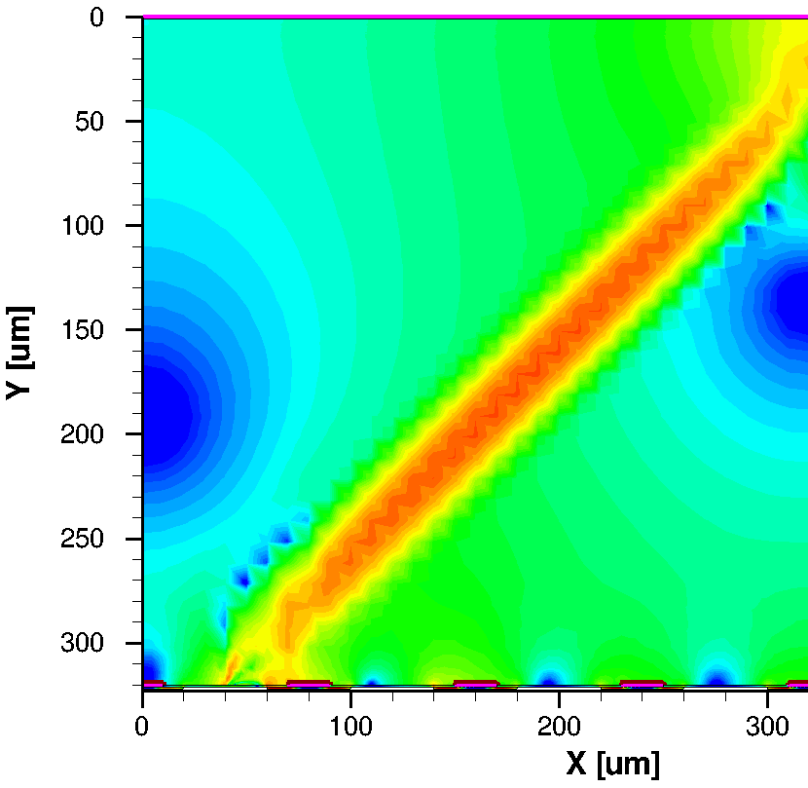
1.1ns

Slide 28
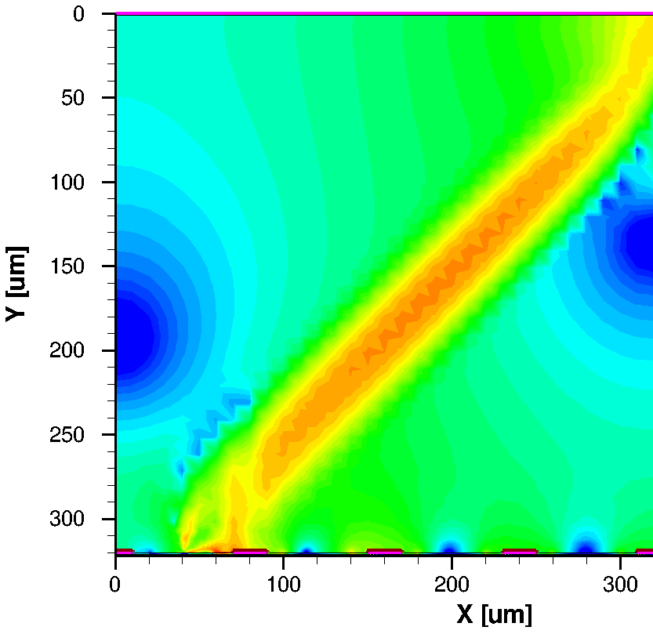
1.2ns

Slide 29
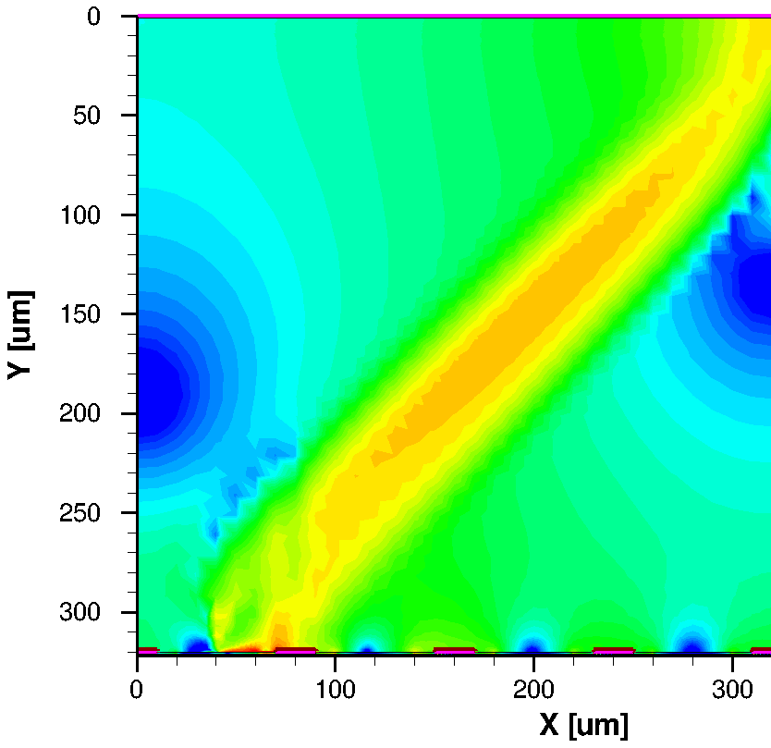
1.3ns

Slide 30
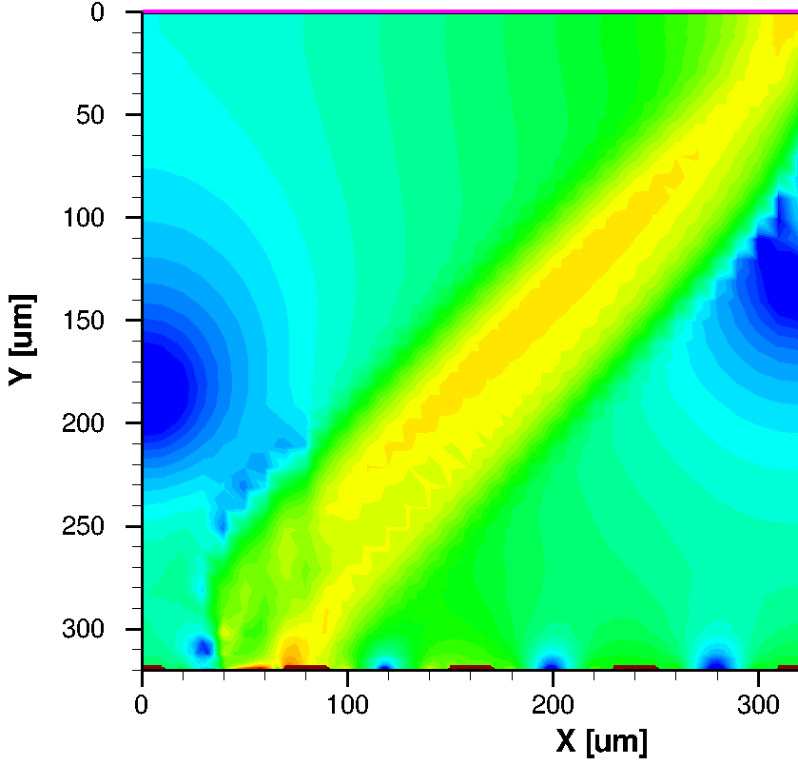
1.4ns

Slide 31
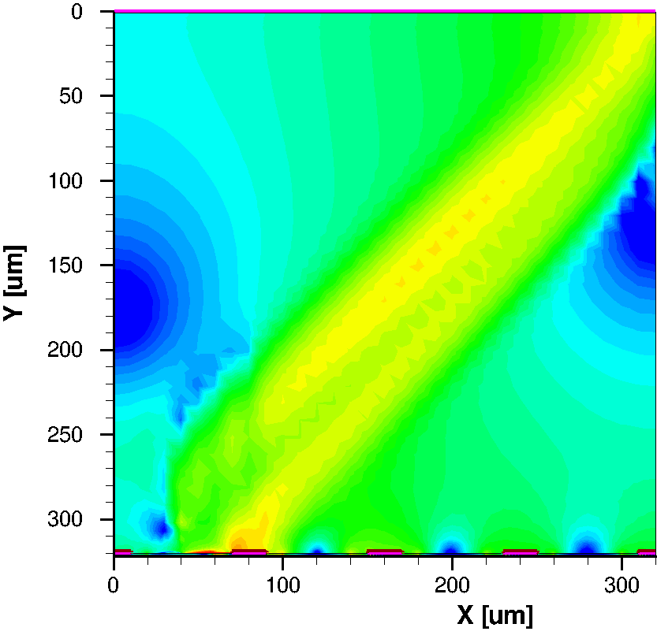
1.5ns

Slide 32
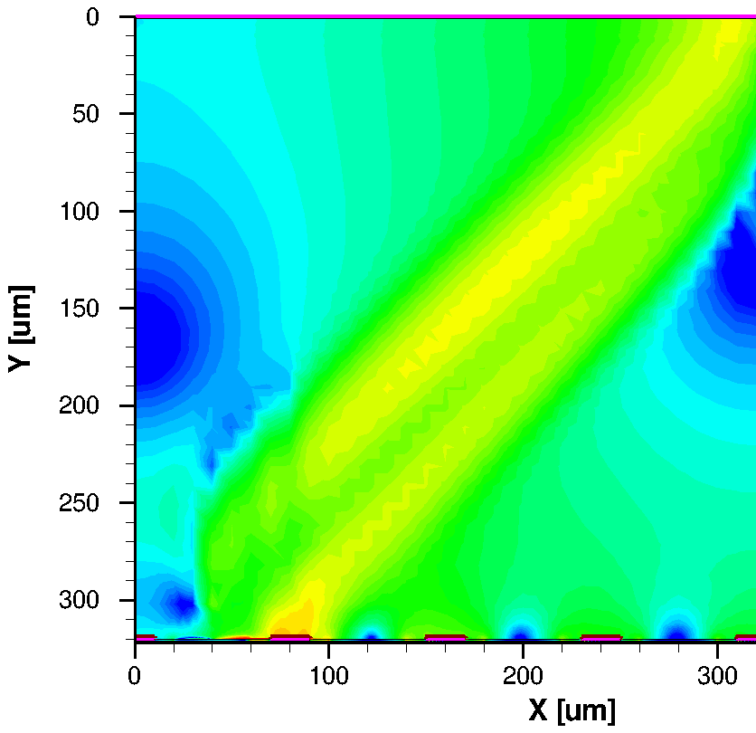
1.6ns

Slide 33
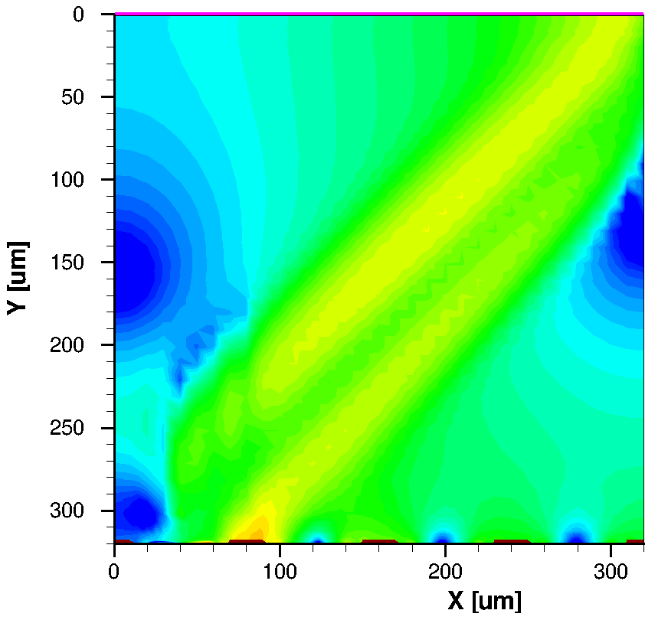
1.7ns

Slide 34
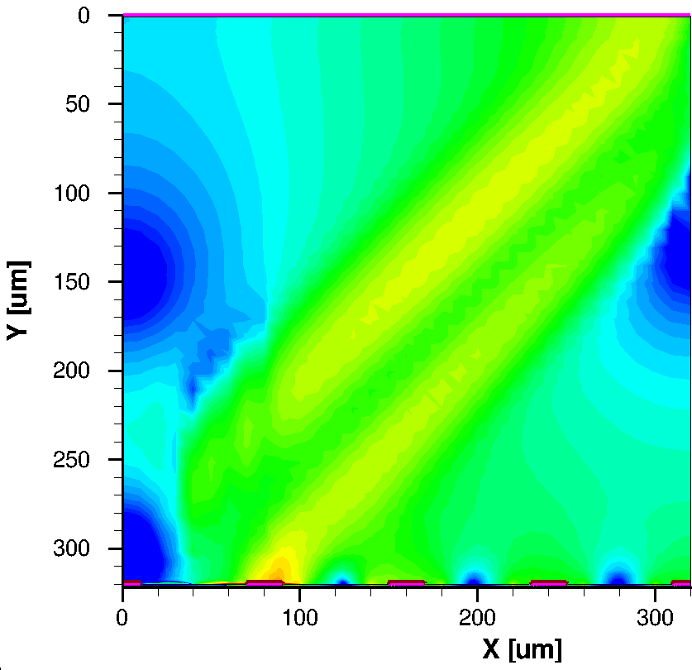
1.8ns

Slide 35
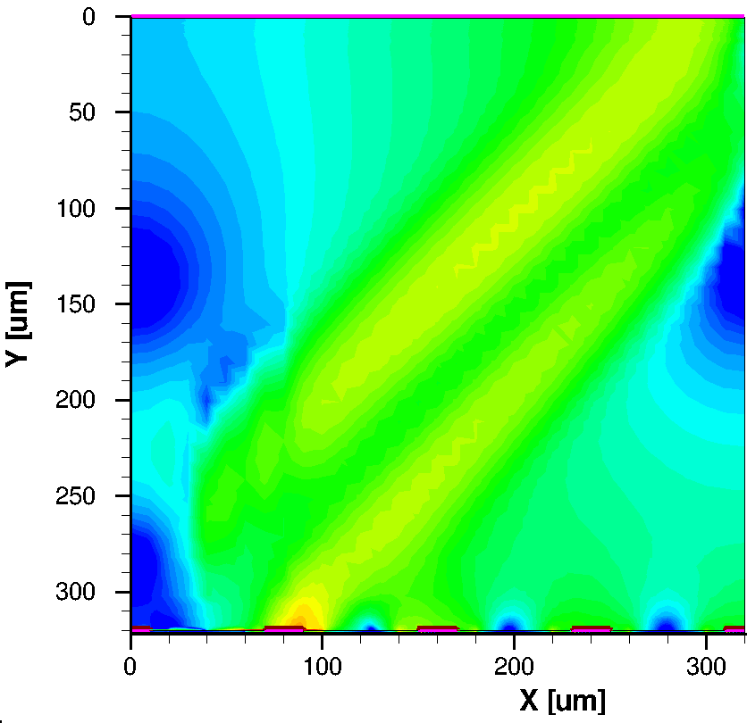
1.9ns

Slide 36
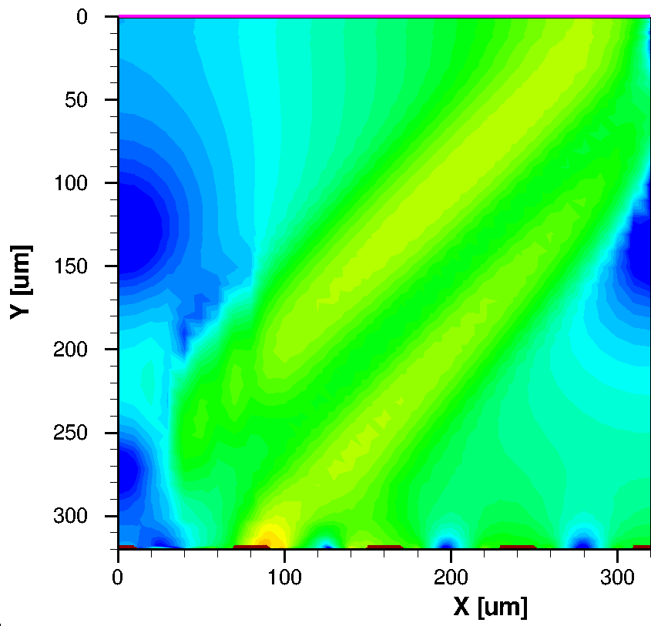
2 ns

Slide 37
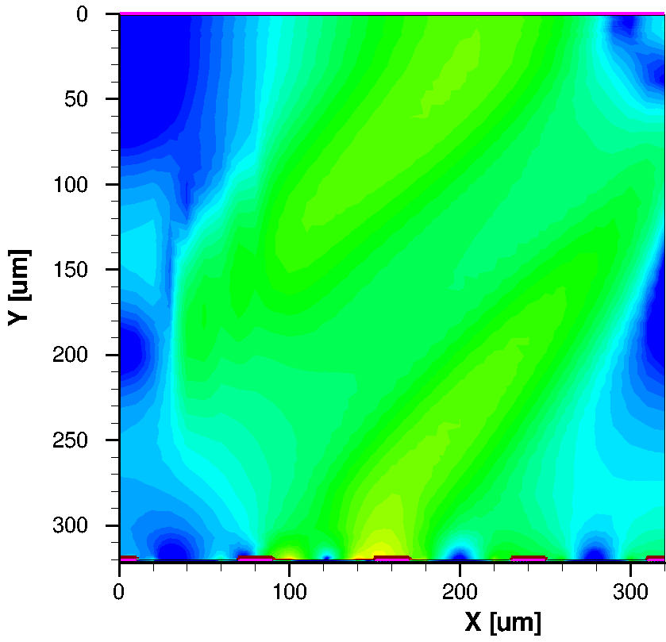
3 ns

Slide 38
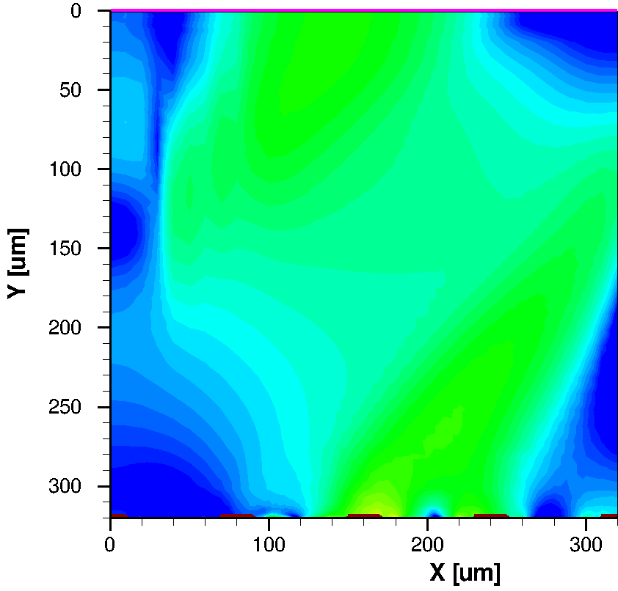
4 ns

Slide 39
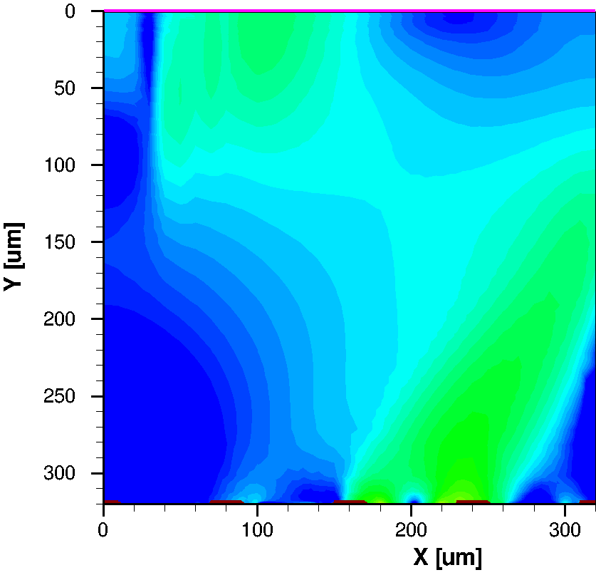
5 ns

Slide 40
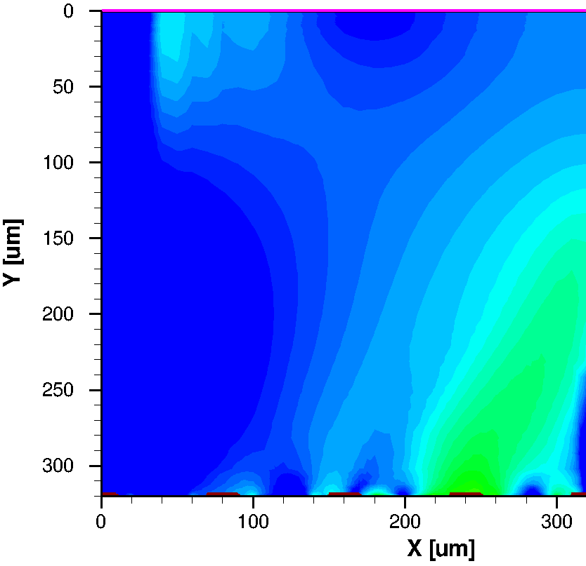
6 ns

Slide 41

7 ns
Mind:
all electrons collected

Slide 42


Hole Charge Collection
(strip & time resolved)
2,27e-15C
Simulation Thomas.Eichhorn
3,04e-15C
3,27e-15C
1,08e-15C

Slide 43


Induced current– Shockley-Ramo
Take home: All signals in particle detectors are due to induction by moving charges.
Once the charges have arrived at the electrodes the signals are ‘over’.
The drift is recorded - the height of the signal is linear proportional to the velocity of the charge
$$i_{K}\left(t\right)=q_{P}\frac{1}{V_{0}}{\vec{E}}_{W}⋅\vec{v}\left(x\left(t\right),y\left(t\right),z\left(t\right)\right)=q_{P}\frac{1}{V_{0}}{\vec{E}}_{W}⋅μ⋅\vec{E}$$
From G. Lutz
p-in-n
20% over-depletion
Si Signals are fast T<10ns.
In case the amplifier peaking time is >20-30ns, the induced current signal shape doesn’t matter.
The entire signal is integrated.
E_{W} is called weighting field – geometry
(distance, capacitance, shape)
µ_{n}(Si, 300 K) ≈ 1450 cm²/Vs
µ_{p}(Si, 300 K) ≈ 450 cm²/Vs
Start: mid-sensor
Gas detector work the same, though the electric field in gas is constant and in Silicon is linear
Notes:
Ask about the fiedl? High at p electrode side!!

Slide 44

Signal Formation – weighting field ~ geometry
An interesting fact is that for diodes (or large pad detector) with an entirely linear field
  electrons and holes contribute the same to the electrode (pad)
For fine segmented sensors pixel and strip one charge type contributes much more; because the electrical fields concentrate at the electrodes;
  the drift velocity there is much higher thus the induced signal is much higher
  Weighting field E_{W} is higher too
    We therefore often say we collect holes, or we collect electrons ☺
The future CMS High Granularity Calorimeter will register both electrons and holes
  Basically a pad detector (with many pads)
The future HL-LHC tracker will register electrons (mainly)
  The current strips registers holes (the pixels electrons)
The weighting field E_{W}
Notes:
Say something about weighting fields

Slide 45


Strip Sensor to Module

Slide 46



Strip vs. Pixel Detectors
A strip detector measures 1 coordinate only. Two orthogonal/angled arranged strip detectors could give a 2-dimensional position of a particle track. However, if more than one particle hits the strip detector the measured position is no longer unambiguous. “Ghost”-hits appear!
True hits and ghost hits in two crossed strip detectors in case of two particles traversing the detector:
Pixel detectors produce unambiguous hits!
Measured hits in a pixel detector in case of two particles traversing the detector:

Slide 47


Hybrid Pixel Detectors
Principle
“Flip-Chip” pixel detector:
On top the Si detector, below the readout chip, bump bonds make the electrical connection for each pixel.
Detail of bump bond connection. Bottom is the detector, on top the readout chip:
L. Rossi, Pixel Detectors Hybridisation,
Nucl. Instr. Meth. A 501, 239 (2003)
Drawback of hybrid pixel detectors: Large number of readout channels
Large number of electrical connections and large power consumption.

Slide 48

Hybrid Pixel Detectors
Bump bonding process
Electron microscope pictures before and after the reflow production step.
In bump, The distance between bumps is 100 μm, the deposited indium is 50 μm wide while the reflowed bump is only 20 μm wide.
C. Broennimann, F. Glaus, J. Gobrecht, S. Heising, M. Horisberger, R. Horisberger, H. Kästli,J. Lehmann, T. Rohe, and S. Streuli, Development of an Indium bump bond process for silicon pixel detectors at PSI, Nucl. Inst. Met. Phys, Res. A565(1) (2006) 303–308 82

Slide 49



Silicon Pad detectors – for calorimeter
CALICE & CMS HGCAL
Hexagonal sensors to maximize use of wafer area
120, 200, 300 μm thick n-in-p pad sensors
  Thickness defines radiation tolerance
Cell size ~0.5 or ~1 cm²
  Smaller cell size in central region
    High occupancy and noise reduction
Cells are wire-bonded to a PCB on top with holes
8” prototype
200μm thick
120μm thick with 0.5cm² cells
300μm thick
n-in-p more radiation tolerant than p-in-n; thinner = radiation tolerant
Higher radiation at lower radius
8” – a first in HEP High Energy Physics
Notes:
We learn from the bees
Signal from e and h

Slide 50
Cautionairy tales of things going wrong - Sensors
No time – I will rush through ☺

Slide 51

Evil plastic

Slide 52












Processing
Dicing
Residues

Slide 53






Faults - Some are visible
Open bias resistor:
Open Strip:
Shorted Strip:
Open implant at via:
Open implant:
“Pinhole” (short between
implant and metal):

Slide 54

➔ High leakage Current
Guess where!

Slide 55


How to break it systematically?
Choose a package, where the sensor moves in the order of 1mm freely!

Slide 56
Corrosion

Slide 57

600V
22°C ~50% RH
Corrosion

Slide 58

600V
22°C ~50% RH
after 17 h

Slide 59

22°C ~50% RH
after 65 h

Slide 60

600V
22°C ~50% RH
after 92 h

Slide 61

600V
22°C ~50% RH
after 162 h

Slide 62



Aluminum corrosion
Passivation (1 µm)
Aluminum (2 µm)
Triple oxide layer (1.5 µm)
Need voltage and RH in air
Oxidation of Al → insulating
  Goes several μm deep
Insufficient cleaning left Pottassium

Slide 63
Charge up

Slide 64



Give your sensors a bath!

Slide 65

Why? - Charge-up!
I experienced several cases
Processing
Shipping in non lint-free envelopes
Antireflective coating for ‘alignment’ sensors with holes
Bathing in de-ionized water helps but is super delicate

Slide 66
Performance

Slide 67


Signal to Noise Ratio
The signal generated in a silicon detector depends essentially only
on the thickness of the depletion zone and on the dE/dx of the particle (see Bethe).
The noise in a silicon detector system depends on various parameters: geometry of the detector, the biasing scheme, the readout electronics, etc.
  Noise is typically given as “equivalent noise charge” ENC.
  This is the noise at the input of the amplifier in elementary charges.
Take home: No charge amplification as in gas detectors
noise distribution
Landau distribution
with noise

Slide 68

Signal to Noise Ratio
Noise contributions
Leakage current (ENC_{I})
Detector capacity (ENC_{C})
Det. parallel resistor (ENC_{Rp})
Det. series resistor (ENC_{Rs})
Alternate circuit diagram of a silicon detector.
e .… Euler number (2.718...) t_{p} …Integration time in µs
e … Electron charge R_{Rs} …Series resistor in Ω
C .…Detector capacity in pF R_{Rp} …Parallel resistor in Ω
The overall noise is the quadratic sum:
Typical values for SNR are 15 to 40.
Notes:
Mind, b in ENC_C is strongly t_p dependent
Mind, even DC coupled sensor have a metal line to reduce series resistance!!
1 and 3 relevant for DELPHI; 2 and 4 for LHC
C bei LEP 15 C bei LHC 64!!

Slide 69
Signal to Noise Ratio
Summary
To achieve a high signal to noise ratio in a silicon detector system the following conditions are important:
Low detector capacity (i.e. small element size)
Low leakage current
Large bias resistor
Short and low resistance connection to the amplifier
Long integration time
Take Home
Obviously some of the conditions are contradictory.
Detector and front end electronics have to be designed as one system. The optimal design depends on the application.

Slide 70

Position Resolution
The position resolution – the main parameter of a position detector – depends on various factors, some due to physics constraints and some due to the design of the system (external parameters).
Physics processes:
  Statistical fluctuations of the energy loss (Landau)
  Diffusion of charge carriers
External parameter:
  Binary readout (thresh hold counter) or read out of analogue signal value
  Distance between strips (strip pitch)
  Signal to noise ratio

Slide 71
Position Resolution
Threshold (binary) readout versus analogue readout
Threshold readout (one strip signal):
  ➔position:
  ➔resolution:
p … distance between strips (readout pitch)
x … position of particle track
Analogue readout with interpolation (signal on two strips):
  ➔Position (charge center of gravity):
  ➔resolution:
x₁,x₂ … position of 1st and 2nd strip
h₁,h₂ … signal on 1st and 2nd strip
SNR … signal to noise ratio
A position resolution of a few µm is achievable with analogue readout !

Slide 72

Silicon properties
– the numbers are simply right
And detector relevant:
Dense: the average energy loss and high ionized particle number with 390eV/μm ∼ 108 (electron–hole pairs)/μm is effectively high due to the high density of silicon.
  No charge amplification needed
very good intrinsic energy resolution: for every 3.6 eV released by a particle crossing the medium, one electron–hole pair is produced. (30 eV to ionize a gas molecule)
Very fast O(10ns)
Mechanical stability
  Self supporting

Slide 73

Radiation damage in silicon sensors
A very very brief glimpse

Slide 74

Examples of crystal defects a defect = ‘energy level in the gap’ ~ dopant
Take home: There is more than Interstitials and Vacancies; especially with impurities present

Slide 75

Mind ‘the Gap’
Rule of Thumb:
● Leakage Current - Relevant from E13 1MeVN_{equiv} onwards – LHC
● Depletion voltage - Relevant from E14 1MeVN_{equiv} onwards - LHC
● Trapping - Relevant from E15 1MeVN_{equiv} onwards – HL- LHC
●
●
●
Defects are simply add. levels in the band gap

Slide 76

Some Relevant Radiation Induced Defects
From studies of RD50 and WODEAN
* Point defects
γ can only do point defects

Slide 77

Then there is „diffusion“ (annealing)
The term “diffusion” used here is more a descriptive one combining effects like diffusion, migration, break-up, re-configuration of defects – also often summarized by the term “annealing”

Slide 78



Macroscopic parameters (in n-bulk FZ sensors)

Slide 79



Defect Engineering – RD50
Introduced in CMS & ATLAS pixel

Slide 80

Radiation Damage – Trapping
Trapping τ_{eff} changes with Φ_{eq}
Different materials behave differently (n, p, FZ, MCz, oxygenated)
Rule of thumb: dominant damage item up to 10¹⁶ 1MeV_{eq}
τ _{eff} (10¹⁵ n1 MeV/cm2) = 2 ns: x = (10⁷ cm/s) · 2 · ns = 200μm
τ _{eff} (10¹⁶ n1 MeV/cm2) = 0.2 ns: x = (10⁷ cm/s) · 0.2 · ns = 20μm
Annealing effect small
➔signal decreases
Notes:
Not a problem for today’s detectors.
Main EVIL for tomorrow

Slide 81
Is this all on irradiation? Not really.
The content of impurities is important and different particles and different energies damage differently wrt V_{FD} / E-field
  create also donors, not only acceptors
When trapping becomes the dominant factor, the field becomes parabolic (was linear).
You need high field to get a signal, thinner sensor help (~d²)
n-in-n or n-in-p sensors ‘register’ electrons which are faster and the electric and weight field is higher at the n-electrode → larger signal

Slide 82

Origin of the double junction
You need:
  Traps and thermal current generators!
Holes / electrons travel to p-electrode / n-electrode – ASYMMETRIC
They are trapped THERE → change effective space charge N_{eff} - ASYMMETRIC
Space charge N_{eff} defines the fields
  Dynamic situation
    generation – trapping – de-trapping
Below depletion voltage, the un-depleted zone is in the middle of the sensor

Slide 83

Everybody still alive?
Ready for coffee?

Slide 84
















The ART of sensor defects
back
nothing
pinhole
Leaky strip
?

