Slide 1
GARD ABP: a path to the roadmap
Z. Huang (SLAC), J. Power (ANL), J.-L. Vay (LBNL), L. Spentzouris (IIT), J. Rosenzweig (UCLA), P. Piot (NIU), and S. Nagaitsev (Fermilab)
June 5, 2020

Slide 2
Discussion topics for today
How do we create a roadmap (a timeline)?
  We propose to present our roadmap by Grand Challenges. Is this optimal?
How to incorporate the following two research topics:
  ML/AI
  Early conceptual integration, optimization and maturity evaluation

Slide 3
2014 P5 report, 2015 GARD report, other GARD road maps
https://www.usparticlephysics.org/ -- the P5 report
https://science.osti.gov/~/media/hep/hepap/pdf/Reports/Accelerator_RD_Subpanel_Report.pdf -- GARD report
https://science.osti.gov/~/media/hep/pdf/accelerator-rd-stewardship/Advanced_Accelerator_Development_Strategy_Report.pdf -- the AAC roadmap
https://science.osti.gov/~/media/hep/pdf/Reports/DOE_HEP_GARD_RF_Research_Roadmap_Report.pdf -- the RF roadmap
https://science.osti.gov/~/media/hep/pdf/Reports/MagnetDevelopmentProgramPlan.pdf -- the HF magnet roadmap

Slide 4
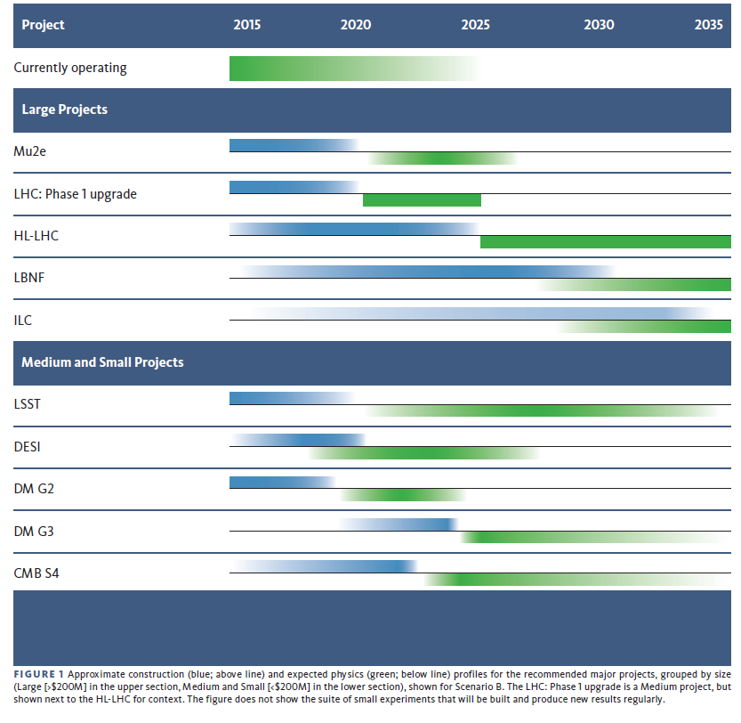
The P5 report timeline

Slide 5

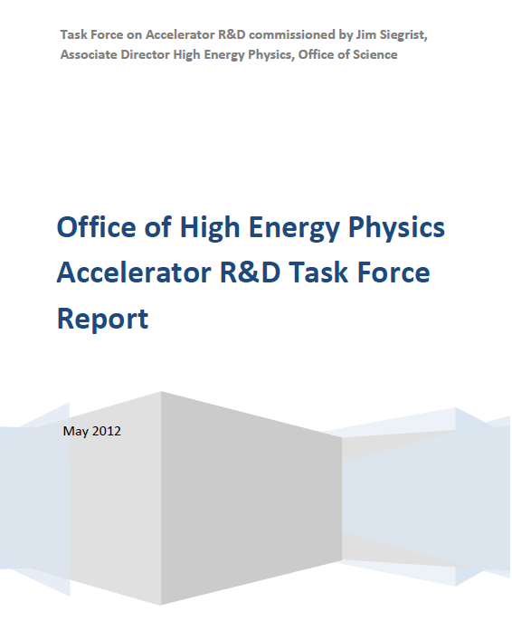
Prior to 2014
2012
~2009

Slide 6
From the 2012 report

Slide 7
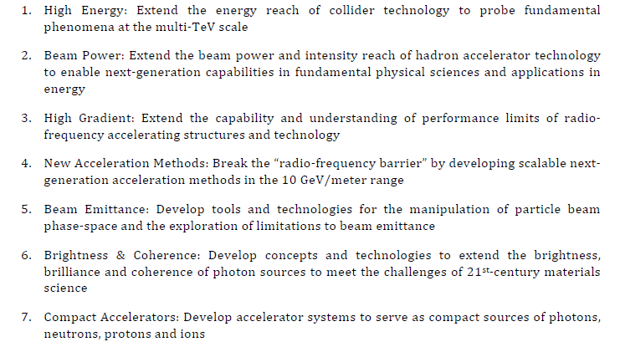
From 2012 report: the seven grand challenges

Slide 8
Our consensus: the four ABP grand challenges
Grand challenge #1 (beam intensity): How do we increase beam intensities by orders of magnitude?
Grand challenge #2 (beam quality): How do we increase beam phase-space density by orders of magnitude, towards quantum degeneracy limit?
Grand challenge #3 (beam control): How do we measure and control the beam distribution down to the level of individual particles?
Grand Challenge #4 (beam prediction): How do we develop predictive “virtual particle accelerators”?

Slide 9
Workshop #1 WGs
Workshop #1 (LBNL, Dec. 9-10, 2019):
  (WG1) Single-particle dynamics, including nonlinearities, and spin dynamics.
  (WG2) High-brightness beam generation (including polarized beams), transport, manipulation and cooling.
  (WG3) Mitigation and control of collective phenomena: instabilities, space charge, beam-beam, beam-ion effects, wakefields, and coherent synchrotron radiation.
  (WG4) Connections to other GARD roadmaps (cross-cutting WG1-3)

Slide 10
Workshop #2 WGs
Workshop #2 (Fermilab, Apr - May, 2020):
https://indico.fnal.gov/event/22709/
Thur Mar 12 morning, WG1: Advanced accelerator instrumentation and controls.
  Conveners: J. Power (ANL), P. Piot (NIU), M. Minty (BNL)
Thur Mar 12 afternoon, WG2: Modeling and simulation tools (including energy deposition); fundamental theory and applied math.
  Conveners: J.-L. Vay (LBNL), T. Zolkin (Fermilab), X. Huang (SLAC)
Fri Mar 13 morning, WG3: Early conceptual integration and optimization, maturity evaluation
  Conveners: J. Rosenzweig (UCLA), V. Shiltsev (Fermilab), J. Seeman (SLAC)
Fri Mar 13 afternoon, WG4: Synergies with non-HEP
  Conveners: Z. Huang (SLAC), L. Spentzuoris (IIT), J. Byrd (ANL)

Slide 11
Research themes identified through workshops
The two workshops are summarized in a Summary document
  Presents research opportunities and directions as collected from the entire GARD ABP community
  It will be ~30 pages long, a collection of research themes, connected to Grand Challenges and to “knowledge and technology gaps”
https://docs.google.com/document/d/1drM2gMInXYZtBlotqjiIVfuI4Zsy7szDqXlF7o0pano/edit?usp=sharing
But this is not yet a Roadmap!

Slide 12
Proposal for the time axis
We now have several roadmaps and schedules, relevant to our GARD ABP thrust
  Neutrino projects at Fermilab (there are plans/concepts extending to ~2035)
  HL-LHC and post-LHC plans in Europe
  The AAC roadmaps

Slide 13
HEP Intensity frontier
Fermilab PIP-II (1.2 MW beam power) ~2027
Fermilab post PIP-II beam power upgrade (2.5 MW) ~2037
The time-scale relevant to ABP is then set by these upgrades
We can propose to aim at 10 MW beam power for HEP intensity frontier in 20 years

Slide 14
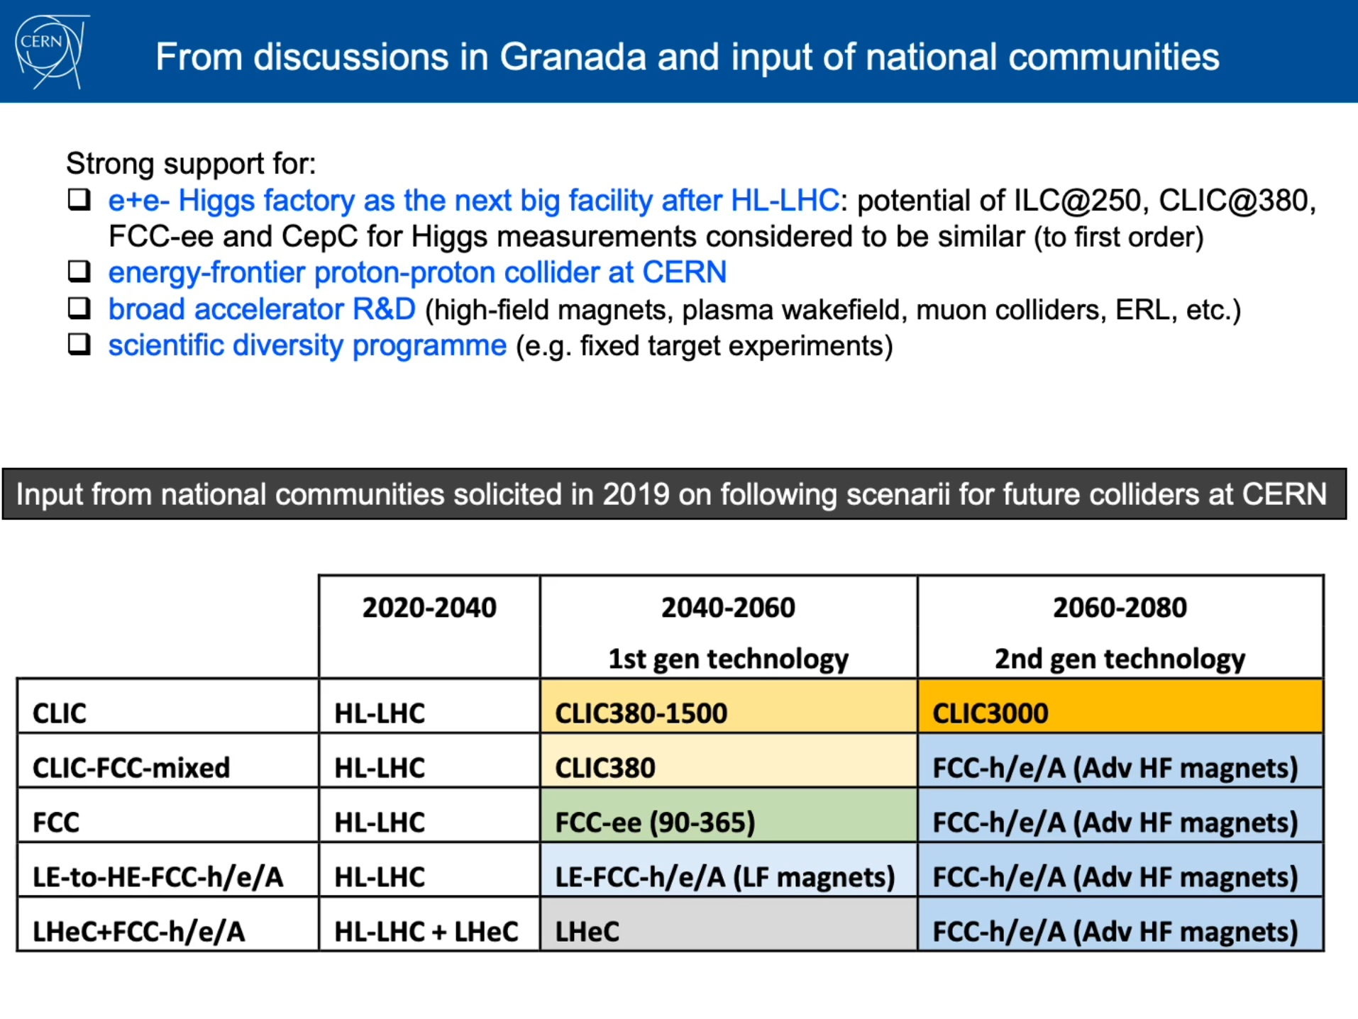
Energy Frontier – hadron (from the IPAC20 talk by Fabiola)

Slide 15
AAC roadmaps for the Energy Frontier -- leptons
https://science.osti.gov/~/media/hep/pdf/accelerator-rd-stewardship/Advanced_Accelerator_Development_Strategy_Report.pdf -- the AAC roadmap

Slide 16
Energy Frontier -- leptons
Roadmap for the development of a LWFA collider. Collider conceptual design time-frame: 2025-2035

Slide 17
Energy Frontier – leptons (continued)
Collider conceptual design time-frame: 2025-2035

Slide 18
Energy Frontier – leptons (continued)
DWFA linear collider road map

Slide 19
Thrust components: mapping to HEP frontiers and synergies
[We received input from Working Groups through workshops]
Thrust focus
 | Intensity Frontier | Energy Frontier: Hadron | Energy Frontier: Lepton | Synergies: SC/GARD thrusts
Single particle dynamics and non-linear effects. Polarized beams |  |  |  | NP, BES
Space charge effects and mitigation |  |  |  | NP, FES, BES
Beam instabilities, control and mitigation; conventional wakefields |  |  |  | NP, BES, FES, GARD: AAC
High brightness / low emittance beam generation: protons, ions, electrons, positrons, muons. Beam quality preservation and advanced beam manipulations. Beam-beam effects |  |  |  | BES, NP, FES, GARD:RF, HFM
Beam cooling and radiation effects in beam dynamics; |  |  |  | BES, NP, GARD:AAC
Advanced accelerator instrumentation and controls |  |  |  | BES, NP, GARD:AAC
Modeling and simulation tools (including energy deposition); fundamental theory and applied math |  |  |  | BES, NP, FES ASCR, GARD:AAC, HPT
Early conceptual integration and optimization, maturity evaluation (coordinated with other thrust) -- focus on science and technology |  |  |  | BES, NP, ASCR, GARD: AAC, HPT, RF, HFM
Thrust activities

