Slide 1
3D Magnet Simulations for SNS Bean Transport Lines
J. G. Wang
SNS/ORNL
In 4th Special Workshop on Magnet Simulations for Particle Accelerators
March 28-April 1, 2011, in PAC11,
New York, NY.

Slide 2
Topics of Presentation
Effect of magnetic fringe fields and interference on beam matching in a Medium Energy Beam Transport (MEBT) line of SNS linear accelerator.
Tracking stripped proton particles in SNS ring injection momentum dump line.
(see poster WEP039)

Slide 3
SNS MEBT line (Courtesy of LBNL design documents)
MEBT32: iron length: 4.5 cm, aperture: 3.2 cm;
MEBT42: 4.5 cm, 4.2 cm.

Slide 4
SNS MEBT lattice
Effective length of MEBT quads: 6.1 and 6.6 cm for MEBT32 and MEBT42

Slide 5
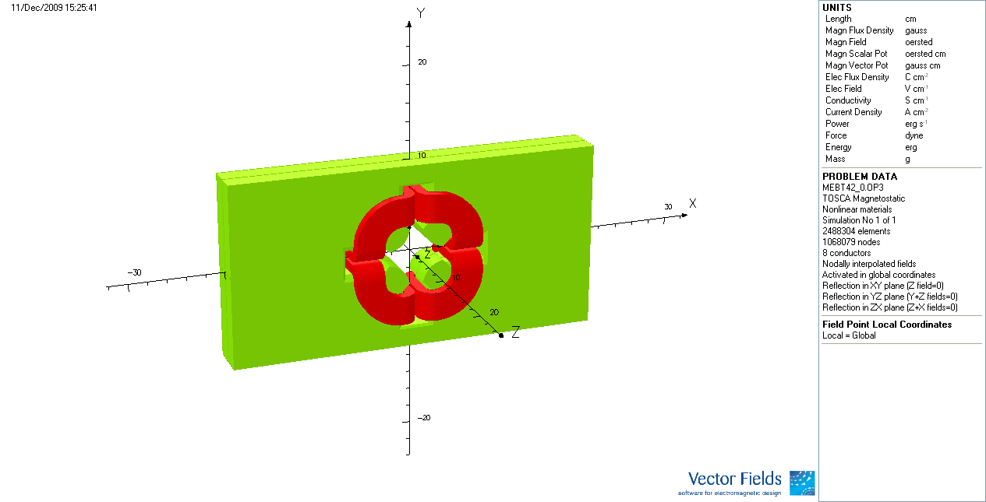
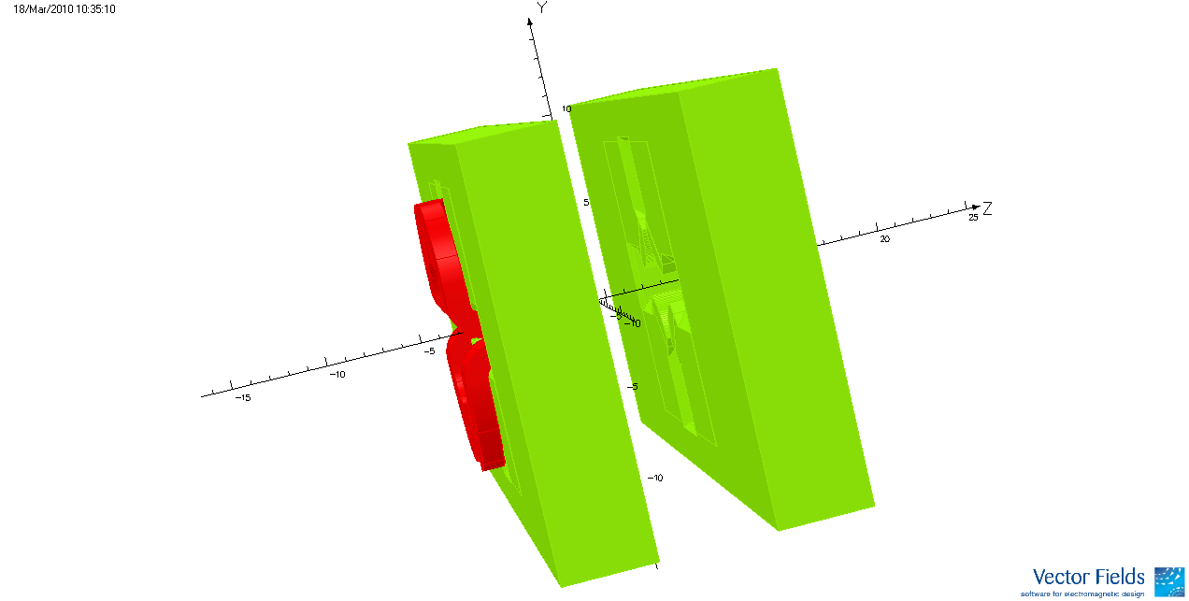
MEBT42 simulation models
A single MEBT42
for fringe field study
Two MEBT42s
for interference study
(10 cm apart)

Slide 6
Field distributions of MEBT42 quads
A single MEBT42
A single MEBT42
3D multipole expansion yields:
Linear quadrupole term;
Pseudo-octupole term;
Dodecapole term;
….
Two MEBT42s

Slide 7
Linear Particle Optics of MEBT42
Transfer matrices of
a single MEBT42
(z from -0.2 to 0.2 m)
Transfer matrices of
two MEBT42s in interference
(z from -0.2 to 0.2 m)
Relative differences between linear optics and design hard edge models
 | Focus | Defocus
δM₁₁ | 18.49% | 0.64%
δM₂₁ | -1.71% | 1.63%
δM₁₂ | 1.56% | 0.05%
δM₂₂ | 18.49% | 0.64%
 | Focus | Defocus
δM₁₁ | 22.39% | 0.35%
δM₂₁ | -2.18% | 0.64%
δM₁₂ | 1.96% | -0.19%
δM₂₂ | 29.62% | -0.01%

Slide 8
Hard edge models for a single MEBT42 quad

Slide 9
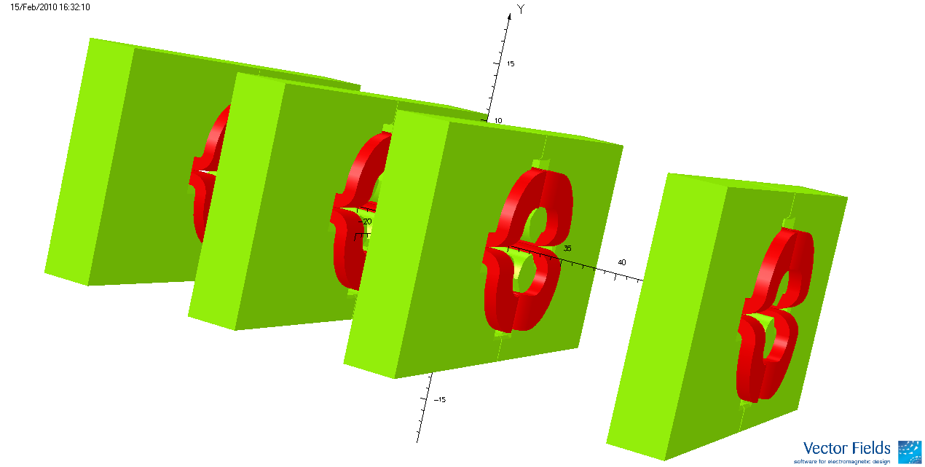
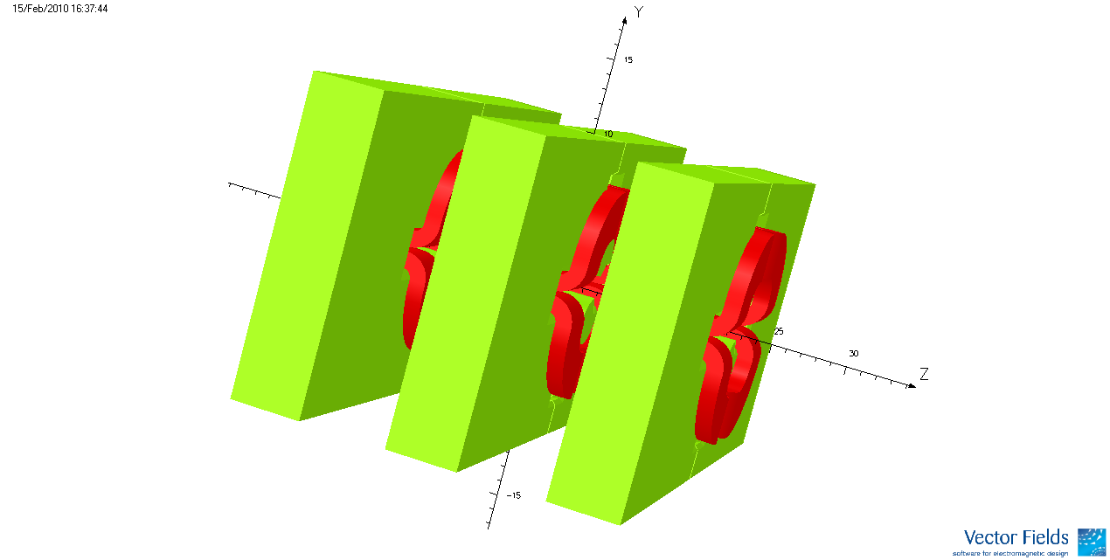
3D simulation models of half MEBT line
MEBT42 Assembly
Q1
Q2
Q3
Q4
MEBT32 Assembly
Q5
Q6
Q7

Slide 10
Hard edge models from design and linear optics

Slide 11
Principle rays in first half MEBT lattice from linear particle optics and design hard-edge models
M12(z) and M22(z) for the x-motion
from two different models
M21(z) and M22(z) for the y-motion
from two different models
At z=1.64 m (MEBT lattice center):
The relative difference in M12 is 41%, while M22 has opposite signs
At z=1.64 m (MEBT lattice center):
The relative difference in M21and M22 is 84% and 704%, respectively.

Slide 12
Beam envelope in first half MEBT lattice from linear particle optics and design hard-edge models
Beam envelope amplitude
from two different models
Beam envelope slope
from two different models
At z=1.64 m (MEBT lattice center):
The envelope amplitudes are fairly close from two difference models
At z=1.64 m (MEBT lattice center):
The relative difference in X_{m}’ is 50%, while Y_{m}’ has opposite signs.

Slide 13
The z-dependent transfer functions for matching
Definition:
The linear focusing function per unit current.
Generation:
- Through 3D magnet modeling and multipole expansion;
- The shape remains and the amplitude changes linearly with current;
- There are 11 independent functions for 14 MEBT quads.
Linear Superimposition:
Correction for magnet core saturation:
Can be made if the saturation properties are known from measurements or simulations

Slide 14
Linear focusing function of first half MEBT lattice from 3D models and superposition

Slide 15
A full 3D beam dynamic model with space charge
(T. P. Wangler, RF Linear Accelerators)
Where k_{x}(z) = k(z)-k_{c}(i) and k_{y}(z) = k(z)+k_{c}(i)
k_{c}(i) is transverse defocusing constant of the 4 cavities (i=1,2,3,4);
k_{z}(z)= k_{z}(i) is longitudinal focusing constant of the cavities;
K3=1.512*10⁻⁸ m is a 3D space-charge parameter for a 38 mA H⁻ beam;
is an ellipsoid form factor.

Slide 16
A 38 mA H⁻ beam envelopes matched with the superimposed transfer functions

Slide 17
Conclusions:
Conventional hard-edge models for quads with large apertures and densely installed are incorrect.
Correct hard-edge models based on linear particle optics can be obtained through 3D magnet modeling and 3D multipole expansion.
For beam matching, smooth, overlapped, z-dependent transfer functions should be generated and employed.
3D magnet simulations are the only way to accomplish these tasks; Though magnet measurements are important for checking simulation accuracy, the existing techniques can not produce desired data for these applications.

Slide 18
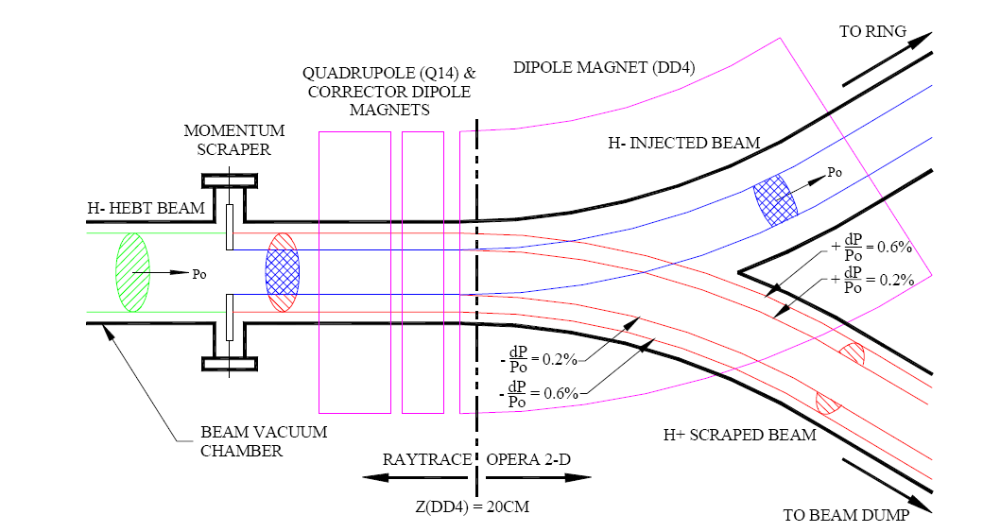
SNS ring injection momentum collimation (courtesy of P. He et al of BNL)

Slide 19
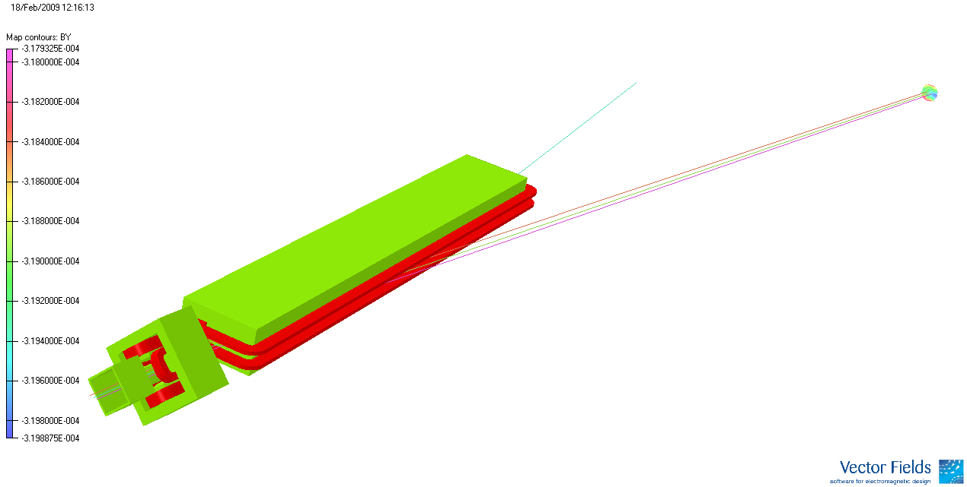
3D simulation model of momentum dump line
H⁻ particle for injection;
DH14 bending angle: 11.25º
Dump window
Scraped proton particles

Slide 20
Reference trajectory for stripped proton beams

Slide 21
3D multipole expansion about reference trajectory
Dipole field B1 at R = 4 cm
and its linear term b1(z),
leading to the curvature of reference trajectory
Quadrupole field B2 at R = 4 cm
and its linear term 2*b2(z)*4,
leading to the linear focusing function along reference track

Slide 22
Linear Particle Optics – Transfer Matrices
Skew terms are small
and can be neglected

Slide 23
Transfer Matrix Calculations
Test particle approach :
About a reference trajectory;
In LCS of a moving frame;
3 test particles for x-motion;
2 test particles for y-motion;
Numerical results:
Approach by Equation of motion:
Where k(s)=2*b₂(s)/B_{ρ}
h(s)=b₁(s)/B_{ρ}

Slide 24
Particle distributions at scrapper and dump window
in the x-x’ phase space
in the y-y’ phase space

Slide 25
Initial particle positions at the scrapper (blue) and final positions at dump window (red)

Slide 26
Summary
3D modeling and 3D multipole expansion are performed for the SNS momentum dump line to obtain field distributions around a reference trajectory;
Linear particle optics – transfer matrices are obtained through test particle approach and the equation of motion;
Particle distributions on the dump window can be calculated with the transfer matrices.

