Slide 1
Helical Solenoids for Helical Cooling Channels
Mauricio Lopes
Fourth Special Workshop on Magnet Simulations

Slide 2
Outline
Introduction
HCC parameters
High field section case study
Correction coil
Coil separation for RF placement
Tuning
Conclusions

Slide 3
Introduction
Helical cooling channels (HCC) based on a magnet system with superimposed solenoid and helical dipole and gradient, and a pressurized gas absorber in the aperture has been proposed to achieve the high efficiency of 6D muon beam cooling.
The total phase space reduction of muon beams is on the level of 10⁵-10⁶.
To reduce the equilibrium emittance the cooling channel was divided into several sections and each consequent section has a smaller aperture and stronger magnetic fields.

Slide 4
Particle dynamics in HCC*
Larmor motion
f
f
e
m_{μ}
= - p_{ϕ}.B_{z}
f
p_{ϕ}
B_{z}
ρ =
Larmor center
ρ
Radial equation of motion with helical dipole
HCC magnet center
f = +
f
f
e
m_{μ}
a
= (p_{z}.B_{ϕ} -p_{ϕ}.B_{z} )
f = γ mr′′- γ mrω²
Particle motion in stable orbit
* Y. Derbenev and R. Johnson, “Six-Dimensional Muon Cooling Using a Homogeneous Absorber”, Phys. Rev. ST AB, 8, 041002 (2005)

Slide 5
Particle dynamics in HCC*
Dispersion factor
Important parameters to design HCC:
Stability condition is
* Y. Derbenev and R. Johnson, “Six-Dimensional Muon Cooling Using a Homogeneous Absorber”, Phys. Rev. ST AB, 8, 041002 (2005)

Slide 6
Helical cooling channel parameters*
Parameter |  |  | Section
 |  |  | 1st | 2nd | 3rd | 4th
Total length |  | m | 50 | 40 | 30 | 40
Period |  | mm | 1000 | 800 | 600 | 400
Orbit radius |  | mm | 159 | 127 | 95 | 64
Solenoidal field | B_{z} | T | -6.95 | -8.69 | -11.6 | -17.3
Helical dipole | B_{t} | T | 1.62 | 2.03 | 2.71 | 4.06
Helical gradient | G | T/m | -0.7 | -1.1 | -2.0 | -4.5
B_{coil} ≈ 21 T
+ operation margin
* K. Yonehara et al, “Studies of a Gas-Filled Helical Muon Cooling Channel”, Proc. of EPAC2006, Edinburgh, Scotland.

Slide 7
Geometry vs. Performance

Slide 8
Geometry vs. Performance

Slide 9
Correction system
B_{z}
B_{t}
G
Solenoidal field excess
I (kA)

Slide 10
Correction system
HS Coil ID (mm) | HS Optimal coil thickness (mm) | HS Operation margin (%) | Straight solenoid nominal field (T)
100 | 200 | 12.9 | 11
120 | 150 | -1.4 | 8
140 | 110 | -17.4 | 6

Slide 11
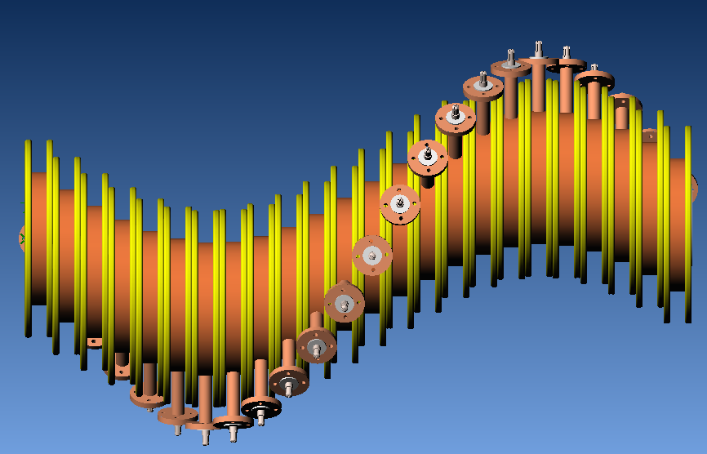
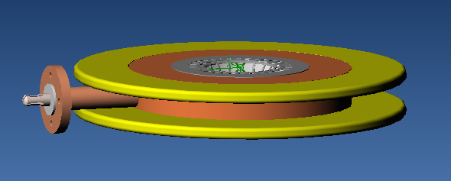
Coil separation

Slide 12
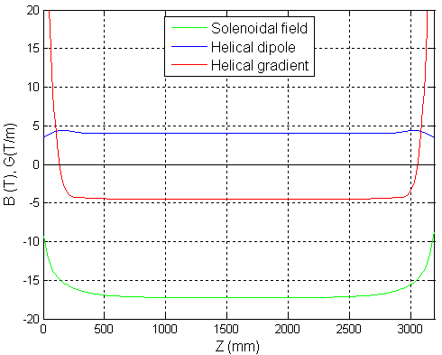
No spacing

Slide 13
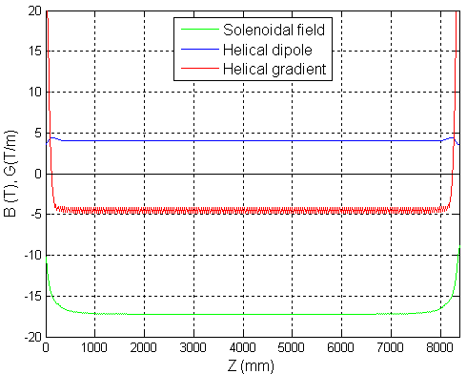
Spacing – type 0

Slide 14
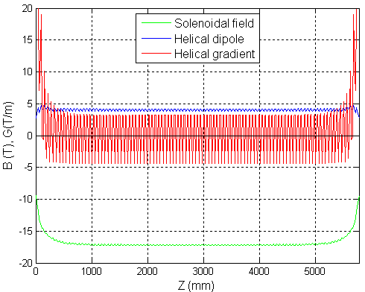
Spacing – type 1

Slide 15
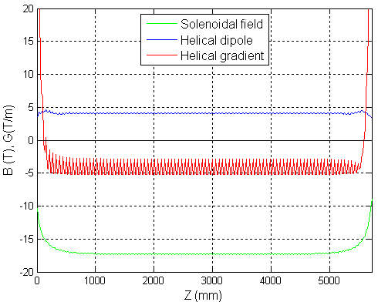
Spacing – type 2

Slide 16
Spacing – type 1

Slide 17
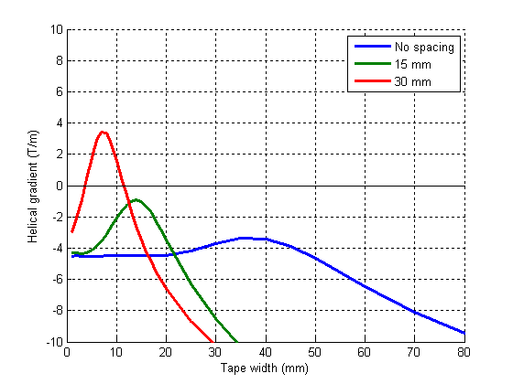
Helical gradient vs. Tape width

Slide 18
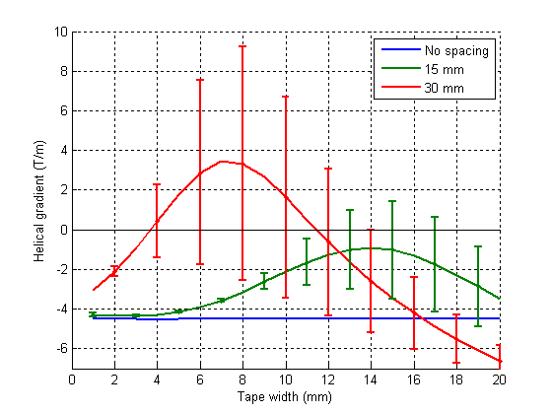
Helical gradient vs. Tape width

Slide 19
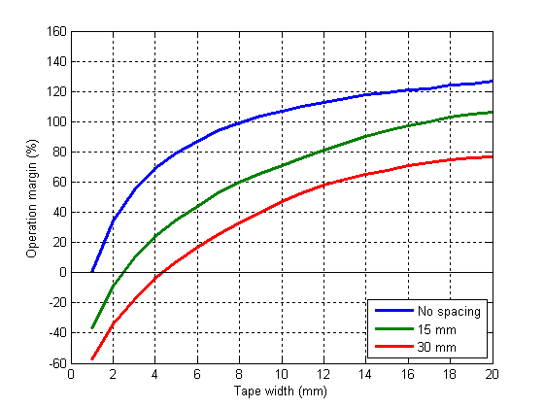
Op. Margin vs. Tape width @4.2 K

Slide 20
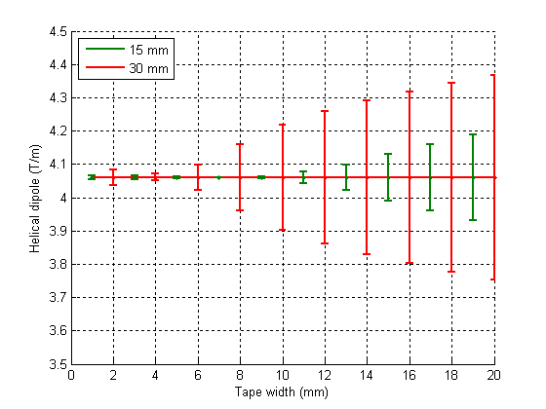
Helical dipole vs. Tape width

Slide 21
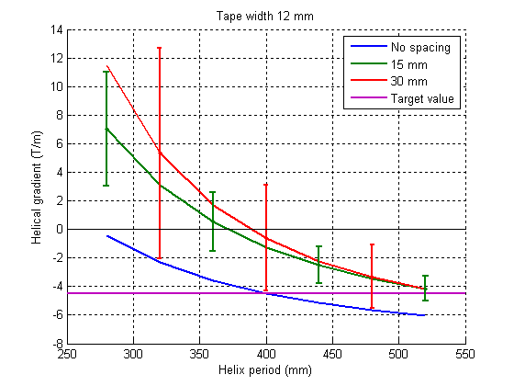
Helical gradient vs. Helix period

Slide 22
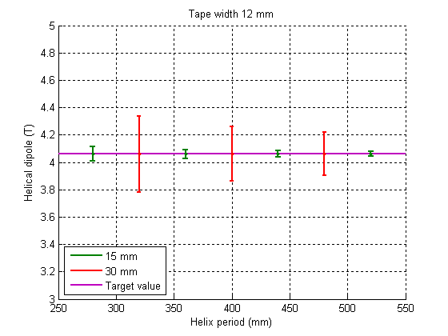
Helical gradient vs. Helix period

Slide 23
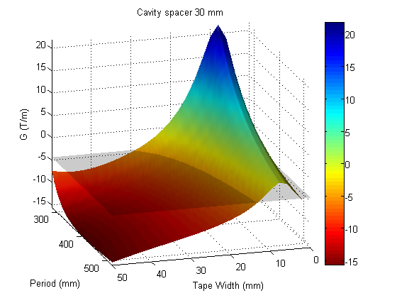
Helical gradient vs. Tape width vs. Helix Period

Slide 24
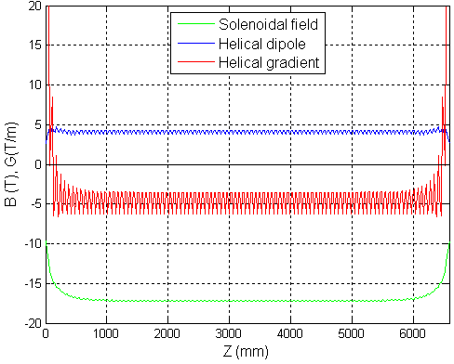

Slide 25
Conclusions
It was demonstrated that it is possible to match all the 3 components relying on the geometry and one correction system (SS).
Two “knobs” to adjust Bz and Bt independently, but none for G.
If a third “knob” is needed, it would lead to a more complicated correction systems.
Coil separation causes ripples in the field components. Helical gradient is the most affected.
Magnitude of the ripple and the mean value could be a problem for the cooling performance.

Slide 26
Conclusions cont.
The coil can be tuned by changing the coil longitudinal thickness or the helix period.
Thinner coils reduce the operational margin.
Wider coils increase the ripple in the helical dipole.
Longer period tends to tune the helical gradient to its target value. The ripple is also reduced.
Changes in the coil longitudinal thickness and in the helix period should be used to achieve smaller ripples.

