Slide 1
300 kHz and 5.1 MHz
AC Dipoles for Mu2e Beam Extinction
David Harding, Vladimir Kashikhin,
Alexander Makarov, George Velev,
Fermilab*
Fourth Special Workshop on Magnet Simulations for Particle Accelerators,
PAC 2011
*Operated by Fermi Research Alliance, LLC
under Contract No. De-AC02-07CH11359
with the United States Department of Energy

Slide 2
Extinction Requirement
~100 ns
~1.5 μs
Maximum allowable beam between pulses: 10⁻¹⁰
Prompt backgrounds
live window
Collimator
Dipole magnet(s)
Accelerator
Experiment
Put dipole(s) in resonant circuit with capacitor bank and run CW.

Slide 4
Issues
Power loss in core from hysteresis
Power loss in core from eddy currents
Cooling of core
  Manganese Zinc or Nickel Zinc ferrite?
Power loss in conductor
Cooling of conductor
  Hollow or stranded conductor?
Electrical insulation

Slide 5
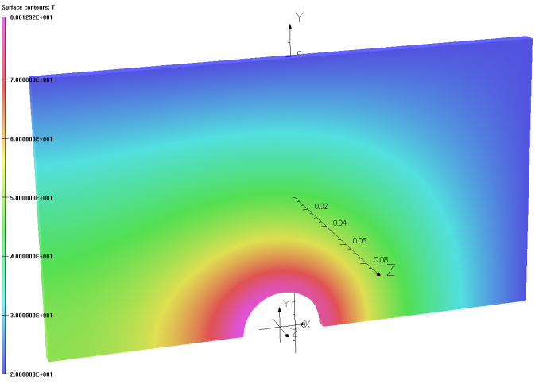
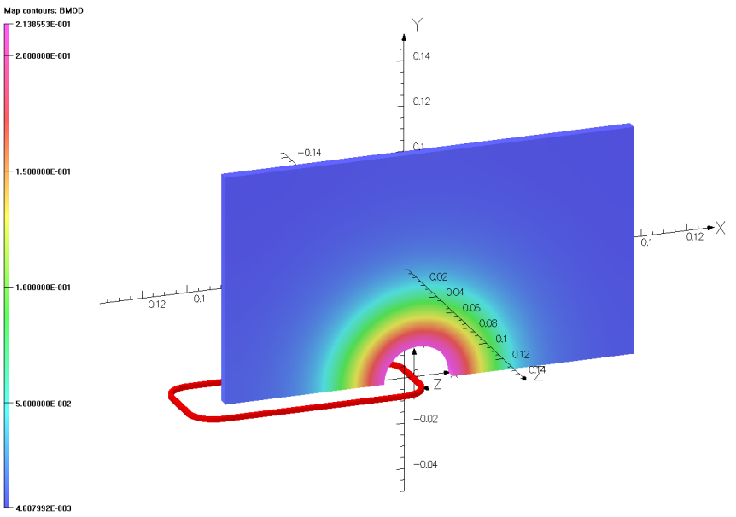
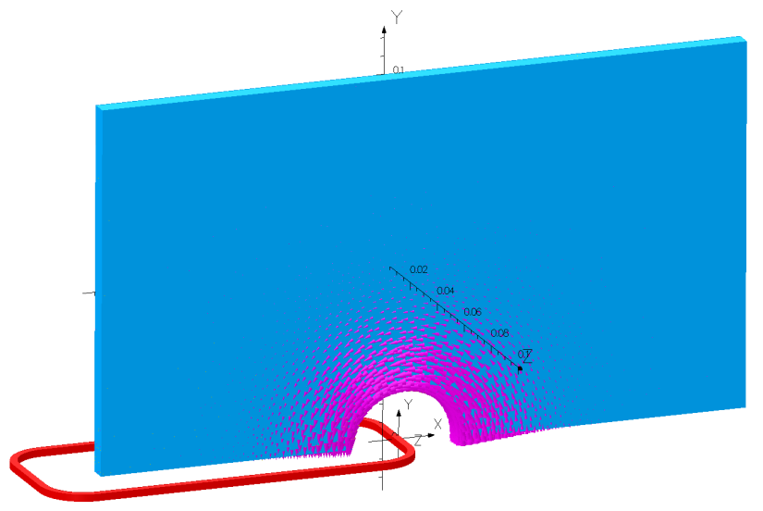
Magnetic Design for Ferrite Sample Tests
ELEKTRA Transient field simulation
Temperature vs. time analysis by TEMPO
Temperature distribution T=f(t) at 15 w losses
Ferrite magnetic properties were investigated by using a single plate approach.
Ferrite magnetic permeability depends on the flux density, frequency, temperature, and geometry.
Measured ferrite plate properties were used for the full scale model design.
Flux density at t=0.8 µs, I=2.5 A

Slide 6
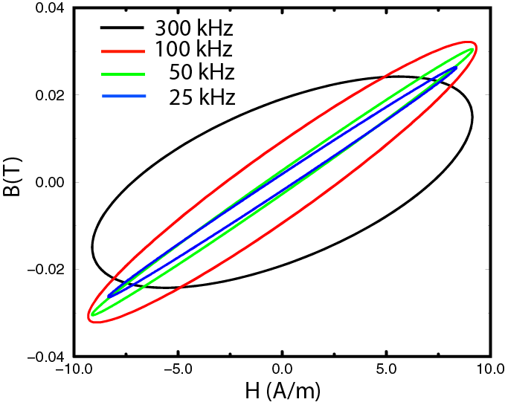
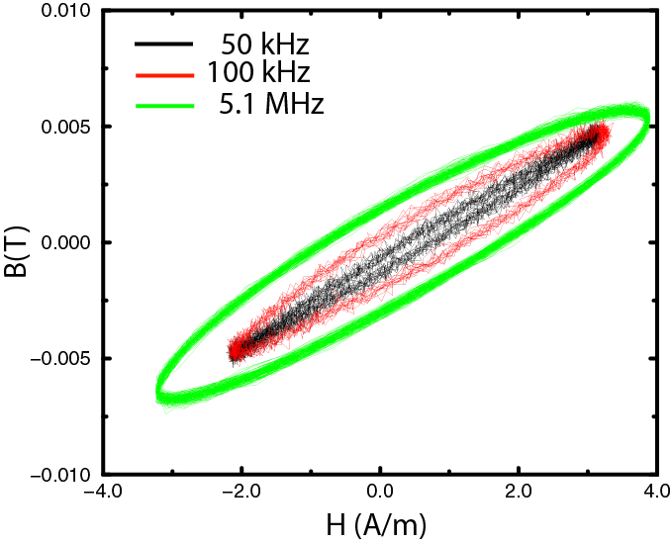
Power losses in sample blocks
B-H curve for MnZi ferrite blocks measured at four frequencies
B-H curve for NiZn ferrite block measured at three frequencies

Slide 7
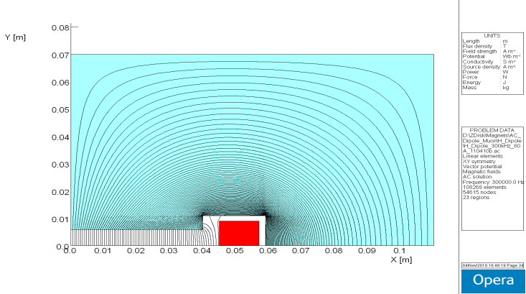
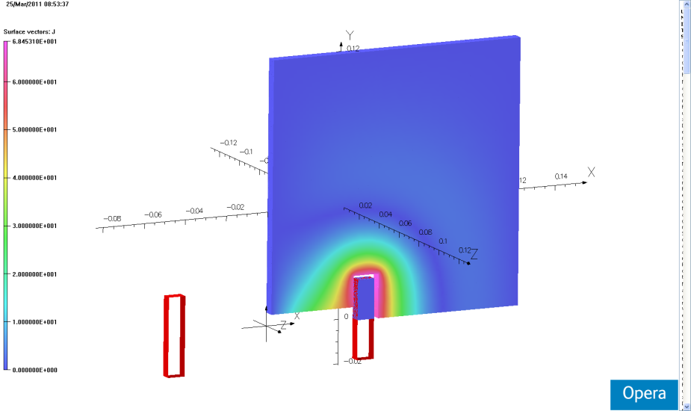
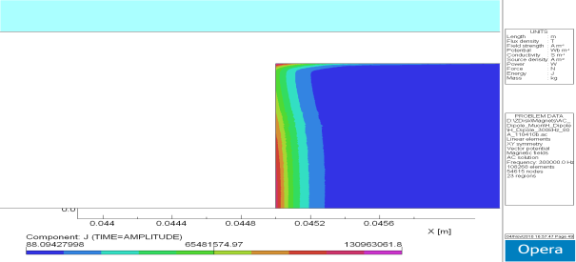
MnZn or NiZn Ferrite?
ELEKTRA eddy currents in MnZn
OPERA 2D for NiZn ferrite
Flux density.
Current density.
Skin depth at 300 kHz is only 0.13 mm.
MnZn Ferrite
Has lower power losses for small ring samples.
Conductive material and induced eddy currents overheat the areas with high flux density.
Ferrite plate should be 5 mm or less thick.
End plates in the magnet will have larger losses and heating proportional B**2.
It is difficult to cool down the ferrite area close to the conductor.
NiZn Ferrite
Has higher power losses for small ring samples.
Low conductivity material and no induced eddy currents. More predictable properties.
Ferrite plate could be thick.
End plates in the magnet will have larger losses which defined only by hysteresis at larger end fields.
Hollow, water-cooled conductor in direct contact with ferrite provides cooling.

Slide 8
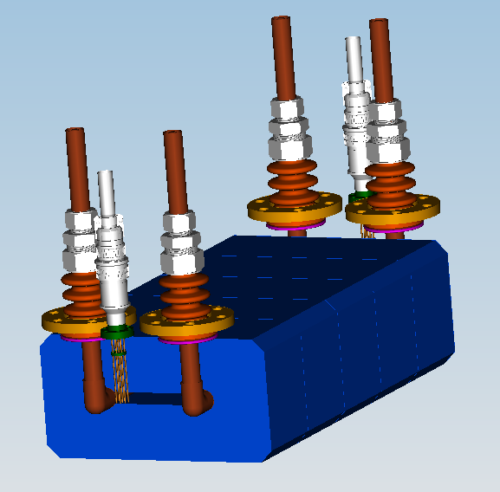
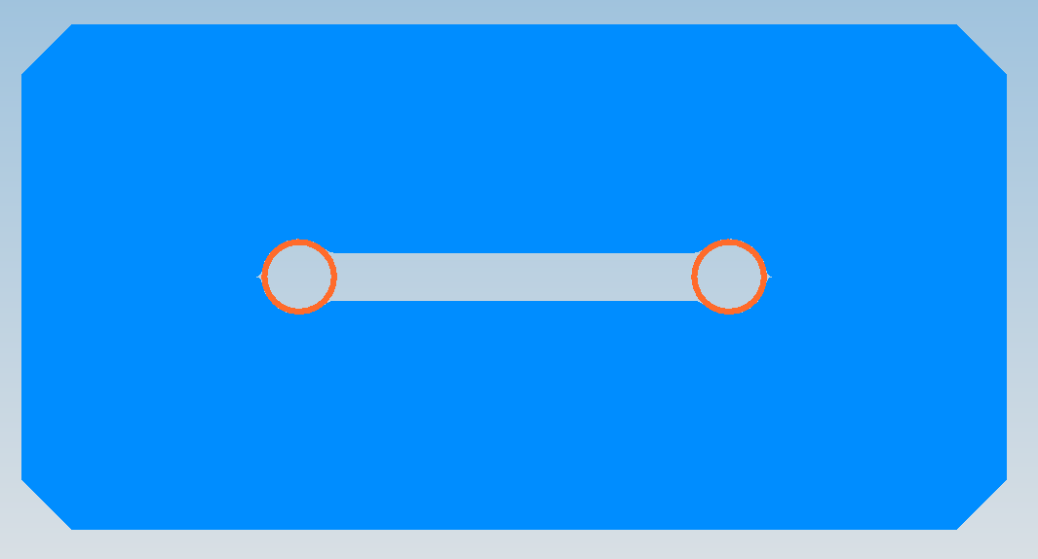
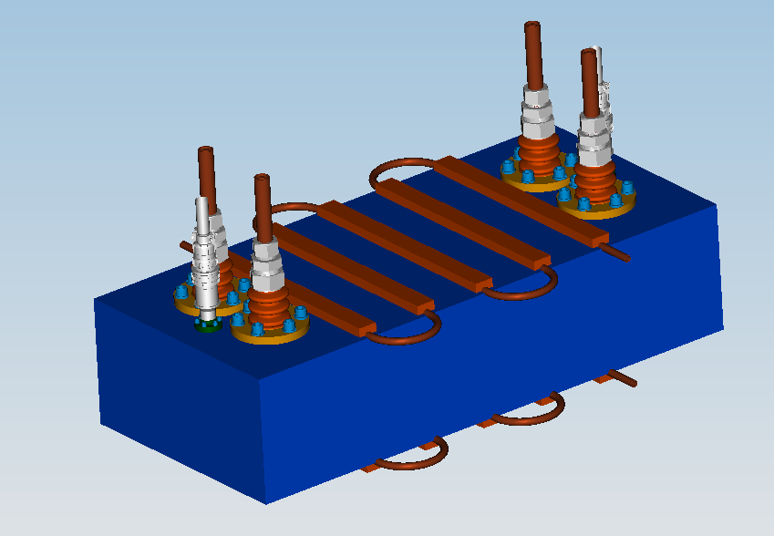
Next step: Prototype Magnet
NiZn ferrite
Hollow conductor

