Slide 1
Long Quadrupole
Giorgio Ambrosio
DOE Review of the LARP Program
June 2nd, 2011
BNL - FNAL - LBNL - SLAC
LQ Task Leaders:
Fred Nobrega (FNAL) – Coils
Jesse Schmalzle (BNL) – Coils
Paolo Ferracin (LBNL) – Structure
Helene Felice (LBNL) – Instrumentation and QP
Guram Chlachidize (FNAL) – Test preparation and test
Notes:
1

Slide 2
Magnet Development Chart
Completed
Ongoing
Starting

Slide 3
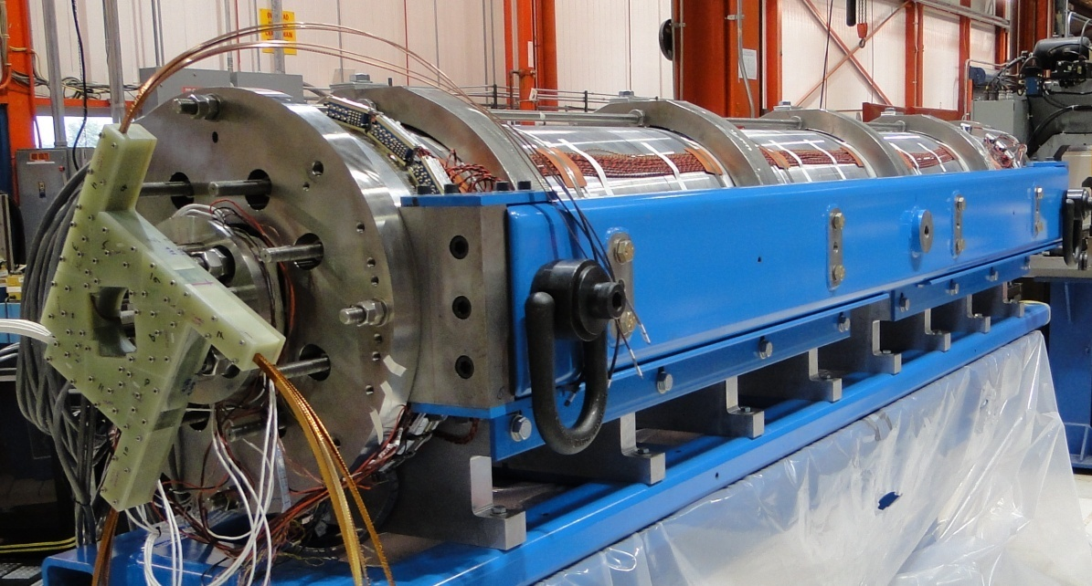
Long Quadrupole†
Main Features:
Aperture: 90 mm
magnet length: 3.7 m
Target:
Gradient: 200 T/m
Goal:
Demonstrate Nb₃Sn magnet scale up:
  Long shell-type coils
  Long shell-based structure (bladder & keys)
  Deadline: by the end of 2009
LQS01 S.S.L. | 4.5 K
Current | 13.7 kA
Gradient | 240 T/m
Peak Field | 12.25 T
Stored Energy | 460 kJ/m
† LQ Design Report available online at:
https://plone4.fnal.gov/P1/USLARP/MagnetRD/longquad/LQ_DR.pdf

Slide 4
LQ Fabrication Process
Cable:
  Cabling: LBNL
  Qualification tests: BNL, FNAL, LBNL
Coils:
  Wind & curing: FNAL
  Reaction & impregnation, BNL, FNAL
  Instrumentation: BNL, FNAL, LBNL
Structure:
  Pre-assembly & magnet assembly: LBNL
Test:
  Warm and cold test: FNAL

Slide 5
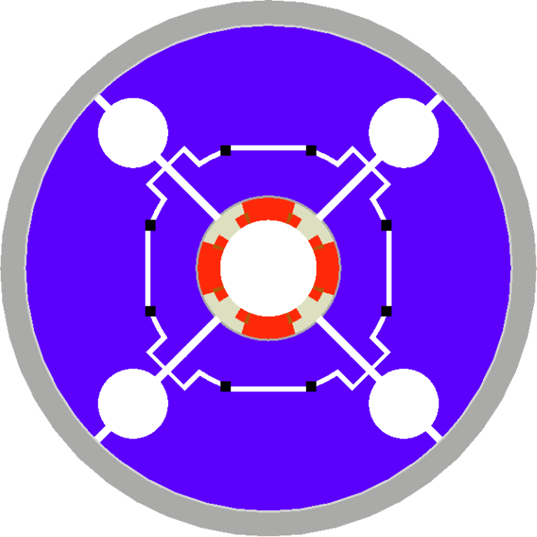
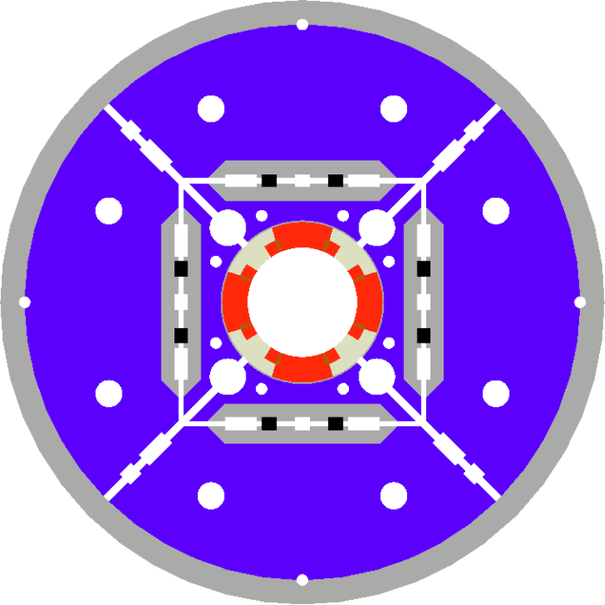
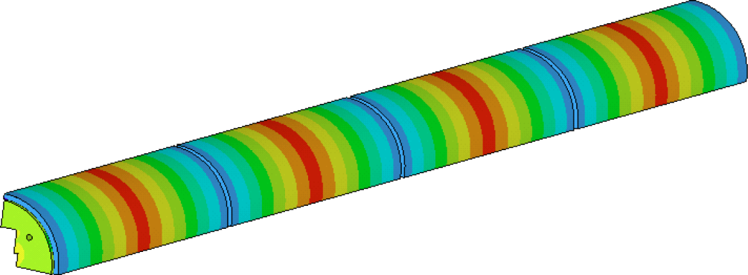
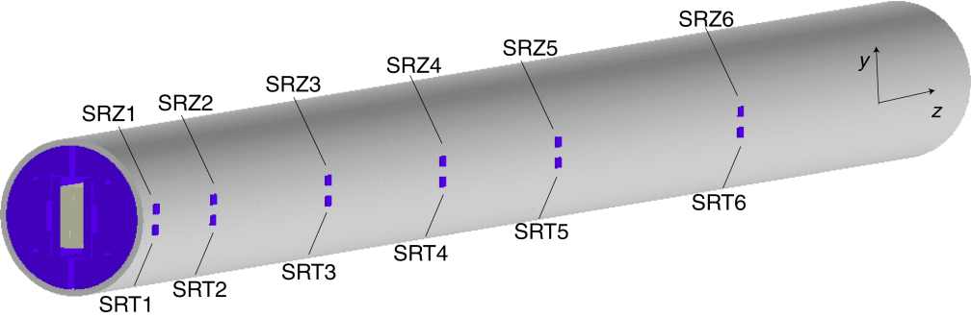
LQ Structure†
LQS is based on TQS (1m model)
and Long Racetrack (4m)
TQS Modifications:
  Added masters
  Added tie-rods for yoke & pad laminations
  Added alignment features for the structure
  Rods closer to coils
  Rods made of SS
Aluminum shell
TQS
LQS
  Segmented shell (4)
† P. Ferracin et al. “Assembly and Loading of LQS01, a Shell-Based 3.7 m Long Quadrupole Magnet for LARP” to be published in IEEE Trans. on Applied Superconductivity.

Slide 6
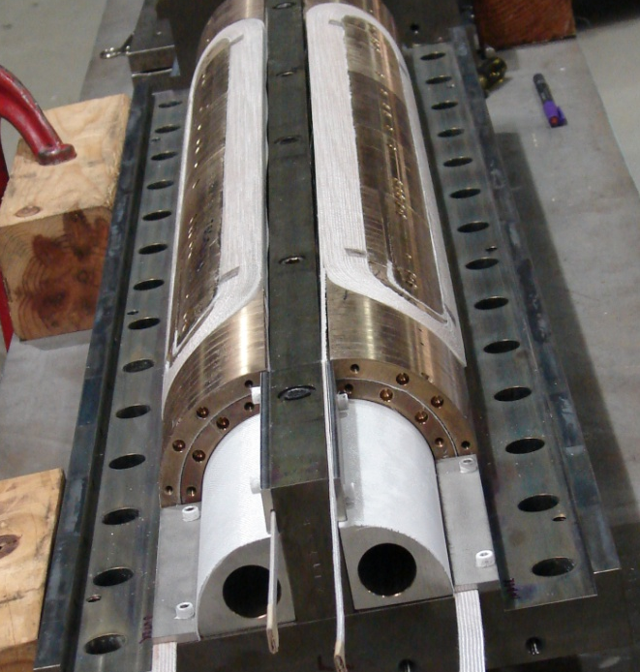
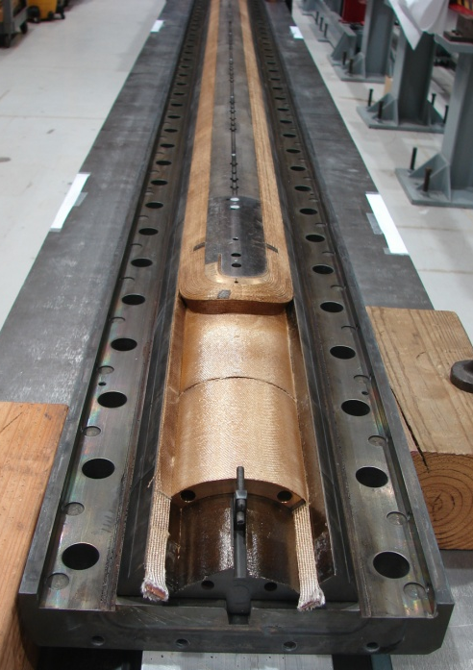
LQ Coils†
Coil design:
  LQ coils = long TQ (1m) coils with gaps to accommodate different CTE during HT
Fabrication technology:
  From 2-in-1 (TQ coils) to single coil fixtures (LQ)
  Mica during heat treatment
  Bridge between lead-end saddle and pole
Cross-section of TQ/LQ coil
LQ Coil Fabrication:
5 practice coils (1 Cu and 4 Nb₃Sn)
coils #6-#9 ➔ LQS01
coils #10-#13 ➔ LQS02
Note: coils #6-#9 had 3 severe discrepancies
† G. Ambrosio et al. “Final Development and Test Preparation of the First 3.7 m Long Nb3Sn Quadrupole by LARP” to be published in IEEE Trans. on Applied Superconductivity.

Slide 7
Scale up Lessons Learnt
Coil #02 (1st Nb₃Sn): bowing after HT
  added mica (less friction) and stiffener plate (more rigid tooling)
Coil #03: longitudinal tension in coil by pole
  added longitudinal gaps (accommodate coil contraction during HT and different CTE coil-pole)
Coil #04 & #05:
  fine tuning of longitudinal gaps
Coil #06: incomplete impregnation
  added soak time to potting cycle
Coil #07: stopped argon flow due to power outage
  modified argon supply line
Coil #08: No major issues
Coil #09: Midplane insulation stuck to potting fixture
  changed mold-release
Coil #10-18 (in progress) : No major issues
Practice
LQS01

Slide 8
LQS01 Internal Readiness Reviews
GOAL: Assess readiness for LQS01 assembly (by evaluating: choice of coils, structure, target pre-stress and assembly procedure) and test (test facility and test plan)
#1: “LQS structure and target pre-stress”
  April 7, 2009 at LBNL with video-link
#2: “LQ coil design and fabrication”
  June 17, 2009 at FNAL with video-link
#3: “LQS01 pre-assembly”
  July 28, 2009 at LBNL with video-link
#4: “Test readiness and test plan”
    October 1, 2009 at FNAL with video-link

Slide 9
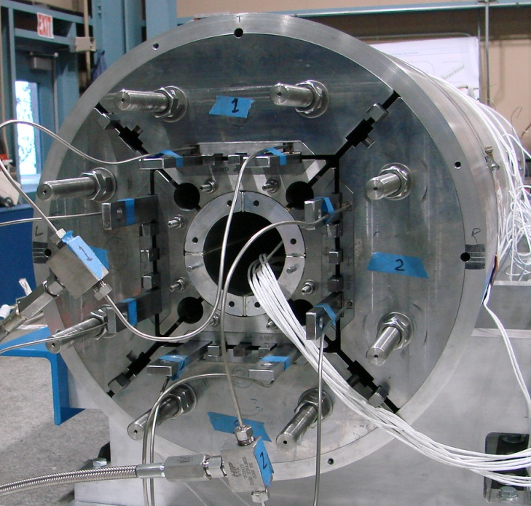
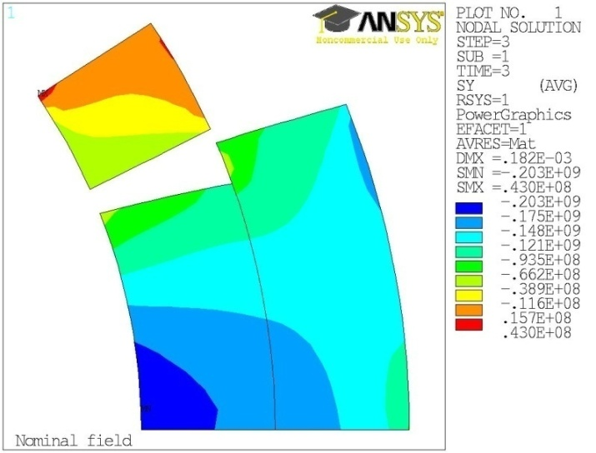
LQS01a Load & Cooldown
Pre-load
  Target stress on shell
  Target stress on roads
  Lower stress on coils ID
Cooldown
  Shell: close to target stress
  Rods: close to target stress
  Coil ID: ~ ½ target stress
  ➔ Could reach excessive stress on midplanes above 200 T/m
Azimuthal stress (Pa) at 200 T/m

Slide 10
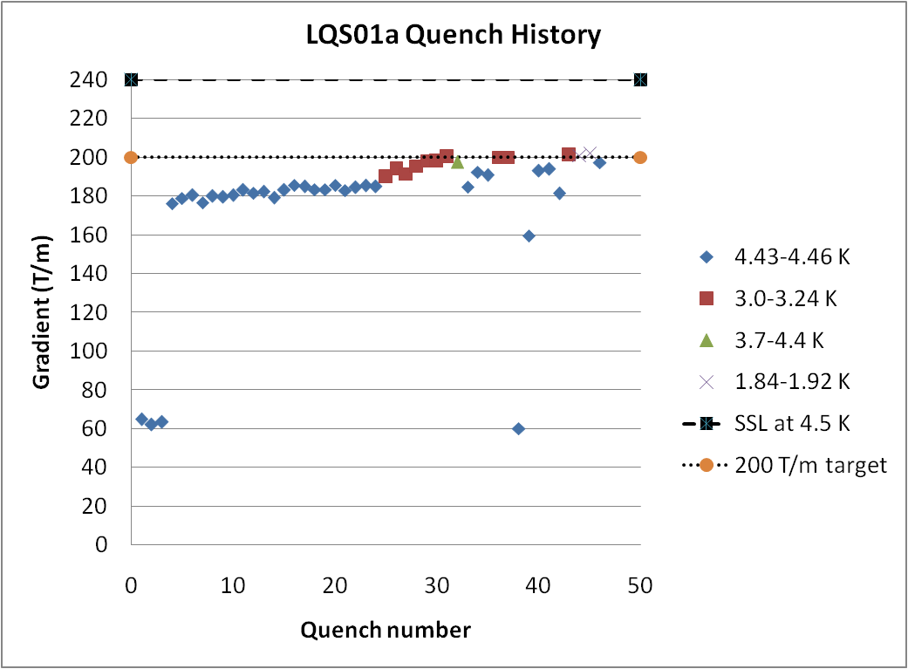
LQS01a Quench History
Slow start
  First quenches at high ramp rate (200 A/s)
  Slow training at 4.5K
    Due to low pre-load on pole turns
Faster training at 3K
  Reached 200 T/m
Stopped training
  to avoid coil damage and to achieve better performance with optimal pre-stress
SSL at 4.5K : 240 T/m
Target: 200 T/m
200 A/s
Test report available online at:
https://plone4.fnal.gov/P1/USLARP/MagnetRD/longquad/report/TD-10-001_LQS01_test_summary.pdf

Slide 11
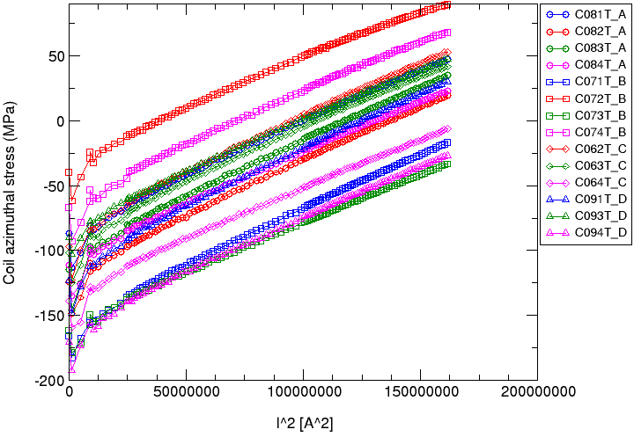
LQS01b (same coils of LQS01a)
More uniform prestress distribution in the coils
  By using thinner coil-pad shims
Higher preload based on 1m models (TQS03 a/b/c)
  Peak load: 190 MPa +/- 30
  No coil-pole separation in LQS01b

Slide 12
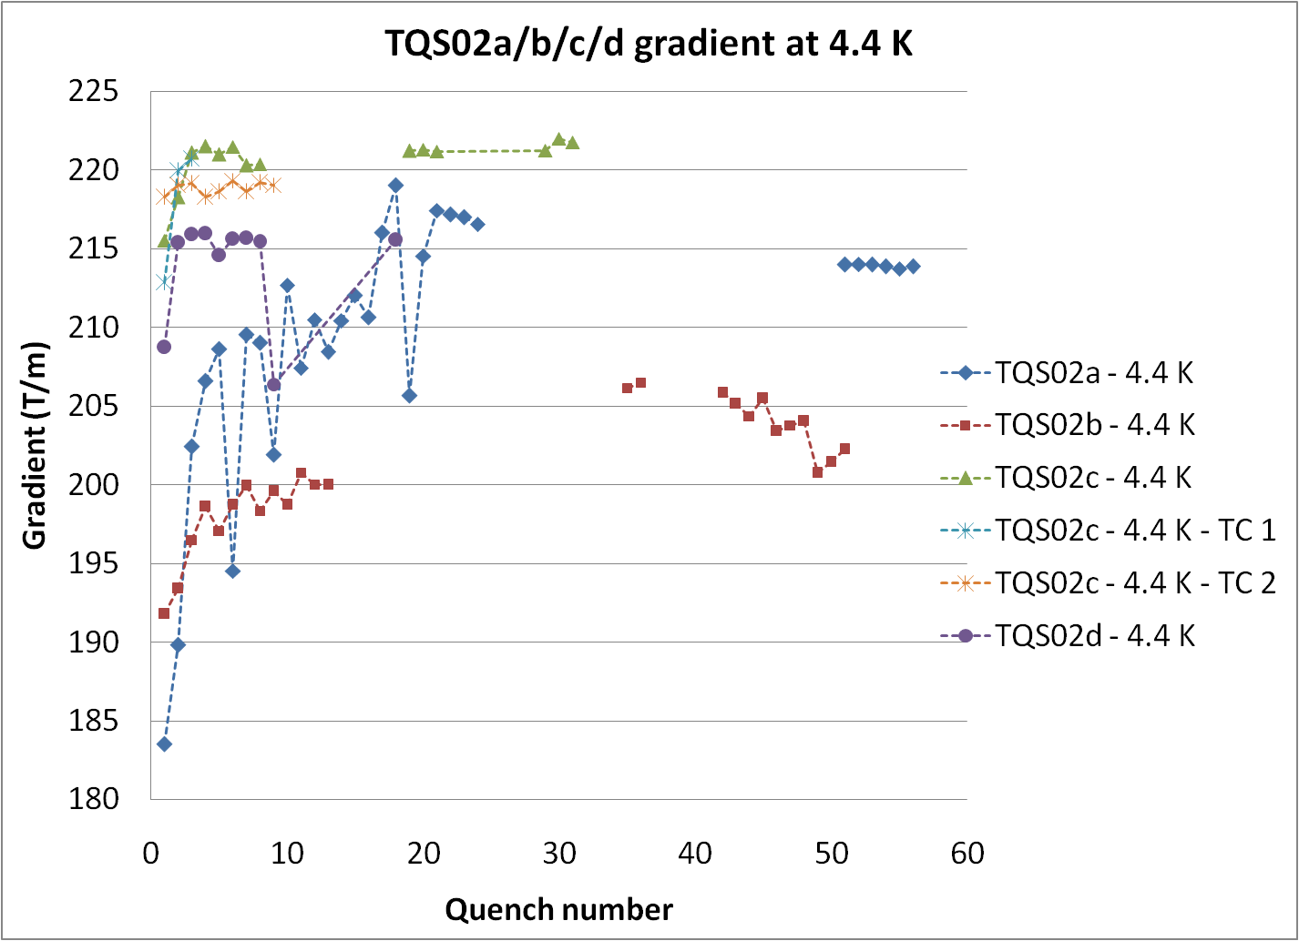
Gradient at 4.4K of all 1m models with RRP 54/61 strand

Slide 13
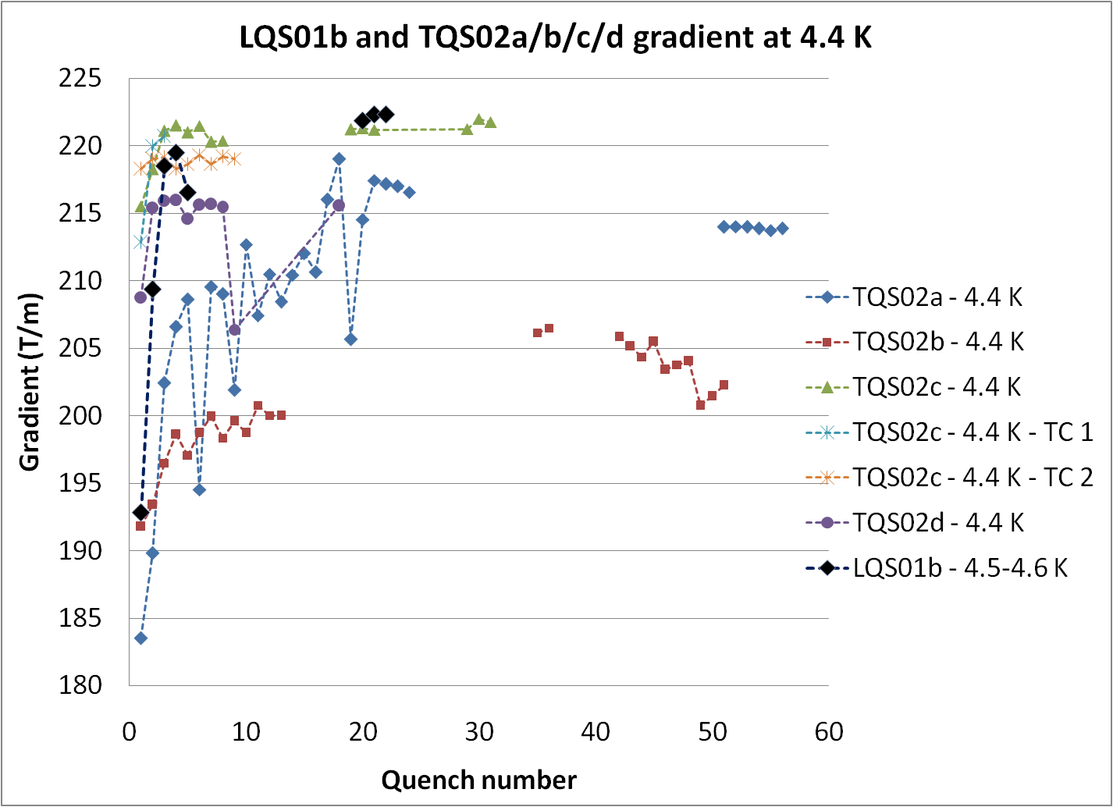
LQS01b: 220 T/m
in 4 quenches
Gradient at 4.4K of LQ & all 1m models with RRP 54/61
LQS01b: 222 T/m
92% ssl based on strand test
(95% ssl based on cable test)

Slide 14
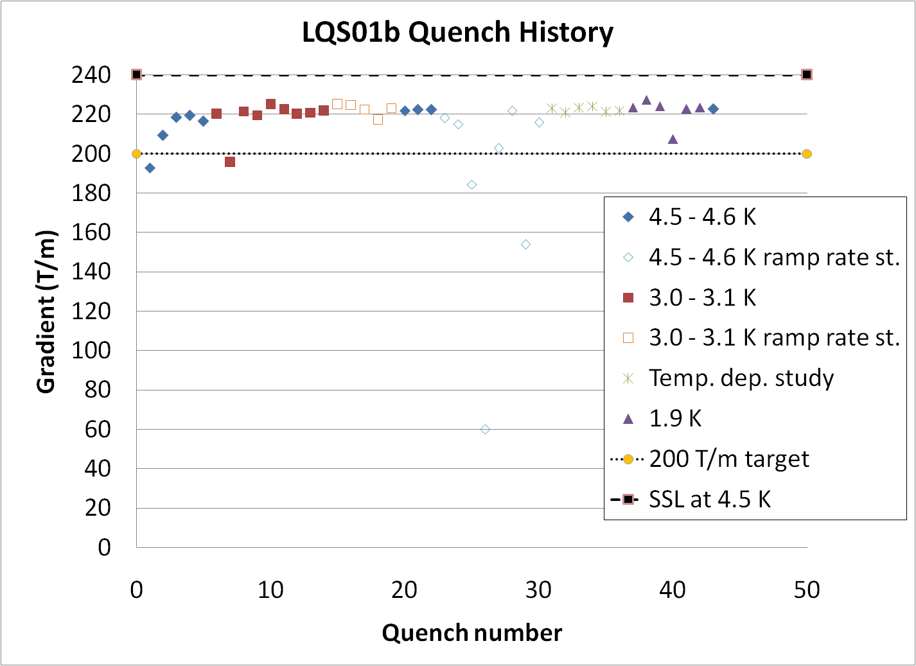
LQS01b Quench History
LQS01b Quench History
SSL at 4.5K : 240 T/m
227
Target: 200 T/m
At 4.5 K: reproducible quenches in coil #8
➔ Iq/Ic = 92 ssl
At 3 K: variable quench curr. in coil #6
➔ limited stability of conductor
At 1.9 K: variable quench curr. in coil #9
➔ limited stability of conductor

Slide 15
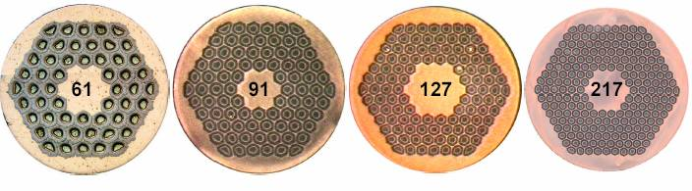
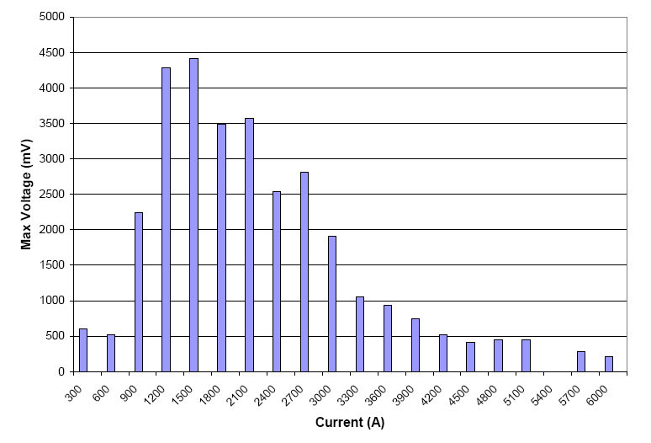
Voltage Spikes
Large voltage spikes
  Due to flux jumps
    Seen in TQ magnets using RRP 54/61
  Larger than in TQs
  ➔Variable quench detection threshold
  ➔Variable ramp-rate during training
    200 A/s ➔ 3 kA
    50 A/s ➔ 5 kA
    20 A/s ➔ 9 kA
    10 A/s ➔ quench
RRP 54/61
by OST
RRP 108/127
by OST
Will be eliminated or significantly reduced by using RRP 108/127
Maximum Voltage Spike amplitude at 4.5 K with 50 A/s ramp rate

Slide 16
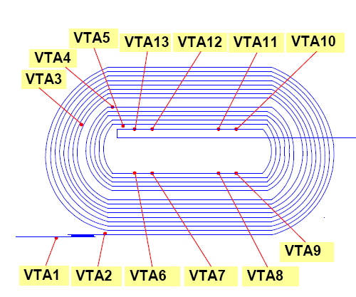
LQS01b Quench Location
Most training quenches in Inner Layer pole turn, with a few exceptions
Plateau quenches in pole turn of Outer Layer of coil 8
Quench # 3:
Coil8_B2_B3
Quench # 9:
Coil 6_B2_B3
6
9
7
8

Slide 17
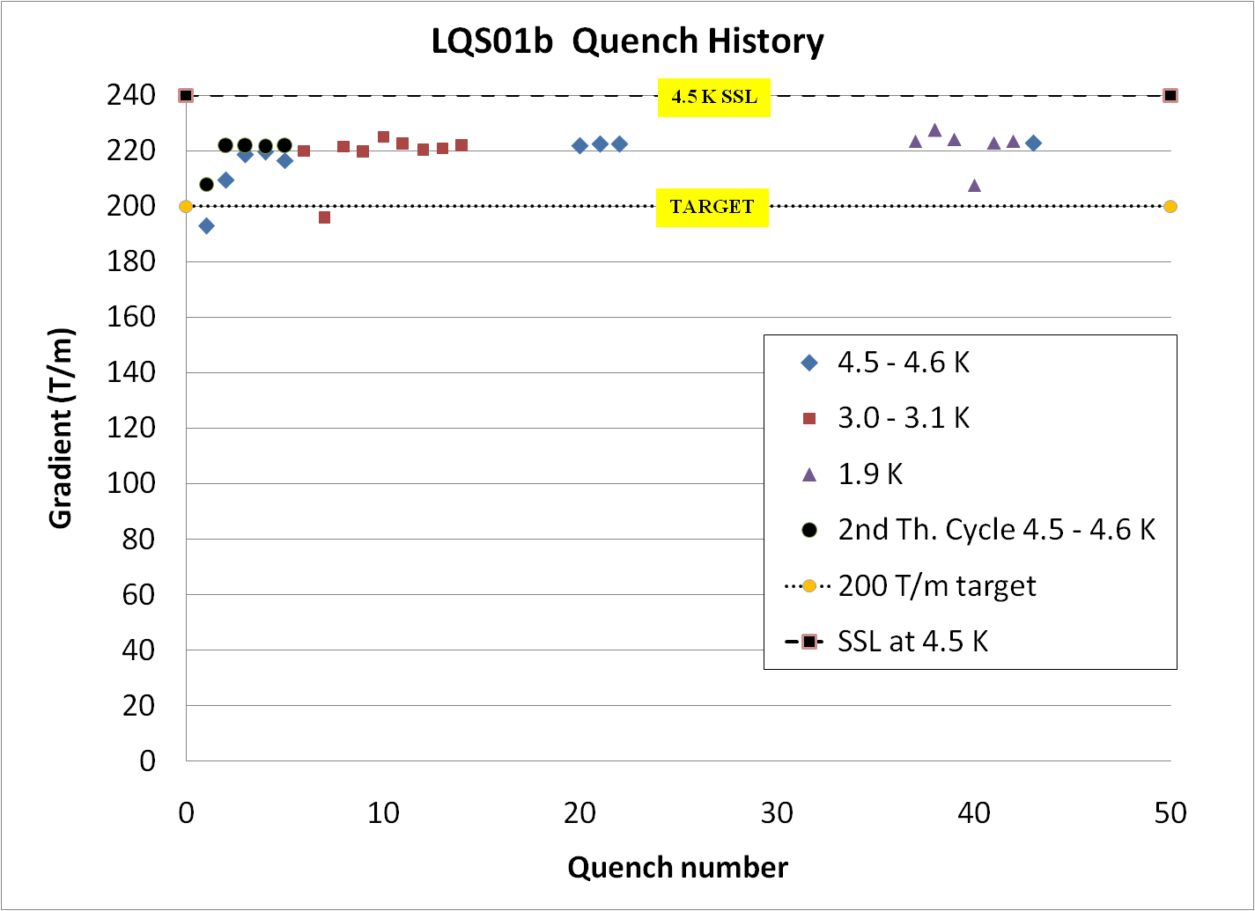
Test After Thermal Cycle
Good memory after thermal cycle with limited ΔT:
  G = 208 T/m in 1st quench after thermal cycle
  G = 222 T/m at 2nd quench after thermal cycle
  ΔT max = 100 K
Thermal cycle with unrestricted ΔT planned for LQS02

Slide 18
Magnetic Measurement
Magnetic measurement at 4.5K:
  Some are a few units different w.r.t. computed
  Similar to short models †
  Normal octupole (b₄) may have been affected by small differences in impregnation molds
    Two molds used
b_{n} a_{n} | TQS 1m |  |  | LQS 4m
 | calc. | measured |  | calc. | Measured
 |  | 01 | 02
b₃ | - | -1.46 | 2.98 | - | 3.43
b₄ | - | -0.52 | 1.31 | - | 6.20
b₅ | - | 3.06 | -1.45 | - | -0.16
b₆ | 5.00 | 5.40 | 6.23 | 8.45 | 10.43
b₇ | - | 0.07 | 0.05 | - | -0.10
b₈ | - | -0.11 | -0.13 | - | -0.58
b₉ | - | 0.02 | 0.10 | - | -0.14
b₁₀ | 0.04 | 0.02 | -0.05 | -0.03 | -0.32
a₃ | - | 4.41 | 0.66 | - | 2.11
a₄ | - | -1.99 | 0.82 | - | 1.34
a₅ | - | 0.71 | -1.50 | - | 0.48
a₆ | - | -0.37 | 0.12 | - | -0.37
a₇ | - | -0.11 | -0.01 | - | -0.30
a₈ | - | -0.18 | -0.10 | - | -0.09
a₉ | - | -0.02 | 0.02 | - | -0.55
a₁₀ | - | 0.00 | -0.08 | - | 0.24
† G. Velev, et al., “Field Quality Measurements and Analysis of the LARP Technology Quadrupole Models”, IEEE Trans. On Applied Supercond. , vol.18, no.2, pp.184-187, June 2008
Average harmonics in the TQS and LQS at 45 T/m (~ 2.6 kA) at the ref. radius r₀ of 22.5 mm

Slide 19
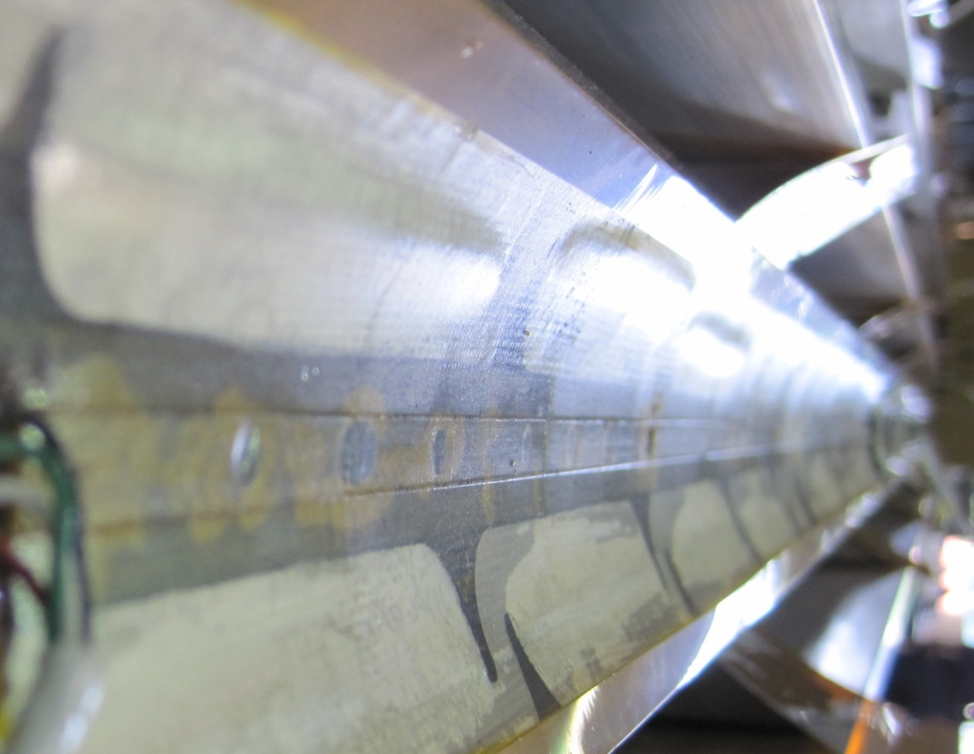
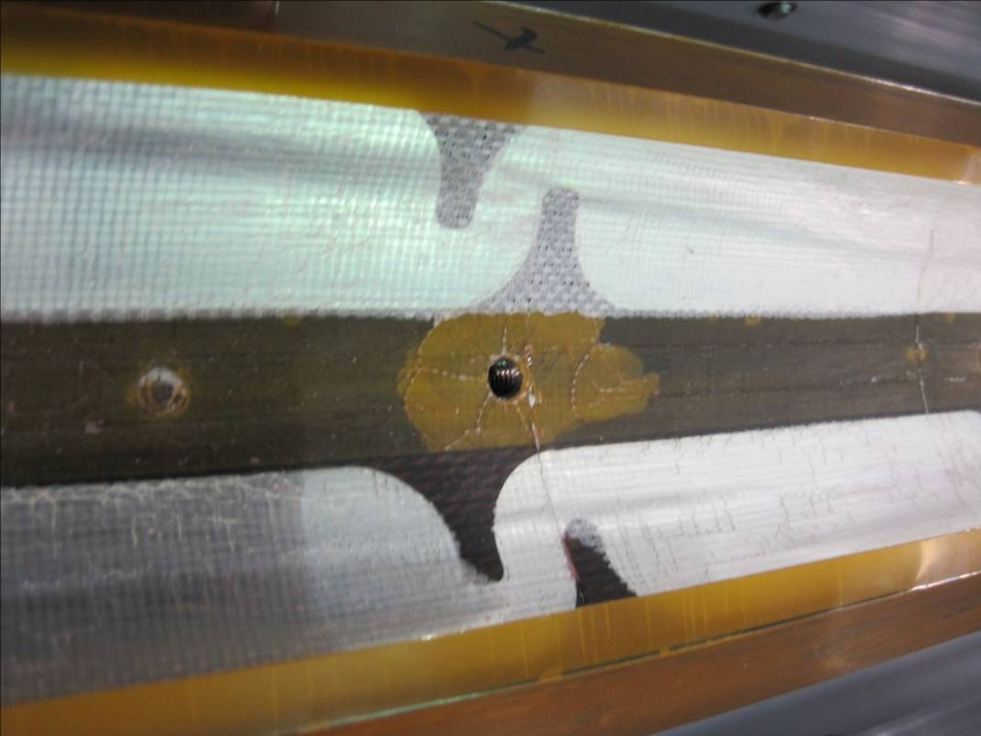
Coils after Test
Some “bubbles” on coils inner layer
  Coil-insulation separation
Possible causes:
  Superfluid helium and heat during quench
    Seen in TQ coils
  Heat from heaters on inner layer
    Only in LQ coils
Plans:
  Strengthen insulation
    coil #13 has 3 materials on ID
  Change heater location

Slide 20
LQS01b Results
LQS01 reached the best performance of all TQS02 series (1m models with same conductor)!
  With the first four LQ-production coils; three of which had “severe” discrepancies
  ➔ We know how to make and fix long Nb₃Sn coils
  Al-shell-based structure is providing support (up to 227 T/m and 92% of ssl) with no signs of limitation
  ➔ Segmented shell structure can be used for long Nb₃Sn magnets with shell-type coils
  Quench protection keeps hot-spot temperature below 260 K
  ➔ We have tools (computation & instrumentation) for protecting long Nb₃Sn magnets above 2.2K

Slide 21
Next Steps & Goals
LQS02 Readiness Review (October 26, 2010)
OK to use coils #10-13
Slightly smaller pre-stress than in LQS01b
LQS02a with new set of 54/61 coils:
  Demonstrate reproducibility, test memory after unrestricted thermal cycle
LQS02b options:
  Change limiting coil of LQS02a
  Test LQS w 4 coils made with the same mold
    May reduce octupole
  Test use of 4m keys & bladders (for longer magnets)
LQS03a/b with 108/127 coils:
  Demonstrate better performance below 4.5 K, and smaller voltage spikes
Need still some R&D:
  Reliable solution for protection heaters on inner layer at 2 K

Slide 22
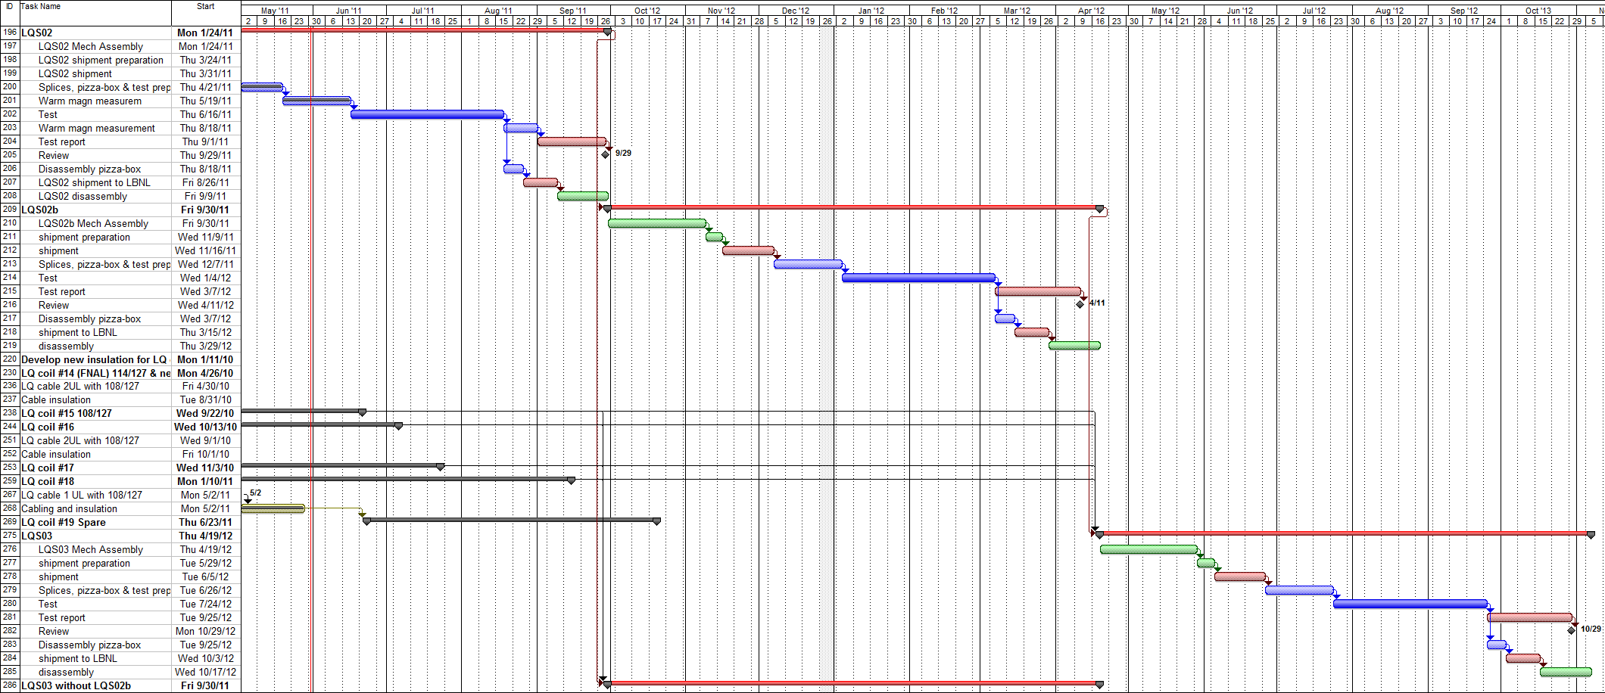
LQ Schedule
2011 | 2012
LQS02 test
LQS02b test
108/127 coils
LQS03 test
LQS03 test
LQ test turn around time: ~ 7 months
LQ test time: 2 months

Slide 23
Conclusions
The Long Quadrupole is demonstrating Nb₃Sn scale-up to 4 m
  With excellent results so far
  With no significant open issues
  Showing that we are still learning, and nonetheless have reached significant performance with the first LQ model
The next steps of the Long Quadrupole R&D are going to give a large contribution to the Nb₃Sn technology demonstration
  Together with other parts of the LARP program (HQ, LHQ ➔ 120 mm...),

