Slide 1
LARP Annual DOE Review
Eric Prebys, Fermilab
Director, US LHC Accelerator Research Program (LARP)

Slide 2
Outline
A few highlights since last review
Response to 2010 DOE review
Topics which won’t be discussed in detail

Slide 3
Some Highlights Since the Last Review*
LHC Operation
  Machine came up smoothly after the break
  Has now broken hadronic luminosity record by ~factor 3 (~1.2x10³³ cm⁻²s⁻¹)
Accelerator Systems
  All instrumentation working and mostly handed off to CERN
  Important progress regarding crab cavity plans
Magnet systems
  Electrical breakdown problems in HQ solved
  Recent test achieved 170 T/m (86% of short sample limit)
Personnel
  LARP LTV’s and Toohig Fellows continue to make important contributions to the LHC.
Big issue last time
*July 15-16, 2010

Slide 4
Context: Important Meetings Since Last Review
CM15 Collaboration Meeting, Nov. 2010, SLAC
  http://tinyurl.com/LarpCM15
LHC Performance Workshop, Jan. 2011, Chamonix
  http://tinyurl.com/Chamonix2011
LARP US/CERN Meeting, Feb. 2011, CERN
  http://tinyurl.com/LarpUSCERN2011
Annual DOE Briefing, Mar. 2011, Germantown
CM16 Collaboration Meeting, May 2011, Montauk, NY
  http://tinyurl.com/LarpCM16

Slide 5
Some Key Results From Chamonix (wrt LARP)
Energy=3.5+3.5
  Most anticipated decision, but no real effect on LARP
Schedule
  As expected, the LHC will run through 2012
    Good news for everyone involved with the shutdown
  Will delay “2016” and “2020” shutdowns
    Affects LARP, but not quantified yet.
Collimation
  Beam losses lower than anticipated, so existing collimation very effective.
  Will probably still be a place for rotatable collimators, but probably no need to increase LARP collimation involvement.
E-Cloud
  The SPS high bandwidth feedback system was discussed and the LARP effort specifically mentioned.

Slide 6
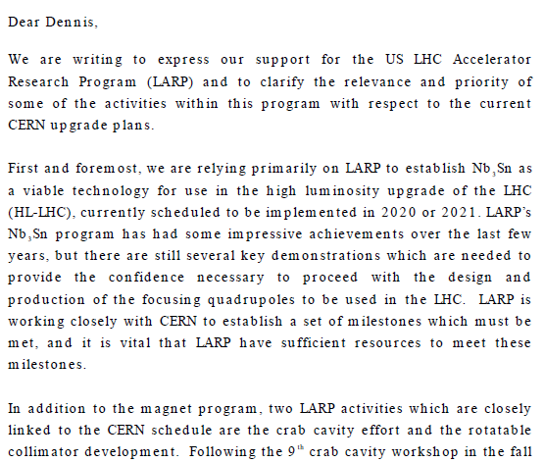

Relevance of LARP to CERN Upgrade*
Letter to Dennis Kovar, Head, DOE
Office of High Energy Physics, 17-August-2010
(…)
*letter suggested at review

Slide 7
HiLumi LHC Design Study
Upgrade planning will be organized under FP7, which authorizes EuCARD*,
  Centrally managed from CERN (Lucio Rossi)
  Non-CERN funds provided by EU
  Non-EU partners (KEK, LARP, etc) will be coordinated by HL-LHC, but receive no money.
Work Packages:
  WP1: Management
  WP2: Beam Physics and Layout
  WP3: Magnet Design
  WP4: Crab Cavity Design
  WP5: Collimation and Beam Losses
  WP6: Machine Protection
  WP7: Machine/Experiment Interface
  WP8: Environment & Safety
Significant LARP and other US Involvement
Over and above current collimation plan (IR3, 7 and Phase II)
*European Coordination for Accelerator R&D

Slide 8
Letter in support of HiLumi-LHC Design Study

Slide 9
Memo from Lucio Rossi
LARP
non-LARP

Slide 10
US Participation Over Next Four Years
LARP and other (Average FTE’s for four years):
Submitted: November, 2010
  Proposal received a perfect 15/15 score
  Approved for $4.9M Euro
Goals
  Preliminary Design Report: 2014
  Technical Design Report: 2015

Slide 11
Other Upgrade Projects
The HiLumi LHC design study focuses specifically on key projects within the LHC.
Other important projects related to the upgrade are still centrally managed at CERN
  LHC
    Machine Protection
    Experiment Interface
    Cryogenics
    Energy deposition and shielding
    11 T dipole
    Integration and de-installation
Injector chain
  Linac 4
  PSB Energy Upgrade
  SPS improvements
US Involvement outside of LARP
Significant LARP Interest

Slide 12
July 2010 Review: Selected Accolades
From the Executive Summary

Slide 13
Recommendations: Crab Cavities
# | Recommendation | Response
1 | Work with the CERN-RF Group to develop clear specifications and a realistic R&D plan with goals for the crab cavities. | Several important developments since last year. R&D addressed in context of HL-HLC Design Study. Still need to spawn separate effort for long term plan.
2 | Prepare a technical design report with clearly-defined roles, responsibilities, schedules, and costs. | Included in HL-LHC technical design report, 2015
3 | Subject the R&D plan and goals to a peer-review in 2011. | Approval process for design study effectively peer review.
4 | Write and submit a proposal to DOE on crab cavities prototyping. | To be done.

Slide 14
Recommendations: Accelerator Physics
# | Recommendation | Response
1 | Perform simulations in the coming year to help guide CERN’s choice of quadrupole aperture. | Integrated into design study.

Slide 15
Recommendations: Magnet Systems
# | Recommendation | Response
1 | The panel strongly recommends that, during the coming year, in close consultation and cooperation with CERN, LARP undertake a substantial role for modeling energy deposition and radiation damage from beam losses and other collider issues related to the IR quad aperture decision. | We have increased the budget for these studies out of this year’s contingency, and Nikolai Mokhov has been made co-leader of this task in the design study.
2 | LARP/APUL magnet program should initiate an aggressive request for funding to respond to the pre-project stages of the LHC Upgrade Project recently defined at Chamonix. | To be done, but expect this
3 | LARP should request a letter from CERN to DOE stating that Nb3Sn Technology is the primary candidate for Interaction Region Quadrupoles of LHC Upgrade Project. | Done. (see letter shown earlier)

Slide 16
Recommendations: Magnet Systems (cont’d)
# | Recommendation | Response
4 | Establish a dialogue with CERN to address and settle the quadrupole length question, then prepare a detailed proposal to DOE for a long quadrupole project. | Length of LHQ has been set.
5 | DOE should develop a protocol such that requests for collaboration, that are out of the existing list of LARP projects, such as the DS and D1 magnets as outlined by Gijs de Rijk at this review, can be responded to. | Agree, but this is really a recommendation for the DOE.
6 | Collaborate with cognizant CERN experts to develop a plan for material selection and testing that can be executed when the CERN comprehensive testing facilities become available. | In progress.

Slide 17
Recommendations: Management
# | Recommendation | Response
1 | Develop a strategic plan for LARP R&D that supports the LHC schedule, ane meets the FY11 budget. Present to DOE by March 15, 2011. | We feel this recommendation is addressed by our formal integration into the ongoing LHC upgrade projects (HL-LHC + Injector project)
2 | Work with DOE and CERN to establish a formalism for the dialog and protocol which will provide the needed specifications in time to meet agreed upon milestones. | In progress. We consider the various memos and letters which have been exchanged to be an important first step.

Slide 18
Things which won’t be discussed in depth
PS2/PSB
  With the cancelation of the PS2 project, LARP delivered its chapters for the white paper, one schedule, as agreed.
  We continue to be interested in the PSB energy upgrade, but it’s not clear where LARP fits in:
    Original CERN plan of hardware contribution not consistent with our mission
    Proposed IPM project not within our budget
General beam modeling
  There will be no single talk on beam modeling
  Beam modeling will be discussed in the context of appropriate effort
    Crab cavities
    Energy deposition
    Beam-beam
    etc

Slide 19
Logistics
This room (Comitium) will be used for
  Executive sessions
  Plenary sessions
  Accelerator Systems
  Closeout
  Coffee will be served just outside this room
1 North (first floor to right of 1 West, entrance to left of bulletin board).
  Magnet systems

