Slide 1
650MHz Intermediate Cryogenic Transfer Line
Joe Hurd, Lead Engineer
650 CTL FDR
September 24, 2020

Slide 2
Purpose
The PIP2IT 650 Test Stand requires connecting the existing PIP2IT cryo transfer line to the 650 MHz cryomodules for testing
Interface of 650 MHz cryomodules does not match HWR
Requires an intermediate transfer line to jumper:
5K Return
40K Supply
80K Return
Remaining lines will not require jumper:
5K supply
2K pumping
An Intermediate Cryo Transfer Line (650 CTL) was designed to serve this purpose
The 650 CTL will also allow for controlled warm-up/cool-down of the 40K shield of the 650 MHz cryomodules

Slide 3
Design Change since PDR
The HB650 cryomodule 40K shield has a cooldown constraint of 20K/hr
The existing PIP2IT Transfer Line does not have controlled warm-up/cool-down capabilities at the North end of the transfer line (the location where the 650 Test Stand will be located)
300K Warm Helium injection port was added to the 650 CTL design
½” ANSI flange will be connected to the warm helium header with control valve supported on the cave wall, similar to SSR1.
Temperature control input will be based on temperature sensors within the HB650

Slide 4
PDR Review/Recommendations
Add vacuum parallel plate by the FDR. Make sure location good for u-tube pulls. Make sure stands and platform do not interfere.
Finish preliminary helium relief requirements by the FDR. Apply this to size the relieve valves.
Develop preliminary design for CTL supports and platforms necessary for U-tube installation/ removal by the FDR.
Develop preliminary procedure for isolation, depressurization, and U-tube installation/removal by the FDR. Verify that technicians have sufficient access to perform all steps in the procedure.
Check tolerance specifications and investigate U-tube design to ensure that a common U-tube set can be used for all cryomodules by the FDR.
Consider a means to ensure that a flex hose is not overstressed should a spider hang up by the FDR.
Consider lowering the elevation of the horizontal section of the CTL toward the floor to help simplify the CTL stand and to allow a platform over it to make U-tube access easier by the FDR.

Slide 5
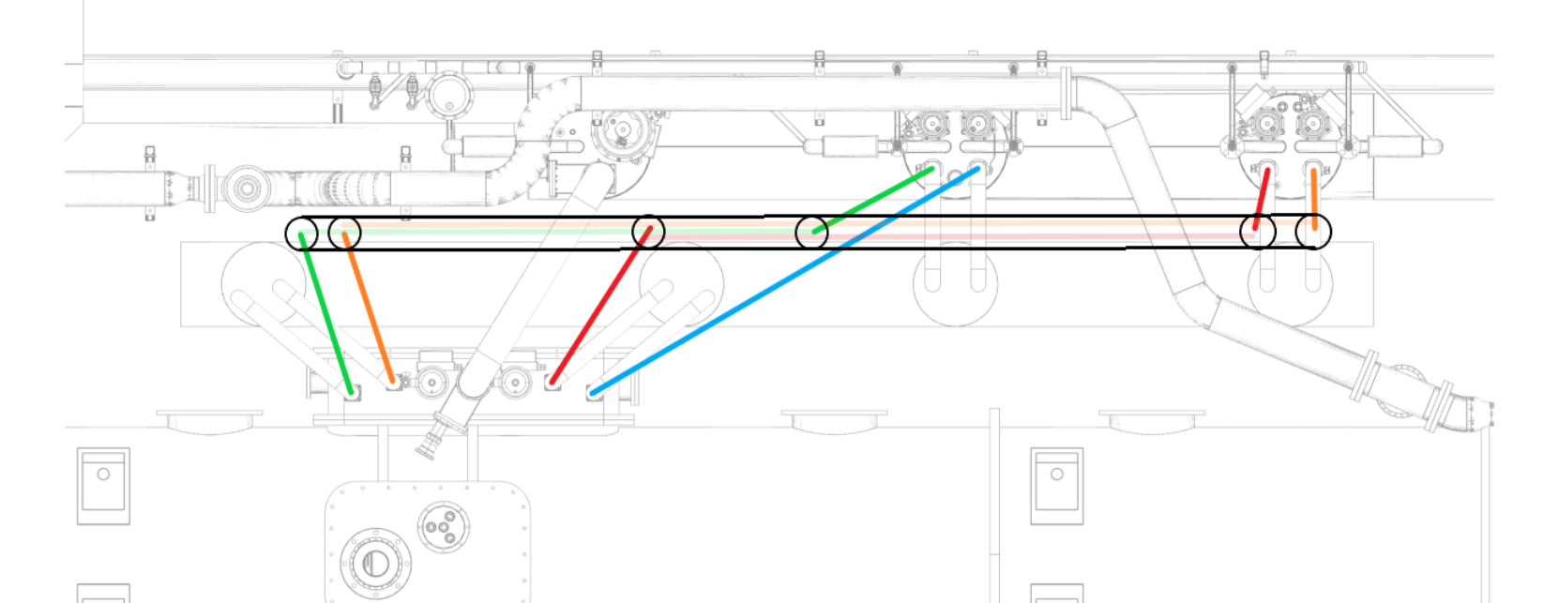
Flow Schematic
PIP2IT transfer line
HB650MHz Cryomodule
Red: 40K Supply. MV-614-H
Orange: 80K Return- MV-616-H
Blue: 5K Supply- MV610-H
Green: 5K Return- MV-612-H
Purple: Warm Helium injection

Slide 6
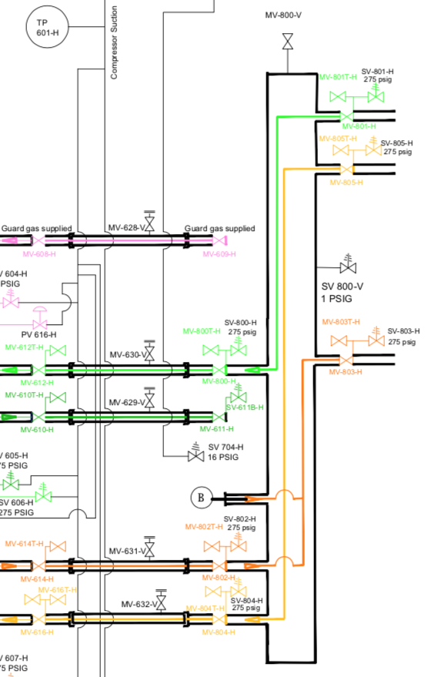
PID
Small snip from the overall PID (F10042546 - Indico site SDP doc#13) will be updated in Teamcenter closer to installation
HB650 CM will be added to this PID once design is known
Orange 40 K Supply
Gold- 80 K Return
Dark Green- 5K Supply
Light Green- 5K Return
Pink- 2K Return
“B” in circle – indicates warm He injection

Slide 7
3D model - in place in PIP2IT
More views available on Indico in 3D Models-CTL Folder

Slide 8
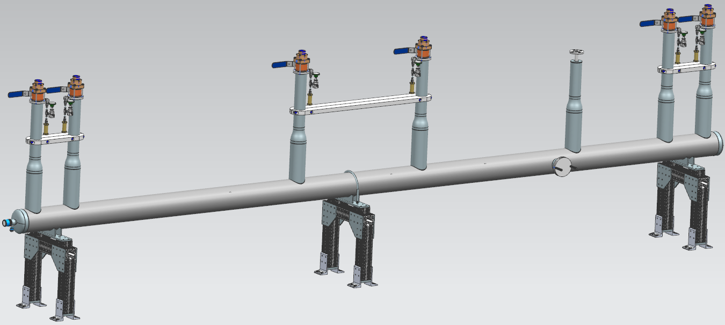
3D model
Warm Helium Injection
80K return
40K Supply
5K Return
80K Return
40K Supply
5K Return

Slide 9
Relief and Bleed Valves + Brace

Slide 10
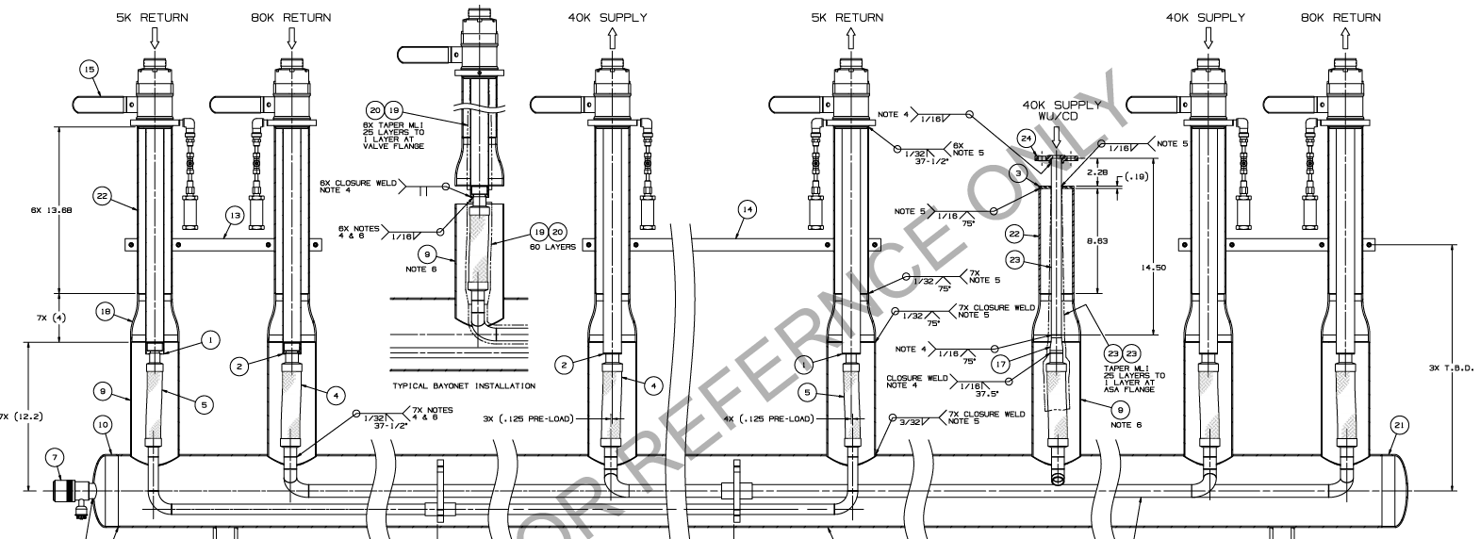
Overview Drawing
Full version (F10126703) located on Indico – CTL Drawings folder
(several sub-component drawings also included)

Slide 11
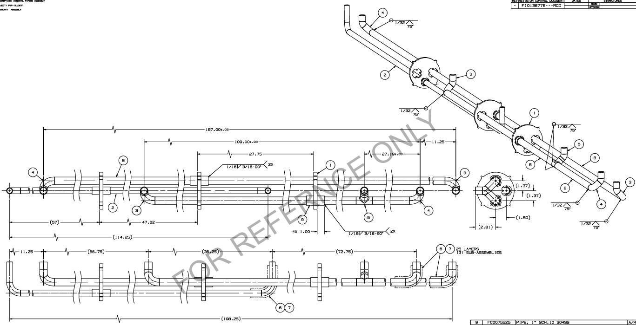
Internal Drawing piping
Full version (F10136778) located on Indico – CTL Drawings folder

Slide 12
Spider-G10
Full version (F10126720) located on Indico – CTL Drawings folder

Slide 13
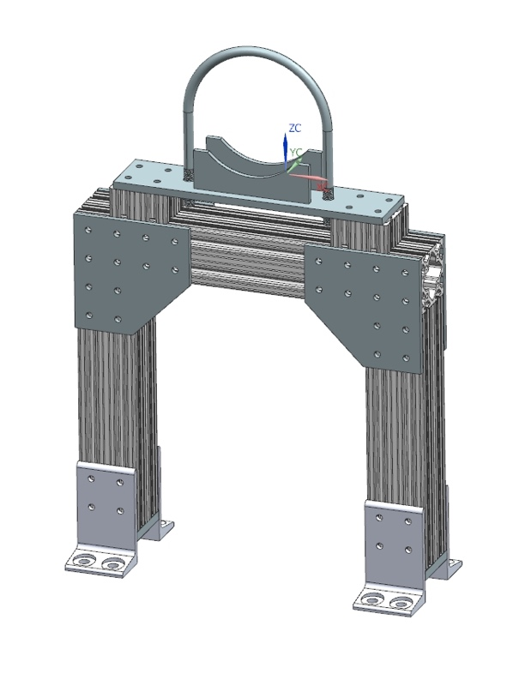
Support Stands
Multiple views located on Indico – 3D Models-CTL support stand folder

Slide 14
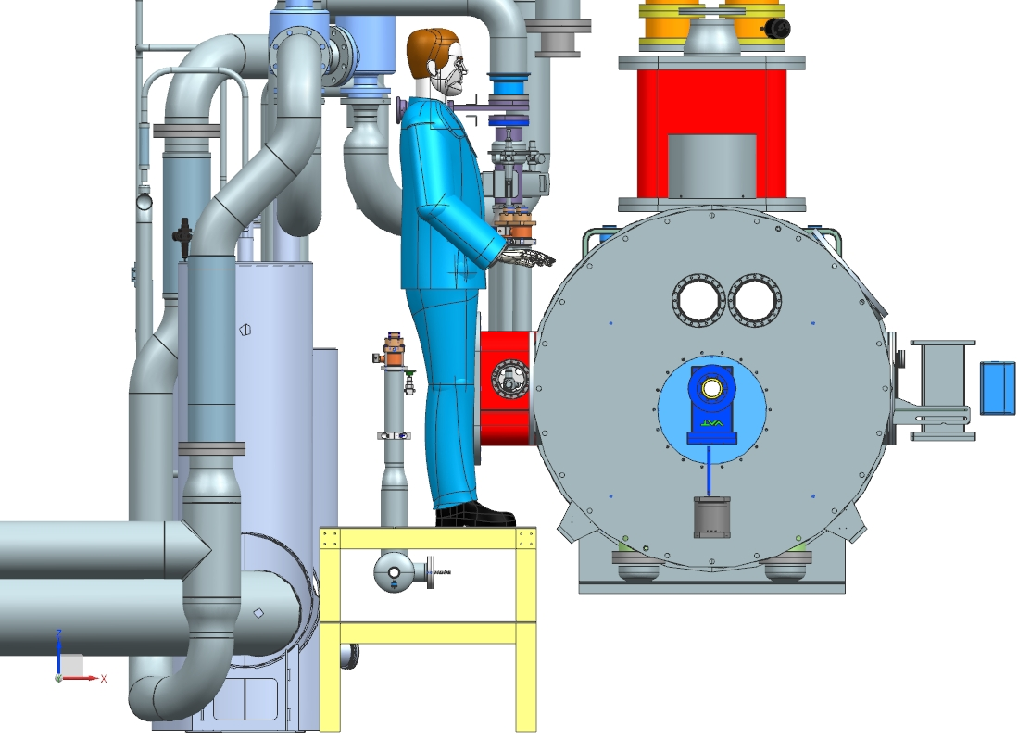
Work Platform
Multiple views located on Indico – 3D Model-Work Platform folder
(Person shown is 6’ 2”)
Horizontal CTL lowered
Work Platform added over CTL
Comfortable working height
Protects CTL and parallel plate relief
~ 50”
~ 30”
~ 30”

Slide 15
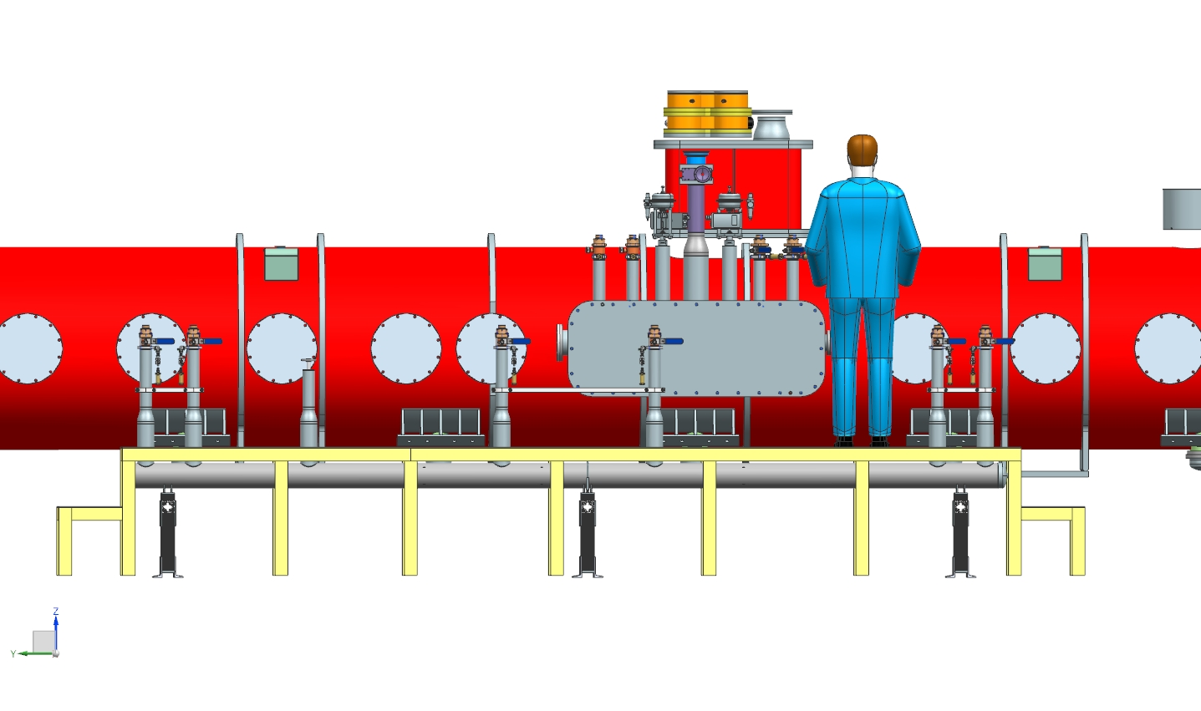
Work Platform
Multiple views located on Indico – 3D Model-Work Platform folder
Provides safe access behind CM
Made out of 80/20
Modular design similar to other PIP2IT platforms (see next slide)

Slide 16
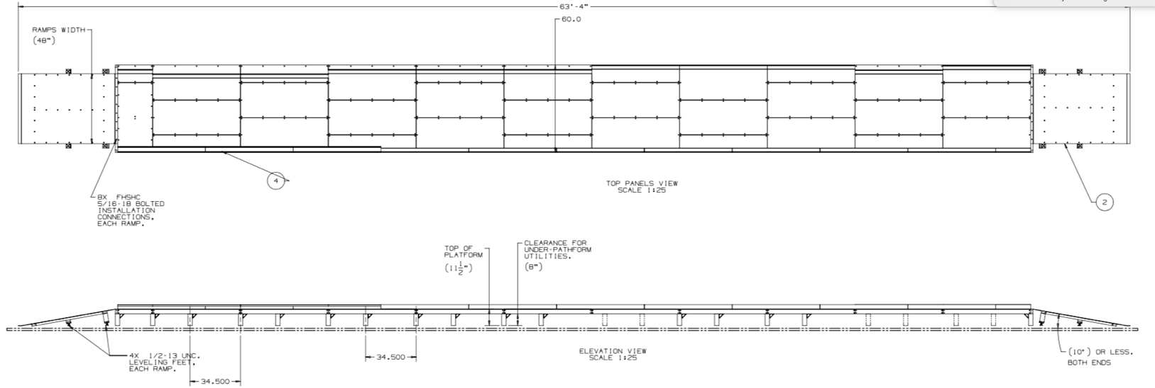
Work Platform – example drawings
Multiple views located on Indico – False Floor and U-tube example folder
Example dwgs/models of existing PIP2IT HWR aisle platform
Made out of 80/20
Modular design

Slide 17
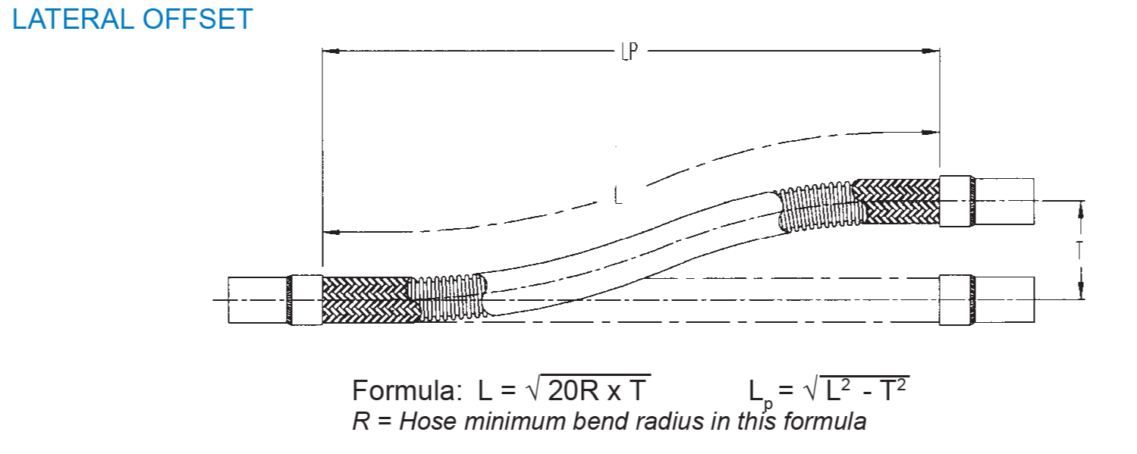
Thermal Flexibility
Indico – SDP doc#15
Line | Length | Contraction | Static Min bend radius Radius | Required Live length with preload | Required Live Length for full pipe | Current live length | FOS with preload | FOS for full length
 | in | in |  | in | in | in
5K return | 57.13 | 0.17 | 1.70 | 1.26 | 2.72 | 5.50 | 4.38 | 2.02
80K return | 93.50 | 0.28 | 2.10 | 2.56 | 4.28 | 5.50 | 2.15 | 1.29
40K Supply | 54.50 | 0.16 | 2.10 | 1.27 | 2.91 | 5.50 | 4.33 | 1.89
Wu/CD | 27.25 | 0.04 | 1.20 | --- | 0.99 | 4.00 | --- | 4.04
Change from PDR: changed use of Dynamic Bending Radius to Static Bending Radius. Leads to 80K Return to use 5.5” live length on flex hose.
Preload of 1/8” implemented in calculation, except for WU/CD supply which is assumed no preload

Slide 18
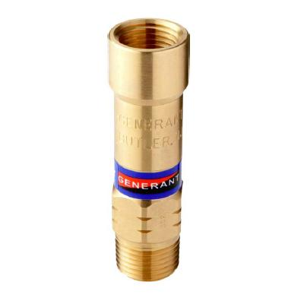
Pressure Relief- Cryogenic Process Pipe
Indico – SDP doc#14
Line | Qa | Factor of Safety
 | ft3/min_Air
5K RETURN | 5.85 | 11.80
40K SUPPLY | 6.14 | 11.25
80K RETURN | 5.91 | 11.70
Generant CRV-500B-K-275-psi (1/4") pressure relief valves will be installed on each manual isolation valve for trapped volume relief
Relief calculated based on CGA S1.3-2008
Reliefs based on one (1) relief valve when there are two (2) installed
Installed Relief Capacity
K_d | 0.67 | - | coefficient of discharge
W_a | 923.63 | lb/hr
 | 69.09 | scfmAir
C | 356 | -
M | 28.97 | mol. Wt
T | 520 | R | when W_a is the rated capacity
A | 0.05 | in2
d_orifice | 0.25 | in

Slide 19
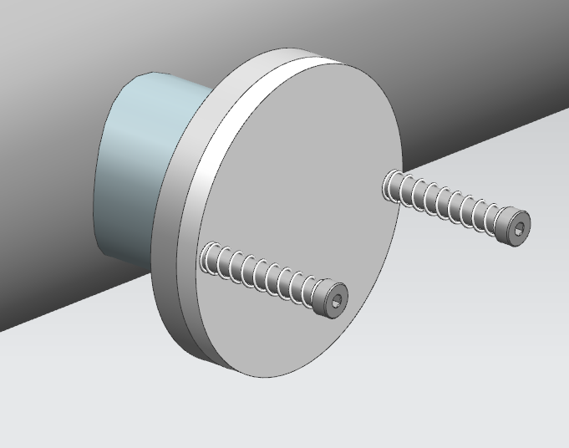
Pressure Relief - Vacuum
Indico – SDP doc#14
Cross section | Water capacity | Volume | Water density multiplier | water capacity | require cross section area | Factor of Safety
in2 | in2/lb | ft3 | lb/ft3 | lbs | in2
4.91 | 0.00024 | 3.77 | 62.40 | 235.32 | 0.06 | 86.92
The vacuum jacket relief capability was analyzed using CGA1.3-2008 requirements.
Per the CGA guidelines, the CVI can not relieve the transfer line adequately. 2 ½” parallel plate installed

Slide 20
Engineering Risk Analysis
Indico – SDP doc#20

Slide 21
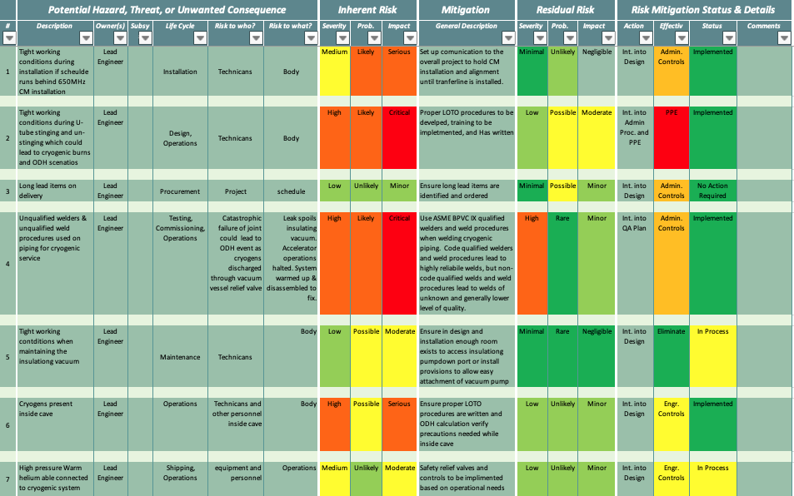
Prevention through Design
Indico – SDP doc#07

Slide 22
Prevention through Design
Procurement
Simple design
Not many long lead items to procure
Safety
650 CTL will be located between the PIP2IT Transfer line and the 650MHz Cryomodule
Space will be tight for personnel to sting and unsting u-tubes. Safety measures must be considered
ODH - Proper LOTO procedure
Tight Space - proper footing and work platforms, clear accessibility, use of crane (similar to current HWR and SSR1 procedures)

Slide 23
FMEA
Failure Mode and Effect analysis shows the simplicity of the design (see Indico-SDP doc#06 for full FMEA)
A manual valve fails closed, it prevents the U-tube from being stung into the 650 CTL
A manual valve fails open, can lead to an ODH event
A safety valve fails closed, there is a redundant safety valve on the line and upstream if the system is stung in
A safety valve fails open, leads to an ODH event
The cave remains safe in both the “failed open” scenarios, as this is accounted for in the ODH analysis
Additionally, alarms and measures are in place to warn personnel of the danger: Personal O2 monitor, O2 monitors mounted on wall with sirens and strobes

Slide 24
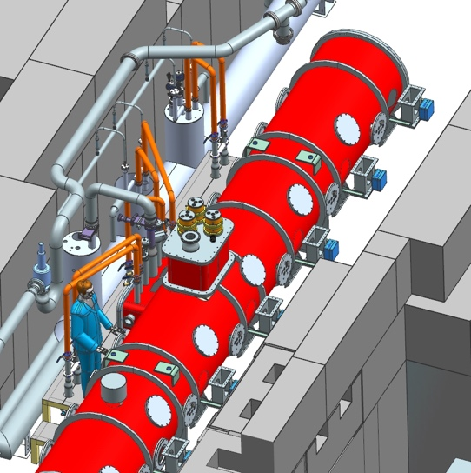
U-tubes
U-tubes will be modeled in the overall 3D to ensure no unnecessary overlap with other u-tubes or existing piping
Once 650 CTL is installed and HB650 CM is in place, Alignment personnel takes measurements for the final fabrication drawing
End pieces will be fabricated ahead of time
Lengths entered in model and final drawings generated
U-tubes fabricated and pressure tested
Piping note written ahead of time if possible
U-tubes installed

Slide 25
Bayonet Tolerances
No bayonet tolerances have been specified for the HB650 Cryomodule design at this time
This effort is being worked on by Andrew Dalesandro of the PIP-II Technical Integration team
Necessary to determine for U-tube reusability within PIP2IT for testing of multiple HB650 cryomodules
LB650 interfaces have not yet been designed as of this presentation.
U-tubes with flexibility will be developed similar to HWR 80K return U-tube shown in next slide

Slide 26
HWR 80K Return - example F10132199
Full version (F10132199) located on Indico – False Floor and U-tube example drawings folder

Slide 27
HWR 2K return - example F10117405
Full version (F10117405) located on Indico – False Floor and U-tube example drawings folder

Slide 28
U-tube Insertion and Isolation Plan
Indico – SDP doc#19
U-tube Insertion and Isolation Procedure ED0012574 based on HWR pump and backfill doc ED0011501
Includes Pump and Backfill procedure for insertion phase
Applied Physics and Superconducting Technology Division Departmental Procedure (TDDP) will be developed for a standard LOTO procedure to be implemented when swapping cryomodules.

Slide 29
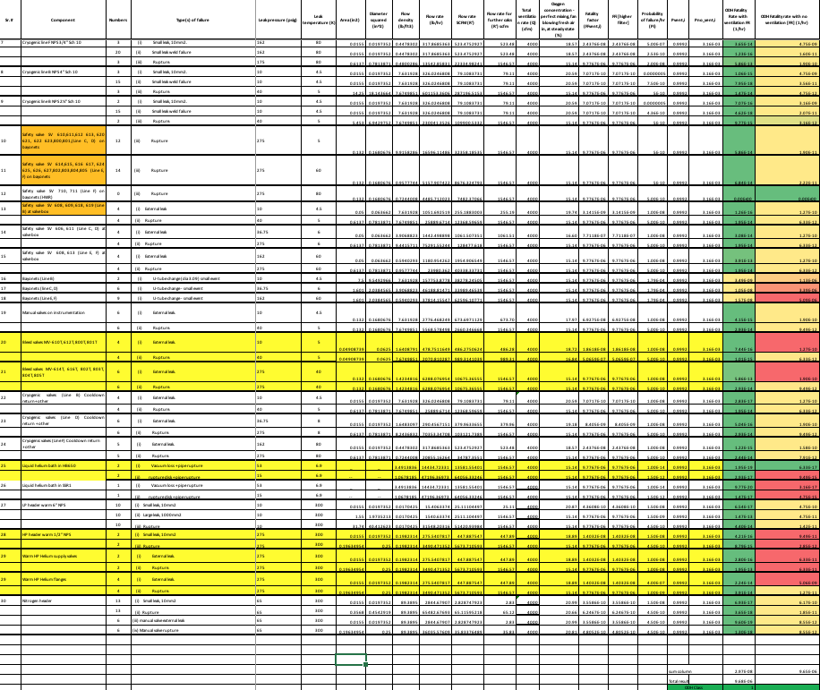
ODH Analysis
Indico – SDP doc#08

Slide 30
ODH Analysis
Indico – SDP doc#08
The PIP2IT cave is currently classified as ODH 2
Due to a low pressure component in HWR, the 2K bath must be vented into the cave leading to the ODH Class
Based on the assumption that the 650MHz Cryomodule 2K rupture disk will relieve outside the cave
ODH Class will change from ODH 2 to ODH 1
Total result | 9.68E-06
ODH Class | 1

Slide 31
Quality Control
Draft QC Plan on Indico-SDP doc#17, maintained in TC ED0011285
Being developed with PIP-II QC group
Joe Hurd worked with Tom Digrazia
Reviewed draft, compared with PIPII standards for QC
QC draft updated to PIPII standards, ready for final review
Goals of the QC document
List Code and Standards for this Intermediate Transfer line
List Inspections and tests to be completed
Lay out common fabrication practices and guidelines to be followed

Slide 32
Draft Schedule
Full P6 schedule for 650 Test Stand on Indico – SDP doc#09
650 Test Stand P6 Baseline Schedule
Procurement/Fabrication – 5 months
Installation – 5 months
Ready for 1st CM installation in Aug. (CM now delayed until Oct. or Dec?)
650 CTL schedule fits well within the baseline schedule
Completion (System ready for cooldown – end of July)
Push out of CM delivery adds additional cushion to CTL schedule

Slide 33
Validation Plan/Schedule
Validation Plan is a combination of
Detailed procurement/fab./install. schedule – SDP doc#18
see next slides
QC Plan – SDP doc#17
U-tube insertion procedure - SDP doc#19
Draft CTL Piping Note – SDP doc#16

Slide 34
Detailed CTL Schedule – Page 1

Slide 35
Detailed CTL Schedule – Page 2

Slide 36
Next Steps
From the PDR, the following was addressed
Optimize/finalize location of 650 CTL (vertical and horizontal) to maximize accessibility
Design support stand for 650 CTL
Complete relief calculations for Cryogenic process piping
Parallel plate relief for transfer line
Finalize u-tube design
Update all calculations, models, and drawings to a final state
Finalize QC Plan

Slide 37
Summary
The 650 CTL design has progressed well
The design is simple and straight forward
We believe the design and documentation are now at a final stage, and that all recommendations from the PDR have been addressed
We feel we are ready to move into the procurement/fabrication phase of the 650 Intermediate Cryogenic Transfer Line
Thank You!

