Slide 1
The Role of Barium Tagging TPCs In the Next Snowmass Period (contributed by Ben Jones, UTA)

Slide 2
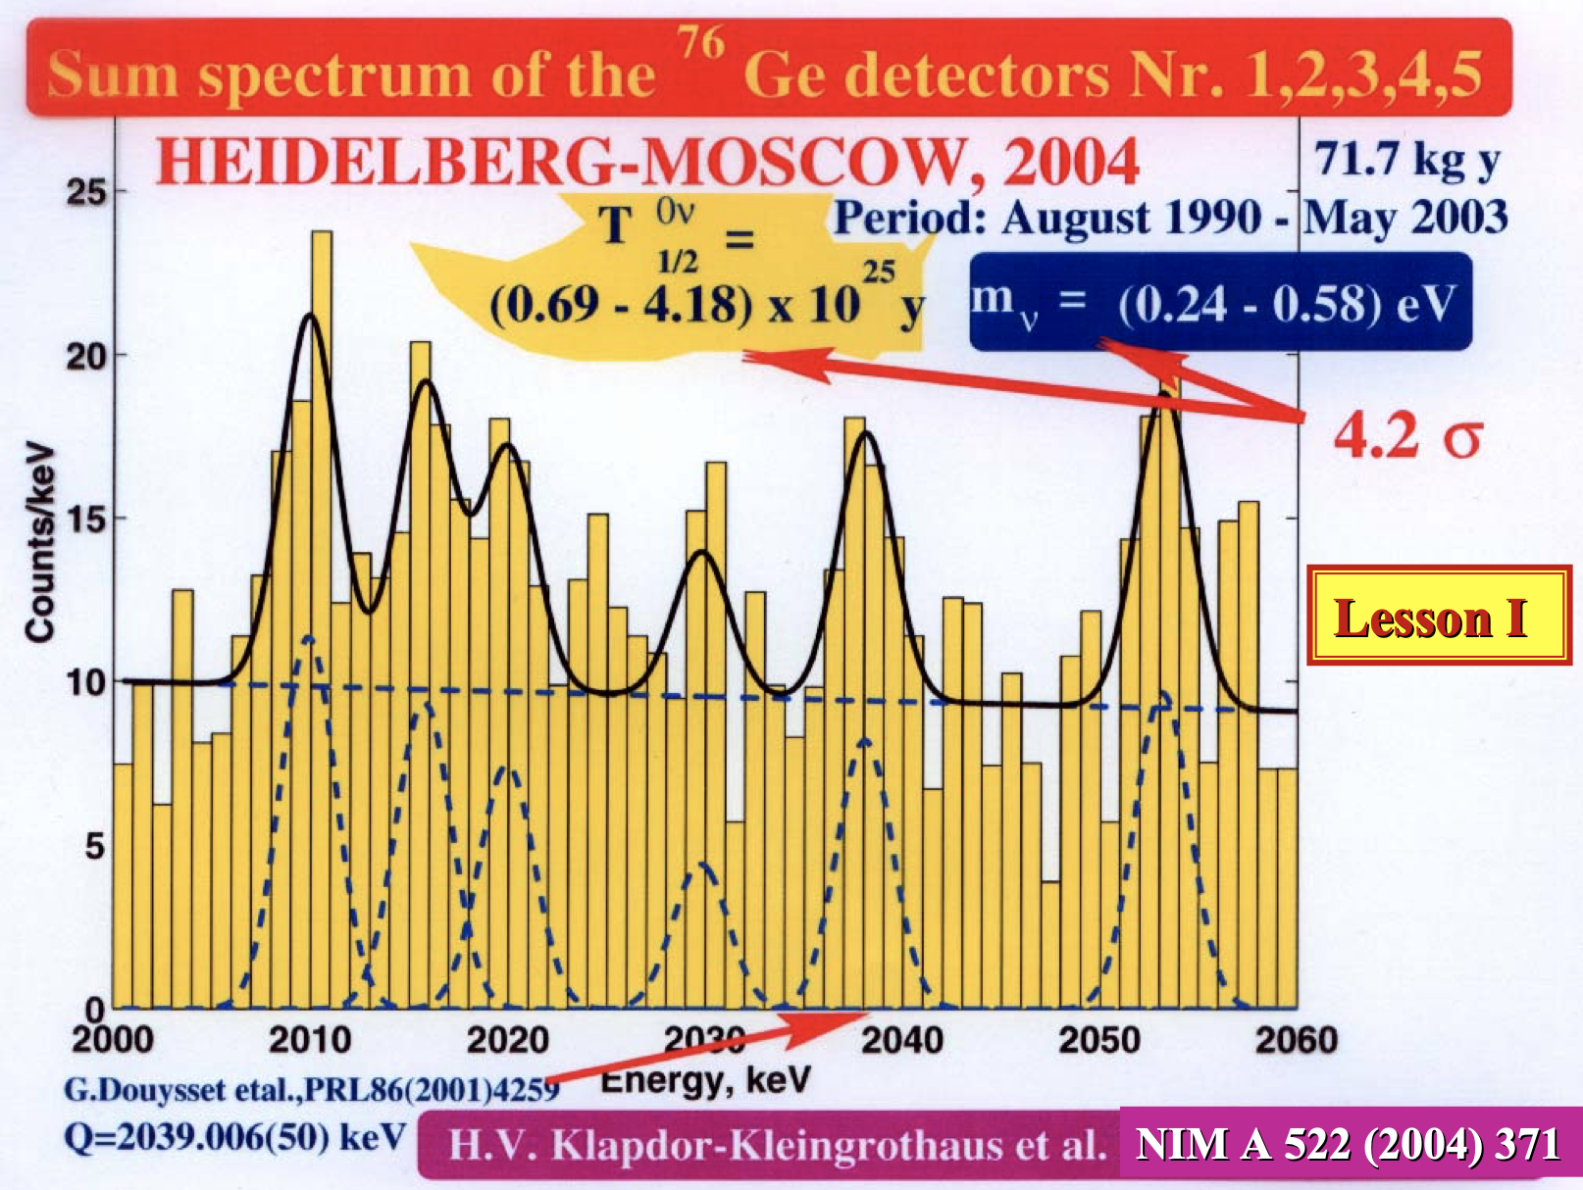
The best-case scenario, the neutrino is Majorana and either mass ordering is inverted or LNV TeV scale physics drives 0nubb
→ A signal would then be within reach of ton-scale conventional experiments.
If accessible, this signal is extremely likely to emerge as an indistinct ”hint”.
As a statistical excess over a finite background, whose prediction relies on Monte Carlo and detector material assumptions;
Nuclear matrix element and physics mechanism uncertainties mean that confirmation with a different isotope will be a “moving target” (although a mandatory step).
We must have a plan to resolve to a definitive discovery in an unambiguous, efficient way.
Remember that it took 10 years to properly refute Heidelberg Moscow.
Confirmation with a new and robust observable within an experiment using the discovery isotope seems the clearest path to confirm or refute a discovery claim.
Daughter ion tagging is a very promising way to do this, if the technology can be realized.
For the technology to be ready in time, R&D must be continuous from now, and not sidelined while ton-scale experiment construction is ongoing.
As a bonus, the reduced background and increased signal efficiency that may be enabled could be the key to reaching into NH sensitivities at multi-ton scales.
Our discovery must be more like this:
Ω⁻ single event discovery
And less like this:

Slide 3
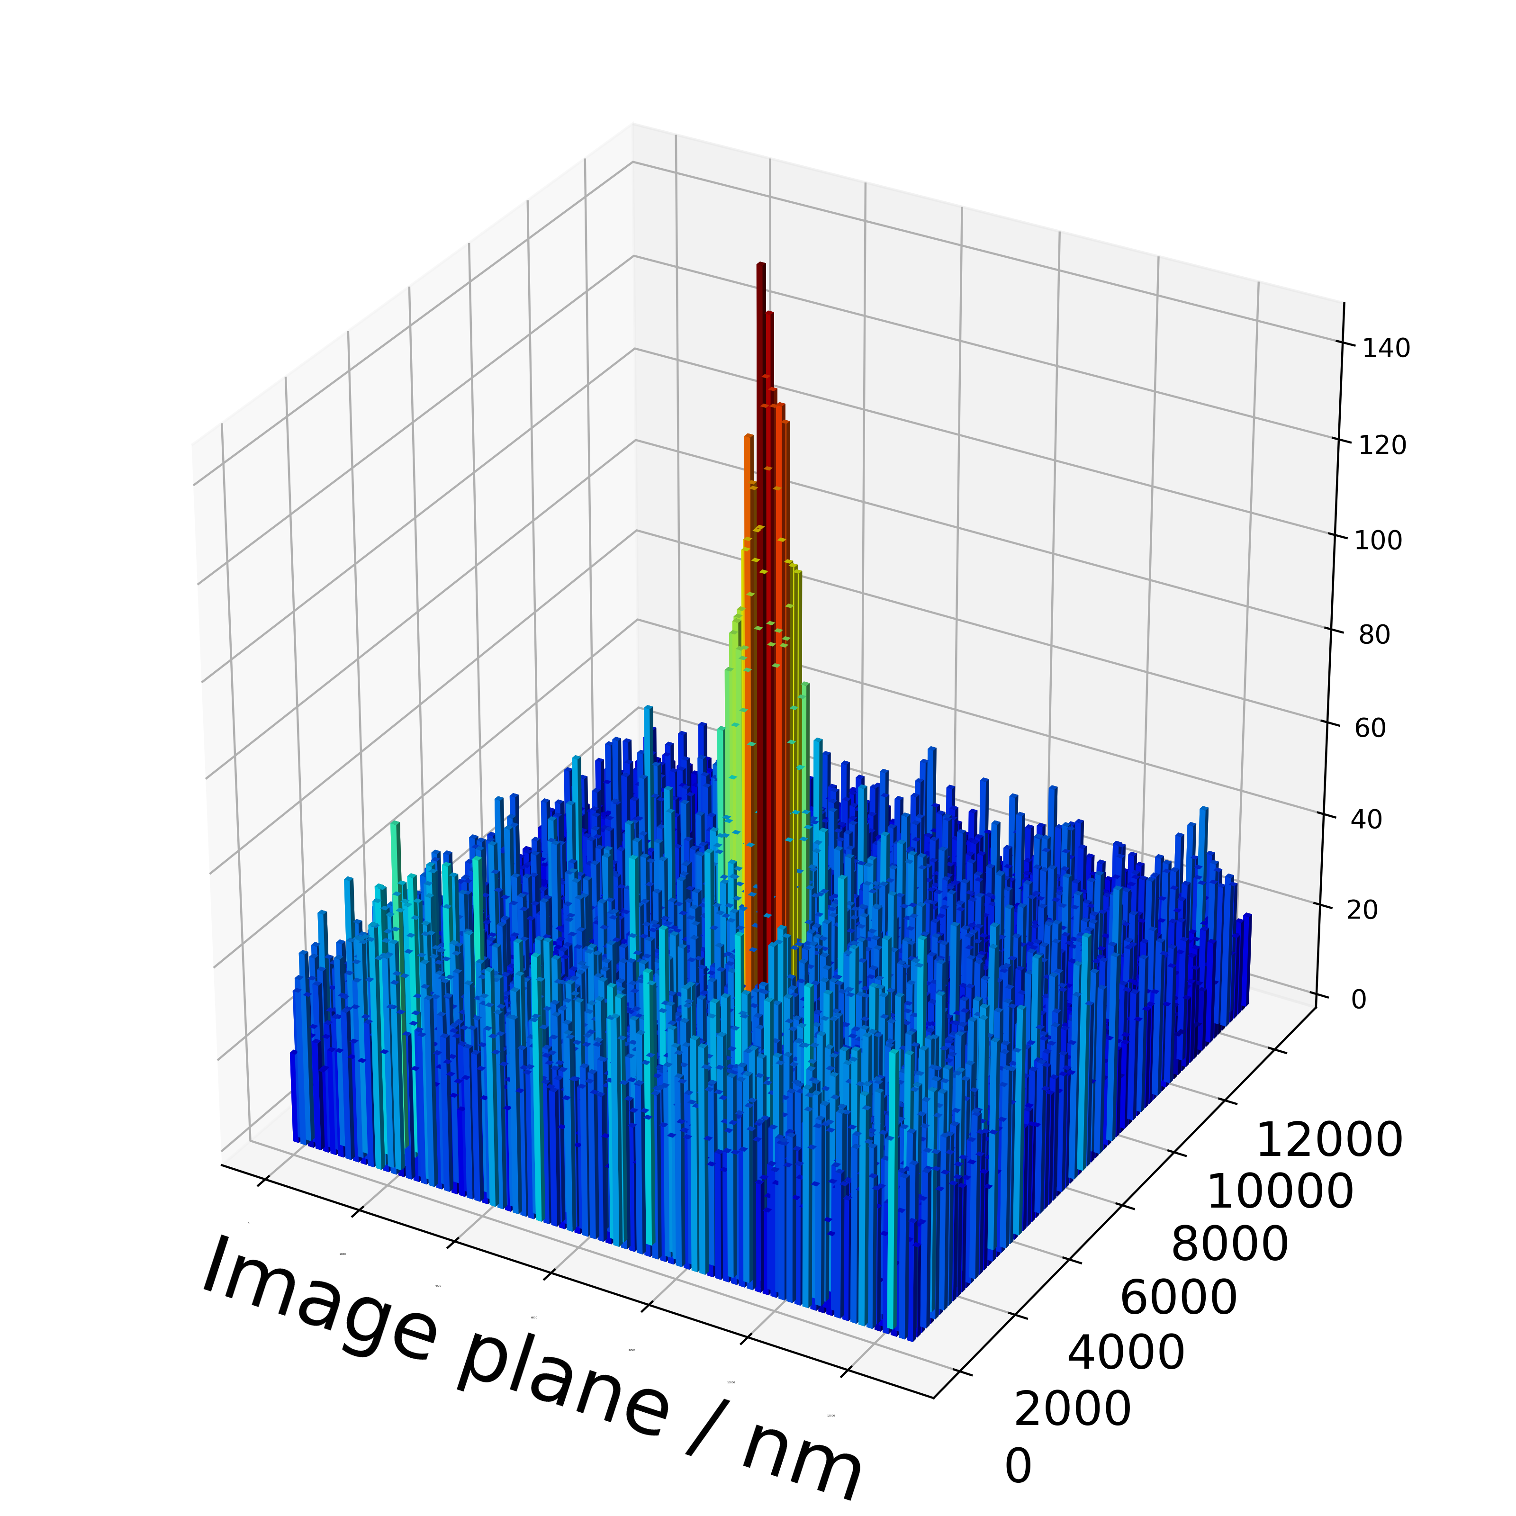
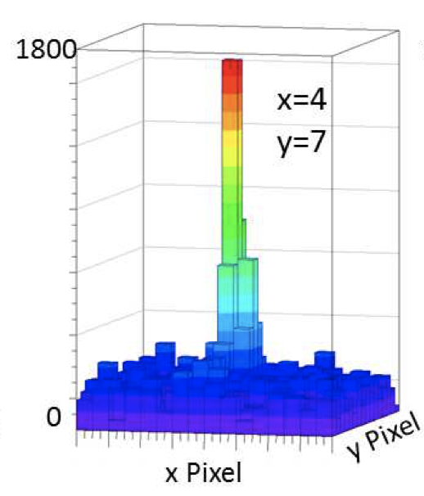
Single barium ion in xenon gas:
(NEXT)
Major advances have been realized by NEXT (using single molecule fluorescence imaging) and nEXO (using xenon-ice atomic spectroscopy) collaborations on barium tagging in the last few years.
While single ion imaging systems are reaching maturity, technological challenges remain in terms of efficient ion capture and extraction from bulk xenon and transport to sensor.
R&D in both liquid and gas expected to yield advances on this front in next 1-2 years.
In another contribution my collaborator Corey Adams will express the need for a demonstrator experiment using barium tagging on 2nubb
Vital to show readiness for 0nubb ton- or multi-ton-scale systems.
Involves R&D on the non-ion-tagging parts of the system as well as the tagging parts
Here I make the case that:
Barium tagging should remain a vital and growing component of the US ¹³⁶Xe 0nubb program, even as energy is directed to ton-scale experiment construction;
There is room for wider engagement from all members of the community and not just a few specialists;
People who have not been xenon people, or not been 0nubb people, or even not been physics people, should be welcomed to participate;
We must be prepared to make a conclusive discovery if a hint emerges, or push on to new frontiers of sensitivity if one does not.
Single barium ion in xenon ice:
(nEXO)

