Slide 1
System or Sub-system 302.X.YY Please use these slides as template
Speaker - Lab
HL-LHC AUP CD-3c Director’s Review – Jul. 28th–30th 2020

Slide 2
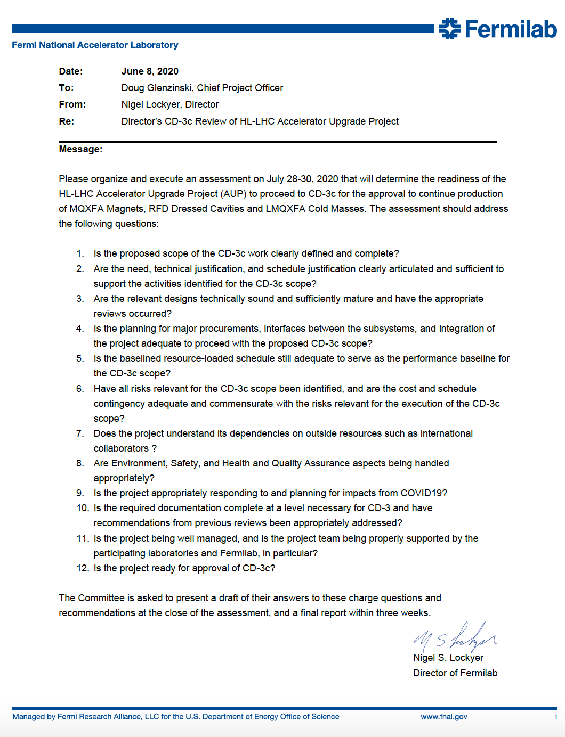
Charges for AUP CD-3c Director’s Review
All questions are “standard CD-3c questions” apart from the one related to COVID19

Slide 3
Early Logistic
Review by Teleconference
Can we run review from 9:00-10:00 AM to 5:00-6:00 PM, therefore maintaining general structure of in-person reviews like CD-1/CD-3a or CD-2/CD-3b ?
Is there any reviewers from Europe or Japan ?
Yes, tentatively Akira (Japan) and Herman (CERN). OPSS to figure out if Akira is based at CERN or Japan.
Also reviewers from the US West Coast.
For Final Design Reviews, AUP accommodated European reviewers/presenters by limiting presentations from 10:00 AM to 1:00 PM, but this resulted in the elongation of a typical 1.5 days Review into 2.5 days.
Strategy is for OPSS to interact with reviewers to confirm we can maintain 2.5 days Review schedule.
OPSS taking care of multiple ZOOM-rooms.

Slide 4
Day 1
Committee Executive Session – 10-15 min
Plenary L1 - Intro
(FNAL, CERN, etc.)
Presentations
Standard Intro’s
Coffee
Plenary L2
(US presentations)
Standard L2 by WBS
Lunch
Magnet Construction (CD-3):
Cavities Construction (CD-3):
Management & CERN Interactions
Standard L3 by WBS
and/or Subject
Standard L3 by WBS
and/or Subject
Coffee
Magnet Construction (CD-3):
cont.
Cavities Construction (CD-3):
cont.
Management & CERN Interactions
Standard L3 by WBS
and/or Subject
Standard L3 by WBS
and/or Subject
Time for Committee
Adjourn

Slide 5
Day 2
Presentations
½ h for Sub-Committees Executive Session
½ h for Committee Executive Session
Presentations starting not earlier than 9:00-9:30 am
Cold Mass & CryoAssemblies (CD-3)
Cavities Q&A
COVID Impact:
Scenarios, BCRs, Risks, Restart & Eff., Re-baseline …
Standard L3 by WBS
and/or Subject
Coffee
Cold Mass & CryoAssemblies (CD-3)
Time for Committee
COVID Impact (cont.)
Standard L3 by WBS
and/or Subject
Lunch
Magnets, CM & CA Q&A
Management Q&A
Drill-Downs selected by Committee
Coffee
Time for Committee
Adjourn

Slide 6
Day 3
Presentations
Answer to Questions (if needed)
Coffee
Time for Committee
Lunch
Close-out

Slide 7
COVID-19 Response Strategy
For Director’s Review (July)
Project Office
Own and Describe high-level impact up to May ‘20
Describe impacts of examined scenarios with assumed efficiencies in AUP activities
L2/L3
Own and describe impact to CAs up to May ‘20
Describe restart status
Describe plan to measure “COVID-restricted” activities efficiencies
For DOE CD-3c Review (November)
Project Office (in agreement with OPSS/IPT)
To-date impacts included in BCRs
Estimate Future impacts in EAC with residual risk captured in Risk Register
Work on new Baseline with CY21 ETC Exercise
CAMs will show solid data on “COVID-restricted” efficiencies to allow “quick” update of COVID-BOEs (if there is a need to act on the Baseline before CY21-ETC).
Procario warning about being ready for early (end-CY20) Congress action

Slide 8
General Points
AUP is now a baselined project (CD-2 approved) asking for CD-3c/CD-3.
At this time we believe that we will request full CD-3 approval for the overall AUP scope to DOE
Director’s Review outcome might push our aspirations backward a little bit on the CD-3 for Cryo-Assemblies.
At the IPR Status Review in January 2020 we demonstrated that we are executing AUP according to the approved “Performance Baseline” (Cost, Schedule, Scope), that any deviations followed acceptable EVMS processes (e.g., BCRs approved at the appropriate level), and that cost/schedule variances were well understood and under control.
The upcoming CD-3c/CD-3 Review is foreseen both as a Status Review AND a CD-3c/CD-3 (approve construction) Review, with slightly more emphasis on the CD-3c part.
We need to show that we can move forward with Production of all AUP deliverables (series production).
We also need to show that we keep under control or are executing properly all other activities (pre-series, CD-3a and CD-3b scope, etc.)

Slide 9
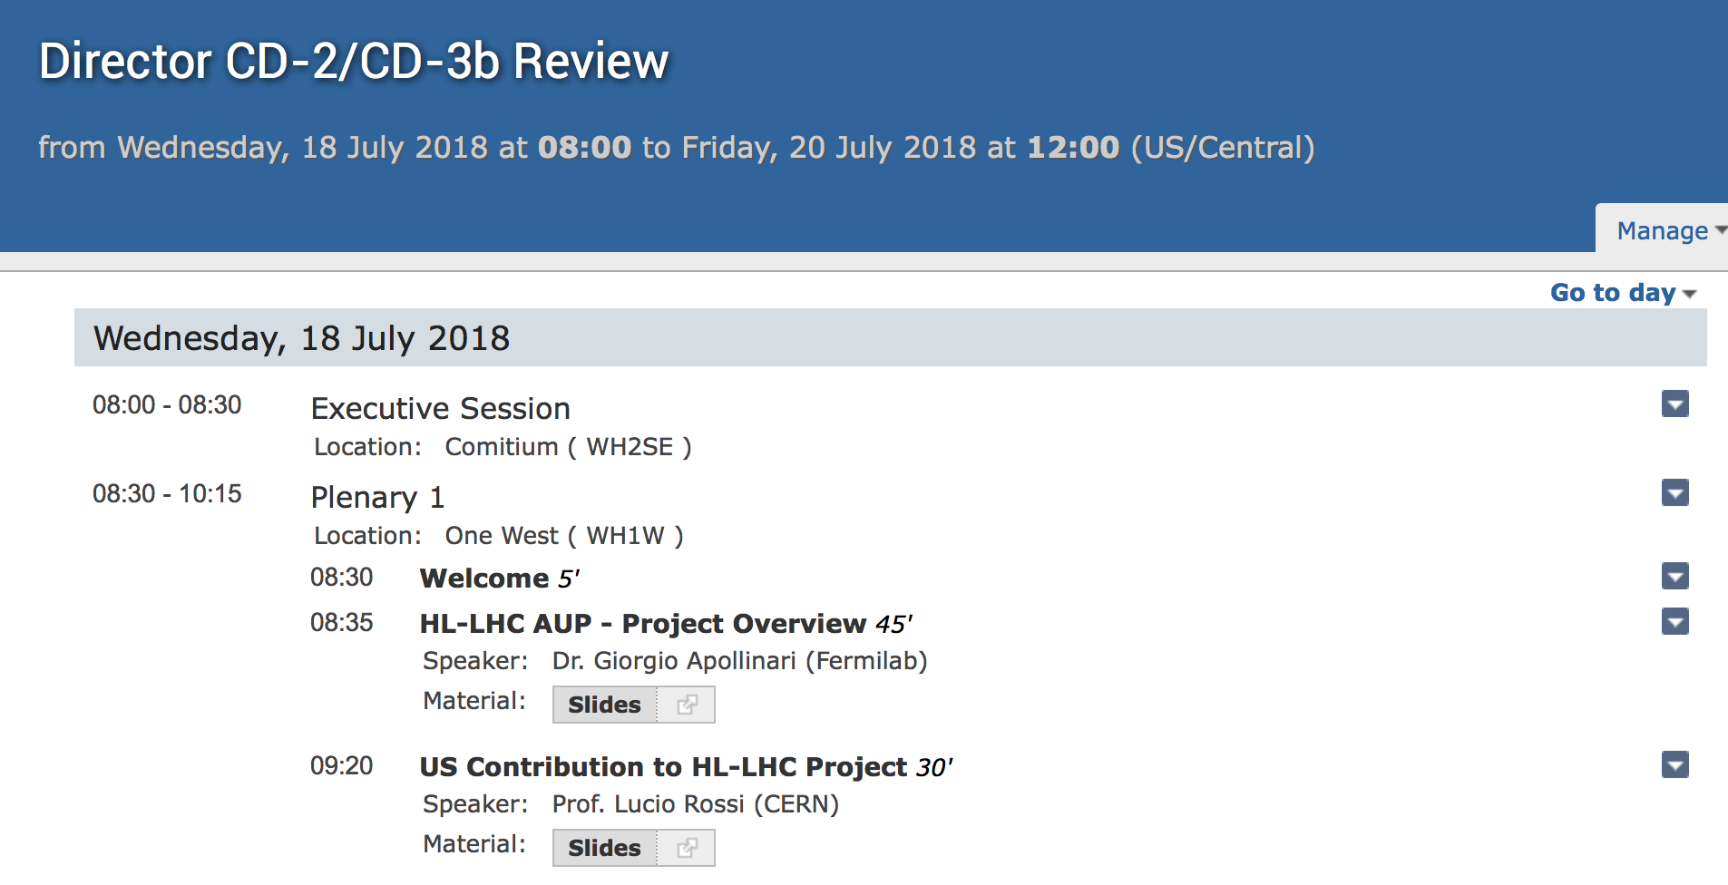
Housekeeping
The title of the presentation, the name of the file and the agenda title shall be the same (modulo version #) !
Presentation Title
File Name
Agenda Title
!! Make the page
# white !!!

Slide 10
Proposed Outline for L2/L3 Presentations
Charge #
If a slide is addressing a specific charge, write
the Charge # on the top of the slide.
If all activities you are discussing are concentrated
in a Lab, you can use a Lab logo here
Lab
Logo

Slide 11
General Outline
Similar to Jan. 2020 IPR with the
exception of bolded additions
Scope, Interfaces, and External Dependencies
Readiness for CD-3 & Technical Status and Progress
Procurement Status and Progress
QA/QC
Approved BCRs and Design Changes
COVID Impact, present and future Plans
Schedule
Cost and Schedule Performance & VAR Reports
Estimate at Completion
Risks
ES&H
Summary
Lab
Logo

Slide 12
WBS 302.X.YY: Scope and Interfaces
List all CERN-approved FRS, Acceptance Criteria, Material Lists, Interfaces that allow you to define your WBS scope.
Use snapshots from WBS dictionary
US-HiLumi-doc-39 (update your WBS entry if needed!)
Use picture/drawings of your scope (if they exist)
If applicable, highlight production yield assumptions and deliverables quantities
Show Interface Matrix and List Interface Control Documents, mention any ICD reviews that took place
Have a clear understanding of your approved CD-3b scope (list from Lorri) and what you are requesting to get approved for CD-3.
Make sure your WAD is signed and up to date
Message: WBS scope is clearly defined and well understood; Interfaces are defined and controlled; WBS is ready for next gate decision (CD-3 Production)

Slide 13
WBS 302.X.YY: External Dependencies
List any external dependencies (from CERN, FNAL, etc.) (P6 Milestones), include agreements and status with links to documents if applicable
Mention risks associated with these external dependencies, any mitigation actions in the plan? Response actions?
Important to show that early delays on deliveries from CERN have been accounted for.
Also important is to show that off-project FNAL Horizontal Test Facility Refurbishment is on-track, test facilities readiness are usually a weak element in projects
Talk about the zero-magnet test, etc.
Message: WBS understands its dependencies on outside resources, external dependencies are captured in the P6 RLS

Slide 14
WBS 302.X.YY: Organization
Organization chart including management and major subsystem, and your place in it.
Down to L3-L4 use official Org structure in US-HiLumi-Docdb 104, then expand to include Team members as you see fit
Message: WBS team in place, there are clear roles and responsibilities
Lab
Logo

Slide 15
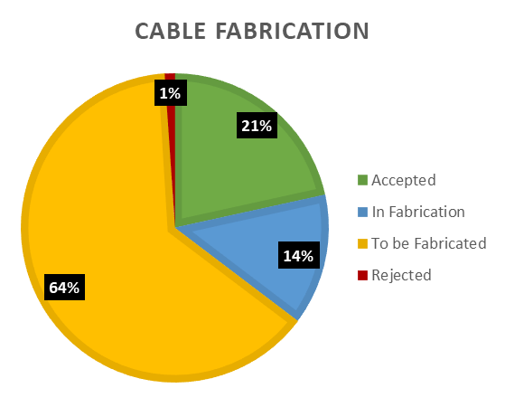
WBS 302.X.YY: Technical Status and Progress
If applicable, include summary Fabrication Status Pie Chart from the “Parts Status” Excel file in FermiPoint (update as needed, information there is from the last Review. CAM is responsible for updating the numbers in Fermipoint, and keep using the same format).
Describe your pre-series scope (already approved) and the scope (series) you are asking approval for
List of achieved technical milestones since DOE IPR review
List any Final Design Review, PRR reviews, outcome, links to report, etc.
Include infrastructure developments, fabrication status, test results
For fabricated items, include actual vs planned production yield
Remember: we promised we would ask for CD-3 approval based on 2 performing MQXFA magnets and 1 Prototype RFD Cavity.
Message: project made the adequate technical progress to be granted CD-3 Production approval.

Slide 16
WBS 302.X.YY: Readiness for CD-3 (if appropriate)
Be knowledgeable of what you are approved for under CD-3a or CD-3b
Summarize the activities that brought you up to CD-3 readiness
Final Design and Validation Plan, Final Design Review
For CD-3c, need to demonstrate two successful pre-series magnets vertical tests. ?For cavities 1 tested prototype?
Describe importance of Production Readiness Reviews and plans for PRRs
Open issues (if any) for Series Production and plans to address and resolve these issues on time for CD-3
Message1: WBS is on track for CD-3. There are no open issues.
Message2: (if pertinent) There are some issues in this WBS that need to be addressed before CD-3 , but there is a clear plan to resolve these issues on time.
Lab
Logo

Slide 17
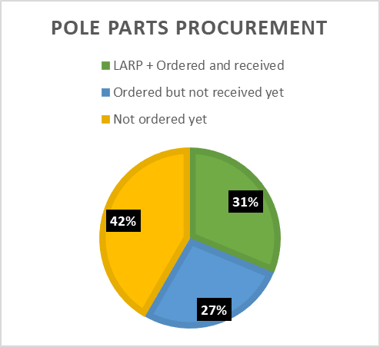
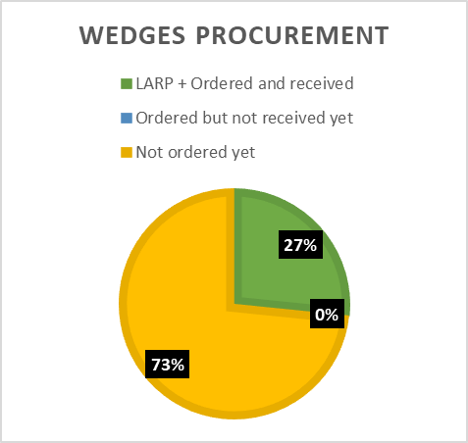
WBS 302.X.YY: Procurement Status and Progress
If applicable, include summary Procurement Status Pie Charts from the “Parts Status” Excel file in FermiPoint (update as needed, information there is from last Review)
List status of important WBS procurements (check with Lorri/Marilyn)
PO placed, Delivery in Progress, Delivered, etc.
Describe vendor visits, close monitoring and control of procurements. Describe any challenges and how are you working to overcome.
List upcoming important procurements; are you on-track?
Did you conduct or plan to conduct any Procurement Readiness Reviews?
Message: WBS procurements are on-track and being managed successfully; WBS procurement plan is clear

Slide 18
WBS 302.X.YY: QA/QC
List any approved CERN MIPs with links for your WBS (show an example)
List any NCRs, for major ones explain root causes and corrective actions
Important topic for Coils Fabrication WBSs because of lower yield than assumed
DON’T MAKE THIS CHEESY !
DON’T REPEAT BOILERPLATE INFO
IT MIGHT APPLY ONLY TO SOME CA (ex: COILS)
Message: WBS follows project QA/QC processes; NCRs corrective actions are effective (problems are not repeated); lessons learned shared; etc.

Slide 19
WBS 302.X.YY: Approved Baseline or Design Change Requests
List approved BCRs initiated by your Control Account, including description and impact (from the fbcr.fnal.gov tool or the AUP BCR log at US-HiLumi-doc-1512). For significant ones, add more explanation.
Demonstrate understanding of the BCR process (e.g., authorized to proceed only after approval, cannot change the past, freeze period and exceptions, current period BCRs require FPD approval, etc.)
Demonstrate awareness and attention to Documentation System to address/discuss/incorporate in AUP workflow proposed Design Change from CERN
Message: WBS baseline changes are justified, well managed, and under control

Slide 20
WBS 302.X.YY: COVID Impact, present and future plans
Describe and own COVID impacts from Spring ‘20 Lock-Down and “COVID-restricted” restart at the Labs.
Lock-Down
What stopped (mostly assembly) and what went forward (procurements, report writing, design where applicable, etc.)
“COVID-restricted” restart
What restarted and how is the restart going.
Demonstrate awareness about need to measure efficiency of “COVID-restricted” activities and show initial outcome of the measurements, with commitment to finalize by end-Sep and be ready for “COVID-BOEs based on experience” by Dec-20
Message: Past COVID impacts have been accounted for and we are preparing the elements to assess them in the future.

Slide 21
WBS 302.X.YY: Schedule
A “Schedule Cartoon” will be provided for the overall L2 activity (Magnets and Cavities). Highlight where your L3 activities fit in the overall schedule.
Be prepared to defend critical dates
Completion of Prototypes, Start of Production, Completion of Production, DOE milestones (CD-1, CD-3a, CD-2, CD-3b, CD-3, “Project” CD-4, DOE ”CD-4”)
Should you be part of the Critical Path (ask your L2) show that you know and understand the implications.
If applicable, state impact to your CA of not receiving CD-3c/CD-3 on schedule
Message: WBS schedule is clear and consistent with overall schedule. You are aware of major milestones and Critical Path. You can show the criticality of not getting CD-3 now.
Lab
Logo

Slide 22
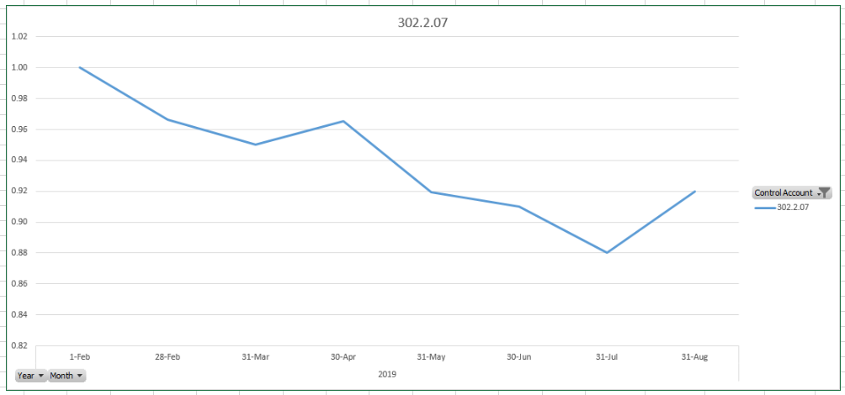
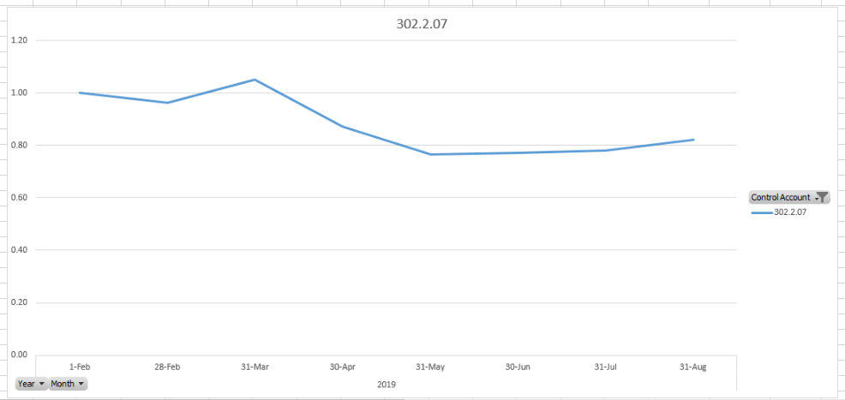
WBS 302.X.YY: Cost and Schedule Performance & VAR Reports
Include cumulative table from CAM e-Toolbox
Plot of historical control account CPI, SPI from FermiPoint Excel file. Lorri will work on labels for better visibility example: CA 302.2.07:
Describe Variances (understand Yellow/Red Thresholds, list of VARs from CAM e-Toolbox) and your plan to bring back to ~ 1.0 (if applicable)
CPI
SPI
Message: Control Account/WBS cost and schedule historical performance is reasonable and under control; variances well understood and documented; plan to recover (if applicable) is sound and credible

Slide 23
WBS 302.X.YY: Estimate at Completion
Include At Complete table from CAM e-Toolbox
Talk about:
your CA Variance at Completion (BAC- EAC) and explain the difference
explain any manual EAC adjustment
what is the impact on your EAC coming from other Control Accounts (e.g., production yield impact from other CAs), etc.
In some cases an EAC table might help (use the information from the P6 Status Sheets “EAC” tab in FermiPoint)
Talk about your CA estimate to complete (ETC) and the outcome of the first “bottoms-up” ETC performed after the last DOE IPR Review (Jan. 2020)
Message: ETC is reasonably up-to-date, accurate, and credible. You are aware of how performance of other control accounts is impacting your ETC

Slide 24
WBS 302.X.YY: Risks
List WBS risks, risks updates since CD-2/3b
Retired risks, realized risks (managed or closed), updated risks, new identified risks, etc
Describe your WBS top risks
Identify any COVID-related impact in your risks.
Message: WBS risks are identified and are being actively managed.

Slide 25
WBS 302.X.YY: ES&H
Any safety reviews? Any Safety incidents?
For fabrication activities, include links to approved equipment ORCs, Hazard Analysis, etc.
DON’T MAKE THIS CHEESY !
DON’T REPEAT BOILERPLATE INFO
SHOW SPECIFIC EXAMPLES (IF YOU HAVE ANY)
Message: WBS ES&H is being handled appropriately

Slide 26
WBS 302.X.YY: Summary
Summarize the main points you made before directly supporting the review charge.
Message: Execution of this WBS is proceeding according to the baseline plan, cost and schedule are in control, risks are understood and actively managed, and you are ready for CD-3 (or have already obtained it)
Lab
Logo

Slide 27
Backup Slides
You should keep the pie-charts and tables from the CAM e-Toolbox as backup slides in case someone asks questions

Slide 28
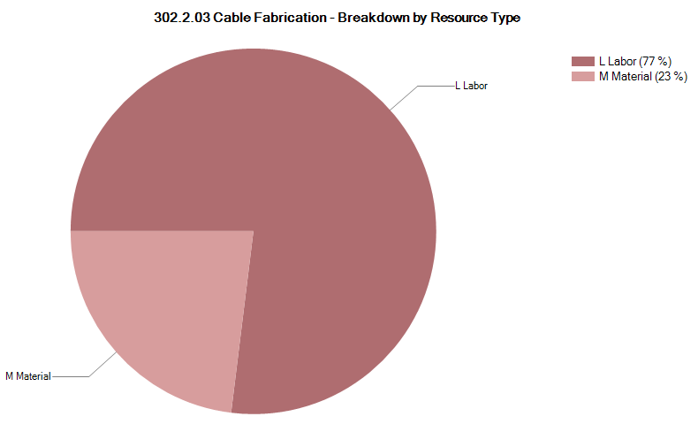
302.2.03 Resource Type Breakdown
77% Labor, 23% M&S
M&S Includes contractors (braiding vendor), travel, shipment, etc.
Example from 302.2.03
Plots to be provided by PO
Lab
Logo

Slide 29
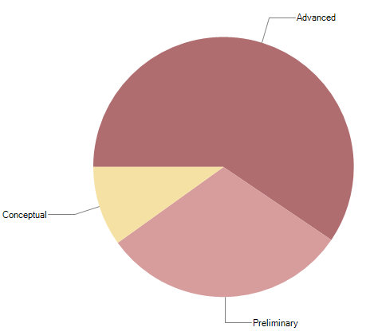
302.2.03 Estimate Quality
Conceptual is related to the RRR measurements
FNAL has been measuring RRR up to earlier this year
LBNL’s new system is undergoing benchmarking approval
Preliminary is mostly related to Insulation
Master Agreement is being placed to lock down the price throughout AUP
The quality of estimate has been updated for CD-2/3b
Example from 302.2.03
Plots to be provided by PO
Lab
Logo

Slide 30
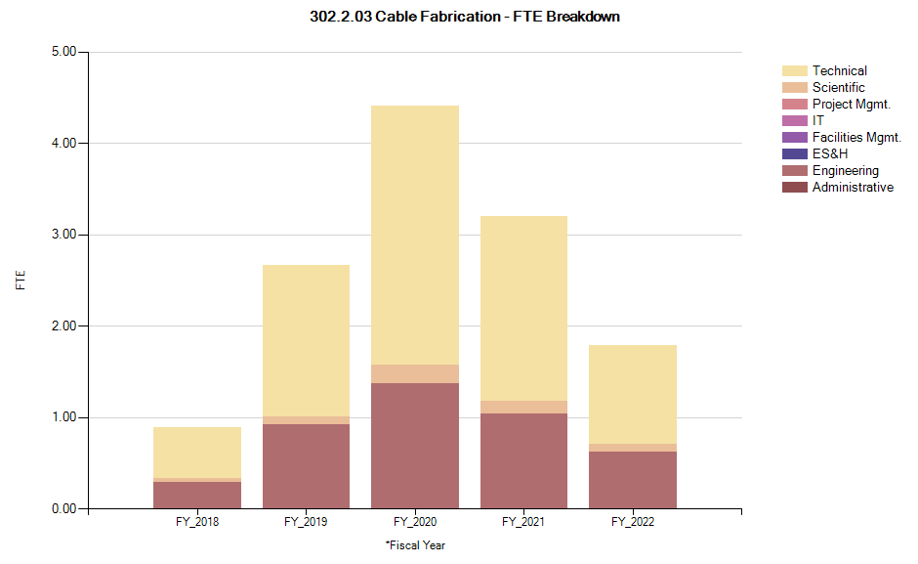
302.2.03 FTE Breakdown
From 5/31/18 forward
Does not include FY18 Actuals
Example from 302.2.03
Plots to be provided by PO
Lab
Logo

Slide 31
302.2.03 Cost Performance Report
BAC = $5.658M
No thresholds crossed in Current Period Cost
No thresholds crossed in Cumulative to Date
Cumulative SPI = 0.9, CPI = 1.05
Example from 302.2.03
Plots to be provided by PO

