Slide 1
Education and Engagement of ML Skills
Savannah Thais
Snowmass Computing Frontier Kickoff
08/11/2020

Slide 2
Framing
ML is its own robust and rapidly evolving field. We must engage the community, understand best practices, and actively exchange ideas.
This talk focuses on 4 key areas:
Knowledge and training
Outreach and community building
Open/benchmark datasets
Ethics and safety of AI
*Caveat: I’ve always worked in LHC physics, so the existing resources highlighted here are definitely biased towards that. None of this (goals, resources, questions) are meant to be extensive!

Slide 3
Knowledge and Training

Slide 4
Goals
Develop a robust understanding of ML within the physics community
Cultivate robust and transferable technical skills
Especially among young physicists
Provide physics specific ML training materials
How techniques are used for our problems
Create reusable/reproducible education materials

Slide 5
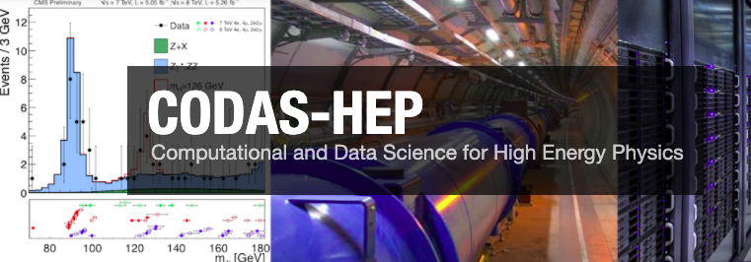
Resources: Summer Schools + Technical Trainings
MLHEP School
Weeklong training eveloped and sponsored by Yandex with collaboration from physicists (HEP focused)
CMS and ATLAS Computing Trainings
Both had short sessions (3-4 hours) on ML, led by experts in the experiments (Experiment focused)
HEP Software Foundation Trainings
Materials for reproducible trainings, ML module in development (LHC focused)
Deep Learning for Science School
5 day training from ML experts and discussion on use in scientific research (General Science focused)
CoDaS-HEP School
5 day advanced computing training including ~2 days on ML led by domain experts with physics connections (HEP focused)

Slide 6
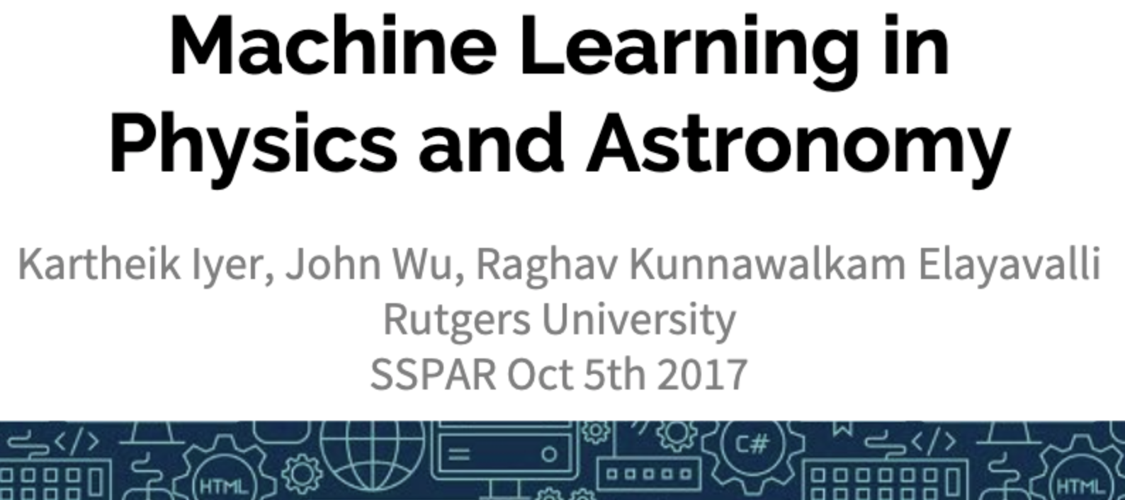
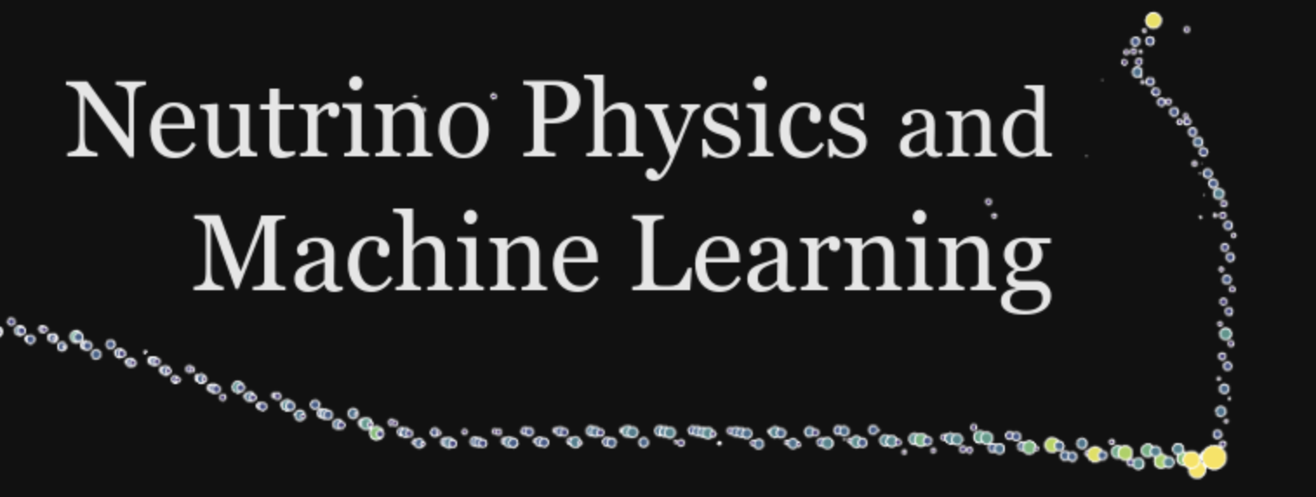
Resources: Within Experiments and Universities
University Courses/Workshops
Varied in home department and target students
Generally start with intro to ML then delve into physics applications
Courses usually require programming homework and extensive pre-reqs
Experiments and Labs
Provide presentation opportunities for experiment specific uses of ML
Centralize resources (trainings, papers, etc) for groups
Support researchers in development of ML methods in their individual experiment

Slide 7
Questions to Consider
What should be included in graduate curriculums?
How can experiments/groups fill the gaps?
What role do summer schools and workshops play?
How can schools with established programs knowledge share?
How can we create centralized resources?
What role should ML experts play in development of the above?
Key Collaborations: CommF2 (Career Pipeline & Development), CommF4 (Physics Education), SEC

Slide 8
Outreach and Community Building

Slide 9
Goals
Develop effective collaborations with industry and Computer Science ML researchers
Stay up-to-date on new ML methods and results
And help develop/inform them
Share physics-focused results in critical ML venues
Provide enhanced training and development opportunities
Can include internships etc

Slide 10
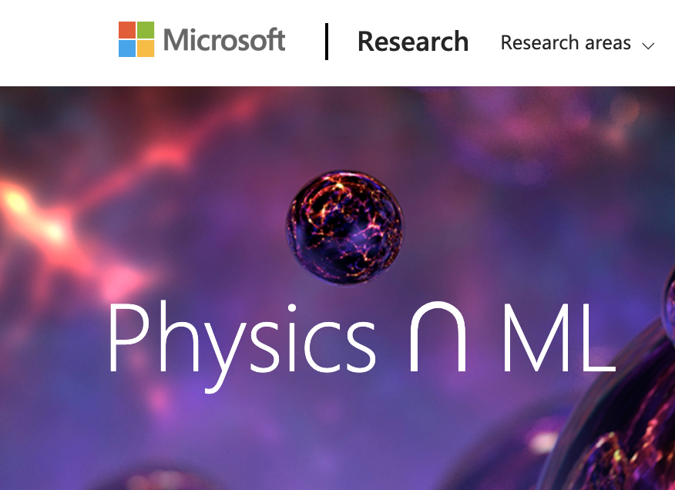
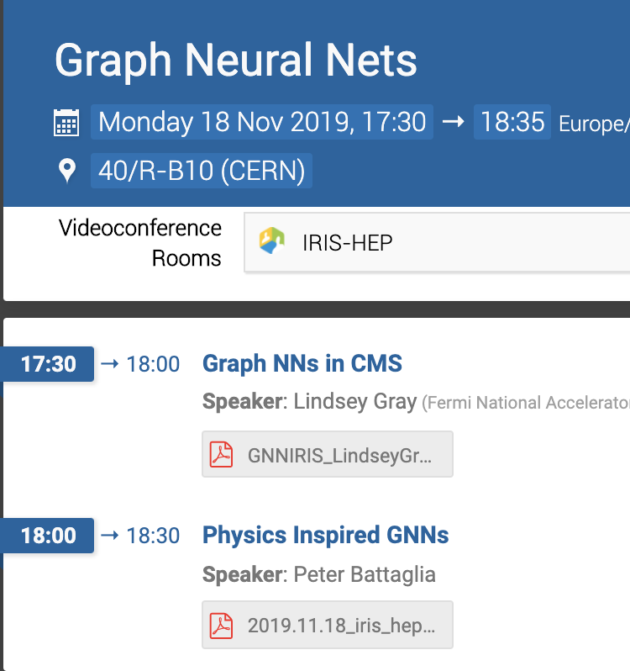
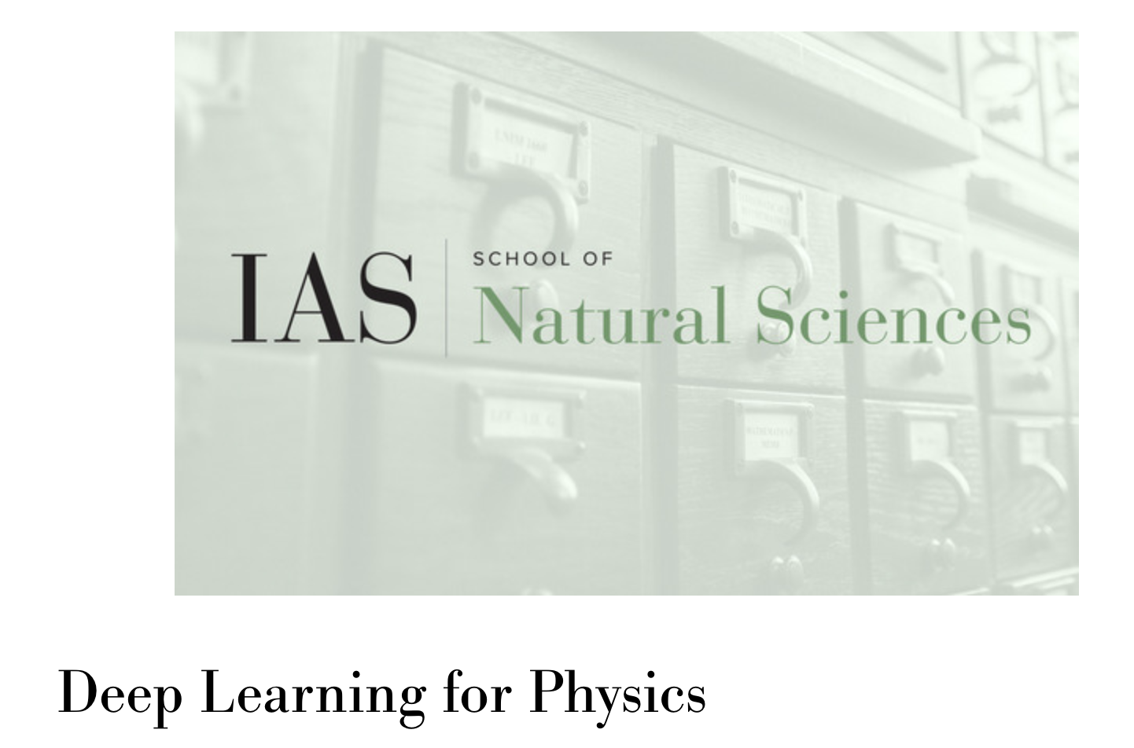
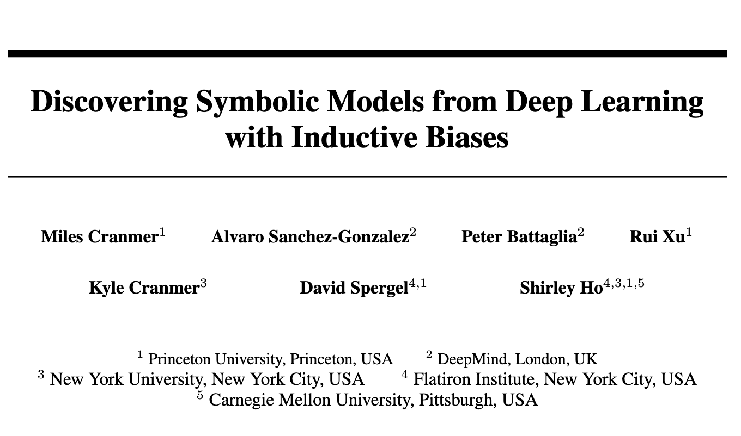
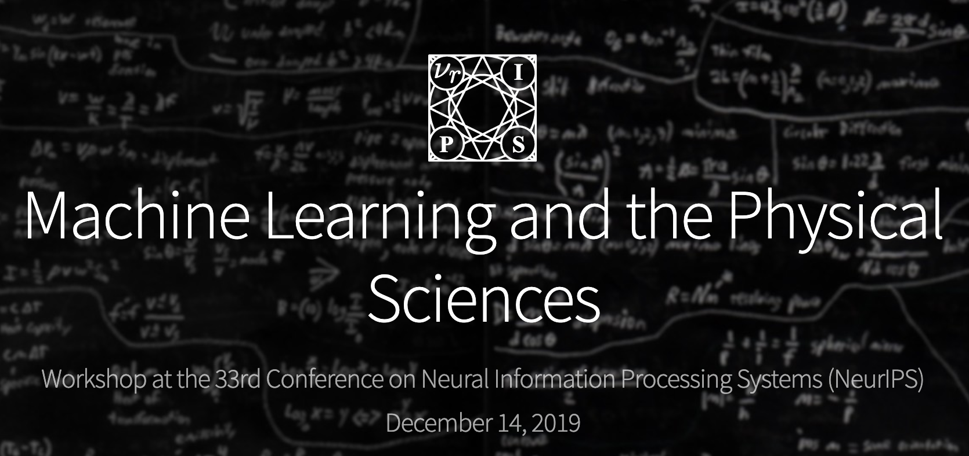
Current Activities
IAS/Princeton sponsored
Microsoft sponsored
Lectures Series
Various groups are organizing lectures where ML researchers present to physics groups (and vice versa)
IRIS-HEP sponsored
Individual Collaborations
Many physicists are collaborating directly with industry researchers; some hold dual appointments across physics and CS
Events at ML Conferences
ML and Physical Sciences Workshop at NeurIPS (2017, 2019), resubmitted for 2020. Brings physics applications and physics for ML together.

Slide 11
Questions to Consider
What are best practices for collaborating across disciplines?
Should it originate from the experiments? Universities? Individuals?
How can we assist physicists in connecting with established ML researchers?
How can the unique constraints of our problems/experiments inform the development of new ML methods?
How can we highlight the work physicists are doing to the wider ML community?
Key Collaborations: CommF1 (Applications and Industry), CommF5 (Public Education and Outreach), SEC

Slide 12
Open/Benchmark Datasets

Slide 13
Goals
Curate datasets to allow easy and accurate comparison of new ML techniques on established physics problems
Provide open data that is accessible to non-experiment specific researchers
Helpful to interested ML researchers and theorists
Cultivate a culture of open science and reproducible results

Slide 14
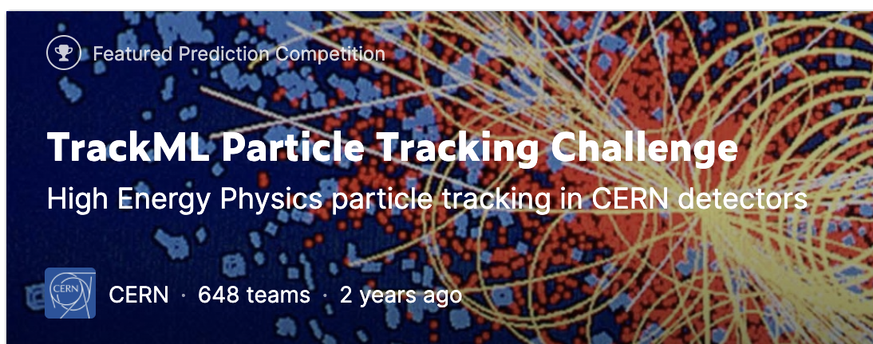
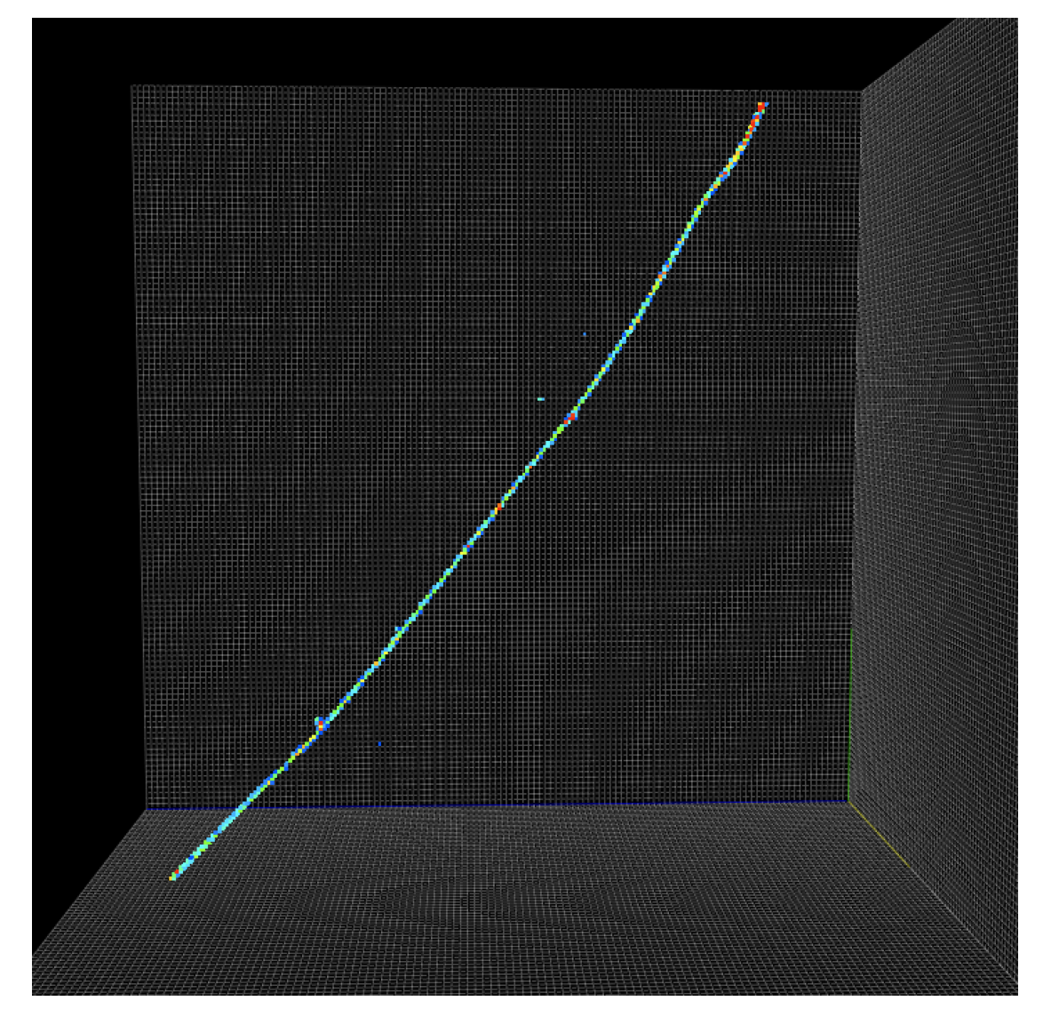
Current Efforts
Kaggle Challenges
Allow anyone to submit solutions to simplified physics problems.
Benchmarking Efforts
IML has started collecting existing benchmark datasets. CMS ML is working on developing more.
Open Datasets
Many experiments are providing open access datasets with necessary scale factors etc

Slide 15
Questions to Consider
What HEP problems need benchmark datasets?
Who should create and maintain them?
How can we ensure open datasets are accessible by non-physicists while still producing useful results?
How can we engage the broader ML community with these datasets?
Key Collaborations: CommF1 (Applications & Industry), CommF4 (Physics Education), CompF7 (Reinterpretation and long-term preservation of data and code)

Slide 16
Ethics and Safety of AI

Slide 17
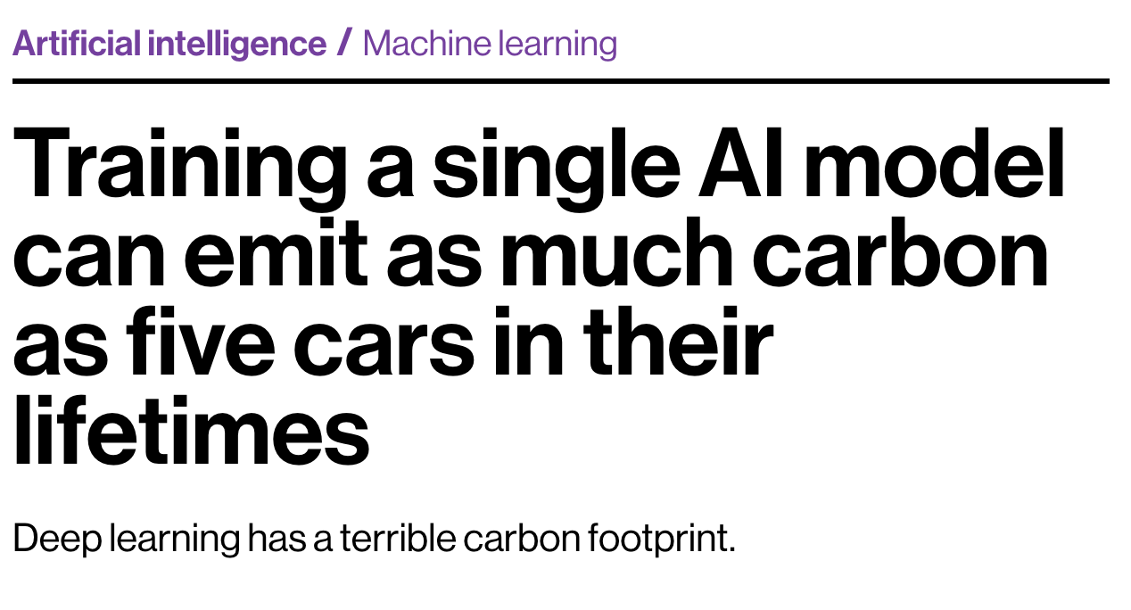
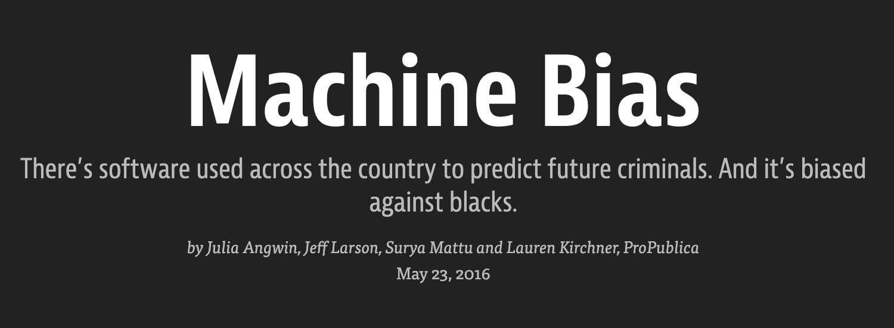
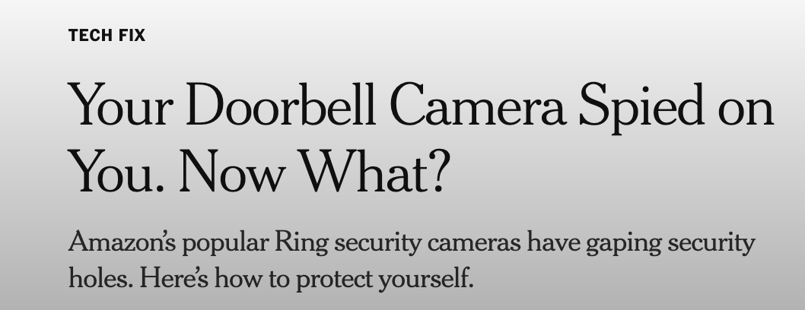
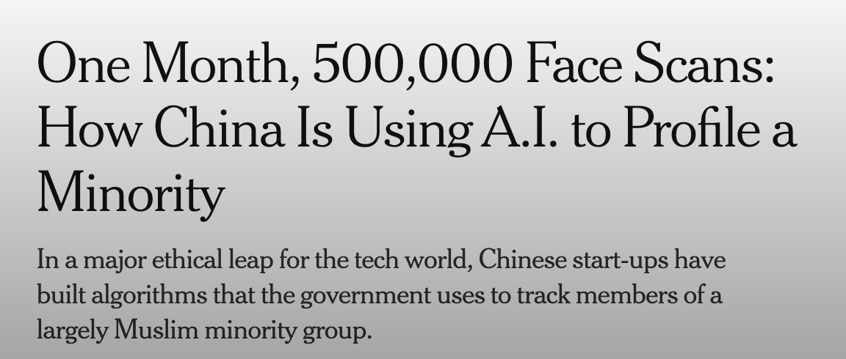
Ethics and Safety of AI
Notes:
Biased against minority communities, sexist, limited accuracy, deployed on disadvantaged communities, used for surveillance and oppression, big carbon footprint

Slide 18
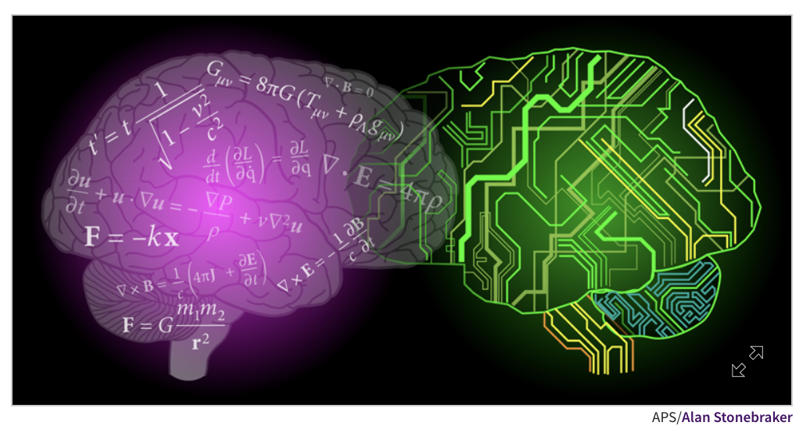
Why It Matters for Physicists
We are community members and developers
Physicists are contributing to and driving ML research
Many students who leave the field continue in industry ML
We are humans and citizens, these issues affect us and the communities we work and live in
We have critical skills and experience
Physics research relies on critical inquiry and robust analysis; we can bring these principles to ML experiments.
Our analyses require precise estimations of uncertainties and systematics; these are crucial calculations for publicly deployed ML
We seek to understand WHY an algorithm works for a certain problem; these methods can inform algorithmic interpretability
Our field has a rich history of public outreach and engagement; we can help develop these programs in ML

Slide 19
Questions to Consider
How can we enable inter-disciplinary conversations around these topics?
How can we ensure the educational resources we develop appropriately address these issues?
What unique perspectives and skills can physicists contribute to addressing these issues?
How can we all support our communities and use our technical skills in an equitable and just manner?
How can we be conscious of our computational power usage and limit it where appropriate?
Key Collaborations: CommF1 (Applications & Industry), CommF3 (Diversity & Inclusion), CommF4 (Physics Education), CommF5(Public Education and Outreach), CommF6 (Public Policy & Government Engagement), SEC

Slide 20
Conclusions
Machine Learning is becoming inextricably linked to physics research
We must ensure our community continues to develop these critical technical skills
We have opportunities to directly contribute to ML research AND to gain from ML researcher involvement
We must be conscious of the ethical implications of this work

