Slide 1



NISQ-era quantum devices for HEP
Norbert M. Linke
Joint Quantum Institute, University of Maryland, College Park, MD, USA
CompF06: Quantum Computing
QSFS Workshop, online
5 August 2020

Slide 2
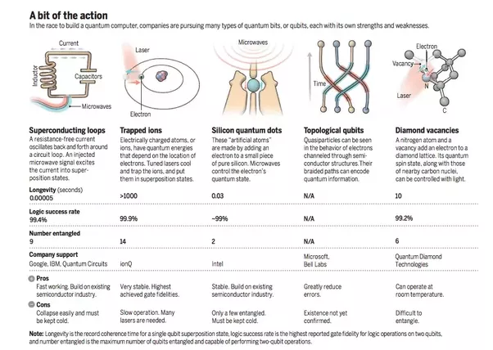
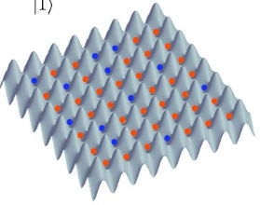
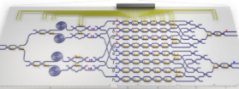
Quantum computer technologies
adapted from Science, Dec 2016
Neutral atoms
Photonics
Neutral atoms store qubits within electronic states. Interactions through Rydberg states
Photonic qubits interact via linear elements
1
97%
20
Google,
IonQ, Honeywell
Microsoft
Diamond Quantum
Technologies
Atom Computing
QuEra
PsiCorp
Xanadu
IBM, Rigetti, QCI
Intel, HRL, SQC
Many qubits, 2D and maybe 3D
Lasers needed, spaghetti physics, atoms escape
Linear optical gates, integrated on-chip
No memory, not clear how to scale

Slide 3
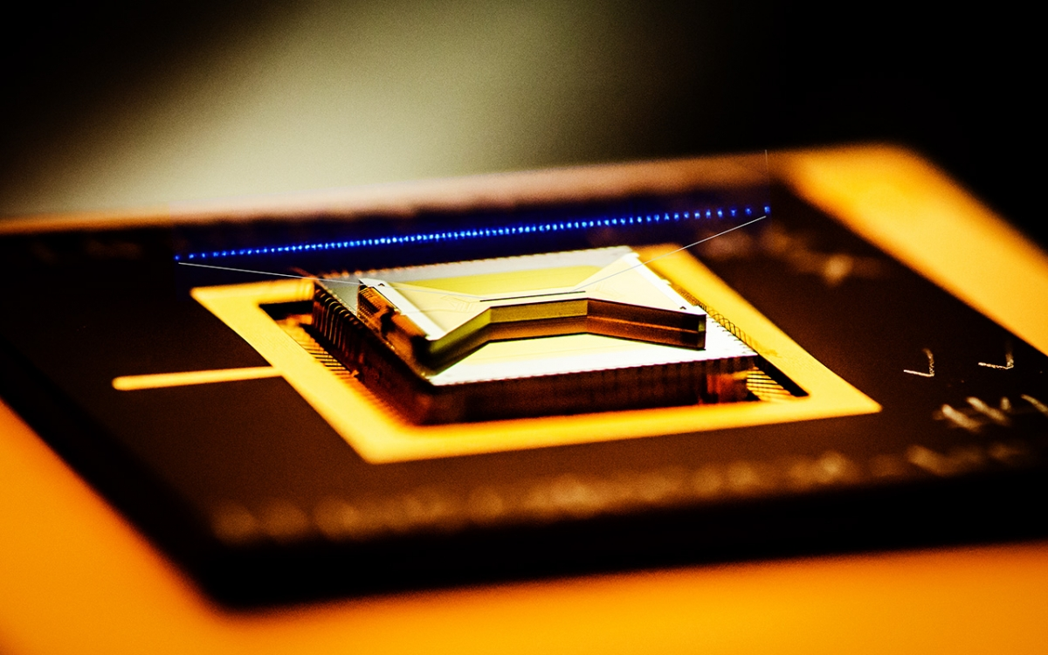
Trapped ions

Slide 4
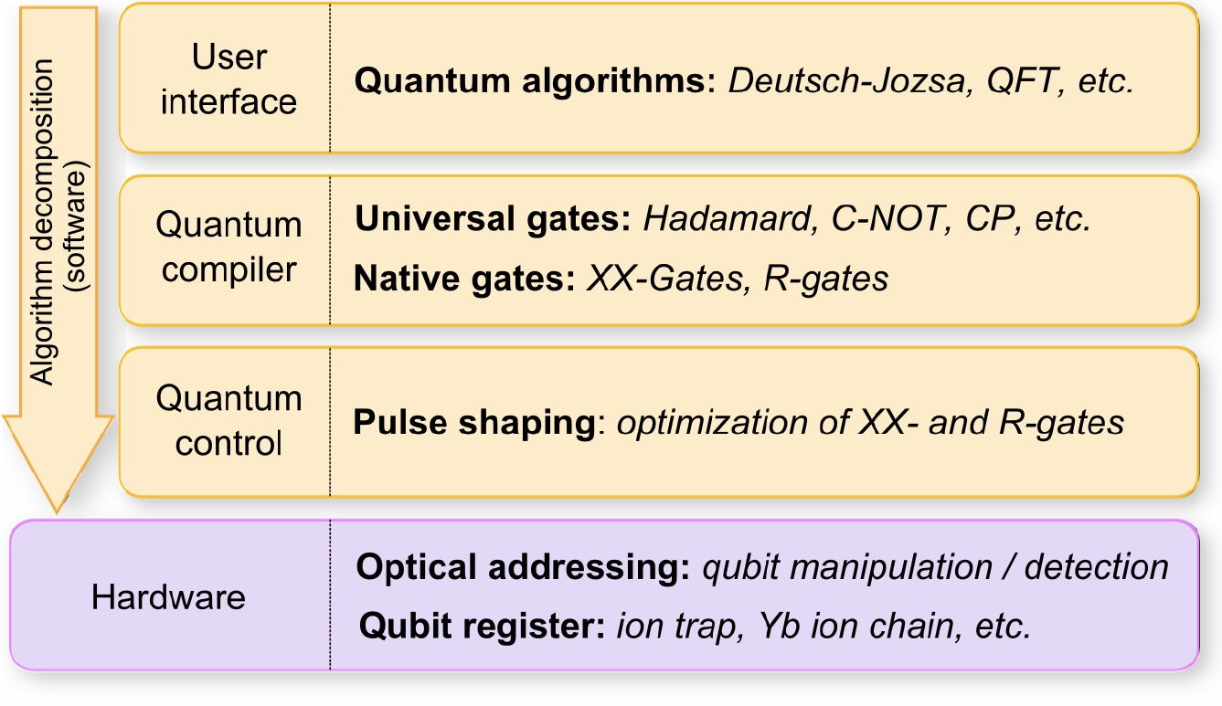

Modular architecture
Grover, Hidden Shift, EC …
S. Debnath et al. Nature 536 (2016)
Notes:
There are opportunities for specialization vs general devices at every level: co-design!

Slide 5
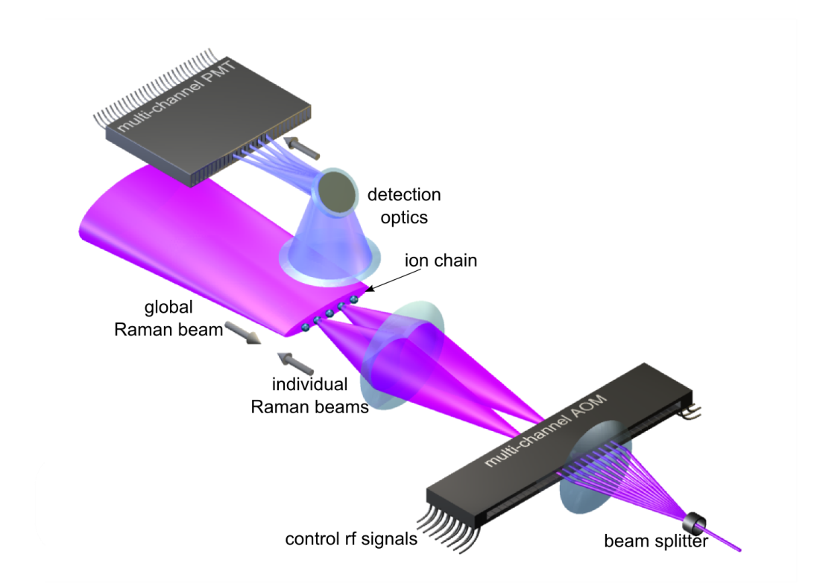
Hardware
¹⁷¹Yb⁺
²P_{3/2}
Δ=66 THz
²P_{1/2}
Δ=33 THz
355 nm
|1⟩
²S_{1/2}
|0⟩

Slide 6
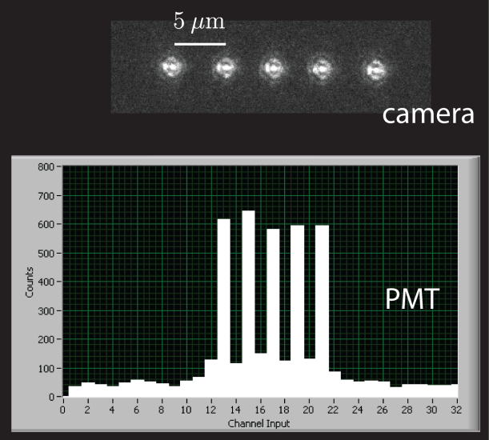
Hardware: Read-out

Slide 7
Modular architecture
Grover, Hidden Shift, EC …
S. Debnath et al. Nature 536 (2016)

Slide 8

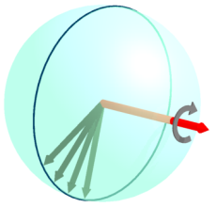
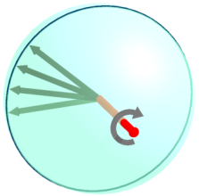


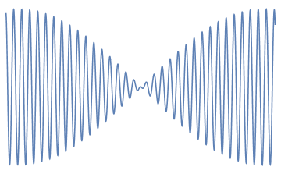
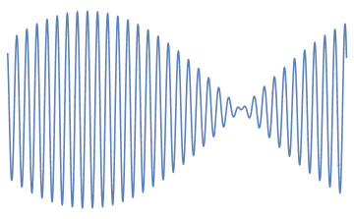
Quantum control
Raman beat note

Slide 9
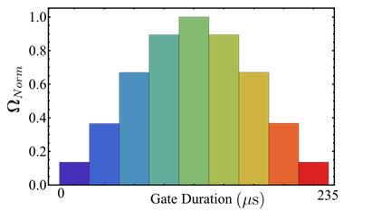

Quantum control
Raman beat note
…
Laser pulse shape: XX (Ising) - interaction

Slide 10
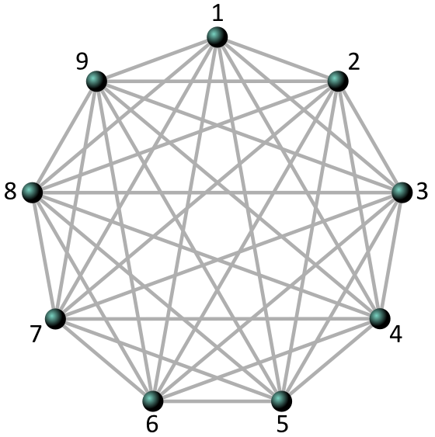
Quantum control: Full connectivity
not limited to local operations
NML et al. PNAS 114, 13 (2017)

Slide 11
Modular architecture
Grover, Hidden Shift, EC …
S. Debnath et al. Nature 536 (2016)

Slide 12
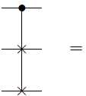
Quantum compiler: Fredkin gate
C-SWAP

Slide 13
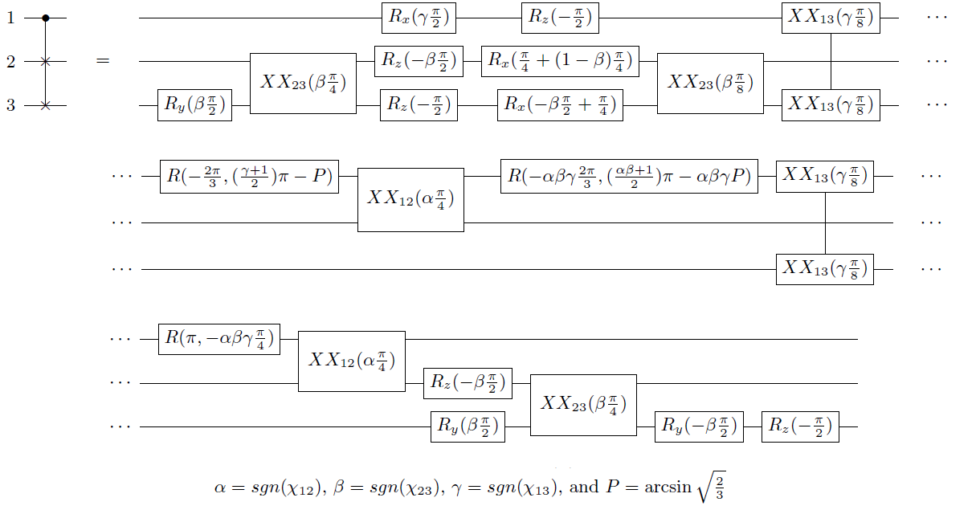
Quantum compiler: Fredkin gate circuit
NML et al., PRA 98, 052334 (2018)

Slide 14
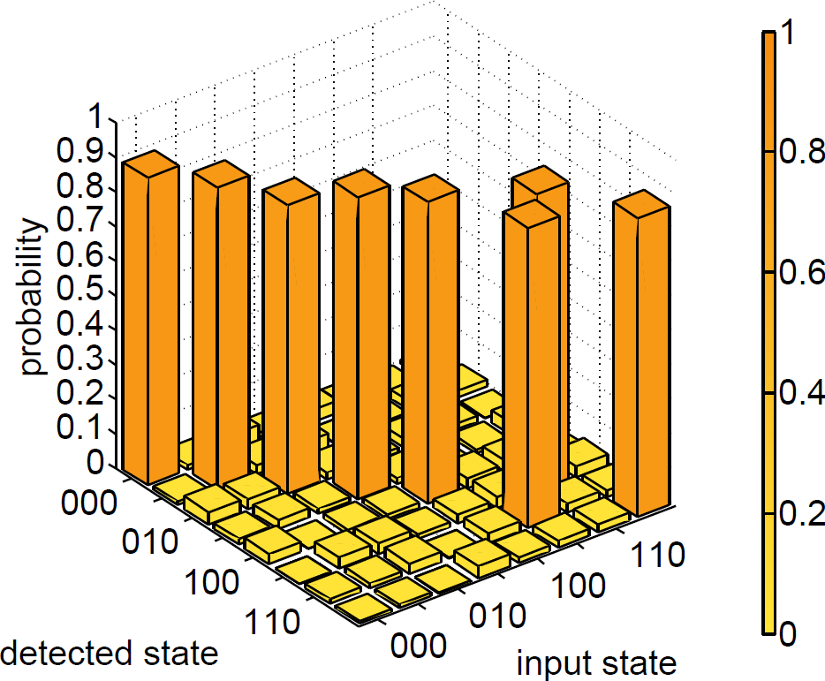
Quantum compiler: Fredkin gate results
Fredkin [1,2:4], F=86.8(3)%
(corrected for 2% spam error)
NML et al., PRA 98, 052334 (2018)

Slide 15
Modular architecture
Grover, Hidden Shift, EC …
P. Murali et al. ISCA-2019, 527-540
S. Debnath et al. Nature 536 (2016)

Slide 16
Schwinger model – digital simulation example
Notes:
Also known as the Quantum Alternating Operator Ansatz

Slide 17

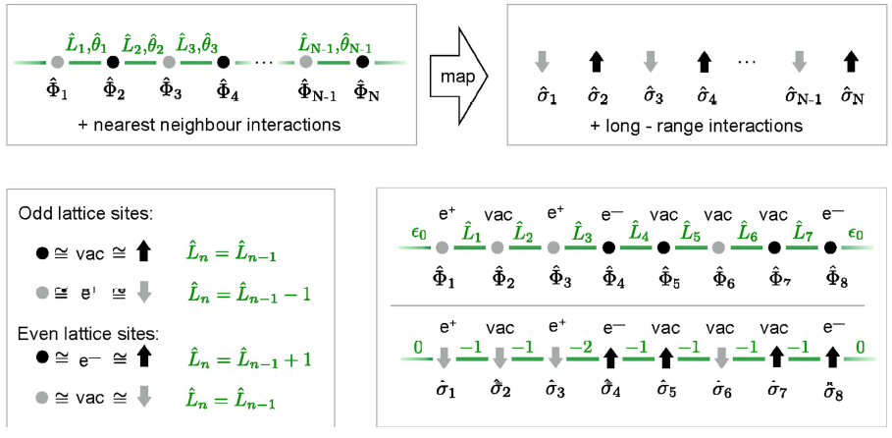
Lattice Schwinger model (spinless 1+1D QFT, discretized space, normalize)
Schwinger model – digital simulation
C. Muschik et al 2017 New J. Phys. 19 103020 (2018)

Slide 18
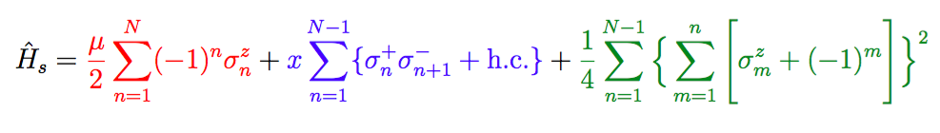
Schwinger model – digital simulation
Final qubit Hamiltonian
Fermion mass, hopping on lattice, E-field interaction
Trotterize, choose parameters

Slide 19
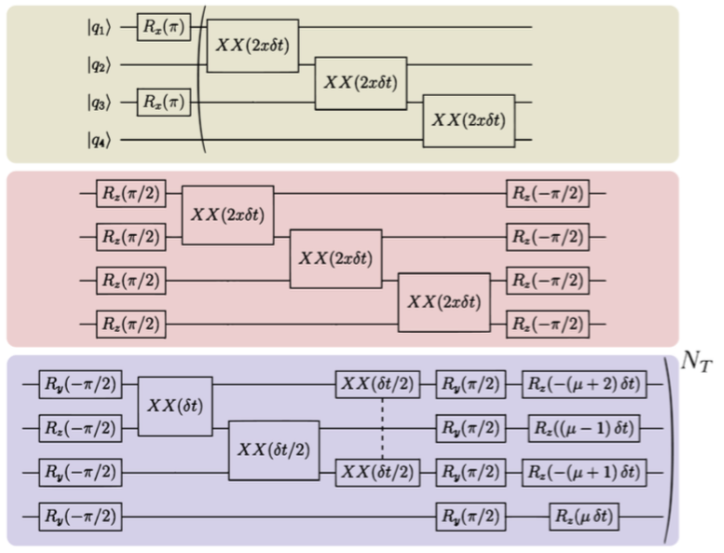
Schwinger model – digital simulation
2-site model circuit

Slide 20
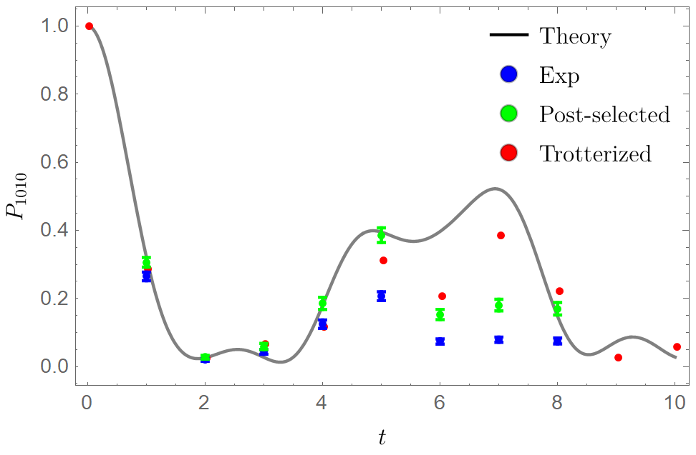
Schwinger model – digital simulation
2-site model circuit
preliminary

Slide 21
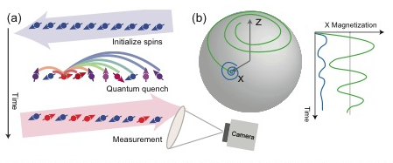
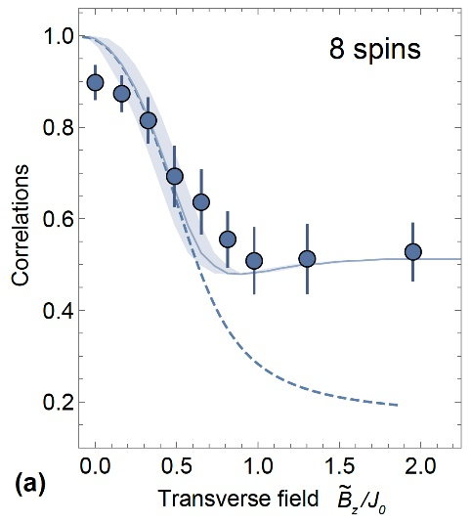
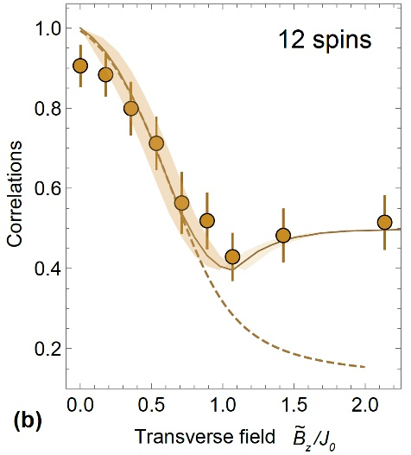
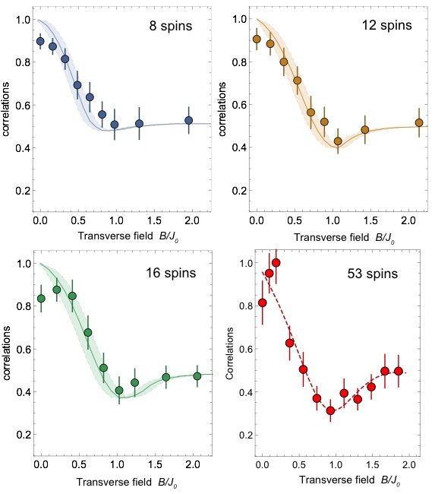
Trapped-ion analog simulations
J. Zhang, GP, et al., Nature 551, 601 (2017)

Slide 22
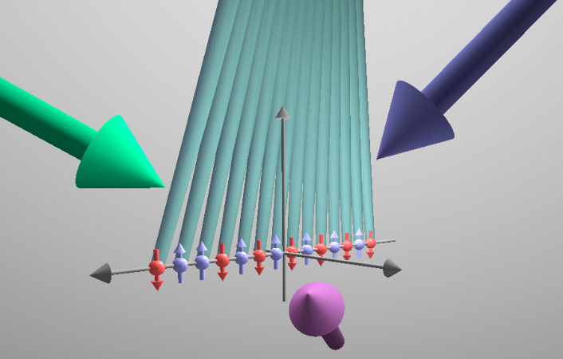
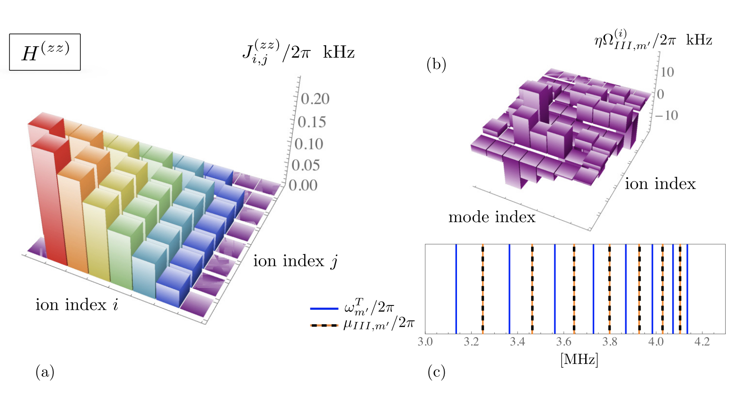
Analog simulation of the 1+1D Schwinger model
A specific device geometry to address a HEP problem
Z. Davoudi et al., PRR 2, 023015 (2020)

Slide 23
Outlook: How to scale up
no system will be fully connected for large N
scaling strategies
D. Kielpinski et al., Nature 417 (2002)
C. Monroe et al., Phys. Rev. A 89 (2014)
D. Hucul, et al., Nature Phys. 11 (2015)
J. M. Pino et al., arXiv:2003.01293 (2020)
L. J. Stephenson, et al., PRL 124 (2020)

Slide 24
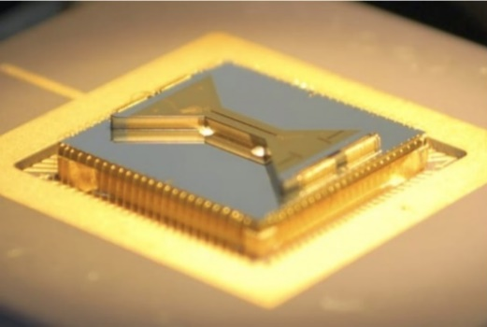

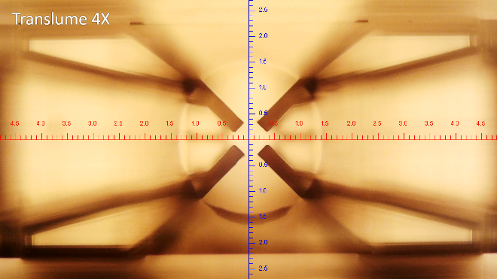
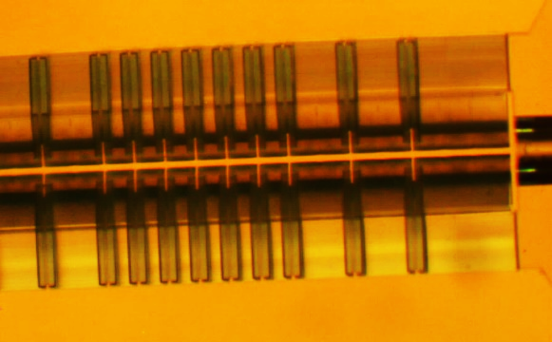
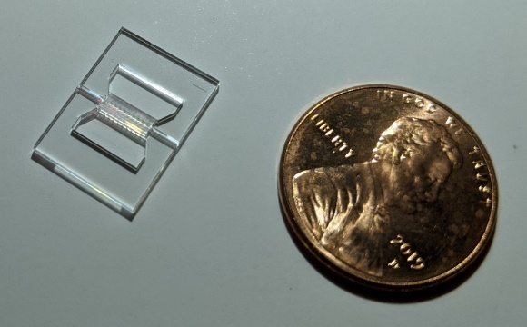
Outlook: the future - scaling up
2D surface traps
C. Monroe group and others
Monolithic 3D ion trap test pieces by Translume Inc. in collaboration with G. Pagano (Rice)

Slide 25
NISQ-era quantum devices for HEP
access to NISQ systems (devices and layers)
QC literacy through practice
co-design of new devices for HEP
challenge/benchmark for QI science

Slide 26
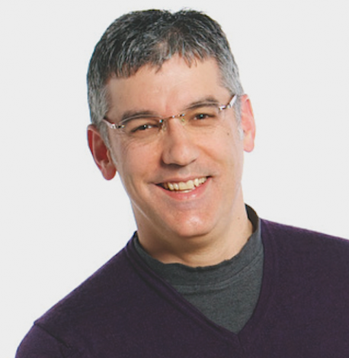
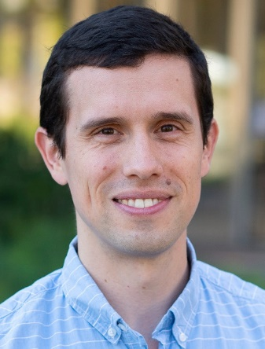

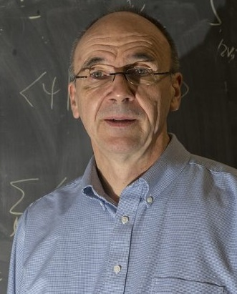

linkelab.umd.edu
Chris Monroe
(-> Duke)
NML
(UMD)
Zohreh Davoudi
(UMD)
Yannick Meurice
(U Iowa)
Guido Pagano
(Rice)
Notes:
Input from others for this presentation

