Slide 1
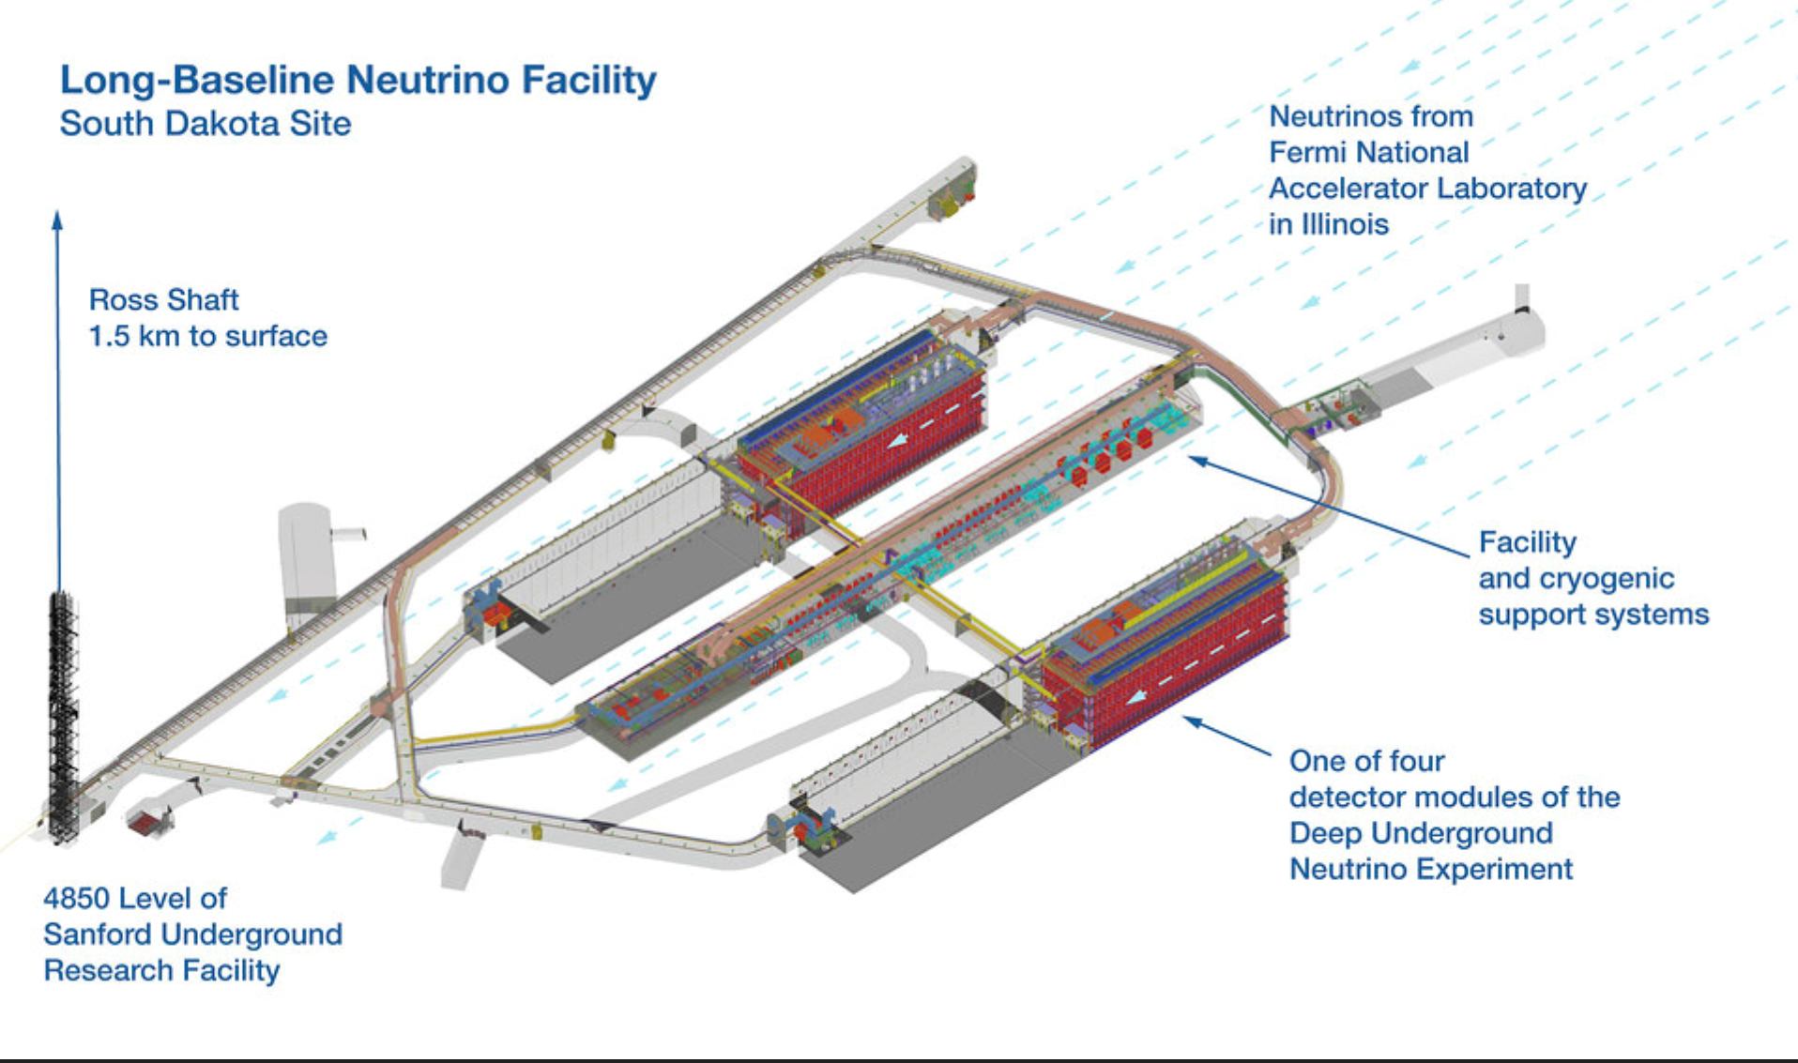
Future Information & Communications Technologies for the HL-LHC Era: 2020-2030, 2030-38 and Beyond
LHC Run3 and HL-LHC
DUNE
LSST SKA
BioInformatics
Earth Observation
LSST
Gateways to a New Era
LBNF/DUNE
Harvey Newman, Caltech
Snowmass Computational Frontier Workshop August 11, 2020 newman@hep.Caltech.edu

Slide 2
ICT Revolutions and HEP Vision for 2028 and Beyond
We will confront several technology between now and ~2028
Processors: 10 nm and 7 nm feature size designs difficult [Intel delay]; where is the limit in practice: 5nm ? 3 nm ? 2 nm ?
Magnetic storage: Below ~10nm “superparamagnetic limit”
Communications: the non-linear Shannon limit, and energy/heat limits
By ~2028 and beyond we will need to avoid the speed/energy tradeoffs of classical electronic systems to sustain our progress and our economy
Fortunately: plans and R&D for the transition are already underway [but HEP is so far relatively unaware]
Nanophotonics, plasmonics, and/or spintronics: ultrafast low energy signaling
Beyond CMOS: memory, logic devices, integrated electronic/photonic systems
Metamaterials and devices: To shape and direct light, form wavefronts and beams; also programmably
Beyond Shannon long haul optical communications systems and methods: SDM
These [R]evolutions will affect more than computing: TriDAS, all comms, intelligent “coherent” systems; our working + home environments
There will be great design and physics opportunities at the HL-LHC in 2030-38, and beyond for future experiments and accelerators
Bottom Line: We will need to follow, join and lead some of these forefront developments, as part of our future experimental roadmap and “frontiers”,

Slide 3
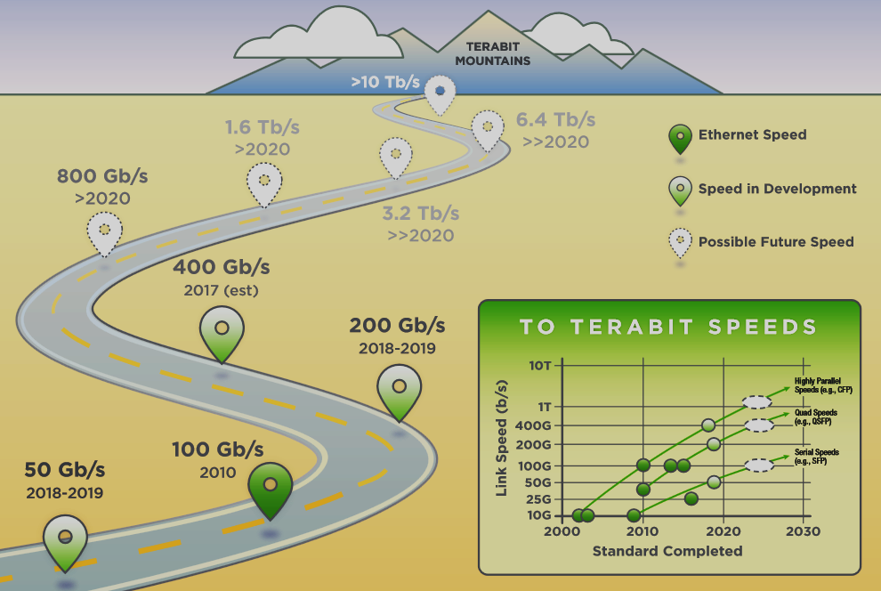
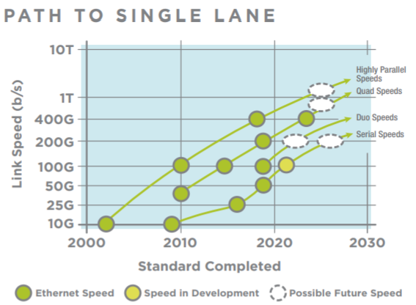
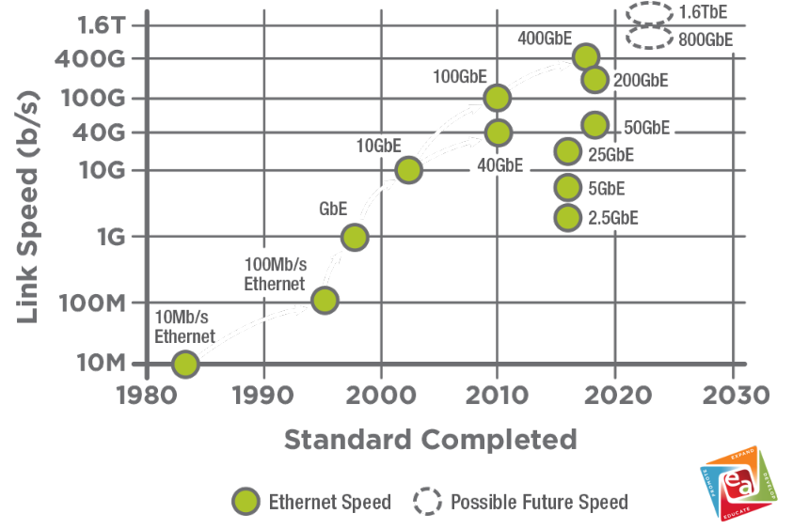
IEEE Ethernet Roadmap 1982 to 2022 to ?
A petabyte transfer would occupy a 100G link for 24 hrs at wire speed now
Circa 2023 (2028), a PB transfer would take 6-7 (3-4) hours on a 400G (800G) link
2018-19: 400G Switches, Optics Arrive
There is no roadmap beyond 0.8 – 1.6T
Due to physics barriers; uncertain, changing paradigms
Ethernet Alliance Roadmap
Beyond the Terabit Mountains: Physics - the Nanoscale Era
https://ethernetalliance.org/technology/2020-roadmap/

Slide 4
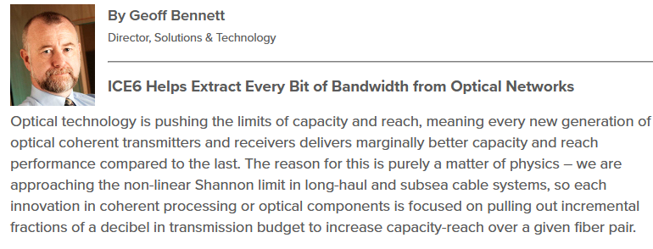
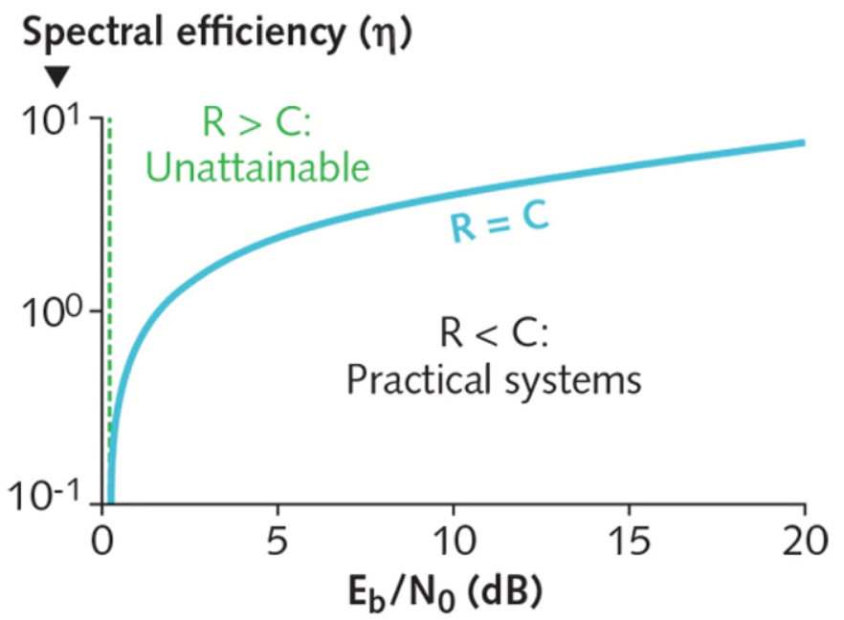
Approaching the Nonlinear Shannon Limit on Longhaul Optical Power Cables (OFC 2019)
Record spectral efficiency
At the technical sessions, engineers from Infinera and Facebook reported setting a record spectral efficiency of 6.21 bits per second per hertz of bandwidth for long-haul data efficiency in tests on the 6605 km MAREA cable between Virginia and Spain.
As installed, MAREA transmitted 20 Tbit/s on each of eight fiber pairs.
The team set aside one fiber for tests using the 16QAM (quadrature amplitude modulation) code on a superchannel with eight evenly spaced laser sources.
bits/sec/Hz
✴
Signal/Noise
https://www.laserfocusworld.com/fiber-optics/article/16556311/fiberoptic-communications-fiber-bandwidth-pushes-closer-to-nonlinear-shannon-limit

Slide 5
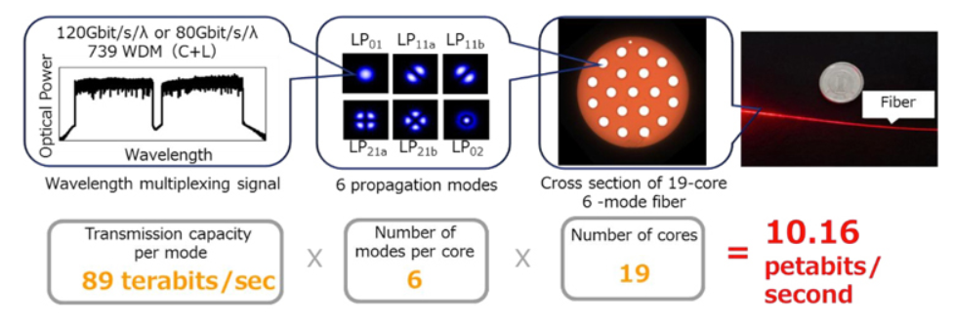
10.2 Petabit/sec over an SDM (multicore, multimode) + WDM fiber https://optics.org/news/8/10/23 (ECOC 2017)
Company says record-breaking result will contribute towards technology to support post-5G mobile communications.
Japan's KDDI Research and Sumitomo Electric Industries announced that their successful ultra-high capacity optical fiber transmission experiment has broken the previous world record for transmission capacity through a single optical fiber (2.15 petabits/second). The group achieved 10.16 petabits/s over multicore optical fiber, which enables 114-fold spatial multiplicity.

Slide 6
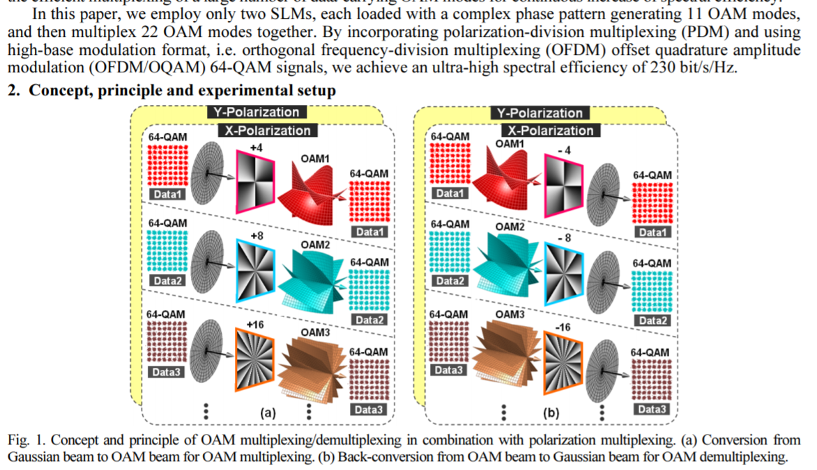
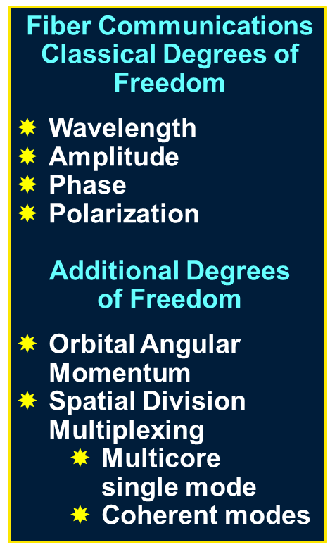
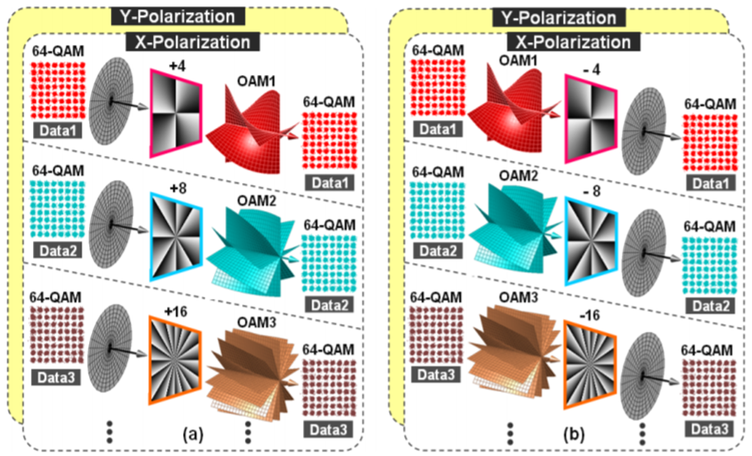
Going Beyond the Shannon Limit: More DOF:
Ultra-High 230-bit/s/Hz Spectral Efficiency using OFDM/OAM 64-QAM Signals over Polarization-Muxed 22 Orbital Angular Momentum (OAM) Modes OFC 2014 J. Wang et al., Paper W1H.4.df

Slide 7
Transistor Architecture: How far can one go ?
Samsung Foundry Forum 2019 https://www.extremetech.com/computing/291507-samsung-unveils-3nm-gate-all-around-design-tools
Planning to launch many process node lines, with development tracks for 7nm, 6nm, 5nm, 4nm, and yes, 3nm. 3nm design kit now in alpha
14nm, 10nm, and 7nm nodes use FinFETs — vertical “fins” above the formerly 2D channel structure, to increase the contact area between transistor channel and the gate.
New Gate All Around (GAA) Architecture with nanowires or nanosheets. From the slide:
“3nm increases performance by 35 percent while reducing power by 50 percent and area by 45 percent compared to 7nm”
Expect 5nm in mass production by (1H) 2020 (predicted gains of 10 percent performance or 20 percent power consumption over 7nm).
Consumer shipments of products built on 5nm would be expected (early) 2021. Samsung’s GAA FinFET is planned for risk production in late 2020 and volume production in late 2021. Consumer shipments would then be expected in early 2023.

Slide 8
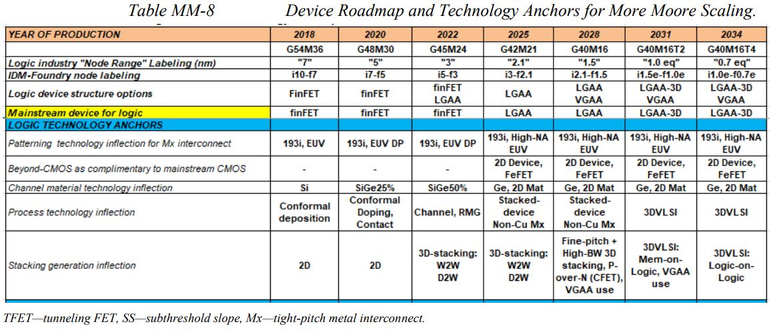
TSMC (Taiwan) Starts Development on 2nm Process Node, but What Technologies Will It Use? (April 29, 2020)
https://www.extremetech.com/computing/309889-tsmc-starts-development-on-2nm-process-node
The International Roadmap for Devices and Systems (IRDS) publishes periodic updates on the future of silicon technology, including a 2018 chapter called “More Moore”. They mapped out the expected technological developments for future nodes in broad strokes:
“The IDRS expects GAA (Gate-all-around) FETs and FinFETs to share the market at 3nm, with GAAFETs replacing FinFETs at 2nm. The acronym “LGAAFETS” refers to lateral gate-all-around FETS, or GAAFETs in a traditional 2D processor. Vertical Gate-all-around FETs would be used in yet-to-be-developed 3D transistor structures.
IDRS estimate of 2025 for 2.1nm is based on forecasting in 2018. The IDRS does not claim to know the exact dates when Intel, TSMC, or Samsung will introduce a node. With 5nm launching in 2020, we might expect 3nm by 2022, and 2nm by 2024 – 2025, so the estimate looks reasonable.”
CMOS ?

Slide 9
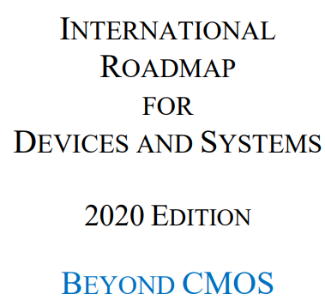
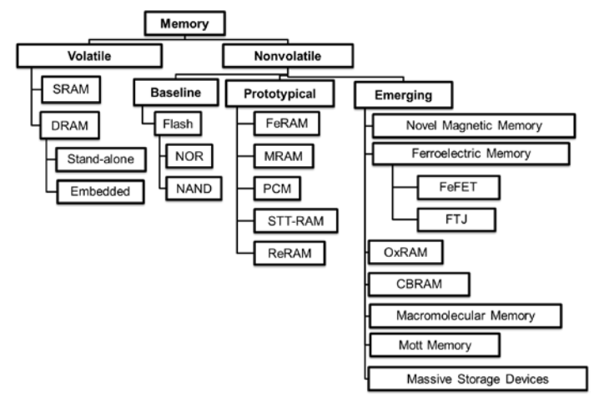
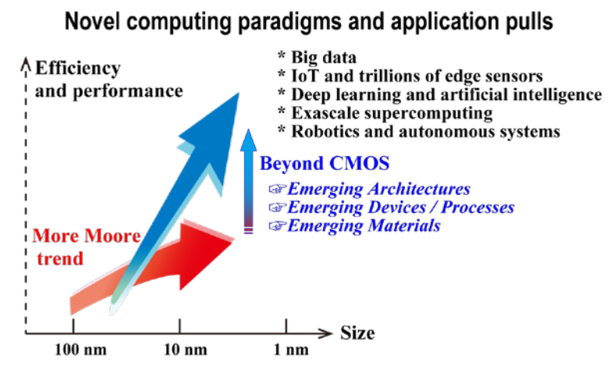
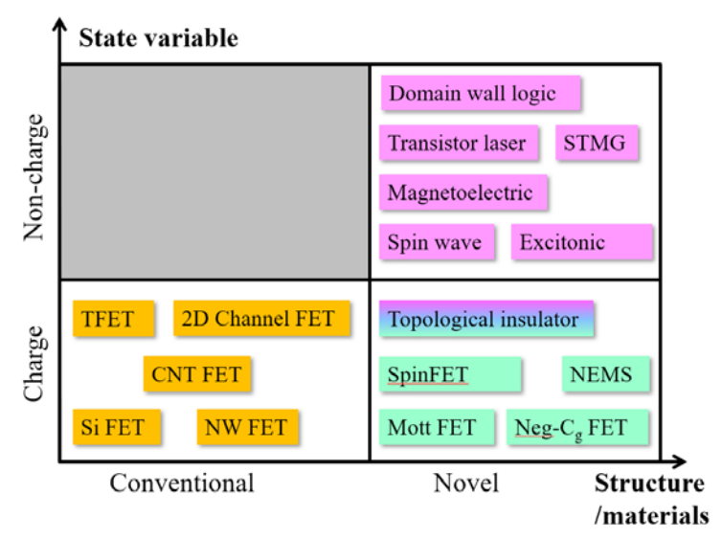
International Roadmap for Devices and Systems
2020 Edition https://irds.ieee.org/
Taxonomy of Emerging Logic Devices
Relationship of More Moore, Beyond CMOS, and Novel Computing Paradigms and Applications
Taxonomy of Emerging Logic Devices

Slide 10
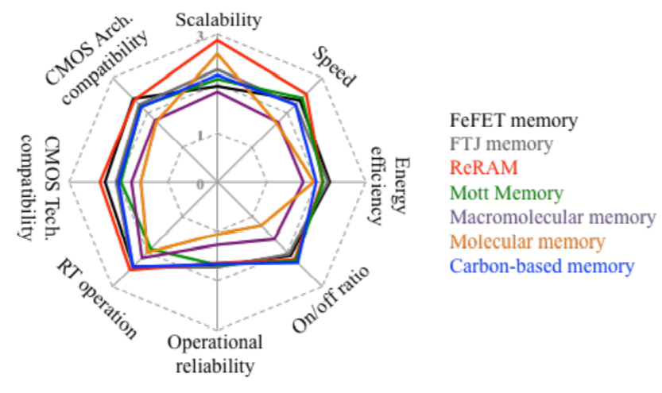
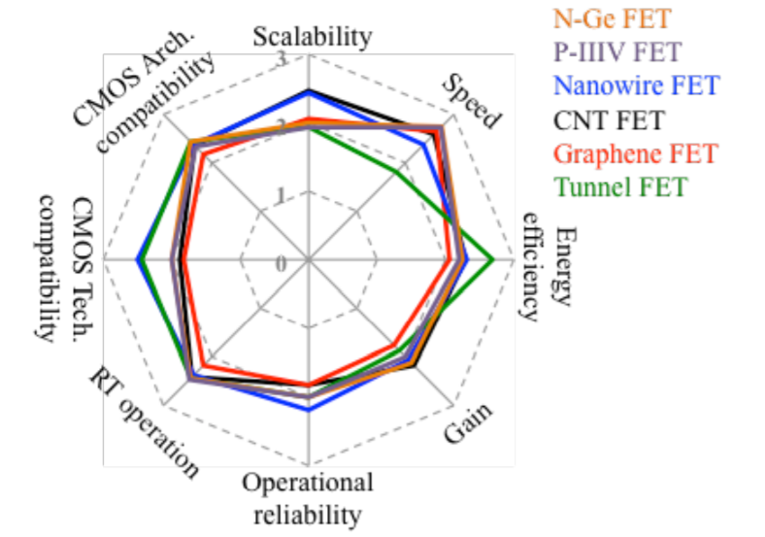
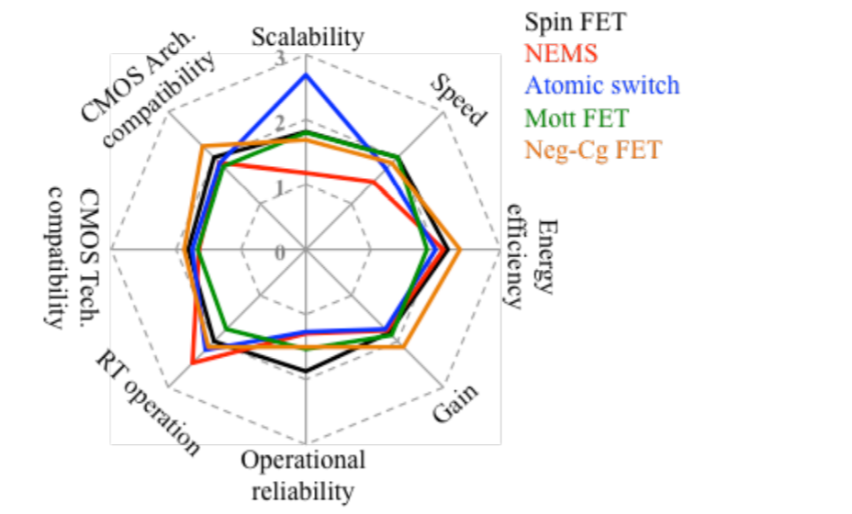
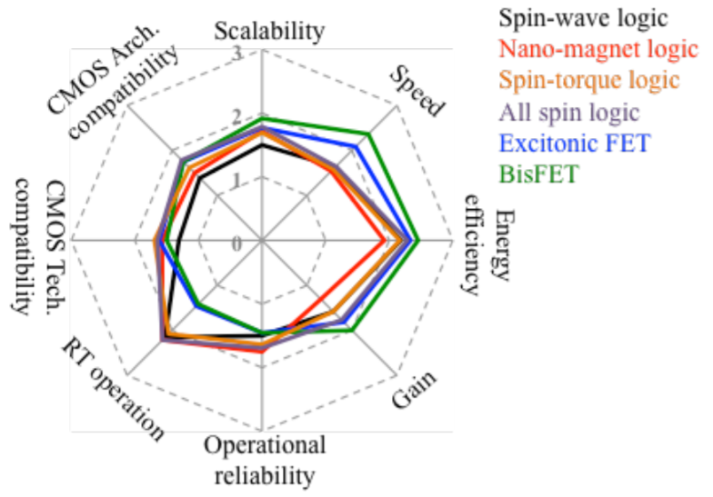
IEEE IRDS 2020 Beyond CMOS Volume 2013 Survey Evaluation of Emerging Memory and Logic Device Alternatives
https://www.dropbox.com/s/v62qtb7bdb0uho6/IRDSBeyondCMOSIEEE_2020Edition.pdf?dl=0
Criteria: 1) Scalability, 2) Speed, 3) Energy Efficiency, 4) Gain (Logic) or ON/OFF Ratio (Memory), 5) Operational Reliability, 6) Operational Temperature, 7) CMOS Technological Compatibility, and 8) CMOS Architectural Compatibility.
Emerging Memory Devices
CMOS Extension Logic Devices
Non-Charge-Based Beyond CMOS Logic Devices
Charge-Based Beyond CMOS Logic Devices

Slide 11
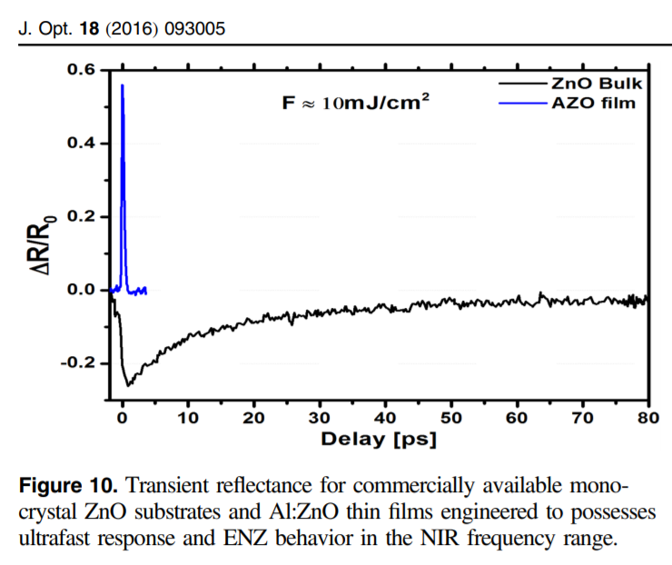
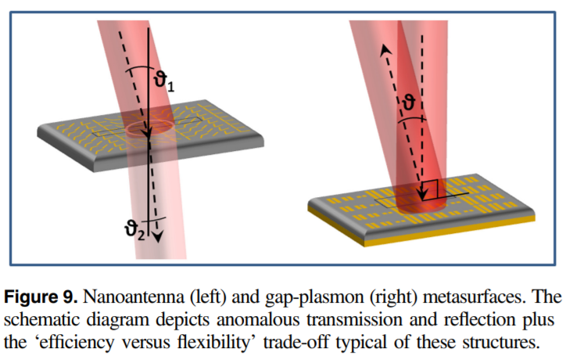
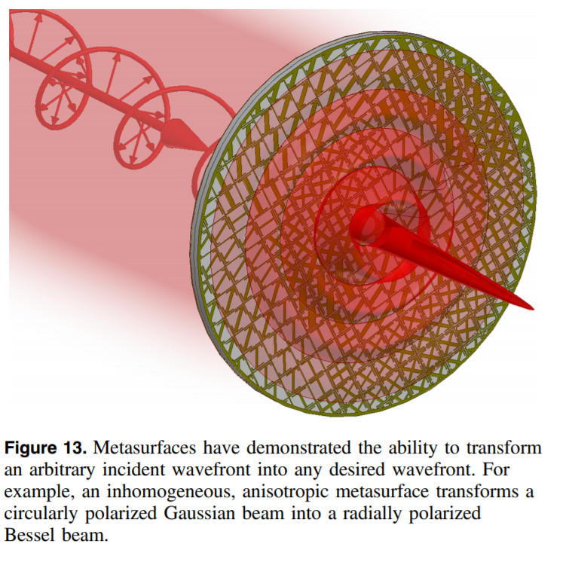
Optical Metamaterial Roadmap: Urbas et al., J. Opt. 18 (2016) 0930005 DOI 10.1088/2040-8978/18/9/093005
Metamaterials with nanopatterned surfaces offer the new possibility to design and engineer materials with desired material parameters temporally, spatially, locally and/or globally
This opens the unprecedented ability to tailor, manipulate, redirect and scatter waves, and form beams and wavefronts as desired with an anisotropic, inhomogeneous metasurface
Introducing metal constituents (exhibiting electric resonances) into the world of photonics allows for extraordinary engineered composite materials with effective optical properties distributed over a more extensive region of the electromagnetic parameter space (ε–μ space)
New materials: transition metal nitrides (TMN) and transparent conductive oxides (TCO) provide lower losses and much improved tunability compared to silver and gold. This makes them promising for next generation metamaterials and plasmonic devices.
(sub-)Picosecond Near-IR reflectance from AlZnO thin film
Anomalous Transmission and Reflection from Metasurfaces
Transforming a circularly polarized Gaussian bean to a radially polarized Bessel beam

Slide 12
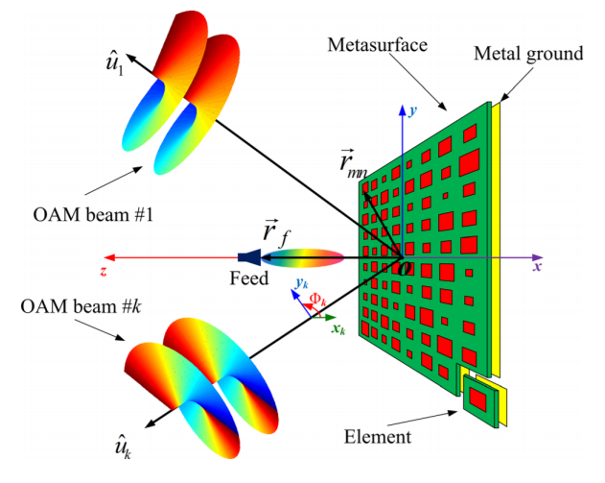
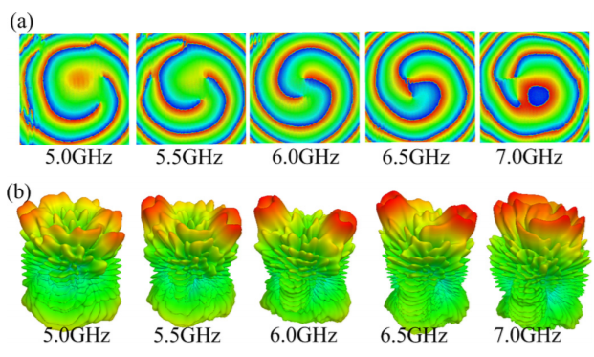
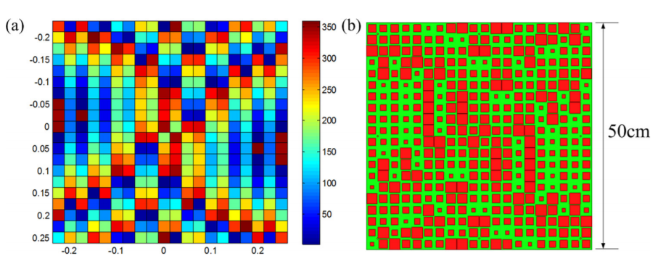
Generating Multiple OAM (Vortex) Beams with a Metasurface RF Phased Anntena Array
Configuration of multi-beam OAM Generating Metasurface OAM Yu et al., APPLIED PHYSICS LETTERS 108, 241901 (2016)
Simulated near-field phase distribution and far-field radiation patterns at different frequencies
Reflection Phase and Geometric Layout of the Array

Slide 13
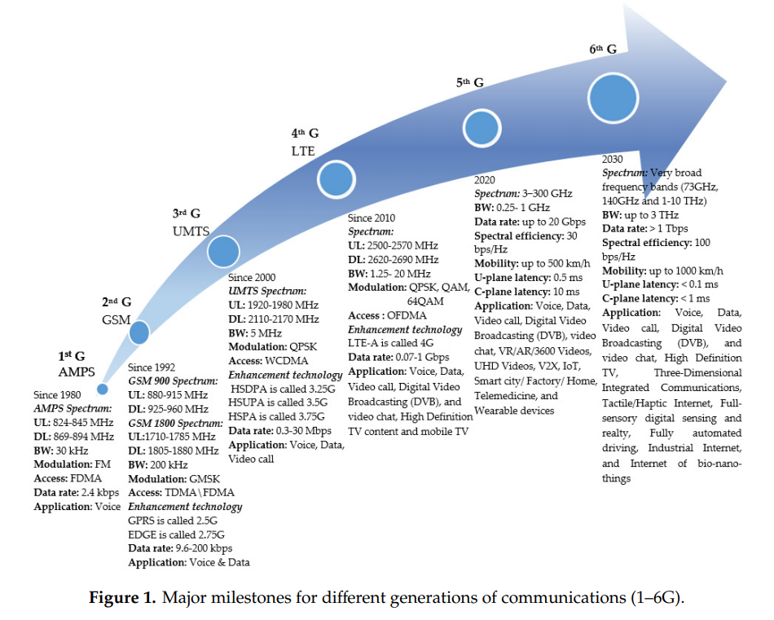
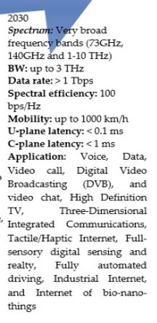
Sixth Generation (6G) Wireless Networks: TeraHz, Tbps; Fully Automated Driving, Io Bio-nano Things
https://www.mdpi.com/journal/symmetry Symmetry 2020, 12, 676; doi:10.3390/sym12040676

Slide 14
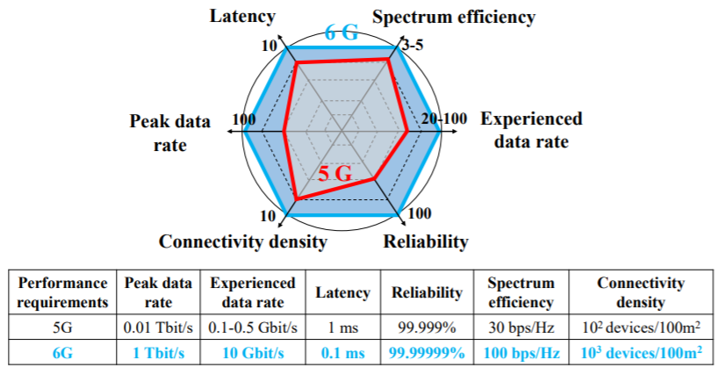
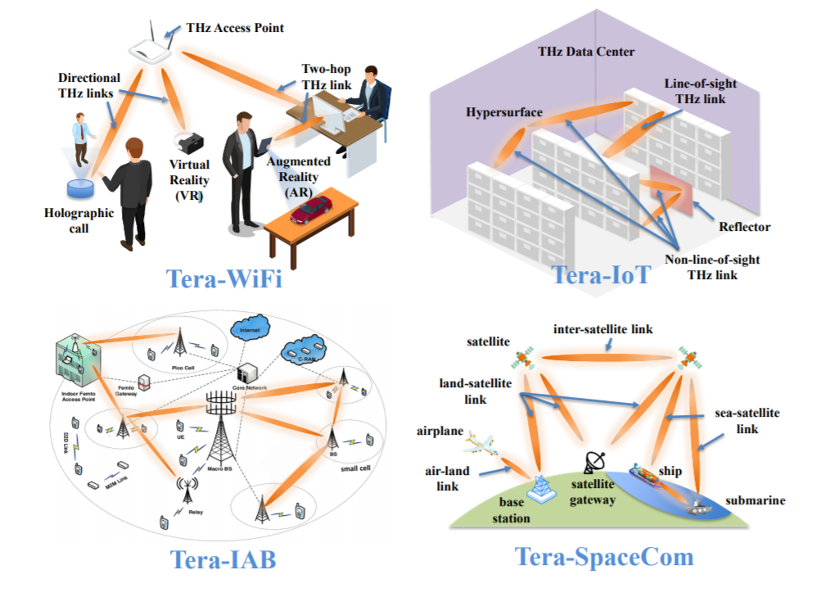
TeraHertz Communications: Challenges and Impact on 6G Wireless Systems C, Han et al., arXiv:1912.06040v1 [eess.SP] 12 Dec 2019
Performance Requirements for 6G
6G Applications in the TeraHertz Band
Disruptive 6G Parameters:
1 Tbps peak data rate
0.1 msec latency
7-Nines reliability
100 bps/Hz spectral efficiency
1000 devices per 100 M2

Slide 15
ICT Revolutions and HEP Vision for 2028 and Beyond
The revolutionary developments underway to overcome the looming barriers in electronic and photonic systems, and hence in computing and communications systems, to maintain progress and economies, offer unprecedented opportunities for our field
As discussed in this talk, these include
Nanophotonics, plasmonics, and/or spintronics: ultrafast low energy signaling
Beyond CMOS: memory, logic devices, integrated electronic/photonic systems
Beyond Shannon long haul optical communications systems and methods: SDM
Metamaterials and devices: To shape and direct light, form wavefronts and frequency dependent beams; + programmably, on several time + distance scales
HEP, and its planning as a community have until now taken only limited account of these Revolutions; [R]evolutions which affect more than computing: TriDAS, all comms, intelligent “coherent” systems; our working + home environments
There will be great design and physics opportunities at the HL-LHC in 2030-38, and beyond for future experiments and accelerators
Bottom Line: We need to follow, join and lead some of these forefront developments, as part of our longterm experimental roadmap and our “frontiers”

Slide 16
Information Sources and References
International Roadmap for Devices and Systems (2020 Edition) https://ieee.irds.org Beyond CMOS Volume:
https://www.dropbox.com/s/v62qtb7bdb0uho6/IRDSBeyondCMOSIEEE_2020Edition.pdf?dl=0 IRDS 2020 Executive Summary
https://irds.ieee.org/images/files/pdf/2020/2020IRDS_ES.pdf
NanoElectronics Roadmap for Europe: Identification and Dissemination (2017), F. Balestra, https://www.nereid-h2020.eu/roadmap
Two-dimensional materials for next-generation computing technologies Nature Nanotechnology 15, 545-557 (2020) https://www.nature.com/articles/s41565-020-0724-3
Samsung Unveils 3nm Gate-All-Around Design Tools https://www.extremetech.com/computing/291507-samsung-unveils-3nm-gate-all-around-design-tools TSMC Starts Development on 2nm Process Node, but What Technologies Will It Use?
https://www.extremetech.com/computing/309889-tsmc-starts-development-on-2nm-process-node
With Spintronics, Intel Sees Efficiency, Density Scaling Far Beyond CMOS
https://www.extremetech.com/extreme/281684-intel-meso-device-offers-efficiency-density-scaling-far-beyond-cmos
Chiplets Do Not ‘Reinstate’ Moore’s Law https://www.extremetech.com/computing/309946-chiplets-do-not-reinstate-moores-law
Chiplets Are Both Solution to and Symptom of a Larger Problem
https://www.extremetech.com/computing/290450-chiplets-are-both-solution-and-symptom-to-a-larger-problem
Optical RAM and integrated optical memories: a survey Alexoudi et al. Light: Science & Applications (2020) 9:91 https://doi.org/10.1038/s41377-020-0325-9
Wireless Industry’s Newest Gambit: Terahertz Communication Bands
https://spectrum.ieee.org/telecom/internet/wireless-industrys-newest-gambit-terahertz-communication-bands
Photonic surface waves on metamaterial interfaces
O Takayama et al 2017 J. Phys.: Condens. Matter 29 463001 https://doi.org/10.1088/1361-648X/aa8bdd
Advances in terahertz communications accelerating by photonics Nature Photonics 10, pp. 371-379 (2016) http://dx.doi.org/10.1038/nphoton.2016.65
Rapid Matchmaking for Terahertz Network Transmitters and Receivers https://spectrum.ieee.org/tech-talk/computing/networks/terahertz-linkdiscovery
Novel Materials Could Help Terahertz Chips Deliver Data at Terabits-Per-Second Rates https://spectrum.ieee.org/nanoclast/computing/hardware/terahertz-chip
Towards Intelligent Metasurfaces: The Progress from Globally Tunable Metasurfaces to Software-Defined Metasurfaces with an embedded Network of Controllers, O. Tsilipakos et al., Adv. Optical Mater. 2020, 2000783 DOI: 10.1002/adom.202000783
New “Network 2030” Group Asks: What Comes After 5G? https://spectrum.ieee.org/tech-talk/telecom/internet/network-2030-wants-to-address-the-problems-5g-could-bring-to-our-communications-systems
Sixth Generation 6G Wireless Networks Vision and Research
https://www.dropbox.com/s/tpgqip0wlc2kvdu/Sixth_Generation_6G_Wireless_Networks_Vision_Resea%281%29.pdf?dl=0
What should 6G be ?, S. Dang et al., Nature Electronics 3 pp. 20-29 (2020) https://doi.org/10.1038/s41928-019-0355-6
Terahertz Communications: Challenges and Impact on 6G Wireless Systems C. Han et al., https://arxiv.org/abs/1912.06040

Slide 17
Information Sources and References (II)
Present and Future of Communications II https://cmte.ieee.org/futuredirections/2019/12/06/present-and-future-of-communications-ii/ https://cmte.ieee.org/futuredirections/2020/07/28/a-momentous-shift-ahead/
IEEE Ethernet Alliance 2020 Roadmap https://ethernetalliance.org/technology/2020-roadmap/
Optical Communications Trends in Data Centers, D. Kom, Corning Optical Communications https://www.sgnog.net/SGNOG7/B.2%20Optical%20Comm%20Trends%20in%20Data%20Centers_20190712%20(wide).pdf
Graphene and two-dimensional materials for silicon technology D. Akinwande et al., Nature 573, pp. 507-518 https://doi.org/10.1038/s41586-019-1573-9
Graphene-based integrated photonics for next-generation datacom and telecom M. Romagnoli et al., Nature Reviews of Materials 3, pp/ 392-414 https://doi.org/10.1038/s41578-018-0040-9
Roadmap on metasurfaces, Oscar Quevedo-Teruel et al 2019 J. Opt. 21 073002 https://doi.org/10.1088/2040-8986/ab161d
Metamaterial, plasmonic and nanophotonic devices F. Monticone and A. Alù 2017 Rep. Prog. Phys. 80 036401 https://doi.org/10.1088/1361-6633/aa518f
Neuro-inspired computer chips, Nature Electronics 3, pp. 371-382, https://doi.org/10.1038/s41928-020-0435-7
L. Liu, Introduction to Nanophotonics, https://nanohub.org/resources/7670/download/Introduction_to_Nanophotonics.pdf
Fiber-optic Communications: Fiber bandwidth pushes closer to nonlinear Shannon limit https://www.laserfocusworld.com/fiber-optics/article/16556311/fiberoptic-communications-fiber-bandwidth-pushes-closer-to-nonlinear-shannon-limit
Exceeding the Nonlinear Shannon-Limit in Coherent Optical Communications by MIMO Machine Learning https://arxiv.org/ftp/arxiv/papers/1802/1802.09120.pdf
Future Trends in Fiber Optics Communications, A. Tiwari et al., International Journal of Engineering Applied Sciences and Technology, International Journal of Engineering Applied Sciences and Technology, 2020 Vol. 4, Issue 10, ISSN No. 2455-2143, Pages 203-207
Multiple Nanophotonics Articles: https://www.sciencedirect.com/topics/physics-and-astronomy/nanophotonics
Optical Communications Roadmap, Agrell et al. (2016), J. Opt. 18 063002 https://iopscience.iop.org/article/10.1088/2040-8978/18/6/063002/pdf
Optical Communications Trends in Data Centers https://www.sgnog.net/SGNOG7/B.2%20Optical%20Comm%20Trends%20in%20Data%20Centers_20190712%20(wide).pdf
Roadmap on All Optical Processing
May 2019 Journal of optics 21(6):063001 DOI 10.1088/2040-8986/ab0e66 https://www.researchgate.net/publication/333180540_Roadmap_on_all-optical_processing
Plasmonic circuits for manipulating optical information
https://www.researchgate.net/publication/310492971_Plasmonic_circuits_for_manipulating_optical_information Roadmap on Optical Metamaterials https://iopscience.iop.org/article/10.1088/2040-8978/18/9/093005
Generating multiple orbital angular momentum vortex beams using a metasurface in radio frequency domain Appl. Phys. Lett. 108, 241901 (2016); https://doi.org/10.1063/1.4953786

Slide 18
Extra Slides Follow

Slide 19
11 Ongoing Technology (R)evolutions in 2019-22
Processors: The Intel “Lakes”: Skylake, Cascade Lake, Ice Lake (10nm)…. AMD EPYC (10nm; 32 cores) to “Rome” (7nm; 64 cores): Today
Computer Buses: PCIe 3.0 to 4.0; 8 to 16Gbps per lane, up to 16 lanes Gen5 and 6 may not be far behind
Optical Networks: 100G to 200G, 400G, 800G; PAM4 Encoding; Transitions in major R&E networks beginning: ESnet6, Internet2 NGI
Switching: 32 X 400G Switches: Arista, Dell, Cisco, Juniper + “Merchant Silicon” from Broadcom (to many companies); ~2M ports by 2022
Network Interfaces: 200GE Ethernet; Matches PCIe 4.0 16 lanes
SSD Storage: Rapid Price Drop. New Form Factors: NF1, Ei.S & L Ruler to 30 Tbytes in 1 Slot; to 20+ Petabytes, to 1.3 Terabytes/sec in one rack
AI Integration: Support for multi-GPUs in 2U to 4U servers; Hybrid systems with low power GPUs to integrate ML in mainstream clusters
GPU and FPGA competition: NVIDIA, AMD, Intel; Habana Labs; Cerebras
New AI chips: Intel 64 Neuromorphic “Loihi” Processor. 8.3M neuron System: 1000x better performance, 10k time lower energy claimed
Disaggregated computing: separate (cores) compute, storage and communications for greater flexibility, adaptability to apps and technology
Higher speed lower energy interconnects: Silicon photonics, plasmonics; integration of nanoparticles. Then Graphene, quantum optics and sensors

Slide 20
Facts of Life Beyond Data Centers, Processing and Analysis: Cultural Change
There are already major changes underway that will have a great impact on our designs and plans
Both between now and 2026, and then beyond
Emergence of machine-to-machine (MTM) communication
~20B devices now; 20B by ~2020
Digital Assistants: AI smartphones + Alexa/Siri: tip of the iceberg
IOT: Expanding intelligence, autonomy, pervasiveness, coordination
Emergence of smart apartments/homes, buildings, neighborhoods and cities
How is it affecting, and will it affect our designs and plans ?:
Real-time low power AI devices: responsive on microsecond to millsecond timescale: already on the radar for the Phase II Trigger
Can we use this for real-time event cleanup ? Pre-processing ?
Autonomous tracking of workflows: real-time remediation if workflow is delayed; managing user/system interactions ?

Slide 21
Information and Communications Technologies During the HL-LHC Era: in 2030 and Beyond
Top Line Message A comprehensive R&D program to develop the architecture, design, prototyping, scaling and optimization of the HL-LHC Operational Computing Model is required
Including the worldwide network as a first class resource coordinated with distributed computing and storage
Including innovative approaches in several areas
Keys to Help Close the Gap: (1) use compact event forms (2) specify data collections by activity and physics group (3) define cache use and other operational steps (4) develop adaptive services; with site-network coordination (5) define metrics of success
Integrating, mediating among sites and networks to form a worldwide fabric supporting HEP workflow
The CMS and ATLAS “Blueprint” Work to Define the HL LHC Computing Model is a crucial activity

Slide 22
Facts of Life: Towards the Next Generation Computing Model
The projected needs and shortfalls in computing, storage and networks for the HL LHC era remain daunting; still with our best code improvements + foreseeable technology evolution through 2028
Steps to mitigate this mismatch: efficient use of all resources, including exascale computing systems, vectorization, massive parallelization (GPUs, FPGAs) etc.
Industrial technology visions are towards “heterogeneous architectures”
Adapted to “AI” at all levels, from HPC systems to desktops, laptops, cellphones, and IOT devices and systems (e.g. smart cities)
General Direction: more towards enabling new capabilities (and market opportunity) rather than lowering costs
Beyond 2025: “physics barriers” will be felt as limits are reached
The transition to nanoscale 2D and post-silicon electronics, nanophotonics and plasmonics will require large global investments; not yet evident
The network dimension: traffic growth rate far outstrips cost evolution
Constraints may already be felt during LHC Run3; definitely by HL LHC
Pointing towards a new deeply network-aware next generation system

Slide 23
ECOM2X: Upcoming Computing Architecture Trends and How They May Affect Us (I)
The failure to keep up with Moore’s Law and the shift towards AI-oriented applications has some major vendors (e.g. IBM, HP, Xilinx, Kingston) seeking a better way:
Disaggregated or “Heterogeneous” Computing: Interconnect CPU, storage, GPUs and FPGAs to form a unified “fabric” via higher speed buses and links.
Overcome basic limits of current architectures, i.e. Loading the main CPU; PCIe Gen3 BW and Limited Lanes to the CPUs
Enable higher throughput parallel processing: e.g. with multiple GPUs or FPGAs in compact ~mass-market systems
Example Visions: IBM Power 9 and 10 Futures Presented at HotChips 30
https://www.hpcwire.com/2018/08/23/ibm-at-hot-chips-whats-next-for-power/

Slide 24
Computing Frontier System Summary
The decadal challenges of globally distributed Exascale data and computation faced by major science programs must be addressed
New approaches: Deeply programmable software driven networked systems. We have just scratched the surface
A new “Consistent Operations” paradigm: SDN-driven goal-oriented end-to-end operations, founded on
Stable, resilient high throughput flows (e.g. FDT)
Controls at the network edges, and in the core
Real-time dynamic, adaptive operations among sites, the switched and optical network layers
Increasing negotiation, adaptation; built-in intelligence
Coordination among VO and Network Orchestrators
Bringing Exascale HPC and Web-scale cloud facilities, into the data intensive ecosystems of global science programs
Petabyte transactions a driver of future network and server technology generations

Slide 25
Game Theory and the Future of Networking http://blog.eai.eu/game-theory-and-the-future-of-networking/
Game theory: Mathematical models of conflict and cooperation among intelligent rational decision-makers
Studies participants’ behavior in strategic situations.
Motive and the need for Increased Reach induce selfish entities to cooperate in pursuit of a common goal
Application Pull: the Internet calls for analysis and design of systems that span multiple entities with diverging information and interests
Technology Push: math and science mindset of GT is similar to that of (many) scientists
Fields of Use: economics, political science, psychology, logic, computer science, biology, poker… and now HEP exascale data
Emergence of the internet has motivated development of GT algorithms for finding equilibrium in games, markets, auctions, peer-to-peer systems, security and information markets
openlab.web.cern.ch
GT is now applied to a wide range of behaviors
It has become an umbrella term for the science of logical decision making
In and among humans and computers
Coherent Interactions among the experiments’ workflow management systems, the end sites, the network and the user groups as a System

Slide 26
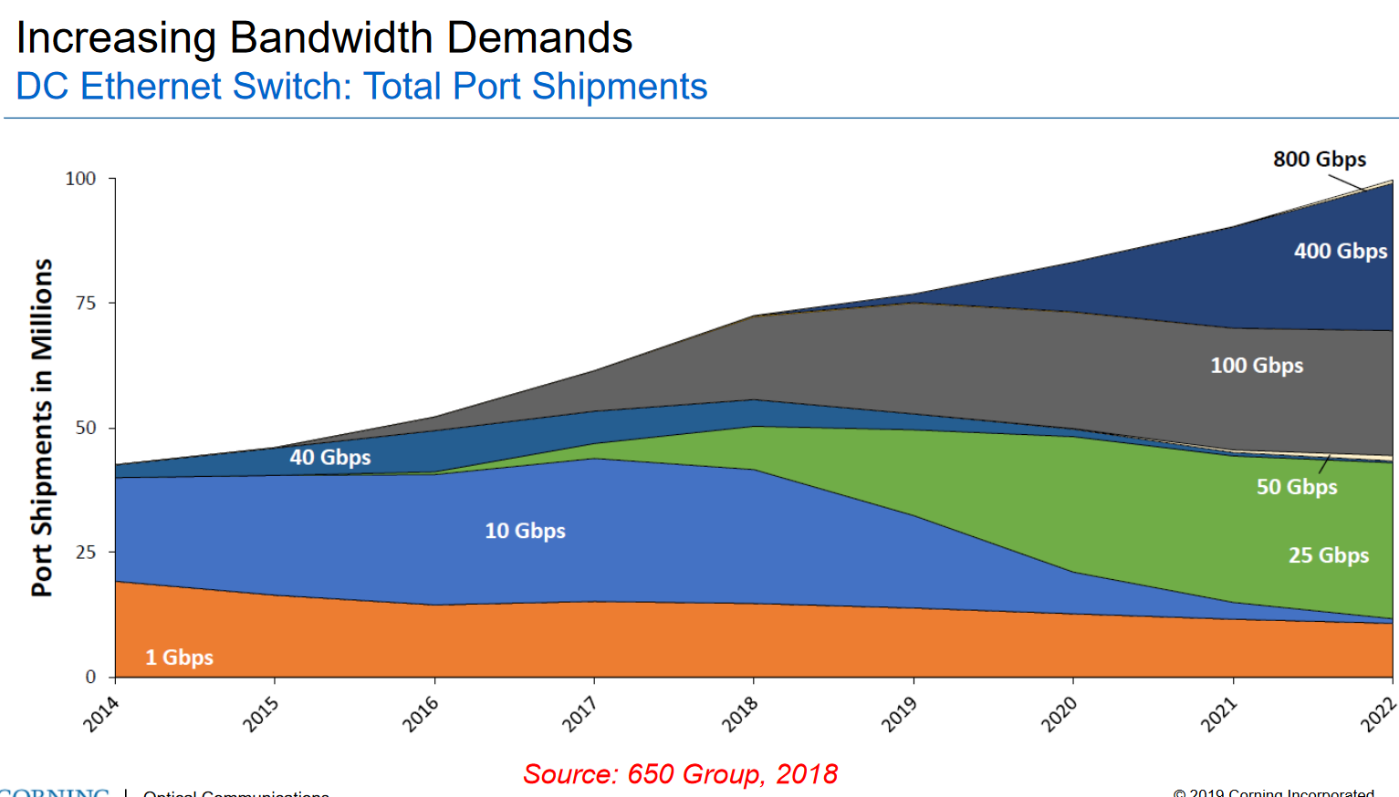
Data Center Server Market Outlook: Port Speeds
https://www.sgnog.net/SGNOG7/B.2%20Optical%20Comm%20Trends%20in%20Data%20Centers_20190712%20(wide).pdf

Slide 27
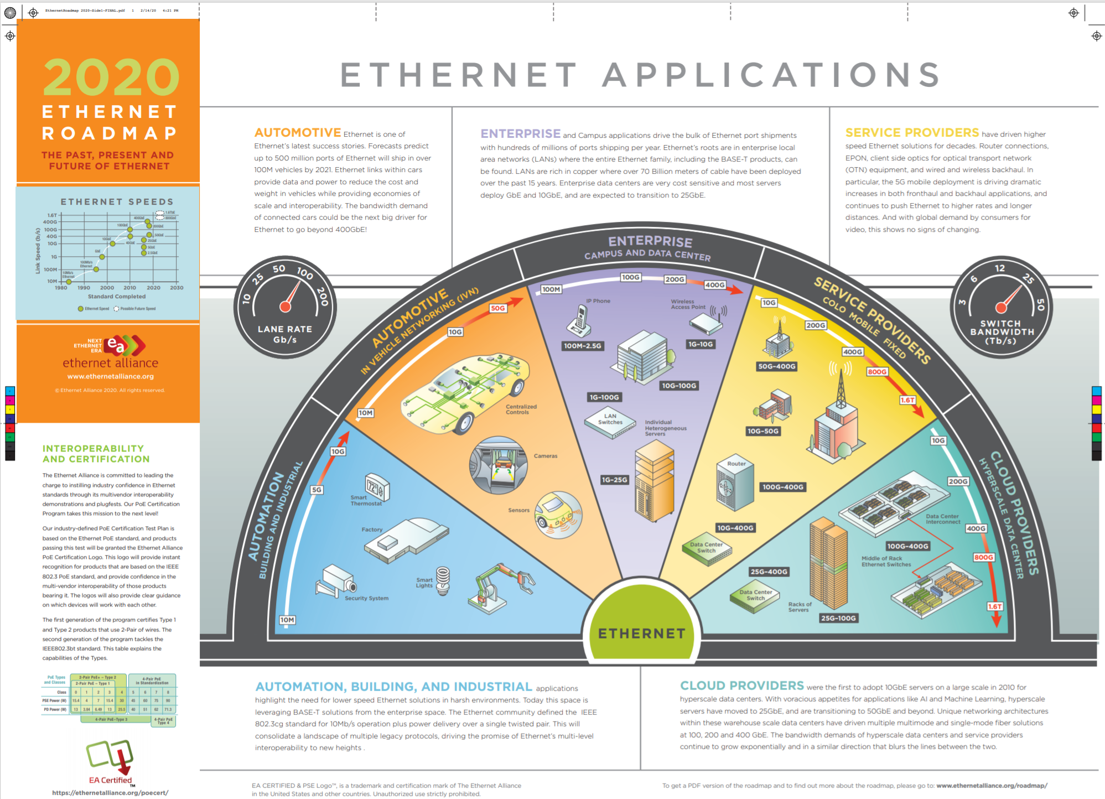
Ethernet Alliance Roadmap 2020
https://ethernetalliance.org/technology/2020-roadmap/

Slide 28
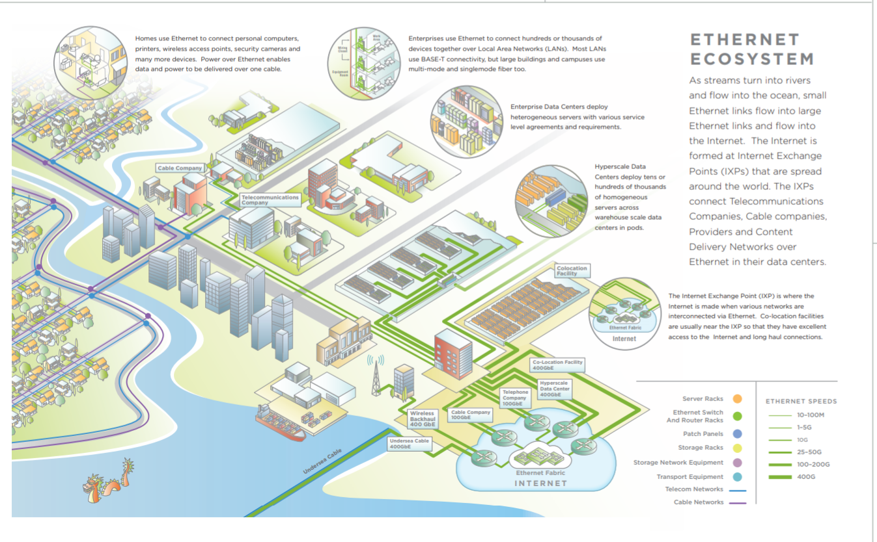
Ethernet Alliance Roadmap 2020 (II)

Slide 29
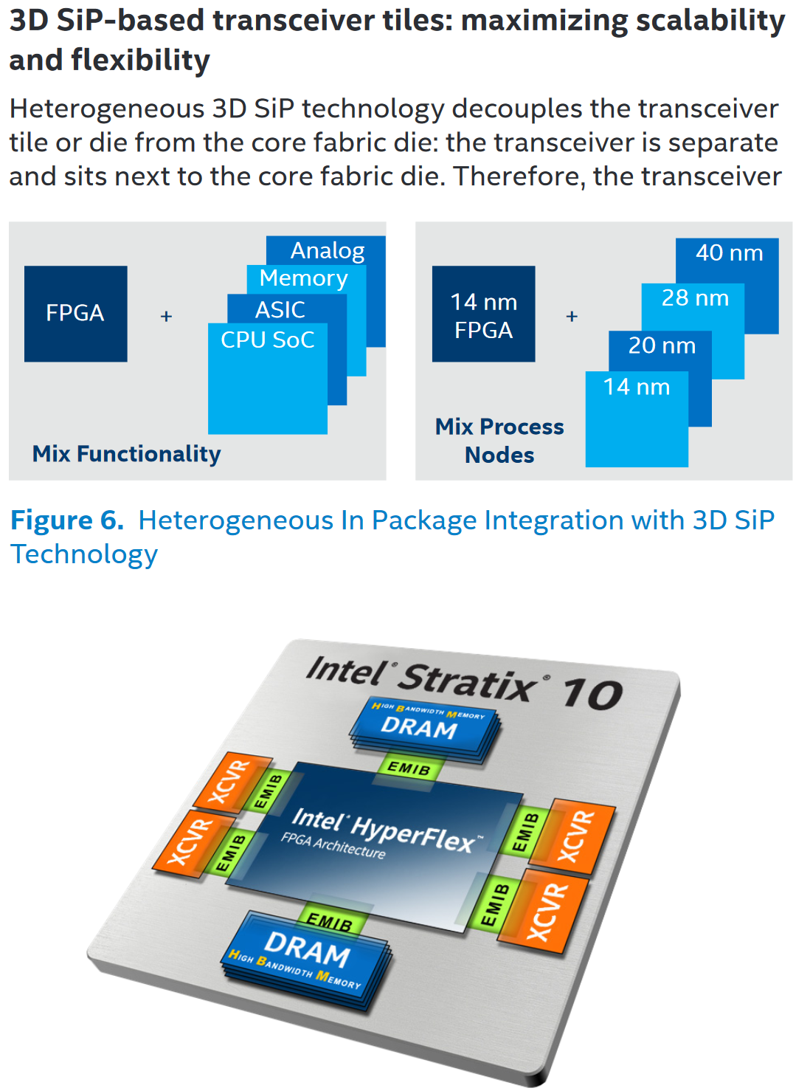
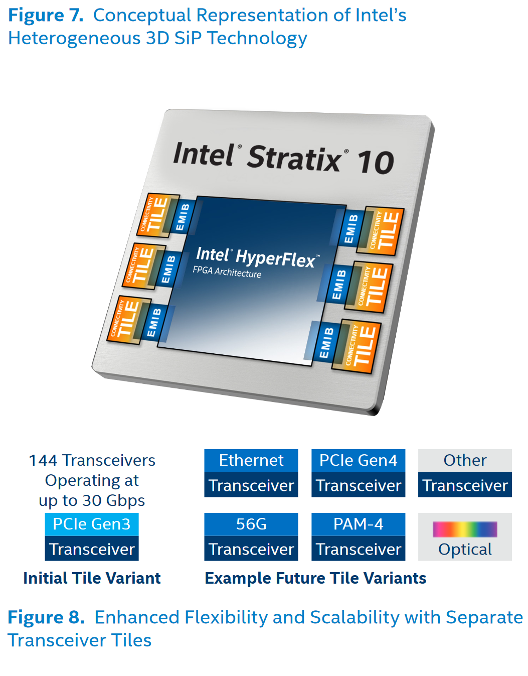
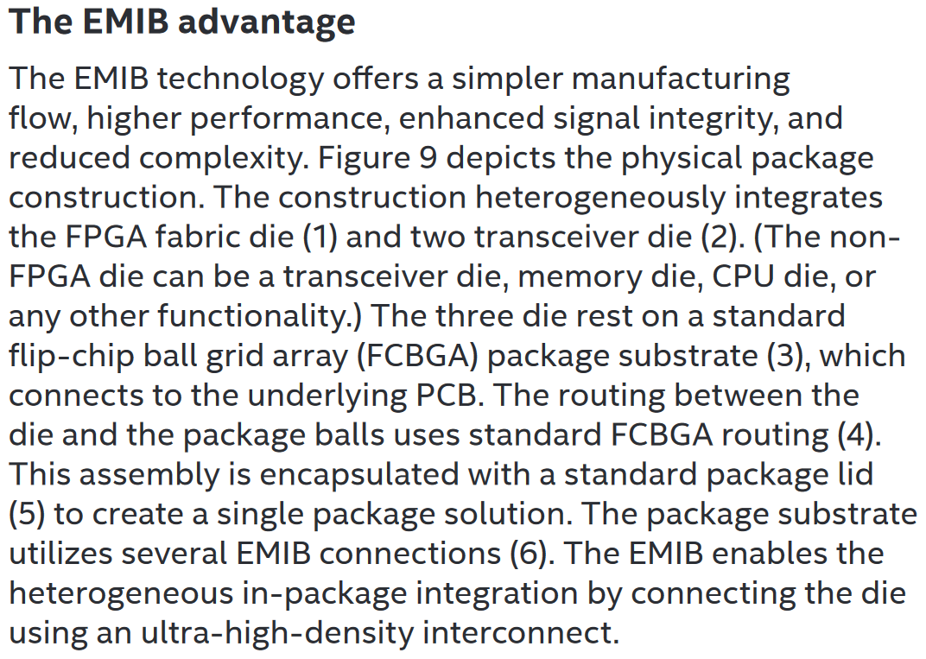
Upcoming Computing Architecture Trends and How They May Affect Us (II)
Another Vision: Intel Acquires Altera ($ 16.7B) December 2015: Intel + Stratix 10 FPGA “Hyperflex” Architecture https://www.intel.com/content/dam/www/programmable/us/en/pdfs/literature/wp/wp-01251-enabling-nextgen-with-3d-system-in-package.pdf
Other Interesting Developments (August 2018): Hot Chips and Flash Memory Storage Conferences. Examples: (1) NRAM (Carbon nanotubes) poised to replace DRAM ? https://www.anandtech.com/show/13252/hot-chips-2018-nanotubes-as-dram-by-nantero-live-blog ; (2) MRAM Developer Day at FMS

Slide 30
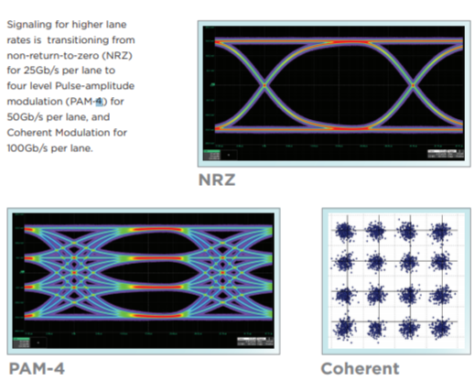
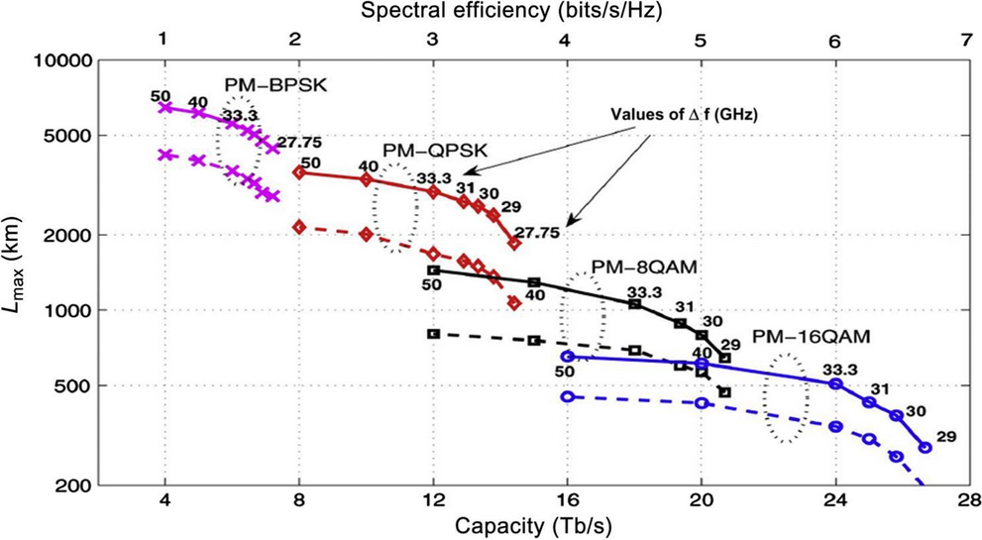
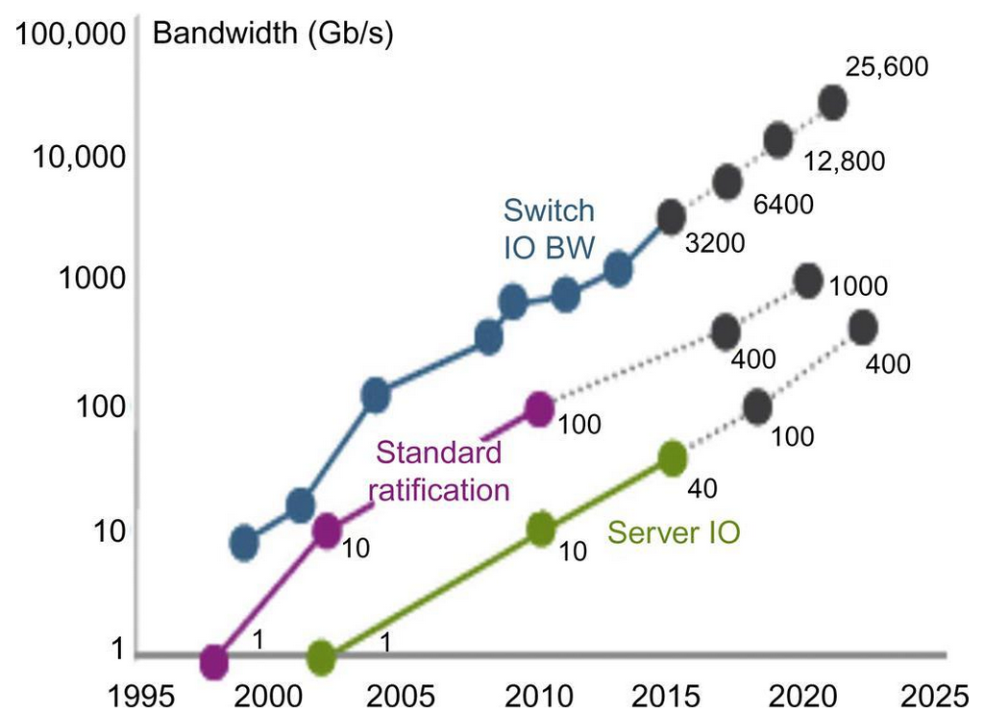
DCI Optical Link
Signaling Methods
Typical DCI Modulation Formats
WDM Fiber: Capacity Vs Reach
DC Switch ASICs: to 25.6T
25.6T  30-60 pJ/bit
Reference: A. Willner (Ed.) Optical Fiber Communications VII (2019)

Slide 31
State of the Art Data Transmission (OFC 19):
400G Transpacific, 600G to 1000 km, 800G 100-200 km
The trend toward higher-capacity and more-flexible systems was evident on the show floor, where the Optical Internetworking Forum ran interoperability demonstrations for both 400 Gbit and Flexible Ethernet. The consortium’s 400 Gbit ZR standard is an inexpensive version of 400 Gbit Ethernet designed for datacenter links extending up to 100 km and wavelength-division multiplexing (WDM). It also can run the high-order 16QAM modulation code.
Most first-generation 400 Gbit systems are limited to spans of 100 km, suitable for links between datacenters in the same urban area. Their data rates typically drop to 200 Gbit/s at metro distances of a few hundred kilometers and to 100 Gbit/s at longer distances. At OFC, both Ciena and Infinera (Sunnyvale, CA) announced plans for a new generation of 800 Gbit systems able to carry two 400 Gbit signals between datacenters.
Market needs are diverging, says Xenos, so Ciena will introduce two versions of its new Wavelogic5 system. The Extreme model focuses on high-bandwidth needs, transporting 800 Gbit to 100 to 200 km and 600 Gbit for up to 1000 km. The Extreme can carry 400 Gbit over transpacific distances when users need long-haul transport.
Operating at 800 Gbit requires using a cutting-edge digital signal processor fabricated with 7 nm features that transmits 95 gigasymbols per second (a rate of about 95 GHz), packing more signals into each symbol, and using high-bandwidth electro-optics. A smaller Nano version with data rates of 100 to 400 Gbit also is planned to fit into smaller places at lower cost, primarily datacenters.
Infinera announced its own 800 Gbit system, the Infinite Capacity Engine (ICE)6, for delivery in the second half of 2020. That will upgrade the current 400 Gbit ICE4 by dynamically adjusting the number of bits per modulation symbol and improving its use of subcarriers to split the signal into multiple carriers using lower baud rates.

Slide 32
Remark: Addressing the Shannon Limit

Slide 33
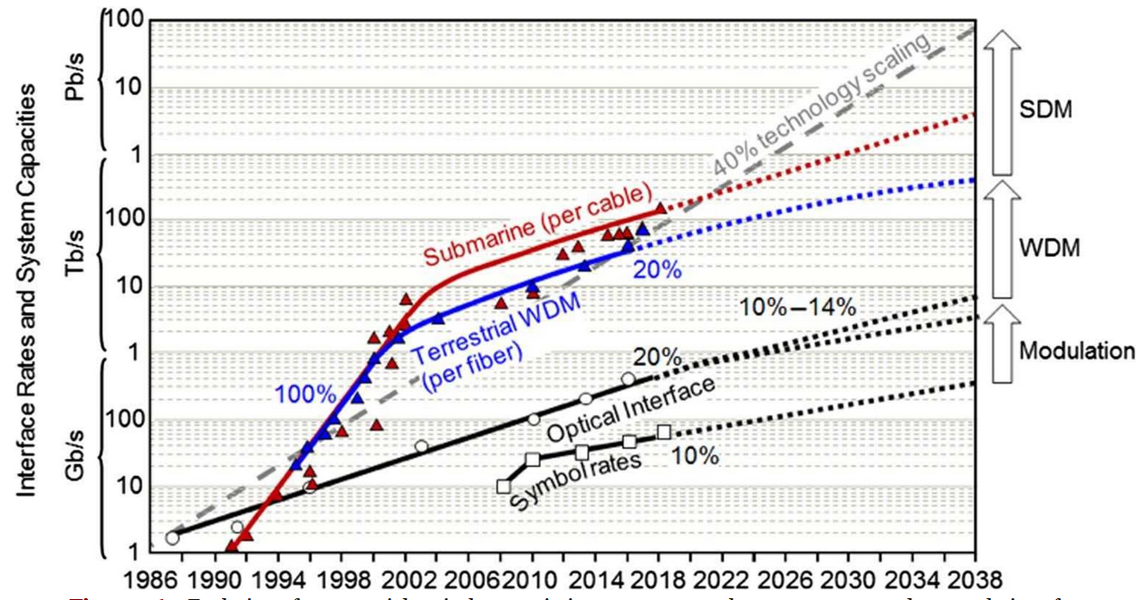
Going Beyond the Shannon Limit: Future Capacity Growth will Require Spatial Channels in SDM (40% CAGR ?)
Evolution of Commercial Optical CableTransmission Capacity Outlook to 2028 and 2038

Slide 34
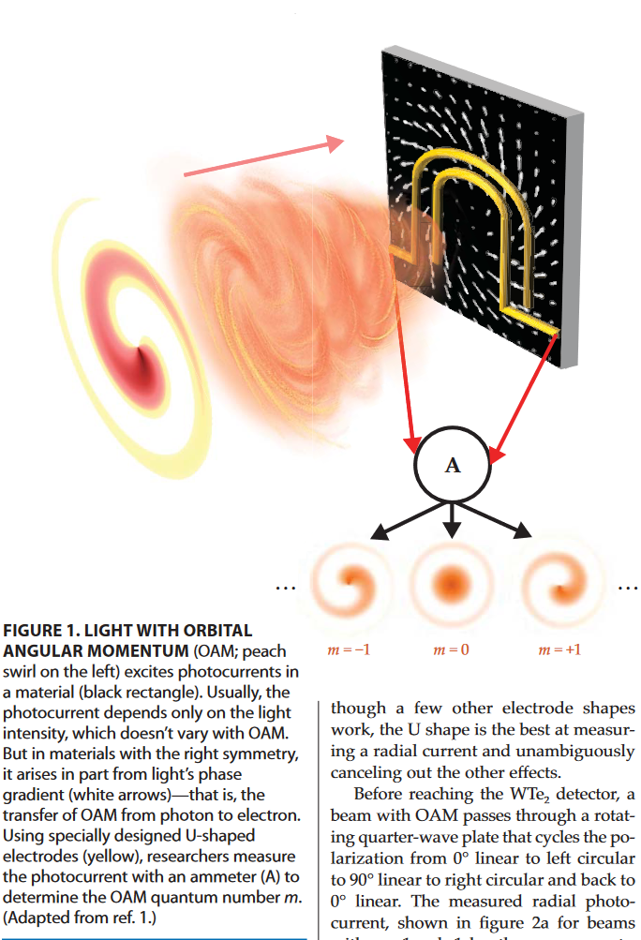
Going Beyond the Shannon Limit: More DOF: Multicore Fibers, OAM, Spatial Division Multiplexing
Fiber Communications
Classical Degrees of Freedom
Wavelength
Amplitude
Phase
Polarization
Additional Degrees of Freedom
Orbital Angular Momentum
Spatial Division Multiplexing
Multicore single mode
Coherent modes
Multicore Fibers Already
Used in Tests
CHIP SCALE SENSOR DETECTS ORBITAL ANGULAR MOMENTUM https://physicstoday.scitation.org/doi/pdf/10.1063/PT.3.4518

Slide 35
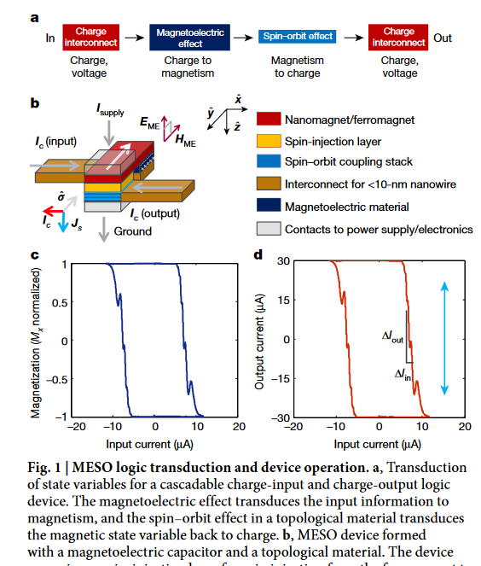
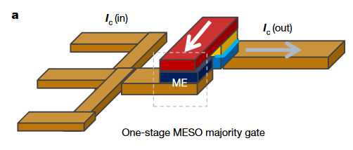
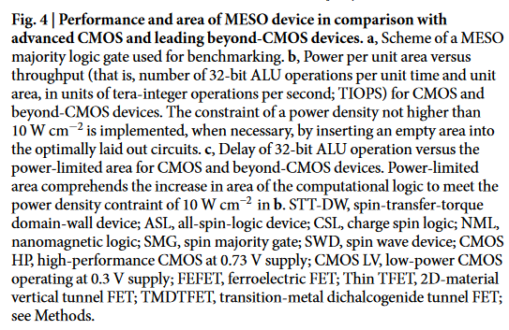
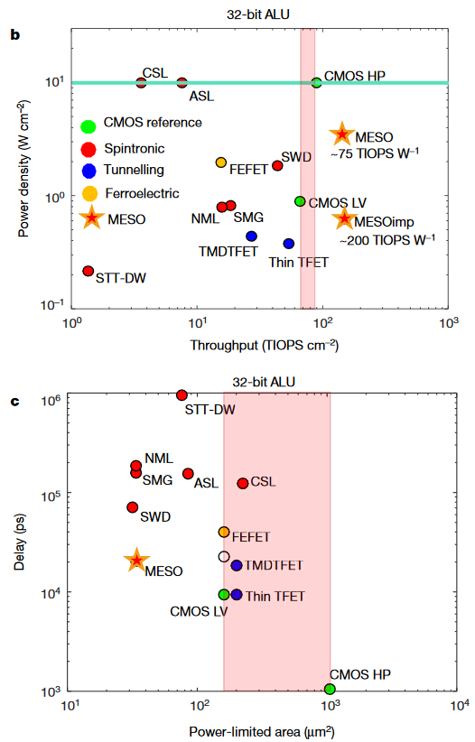
Beyond CMOS: MagnetoElectric Spin Orbit Device (vs others) Intel: “Scalable energy-efficient magnetoelectric spin–orbit logic” Nature volume 565, pages 35–42 (2019) (*)
“We describe progress in magnetoelectric switching and spin–orbit detection of state, and show that in comparison with CMOS technology our device has superior switching energy (by a factor of 10 to 30), lower switching voltage (by a factor of 5) and enhanced logic density (by a factor of 5). + Its non-volatility enables ultralow standby power, which is critical to modern computing”
(*) Note: Submitted April 2016; Accepted December 2018
Competitors: Spin-wave, All spin, nanomagnetic; 2D material vertical tunnel FET, etc.

Slide 36
Next Generation Wireless: 6G First 6G (and 5G) Summit: http://www.6gsummit.com/2019/
NOKIA Bell Labs
http://www.6gsummit.com/2019/wp-content/uploads/2019/04/Day3_Session1_Vetter_Nokia_Bell_Labs.pdf

Slide 37
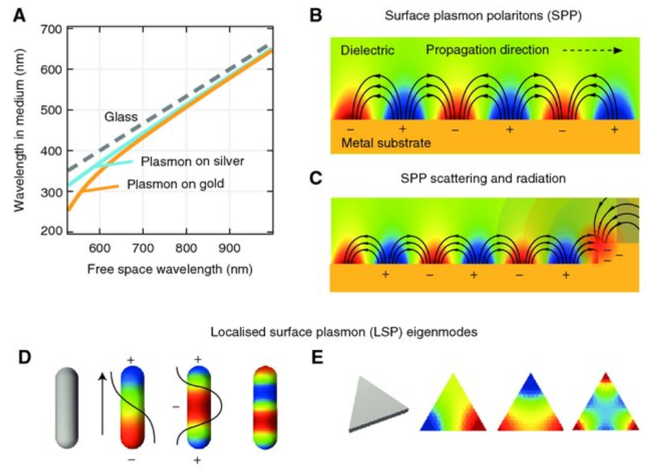
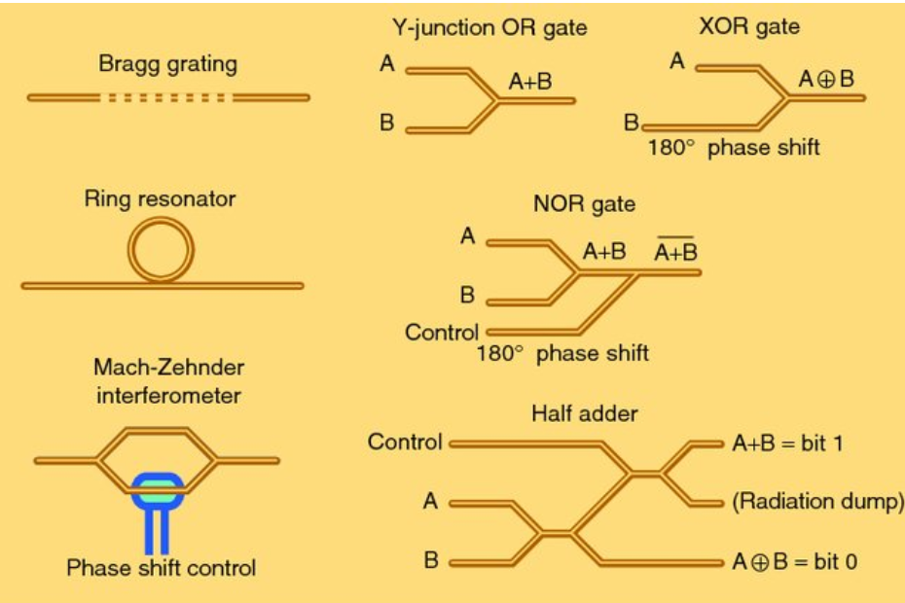
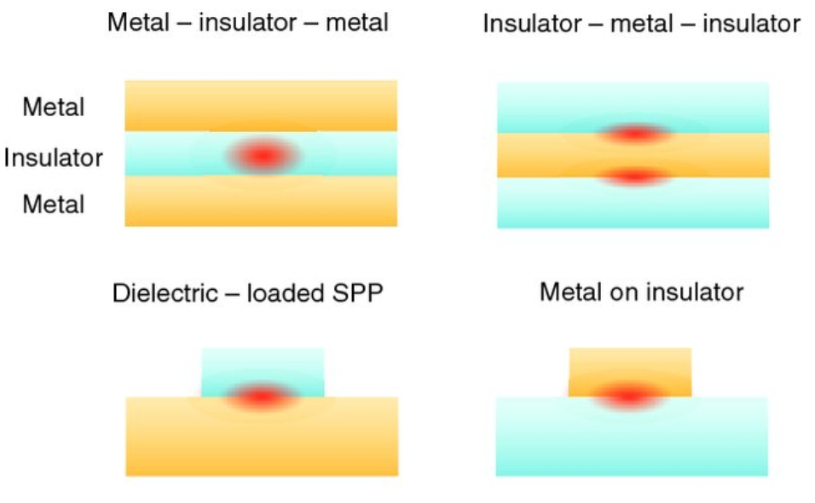
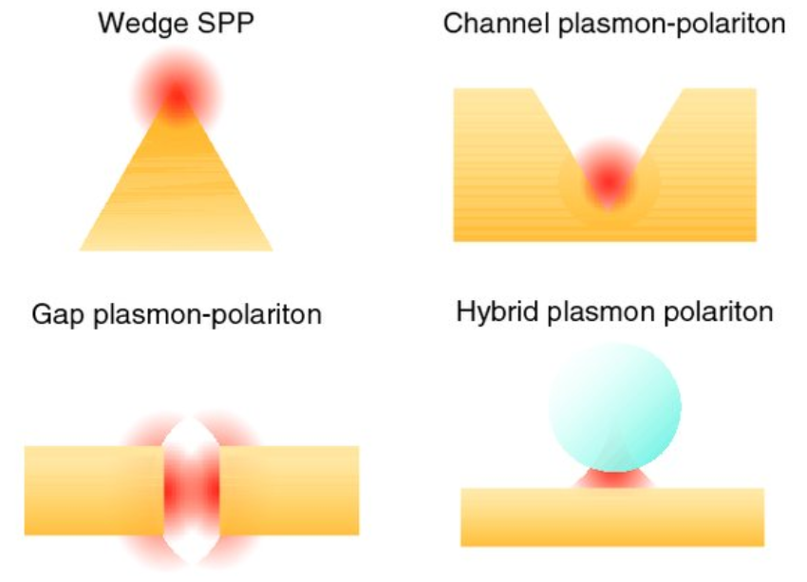
Plasmonics for Optical Information Processing
Plasmonic waveguide devices for performing optical processing. The logic circuits operate using phase shifts and interference.
Cross sections of different types of plasmon waveguides

Slide 38
Sixth Generation (6G) Wireless Timeline A Global Initiative

Slide 39
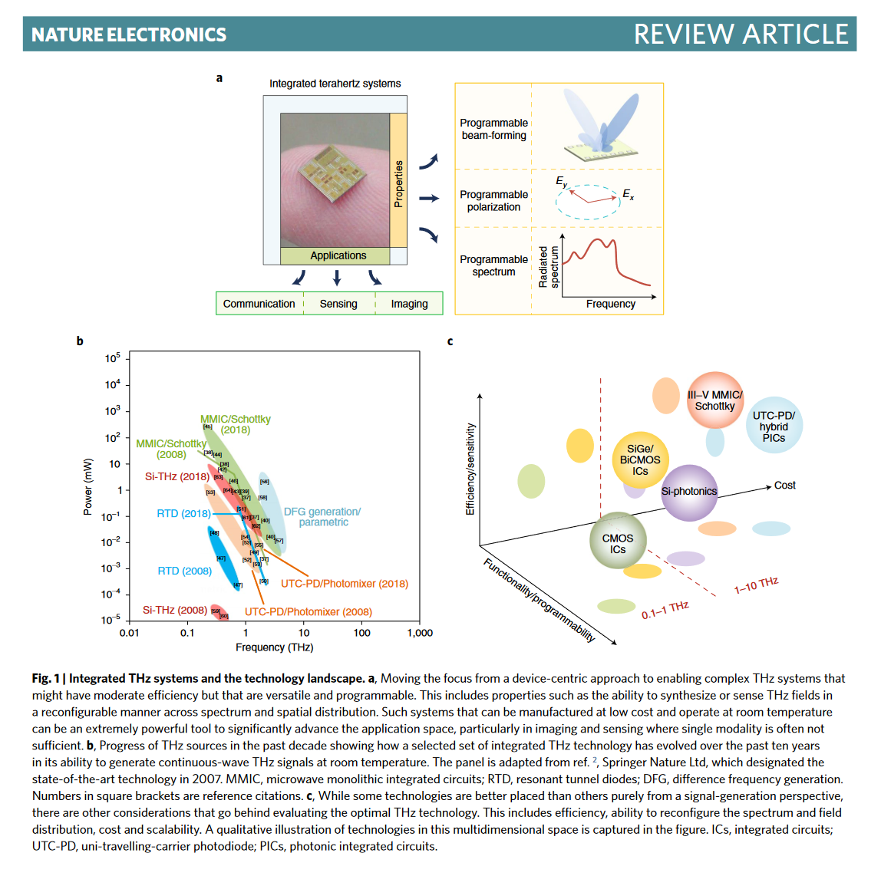
Next Generation Wireless: TeraHz, to Tbps speeds Integrated photonic and hybrid devices and systems avoiding the speed vs energy tradeoffs of classical electronic design
https://www.brown.edu/research/labs/mittleman/sites/brown.edu.research.labs.mittleman/files/uploads/Sengupta_Review.pdf
Device Tradeoffs: power vs THz frequency
System Tradeoffs: efficiency/sensitivity vs functionality/programmability
Integrated System Applications: Communications, sensing, imaging
System Programmable Functions: spectrum, polarization, beam forming
Wireless Industry’s Newest Gambit: Terahertz Communication Bands
While communication system designers are preoccupied with readying millimeter wave for 5G, experiments are underway on teraHz bands for indoor wireless, localization studios, and gigabyte Wi-Fi networks https://spectrum.ieee.org/telecom/internet/wireless-industrys-newest-gambit-terahertz-communication-bands

