Slide 1
Particle Physics and Machine Learning in Education
Mark Neubauer
University of Illinois at Urbana-Champaign
Snowmass Computational Frontier Workshop
August 11, 2020

Slide 2
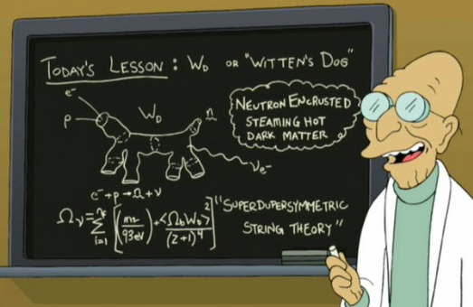
Particle Physics in Education
Particle physics holds a prominent role within academic curriculum
”Fundamental” physics
Historical development is interesting and compelling
Theory applies & develops advanced mathematics
Powerful applications and spin-off technologies

Slide 3
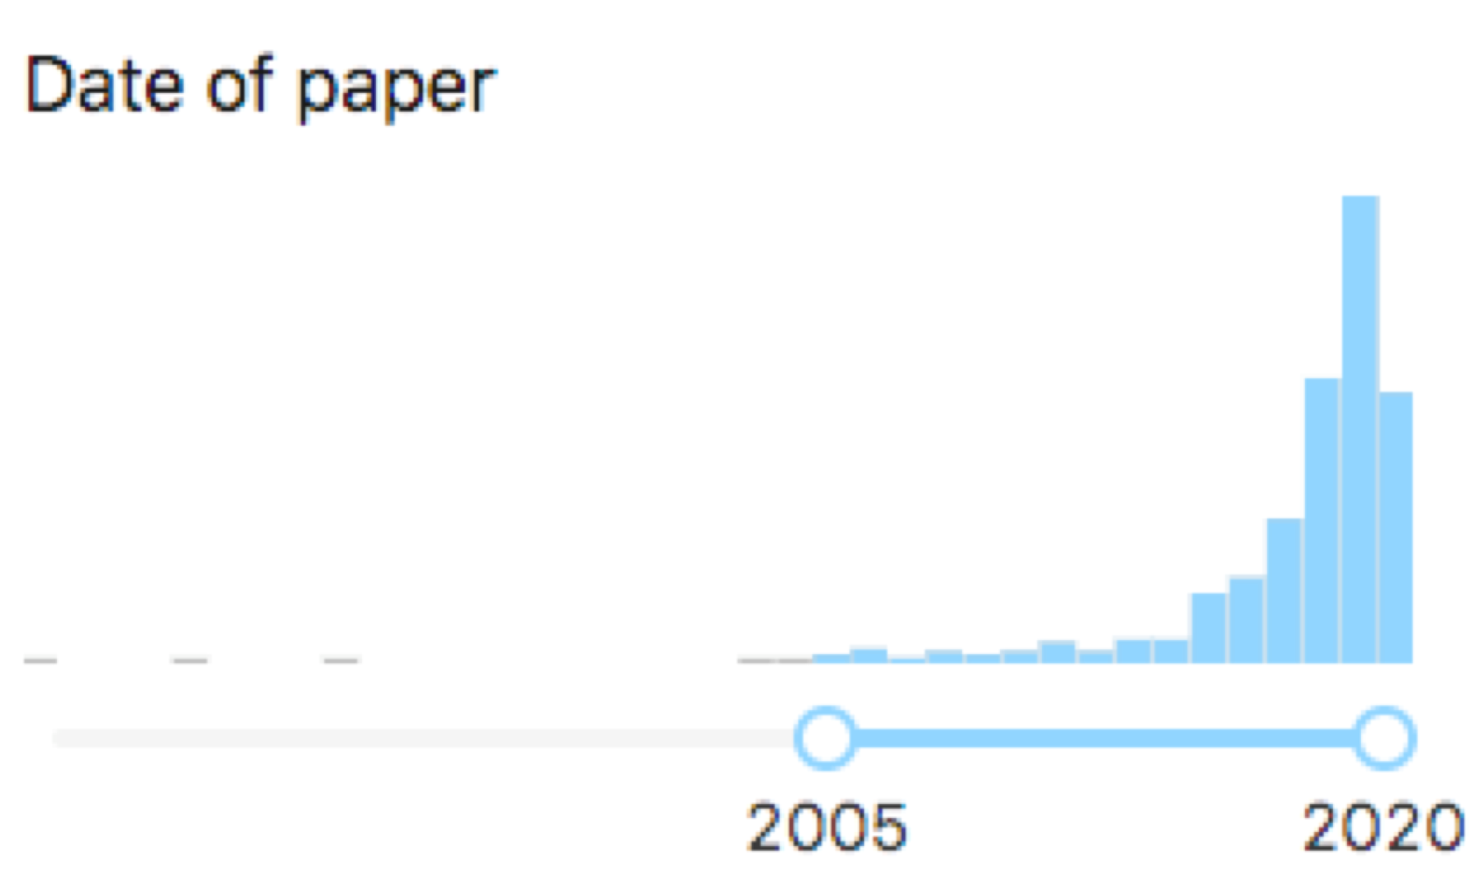
Rise of the Machines…
ML has an increasingly prominent role within particle physics
(ML in title from INSPIRE-HEP)
and of the Physicists (in ML)…
From D. Whiteson’s talk yesterday
Physicists are increasingly collaborating with CS and industry partners to develop physics-driven ML approaches

Slide 4
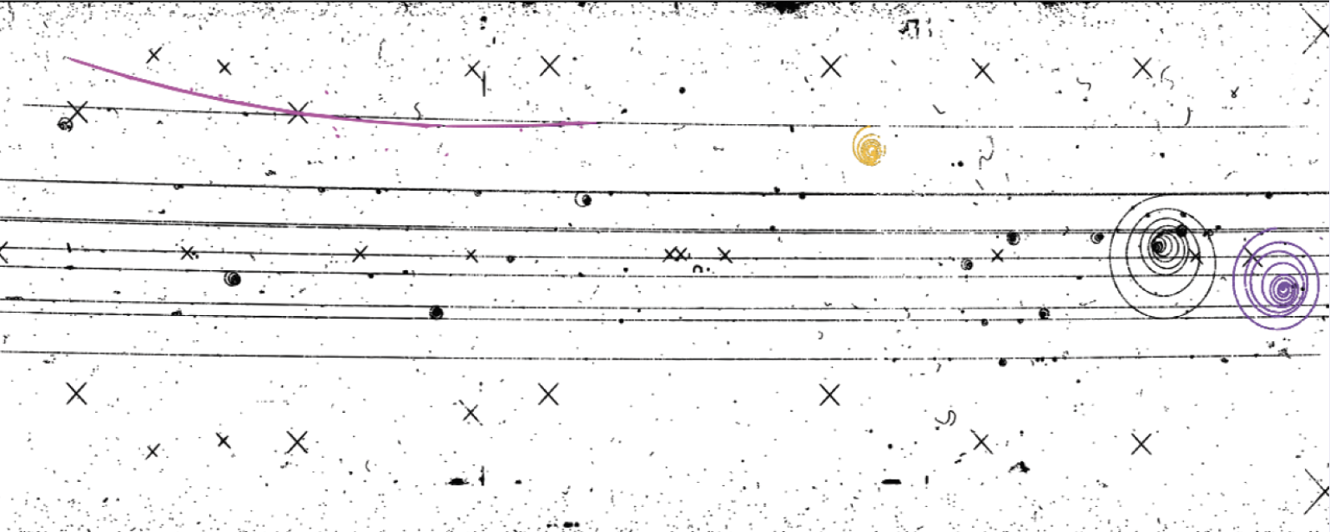
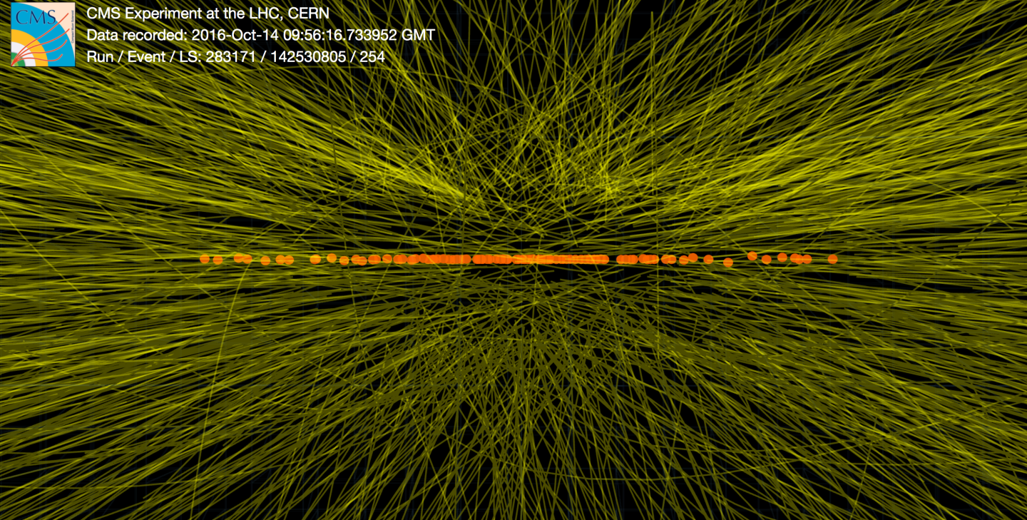
Bender: Come on, Fry. I really wanna see it [the year 2000]. You know how I yearn for a simpler time... a time of barn dances and buggy rides before life was cheapened by heartless, high-tech machines.
Credit: CERN
Leela: But, Bender, you are a—
Bender: [dismissive] blah blah blah blah …
We’ve come a long way!
Collision event recorded by the CMS detector during a high luminosity running of the LHC with <μ> ~ 100

Slide 5
ML in Physics Education: Opportunites
Physics departments are increasingly offering curricula to their (under)graduate students at the intersection of physics, data science and ML
These courses provide opportunities for particle physicists to
Describe synergies between ML and particle physics research
Make connections with colleagues from other departments and those in your department in other research domains
Recruit students interested in ML ⋂ particle physics
Learn ML ;)

Slide 6
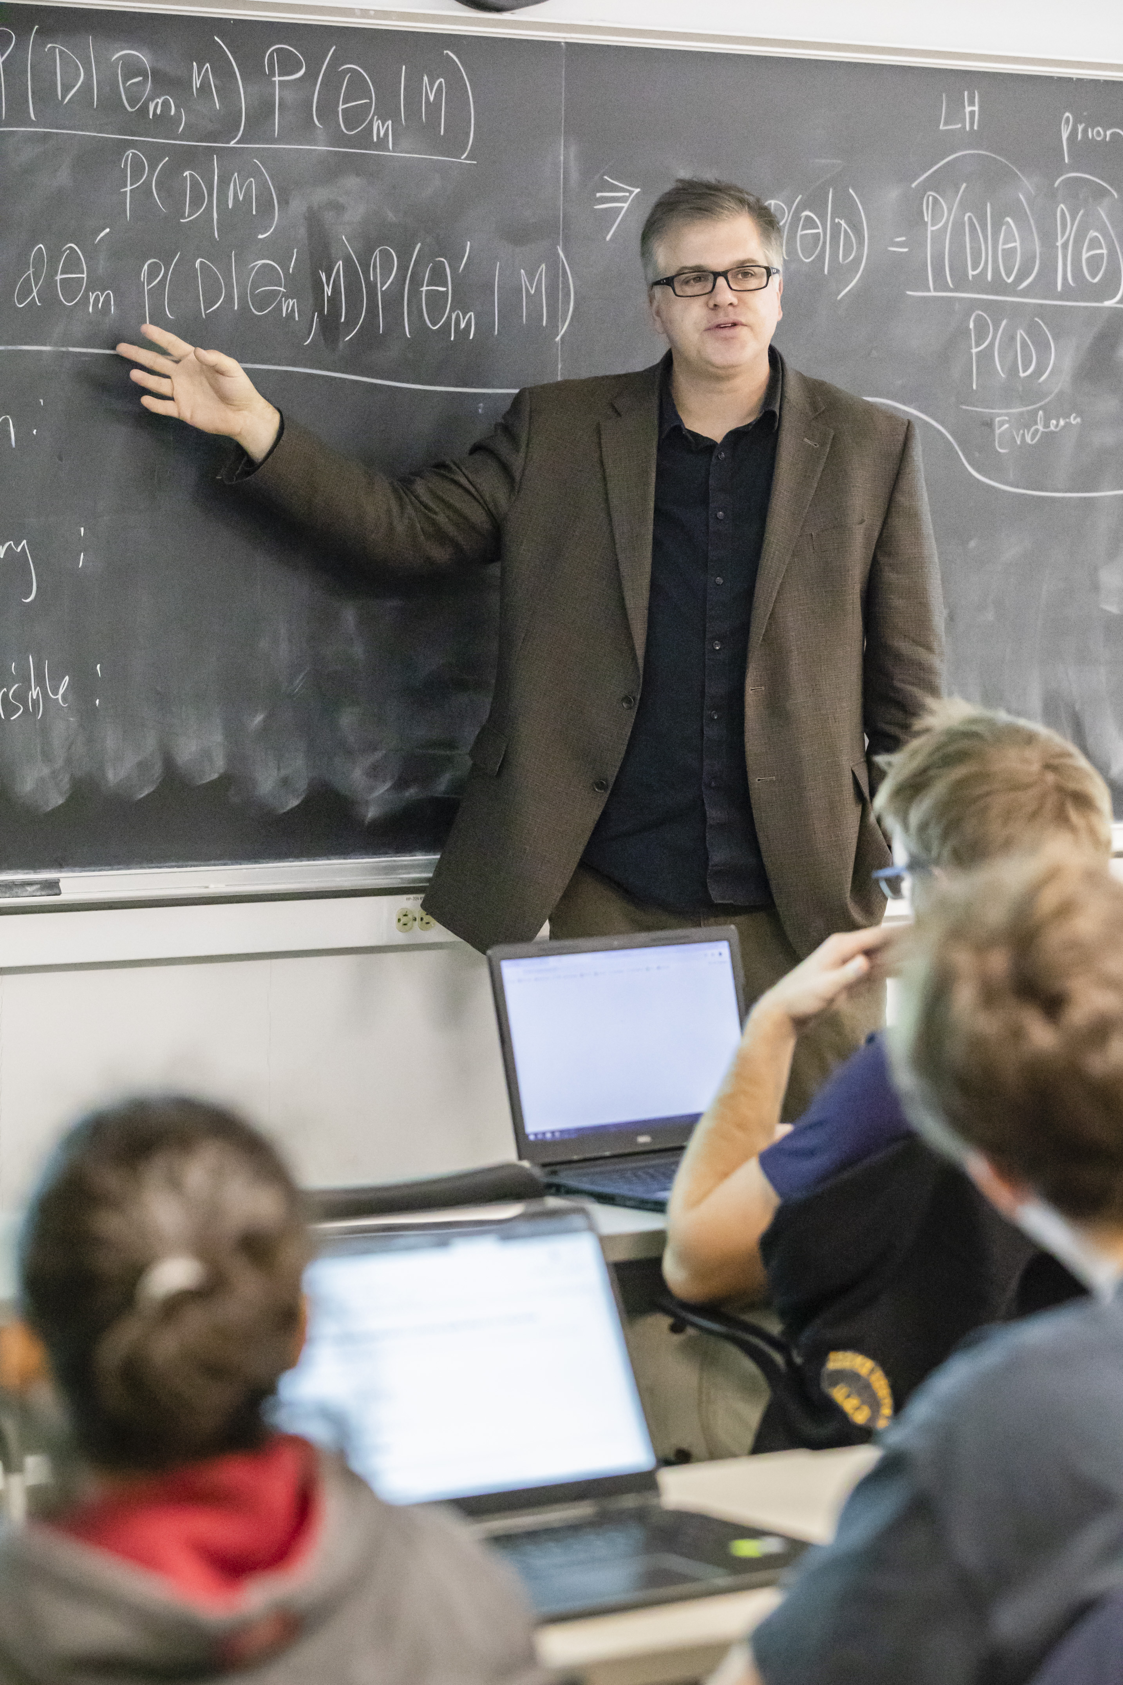
My Experience
I developed a new course in our Department titled “Data Analysis and Machine Learning Applications for Physicists”
Taught it Spring 2018 & Fall 2019
Teaching in Spring 2021
Developing a grad-level version
HEP postdoc Matthew Feickert and HEP grad student Dewen Zhong helped develop the course

Slide 7
ML in Physics Education: Challenges
Not trying to do too much
Stick to our strengths of analysis and interpretation of large scientific data sets and physics-inspired AI
Leave the foundational AI pedagogy to the CS courses
Open Data for education
Projects based on ML applications to physics data are a strength of these courses → A curated set of data for education is critical
Role of Snowmass study data sets for education?
ML for education, outreach and engagement is an integral part of Snowmass
Would be great to curate a list of courses → feel free to reach out

