Slide 1
Snowmass’21 Joint AF-EF Meeting on Future Colliders “Day 1” (June 24, 2020 – Projects with TDRs or CDRs)
Summary: Machine Parameter “Standard Tables”
https://indico.fnal.gov/event/43871/
https://indico.fnal.gov/event/43872/

Slide 2
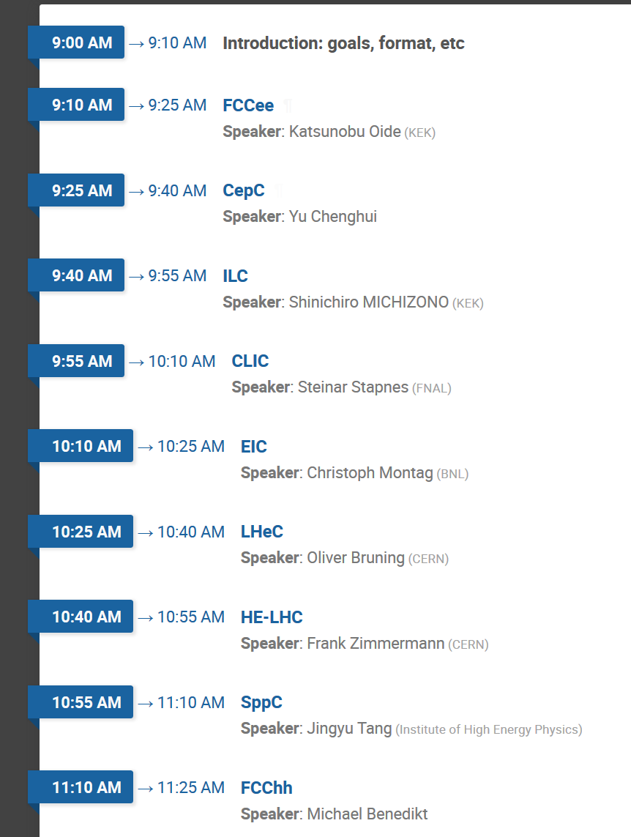
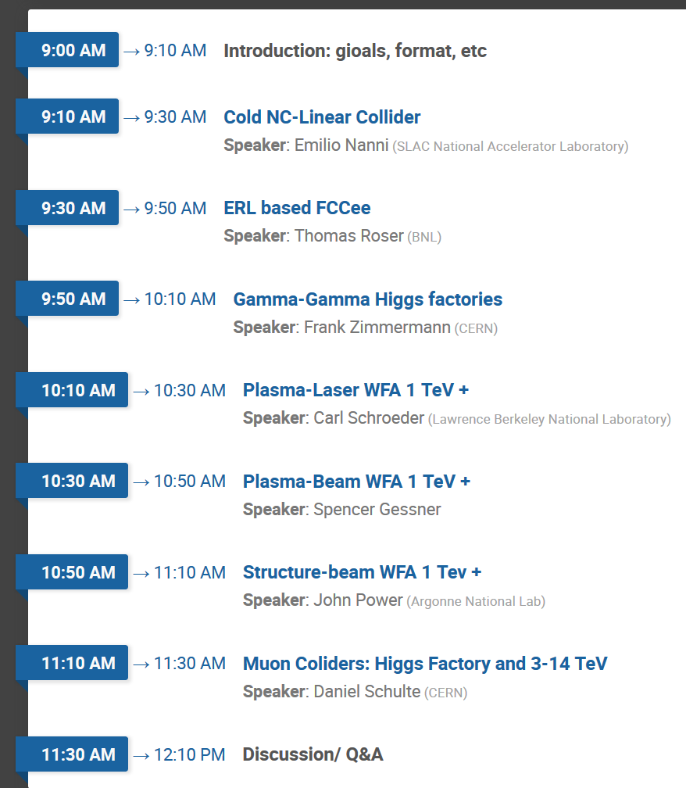
June 24 and July 1 AF-EF talks (10 am EST) Day 1: 10 min + 5 min Q&A = 15 min total/talk Day 2: 10 min + 10 min Q&A = 20 min total/talk
Day 1: https://indico.fnal.gov/event/43871/
Day 2: https://indico.fnal.gov/event/43872/
6/24/2020

Slide 3
Facility “Standard Table”
Facility / Your name* | Particle species | * Contact email for Qs
Beam Energy | GeV
Peak Luminosity (10^34) | cm-2 s-1
Int. Luminosity | ab-1/yr
Beam dE/E at IP
Transv. Beam sizes at IP x/y | um
Rms bunch length / beta* | cm
Crossing angle | urad
Rep./Rev. frequency | Hz
Bunch spacing | ns
# of IPs
# of bunches
Length/Circumference | km
Facility site power | MW
Cost range | $B US | (day 2 speakers – feel free to skip)
Timescale till operations

Slide 4
FCCee – Katsunobu Oide
FCC-ee / K. Oide | e⁺e⁻ | katsunobu.oide@cern.ch
Beam Energy, range | GeV | 45.6, ±2 | 80, ±2 | 120, -10+5 | 182.5, -12+2
Peak Luminosity (10^34) | cm-2 s-1 | 460 / 2IP | 56 / 2IP | 17 / 2IP | 3.1 / 2IP
Int. Luminosity | ab-1/yr | 48 / 2IP | 6 / 2IP | 1.7 / 2IP | 0.34 / 2IP
Beam dE/E at IP |  | 3.8x10⁻⁶ | 10x10⁻⁶ | 26x10⁻⁶ | 73x10⁻⁶
Transv. Beam sizes at IP x/y | um | 6.4 / 0.028 | 13.0 / 0.041 | 13.7 / 0.036 | 38.2 / 0.068
Rms bunch length /length of interaction area/ beta* | cm | 1.21/0.042/0.08 | 0.60/0.085/0.1 | 0.53/0.09/0.1 | 0.25/0.18/0.16
Crossing angle | urad | ±15000
Rep./Rev. frequency | Hz | 3066.7
Bunch spacing | ns | 17.5 | 160 | 990 | 3400
# of IPs |  | 2
# of bunches |  | 16640 / ring | 2000 / ring | 328 / ring | 48 / ring
Length/Circumference | km | 97.756
Facility site power | MW | 259 | 277 | 282 | 340
Cost range | $B US | 10.5 (BCHF) |  |  | +1.1 (BCHF)
Timescale till operations | yr | 19 | +4 | +2 | +4

Slide 5
CepC – Yu Chenghui
Beam Energy | GeV | 120
Peak Luminosity (10^34)/IP | cm-2 s-1 | 3.0
Int. Luminosity | ab-1/year | 1.4
Beam dE/E at IP |  | 0.00134
Transv. Beam sizes at IP x/y | um | 20.9 / 0.06
Rms bunch length / betaY* | mm | 4.4 / 1.5
Crossing angle | mrad | 33
Rep./Rev. frequency | Hz | 3000
Bunch spacing | ns | 680
# of IPs |  | 2
# of bunches |  | 242
Length/Circumference | km | 100
Facility site power | MW | 300
Cost range | $B US | 5.0
Timescale till operations |  | 2030

Slide 6
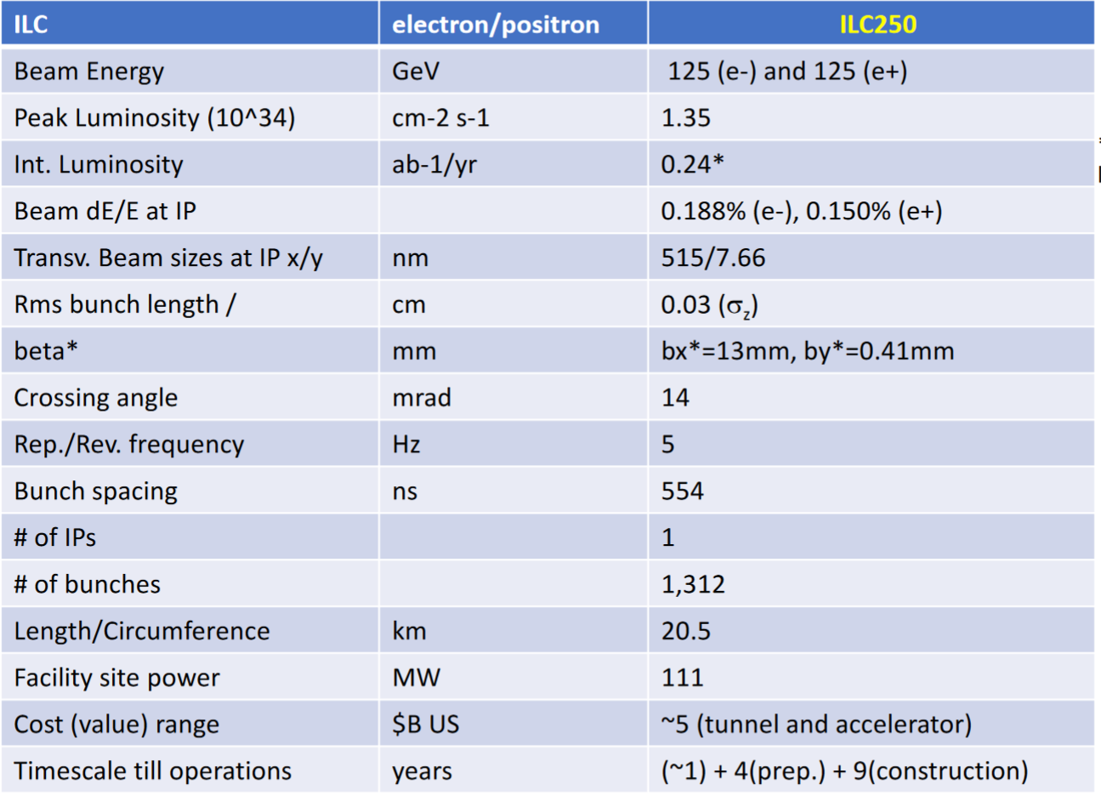
ILC – Shinichiro Michizono

Slide 7
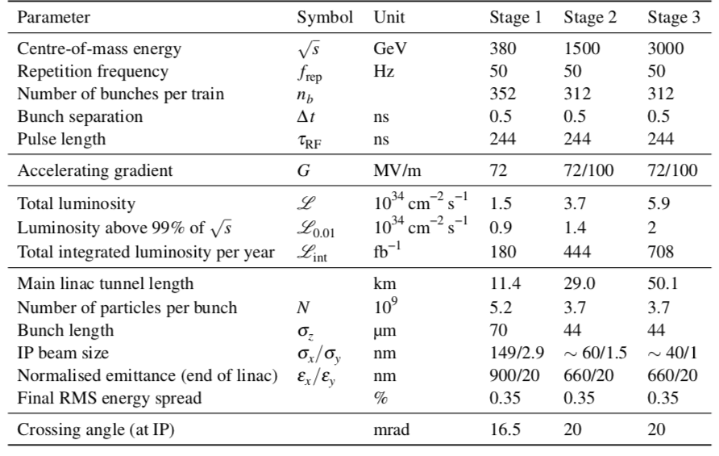
CLIC – Steinar Stapnes

Slide 8
EIC – Christoph Montag
EIC/Christoph Montag | e - p | Montag@bnl.gov
Beam Energy | GeV | e: 5, p: 41
Peak Luminosity (10^34) | cm-2 s-1 | 0.044
Int. Luminosity | ab-1/yr | 4.4
Beam dE/E at IP |  | e: 6.8, p: 10.3
Transv. Beam sizes at IP x/y | um | 198/27
Rms bunch length / beta* | cm | e: 2, p: 7.5
Crossing angle | urad | 25
Rep./Rev. frequency | Hz | 78000
Bunch spacing | ns | 10
# of IPs |  | 1 (up to 2)
# of bunches |  | 1160
Length/Circumference | km | 3.8
Facility site power | MW | 58
Cost range | $B US | $1.6B - $2.6B
Timescale till operations |  | ~2030

Slide 9
LHeC – Oliver Bruning
Facility / Your name* | Particle species | * Contact email
Beam Energy | 30-60 GeV | Oliver.bruning@cern.ch
Peak Luminosity (10^34) | 1 cm-2 s-1 | mklein@hep.ph.liv.ac.uk
Int. Luminosity | 20fb⁻¹ to 200fb⁻¹ with 1 ab⁻¹ over 10 years
Beam dE/E at IP | Few 10⁻⁴
Transv. Beam sizes at IP x/y | 10 μm
Rms bunch length / beta* | 0.15cm / 10cm
Crossing angle | 0 urad
Rep./Rev. frequency | CW with 40MHz
Bunch spacing | 25ns
# of IPs | 1
# of bunches | CW
Length/Circumference | 5.5km to 9km
Facility site power | 100 MW
Cost range | Ca. 1 $B US
Timescale till operations | 2030-2040 LHC / 2045- 2050 FCC

Slide 10
HE-LHC – Frank Zimmermann
HE-LHC | p-p (p-A, A-A) | * frank.zimmermann@cern.ch
Beam Energy | GeV | 13500 (p-p)
Peak Luminosity (10³⁴) | cm⁻²s⁻¹ | 16 (p-p)
Int. Luminosity | ab⁻¹/yr | ≥0.5
Beam dE/E at IP (rms) |  | 8x10⁻⁵
Transv. Beam sizes at IP x/y | μm | 9/9 (initial)
Rms bunch length / beta* | cm | 9, 45
Crossing angle | μrad | 330 (full)
Rep./Rev. frequency | Hz | Rep rate = 2.7x10⁻⁵ Hz (5 h t.-a. + 5.3 h run length); rev freq.=11,245 Hz
Bunch spacing | ns | 25
# of IPs |  | 2
# of bunches |  | 2808 / beam
Length/Circumference | km | 26.7
Facility site power | MW | 162
Cost range | $B US | 7-8
Timescale till operation |  | > 2050

Slide 11
SPPC – Jingyu Tang
Parameter | Unit | Value
 |  | PreCDR | CDR | Ultimate
Circumference | km | 54.4 | 100 | 100
C.M. energy | TeV | 70.6 | 75 | 125-150
Dipole field | T | 20 | 12 | 20-24
Injection energy | TeV | 2.1 | 2.1 | 4.2
Number of IPs |  | 2 | 2 | 2
Nominal luminosity per IP | cm⁻²s⁻¹ | 1.2e35 | 1.0e35 | -
Beta function at collision | m | 0.75 | 0.75 | -
Circulating beam current | A | 1.0 | 0.7 | -
Bunch separation | ns | 25 | 25 | -
Bunch population |  | 2.0e11 | 1.5e11 | -
SR power per beam | MW | 2.1 | 1.1 | -
SR heat load per aperture @arc | W/m | 45 | 13 | -

Slide 12
FCC-hh – Michael Benedikt
FCC-hh | p-p (p-A, A-A) | michael.benedikt@cern.ch
Beam Energy, range | TeV | 50
Peak Luminosity (10^34) | cm-2 s-1 | 30
Int. Luminosity | ab-1/yr | 1.5-2 / 2IP
Beam dE/E at IP |  | 6.2x10⁻⁵
Transv. Beam sizes at IP x/y | um | 3.5
Rms bunch length / beta* | cm | 8
Crossing angle | urad | 200
Rep./Rev. frequency | Hz | 3066.7
Bunch spacing | ns | 25
# of IPs |  | 4 (2 with high-luminosity)
# of bunches |  | 10400 / ring
Length/Circumference | km | 97.756
Facility site power | MW | 560
Cost range | $B US | 17 following FCC-ee in integrated program 24 standalone
Timescale till operations | yr | 35-45

