Slide 1
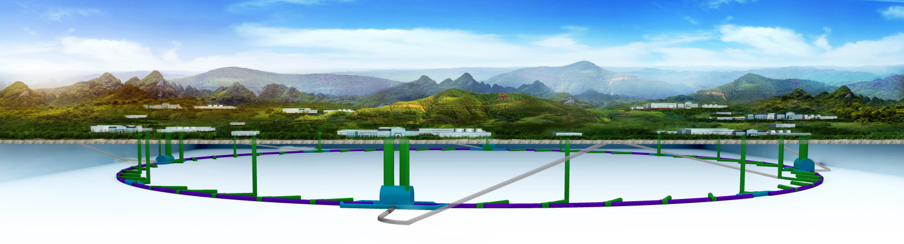
Overview of the Circular Electron Positron Collider (CEPC) design
Chenghui Yu
for the CEPC accelerator team
June 24, 2020

Slide 2
Outline
Physics goals of CEPC
Overview of the facility
Machine introduction
Collider ring ← Booster ← Linac
Key beam physics challenges
Summary

Slide 3
Physics goals of CEPC
Precision measurement
e⁺e⁻ Higgs & Z factory
E_{cm} ≈ 240GeV, luminosity/IP ≈ 3×10³⁴cm⁻²s⁻¹, 2 IPs, >1M Higgs in 10 years
E_{cm} ≈ 91GeV, luminosity/IP > 1×10³⁴cm⁻²s⁻¹, 2 IPs, 10¹⁰ Z /year
Precision measurement of the Higgs boson and the Z boson
Higgs precision 1% or better
Potential for beam energy upgrade
→ enough magnet length space in ARC and long enough straight section in RF region
BEPCII has already operated for 12 years
CEPC – possible accelerator based particle physics program in China after BEPCII

Slide 4
Beam Energy | GeV | 120
Peak Luminosity (10^34)/IP | cm-2 s-1 | 3.0
Int. Luminosity | ab-1/year | 1.4
Beam dE/E at IP |  | 0.00134
Transv. Beam sizes at IP x/y | um | 20.9 / 0.06
Rms bunch length / betaY* | mm | 4.4 / 1.5
Crossing angle | mrad | 33
Rep./Rev. frequency | Hz | 3000
Bunch spacing | ns | 680
# of IPs |  | 2
# of bunches |  | 242
Length/Circumference | km | 100
Facility site power | MW | 300
Cost range | $B US | 5.0
Timescale till operations |  | 2030
Overview
of
the facility

Slide 5
CEPC Timeline (preliminary and ideal)
Current time
CEPC
Pre-studies (2013-2015)
R&D Engineering Design (2016-2022)
Construction (2022-2030)
Data taking (2030-2040)
1st Milestone: Pre-CDR (by the end of 2014) ; 2nd Milestone: R&D funding from MOST (in Mid 2016); 3rd Milestone: CEPC CDR progress Report (by the end of 2016); 4th Milestone: CEPC CDR Report (by the end of Aug 2018); 5th Milestone: CEPC TDR Report and Proto R&D (by the end of 2022); 6th Milestone: CEPC construction start (2022);

Slide 6
arXiv:1809.00285
CEPC accelerator CDR completed in June 2018
  Introduction
  Machine Layout and Performance
  Operation Scenarios
  CEPC Collider
  CEPC Booster
  CEPC Linac
  Systems Common to the CEPC Linac, Booster and Collider
  8. Super Proton Proton Collider
  9. Conventional Facilities
  10. Environment, Health and Safety
  11. R&D Program
  12. Project Plan, Cost and Schedule
CDR International Review June 28-30, 2018. Final CDR (accelerator) released on Sept. 2, 2018

Slide 7
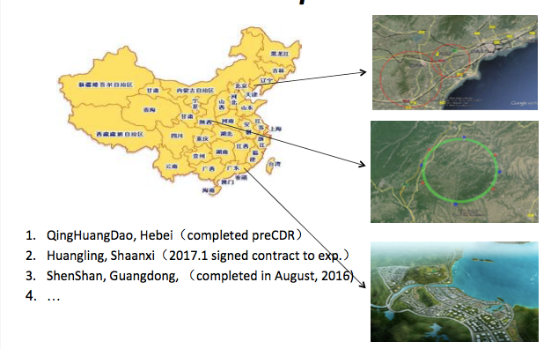
Candidate sites of CEPC

Slide 8
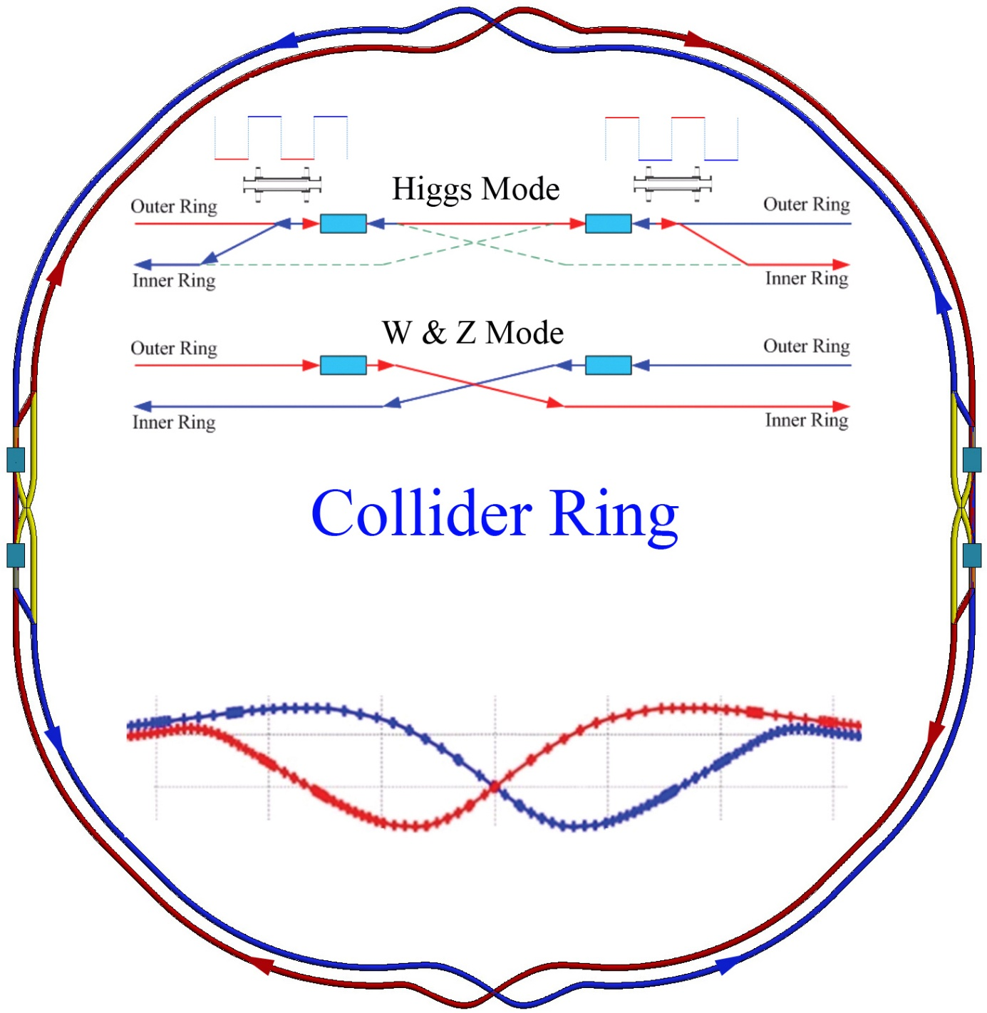
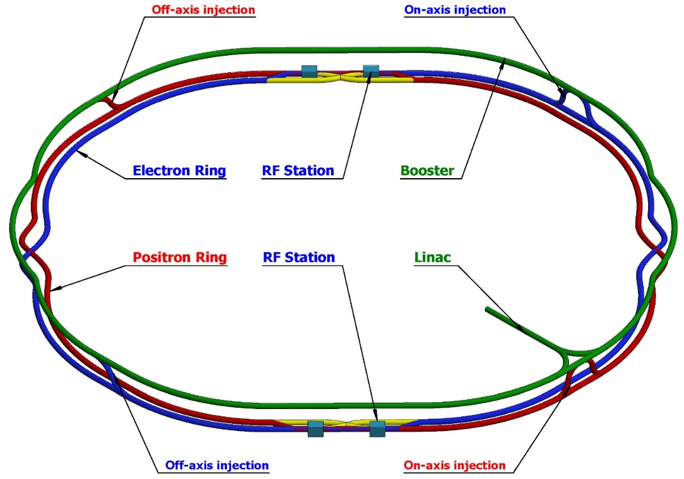
Machine introduction
Double ring collider with 2 IPs
Compatible with the geometry of SPPC

Slide 9
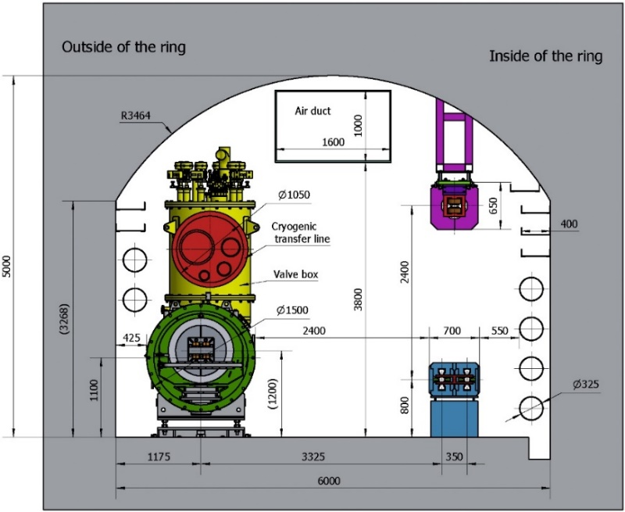
Machine introduction
CEPC which aims at researching Higgs boson is a double ring scheme optimized at the beam energy of 120GeV.
Super proton-proton collider (SPPC) will be the next project after the operation of CEPC in the future.
The circumference of CEPC is 100km which is determined by the requirements of SPPC.
The arc regions of the SPPC collider ring, the CEPC collider ring and the CEPC booster ring are in the same tunnel.
The booster ring of CEPC is located above collider ring with the distance of 2.4m.

Slide 10
Machine introduction
 | Higgs | W | Z
Number of IPs | 2
Beam energy (GeV) | 120 | 80 | 45.5
Circumference (km) | 100
Synchrotron radiation loss/turn (GeV) | 1.73 | 0.34 | 0.036
Crossing angle at IP (mrad) | 16.5×2
Piwinski angle | 3.48 | 7.0 | 23.8
Number of particles/bunch N_{e} (10¹⁰) | 15.0 | 12.0 | 8.0
Bunch number (bunch spacing) | 242 (0.68μs) | 1524 (0.21μs) | 12000 (25ns+10%gap)
Beam current (mA) | 17.4 | 87.9 | 461.0
Synchrotron radiation power /beam (MW) | 30 | 30 | 16.5
Bending radius (km) | 10.7
Momentum compact (10⁻⁵) | 1.11
β function at IP β_{x}* / β_{y}* (m) | 0.36/0.0015 | 0.36/0.0015 | 0.2/0.001
Emittance ε_{x}/ε_{y} (nm) | 1.21/0.0024 | 0.54/0.0016 | 0.18/0.0016
Beam size at IP σ_{x} /σ_{y} (μm) | 20.9/0.06 | 13.9/0.049 | 6.0/0.04
Beam-beam parameters ξ_{x}/ξ_{y} | 0.018/0.109 | 0.013/0.123 | 0.004/0.079
RF voltage V_{RF} (GV) | 2.17 | 0.47 | 0.10
RF frequency f _{RF} (MHz) (harmonic) | 650 (216816)
Natural bunch length σ_{z} (mm) | 2.72 | 2.98 | 2.42
Bunch length σ_{z} (mm) | 4.4 | 5.9 | 8.5
HOM power/cavity (2 cell) (kw) | 0.46 | 0.75 | 1.94
Energy spread (%) | 0.134 | 0.098 | 0.080
Energy acceptance requirement (%) | 1.35 | 0.90 | 0.49
Energy acceptance by RF (%) | 2.06 | 1.47 | 1.7
Photon number due to beamstrahlung | 0.082 | 0.050 | 0.023
Beamstruhlung lifetime /quantum lifetime* (min) | 80/80 | >400
Lifetime (hour) | 0.43 | 1.4 | 2.5
F (hour glass) | 0.89 | 0.94 | 0.99
Luminosity/IP L (10³⁴cm⁻²s⁻¹) | 3 | 10 | 32
Collider ring
The machine parameters for the Z and w modes do not increase the budget which is based on operation as a Higgs factory.

Slide 11
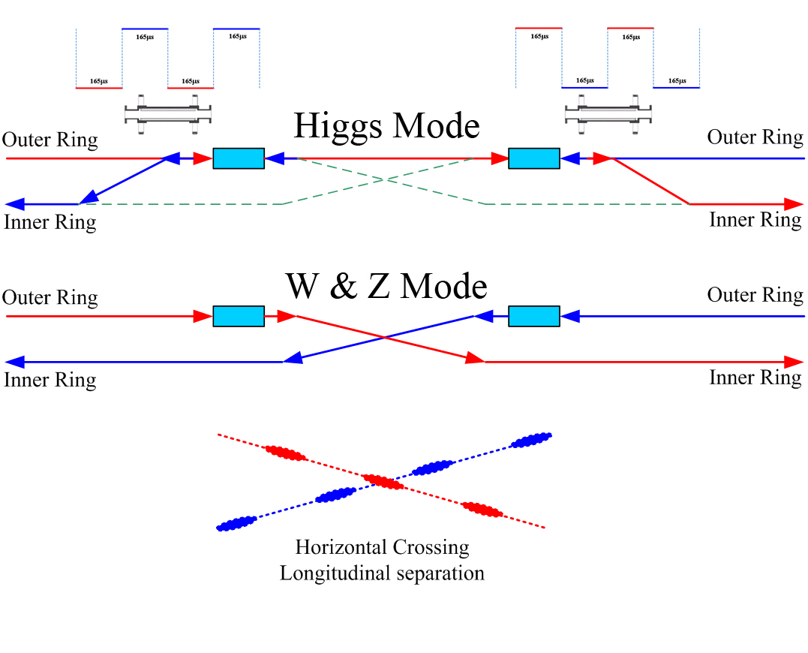
Machine introduction
Higgs, W and Z modes can be switched at any time
  Common cavities for Higgs mode, bunches filled in half ring for e+ and e-.
  Independent cavities for W & Z mode, bunches filled in full ring.
  Two cell & 650MHz RF cavity.
CW=6.06kHz, 50%
During the operation of Higgs mode all the RF cavities are shared by both e+ and e- beams with the application of the kicker and pulser power supply nearby the RF cavities.
For the W and Z modes the surveys of e+ and e- rings in the RF region are designed independently by turning off the kickers so that all bunches can be filled along the whole rings.

Slide 12
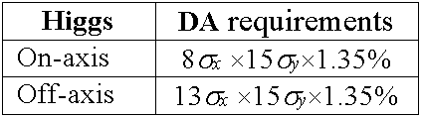
Machine introduction
On-axis injection only for Higgs mode
Circumference is same
Trajectory difference is 0.011m
0.037ns in time
17 degree RF phase shift in the booster
Several circulating bunches from Collider are extracted to the Booster. The Booster circulating bunches are then merged with the injected bunches from Collider. Then, the merged bunches in the Booster are injected back into collider ring by vertical on-axis injection. The procedure will be repeated several times so that all the circulating bunches in the Booster can be accumulated into the Collider. The beamloading effect in the Booster RF system is weak. The maximum cavity voltage drop is 0.48% and the maximum phase shift is 0.63 degree. The peak HOM power per RF cavity is 62W.

Slide 13
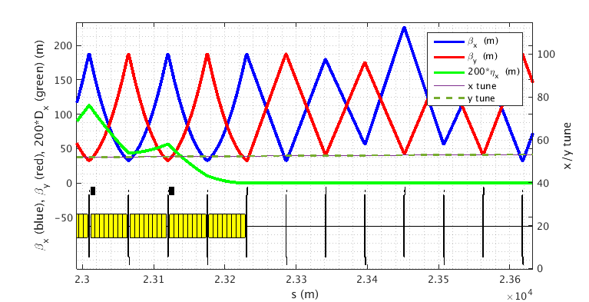
Machine introduction
Booster ring
Standard TME cells are chosen for lower booster emittance to relax the DA requirement of collider ring.
The magnetic field quality at the injection energy of 10GeV is still a challenge for both FODO and TME schemes. DA of Booster should be estimated carefully.
→ Pre-Booster (10GeV to 45GeV) to deal with the low field problem
High precision requirement for the orbit control at the entrance of collider ring.

Slide 14
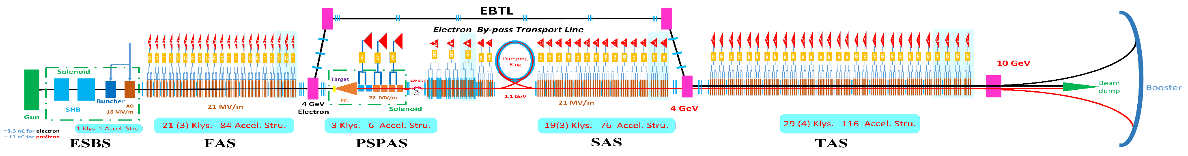
Machine introduction
Linac
1.1GeV
1200m
Parameter | Symbol | Unit | Designed
e⁻ /e⁺ beam energy | E_{e-}/E_{e+} | GeV | 10
Repetition rate | f_{rep} | Hz | 100
e⁻ /e⁺ bunch population | N_{e-}/N_{e+} |  | > 9.4×10⁹ / >9.4×10⁹
 |  | nC | > 1.5
Energy spread (e⁻ /e⁺ ) | σ_{e} |  | < 2×10⁻³ / < 2×10⁻³
Emittance (e⁻ /e⁺ ) | ε_{r} | nm⋅ rad | 40
Bunch length (e⁻ /e⁺ ) | σ_{l} | mm | 1 / 1
e⁻ beam energy on Target |  | GeV | 4
e⁻ bunch charge on Target |  | nC | 10
The total beam transfer efficiency from transfer line to the injection point of collider ring is greater than 90%.
The transfer efficiency can be made much higher with a damping ring of energy 1.1GeV while the beam emittance of Linac can be controlled below 40 nm.

Slide 15
Key beam physics challenges
Project is the integration of physics goals, beam performance, construction cost and operation cost.
For the CEPC beam physics,
Beam performance reduction caused by fluctuation and beamstruhlung effects
Enough dynamic aperture vs. Beam lifetime and injection
→ FODO cell, 90°/90°, non-interleaved sextupole scheme in ARC
→ Selection of BetaY*, IR design, On-axis injection, etc
→ Powerful DA optimization logic
→ Relax errors tolerance of the machine
→ Flexibility and robust

Slide 16
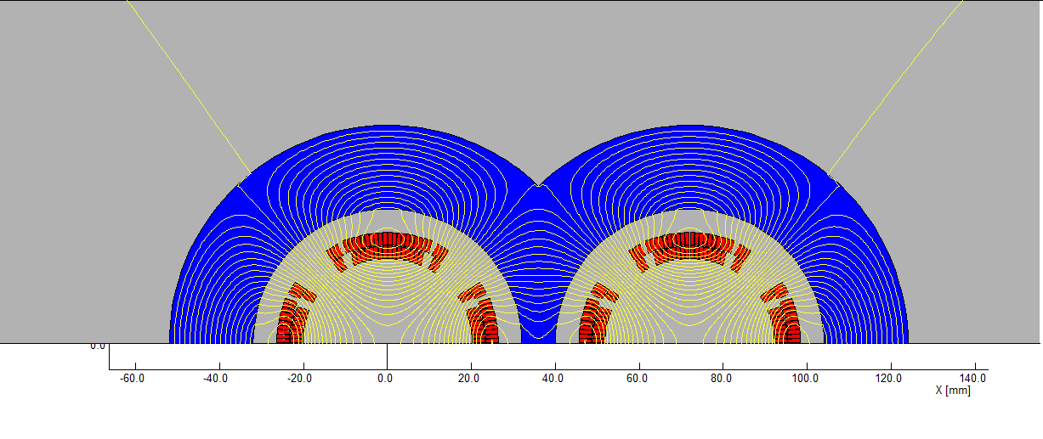
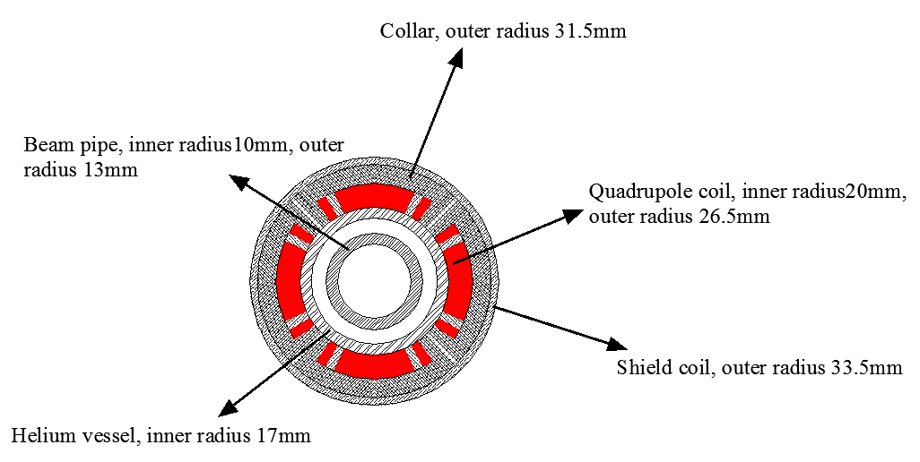
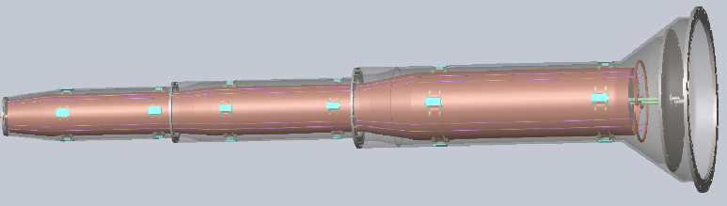
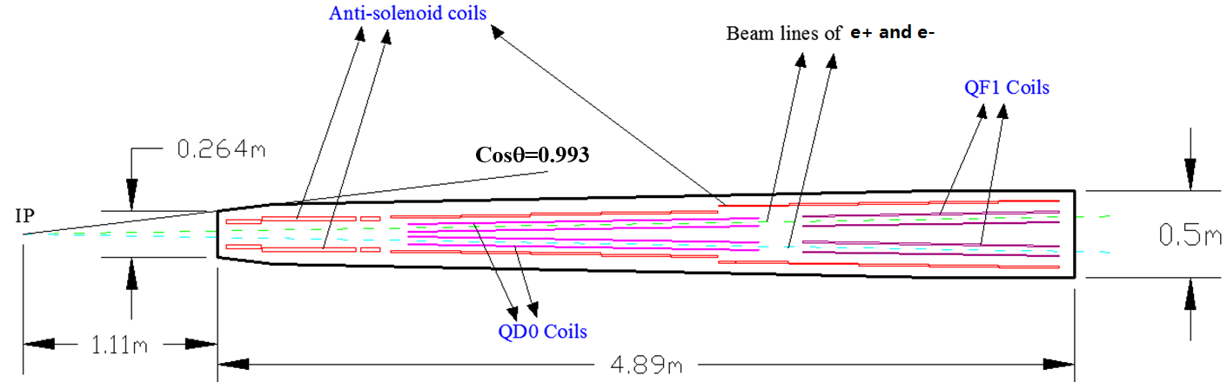
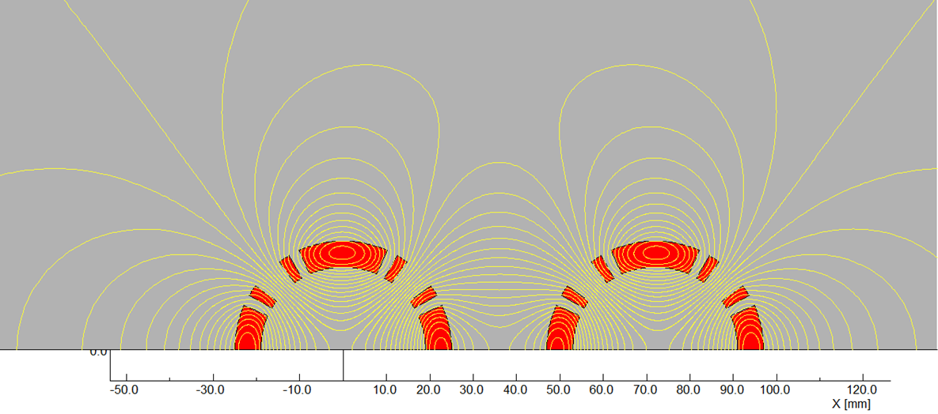
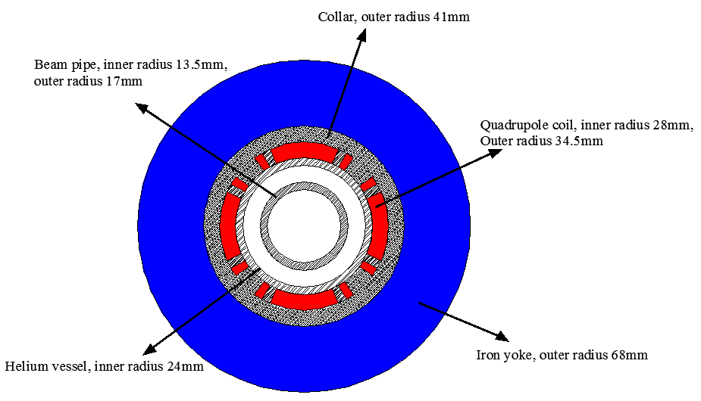
Key beam physics challenges
Design of interaction region
✓ L*=2.2m, θc=33mrad, βx*=0.36m, βy*=1.5mm, Detector solenoid=3.0T
  Lower strength requirements of anti-solenoids (B_{z}~7.2T)
  Enough space for the SC quadrupole coils in two-in-one type (Peak field 3.8T & 136T/m) with room temperature vacuum chamber.
The length of cryostat is 4.9m

Slide 17
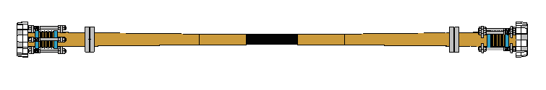
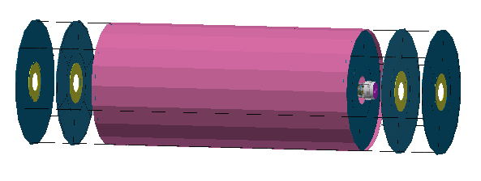
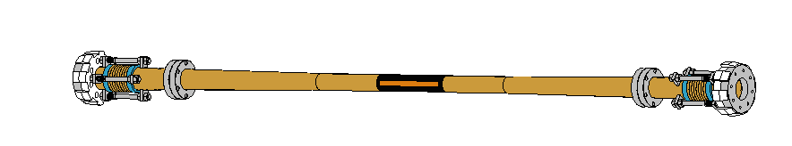
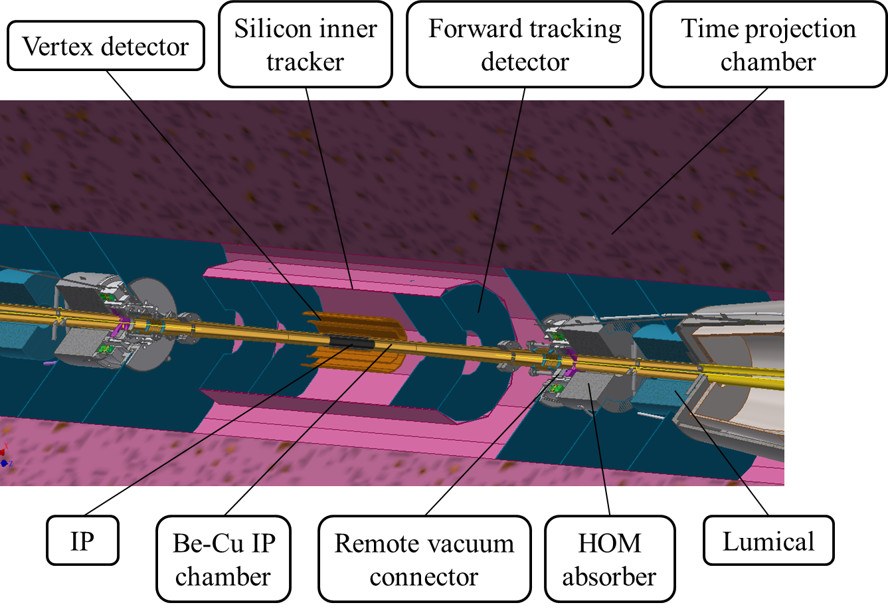
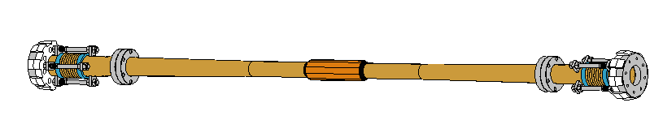
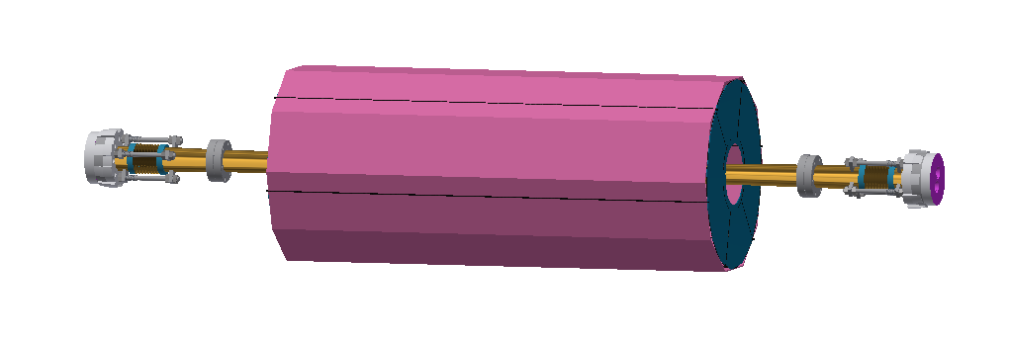
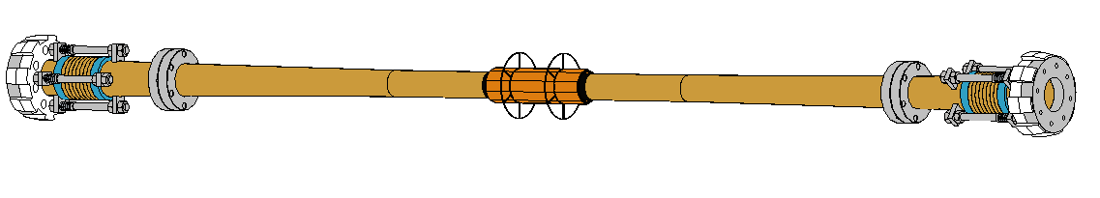
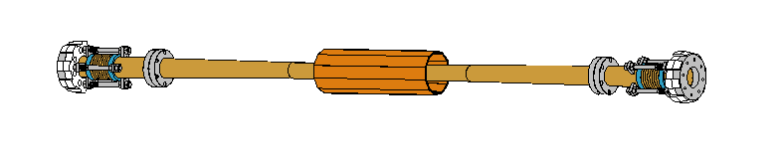
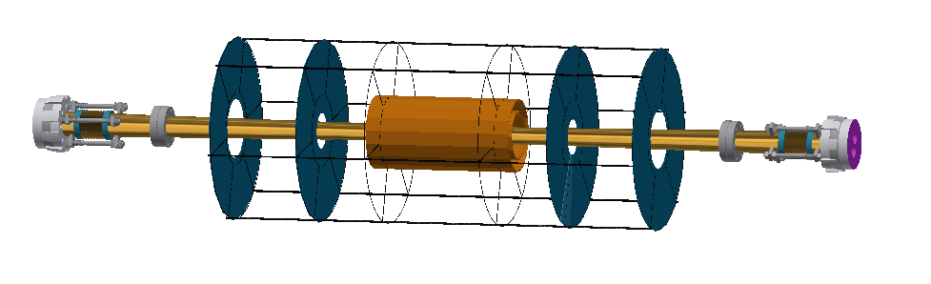
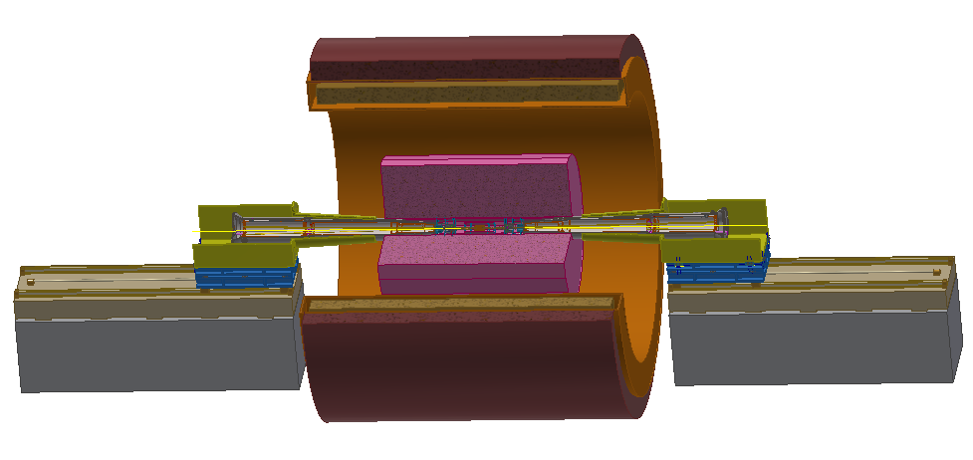
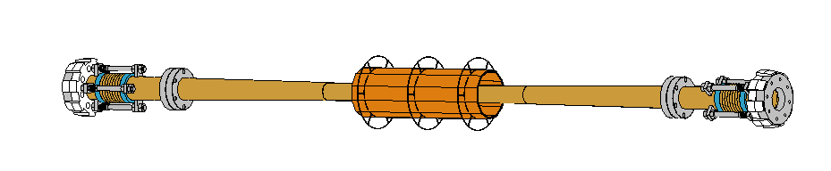
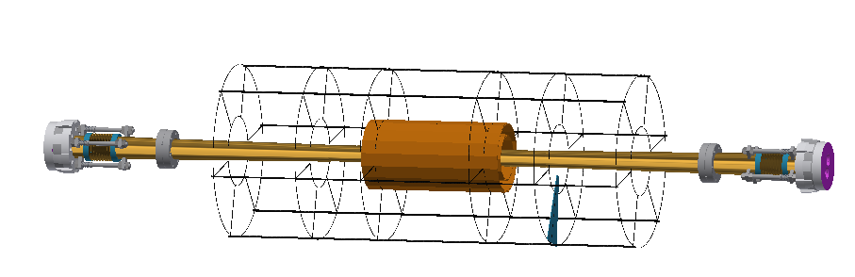
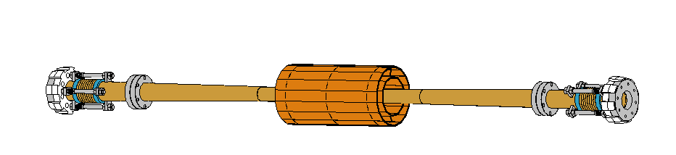
Key beam physics challenges
IP assembly
  Support and connection (Preliminary)
  Alignment (No idea)
Connect the flanges using RVC

Slide 18
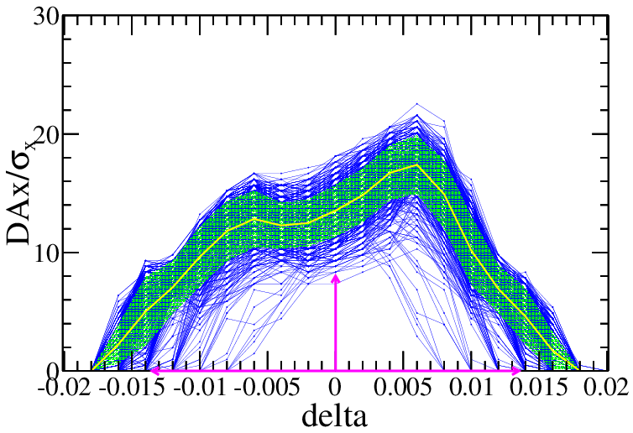
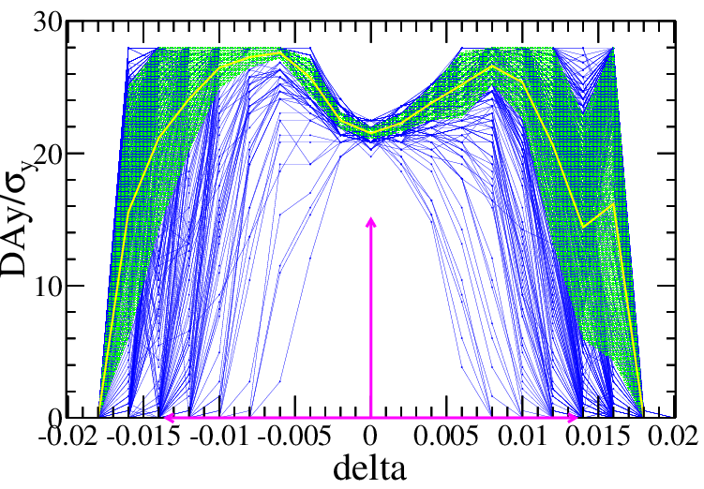
Key beam physics challenges
Dynamic aperture optimization with errors @ Higgs
Crab waist=100%
SAD code for tracking
145 turns tracked
100 samples
IR sextupoles + 32 arc sextupoles
(Max. free various=254)
Damping at each element
RF ON
Radiation fluctuation ON
Sawtooth on with tapering
$$10σ_{x}×20σ_{y} \& 0.014$$
> 90% of 1000 seeds
Component | Δx (mm) | Δy (mm) | Δz (mm) | Δθ_{x} (mrad) | Δθ_{y} (mrad) | Δθ_{z} (mrad) | Field error
Dipole | 0.10 | 0.10 | 0.10 | 0.1 | 0.1 | 0.1 | 0.01%
Arc Quadrupole | 0.10 | 0.10 | 0.10 | 0.1 | 0.1 | 0.1 | 0.02%
FF Quadrupole | 0.03 | 0.03 | 0.03 | 0.03 | 0.03 | 0.03
Sextupole | 0.10 | 0.10 | 0.10 | 0.1 | 0.1 | 0.1
Dipole | Quadrupole | Sextupole
B₂/B₀≤4×10⁻⁴ B₃/B₀≤0.8×10⁻⁴ B₄/B₀≤0.2×10⁻⁴ B_{n}(n>4)/B₀≤0.8×10⁻⁴ | B₂/B₁≤4×10⁻⁴ B₃/B₁≤4×10⁻⁴ B₄/B₁≤2×10⁻⁴ B_{n}(n>4)/B₁≤1×10⁻⁴ | B₃/B₂≤20×10⁻⁴ B₄/B₂≤3×10⁻⁴ B₅/B₂≤20×10⁻⁴ B_{n}(n>5)/B₂≤10×10⁻⁴
RMS
R=12mm
RMS close orbit distortions are smaller than 40 µm in both horizontal and vertical plane. Beta beatings < 1.5% , Coupling < 0.2%

Slide 19
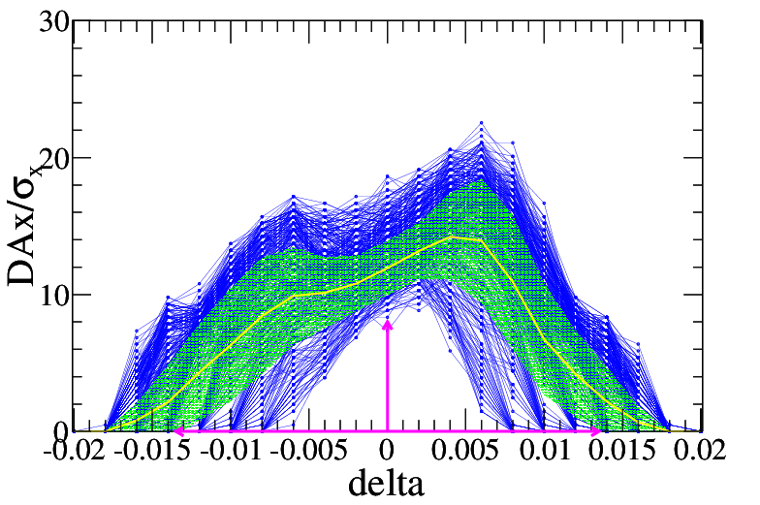
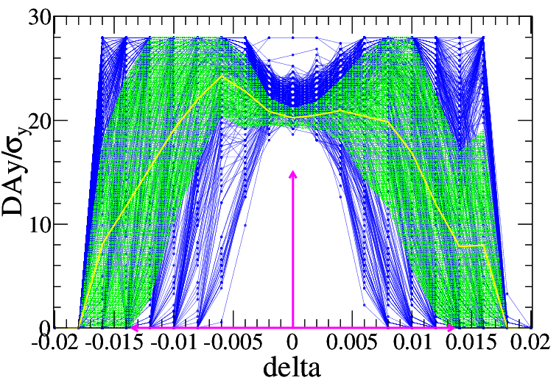
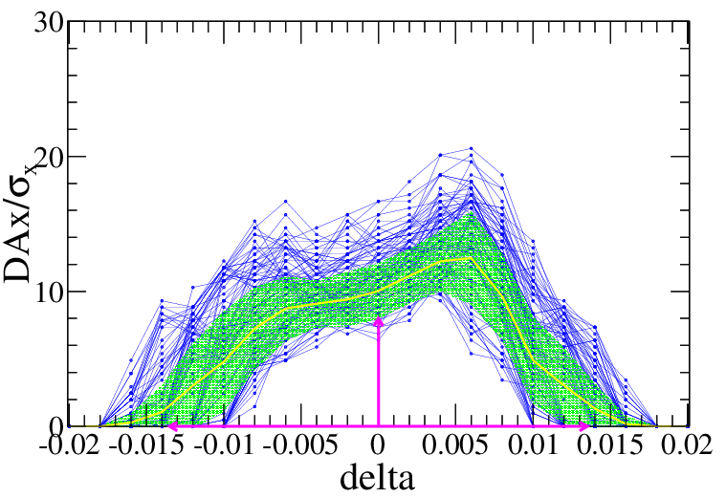
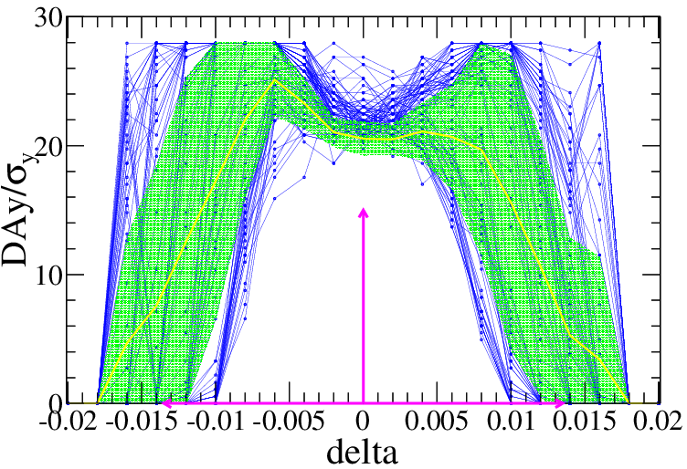
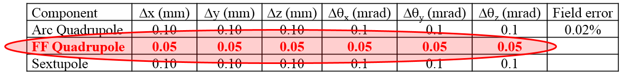
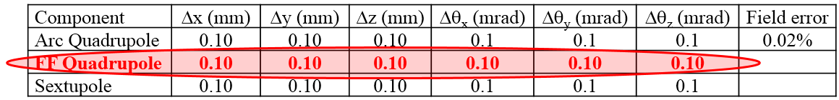
Key beam physics challenges
Dynamic aperture optimization with errors @ Higgs
~50% of 1000 seeds
~10% of 1000 seeds
The optics correction is very challenging for the relaxed tolerance of the imperfections.
More finer correction of orbit and optics
More harsh alignment restrictions

Slide 20
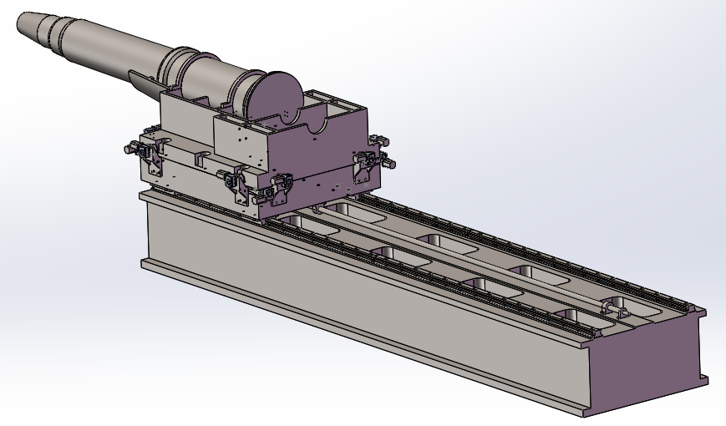
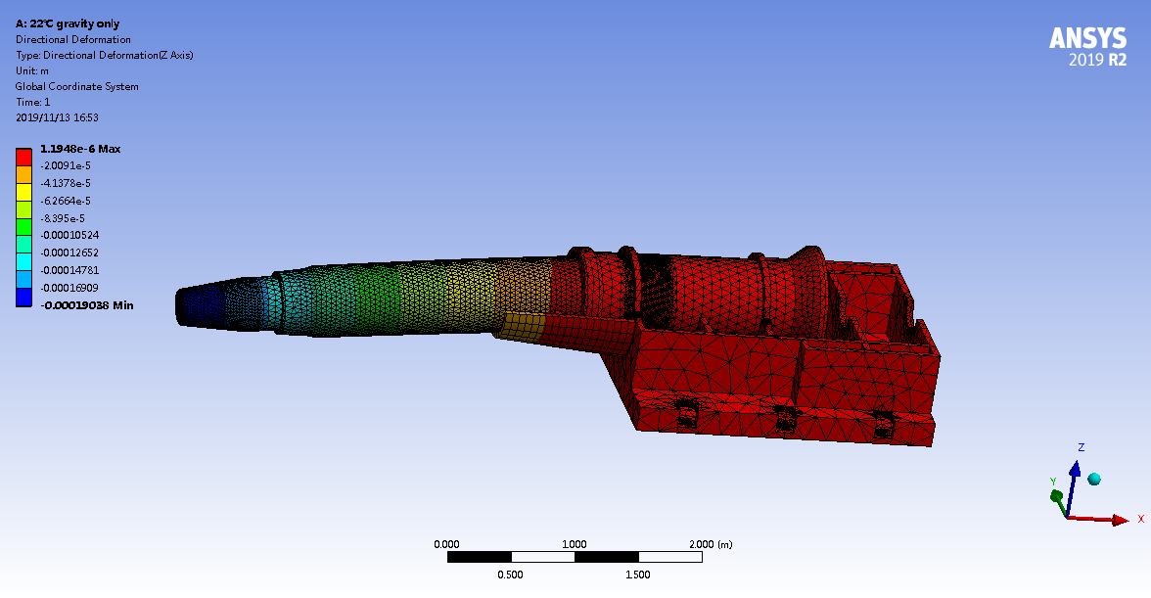
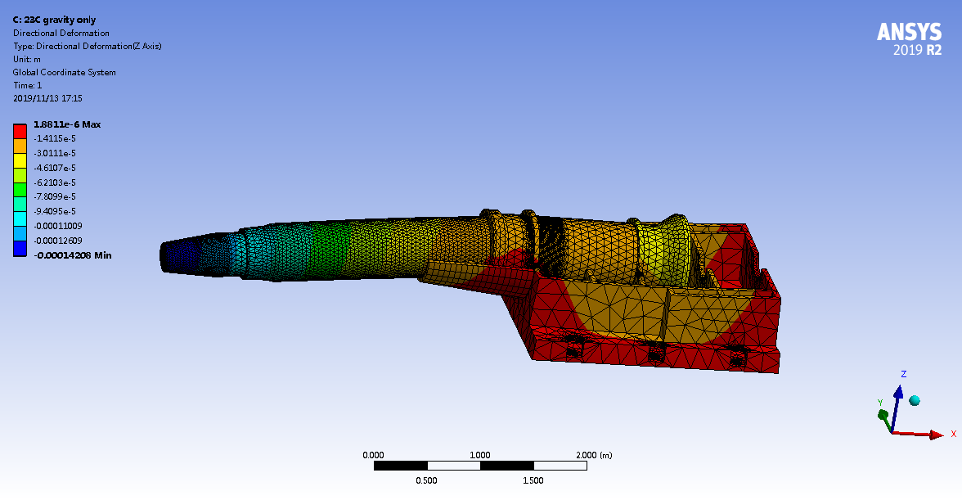
Key beam physics challenges
In fact
Under gravity, deformation=190μm
1°C variation, deformation=48μm
Under magnetic field force the deformation> 0.5mm
  We still have no effective online measurement and alignment.
  Short FF system → larger betaY* → Decreasing the luminosity

Slide 21
Summary
CEPC which aims at researching Higgs boson is a double ring scheme optimized at the beam energy of 120GeV.
The machine parameters for the Z and w modes do not increase the budget which is based on operation as a Higgs factory.
The key beam physics issues are DA and dominant factors which can reduce the DA.
IR design is the most important for the whole machine.

