Slide 1
EIC
Christoph Montag, BNL
June 24, 2020

Slide 2
Requirements for the Electron Ion Collider
High luminosity: L = 10³³ to 10³⁴ cm⁻²sec⁻¹ - factor 100 to 1000 beyond HERA
Large energy range: E_{cm}= 20 to 140 GeV
Polarized beams with flexible spin patterns
Favorable conditions for detector acceptance such as p_{T} =200 MeV
Large range of hadron species: protons ….Uranium
Collisions of electrons with polarized protons and light ions (h³He, hd,…)

Slide 3
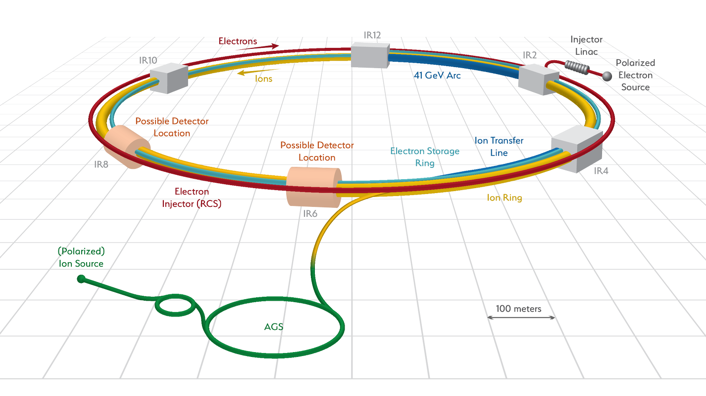
Facility layout
Electron complex to be installed in existing RHIC tunnel – cost effective

Slide 4
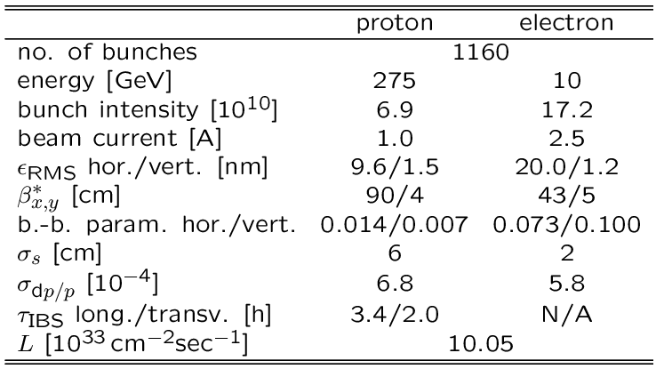
Parameters for Highest Luminosity
Hadron beam parameters similar to present RHIC, but smaller vertical emittance and many more bunches
2 hour IBS growth time requires countermeasures for meaningful store lengths
Electron beam parameters resemble a B-Factory
Facility optimized for high luminosity at high energy
Alternative optimizations are possible, for example for high luminosity at low energy

Slide 5
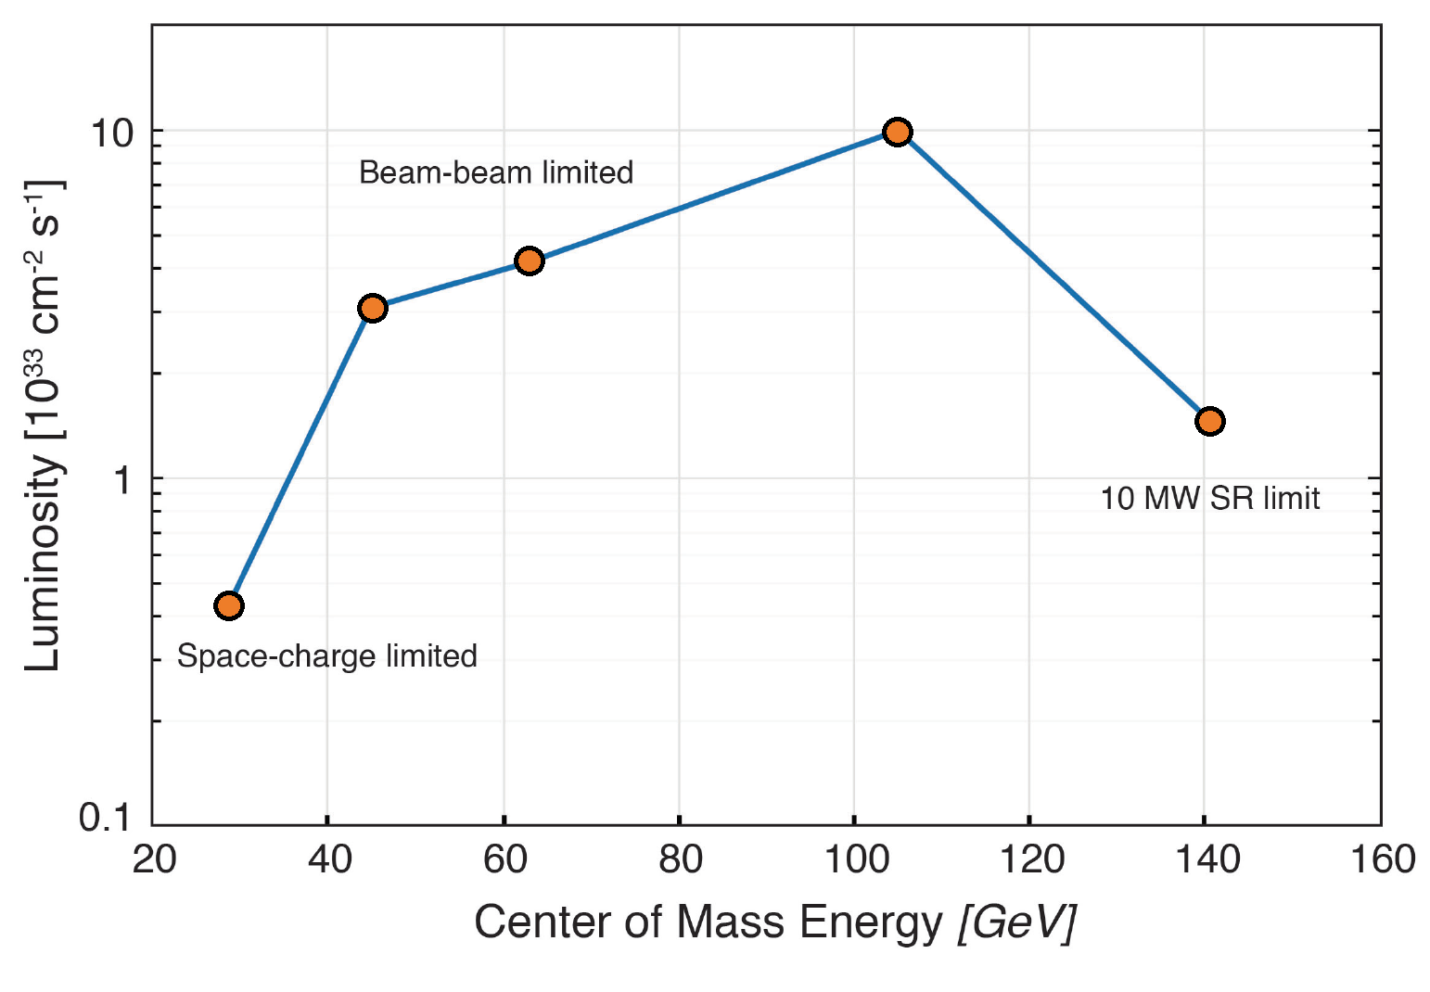
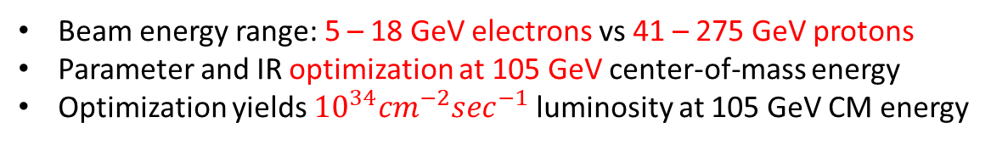
Luminosity vs. CM Energy
Beam energy range: 5 – 18 GeV electrons vs 41 – 275 GeV protons
Parameter and IR optimization at 105 GeV center-of-mass energy
Optimization yields ${10}^{34}{cm}^{−2}\sec^{−1}$luminosity at 105 GeV CM energy

Slide 6
Challenges
Beam-beam with crab crossing for hadrons
  25 mrad crossing angle, 7 cm long hadron bunches, 197 MHz crab cavities, harmonic crabs
Counteracting 2h IBS time
  Strong hadron cooling at up to 275 GeV
  or
  Utilizing the second RHIC hadron ring as on-energy injector, replacing entire fill every few hours
Continuous electron bunch replacement to counteract depolarization
  ~10 nsec bunch spacing, replace two 28 nC bunches per second

Slide 7
Full-energy polarized electron injector
  Spin resonance-free Rapid Cycling Synchrotron
Minimizing backgrounds, detector downtime during injection/replacement
  Collimation
  Synchrotron radiation masks
  Detector design for fast turn around
High acceptance interaction region
  Superconducting NbTi magnets
  Large apertures for forward scattered particles, and for synchrotron radiation on rear side
  Coldmasses shared between beams
Electron clouds and image currents in hadron ring with 10 nsec bunch spacing
  Insertion of pre-coated sleeves, or in-situ beam pipe coating

Slide 8
EIC Timeline
CD-0 12/19/2019
Siting Decision 01/09/2020
CD-1 03/31/2021
CD-2 09/30/2022
CD-3 09/30/2023
Early Finish 09/30/2029
CD-4 09/30/2030

Slide 9
Potential Upgrades

Slide 10
Positrons
Necessary preparation during EIC construction
  Provide space for future LINAC and source building
  Foresee polarity change of superconducting IR magnets
  Provide space for a positron damping ring
Luminosity
  Unpolarized: same as for electrons
  Polarized: challenging, but many ideas around
  (self-polarization at 18 GeV for free, but
          No arbitrary spin patterns)
Cost
  LINAC $20M, building $50M, Damping Ring $40M

Slide 11
Energy Upgrade
Electron energy is essentially at its economical maximum at 18 GeV
Hadron energy limited by existing superconducting 3.5 tesla hadron ring magnets
Hadron energy could be more than doubled by replacing hadron ring with state-of-the-art magnets (LHC: 7 tesla)

Slide 12
Standard Parameter Tables

Slide 13
EIC/Christoph Montag | e - p | Montag@bnl.gov
Beam Energy | GeV | e: 5, p: 41
Peak Luminosity (10^34) | cm-2 s-1 | 0.044
Int. Luminosity | ab-1/yr | 4.4
Beam dE/E at IP |  | e: 6.8, p: 10.3
Transv. Beam sizes at IP x/y | um | 198/27
Rms bunch length / beta* | cm | e: 2, p: 7.5
Crossing angle | urad | 25
Rep./Rev. frequency | Hz | 78000
Bunch spacing | ns | 10
# of IPs |  | 1 (up to 2)
# of bunches |  | 1160
Length/Circumference | km | 3.8
Facility site power | MW | 58
Cost range | $B US | $1.6B - $2.6B
Timescale till operations |  | ~2030

Slide 14
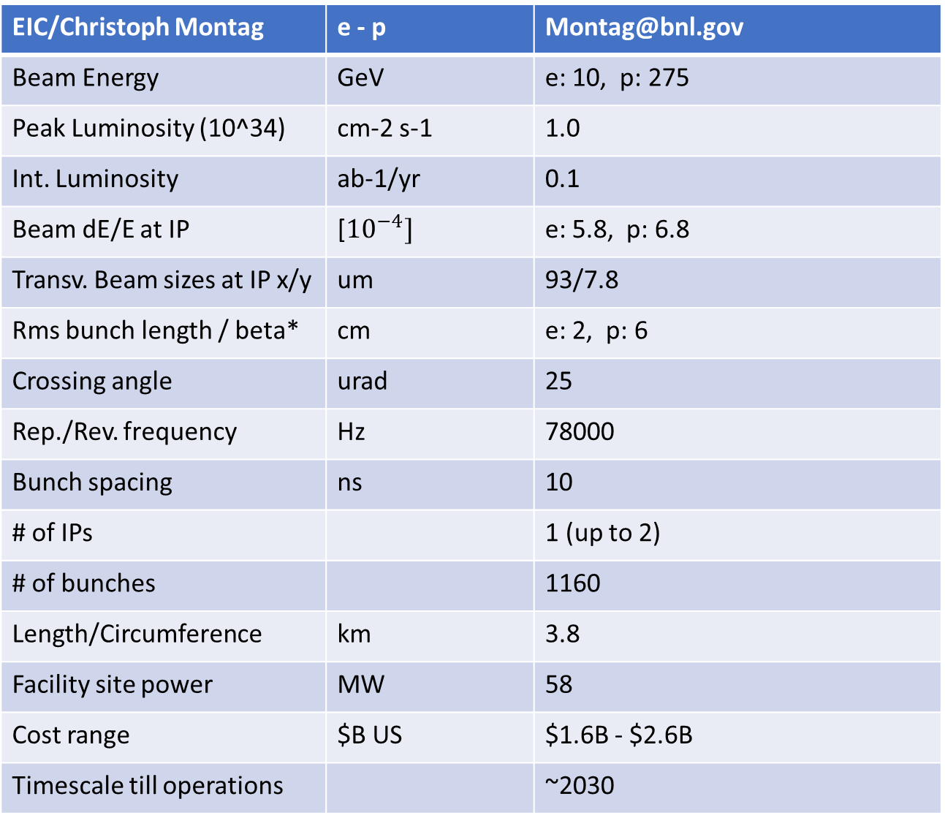
EIC/Christoph Montag | e - p | Montag@bnl.gov
Beam Energy | GeV | e: 10, p: 275
Peak Luminosity (10^34) | cm-2 s-1 | 1.0
Int. Luminosity | ab-1/yr | 0.1
Beam dE/E at IP | [${10}^{−4}]$ | e: 5.8, p: 6.8
Transv. Beam sizes at IP x/y | um | 93/7.8
Rms bunch length / beta* | cm | e: 2, p: 6
Crossing angle | urad | 25
Rep./Rev. frequency | Hz | 78000
Bunch spacing | ns | 10
# of IPs |  | 1 (up to 2)
# of bunches |  | 1160
Length/Circumference | km | 3.8
Facility site power | MW | 58
Cost range | $B US | $1.6B - $2.6B
Timescale till operations |  | ~2030

Slide 15
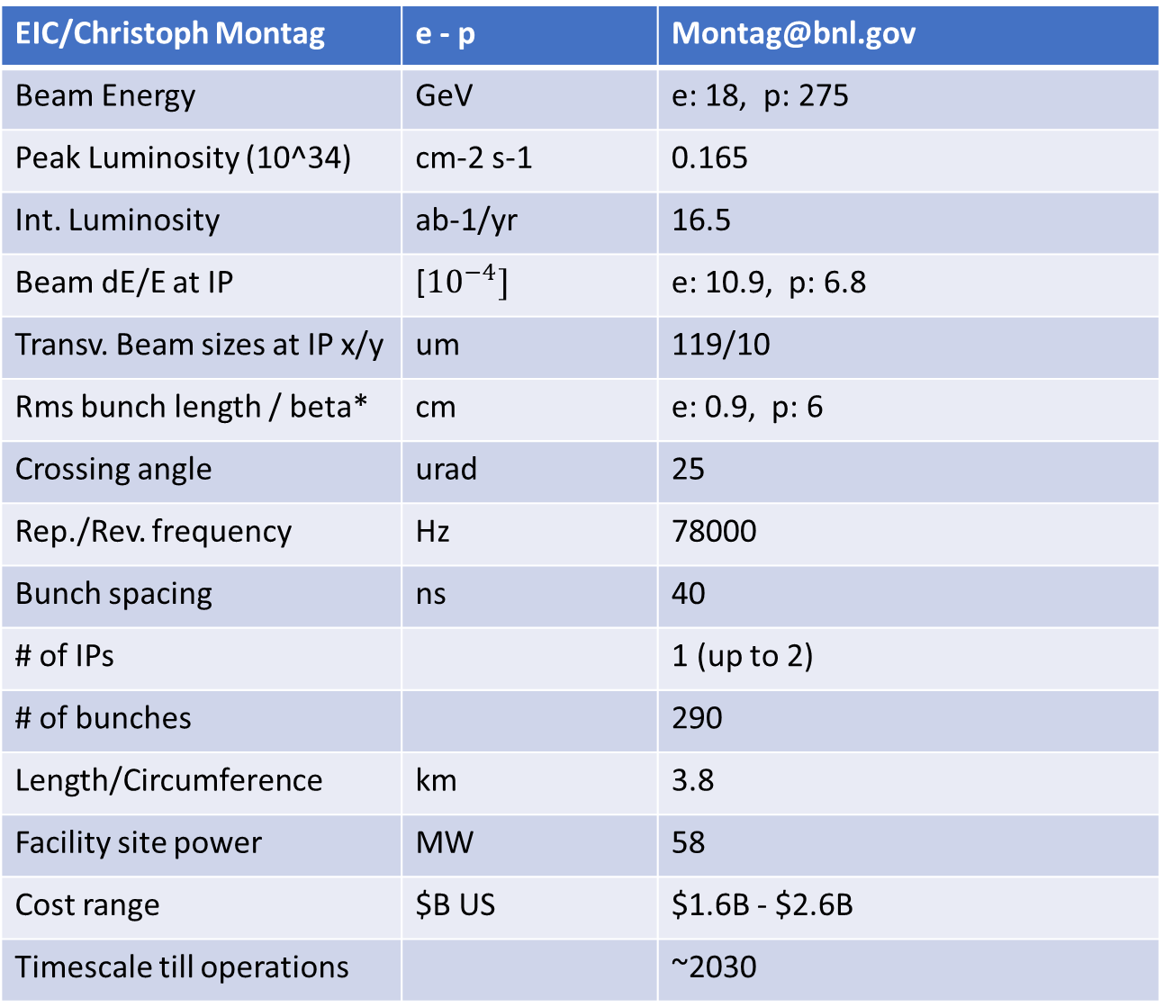
EIC/Christoph Montag | e - p | Montag@bnl.gov
Beam Energy | GeV | e: 18, p: 275
Peak Luminosity (10^34) | cm-2 s-1 | 0.165
Int. Luminosity | ab-1/yr | 16.5
Beam dE/E at IP | [${10}^{−4}]$ | e: 10.9, p: 6.8
Transv. Beam sizes at IP x/y | um | 119/10
Rms bunch length / beta* | cm | e: 0.9, p: 6
Crossing angle | urad | 25
Rep./Rev. frequency | Hz | 78000
Bunch spacing | ns | 40
# of IPs |  | 1 (up to 2)
# of bunches |  | 290
Length/Circumference | km | 3.8
Facility site power | MW | 58
Cost range | $B US | $1.6B - $2.6B
Timescale till operations |  | ~2030

Slide 16
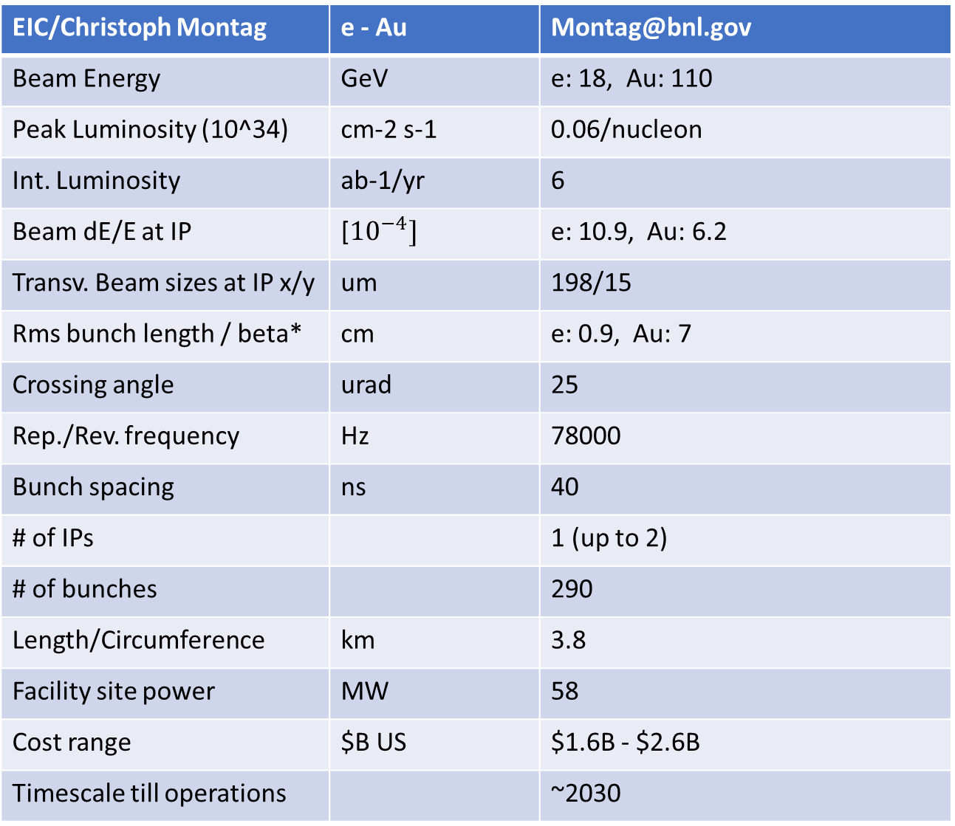
EIC/Christoph Montag | e - Au | Montag@bnl.gov
Beam Energy | GeV | e: 18, Au: 110
Peak Luminosity (10^34) | cm-2 s-1 | 0.06/nucleon
Int. Luminosity | ab-1/yr | 6
Beam dE/E at IP | [${10}^{−4}]$ | e: 10.9, Au: 6.2
Transv. Beam sizes at IP x/y | um | 198/15
Rms bunch length / beta* | cm | e: 0.9, Au: 7
Crossing angle | urad | 25
Rep./Rev. frequency | Hz | 78000
Bunch spacing | ns | 40
# of IPs |  | 1 (up to 2)
# of bunches |  | 290
Length/Circumference | km | 3.8
Facility site power | MW | 58
Cost range | $B US | $1.6B - $2.6B
Timescale till operations |  | ~2030

Slide 17
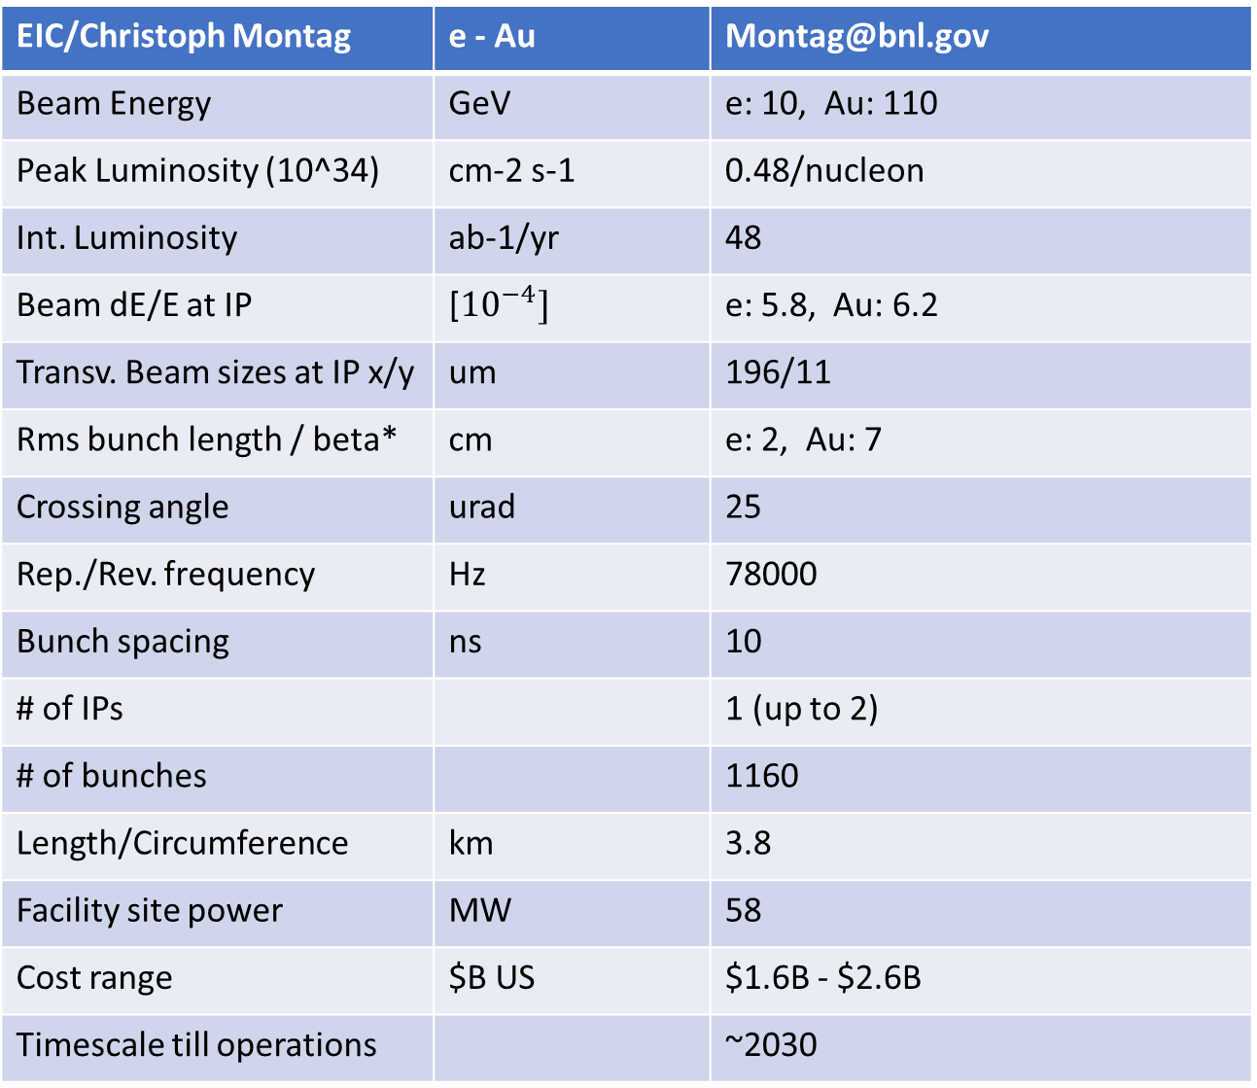
EIC/Christoph Montag | e - Au | Montag@bnl.gov
Beam Energy | GeV | e: 10, Au: 110
Peak Luminosity (10^34) | cm-2 s-1 | 0.48/nucleon
Int. Luminosity | ab-1/yr | 48
Beam dE/E at IP | [${10}^{−4}]$ | e: 5.8, Au: 6.2
Transv. Beam sizes at IP x/y | um | 196/11
Rms bunch length / beta* | cm | e: 2, Au: 7
Crossing angle | urad | 25
Rep./Rev. frequency | Hz | 78000
Bunch spacing | ns | 10
# of IPs |  | 1 (up to 2)
# of bunches |  | 1160
Length/Circumference | km | 3.8
Facility site power | MW | 58
Cost range | $B US | $1.6B - $2.6B
Timescale till operations |  | ~2030

Slide 18
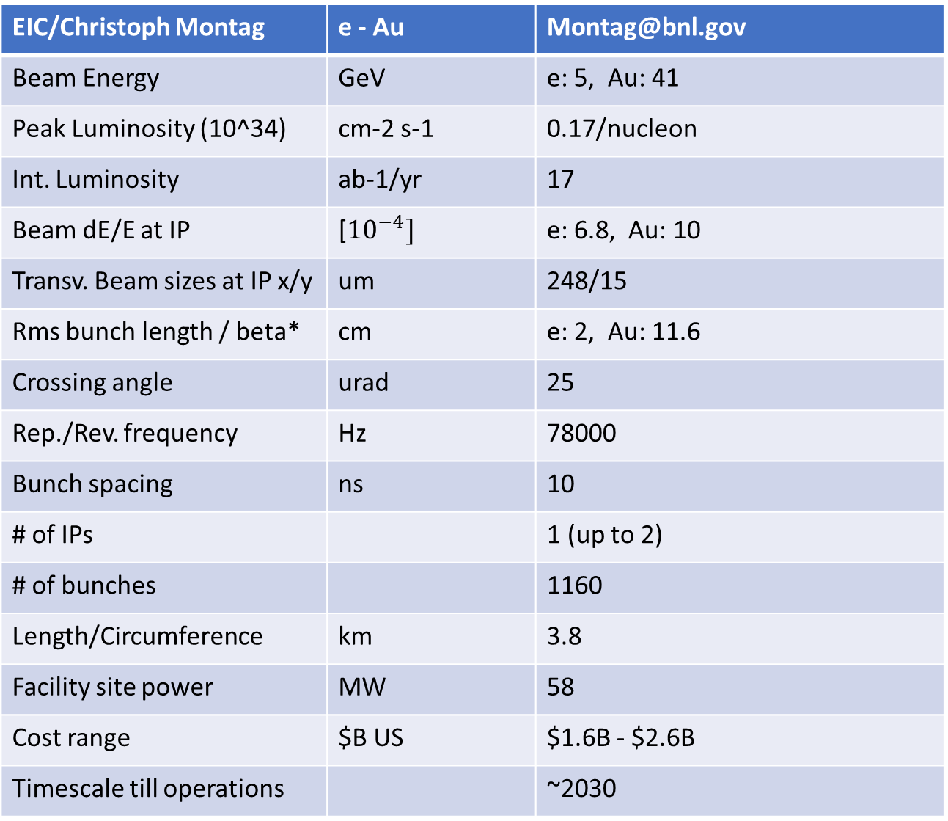
EIC/Christoph Montag | e - Au | Montag@bnl.gov
Beam Energy | GeV | e: 5, Au: 41
Peak Luminosity (10^34) | cm-2 s-1 | 0.17/nucleon
Int. Luminosity | ab-1/yr | 17
Beam dE/E at IP | [${10}^{−4}]$ | e: 6.8, Au: 10
Transv. Beam sizes at IP x/y | um | 248/15
Rms bunch length / beta* | cm | e: 2, Au: 11.6
Crossing angle | urad | 25
Rep./Rev. frequency | Hz | 78000
Bunch spacing | ns | 10
# of IPs |  | 1 (up to 2)
# of bunches |  | 1160
Length/Circumference | km | 3.8
Facility site power | MW | 58
Cost range | $B US | $1.6B - $2.6B
Timescale till operations |  | ~2030

Slide 19
Backup Slides

Slide 20
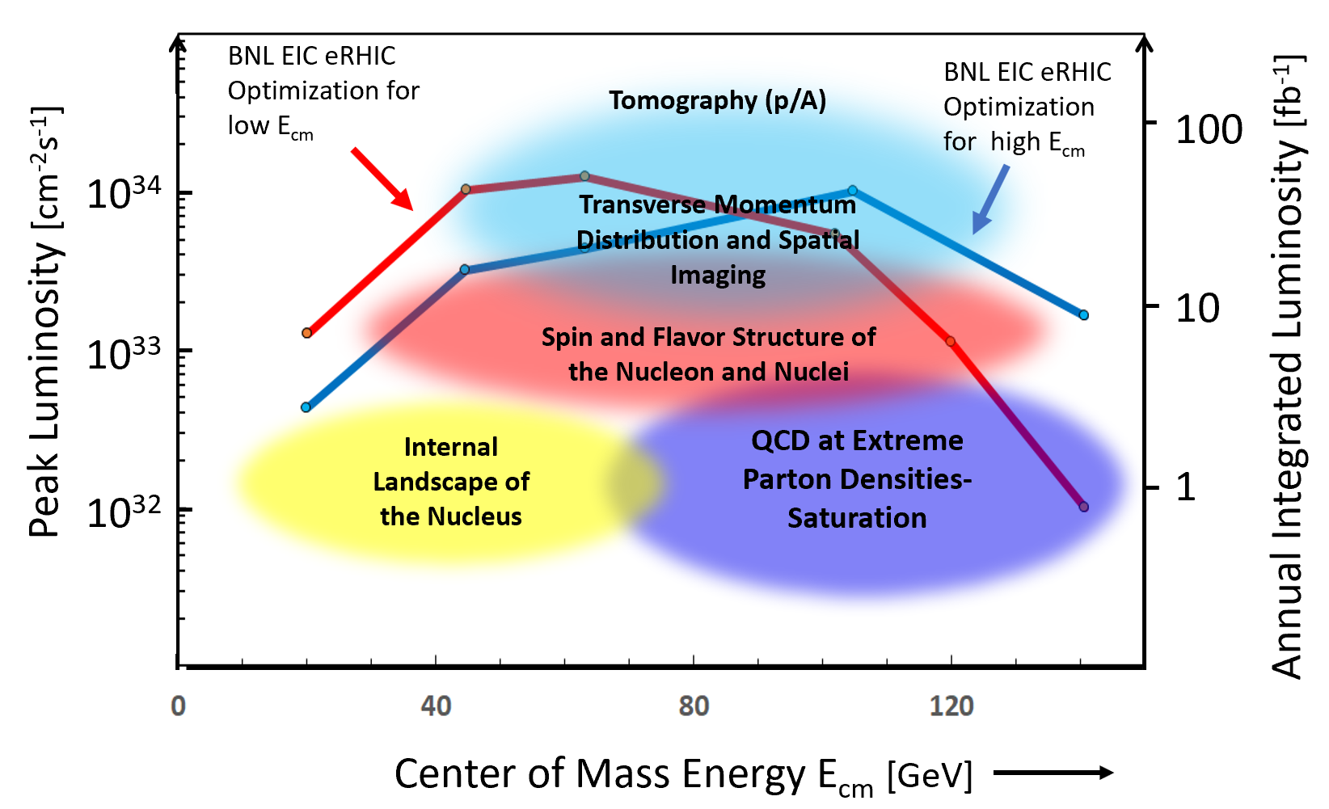
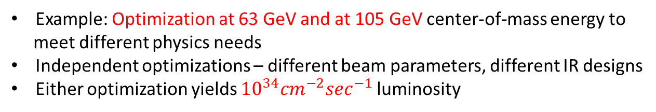
Alternative Luminosity Optimizations
Example: Optimization at 63 GeV and at 105 GeV center-of-mass energy to
meet different physics needs
Independent optimizations – different beam parameters, different IR designs
Either optimization yields ${10}^{34}{cm}^{−2}\sec^{−1}$luminosity

