Slide 1






FCC-hh
Michael Benedikt, for the FCC Collaboration
24 June 2020
gratefully acknowledging input from FCC coordination group,
global design study team and all contributors
LHC
PS
SPS
FCC
http://cern.ch/fcc
Work supported by the European Commission under the HORIZON 2020 projects EuroCirCol, grant agreement 654305; EASITrain, grant agreement no. 764879; ARIES, grant agreement 730871; and E-JADE, contract no. 645479
photo: J. Wenninger
photo: J. Wenninger

Slide 2

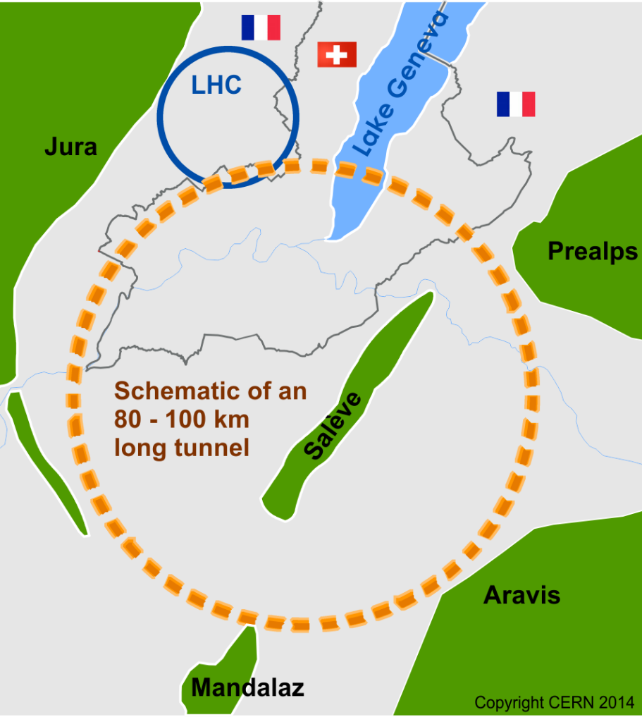
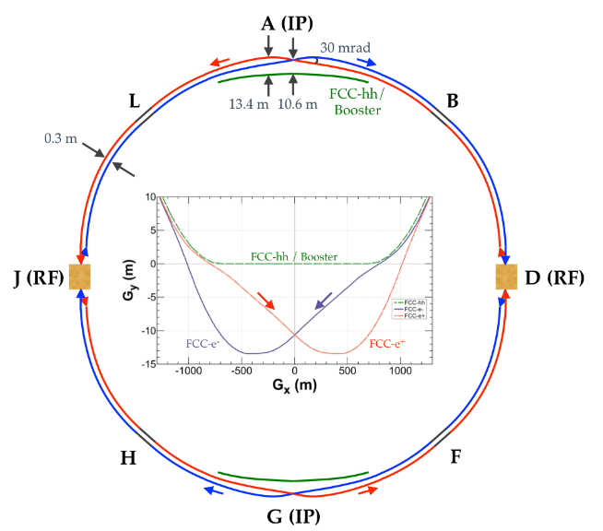
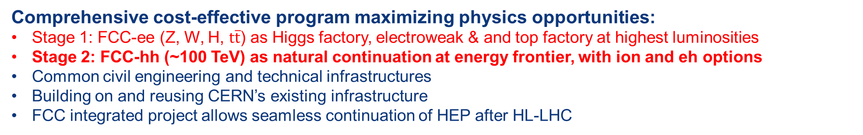
FCC-hh as part of the FCC integrated program
inspired by successful LEP – LHC programs at CERN
Comprehensive cost-effective program maximizing physics opportunities:
Stage 1: FCC-ee (Z, W, H, $\text{t}\overline{\text{t}}$) as Higgs factory, electroweak & and top factory at highest luminosities
Stage 2: FCC-hh (~100 TeV) as natural continuation at energy frontier, with ion and eh options
Common civil engineering and technical infrastructures
Building on and reusing CERN’s existing infrastructure
FCC integrated project allows seamless continuation of HEP after HL-LHC
FCC-ee
FCC-hh
24/06/2020
Snowmass AF-EF Meet 2020
2
Notes:
The FCC study and program comprises of two accelerators: the Lepton Collider FCC-ee and the Hadron Collider FCC-hh.
The aim of this setup is devise a comprehensive, cost-effective program to maximizing the physics opportunities.

Slide 3
FCC-hh overview and layout
Two high-luminosity experiments (A & G)
Two other experiments combined with injection (L & B)
Compatible with LHC or SPS as injector
Dedicated insertions:
  Betatron cleaning (J)
  Momentum cleaning (F)
  Extraction insertion (D)
  RF insertion (H)
Hadron collider with 100 TeV centre of mass collision energy and integral luminosity goal of >30 ab⁻¹ in 25y.
Part of FCC Integrated Program

Slide 4
Brief description of FCC-hh (i)
Physics aspects
  Highest centre of mass energy for direct production up to 20 - 30 TeV
  Huge production rates for single and multiple production of SM bosons (e.g. > 10¹⁰ H) and quarks
  Complementarity with electro-weak and Higgs factories (e.g. Higgs self coupling few %)
  Fundamental synergy with FCC-ee due to re-use of tunnel and surface infrastructures and technical infrastructures. Common physics program >50 years duration)
Main systems
  Double-ring hadron collider based on two-in-one high-field cryo dipole magnets.
  2 main high-luminosity interaction points (IP) & 2 lower luminosity IPs.
  Existing CERN proton machines as injector complex, baseline design with 3.3 TeV injection energy from modified LHC.
  100 km tunnel and surface infrastructures common with FCC-ee lepton collider

Slide 5
Brief description of FCC-hh (ii)
Key technologies and maturity
  High-field main bending magnets O(16T) based on Nb₃Sn technology (upgrades possibly with HTS). Major long-term global R&D needed on material and technologies, to reach performance and cost goals. To be followed by industrialization phase.
  Technologies associated with beam handling and beam loss management (injection/extraction elements, collimators, beam dump)
  Technologies associated with cryo operation of main magnets (cryogenic beam vacuum system, cryo plants, cryo distribution)
Key beam physics challenges
  Machine and operation concepts based on LHC and HL-LHC experience and technologies.
  Bunch parameters similar to present LHC parameters with 25 ns bunch spacing.
  Beam stored energy (8 GJ/beam) and associated required beam handling and beam loss management
  Synchrotron radiation in cold arc magnets (5 MW total) and associated damping effects

Slide 6
Brief description of FCC-hh (iii)
Key detector challenges
  Event pile up of 1000/bunch crossing at luminosity of 3x10³⁵ cm⁻²s⁻¹.
  Radiation damage.
Upgrade potential
  Luminosity upgrade already part of the 25 year run plan program.
  Ion operation and ion-proton operation already considered in the design.
  Collision energy upgrade via higher field magnets (HTS?).
  Possible extension to FCC-eh in one IP via addition of an ERL based 50-60 GeV electron beam facility.
Timeline (assuming prior construction and operation of FCC-ee)
  20-25 years for SC material & magnet R&D, prototyping and industrialization.
  Engineering & prototyping of other technologies will be performed in parallel with above
  10-15 years for production and installation.

Slide 7
FCC Hadron collider parameters (pp)
parameter | FCC-hh |  |  | HL-LHC | LHC
collision energy cms [TeV] | 100 |  |  | 14 | 14
dipole field [T] | 16 |  |  | 8.33 | 8.33
circumference [km] | 97.75 |  |  | 26.7 | 26.7
beam current [A] | 0.5 |  |  | 1.1 | 0.58
bunch intensity [10¹¹] | 1 |  | 1 | 2.2 | 1.15
bunch spacing [ns] | 25 |  | 25 | 25 | 25
synchr. rad. power / ring [kW] | 2400 |  |  | 7.3 | 3.6
SR power / length [W/m/ap.] | 28.4 |  |  | 0.33 | 0.17
long. emit. damping time [h] | 0.54 |  |  | 12.9 | 12.9
beta* [m] | 1.1 | 0.3 |  | 0.15 (min.) | 0.55 (0.25)
normalized emittance [μm] | 2.2 |  |  | 2.5 | 3.75
peak luminosity [10³⁴ cm⁻²s⁻¹] | 5 |  | 30 | 5 (lev.) | 1
events/bunch crossing | 170 |  | 1000 | 132 | 27
stored energy/beam [GJ] | 8.4 |  |  | 0.7 | 0.36

Slide 8
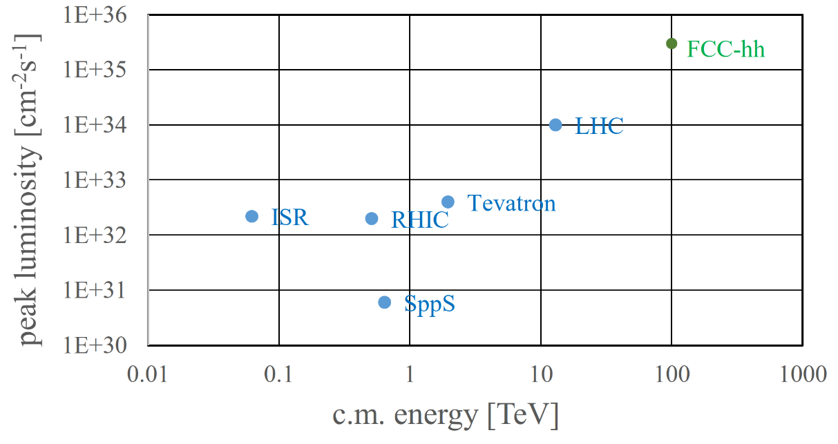
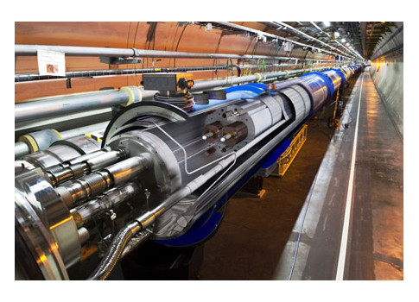
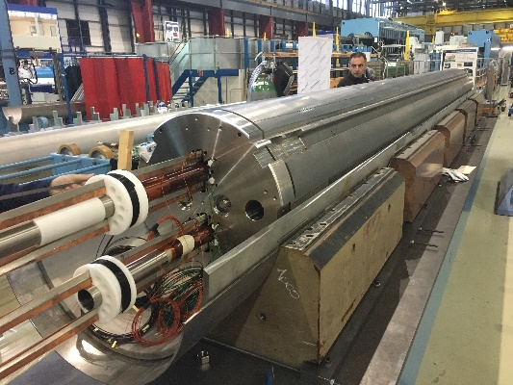
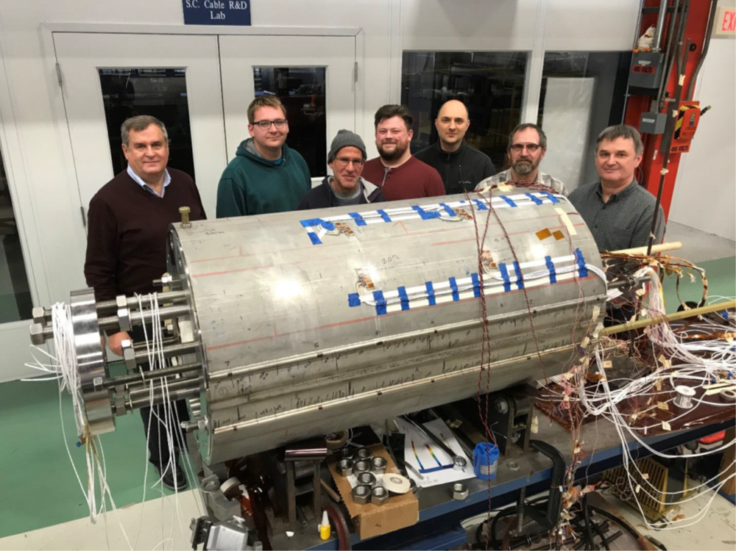
FCC-hh: main advantages and key technologies
order of magnitude performance increase in both energy & luminosity
100 TeV cm collision energy (vs 14 TeV for LHC)
20 ab⁻¹ per experiment collected over 25 years of operation (vs 3 ab⁻¹ for LHC)
similar performance increase as from Tevatron to LHC
key technology: high-field magnets
from
LHC technology
8.3 T NbTi
via
HL-LHC technology
11 T Nb₃Sn
FNAL demonstrator
14.1 T Nb₃Sn
(Accelerating News)

Slide 9
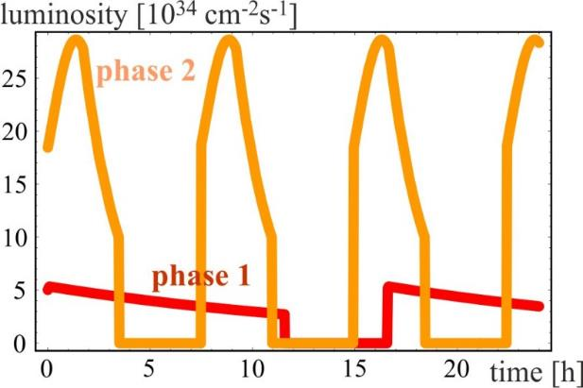
FCC-hh operation phases and luminosity
phase 1: β*=1.1 m, ΔQ_{tot}=0.01, t_{ta}=5 h, 250 fb⁻¹ / year
phase 2: β*=0.3 m, ΔQ_{tot}=0.03, t_{ta}=4 h, 1 ab⁻¹ / year
Transition via operational experience, no HW modification
radiation damping: τ~1 h
Total integrated luminosity over 25 years operation:
O(20) ab⁻¹/experiment
consistent with
physics goals
PRST-AB 18, 101002 (2015)
Interplay of radiation damping, luminosity burn-off, controlled transverse blow-up
24/06/2020
Snowmass AF-EF Meet 2020
9

Slide 10
FCC hh schedule as part of
FCC integral project technical schedule
1
2
3
4
5
6
7
8
9
10
11
12
13
14
15
16
17
18
15 years operation
34
35
36
37
38
39
40
41
42
43
~ 25 years operation
70
Project preparation &
administrative processes
Permis-sions
Update
Permissions
Funding strategy
Funding and
in-kind contribution agreements
Funding and
in-kind contribution agreements
Geological investigations, infrastructure detailed design and tendering preparation
Tunnel, site and technical infrastructure construction
FCC-ee dismantling, CE & infrastructure adaptations FCC-hh
FCC-ee accelerator R&D and technical design
FCC-ee accelerator construction, installation, commissioning
FCC-hh accelerator R&D and technical design
FCC-hh accelerator construction, installation, commissioning
Set up of international experiment collaborations, detector R&D and concept development
FCC-ee detector technical design
FCC-ee detector
construction, installation, commissioning
FCC-hh detector R&D,
technical design
FCC-hh detector
construction, installation, commissioning
Superconducting wire and magnet R&D, short models
Long model magnets, prototypes, preseries
16 T magnet industrialization and
series production
24/06/2020
Snowmass AF-EF Meet 2020
10

Slide 11
FCC-hh cost estimate as part of
FCC-integrated project cost estimate
Total construction cost FCC-ee (Z, W, H) amounts to 10,500 MCHF & 1,100 MCHF (tt).
Total construction cost for subsequent FCC-hh amounts to 17,000 MCHF.
(FCC-hh stand alone cost would be 25 BCHF)
24/06/2020
Snowmass AF-EF Meet 2020
11

Slide 12
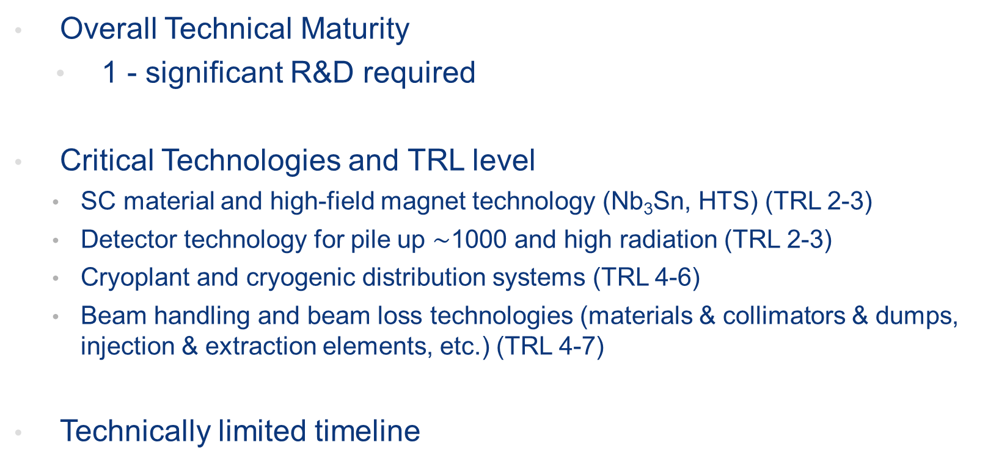
FCC hh technical maturity
Overall Technical Maturity
  1 - significant R&D required
Critical Technologies and TRL level
    SC material and high-field magnet technology (Nb₃Sn, HTS) (TRL 2-3)
    Detector technology for pile up $\sim$1000 and high radiation (TRL 2-3)
    Cryoplant and cryogenic distribution systems (TRL 4-6)
    Beam handling and beam loss technologies (materials & collimators & dumps, injection & extraction elements, etc.) (TRL 4-7)
Technically limited timeline
R&D
Construction
5 10 15 20 25 30 35 40 45
24/06/2020
Snowmass AF-EF Meet 2020
12

Slide 13

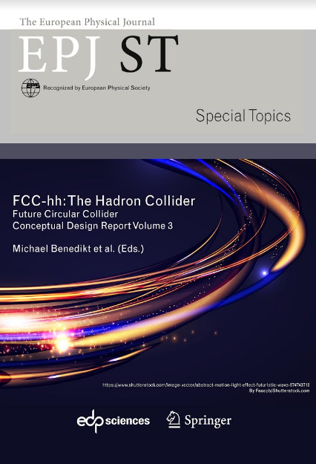
FCC-hh references
  FCC Physics Opportunities, FCC CDR vol. 1 (M. Mangano et al.), EPJ C 79, 6 (2019) 474
  FCC-hh: The Hadron Collider, FCC CDR vol. 3 (M. Benedikt et al.), EPJ ST 228, 4 (2019) 755-1107
  ESPPU 2020 Physics Briefing Book, CERN-ESU-4
  FCC-hh input document to ESU 2019/20, https://cds.cern.ch/record/2653674
  Optimizing integrated luminosity of future hadron colliders, Michael Benedikt, Daniel Schulte, and Frank Zimmermann, Phys. Rev. ST Accel. Beams 18, 101002 (2015)
  Machine Parameters and Projected Luminosity Performance of Proposed Future Colliders at CERN, F. Bordry et al., https://arxiv.org/abs/1810.13022 (2018)
24/06/2020
Snowmass AF-EF Meet 2020
13

Slide 14
Facility “Standard Table”
FCC-hh | p-p (p-A, A-A) | michael.benedikt@cern.ch
Beam Energy, range | TeV | 50
Peak Luminosity (10^34) | cm-2 s-1 | 30
Int. Luminosity | ab-1/yr | 1.5-2 / 2IP
Beam dE/E at IP |  | 6.2x10⁻⁵
Transv. Beam sizes at IP x/y | um | 3.5
Rms bunch length / beta* | cm | 8
Crossing angle | urad | 200
Rep./Rev. frequency | Hz | 3066.7
Bunch spacing | ns | 25
# of IPs |  | 4 (2 with high-luminosity)
# of bunches |  | 10400 / ring
Length/Circumference | km | 97.756
Facility site power | MW | 560
Cost range | $B US | 17 following FCC-ee in integrated program 24 standalone
Timescale till operations | yr | 35-45
24/06/2020
Snowmass AF-EF Meet 2020
14

