Slide 1
Snowmass’21 Joint AF-EF Meeting on Future Colliders “Day 1” (June 24, 2020 – Projects with TDRs or CDRs)
Introduction:
Vladimir SHILTSEV (AF)
Meenakshi Narain and Dmitri Denisov (EF)
“Day 2” - July 1, 2020 – “Projects w/o CDRs yet”

Slide 2
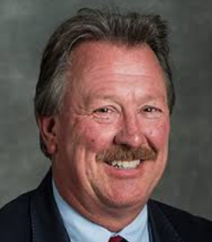
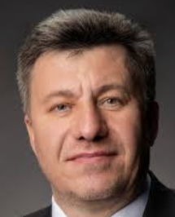
Accelerator Frontier
https://snowmass21.org/accelerator/start
Steve Gourlay (LBNL)
Tor Raubenheimer (SLAC)
Vladimir Shiltsev (FNAL)
Topical Group |  | Topical Group co-Conveners
AF01 | Beam Phys & Accel. Education | Z. Huang (Stanford) | M. Bei (GSI) | S. Lund (MSU)
AF02 | Accelerators for Neutrinos | J. Galambos (ORNL) | B. Zwaska (FNAL) | G. Arduini (CERN)
AF03 | Accelerators for EW/Higgs | M. Ross (SLAC) | Q. Qin (IHEP, Beijing) | Georg Hoffstaetter (Cornell)
AF04 | Multi-TeV Colliders | M. Palmer (BNL) | A. Valishev (FNAL) | N. Pastrone (INFN, Torino)
AF05 | Accelerators for PBC and Rare Processes | E. Prebys (UC Davis) | M. Lamont (CERN) | Richard Milner (MIT)
AF06 | Advanced Accelerator Concepts | C. Geddes (LBNL) | M. Hogan (SLAC) | P. Musumeci (UCLA) | R. Assmann (DESY)
AF07 | Accelerator Technology R&D
 | Sub-group RF | E. Nanny (SLAC) | S. Posen (FNAL) | H. Weise (DESY)
 | Sub-Group Magnets | G. Sabbi (LBNL) | S. Zlobin (FNAL) | S. Izquierdo Bermudez (CERN)
 | Sub-Group Targets/Sources | C. Barbier (ORNL) | Y. Sun (ANL) | Frederique Pellemoine (FNAL)

Slide 3
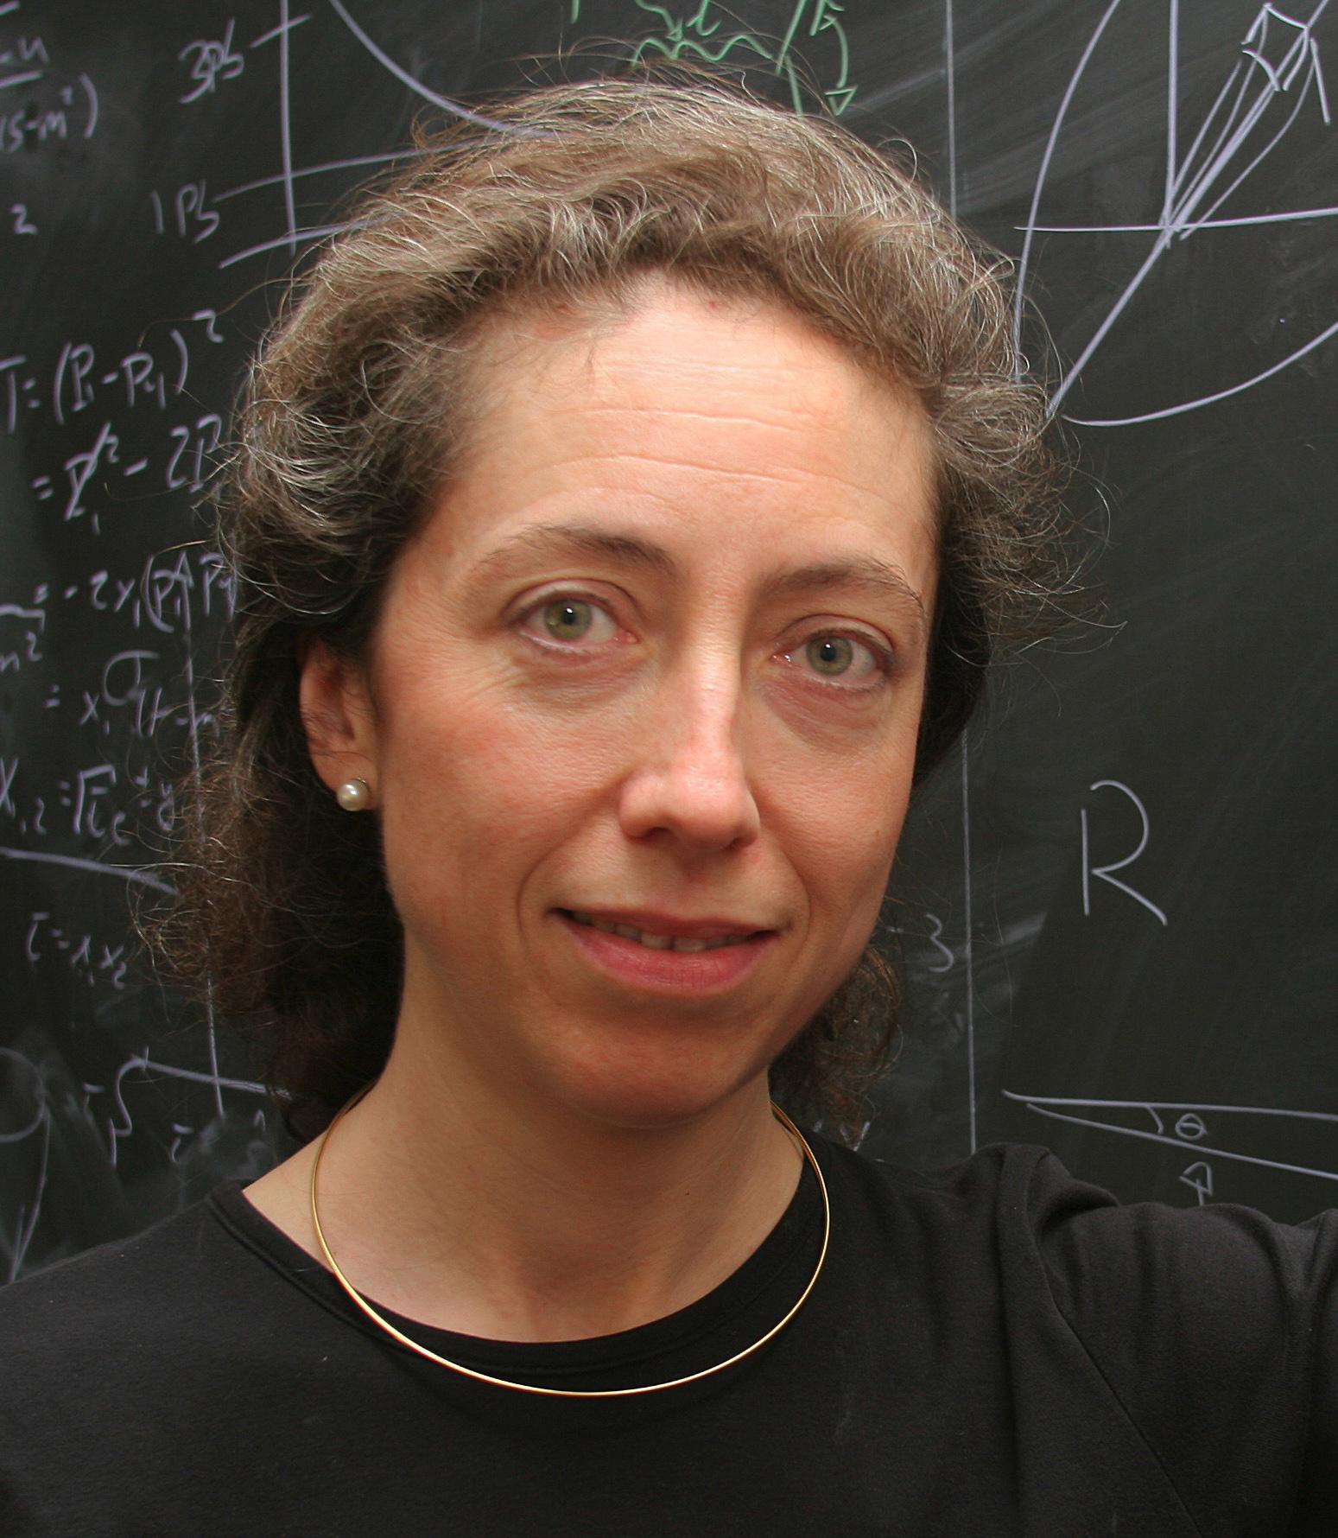
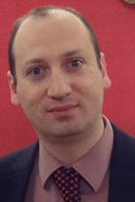
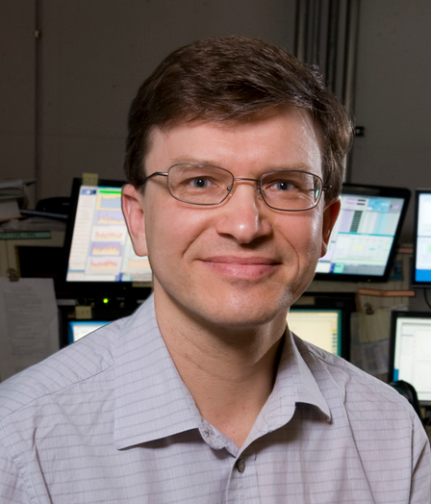
Energy Frontier
Co-Conveners
The Energy Frontier (EF) group will explore the TeV energy scale and beyond: EW Physics, QCD and Strong Interactions, BSM Physics under different future accelerators, incl. lepton-lepton, h-h, and l-h colliders.
AF-EF liaisons
Alessandro Tricoli
(BNL)
Meenakshi Narain
(Brown U)
Laura Reina
(FSU)
Dmitri Denisov
(BNL)
Meenakshi Narain
(Brown U)

Slide 4
Two Joint AF-EF Sessions are…
To discuss various machines to be considered for accelerator and physics studies during the Snowmass process.
The talks will be presented by accelerator experts and will include brief introduction of a machine, table with a range of machine parameters and Q&A time.
The audience will consist mainly of particle physicists.

Slide 5
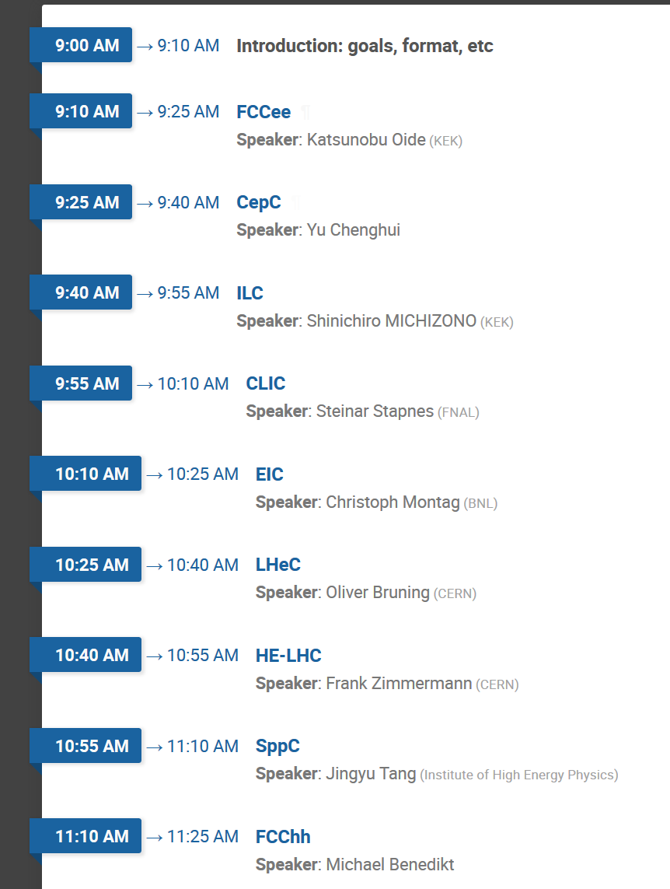
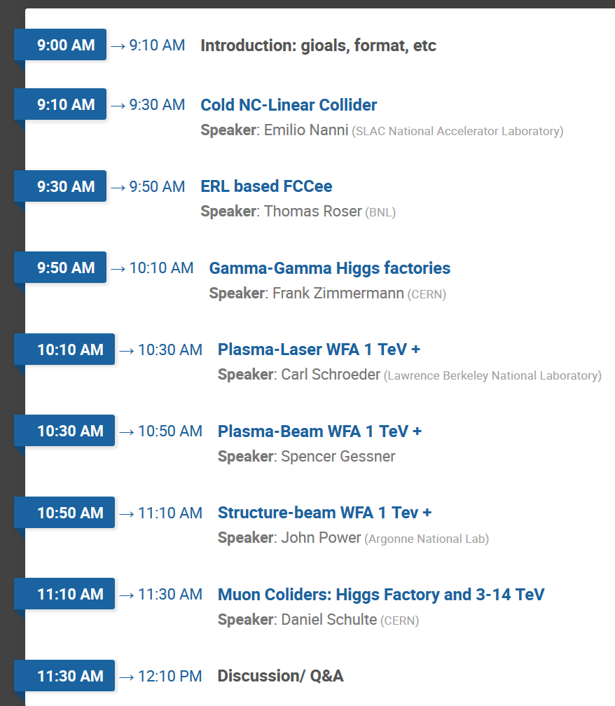
June 24 and July 1 AF-EF talks (10 am EST) Day 1: 10 min + 5 min Q&A = 15 min total/talk Day 2: 10 min + 10 min Q&A = 20 min total/talk
Day 1: https://indico.fnal.gov/event/43871/
Day 2: https://indico.fnal.gov/event/43872/
6/24/2020

Slide 6
Each talk to address:
Energy per beam and cme and ability to change it and scan it (range)
Peak luminosity , annual luminosity
Time structure of collisions
IP parameters and conditions: beam sizes 3D, crossing angles, crabs, radiation, etc
Potentials for upgrades: of Energy (main obstacles) , of Luminosity (main obstacles)
Main advantages: from the point of view of accelerator
Very briefly: status of technology, status of project, technically limited schedule [pre-start, construction, commissioning, ops] , cost range, facility power estimate.
detectors backgrounds – known issues, challenges

Slide 7
Facility
Brief Description – in any order, eg:
[ for particle physics audience ]
General : main systems
Key technologies and maturity (approx.)
Define max energy and cost risks (see slide #4)
Key beam physics challenges
Define luminosity risk
Key parameters and input to the “Big Table”
Timeline(s) - technically limited, other

Slide 8
Technical Maturity
1- Significant R&D required
2– Some R&D in a few key areas required
3 – Shovel ready
Overall Technical Maturity
Critical Technologies and TRL level
A
B
C
Technically limited timeline
R&D
Construction
5 10 15 20
(Modify as appropriate)

Slide 9
Facility “Standard Table”
Facility / Your name* | Particle species | * Contact email for Qs
Beam Energy | GeV
Peak Luminosity (10^34) | cm-2 s-1
Int. Luminosity | ab-1/yr
Beam dE/E at IP
Transv. Beam sizes at IP x/y | um
Rms bunch length / beta* | cm
Crossing angle | urad
Rep./Rev. frequency | Hz
Bunch spacing | ns
# of IPs
# of bunches
Length/Circumference | km
Facility site power | MW
Cost range | $B US | (day 2 speakers – feel free to skip)
Timescale till operations

Slide 10
Accelerator and Energy Frontiers
Intro (cont.)
AF-EF Joint meeting Meeting, June 24 2020
Dmitri Denisov (BNL)
Meenakshi Narain (Brown U.)

Slide 11
Energy Frontier
EF science goals currently envision two types of future colliders (in arbitrary order)
Higgs (and other known elementary particles) factory
Next high energy frontier machine
Discoveries at the Energy Frontier are intricately linked to the progress in accelerators.
To do physics studies of options, and to make a physics case, machine parameters, and estimates of luminosity and backgrounds are needed for the proposed options.
An important aspect is the community participation
While we can help find resources, the drive/enthusiasm to perform the study needs to come from a group interested in promoting specific option
Inputs from AF groups for the studies is critical
It will be an iterative process between AF and EF groups to identify most valuable options
The two joint meetings (today and next Wednesday July 1), will provide a table with parameters, technical readiness/feasibility, cost, timeframe for start of construction, for various collider options
These will form the baseline for the studies pursued by the Energy Frontier groups

Slide 12
Energy Frontier
Classify options by technical maturity & timeframe
Short term - ILC, CLIC, HE-LHC, FCC-ee, CepC, LHCeC, EIC, etc.
Medium term - FCC-hh, SppC, muon-collider, etc.
Longer term - gamma-gamma collider, plasma collider …
The medium and long term options may not become mainstream by the time of Snowmass/report P5, while help to argue for continuing R&D on specific options
We thank Accelerator Frontier for coordinating these meetings and all the representatives of different colliders for help with this important process!

