Slide 1
C³ – Cool Copper Collider:
An Advanced NCRF Linac Concept for a High Energy e⁺e⁻ Linear Collider
July 1, 2020
Snowmass AF-EF Meet 2020

Slide 2
Acknowledgements
Sami Tantawi
Mamdouh Nasr
Marty Breidenbach
Emilio Nanni
Karl Bane
Tim Barklow
Craig Burkhart
Robert Conley
Robert Reed
Eric Fauve
Alysson Gold
Vincent Heloin
Mark Kemp
Zenghai Li
Marco Oriunno
James Paterson
Michael Peskin
Tor Raubenheimer
Brandon Weatherford
Jamie Rosenzweig
Bruno Spataro
Frank Krawczyk
Evgenya Simakov
More Details See: Bane et al., ArXiv 1807.10195 (2018)
C³ Colloquium: https://sites.slac.stanford.edu/colloquium/node/159

Slide 3
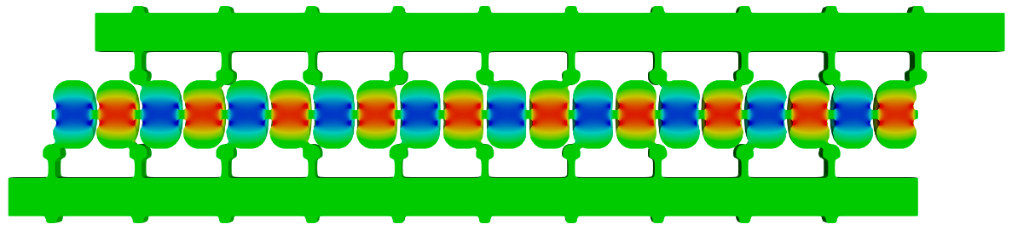
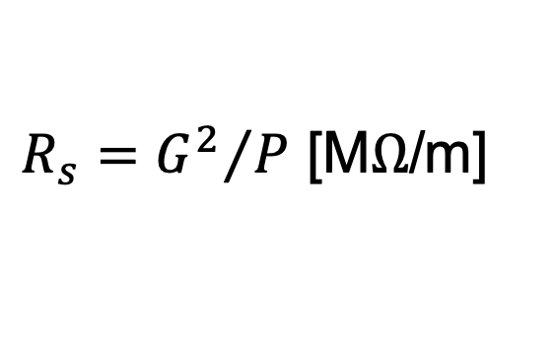
Breakthrough of Distributed RF Coupling Changes the Paradigm for RF Accelerator Performance
RF power coupled to each cell – no on-axis coupling
Full system design requires modern virtual prototyping
Optimization of cell for efficiency (shunt impedance)
Control peak surface electric and magnetic fields
  Key to high gradient operation
RF Power
Beam
Electric field magnitude produced when RF manifold feeds alternating cells equally
$R_{s}={G^{2}}/P$ [M$Ω$/m]
Tantawi et al. “Distributed coupling and multi-frequency microwave accelerators,” Jul. 5 2016, US Patent 9,386,682.

Slide 4
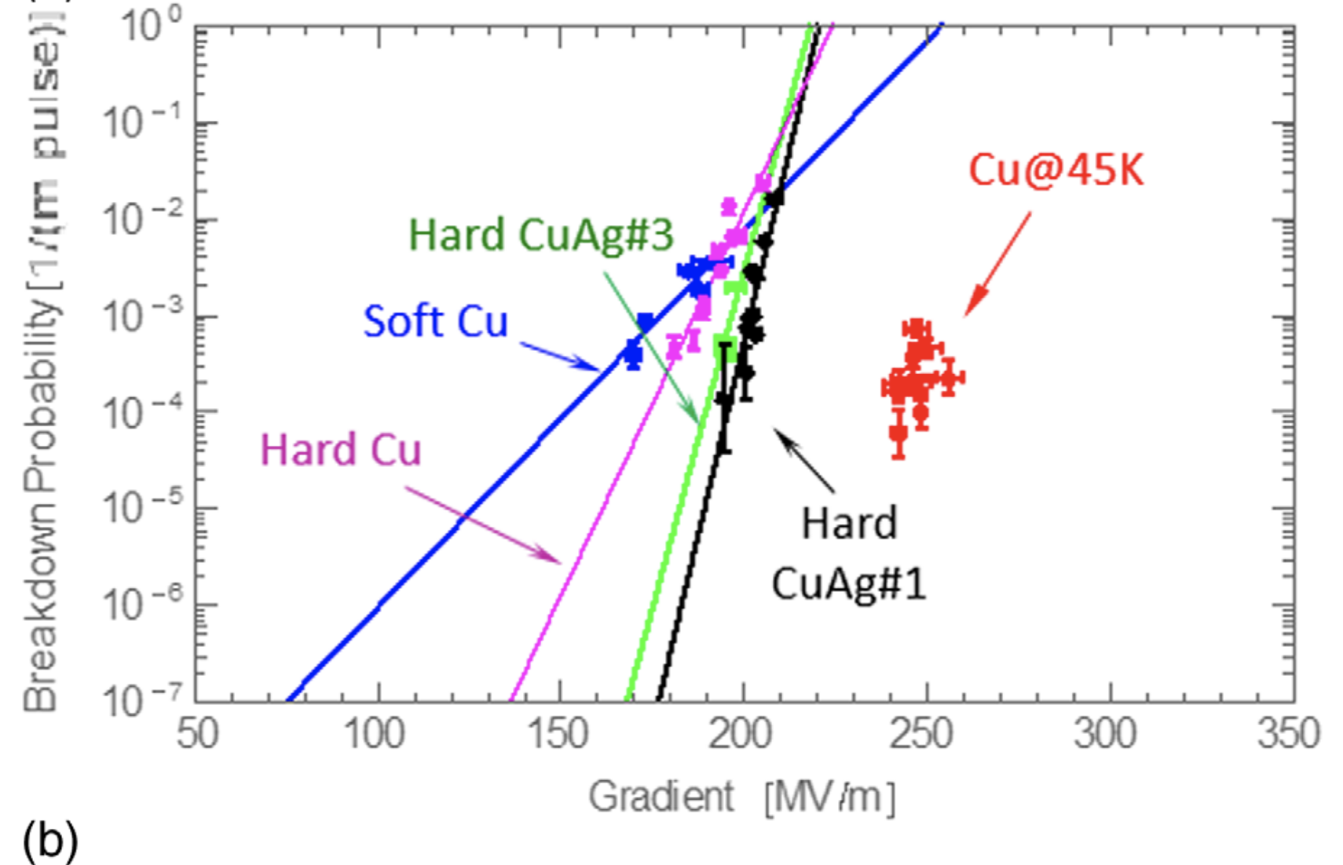
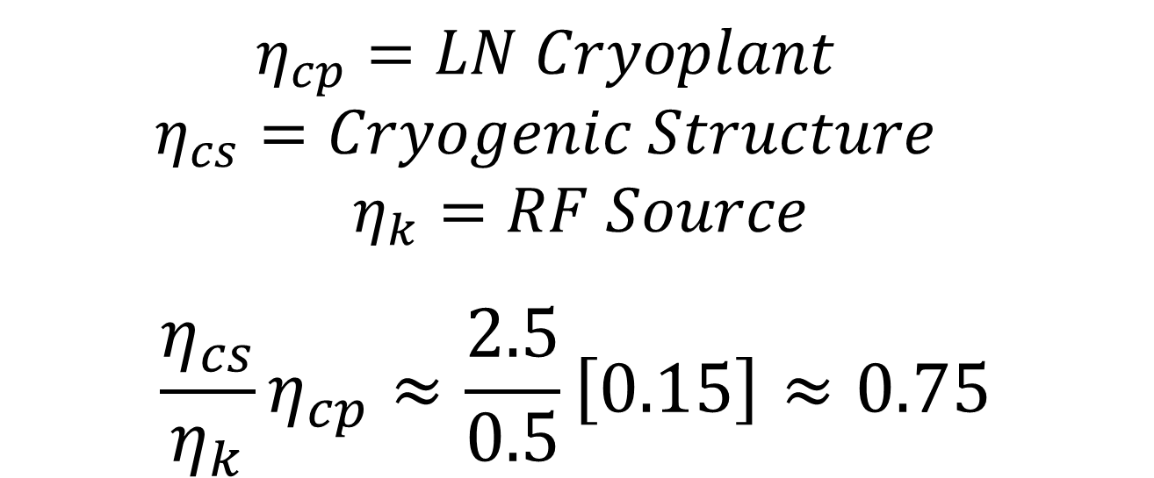
Transformative Impact for Efficient High-Gradient Operation with Cryo-Copper Accelerators in RF
Cryogenic temperature elevates performance in gradient
  Material strength is key factor
Impact of high fields may eliminate need for one damping ring
Operation at 77 K with liquid nitrogen is simple and practical
  Large-scale production, large heat capacity, simple handling
  Small impact on electrical efficiency
Cahill, A. D., et al. PRAB 21.10 (2018): 102002.
Rosenzweig, et al. NIMA 909 (2018): 224-228.

Slide 5
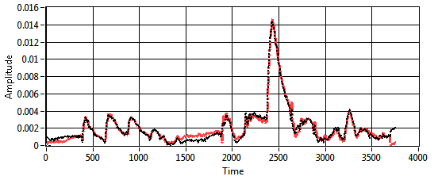
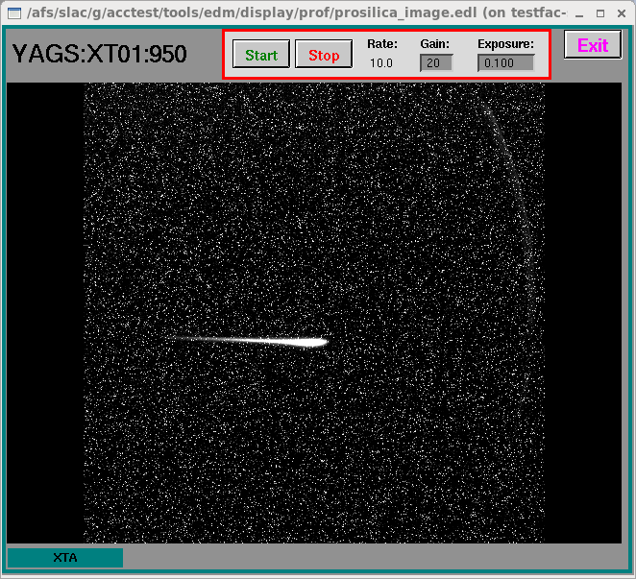
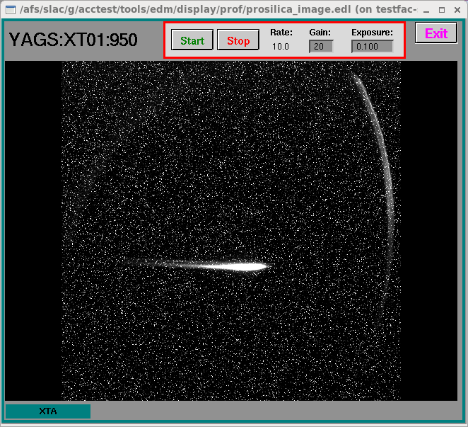
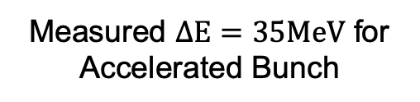
Cryogenic X-band Structure in High Power Test to Confirm RF Performance and Measure Breakdown Statistics
Increased conductivity and hardness enables higher gradients
2.5X less power establishing gradient allows for heavy beam loading even at high gradient – improving system efficiency
Structure operates at 150 MV/m
Reflected RF power matches molded performance
Measured acceleration with beam from photoemission RF gun
Measured vs Modeled Reflected Power
Measured $ΔE=35MeV$ for Accelerated Bunch
High Gradient Operation at 150 MV/m
Stn3 OFF
Stn3 ON
62.5 MeV
97.5 MeV
M. Nasr, S. Tantawi, E. Nanni et. al.

Slide 6
NCRF Accelerator Concept Starting Point for a High Energy e⁺e⁻ Linear Collider
Using established collider designs to inform initial parameters
Quantifying impact of wakes requires detailed studies
  Most important terms – aperture, bunch charge (and their scaling with frequency)
Target design at 2 TeV CoM
9 MW single beam power
Luminosity
Machine | CLIC | NLC | C³
Freq (GHz) | 12.0 | 11.4 | 5.7
a (mm) | 2.75 | 3.9 | 2.6
Charge (nC) | 0.6 | 1.4 | 1
Spacing | 6 | 16 | 19
# of bunches | 312 | 90 | 75
Beam Power
https://clic-meeting.web.cern.ch/clic-meeting/clictable2010.html
NLC, ZDR Tbl. 1.3,8.3
https://arxiv.org/abs/1711.00568
https://arxiv.org/abs/1608.07537

Slide 7
NCRF Accelerator System Cost Model for Innovative Standing-Wave Accelerator Topologies
Total accelerator system cost (C) can be expressed as:
  C ≈ xE/G + yE(I + G/R_{s}) + aux systems cost (e.g. injector)
  Where
    E – beam energy (eV)
    x – accelerator cost/length ($/m)
    (tunnel cost + structure cost)
    G – accelerating gradient (V/m)
    y – RF system cost/peak power ($/kW)
    (include power supply, RF source,...)
    R_{s} – shunt impedance (Ω)
    I – beam current (A)
  Cost Optimized Gradient
    G=(R_{s} x/y)^{0.5}
Parameter* | Value
Source Efficiency (%) | 50
Repetition Rate (Hz) | 120
RF Source Cost ($/Peak kW) | 2
Electrical Pwr (cents/kW-hr) | 7
CoM Energy (TeV) | 2
Single Beam Power (MW) | 9
Bunch Charge (nC) | 1
Instr. Add on Length (%) | 10
Tunnel Cost ($k/m) | 50
Structure Cost: Warm – 300K / Cold – 77K ($k/m) | 50/100
RF Compressors ($k/m) | 15
Length
Beam
Power
Power Dissipated
Structure
*Will hold these assumptions chosen to evaluate relationship between parameters constant unless specified
Notes:
Use conservative estimates for tunnel and structure

Slide 8
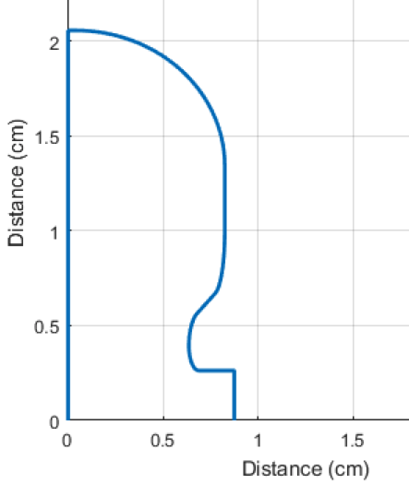
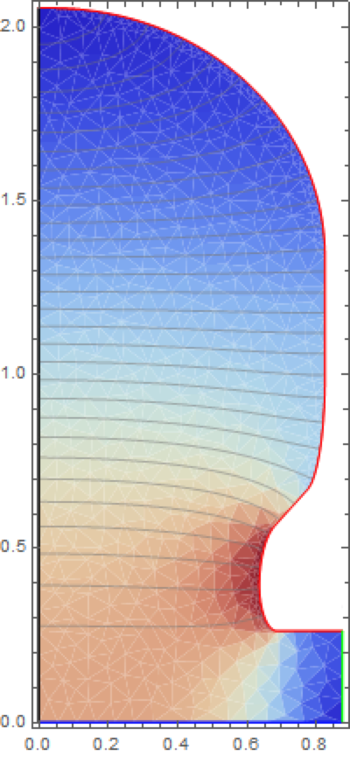

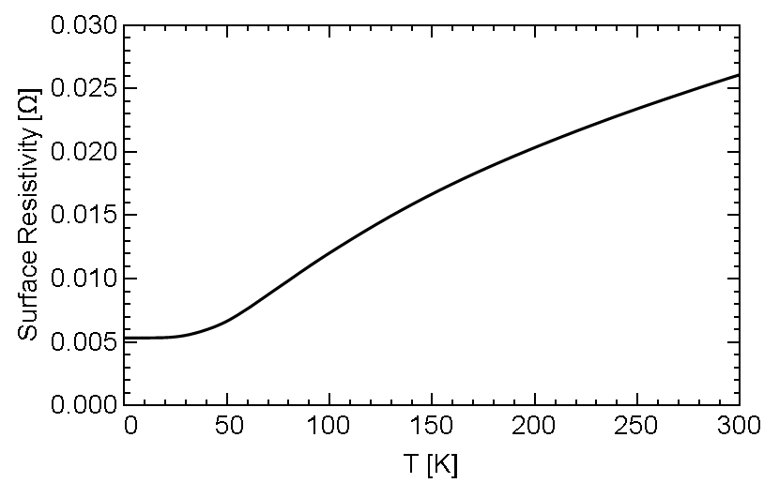
Optimized Cavity Geometries for 2π/3-mode Standing Wave LINAC
Small aperture for reduced phase achieves exceptional R_{s}
Cryogenic operation: Increased R_{s}, reduced pulse heating
Frequency | a/λ | Phase Adv. | Rs (MΩ/m) 300K | Rs (MΩ/m) – 77K
C-band (5.712 GHz) | 0.05 | π | 121
C-band (5.712 GHz) | 0.05 | 2π/3 | 133 | 300
X-band (11.424 GHz) | 0.1 | π | 133 | 300
Rs (MΩ/m) 77K
272
300
300
Electric Field
Surface Resistivity vs. Temp
A. Cahill, et al. IPAC (2016).

Slide 9

Gaussian Detuning Provides Required 1st Band Dipole Suppression for Subsequent Bunch, Damping Also Needed
Dipole mode wakefields immediate concern for bunch train
4$σ$ Gaussian detuning of 80 cells for dipole mode (1st band) at $f_{c}=9.5$ GHz, w/ $∆f/f_{c}=5.6\%$
First subsequent bunch s = 1m, full train ~75m in length
  Damping needed to suppress re-coherence
re-coherence
Damped/Detuned
de-coherence
drop
Detuned
Li
(Only copper surface loss damping included)
(1.0e3 Q total HOM damping included)

Slide 10
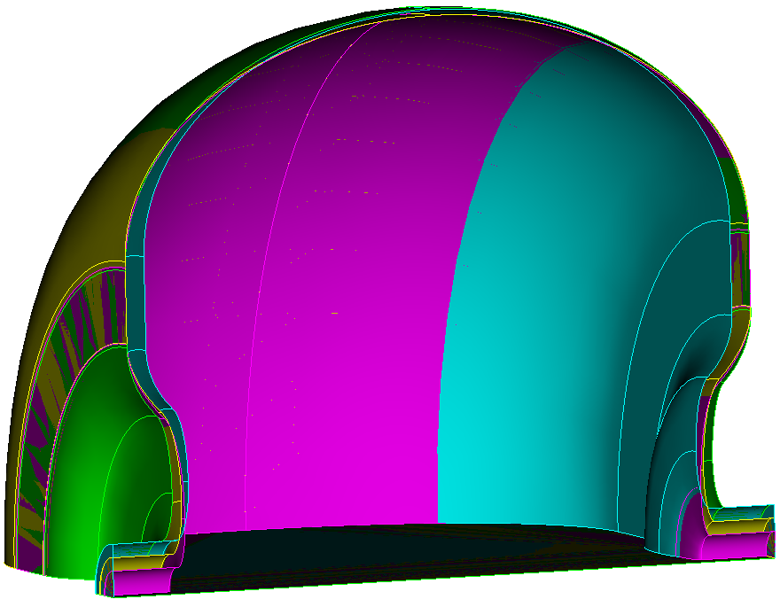
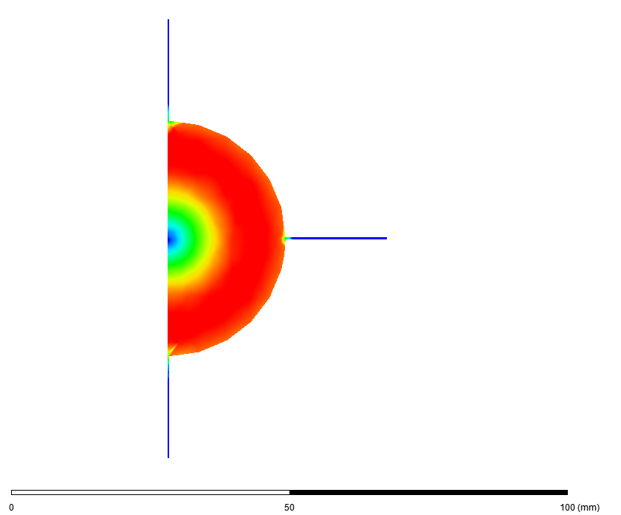
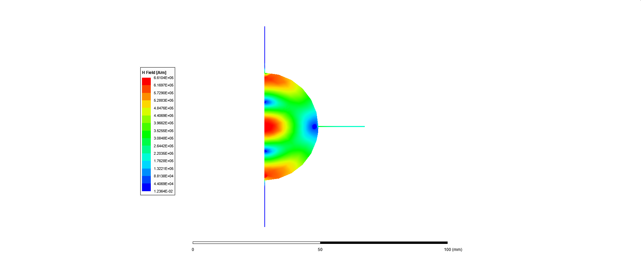
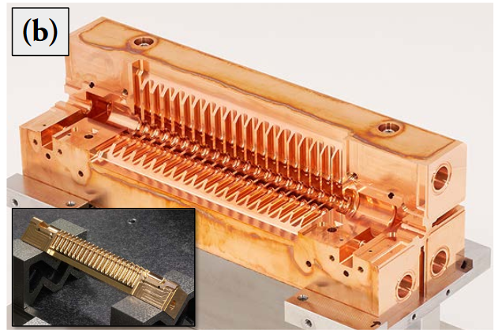

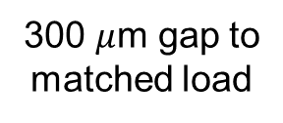
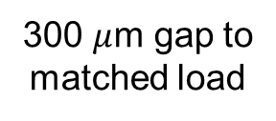
Distributed Coupling Structures Provide Natural Path to Implement Detuning and Damping of Higher Order Modes
Individual cell feeds necessitate adoption of split-block assembly
Perturbation due to joint does not couple to accelerating mode
Exploring gaps in quadrature to damp higher order mode
Design of Detuned Cavities
300 $μ$m gap to
matched load
300 $μ$m gap to
matched load
H-field
Quadrant Structure
Q $≈$ 10³ (vs 4x10⁴)
Accelerating Mode
Dipole
Mode
Abe et al., PASJ, 2017, WEP039

Slide 11
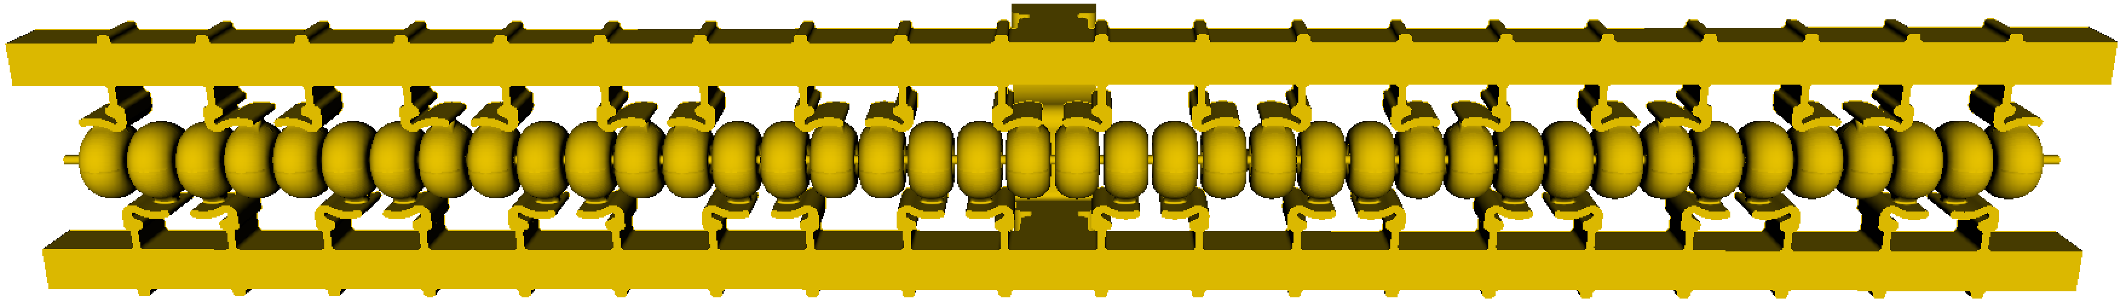
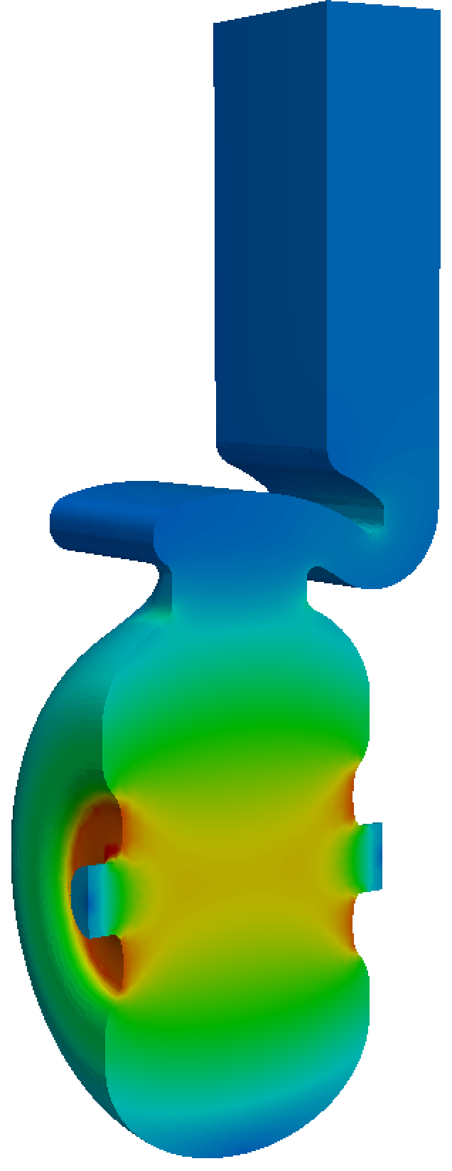
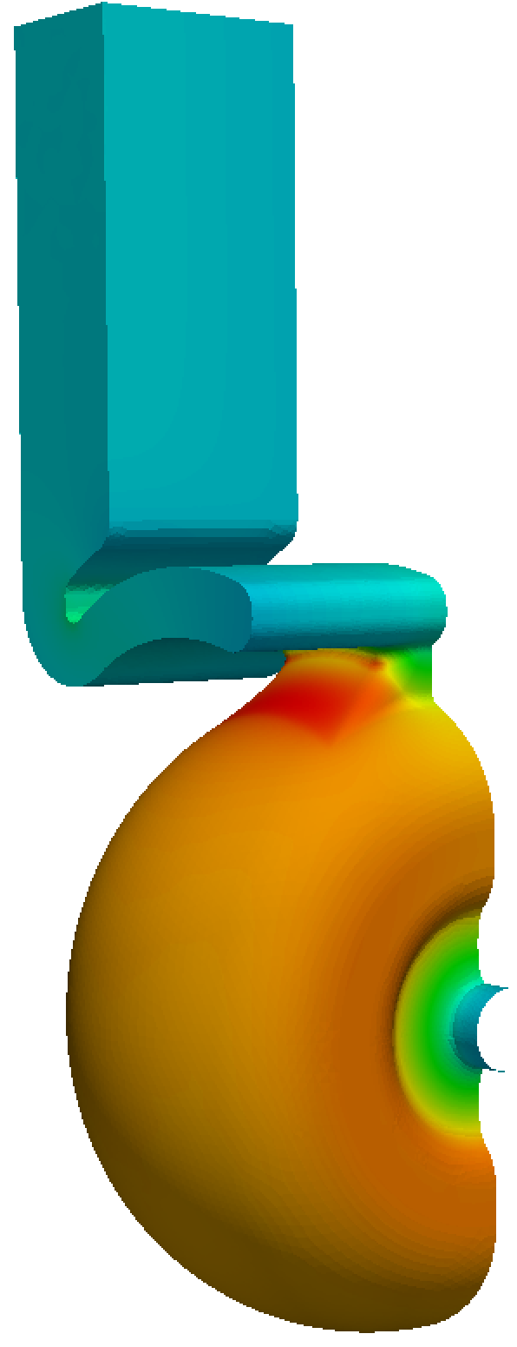
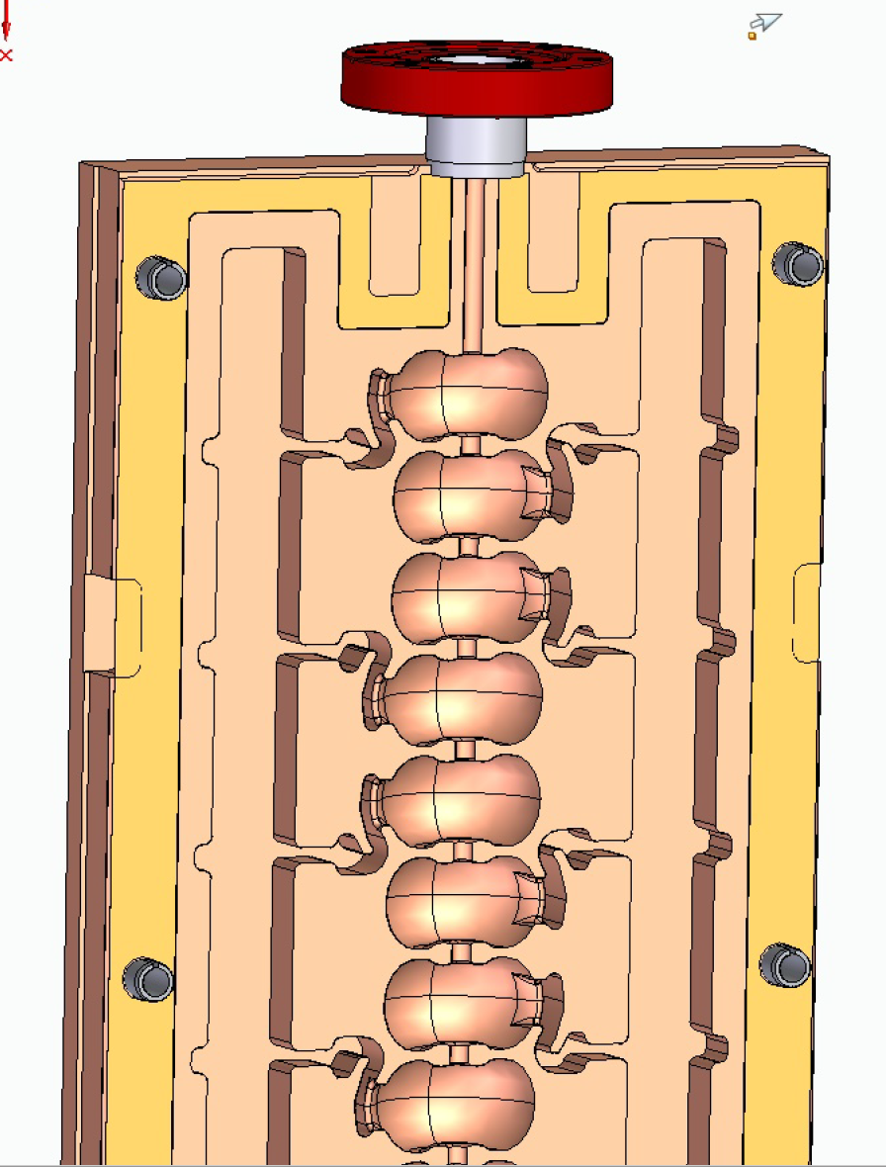
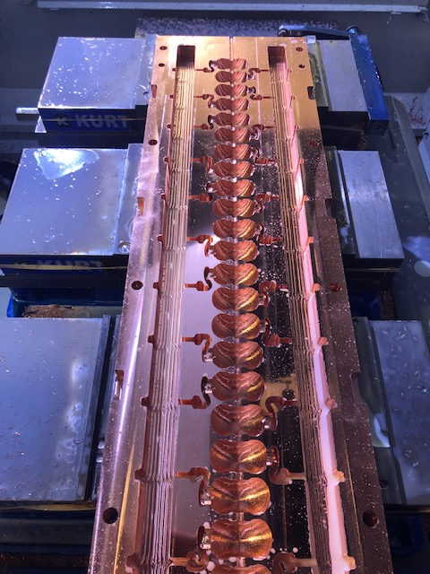
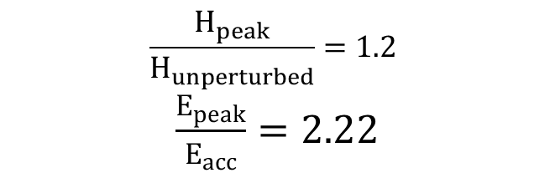
First Meter Scale Prototype in Development at C-band
One meter (40-cell) C-band design with reduce peak E and H-field
Scaling fabrication techniques in length and including controlled gap
$$\frac{H_{peak}}{H_{unperturbed}}=1.2$$
$\frac{E_{peak}}{E_{acc}}=2.22$
S. Tantawi, and Z. Li

Slide 12
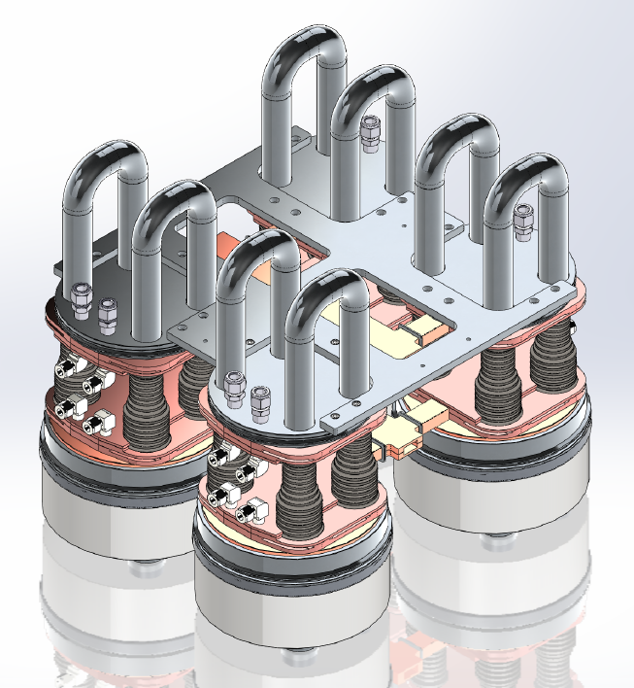
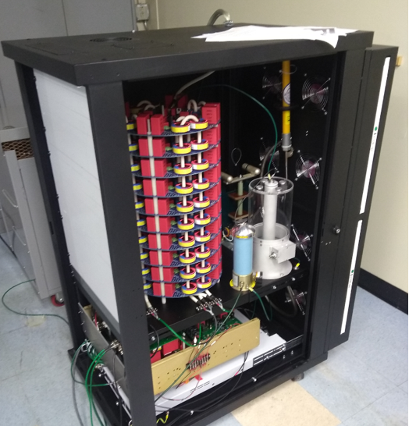
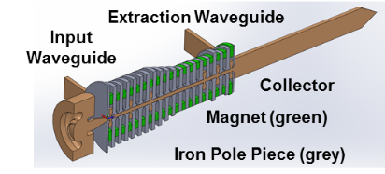
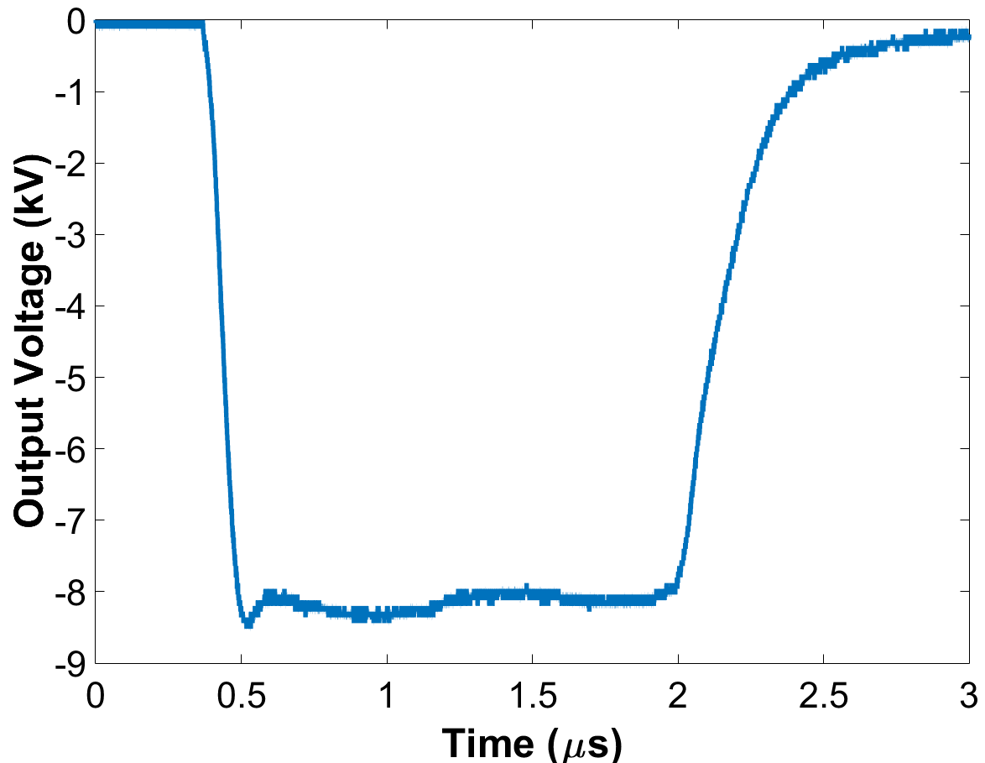
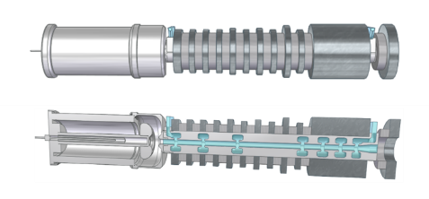
RF Source Development for Accelerator Technology Requires Large Commercial Scale Applications
Multiple active programs for compact high-flux x-ray sources for security and medicine: NNSA, DHS, Stanford Medical
DHS: Cost is a key driver - full screening at ports of entry requires km-scale production
All aspects of RF accelerator transitioning to industry
Low-cost “Digikey Catalog” Marx Modulator
Integrated Pole Pieces/
Long Period Halback Arrays
Modular Klystron Array operating at extremely low voltages

Slide 13
Efficient and Cost-Effective High-Gradient Normal Conducting Accelerators
Optimizing the cost of NCRF technology a fundamental requirement for its implementation for future facilities
RF source cost is the key driver for gradient and cost – need to focus R&D on reducing source cost
Gradient/Cost Scaling vs RF Source Cost for 2 TeV CoM
Optimized
Gradient (MV/m)
Relative Cost
Peak RF Power Cost ($/kW)
Peak RF Power Cost ($/kW)
Understand the Impact on Advanced Collider Concept Enabled by the Goals Defined in the DOE GARD RF Decadal Roadmap
https://science.energy.gov/~/media/hep/pdf/Reports/DOE_HEP_GARD_RF_Research_Roadmap_Report.pdf

Slide 14
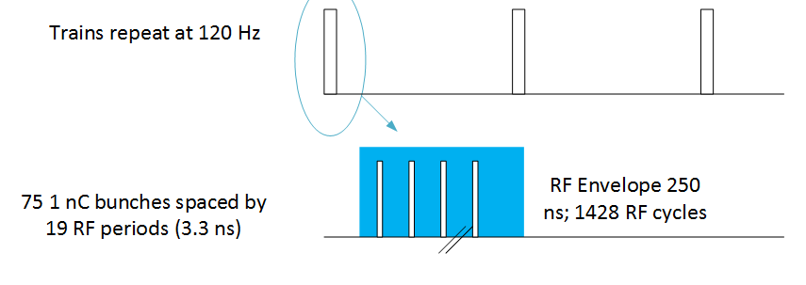
Summary of Parameters for 2 TeV Conceptual Design Based on C-Band 5.712 GHz, a/λ=0.05, 2𝜋/3 Structure
Parameter (2 TeV CoM) | Units | Value
Reliquification Plant Cost | M$/MW | 18
Single Beam Power (1 TeV linac) | MW | 9
Total Beam Power | MW | 18
Total RF Power | MW | 86
Heat Load at Cryogenic Temperature | MW | 25
Electrical Power for RF | MW | 172
Electrical Power for Cryo-Cooler | MW | 170
Temperature (K) | 77
Beam Loading (%) | 42.5
Gradient (MeV/m) | 117
Pulse Length (µs) | 0.25
Cryogenic Load @ 77K (MW) | 25
Electrical Load (MW) | 342
Pulse Format

Slide 15
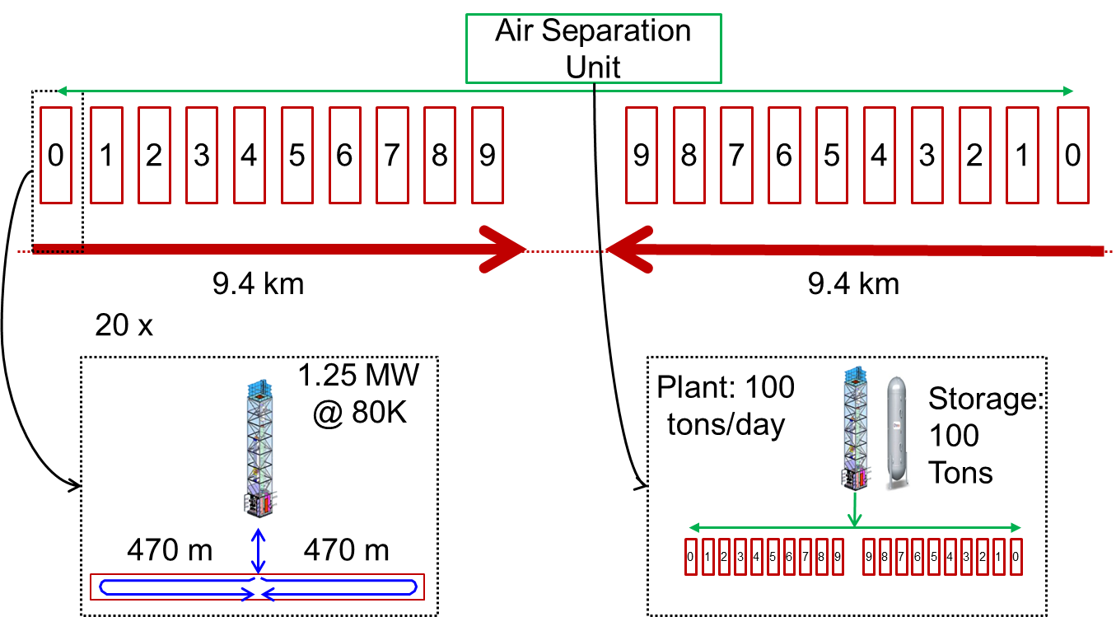
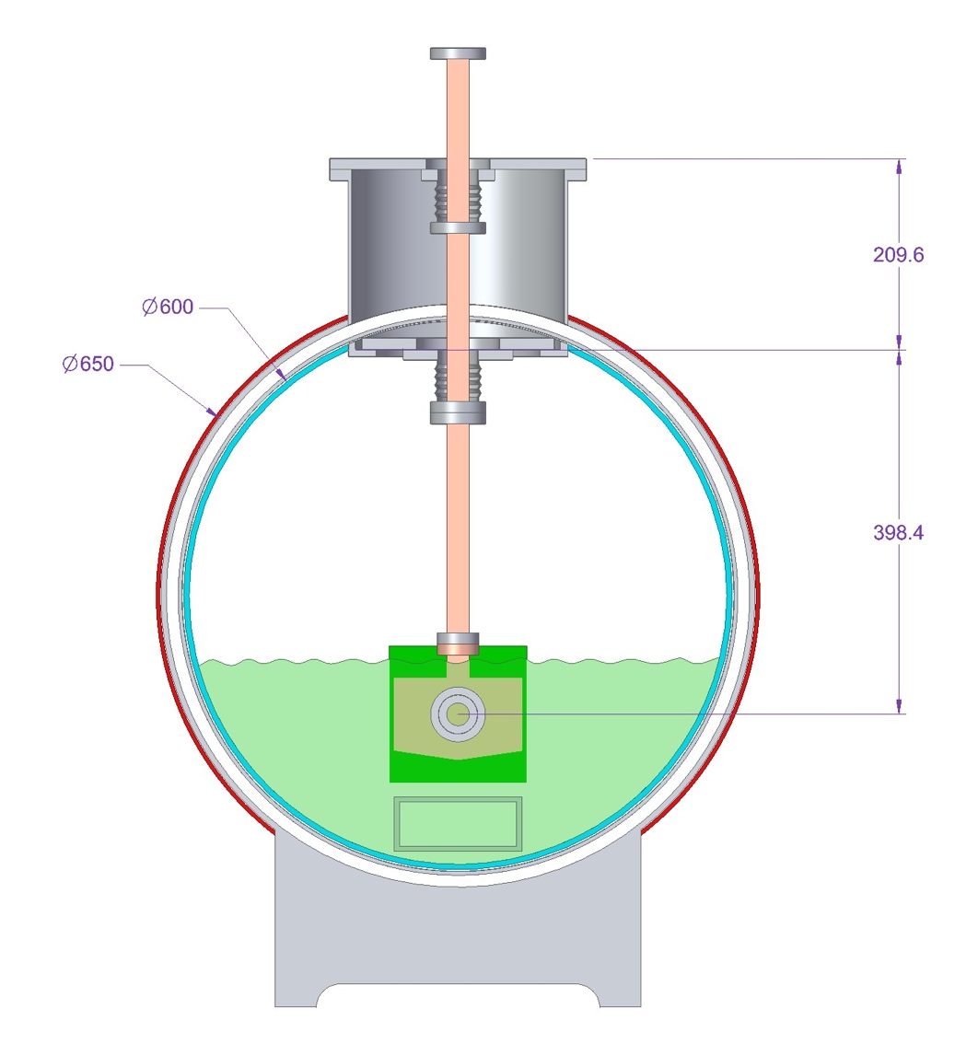
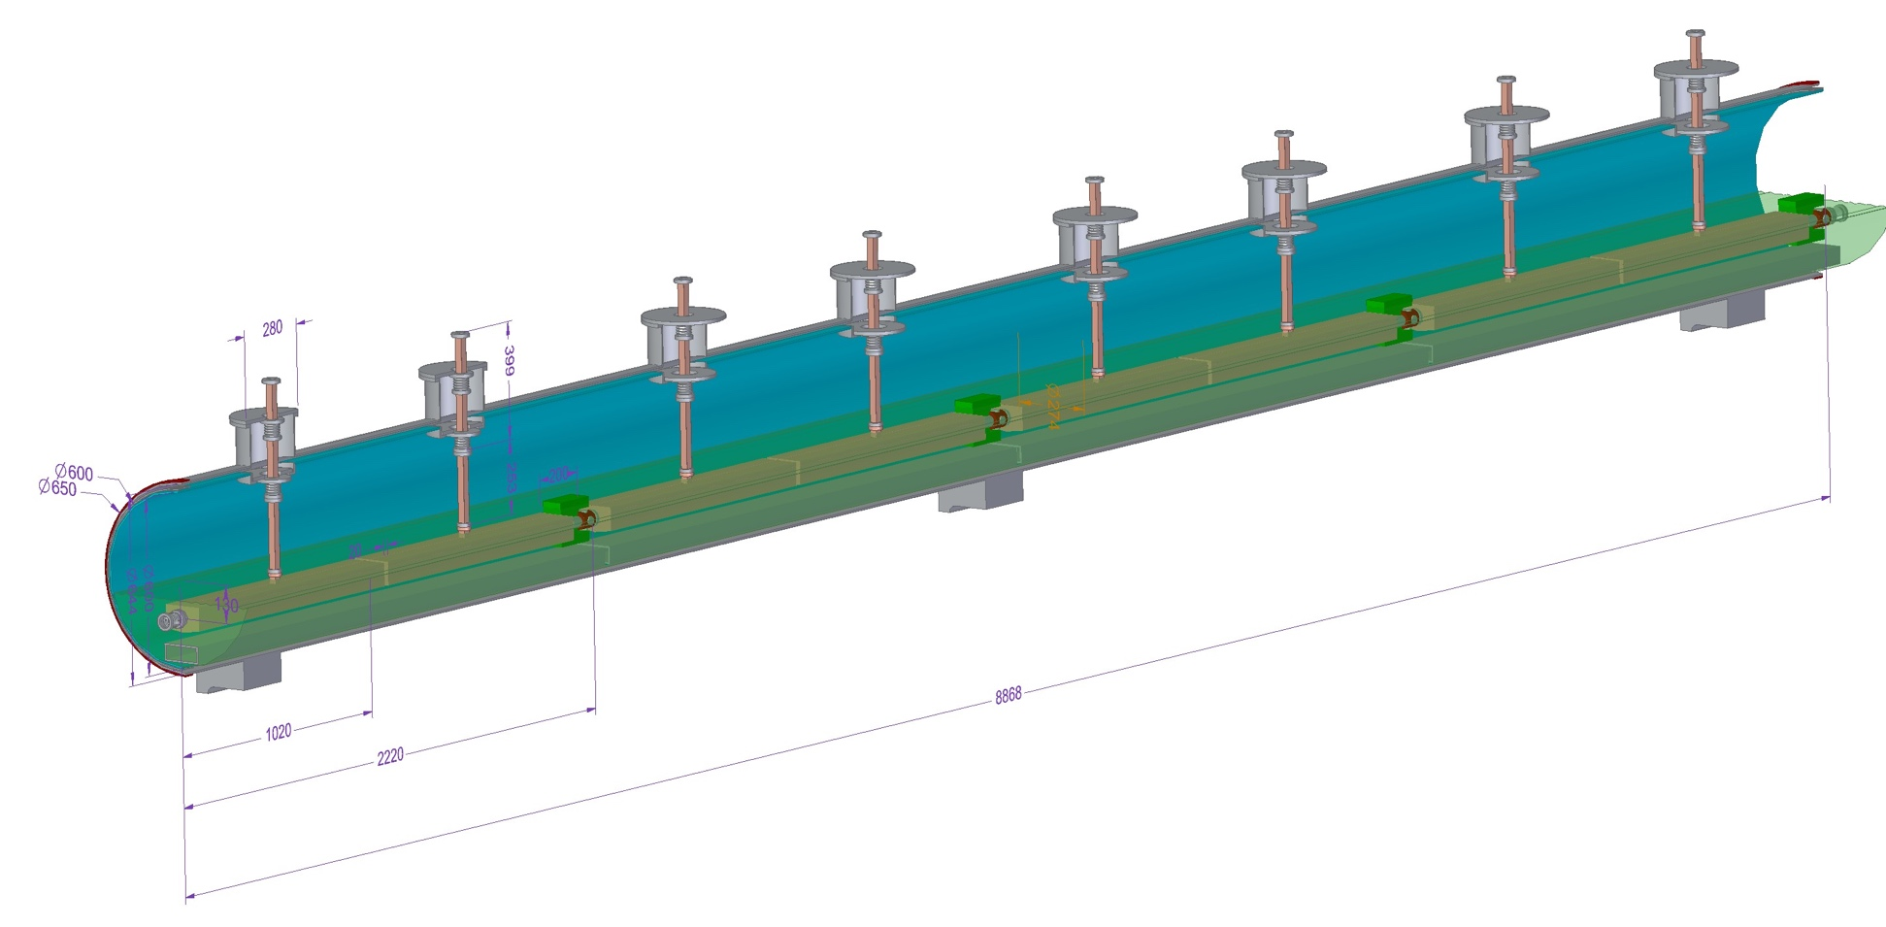

Preliminary $∆$E = 1 GeV Cryomodule Design for High Average Power Implementation with ~90% Fill Factor
X-band structure demonstrated full average power over short length (0.25 m)
Cryomodule design developed for cryoplant layout to cool 24 MW/linac thermal load at 77K
Shared nitrogen supply and return
~8.9m Cryomodule
Oriunno, Breidenbach

Slide 18
Questions?

