Slide 1
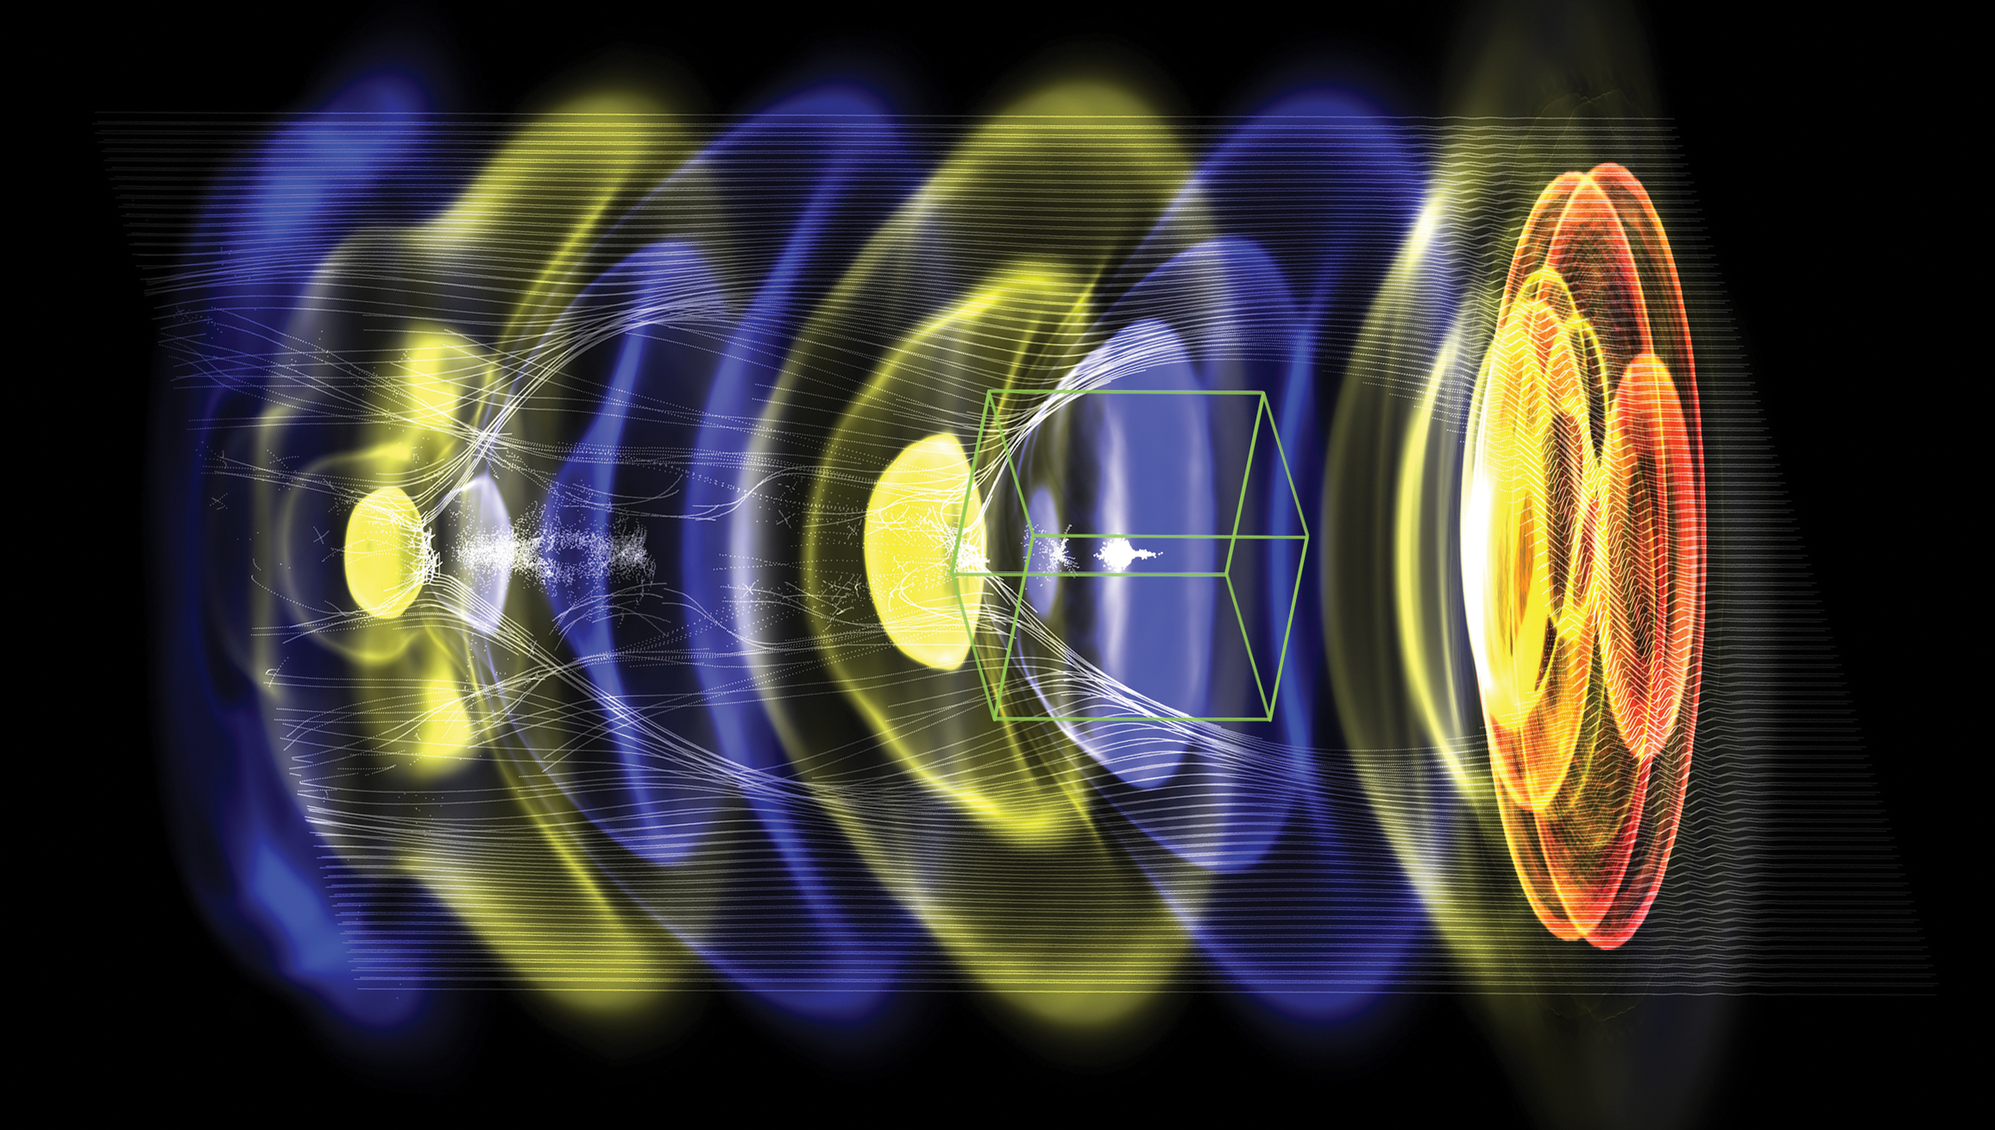


Plasma – Laser Wakefield Accelerators
1 TeV and beyond
Carl Schroeder
BELLA Center
Lawrence Berkeley National Laboratory
WarpX
July 1, 2020, Joint AF-EF Meeting of Future Colliders: Day 2
Work supported by the U.S. DOE, Office of Science, Office of High Energy Physics, under Contract No. DE-AC02-05CH11231

Slide 2
Novel accelerator technology based on wakefields
Novel accelerator technologies / advanced accelerator concepts based on wakefields producing gradients >1 GV/m
Goal: to develop accelerator technology to build an e-/e+/gamma linear collider at the TeV energy scale (and beyond), with much reduced footprint (and cost)
medium
Dielectric (~1 GV/m)
Plasma (~10 GV/m)
Laser
Dielectric Laser Accelerator (DLA)
Laser wakefield accelerator (LWFA)
driver
Beam
Structure-based wakefield accelerator (SWFA)
Plasma wakefield accelerator (PWFA)
Common features: ultra-high gradient; small structures; short bunches
Technical maturity and time frame: Longer-term collider options
2

Slide 3
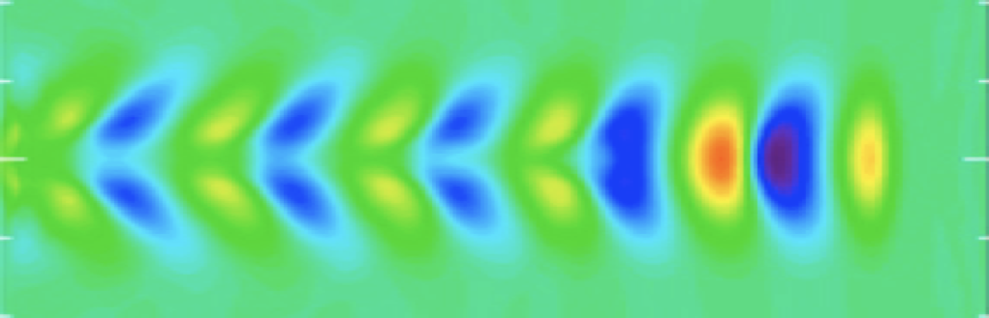
Laser-driven plasma wakefield accelerators (LWFA)
Esarey, Schroeder, Leemans, Rev. Mod. Phys. (2009)
Wakefield (plasma wave) driven by the ponderomotive force of a resonant laser pulse in plasma
Focusing and acceleration provided by plasma wave
Characteristic size of accelerating field:
    Plasma density n₀=10¹⁷ cm⁻³ yields E=30 GV/m
Uses short duration, high intensity drivers [laser drivers rely on Chirped Pulse Amplification (CPA) – Nobel prize 2018]
Compact coupling (< 1 m) of laser drivers using plasma mirrors
electron plasma density
laser driver
particle beam
plasma wavelength
Main advantage of laser-plasma accelerator technology: compact linac footprint (both accelerating plasma cell and drive laser beam)
3

Slide 4
Basic configuration of a laser-plasma-based linear collider
Linac: staged laser wakefield accelerators (LWFAs):
Preliminary/Strawperson designs have been produced to guide R&D
R&D focus has been on developing accelerator technology
No complete conceptual design is ready
Key characteristics of a LWFA-based collider:
Design (optimizing operational plasma density) yields 5 GeV/stage (100 stages/linac for 1 TeV):
    Geometric/average gradient = 2.3 GV/m
Time structure at IP:
    single bunches, separated by 20 μs
Short (8.5 μm rms), shaped (trapezoidal current dist.):
    beamstrahlung reduction:
    𝞂_{z}< β*
Flat or round beams may be accelerated
Leemans & Esarey Phys. Today (2009)
4

Slide 5
Potential Facility Table
Laser-plasma collider - e-/e+ |  | 1 TeV cme | 3 TeV cme | 30 TeV cme
Beam Energy | TeV | 0.5 | 1.5 | 15
Luminosity (10^34) | cm-2 s-1 | 1 | 10 | 1000
Int. Luminosity | ab-1/yr | 0.18 (5000hrs) | 1.8 (5000hrs) | 18 (5000hrs)
Beam dE/E at IP |  |  |  | (Y>>1 regime)
Transv. Beam sizes at IP x/y | nm | 50 / 1 | 10 / 0.5 | 0.2 / 0.2
Rms bunch length / beta* | mm | 0.0085 / 0.1 | 0.0085 / 0.1 | 0.0085 / 0.2
Crossing angle | urad
Rep. frequency | kHz | 47 | 47 | 47
Bunch spacing | us | 21 | 21 | 21
# of IPs |  | 1 | 1 | 1
# of bunches |  | 1 | 1 | 1
Length (2x main linac tunnel) | km | 0.44 | 1.3 | 13
Facility site power (2 linacs) | MW | 105 | 315 | 3151
Cost range | $B US
Timescale till operations |  | >30 years | >30+ years | >30++ years
1 um laser wavelength
10¹⁷ cm⁻³ plasma density
Schroeder et al. NIMA (2016)
ALL PARAMETERS NEED SYSTEM-INTEGRATED DESIGN STUDY
TBD: similar to conventional collider designs
Laser rep. rate not available with present laser technology
Upgrade potential: Same laser system for 1, 3, 30 TeV
requires laser tech maturity before estimate
5

Slide 6
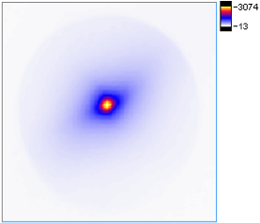
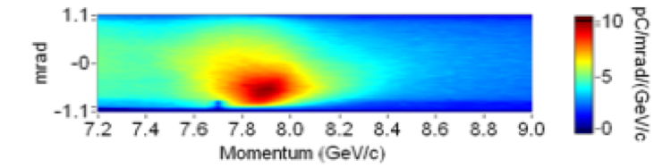
Status of LWFA experimental R&D
  Single LWFA stage achieved multi-GeV acceleration: 8 GeV in 20 cm (40 GV/m)
divergence:
150 mrad
discharge-capillary plasma waveguide
Gonsalves et al. PRL (2019)
2019 (LBNL)
Energy gain (GeV) in LWFA stage
2014 (LBNL)
  1 Hz rep. rate
  Reproducibility limited by laser fluctuations (at ~100 Hz)
2013 (GIST)
2013 (TPW)
2006 (LBNL)
  Proof-of-principle staging of LWFAs
Operational plasma density (x10¹⁸ cm⁻³)
Compact driver coupling using plasma mirrors
Steinke et al. Nature (2016)
Plasma lens focusing of beam
  Proof-of-principle experiment demonstrate 100 MeV energy gain
  Multi-GeV staging experiments are planned / being commissioned
6

Slide 7
Laser technology requirements for collider applications
1 kW
10 kW
100 kW
existing laser system
CoReLS (Korea)
technically feasible today
BELLA (LBNL)
HAPLS (ELI)
collider requirement
Laser energy/pulse [J]
fiber
+
kBELLA
(Ti:Sa)
Tm:YLF
fiber
rep. rate [kHz]
Two promising laser architectures for collider applications:
  Coherent combination of fiber lasers (1 micron). R&D at Jena, Michigan, LBNL, LLNL, et al.
      ~40-60% wall-to-laser efficiency
  Tm:YLF (1.9 micron) – (4x as many LWFA stages). R&D at LLNL
7

Slide 8
Key accelerator R&D challenges
Laser technology development
  Coherent combining of fiber lasers
  Development of Tm:YLF
  kW average power systems feasible today
Robust e+ acceleration configuration
  Proposed configurations (hollow plasma channels, plasma columns) require experimental demonstrations
Beam matching/coupling between stages
  Strong focusing forces in plasma: β~ 0.01 - 0.1 m
Alignment
  Small structures (~10-100 um) place severe (~nm) alignment tolerances
Stability in main linac
  Transverse stability (BBU) is issue in strong wakefield regime
  Proposed mitigation methods (ion motion, plasma focusing chirp) require R&D
common challenges for advanced accelerator concepts
8

Slide 9
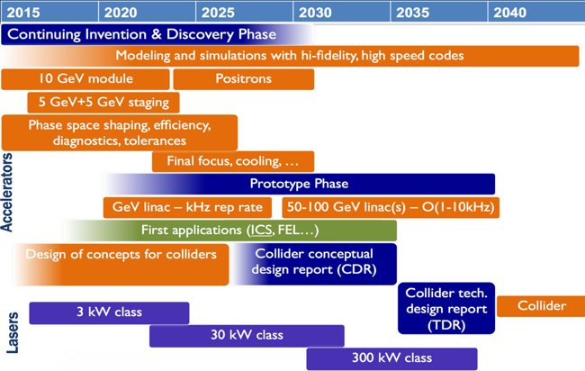
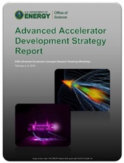
LWFA R&D timeline towards a collider
  US AAC community outlined R&D goals in 2016 roadmap
  Progress on all R&D goals
  Roadmap to be updated
DOE HEP AAC Roadmap (2016)
Critical Technologies:
  High average power laser development: TRL2
  Plasma cell development: TRL3
  Multi-GeV/cell acceleration: TRL4
  Staging of LWFAs: TRL3
  Positron acceleration methods: TRL2
  Stability: TRL3
  Alignment: TRL2
  Technically limited timeline:
R&D
Construction
5 10 15 20 25 30
years
9

Slide 10
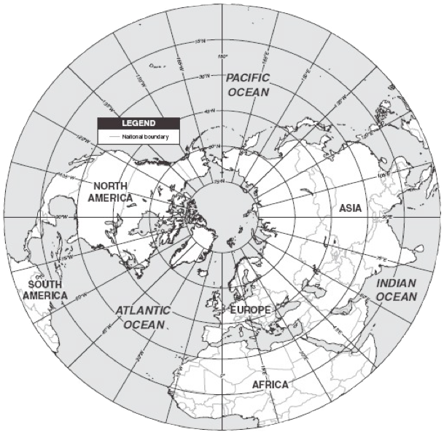
LWFA R&D facilities world-wide
US LWFA R&D Laboratories:
LBNL – BELLA
LLNL – JLF
BNL – ATF
SLAC – MEC
U. Texas
U. Michigan
LLE (Rochester)
U. Nebraska
NRL
UCLA
U. Maryland
International LWFA R&D Laboratories:
ELI-Beamlines (Czech)
ELI-NP (Romania)
U. Lund (Sweden)
HZDR (Germany)
DESY (Germany)
LMU (Germany)
Jena (Germany)
RAL (UK)
SCAPA (UK)
U. Oxford (UK)
LOA (France)
Apollon (France)
LULI (France)
INFN (Italy)
CoReLS (Korea)
KPSI (Japan)
Tsinghua U. (China)
SIOM (China)
SJTU (China)
TIFR (India)
IAMS (Taiwan)
ALLS (Canada)
Weizmann Inst. (Israel)
Compactness of laser systems has led to proliferation of LWFA R&D in laboratories and universities world-wide
10

Slide 11


International community working toward addressing collider R&D challenges
Advanced LinEar collider
study GROup
ICFA
ICFA ANA Panel
http://www.lpgp.u-psud.fr/icfaana/alegro
Foster Advanced Linear Collider activities based on Advanced and Novel Acceleration (ANA) concepts
Framework to amplify international coordination, broaden the community, involving accelerator labs/institutes
Identify topics of ANAs requiring intensive R&D and facilities needed
B Cros
C Schroeder
P Muggli
ALEGRO Steering Group
Euronnac
ALEGRO Working Groups
Worldwide
R&D for all aspects of collider design
Physics
Case
LWFA
SWFA
Positron Acceleration
Collider Machine Design
PWFA
DLA
Theory
Modeling Simulations
Input document for the European Strategy
Global Scientific Roadmap
Development of an Advanced Linear Collider (ALIC) at the energy frontier
Contribution to the US strategy
arXiv:1901.08436
arXiv:1901.10370
11

Slide 12
Summary
Overall Technical Maturity: 1-Significant R&D Required
Laser-driven plasma accelerators:
  Ultra-high gradient accelertor technology: ~10 GV/m
  Goal: e-/e+/gamma linear collider at the TeV energy scale (and beyond), with much reduced footprint (and cost)
  Longer-term collider option: >30 years
Experimental facilities to advance LWFA R&D in next 5-10 years planned: kBELLA, EuPRAXIA, etc.
Near- and mid-term applications (LWFA-driven X-FEL, compact gamma-ray source, ion acceleration for medical applications, etc.) are actively being pursued
  Near-term applications are important demonstrations of accelerator technology that will advance collider R&D
12

Slide 13
Thank you.
13

