Slide 1
Beam-Driven Plasma Linear Collider
Spencer Gessner
Joint AF-EF Meeting
July 1st, 2020

Slide 2
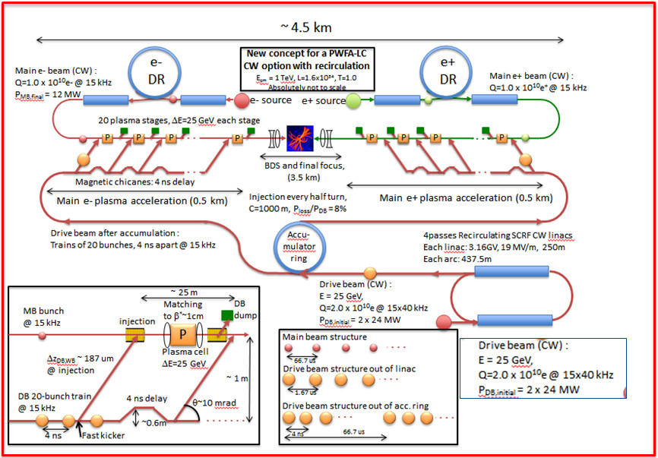
Past and Ongoing Design Efforts
There have been several attempts to outline what a beam-driven plasma linear collider (PLC) could look to like.
Recent efforts include:
Snowmass 2013: Beam-Driven PLC
DOE 2016: Advanced Accelerator Strategy Report
ICFA 2017: ANAR Roadmap
ESPP 2019: ALEGRO Contribution
E. Adli et. al., arXiv:1308.1145 [physics.acc-ph]

Slide 3
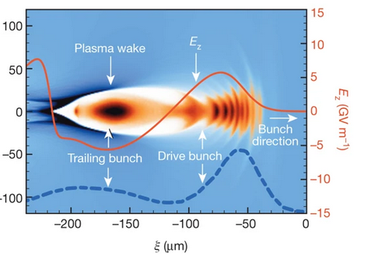
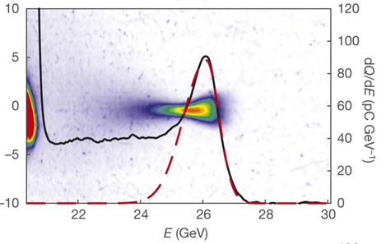
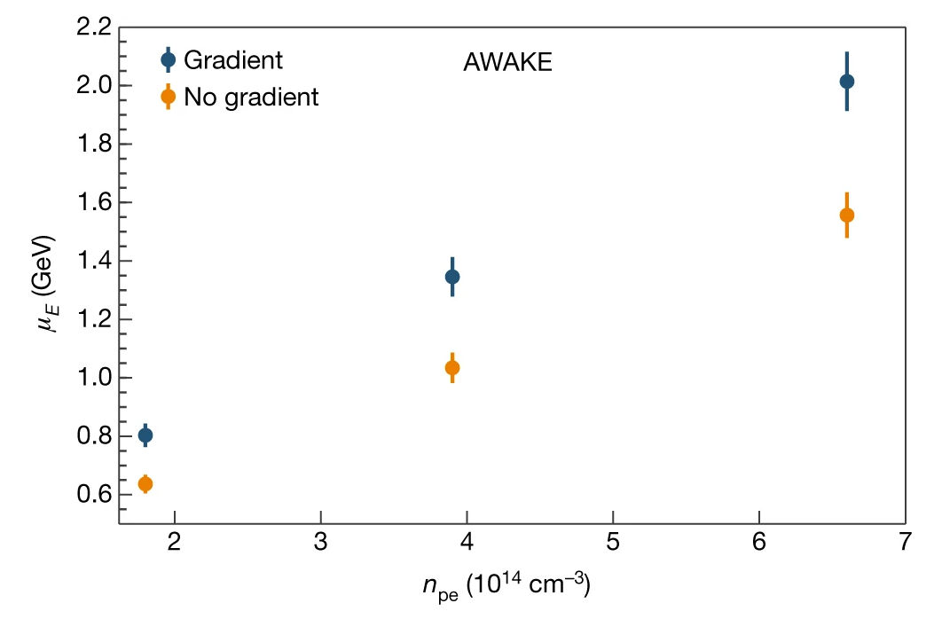
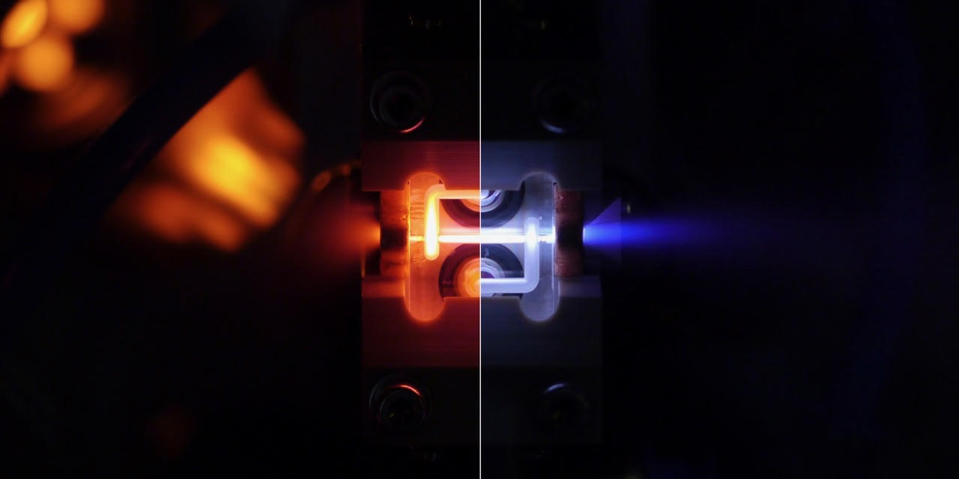
Advances Since Snowmass 2013
High-efficiency acceleration of an electron beam in a plasma
wakefield accelerator. M. Litos, et. al. Nature 515, 92–95 (2014)
Multi-gigaelectronvolt acceleration of positrons in a self-loaded
plasma wakefield. S. Corde, et. al. Nature 524, 442–445 (2015)
Acceleration of electrons in the plasma wakefield of a proton bunch.
E. Adli, et. al. (AWAKE Collaboration) Nature 561, 363–367 (2018)
Emittance Preservation in an Aberration-Free Active Plasma Lens.
C. A. Lindstrøm, et. al. Phys. Rev. Lett. 121, 194801 (2018)

Slide 4
Context for the Plasma Linear Collider
The particle physics community would like an electron-positron collider “soon”.
Plasma technology is not sufficiently developed to start construction of a PLC.
The PLC is a potential energy upgrade to a linear collider.

Slide 5
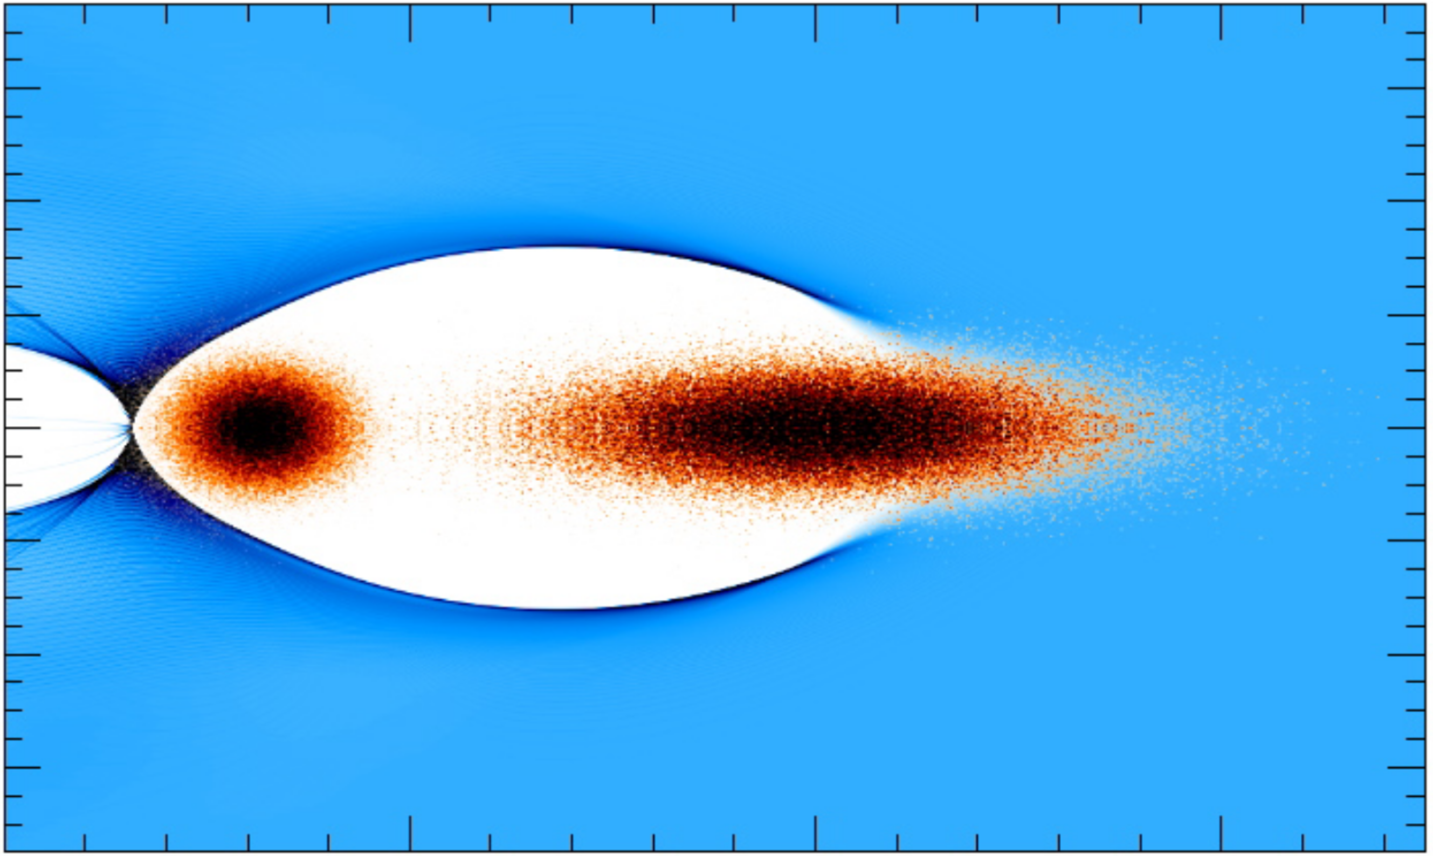
Plasma Wakefield Concept
Witness Beam
Accelerated by the wake
Drive Beam
Creates plasma wakefield
Transfers energy to plasma
Plasma wakefield (blowout regime)
Decelerates drive beam, Accelerates witness beam
Focuses both beams*
QuickPIC Simulation, W. An. UCLA

Slide 6
Challenges on the path to a PLC
Challenges include:
High-efficiency, high-quality acceleration in a single stage.
Coupling between plasma stages.
Positron acceleration in plasma.
High repetition-rate plasma acceleration.
Final focusing and alignment of beams at the collision point.

Slide 7
The Efficiency Challenge
250 GeV CM | MW | Eff.
Wall Plug￫Drive | 30￫12 | 40%
Drive￫Plasma | 12￫9 | 75%
Plasma￫Witness | 9￫6 | 66%
Site Power | 133
Drive Beam
Wall plug to RF and cryo
RF to drive beam
Witness Beam
Plasma to witness beam
Energy that is not transferred to witness beam stays in the wakefield. Need high-efficiency to avoid MW heating of plasma!
10 TeV CM | MW | Eff.
Wall Plug￫Drive | 205￫81 | 40%
Drive￫Plasma | 81￫61 | 75%
Plasma￫Witness | 61￫40 | 66%
Site Power | 537
Plasma wakefield
Drive beam to plasma
E. Adli et. al.,
arXiv:1308.1145 [physics.acc-ph]
QuickPIC Simulation, W. An. UCLA

Slide 8
Stability and Efficiency
The figure-of-merit for a linear collider is luminosity per wall plug power. This requires highly-efficient and stable acceleration to produce low-emittance beams.
Our high-efficiency design attracted interest from the general accelerator community. There is a claim that you must trade stability for efficiency:
Efficiency versus instability in plasma accelerators. V. Lebedev, et. al. PRAB 20, 121301 (2017)
This prompted several people to think about solutions (including the authors of the criticism):
Ion Motion Induced Emittance Growth of Matched Electron Beams in Plasma Wakefields. W. An, et. al. PRL 118, 244801 (2017)
Beam Breakup Mitigation by Ion Mobility in Plasma Acceleration. A. Burov, et. al. arXiv:1808.03860 [physics.acc-ph] (2018)
Suppression of Beam Hosing in Plasma Accelerators with Ion Motion. T. J. Mehrling, et. al. PRL 121, 264802 (2018)
Constructive criticism strengthens PLC concept and leads to collaboration.

Slide 9
Parameters and Technological Readiness
Parameters in this table come from the Snowmass 2013 PLC whitepaper (arXiv:1308.1145).
We have learned a lot since 2013!
Is our design self-consistent?
We need an Integrated Design Study to address this issue.
Plasma Linear Collider | Electron/Positron | Higgs Fact. | Multi-TeV
Beam Energy | GeV | 250 | 10000
Peak Luminosity (10^34) | cm-2 s-1 | 1.57 × 10³⁴ | 1.05 × 10³⁵
Int. Luminosity | ab-1/yr | 0.157 | 1.045
Beam dE/E at IP |  | 0.1 | 0.1
Transv. Beam sizes at IP x/y | um | 0.7 / 4 × 10⁻³ | 0.1 / 6 × 10⁻⁴
Rms bunch length / beta* | cm | 2 × 10⁻³/0.01 | 2 × 10⁻³/0.01
Crossing angle | urad | 1400 | 1400
Rep./Rev. frequency | Hz | 30000 | 5000
Bunch spacing | ns | 33333 | 200000
# of IPs |  | 1 | 1
# of bunches |  | 1 | 1
Length/Circumference | km | 2.25 | 18
Facility site power | MW | 132.92 | 537.22
Cost range | $B US
Timescale till operations

Slide 10
Integrated Design Study
An Integrated Design Study (IDS) will:
Develop a self-consistent picture of a linear collider.
Explore trade-offs in design choices
Establish minimal parameters to be demonstrated by current experiments at FACET-II/SLAC and FlashForward/DESY.

Slide 11
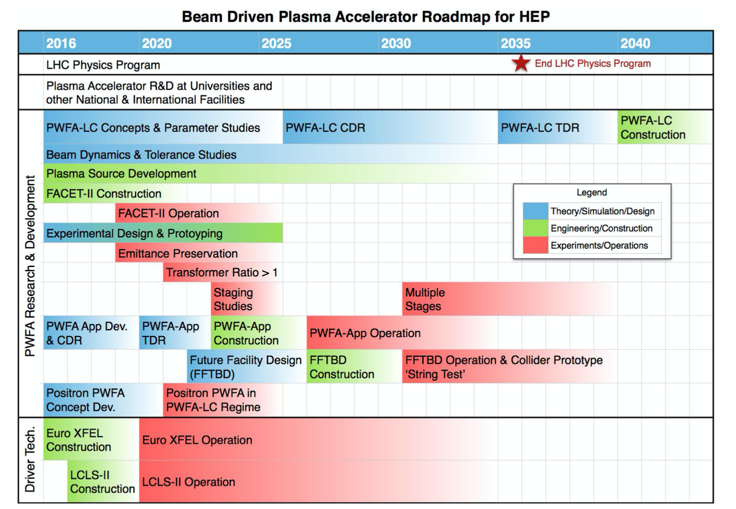
IDS and DOE Roadmap
The IDS is important for keeping pace with the DOE PWFA roadmap:
Advanced Accelerator Development Strategy Report: DOE Advanced Accelerator Concepts Research Roadmap Workshop
Context is important:
Green-field design or assume ILC parameters and infrastructure?
IDS

Slide 12
Near-Term Applications
Near-term applications are important for establishing PWFA technology and demonstrating reliability. Possible applications include:
Driver for very hard x-ray and gamma ray sources.
Non-linear QED experiments.
High-energy beam dump experiments.
Injectors for rings.

Slide 13
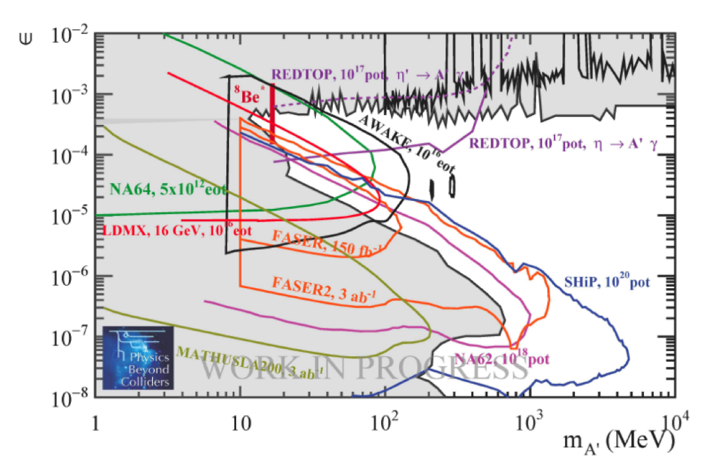
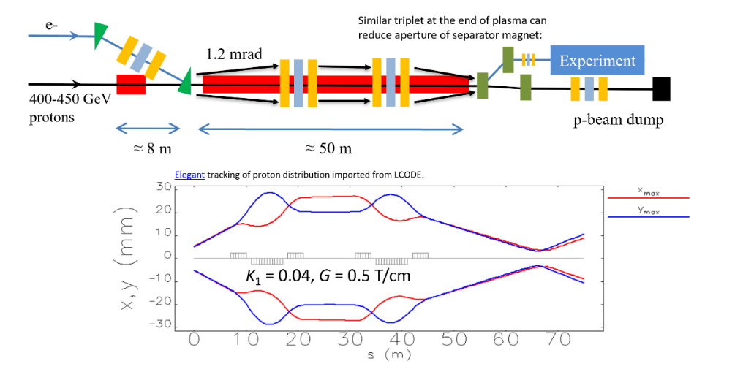
AWAKE++ Beam Dump Experiment
AWAKE at CERN uses a proton beam to drive the plasma wakefield and accelerate electrons to energies greater than 50 GeV. They have identified part of the dark photon parameter space as a target application.
AWAKE++: the AWAKE Acceleration Scheme for New Particle Physics Experiments at CERN

Slide 14
Conclusions
The Plasma Linear Collider concept is a possible energy upgrade for a future linear collider.
An Integrated Design Study is required to put forward a self-consistent design for a PLC. This will also help to define experimental goals.
Near-term applications are critical for establishing PWFA technology and demonstrating reliability.

Slide 15
Backup

Slide 16
The Positron Acceleration Challenge
e⁻
e⁺
m_{ion} >> m_{elec}
The plasma responds asymmetrically to beams of opposite charge. No other accelerating mechanism exhibits this behavior.

Slide 17
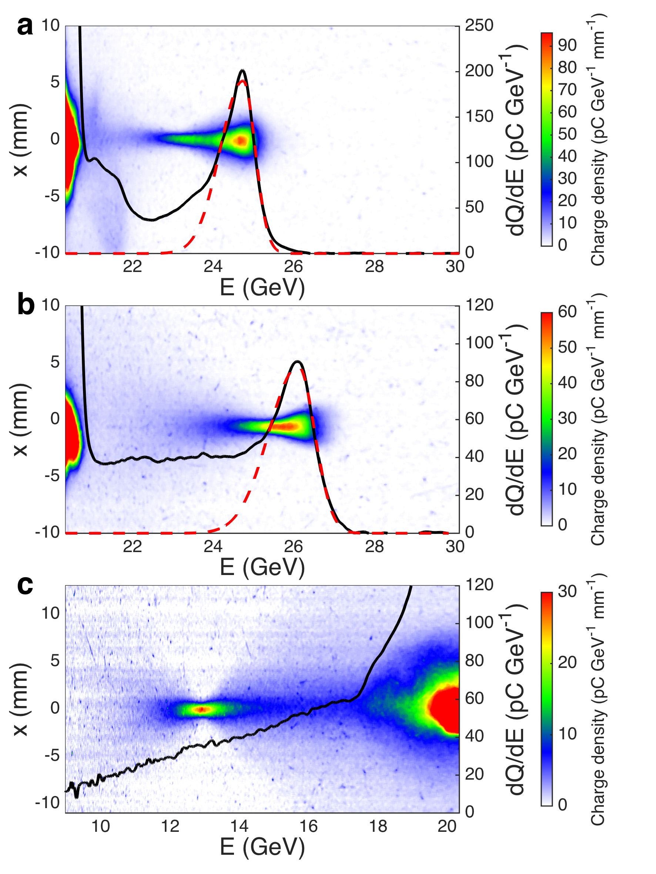
Non-Linear Positron PWFA
Experimental results in 1.3 m plasma
FACET was able to provide high-density, compressed positron beams for non-linear PWFA experiments.
This led to new observations:
Accelerated positrons form a spectrally-distinct peak with an energy gain of 5 GeV.
Energy spread can be as low as 1.8% (r.m.s.).
S. Corde et al., Nature 524, 442 (2015)

Slide 18
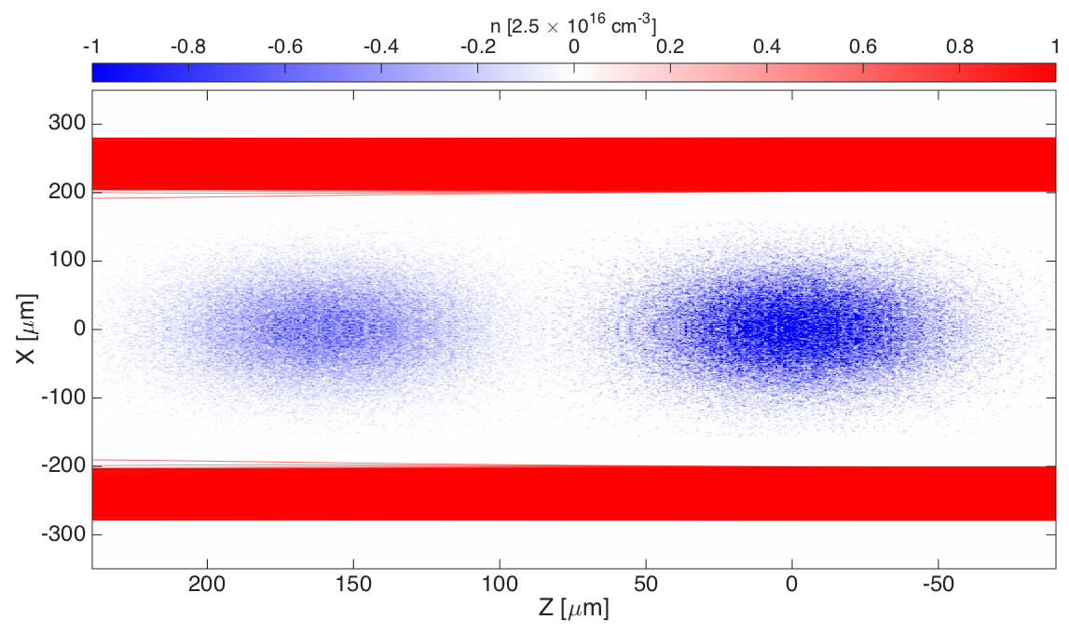
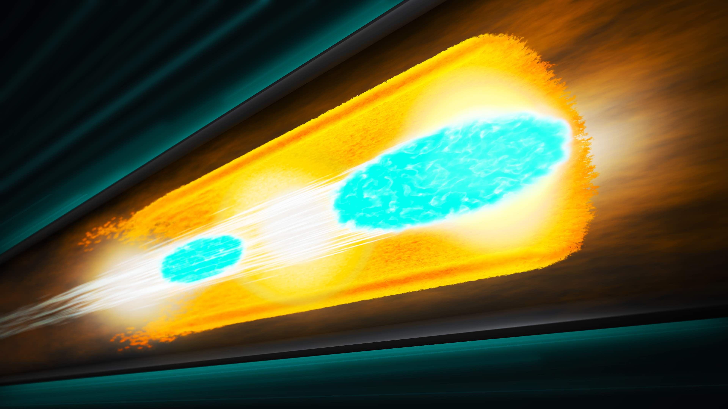
Hollow Channel Plasma
Plasma
Vacuum
Witness Beam e⁺
Drive Beam e⁺
The Hollow Channel Plasma is a structure that symmetrizes the response of the plasma to electron and positron beams.
There is no plasma on-axis, and therefore no focusing/defocusing force from plasma ions.
S. Gessner et. al. Nat. Comm. 7, 11785

Slide 19
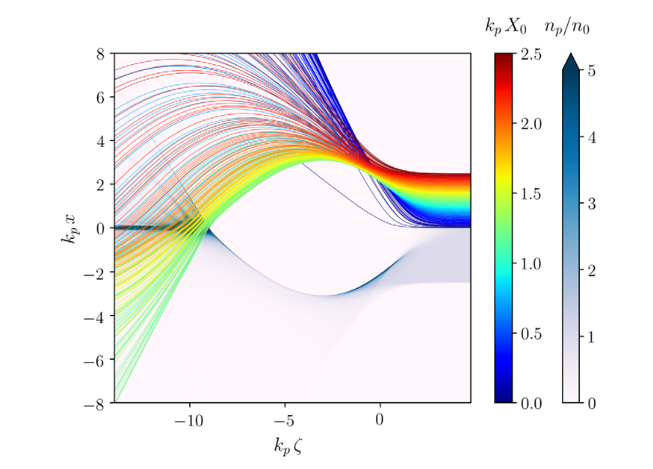
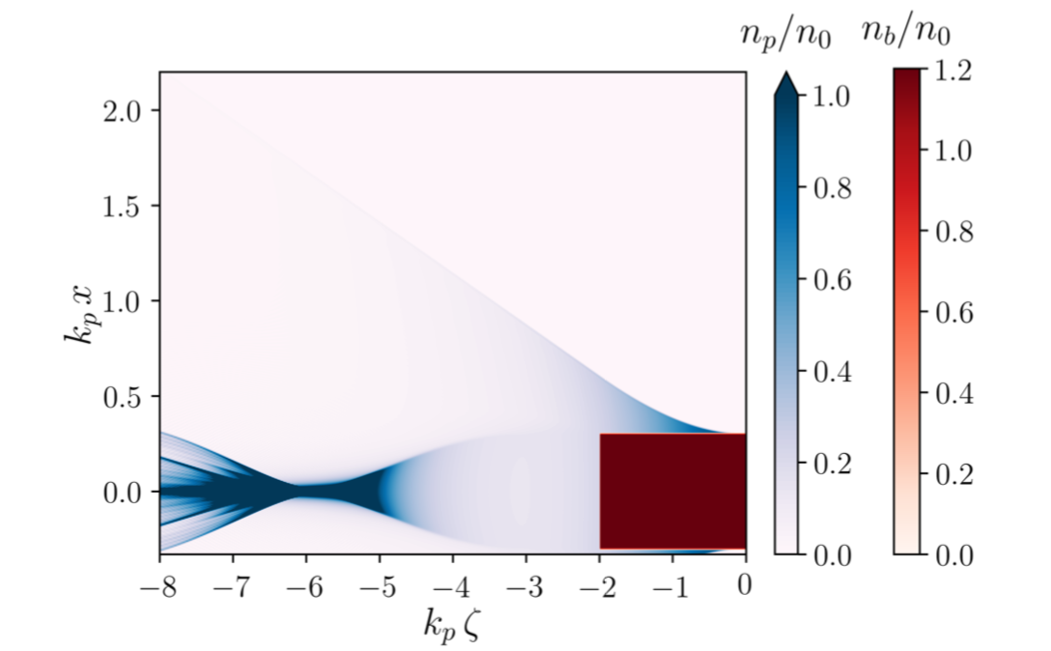
Plasma Filaments
S. Diederichs et. al. Phys. Rev. Accel. Beams 22 081301 (2019)
S. Dietrichs. M.S.c. Thesis, DESY
By driving a wakefield in a plasma filament, you can create a region of uniform focusing and acceleration for positrons at the back of the wake.
Transverse plasma electron motion appears to be an important factor.

