Slide 1
Muon Collider
D. Schulte

Slide 2
Overview
In the past, muon colliders have mainly be studied in the US (MAP collaboration)
  Muon beams produced from proton beam
  MICE in the UK to demonstrate required muon cooling, concluded its programme recently
Some activity on alternative muon source using positron beam mainly in Italy
For the European Strategy working group was formed to assess muon collider potential
  N. Pastrone et al.
  recommended to strategy process arXiv:1901.06150
  Strategy proposes international muon collider design study
So I am not representing a collaboration
  but are forming one: Friday July 3rd, https://indico.cern.ch/event/930508/

Slide 3
Lepton Collider Energy Limit
Electron-positron rings are multi-pass
but limited by synchrotron radiation
That is why proton rings are energy frontier (otherwise would use e⁺e⁻ in LHC)
N
N
S
S
Electron-positron linear colliders avoid synchrotron radiation
But are single pass is acceleration and collision
This limits energy and luminosity (CLIC cost extrapolated to 14 TeV: O(60 GCHF), power O(1.7-2.8 GW)
Novel approach: muon collider
Large mass suppresses synchrotron radiation => multi-pass
Fundamental particle requires less energy than protons
But lifetime at rest only 2.2 μs

Slide 4
Proton-driven Muon Collider Concept (MAP)
From the MAP collaboration: Proton-driven source (M. Palmer et al.)
Acceleration to collision energy
Collision
Short, intense proton bunches to produce hadronic showers
Pions decay into muons that can be captured
Muon are captured, bunched and then cooled
No CDR exists, no fully integrated baseline
No cost estimate
Need to extend to higher energies (10+ TeV)
But did not find something that does not work

Slide 5
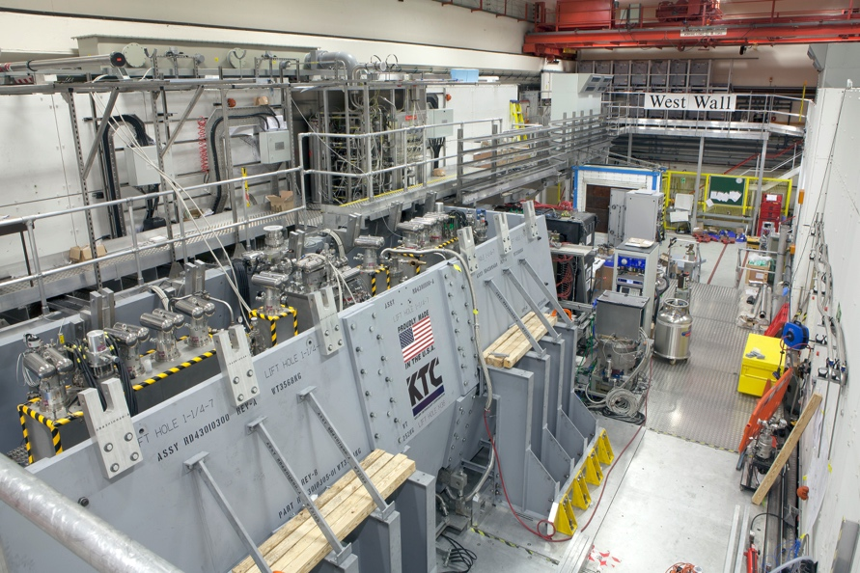
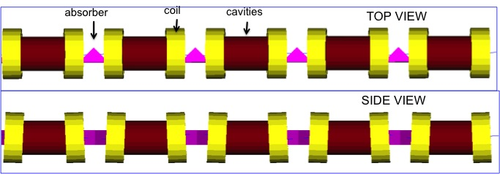
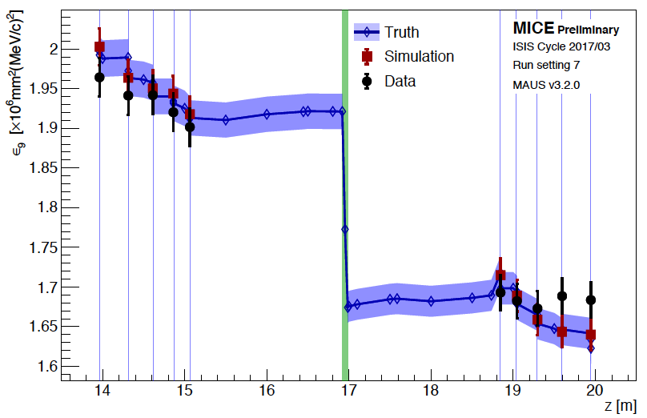
Cooling Concept (Transverse)
MICE (UK)
Noticeable reduction of 9% emittance
Design exists for reduction of phase space by O(10⁻⁶)
need to improve final cooling
but room to improve design, hardware better than projected
Principle of ionisation cooling has been demonstrated
worked as predicted in simulation

Slide 6
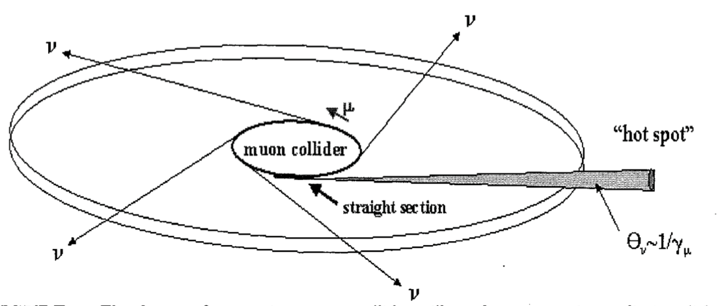
High Energy Complex
Collider ring
Need highest fields to minimise circumference
Ambitious focusing at collision point
Need to avoid gaps in arcs to minimise neutrino radiation
Find novel solutions to mitigate neutrino radiation
Need to shield magnets from muon decay
Need to shield experiment from muon decay
Fast ramping ring
Or large energy bandwidth ring
Energy recovery for fast ramping magnets
Combination of accelerator and collider ring proposed (V. Shiltsev, D. Neuffer), exploration required

Slide 7
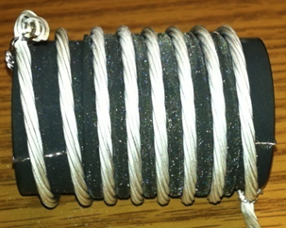
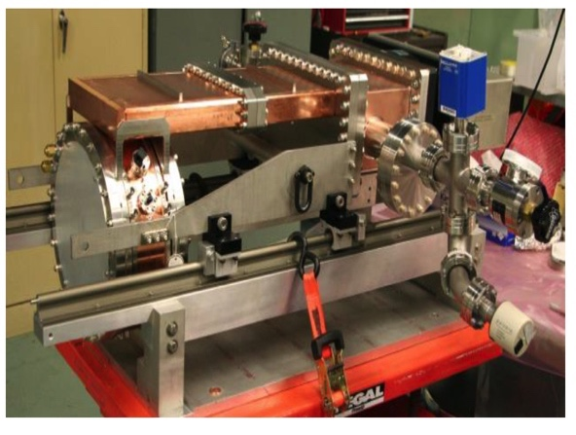
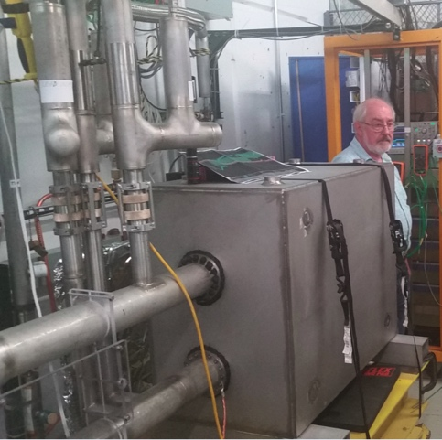
Technology Status
Many components have been developed and tested
More is needed
production targets, fast-ramping magnets and energy recovery power converters, robust high field collider magnets, efficient shielding, efficient cooling, normal and superconducting RF, …
Facility to integrate
  addresses the more “subtle” issues (e.g. full width of technologies, but also safety, …)
MICE
(UK)
MuCool: >50 MV/m in 5 T field
FNAL
Breakthrough in HTS cables
NHFML
32 T solenoid with low-temperature HTS
FNAL
12 T/s HTS
0.6 T max
Mark Palmer

Slide 8
Target Parameter Examples
From the MAP collaboration: Proton source
Even at 6 TeV above target luminosity with reasonable power consumption
But have to confirm power consumption estimates

Slide 9
The LEMMA Scheme
From the LEMMA team: Positron-driven source (M. Antonelli et al.)
45 GeV positrons to produce muon pairs
Accumulate muons from several passages
Low emittance muon beam
no cooling required, much less radiation
But large positron current and production needed O(10¹⁷/s)
Target is challenging
Currently, do not reach luminosity goal
More work is needed to conclude

Slide 10
European Strategy Recommendations
From the deliberation document for the European Strategy Update for Particle Physics
High-priority future initiatives
a) [..]
b) [..]
In addition to the high field magnets the accelerator R&D roadmap could contain:
[..]
an international design study for a muon collider, as it represents a unique opportunity to achieve a multi-TeV energy domain beyond the reach of e+e–colliders, and potentially within a more compact circular tunnel than for a hadron collider. The biggest challenge remains to produce an intense beam of cooled muons, but novel ideas are being explored;
Note: High-field magnets are also instrumental for a muon collider

Slide 11
Proposed Tentative Timeline (2019)
CDRs
TDRs
Technically limited
DETECTOR
R&D detectors
Large Proto/Slice test
Prototypes
MDI & detector simulations
1
2
3
4
5
6
7
8
9
10
11
12
13
14
15
16
17
Design
Baseline design
Design optimisation
Project preparation
Approve
Test Facility
Design
Construct
Exploit
Exploit
MACHINE
Technologies
Design / models
Prototypes / t. f. comp.
Prototypes / pre-series
Ready to decide on test facility
Cost scale known
Ready to commit
to collider
Cost known
Ready to construct

Slide 12
Proposed Scope
“In the first period, in time for the next European Strategy for Particle Physics Update, the study aims to establish whether the investment into a full CDR and a demonstrator is justified. It will provide a baseline concept, well-supported performance expectations and assess the associated key risk as well as cost and power consumption drivers. It will also identify an R&D path to demonstrate the feasibility of the collider.”
Benchmark region around O(3 TeV), L = O(10³⁴ cm⁻²s⁻¹)
  Well above higgs factory energy
  Should focus on technologies ready in 10-20 years
  MAP did work on this range
Benchmark region 10+ TeV, L = O(10³⁵ cm⁻²s⁻¹)
  New territory, beyond what CLIC can do
  Need to fully understand physics needs
  Need to address a number of additional challenges
Exploration of synergies
  Neutrino factory
    potential useful application, would be large-scale demonstrator
  Higgs factory
    more mature options exist currently, but we can come back if no one is moving forward

Slide 13
Tentative Target Parameters?
Parameter | Unit | 3 TeV | 10 TeV | 14 TeV
L | 10³⁴ cm⁻²s⁻¹ | 1.8 | 20 | 40
N | 10¹² | 2.2 | 1.8 | 1.8
f_{r} | Hz | 5 | 5 | 5
P_{beam} | MW | 5.3 | 14.4 | 20
C | km | 4.5 | 10 | 14
<B> | T | 7 | 10.5 | 10.5
ε_{L} | MeV m | 7.5 | 7.5 | 7.5
σ_{E} / E | % | 0.1 | 0.1 | 0.1
σ_{z} | mm | 5 | 1.5 | 1.07
β | mm | 5 | 1.5 | 1.07
ε | μm | 25 | 25 | 25
σ_{x,y} | μm | 3.0 | 0.9 | 0.63
Note:
Based on extrapolation
CLIC @ 14 TeV would need
130 MW beam power
for L = 28 x 10³⁴ cm⁻²s⁻¹
of which 1/3 is within 1% around nominal energy
Additional benefits for muon collider less initial state radiation and smaller beam energy spread
2 IPs in each case
Single bunch
Luminosity decays exponentially
Note: The study will have to verify that these parameters can be met

Slide 14
Initial Key Issues
Neutrino radiation
  known to need mitigation for 10+ TeV
  explore mitigation methods
MDI and background conditions
Cost and power drivers
  fast ramping magnet systems
  collider ring magnets
  RF systems
Beam quality
  Muon source, two options, define baseline and alternative, improve performance
    Improvement of cooling channel for proton-driven scheme appears possible because hardware performance is better than initially assumed
  Preservation of beam quality
Define demonstration programme for implementation in second half of the decade
  test facility and components

Slide 15
Conclusion
Muon collider has found interest in Europe
It has unique high-energy promise
Much of its technology is similar to other colliders
Need to develop technology, address risks, cost and power consumption, develop physics case
Following strategy, are preparing the ground for collaboration
formal process will take some time
US would be most important partner
most of the expertise is in the US
Meeting to prepare ground for collaboration July 3: https://indico.cern.ch/event/930508/
Many thanks to M. Palmer, V. Shiltsev, N. Pastrone,
the MAP and the MICE collaborations, the LEMMA team
and the muon collider working group

Slide 16
Reserve

Slide 17
Muon Collider Luminosity Scaling
Collider ring
High energy
Muon source
No degradation
High beam power
Neutrino radiation
Collider ring magnets
Main cost

