Slide 1
Snowmass 2021
Advisory Group Meeting
June 18, 2020
Young-Kee Kim
University of Chicago
DPF Chair

Slide 2
Snowmass Advisory Group
DPF Executive Committee
  Chair: Young-Kee Kim
  Chair-Elect: Tao Han
  Vice Chair: Joel Butler
  Past Chair: Prisca Cushman
  Secretary/Treasurer: Mirjam Cvetic
  Councilor: Elizabeth Simmons
  Member-at-Large: Rick Van Kooten
  Member-at-Large: Elizabeth Worcester
  Member-at-Large: Natalia Toro
  Member-at-Large: Andre de Gouvea
  Member-at-Large: Mary Bishai
  Member-at-Large: Lauren Tompkins
  Early Career Member-at-Large: Sara Simon
Editor and Communication
  Editor – Michael Peskin
  Communication – Bob Bernstein
Representatives from other Divisions
  DPB: Sergei Nagaitsev
  DNP: Yury Kolomensky
  DAP: Glennys Farrar
  DGRAV: Gabriela Gonzales
Representatives from the Int. Community
  Africa / Middle East
    Azwinndini Muronga, Nelson Mandela Metropolitan Univ, South Africa
  Asia / Pacific
    Atsuko Ichikawa, Kyoto University, Japan
    Xinchou Lou, IHEP, China
  Canada
    Heather Logan, Carleton University, Canada
  Europe / Russia
    Val Gibson, Cavendish Laboratory, UK
    Berrie Giebels, CNRS, France
  Latin America
    Claudio Dib, Universidad Tecnica Federico Santa Maria, Chile
Steering Group

Slide 3
Snowmass
long-term planning exercise for the particle physics community
Its goal is to develop the community’s long-term physics aspirations.
Its narrative will communicate
the opportunities for discovery in particle physics
to the broader scientific community and to the government.

Slide 4
U.S. Strategic Planning Process for Particle Physics
~year-long process
Snowmass Community-Wide “Science” Study
Organized by Division of Particles and Fields (DPF) of APS
Input to P5
~year-long process
P5 (Particle Physics Project Prioritization Panel)
formulate a 10-year plan (20 year vision) within funding constraints
Subpanel of HEPAP, High Energy Physics Advisory Panel for DOE/NSF funding agencies
Long-Range Plan for Nuclear Science (ν-less double beta decay)
Decadal survey on Astronomy and Astrophysics (dark energy, CMB)
HEPAP Accelerator R&D Subpanel Report

Slide 5
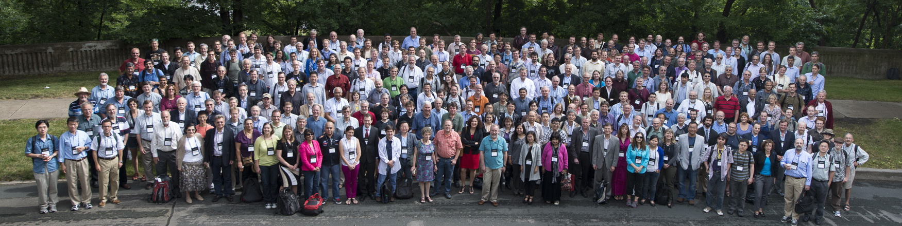
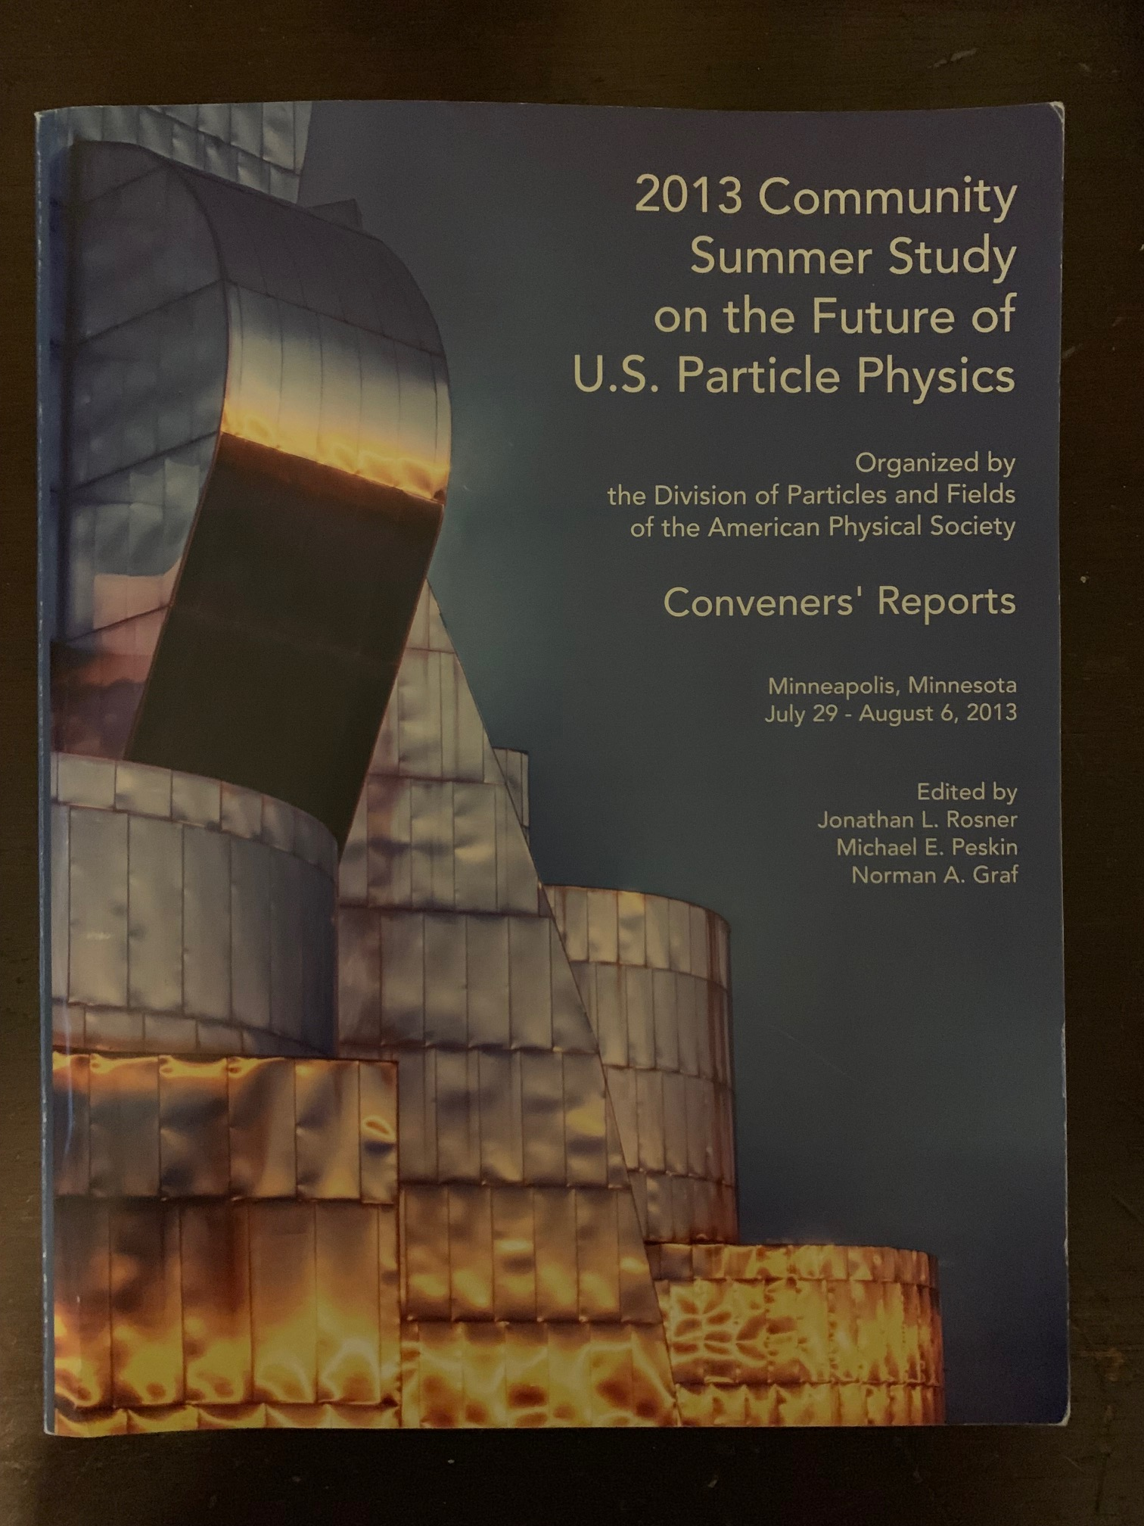
Snowmass 2013
Snowmass Planning Meeting at Fermilab, October 2012
Various frontier workshops in multiple locations
Snowmass Summer Study at Minnesota (July 29 – August 6, 2013)
Snowmass Report (December 2013)
A successful Snowmass process results in community buy-in, even when hard budgetary decisions need to be made

Slide 6

Snowmass 2013 topics led to P5 Science Drivers
Snowmass 2013 Report
Frontiers
  Energy Frontier
  Intensity Frontier
  Cosmic Frontier
Cross-Cutting
  Facilities (Underground and Accelerator)
  Instrumentation
  Computing
  Theory
  Communication
P5 2014 Report

Slide 7
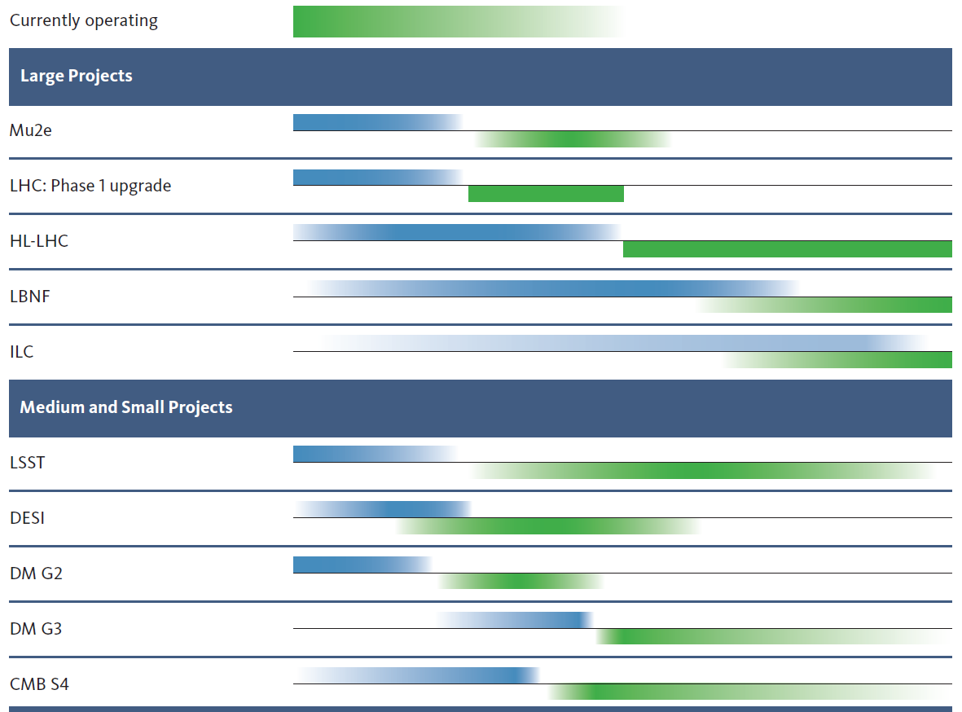
P5 2014 has been very successful !!
10 year plan
Scientific Drivers
HEP Science Output
[>$200M]
The Unknown (U.S.)
construction
operation
Higgs as a tool
The Unknown
(Europe)
Neutrino (U.S.)
LBNF/DUNE (and PIP-II)
LBNF/DUNE & PIP-II schedules advanced
[<$200M]
Cosmic Acceleration (U.S.)
Dark Matter (U.S.)
Cosmic Acceleration (U.S.)
(SuperCDMS, LZ, ADMX)
We are here
Construction
Expected Physics

Slide 8
Particle Physics is Global
Europe and U.S.
Frequency: 7 years (Europe), ~8 years (U.S.)
Process: ~2 years in total (~1 year on science by the community + ~1 year priorities)
Japan, Canada, China, Latin America, …
Snowmass (U.S.)
P5 (U.S.)
Year
11 | 12 | 13 | 14 | 15 | 16 | 17 | 18 | 19 | 20 | 21 | 22 | 23 | 24 | 25 | 26 | 27
2006 plan
Europe
Executing the 2013 plan
Planning
2008 plan
U.S.
10 year plan: Executing the 2014 plan
Planning
Europe
Planning
U.S.
10 year plan
Planning
Now

Slide 9
Snowmass 2021: Timeline
Today
11/19 | 12/19 | 1/20 | 2/20 | 3/20 | 4/20 | 5/20 | 6/20 | 7/20 | 8/20 | 9/20 | 10/20
Preparation
Letters of Interest
Contributed Papers
Frontier & Topical Groups: Meetings & Workshops
Planning Meeting
Nov 4-6, 2020 (Fermilab)
Summer Study
July 11-20, 2021 (UW Seattle)
11/20 | 12/20 | 1/21 | 2/21 | 3/21 | 4/21 | 5/21 | 6/21 | 7/21 | 8/21 | 9/21 | 10/21
Contributed Papers
Snowmass
Report
Frontier & Topical Groups: Meetings & Workshops

Slide 10
Snowmass 2021: Frontier & Topical Groups
Ten Frontiers
  Energy Frontier (3 co-conveners)
  Frontiers in Neutrino Physics (3 co-conveners)
  Frontiers in Rare Processes & Precision Measurements (3 co-conveners)
  Cosmic Frontier (3 co-conveners)
  Theory Frontier (3 co-conveners)
  Underground Facilities and Infrastructure Frontier (4 co-conveners)
  Accelerator Frontier (3 co-conveners)
  Instrumentation Frontier (3 co-conveners)
  Computational Frontier (3 co-conveners)
  Community Involvement (2 co-conveners)
    Diversity and Inclusion Topical Group ←→ DPF Ethics Task Force
Topical groups
  6~10 topical groups for each frontier
  ~3 co-conveners for each topical group

Slide 11
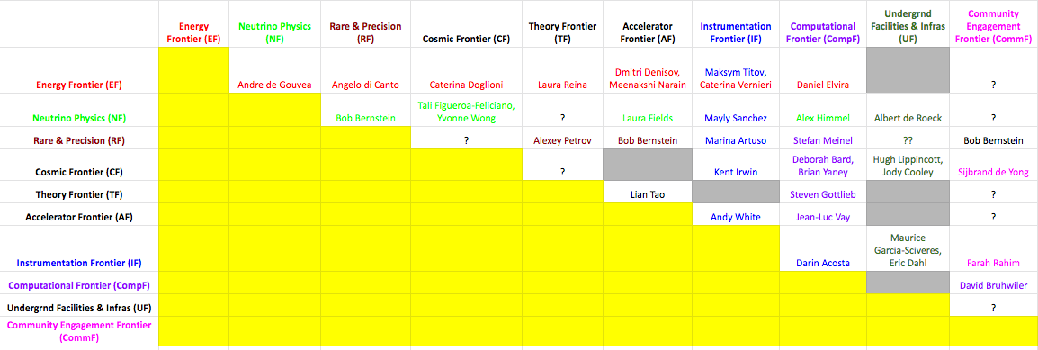
Snowmass 2021: Liaisons

Slide 12
Snowmass 2021: Early Careers
Forming representatives for Snowmass Young
  Soliciting nominations
  Nominees: early career members (e.g. grad students, postdocs, etc.). Nominees need not be APS members to participate in the process. Nominations can include self-nominations
  ~250 nominated!!
  Coordinated by
    Sara M. Simon, 2020 DPF Executive Committee Early Career Member
    Fernanda Psihas, 2019 DPF Executive Committee Early Career Member

Slide 13
Snowmass Preparation Work
General meetings
  Weekly Steering group
  Monthly all Frontier conveners meetings with Advisory Group
  Monthly Advisory group meetings
Frontier / topical group / cross-cutting (joint)
  Regular meetings
  Workshops
Communication to the community
  Snowmass Wiki
  Snowmass email (snowmass@fnal.gov, snowmass-young@fnal.gov)
  Slack Channels
  Monthly Snowmass Newsletter

Slide 14
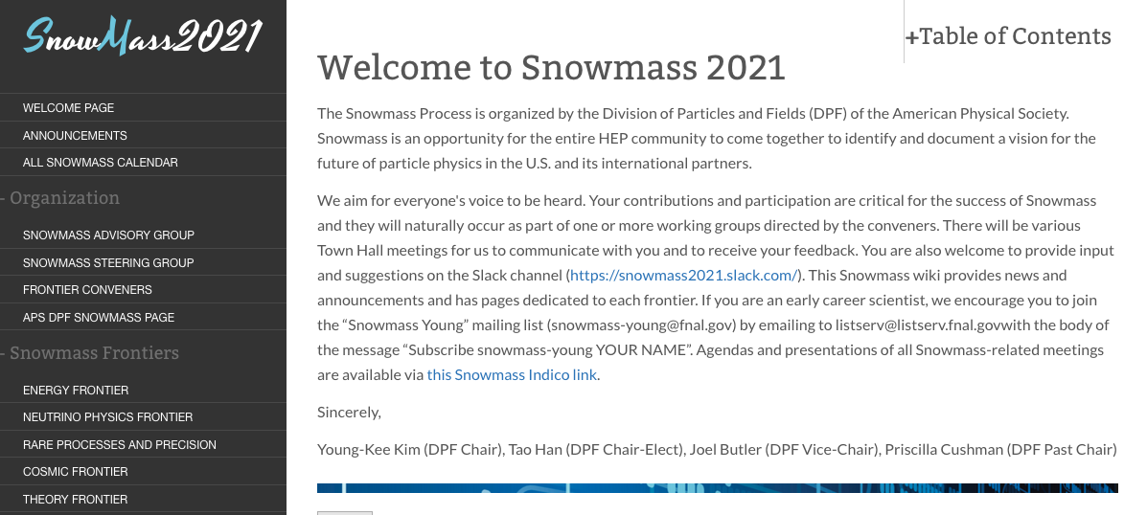
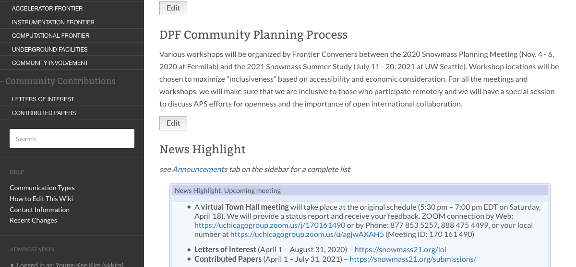
Snowmass Wiki
Sergei Chekanov (ANL)

Slide 15
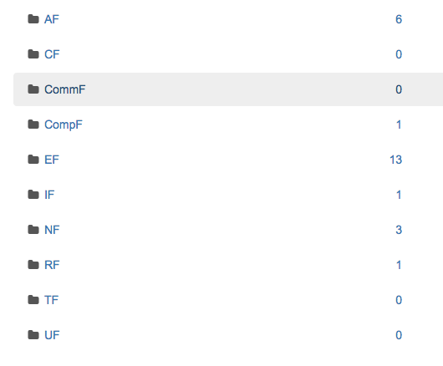
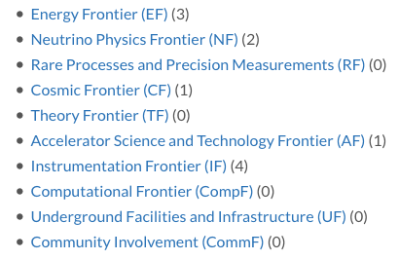
Community Contributions
Letters of Interest (Apr 1 – Aug 31, 2020)
  Help conveners to prepare the Snowmass Planning Meeting (Nov. 4 - 6, 2020)
  Letters should give brief descriptions and cite the relevant papers to study.
Contributed Papers (April 1, 2020 – July 31, 2021)
  Part of the Snowmass proceedings.
  White papers on specific scientific areas, technical articles presenting new results on relevant physics topics, and reasoned expressions of physics priorities, including those related to community involvement.

Slide 16
Community Planning Meeting 2012
CPM 2012 (https://indico.fnal.gov/event/5841/)
  Day 1: Plenary
    Questions for the community from DOE & NSF
    Plans in other regions: Japan, China, India, Canada, Europe
    Plans in other related fields: Astro 2010
    7 Frontiers: Status and Charge for CPM
    Laboratory Corner: FNAL, SLAC, BNL, LBNL, Argonne
  Day 2:
    Breakout sessions (each Frontier or Joint)
    Plenary: Town Hall meeting (1hr 45’)
  Day 3: Plenary
    Summaries of breakout sessions and next steps
    Snowmass Young

Slide 17
Community Planning Meeting 2020
Format
  100% virtual
    Input from several Frontier Groups
    Their preference after discussing with their tropical groups.
    At this time: too high uncertainty (large group in-person meeting, travel, …)
    Groups favor "100% virtual" meeting
  Concerns on inclusiveness (to be discussed at the next all conveners meeting)
    With Fermilab (DOE national lab) as the organizing institution, members from sensitive countries may not be able to register the CPM even if it is a virtual meeting
    Similar rules are applied to in-person meeting registration and virtual meeting registration.

Slide 18
Community Planning Meeting 2020
Program Committee (this is in addition to the Local Organizing Group who handles the meeting logistics)
  CMP's goal (tentative)
    Identify input needed to define the scientific questions of our time
    Establish cross working-group discussions and new areas to focus
  Program Committee's roles
    Revisit (improve) the goal and vision of the CMP
    Plan the meeting structure (plenaries, panels, cross working group meetings, parallel sessions, …)
    Plan talks, organize panel discussions, and invite speakers / panelists
  Committee Composition
    10 Frontier representatives (1 representative from each Frontier group)
    2 early careers (1 from an accelerator based program and 1 from a non-accelerator based program)
    ~2 from the 2013 Snowmass leadership who has a global view

Slide 19
Snowmass in the Global Context
International Community's Engagement
Feedback from International Members of SAG
  Africa / Middle East
    Azwinndini Muronga, Nelson Mandela Metropolitan Univ, South Africa
  Asia / Pacific
    Atsuko Ichikawa, Kyoto University, Japan
    Xinchou Lou, IHEP, China
  Canada
    Heather Logan, Carleton University, Canada
  Europe / Russia
    Val Gibson, Cavendish Laboratory, UK
    Berrie Giebels, CNRS, France
  Latin America
    Claudio Dib, Universidad Tecnica Federico Santa Maria, Chile

