Slide 1
Heat Shrink
18 June 2020

Slide 2
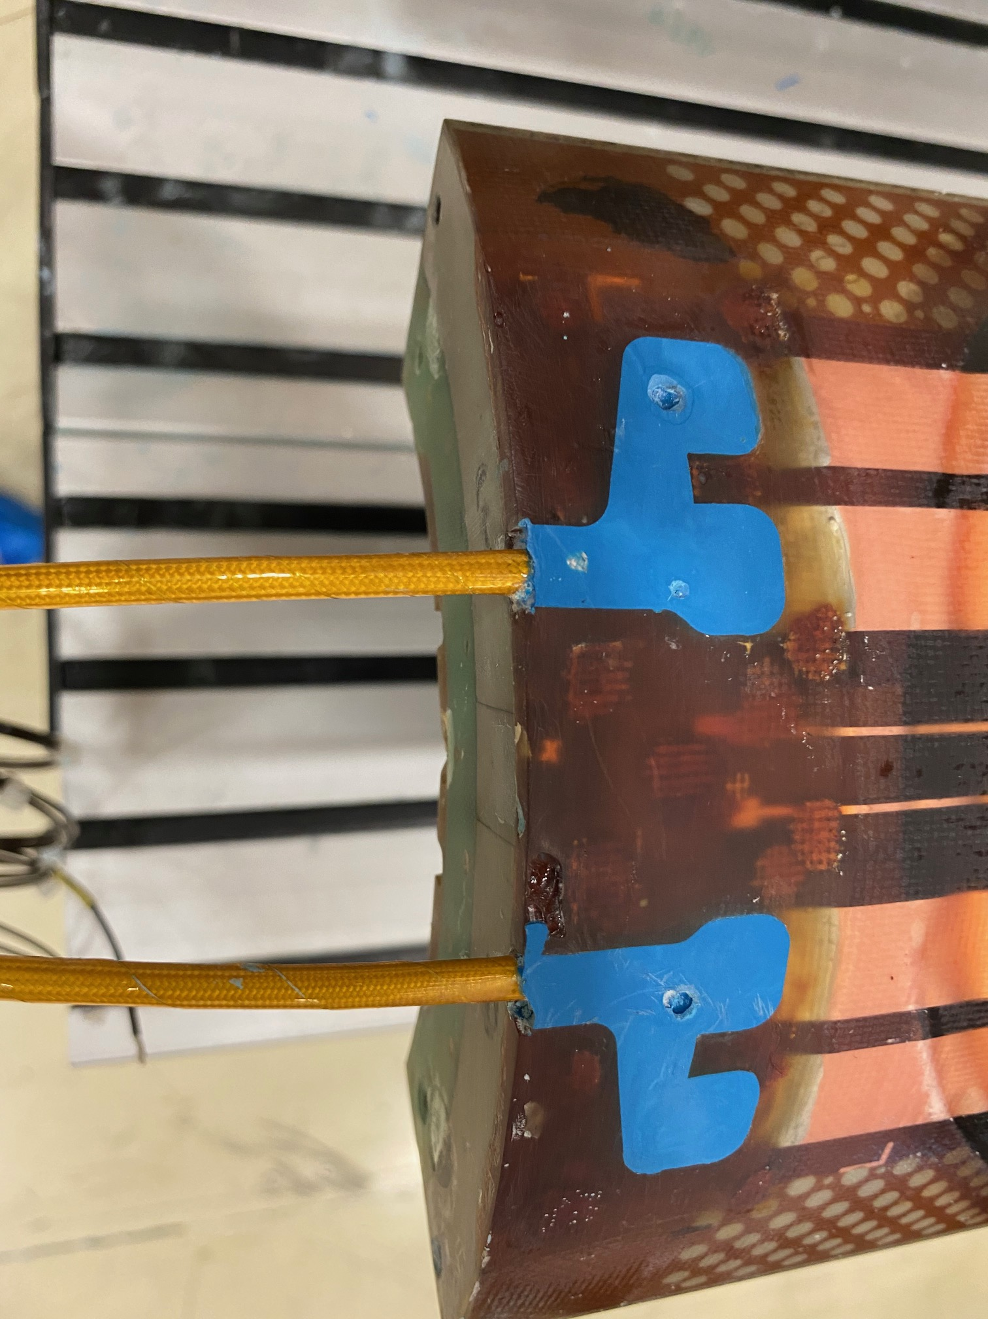
Prototype coils quench heater wires are protected with Heat Shrinkable Tubing (not radiation resistance)
For series coils, we will use a polyimide pre-formed tube

