Slide 1
Heater Quality Control at CERN
Susana Izquierdo Bermudez with inputs from Christian Scheuerlein and Ludovic Grand Clement
Acknowledgments: Nicholas Lusa, Beatriz Arias Alonso, Attilio Milanese, Francois Olivier Pincot, Juan Carlos Perez and the rest of the production and QA team.
18 June 2020

Slide 2
HV Test Procedure
Following the failure QH to coil in the first 11 T prototype (summer 2018, failure QH to coil at 2 kV after He exposure, more details here), different HV tests procedures were applied on heaters:
Heaters tested on top of a thin aluminium foil (procedure applied before summer 2018, similar to AUP procedure)
Test the heaters under a high pressure using a roller.
Abandoned since there is a high risk of damaging the heaters.
Rigid steel plate under slight pressure (applied by few cm thick plate of insulation material). This is the procedure we use now to qualify the heaters.

Slide 3
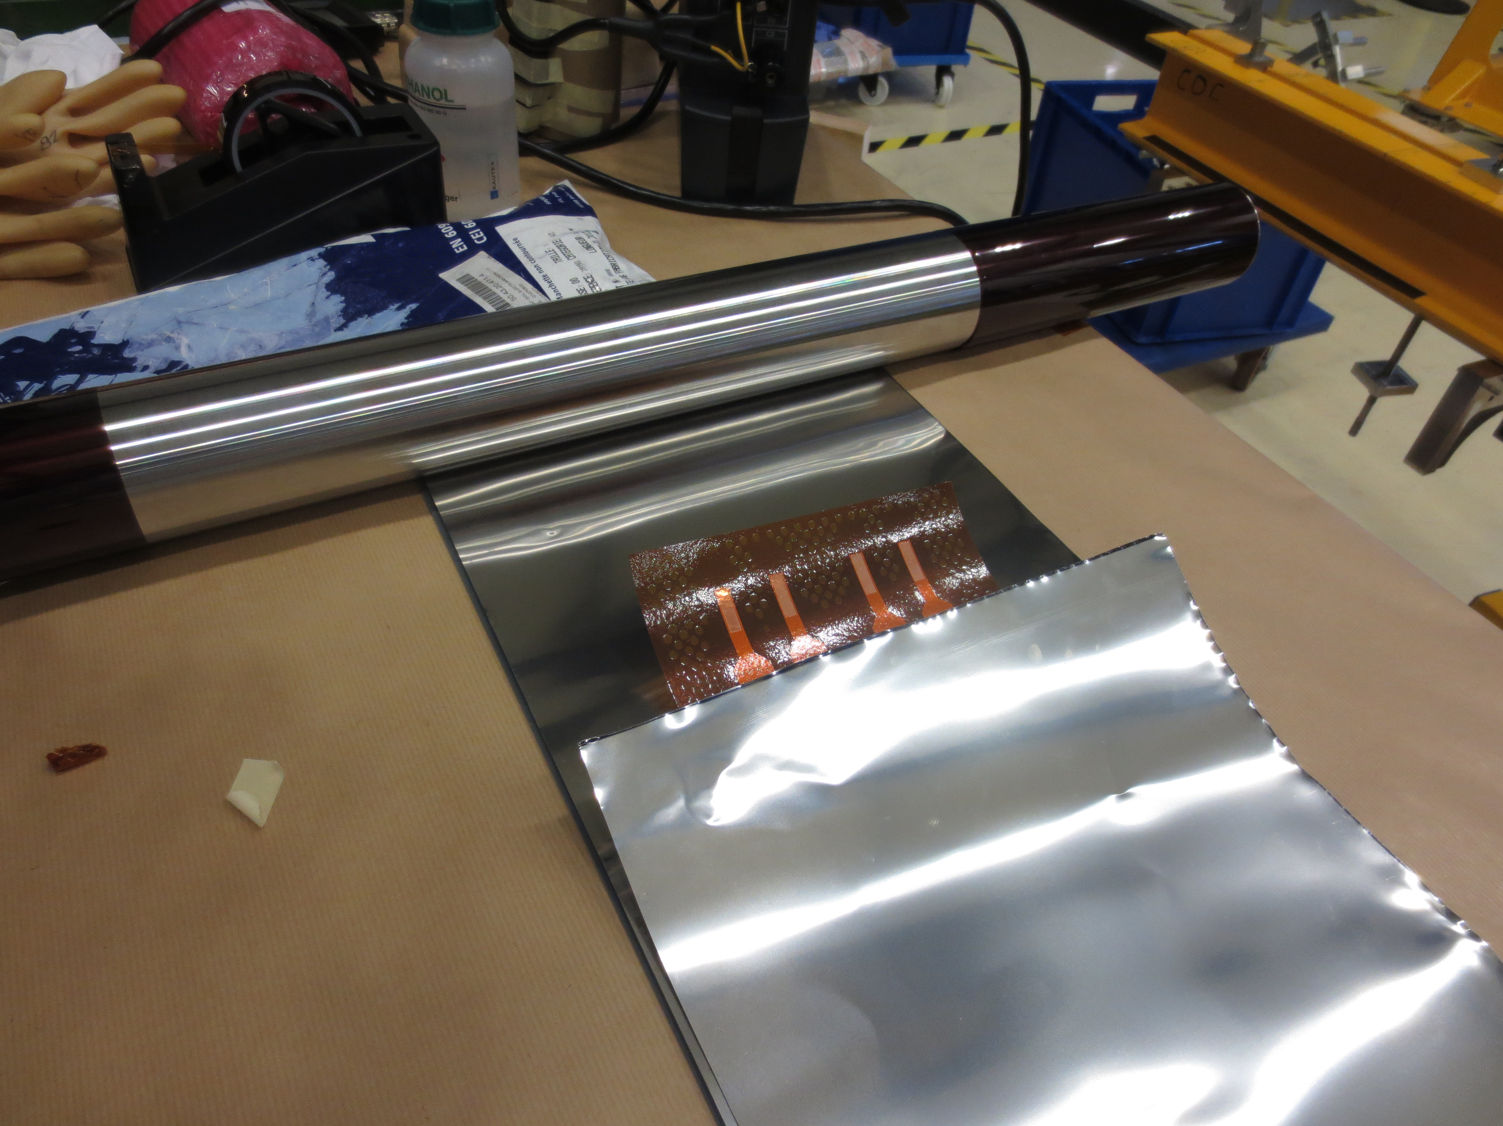
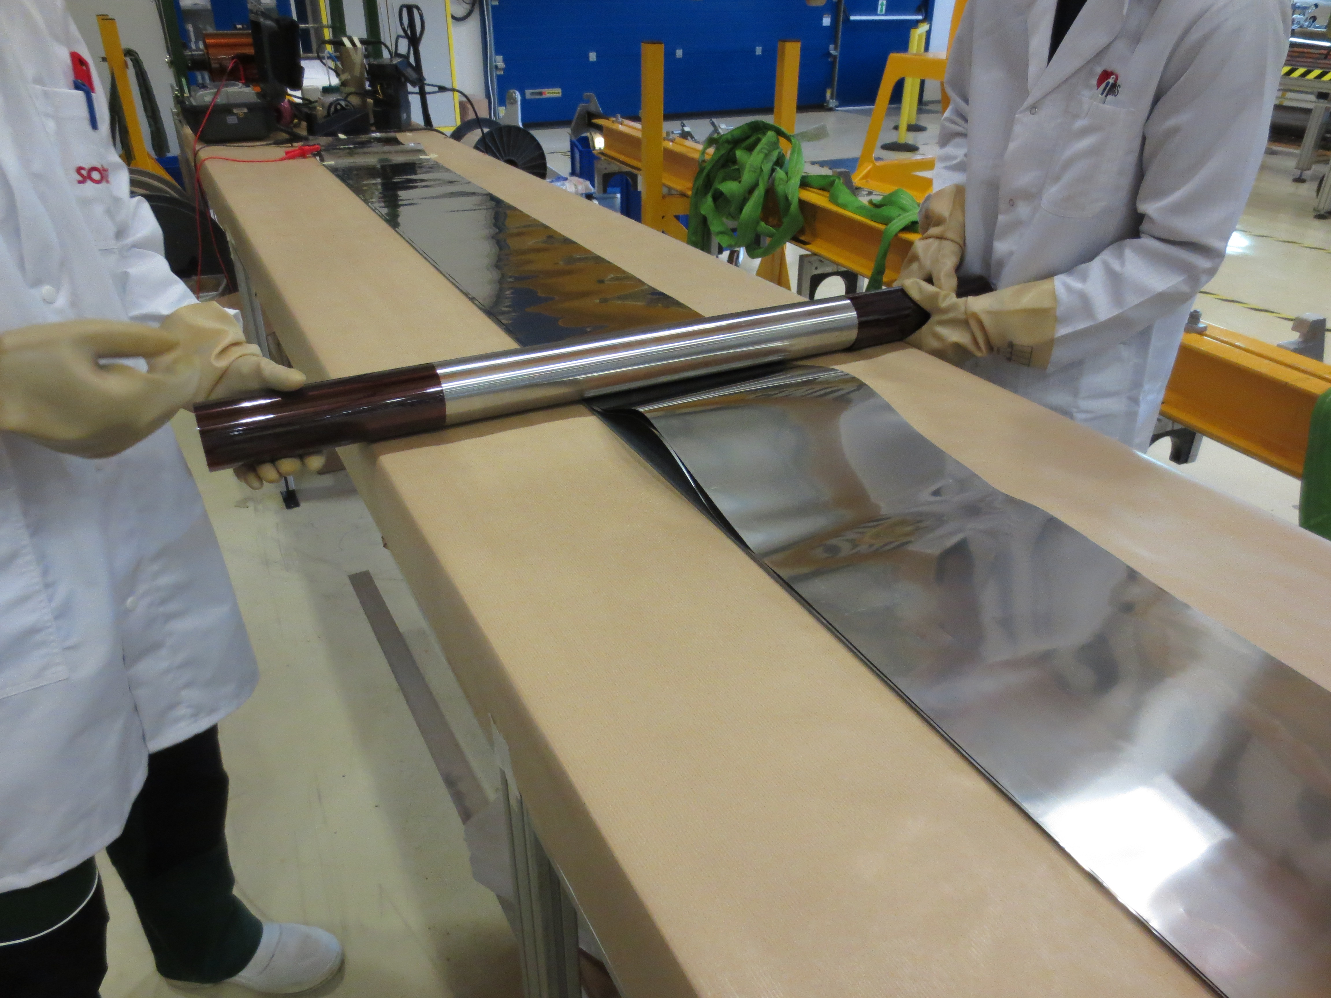
HV Test Set Up (Attempt with rollers)
LHC heaters were qualified under pressure (around 20 MPa, see EDMS 316296)→ similar set up was developed to qualify 11 T heaters. Abandoned:
Risk of perforating the trace if small particles are present in the table
Risk to damage in case of bad alignment of the cylinder.

Slide 4
Spec Dielectric checks in LHC heaters

Slide 5
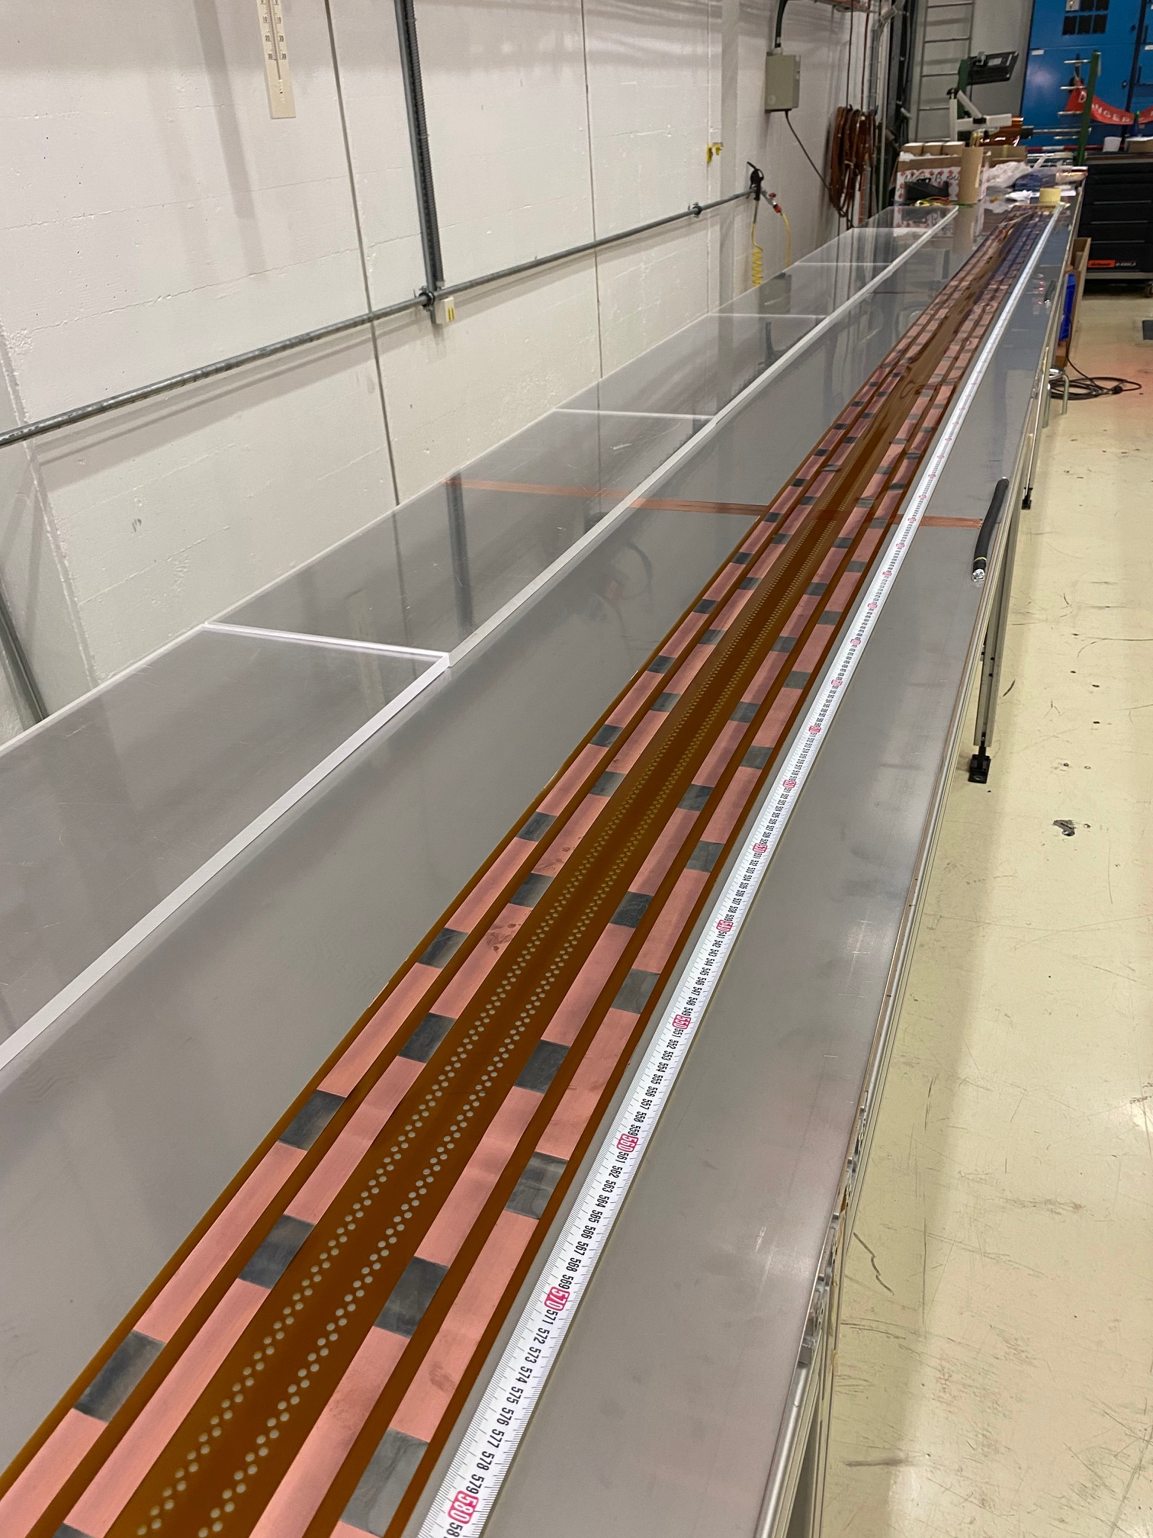
HV Test Procedure - CERN
The current solution for HV test is to test the heaters in a stainless steel plate under slight weight (plexi)
Test device: Megger S1-5010
Test voltage: 3.7 kV (same voltage level they need to pass in the coil).

Slide 6
HV Test Report (Example)

Slide 7
HV – Test level
After the NC in coil 114, the test voltage level of the trace was questioned. Should we test to slightly higher voltage level? (for example, +20% → 4.4 kV):
3.7 kV are considered sufficient to detect any defect on the polyimide below the heater → going to higher voltage will not bring added value.
Risk of breakthrough the surface:
Prototype heaters: 4 mm HF heater to hole, 5 mm LF heater to edge
Series heaters: 10 mm HF heater to hole, but still 5 mm LF heater to edge
One of the first series heaters was qualified to higher voltage level (see EDMS 2384489)
First HV to 3.7 kV showed two pin-holes, which were repaired using 50 mm wide and 50 µm thick polyimide tape.
After reparation, the trace passed the test at 3.7 kV, 4.4 kV and 5 kV.
Outcome:
Confirm the statement that test at higher voltage does not show defects not visible at 3.7 kV
How much risk are we adding in the heater when increasing from 3.7 kV to 4.4 kV?

Slide 8
Production flow (prototype coils)
Quality control on the QH upon reception from manufacturer, including production data, resistance measurements, high voltage and visual inspection (example EDMS 2360125, quench heater quality control report) → Component is accepted by Christian Scheuerlein and stored until it is needed for installation in the coil.
All Hi-Lumi QH are produced by the same manufacturer (CERN PCB lab and Trackwise). See EDMS 2346140
Before installation in the coil, trace is taken from the stock, unrolled in the QH preparation table, and production team performs a visual inspection.
The trace is then placed on top of the coil in order to define the locations of the VTAPS and windows to glue the trace
The trace goes back to the QH preparation table where we do the final preparations (removal of the copper patches on the sides, vtaps holes…)
The trace goes back to the coil, we do the final installation

Slide 9
Production flow (series coils)
Screening of the heaters upon reception (Christian)
Before installation in the coil, trace is taken from the stock, unrolled in the QH preparation table, and production team performs a visual inspection.
Electrical team does the final qualification of the trace with the high voltage test → Component is accepted by Christian Scheuerlein
Production team does the final preparations in the QH preparation table (since we don’t have internal VTAPS any more, we think we can do it without placing first the trace on the coil)
QA team performs a final visual inspection including pictures of both sides of the quench heater
The trace goes (for first time) to the coil, we do the final installation

Slide 10
Defect Catalogue (1)
Around 1/3 of MQXFB heaters, have pin holes
Before Summer 2018, holes were repaired using self adhesive Kapton tape and they were used in the coils
After the problem in the 11 T prototype, heaters are still repaired but they are not used in coils. Concerns:
Over-thickness on the location of the default
Introduction of a weakly bonded surface with might end in a more likely location for short quench heater to coil after cool down, powering and quench.

Slide 11
Defect Catalogue (1)
We agree on a repair procedure (that does not mean that we have to agree that repaired heaters will be used, we can for the moment only use not repaired heaters , and decide this later)
We are exploring now a more solid repair procedure with the PCB lab.
The heaters are repaired immediately after the HV test according to this procedure
The team performing the HV test takes photos and adds them to the test report .
The test report is uploaded in EDMS.
WPE decides later what to do with the repaired heaters.

Slide 12
Reparation last heater
QH211
QH212

Slide 13
Defect Catalogue (2)
Polyimide joint in some traces (see EDMS 2346140)
If the joint is in the straight section, it is rejected
If the joint is in the ends, discussion on-going

Slide 14
Defect Catalogue (3)
Small (few mm) scratches in the copper:
If surface is smooth, accepted
If the stainless steel base material is damaged, further investigation needed.

Slide 15
Additional slides

Slide 16
Design | 10 K | 75 K | 150 K | 300 K
Polyimide BD Voltage (50 um) |  |  |  | 11200 V
He BD (4 mm) | 11000 V | 2500 V | 1500 V | 900 V
Table 3: Breakdown (BD) voltages for 50 um polyimide layer and 4 mm He direct path.

