Slide 1
Issue and autopsy on coil CR114
N. Lusa
18 June 2020

Slide 2
Outline
Description of the issue:
Localisation
Microscopic analysis
Repair process
Conclusion

Slide 3
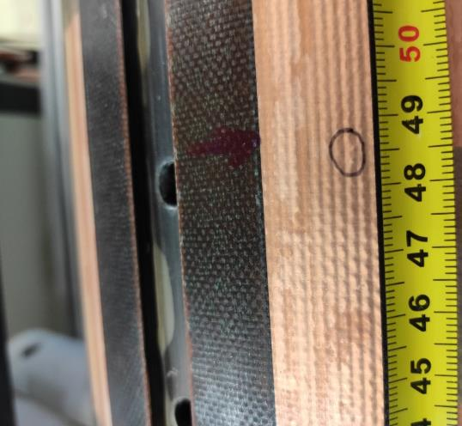
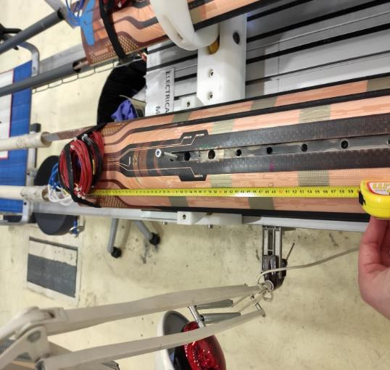
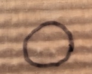
Description of the issue: localisation
During the acceptance electrical test of the coil, an electrical weakness was detected: low insulation resistance between quench heater circuit QH213 and MQXFB coil CR114 (all details about the non-conformity can be found on EDMS, document n° 2377455).
The default was localized using an ohmmeter connected between the coil and QH213, and by applying a finger pressure along the QH213 strip until a change in resistance was detected (localization at 485mm from LS).

Slide 4
Outline
Description of the issue:
Localisation
Microscopic analysis
Repair process
Conclusion

Slide 5
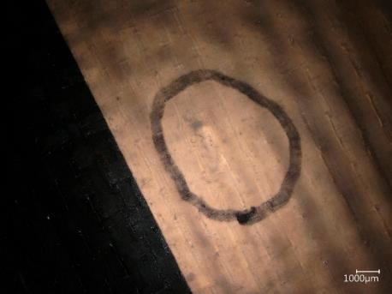
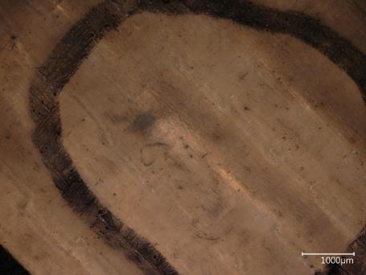
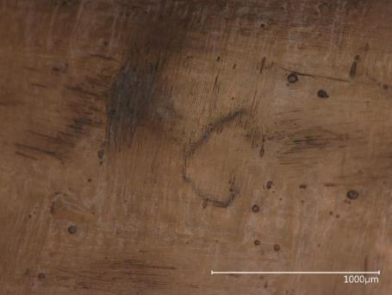
Description of the issue: microscopy analysis
An analysis of the quench heater area where the insulation weakness was localised with a microscope has been performed, but unfortunately the examination of the surface could not bring much more information.

Slide 6
Outline
Description of the issue:
Localisation
Microscopic analysis
Repair process
Conclusion

Slide 7
Repair process
The insulation weakness was possibly caused by a hard particle (if any) between coil and quench heater circuit that may have damaged the polyimide insulation under external pressure, so the assumption is figured here below:
Different solutions have been tested and finally the one decided was the local chemical etching of the heater circuit around the defective area using ferric perchloride to chemically attach the metallic strip of the QH after having scratched the surface till the copper of the QH.
OUTER DIMENSION OF COIL
CC
COC
CABLE
3 LAYERS FIBRE GLASS + EPOXY
PARTICLE
QH

Slide 8
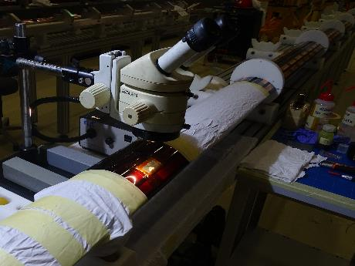
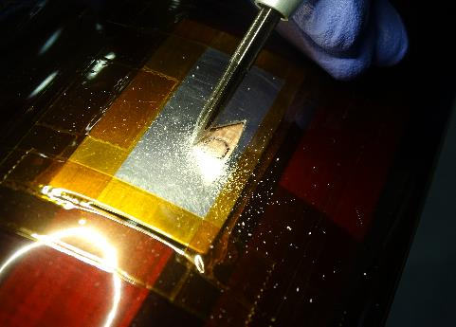
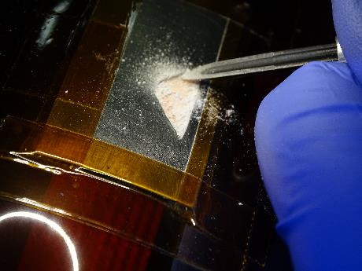
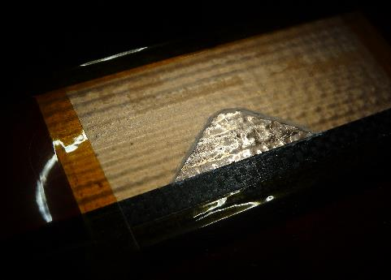
Repair process
After having set the working place and protect the coil, starting from the surface, the external fiber glass layers mixed with epoxy were manually scraped until the copper of the QH with the constant use of a microscope.

Slide 9
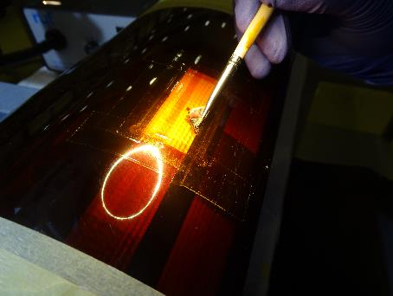
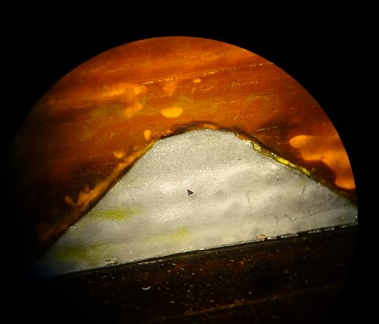
Repair process
With the copper exposed, it has begun the chemical etching of the strip with the use of ferric perchloride.
This step required the frequent refreshing of
the chemical and the cleaning of the area
with distilled water and iso-propylic alcohol
in order to neautralize the action of the etchant.
A few minutes after the application of the chemical product, a small hole located in correspondence of the “bump” observed during preliminary control was found.
This hole is exactly on a turn of the coil.
Revealed hole in the stainless-steel strip

Slide 10
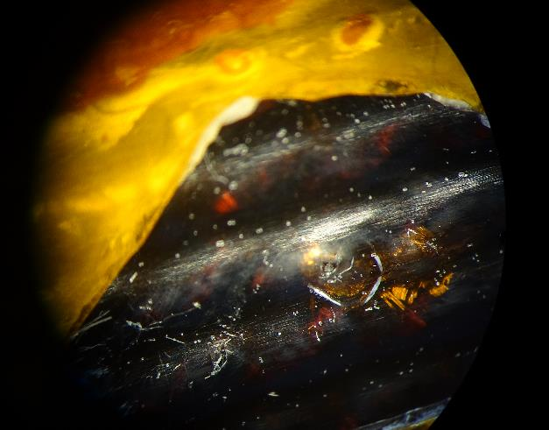
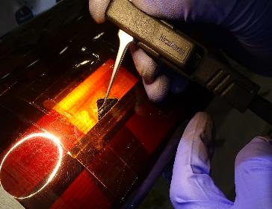
Repair process
Once the circuit area was etched away, we had the opportunity to better see the dark spot revealed before.
At this point, an electrical check with a multimeter was performed connecting one wire to a lead and the other to the concerned spot and a “beep” was heard. That led us to two possible conclusions:
An external particle was in contact
with the cable.
We were touching the cable.
Polyimide layer of the QH
Dark spot

Slide 11
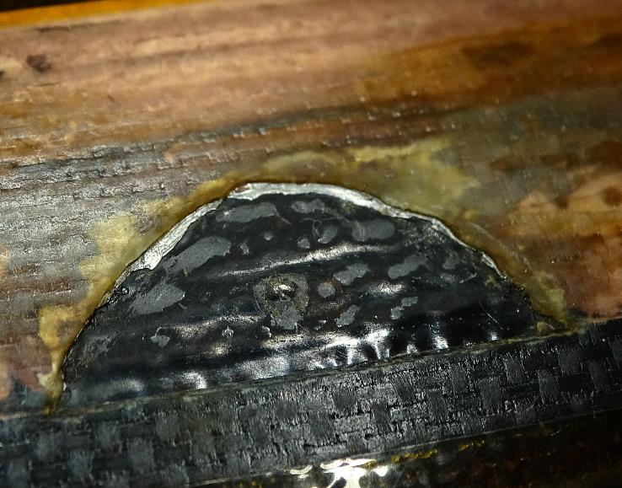
Repair process
After having completely removed the metallic layer of the QH, a Hi-Pot insulation test electrical test was performed: 500 V QH213 to coil, passed and the measured resistance was 12.8 GΩ.
In accordance with the work package engineer, it was decided to keep going with the investigation of the defect.
Surface of the coil
Polyimide insulation of the QH
Cable
Limited area of intervention where polyimide insulation of the QH has been removed

Slide 12
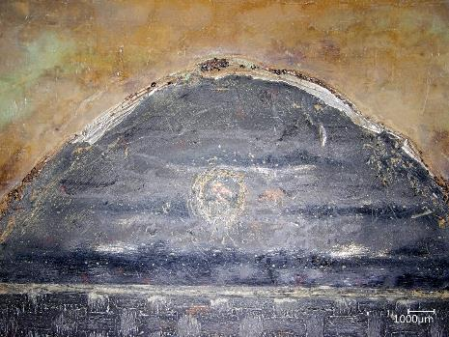
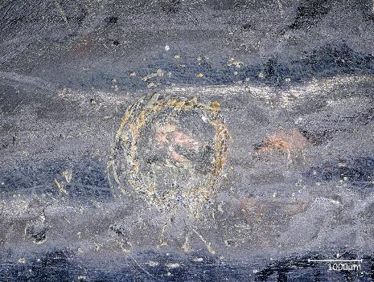
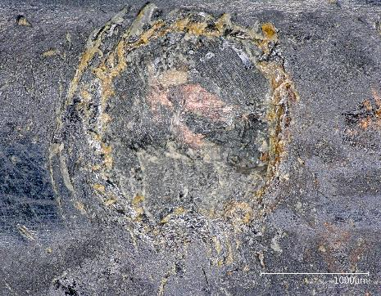
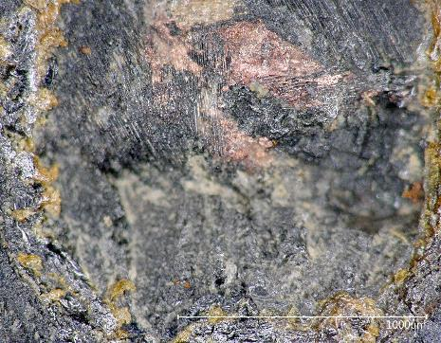
Repair process
During the delicate scraping of the polyimide film, no external particle has been observed. In order to verify the hypothesis that it was the cable and to check its status, a microscopy analysis was performed.
Fiber glass insulation around the cable
Cable
Cable
Polyimide layer of the QH

Slide 13
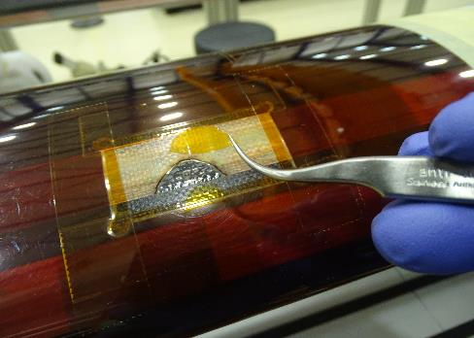
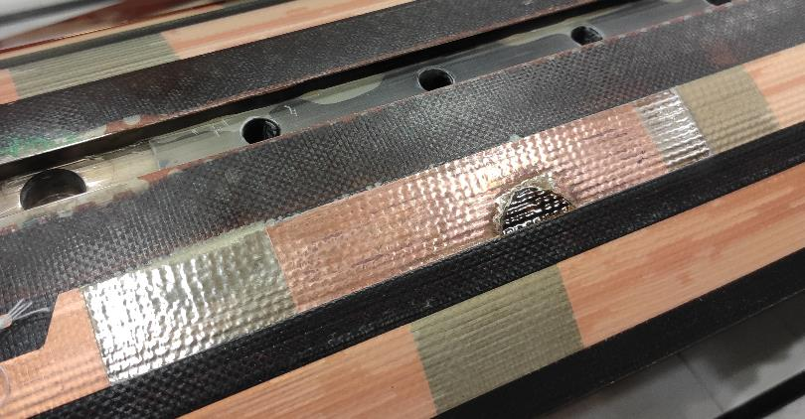
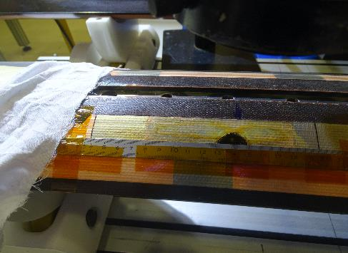
Repair process
In order to better clean ferric perchloride that migrated between fiber glass + epoxy and metallic strip of the quench heater, it was decided to scrape a bigger area at the surface of the coil.
Polyimide tape to protect and insulate the cable
Metallic strip of the QH cleaned with distilled water and iso-propylic alcohol

Slide 14
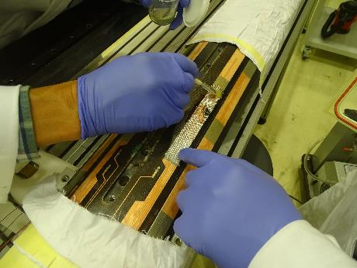
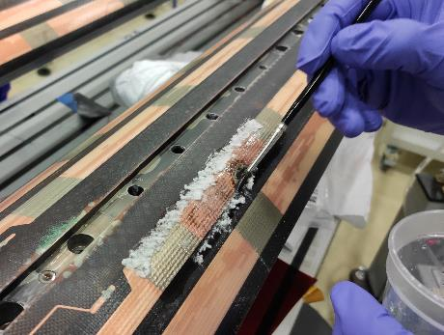
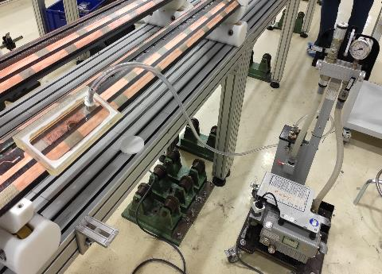
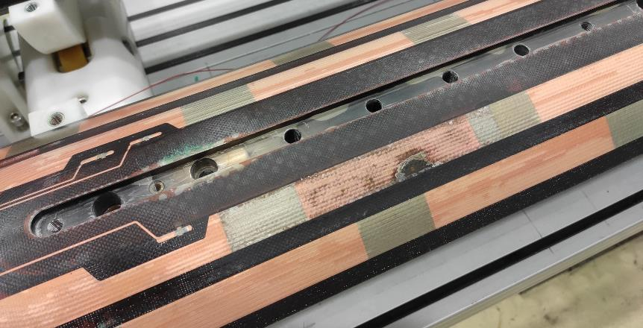
Repair process
Local impregnation under vacuum of the affected area with fiber glass (both sheets and crushed) and epoxy resin (50% Araldite MY-750 and 50% Jeffamine D-40).

Slide 15
Outline
Description of the issue:
Localisation
Microscopic analysis
Repair process
Conclusion

Slide 16
Conclusion
Two different hypothesis could be formulated:
A small external particle was trapped between the quench heater and the coil during the preparation for impregnation and was impregnated. Due to the dark colour of the fiber glass insulation around the cable after reaction and the small dimensions of this external particle, it passed unnoticed. Most probably, this external particle pierced the polyimide layer of the quench heater due to the pressure involved during the closing of the fixture. During the acceptance electrical test of the coil, due to the energy released, the external particle could have been burnt causing a hole on the stainless-steel of the quench heater, explaining why even at lower tension the test didn’t pass.
A pin hole was already present in the mid-right strip of the QH, that had passed unnoticed due to the microscopic dimension of the defect. During the acceptance electrical test of the coil an anomalous behaviour was observed, that could be explained by the epoxy resin itself: at 500 V the thinner layer of fiber glass mixed with epoxy (145μm in theory) has well insulted the cable from the QH but increasing the tension to 3.7 kV the thickness of this layer wasn’t enough to guarantee a proper insulation due to the pre-existing pin hole in the polyimide film of the QH.

Slide 17
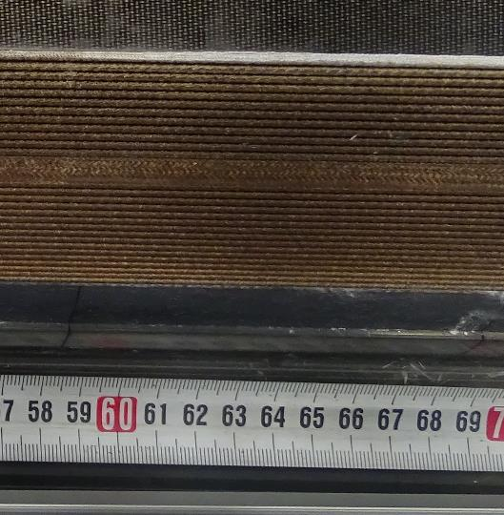
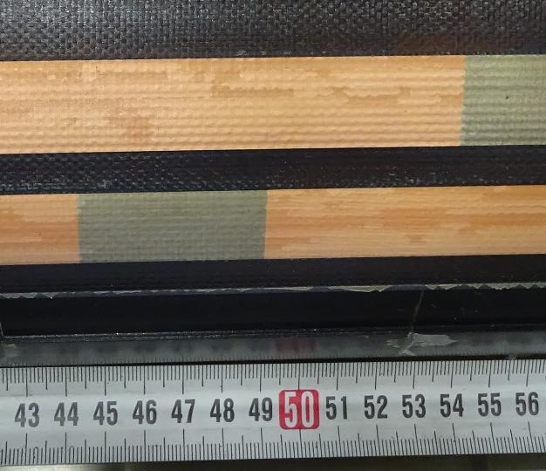
Conclusion
Checking the pictures taken by QA team after reaction and after impregnation with the coil on the base plate, the evidence is that any defect was observed.
After reaction After impregnation
The beginning of the measure after reaction does not match with the beginning of the measure taken after impregnation as the reference isn’t the same so the defect (if any) is located at about 630mm.

Slide 18
Thank you

