Slide 1
QXFA Trace Hipot Procedure
Marcellus Parker
HL-LHC AUP
June 18, 2020

Slide 2
QXFA Trace Hipot Procedure
Clean granite table with using isopropyl alcohol using wipes
Place 2 layers of 5 mil Kapton (15.5’ x 1.5’) atop the table for electrical insulation. Clean with isopropyl alcohol.
Remove trace from packaging – place on table and clean thoroughly with isopropyl alcohol (both faces) using chem wipes.
** Prior QC Steps include an inspection of trace VT flags, heater build quality, and electrical resistance. (Discussed in extra slides)
Place trace, heater facing down (smooth Kapton facing up), onto of the two layers of 5 mil Kapton.
Lay a small cut-out of SS foil (1 mil thick & approximately the same width as the trace) between the LE edge of the trace and Kapton-insulated granite table. Repeat this process on the RE
Use a Kapton insulated flat weight (A Steel Block is used at FNAL) to ensure contact between foil, trace, and voltage flags on the LE and RE. Allow for small section of foil to extrude from trace material on the LE only.
Using alligator connection, connect the SS foil (LE only) to the HV port (red) wire that connects to the red HV terminal on the Hypot Ultra 7850.
Connect the grounding brush to the grounding terminal (black) of the Hipot machine.
Using the program labeled “QXFA Trace”

Slide 3
QXFA Trace Hipot Procedure
Load the program labeled “QXFA Trace” on the Hypot Ultra. Check to unsure the following setting are established:
Voltage type: DCW (DC Withstand)
Voltage: 3700 V
HI-Limit: 10 µA
LO-Limit: 0
Ramp Up: 4.0 s
Dwell Time: 0.0 s
Ramp Down: 0.02
Charge Lo: 0.0 µA
Arc Detection: Off
Arc Sense: 5
Ramp Hi: 0.0 µA
Offset: 0.0µA
Continuity: Off
Range: Auto
Low Range: Off

Slide 4
QXFA Trace Hipot Procedure
Using the proper PPE (Gloves rated to > 7.5 kV) turn on the Hypot Ultra, and slowly sweep the grounding brush along the heaters and LE voltage taps.
Continue down the span of the trace going over each of the 4 heaters. (The “Brush” used at FNAL spans the width of the trace requiring only one sweep)
In the event of a Breakdown failure due to a pinhole in the Kapton, record its location, capture an image of it, and place a 1 mil layer of Kapton tape atop the pinhole. Perform the hipot again to affirm the troubled area has been repaired.

Slide 5
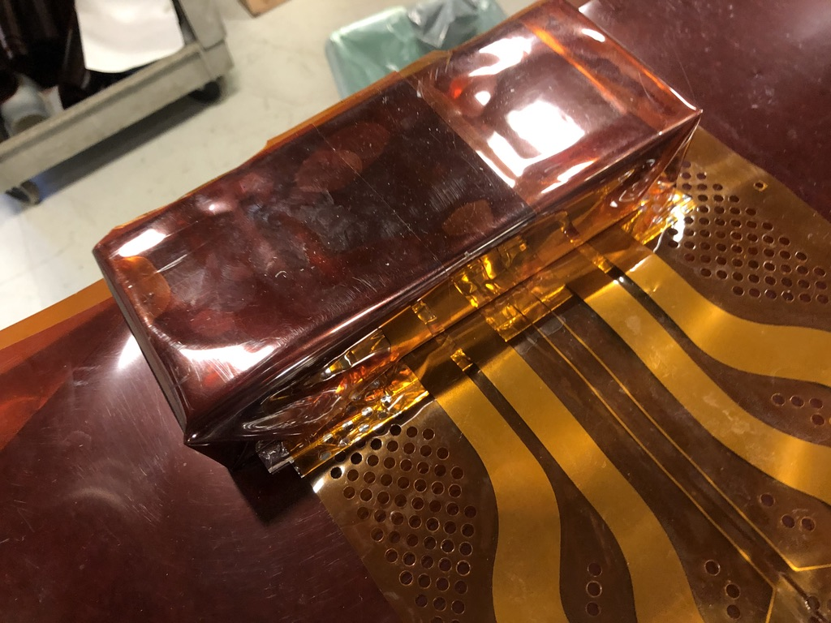
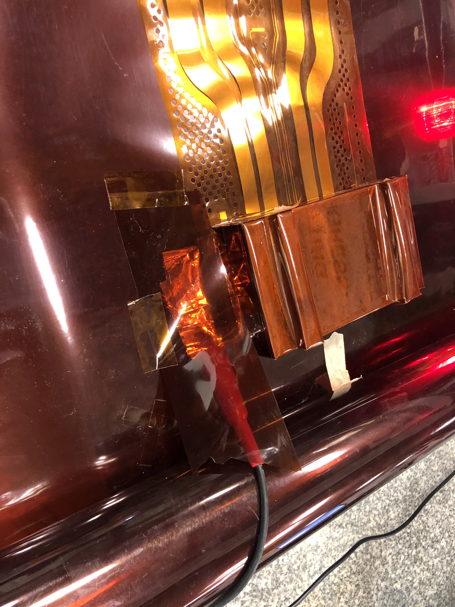
QXFA Trace Hipot Procedure
Kapton
Trace
Hypot ultra 7850
RE
LE
Granite Table
RE
LE

Slide 6
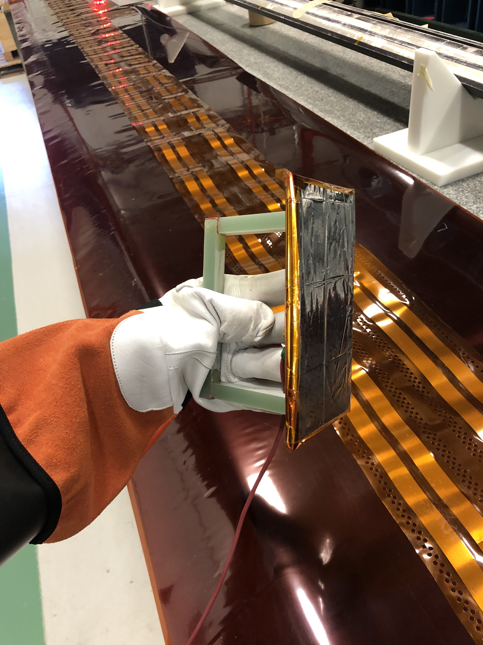
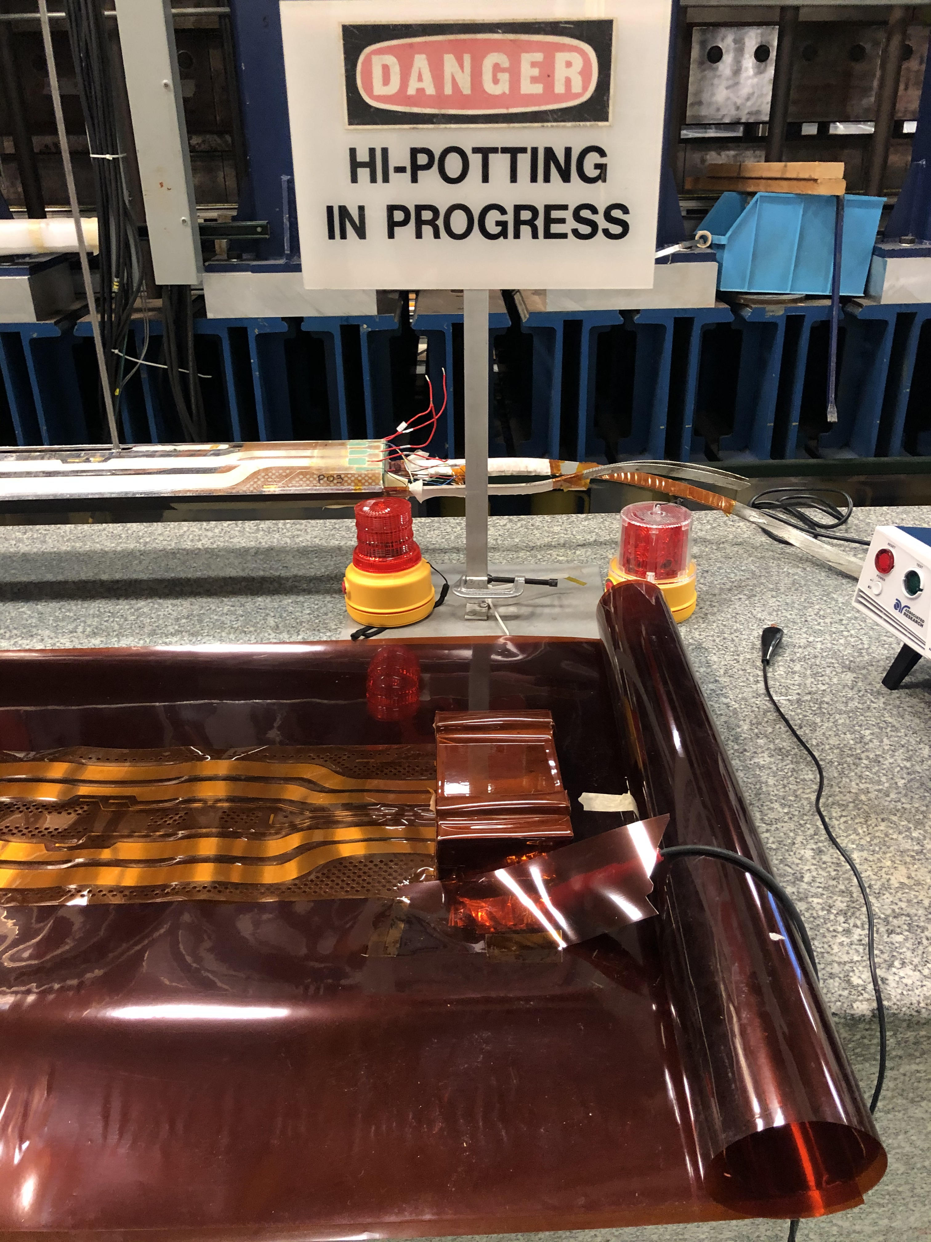
Hipot Procedure

Slide 8
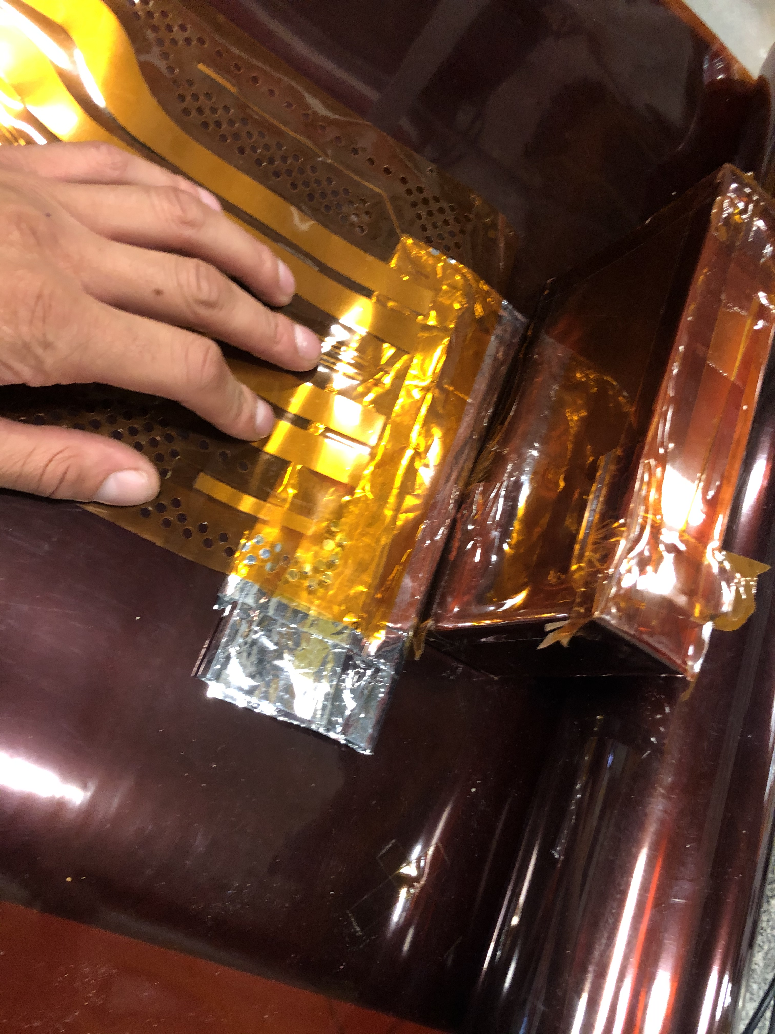
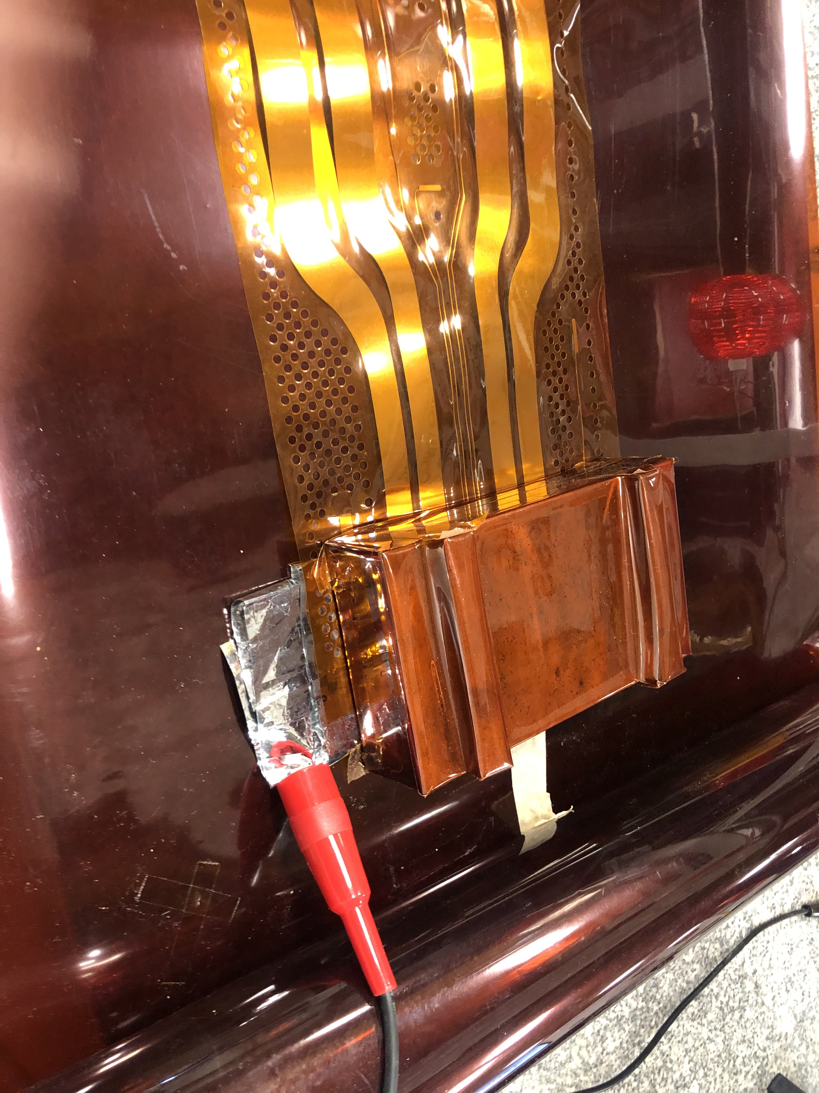
Extra Slides

Slide 9
Extra Slides – Trace QC Procedure
Wipe clean all surfaces with isopropyl
Using non-black permanent marker, write trace Serial Number on copper window (shown below)
Visually inspect both faces of the trace for obvious imperfections and report in Traveler
Measure trace W + Circuit L & W
Measure Hole to hole distance, Hole diameter, and Heater to hole or edge distance
Measure distance between inner and outer heaters.
Choosing three points at random Measure Kapton, Kap + SS, and Kap + SS + Cu thicknesses at LE, Mid, and RE
Conduct a 4-wire Measurement to all four heaters

