Slide 1
LBNF Hadron Absorber Preliminary Design Review LBNF Hadron Absorber Overview
Abhishek Deshpande
June 25 , 2020

Slide 2
Overview
Introduction
Scope of the Absorber
Requirements, specifications, and recommendations
Supporting documentation
Questions and discussion

Slide 3
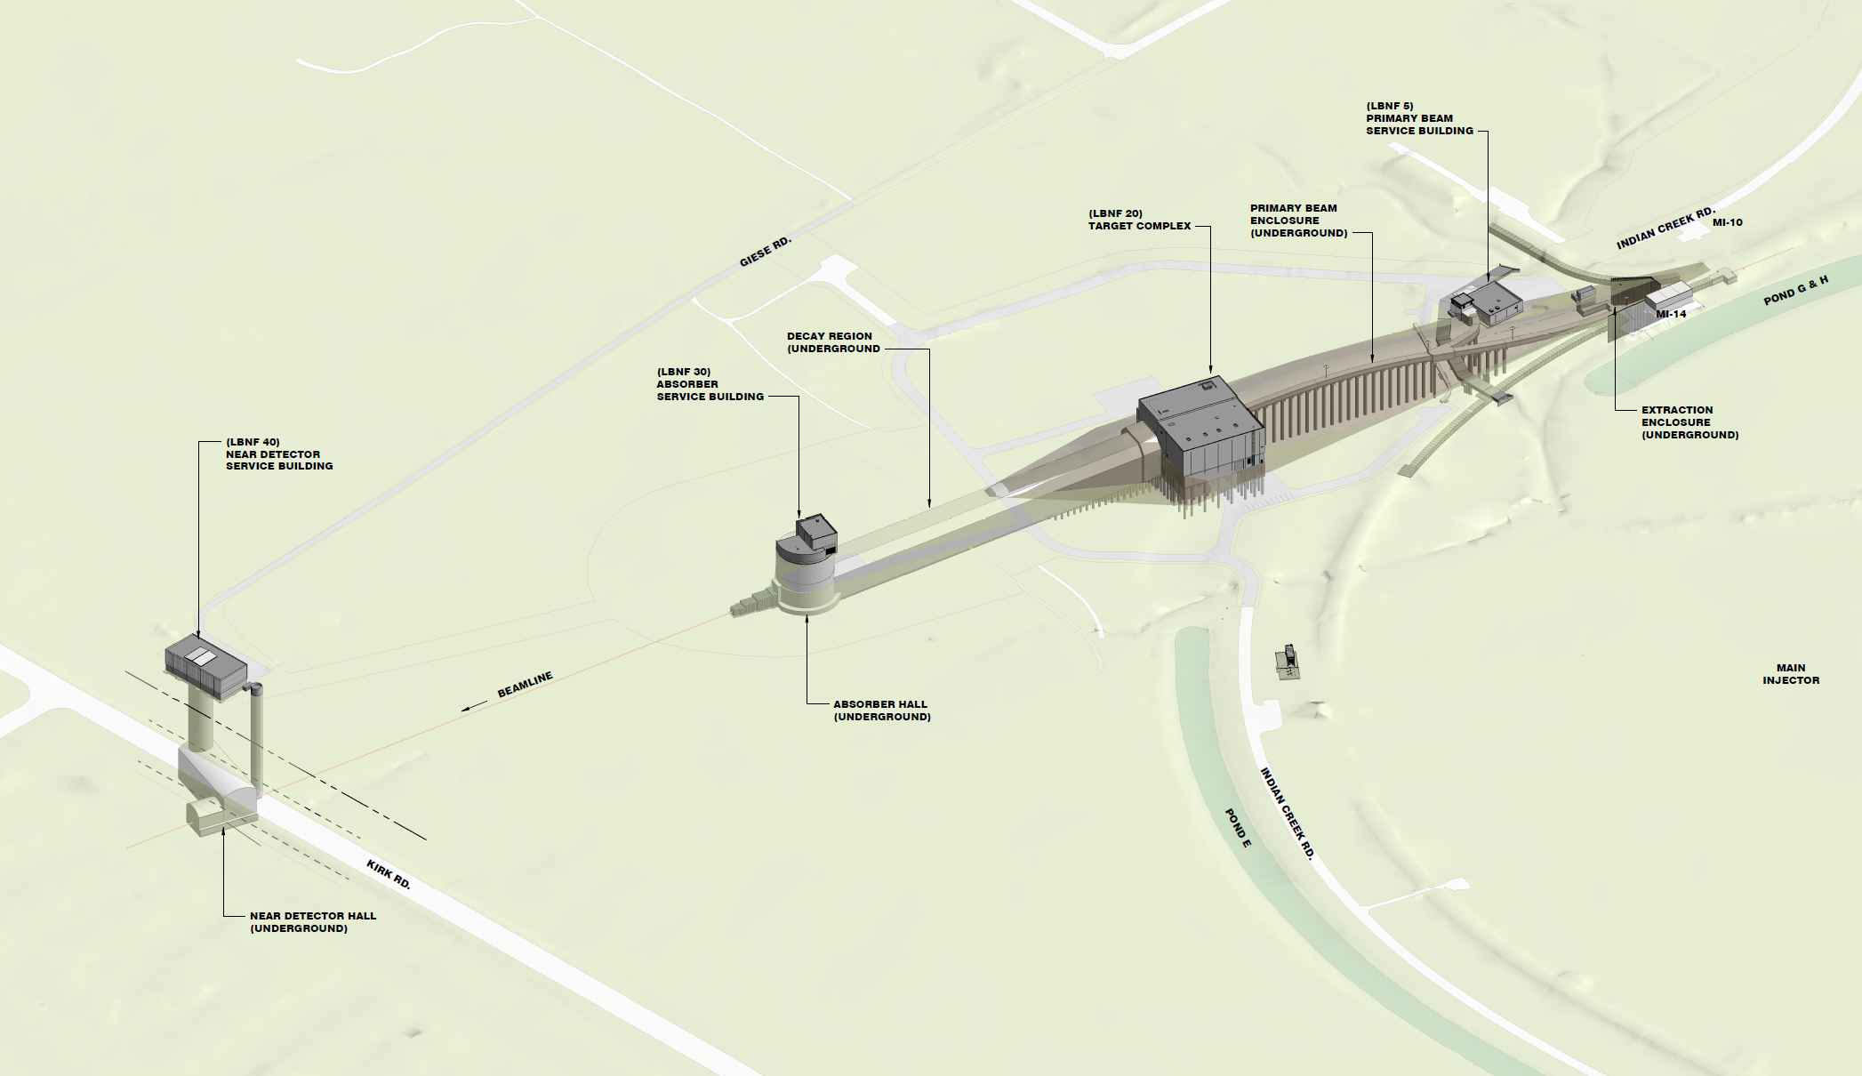
Introduction
Long-Baseline Neutrino Facility at Fermilab
Hadron Absorber located in Absorber Hall

Slide 4
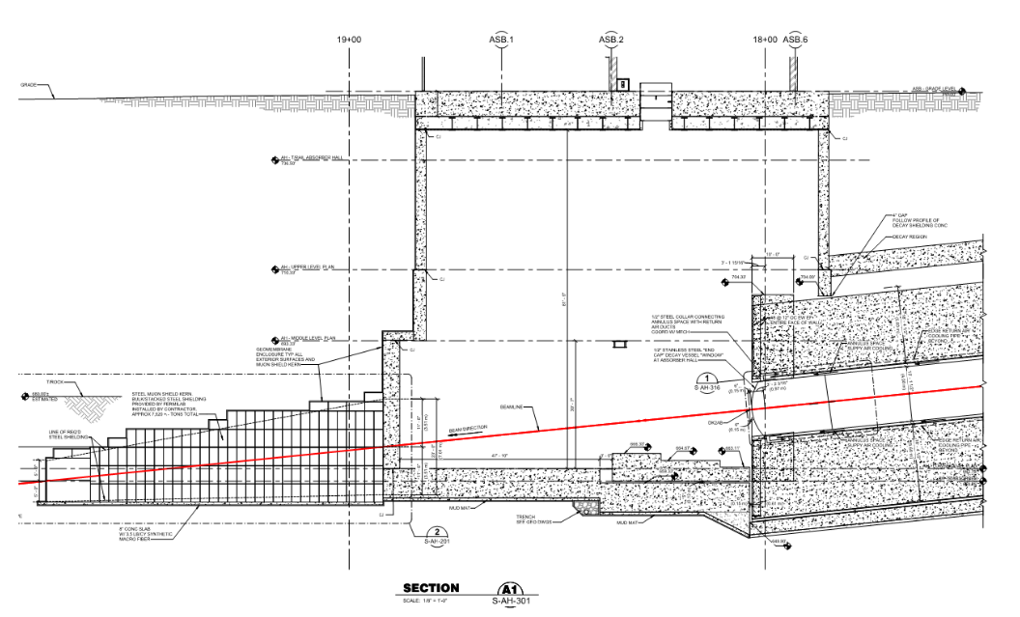
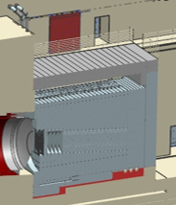
Introduction
Long-Baseline Neutrino Facility at Fermilab
Hadron Absorber Cross-section
Muon shielding steel
Muon monitor alcove
Hadron Absorber
Decay Pipe
Decay Pipe

Slide 5
Introduction: Hadron Absorber
Located directly downstream of the decay pipe –made up of actively cooled Aluminum and Steel blocks surrounded by concrete.
Provides radiation protection to people and keeps soil/groundwater activation levels to below allowable limits.
Designed for the worst case condition at 2.4 MW operation:
Shortest possible decay distance [221m from MCZero to end of decay pipe].
Helium filled decay pipe.
For a 1.5-m RAL style target.
Designed to sustain 2 successive beam accident pulses –interlock system limits the accident pulses to 1.

Slide 6
Scope of the Hadron Absorber
The scope includes the Absorber core and surrounding supporting steel structure.
Surrounding steel shielding.
Accident condition beam interlock system.
Remote handling system.
Hadron Absorber review scope excluding the Hadron Monitor

Slide 7
Requirements, specifications, and recommendations
The requirements/specifications of the Absorber are highlighted in: https://edms.cern.ch/document/2322285/2
They are:
Requirement | Description
Absorber - radiation protection | The absorber shall provide radiation protection to people, in compliance with the FRCM.
Absorber - energy absorption | The absorber shall absorb the energy of the particles exiting the decay pipe and transfer this energy away using an active cooling system.
Absorber - lifetime | The absorber shall keep its operational ability for the life of the LBNF experiment. Near Site Conventional Facility (NSCF or CF) life is 30-years. And, the LBNF/DUNE experiment life is 20-years.
Absorber - accident conditions | The absorber shall sustain the beam energy deposition under all accident situations that may occur with some reasonable probability.
AC - Absorber Bunker Liner | Beamline shall provide a 24 inch high, leak tight stainless steel pan liner at the bottom of the Absorber bunker

Slide 8
Requirements, specifications, and recommendations
…continued
Specification | Description
Absorber - accident pulses | The absorber shall sustain at least 2 successive accident beam pulses without damage to components or loss of functional ability.
Absorber - accident pulses | The absorber shall include an interlock system that limits the accident pulses to 1.
Absorber - dose rate | The absorber shall have a residual dose at 1 foot (measured from outside the absorber shielding) after 100 day irradiation and 4 hr. cooling that does not exceed 20 mrem/hr.
Cooling System - heat removal | The cooling system shall remove 473 kW of dissipated heat during normal operation. 233 kW using water cooling and 240 kW using forced air/gas ventilation system. This assumes a 1.5-m RAL Target at 2.4-MW beam operations.

Slide 9
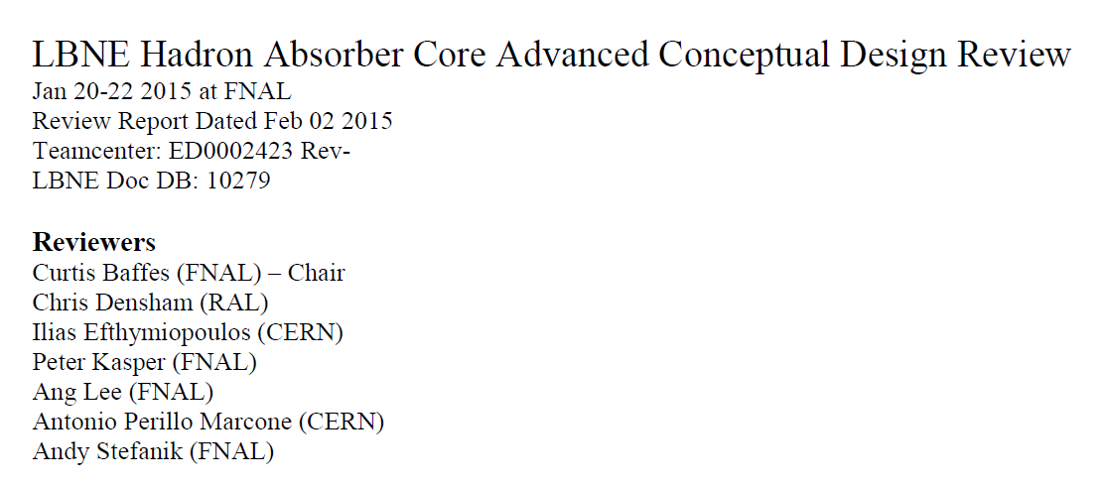
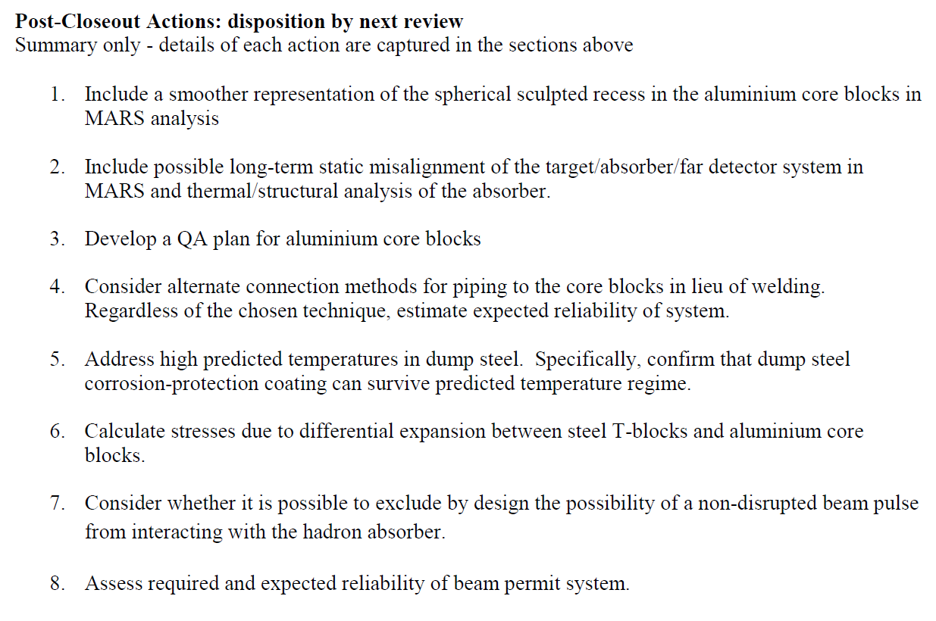
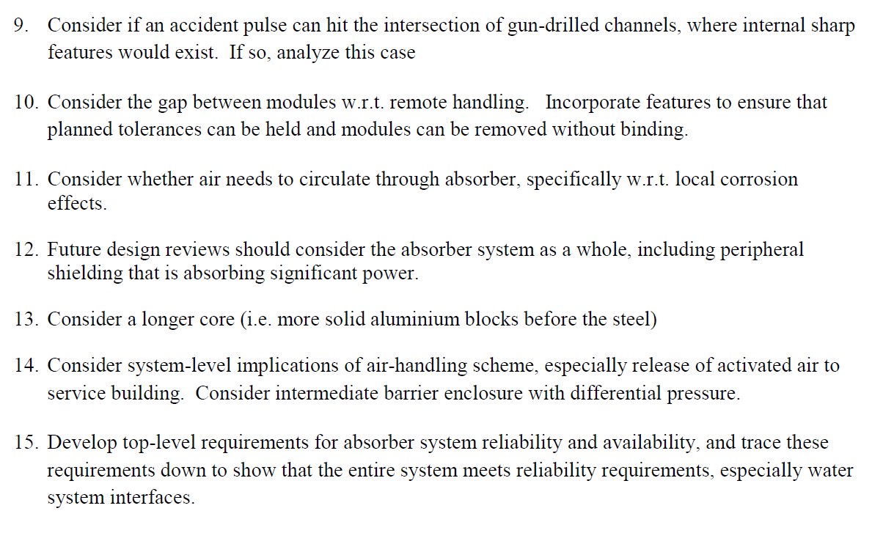
Requirements, specifications, and recommendations
Recommendations from the 2015 advanced conceptual review:
Lbne-doc-10279

Slide 10
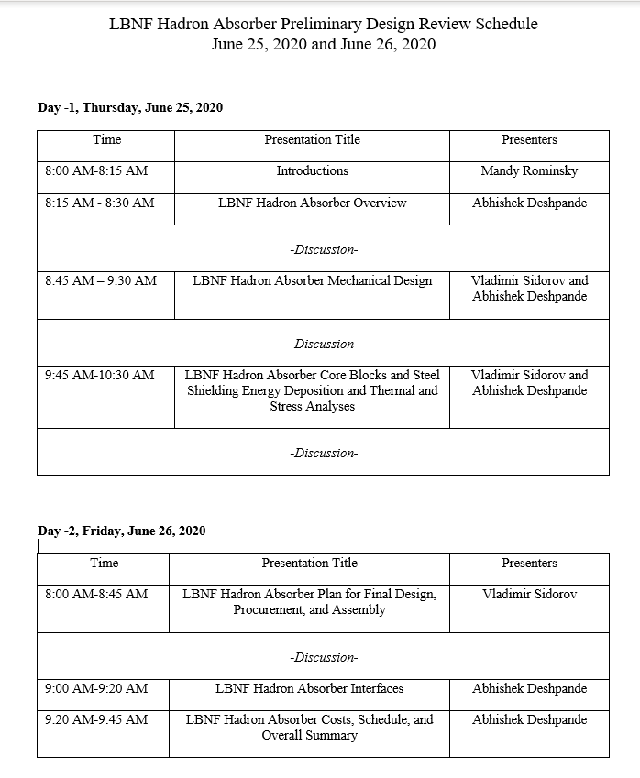
Supporting documentation
The supporting documentation for the design review has been assembled at: DUNE-doc-19734-v1.
During this review, we will show that the design meets the requirements.
Also, that previous review recommendations have been addressed.

Slide 11
Questions and discussion

