Slide 1
LBNF Hadron Absorber Plan for Final Design, Procurement, and Assembly
Hadron Absorber Preliminary design review
Vladimir Sidorov and Abhishek Deshpande
26 June 2020

Slide 2
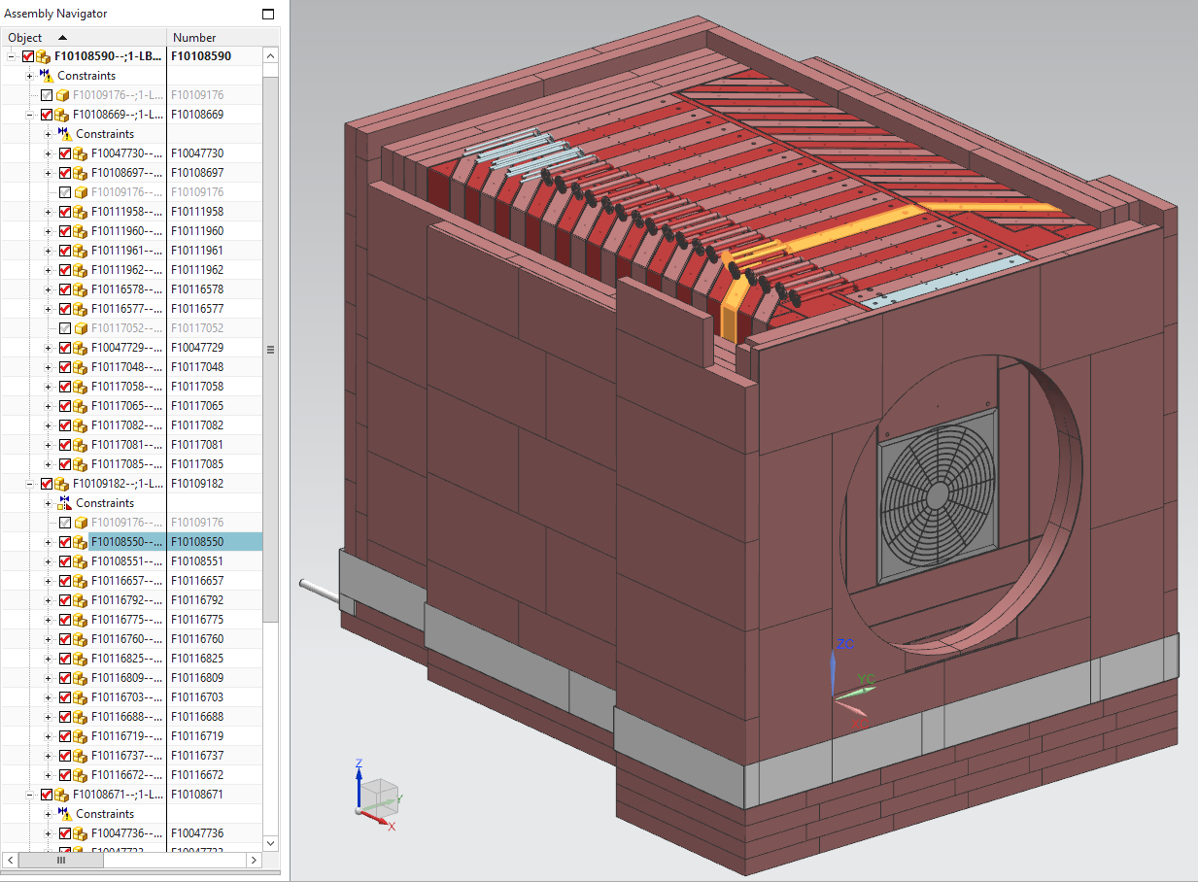
Absorber final design planning .
All Absorber components models and drawings are located in the Team center.
Before the absorber final design beginning the energy deposition in the Absorber Complex MARS calculations, the core blocks and steel shielding thermo and stress analyses, the absorber-decay pipe, the absorber-water cooling system, the absorber- air cooling system, the absorber –Hadron monitor interface have to be completed.
Absorber core
blocks and
shielding assembly

Slide 3
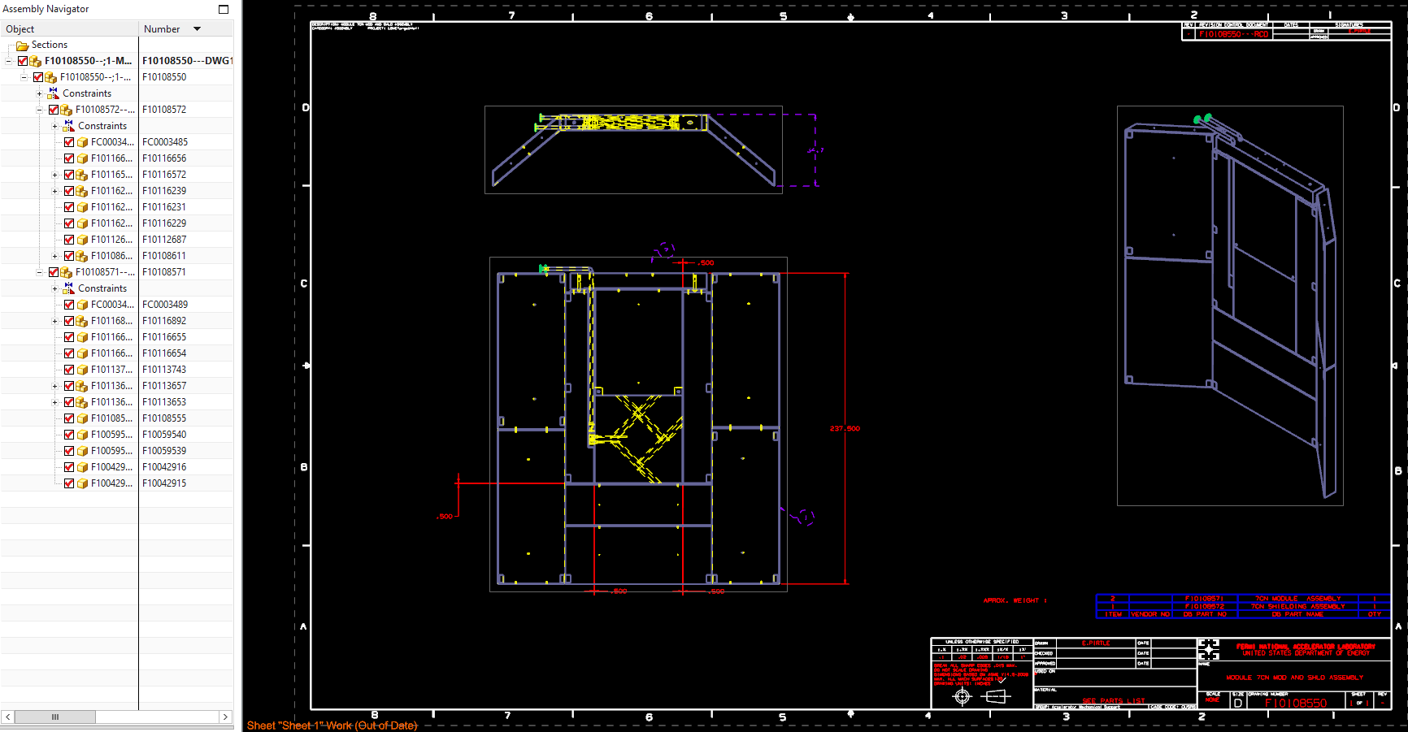
Highlighted assembly drawing F10108550

Slide 4
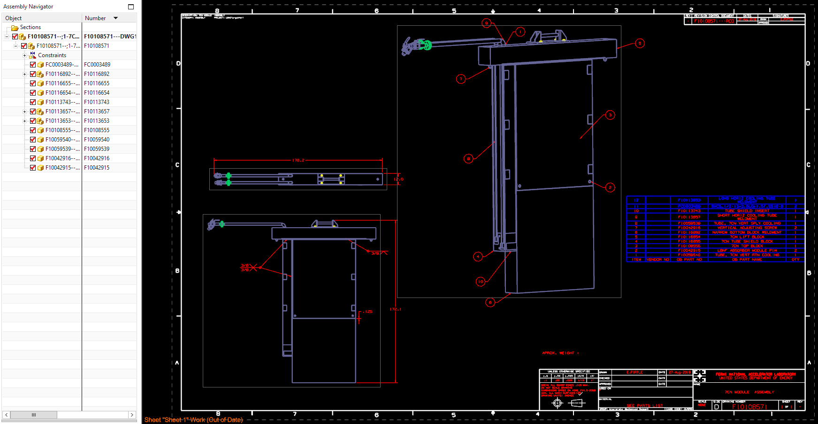
Module – Core block assembly drawing

Slide 5
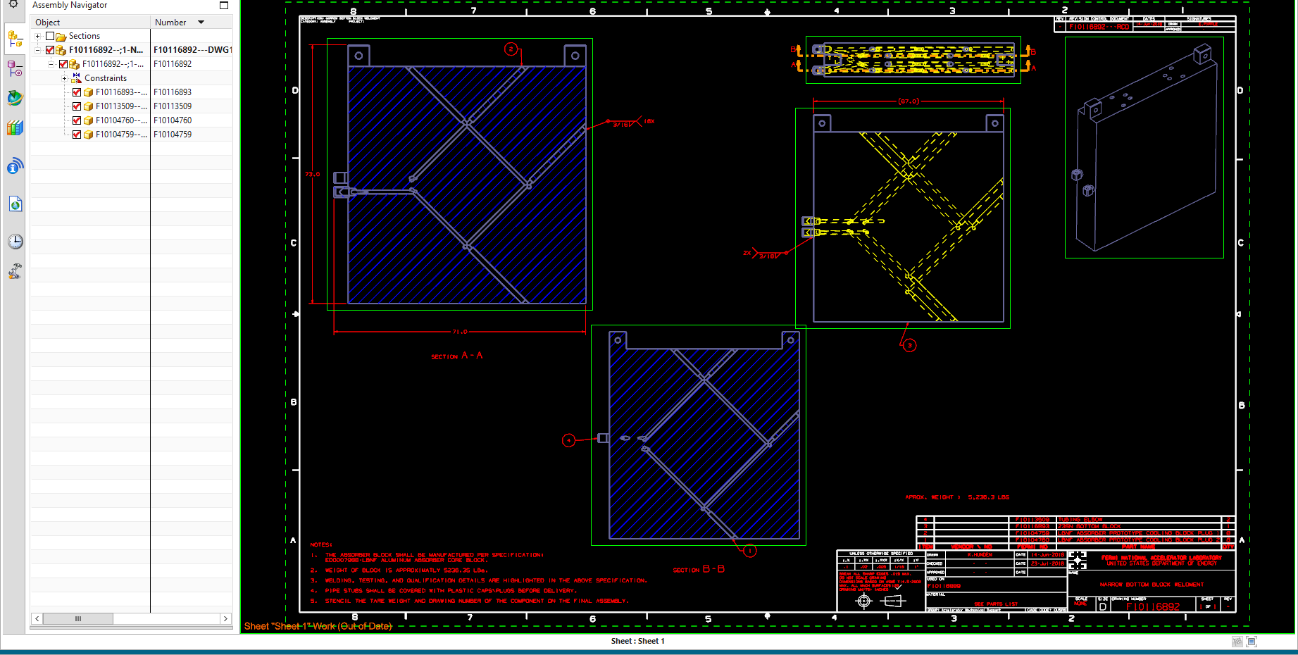
Core block weldment drawing

Slide 6
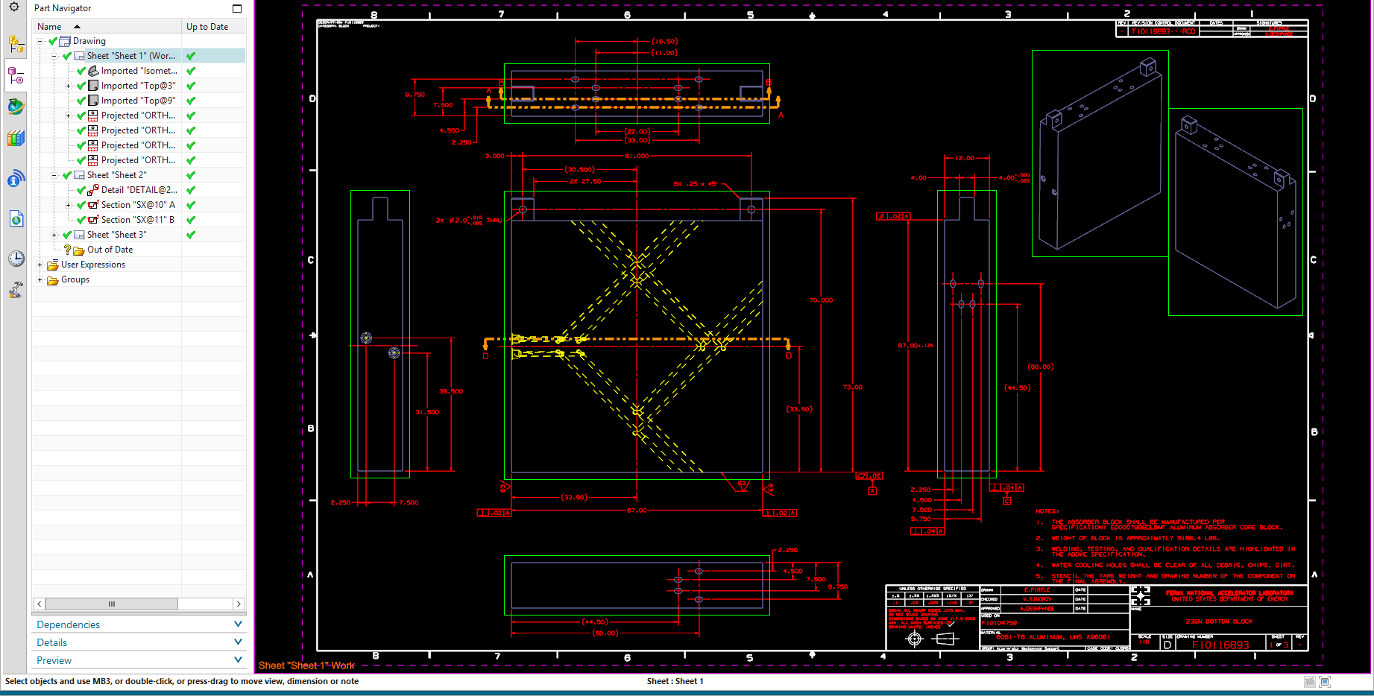
Core block drawing

Slide 7
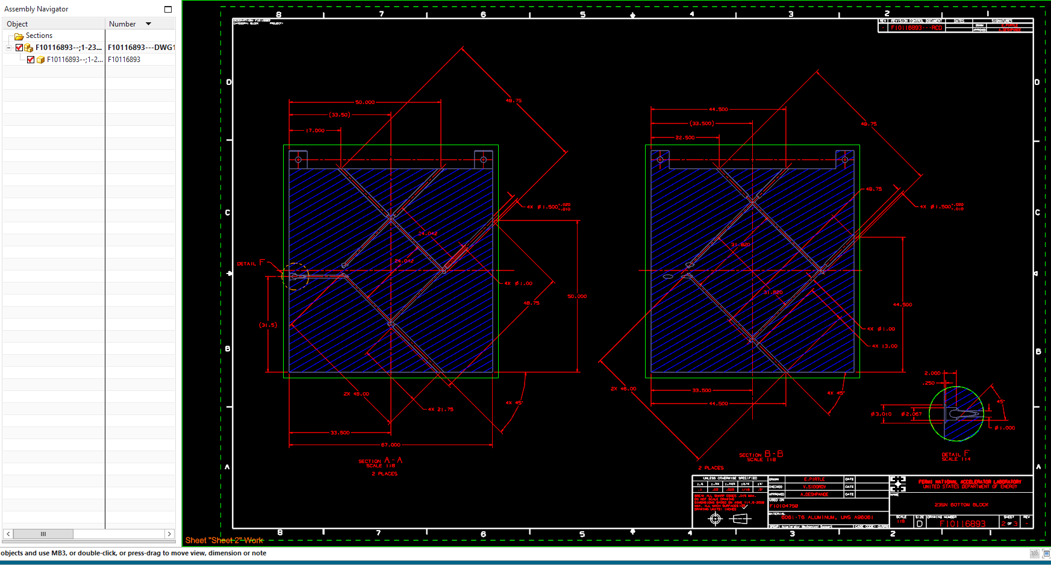
Core block drawing

Slide 8
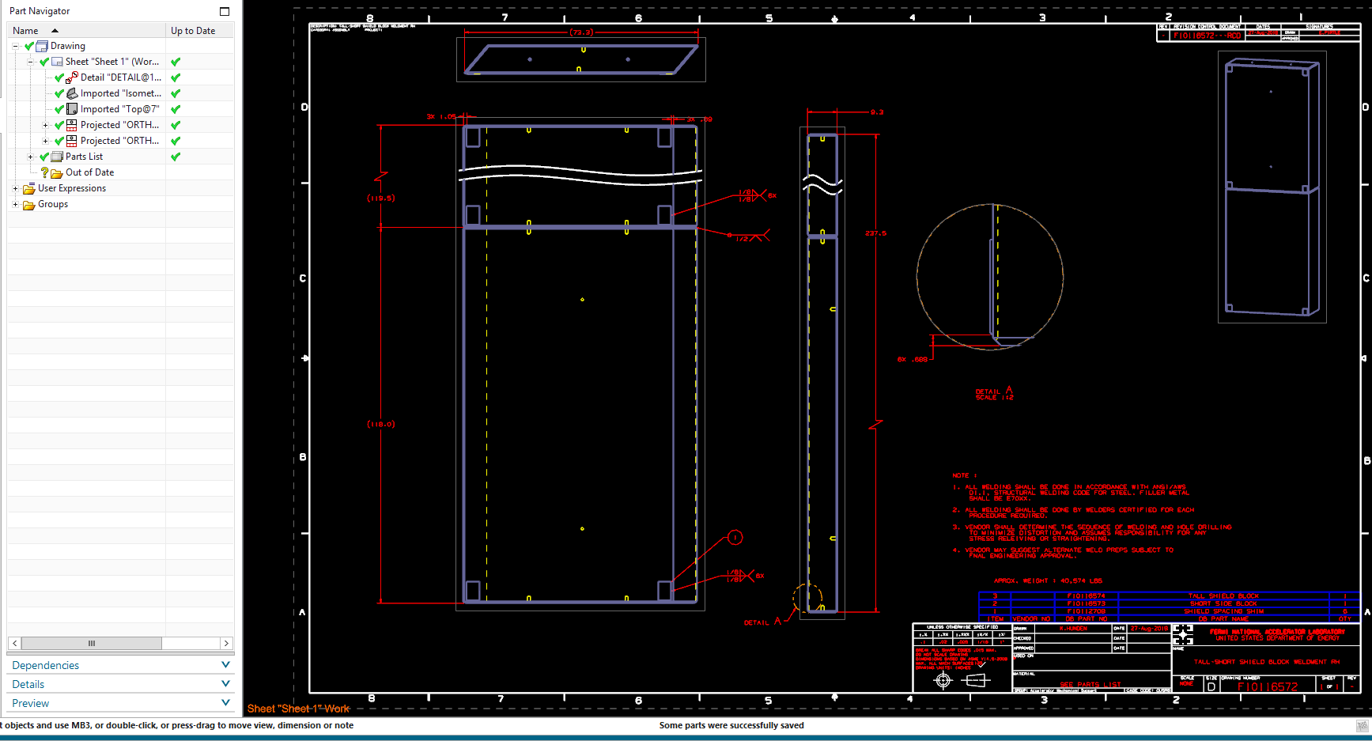
Shielding plate drawing

Slide 9
Procurement Planning
The procurement is planned to start in January 2025.
The procurement plan and specification will be developed.
The Fermilab and Vendors responsibilities will be signed.

Slide 11
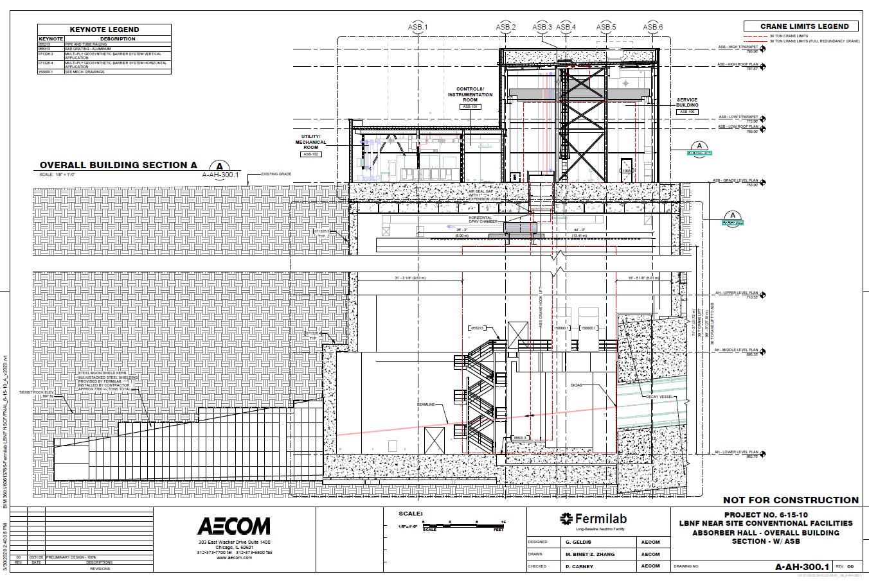
Hadron Absorber assembly scheme
The absorber components will be installed by two 30 ton the service building and the absorber hall crane. Components are delivered to the absorber hall by service building crane through the penetration.
Service building
crane
Penetration
Absorber Hall
crane

Slide 12
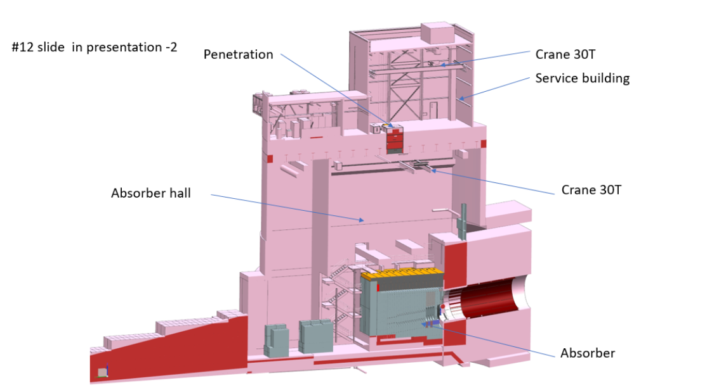
Absorber Complex Cross-section

Slide 13
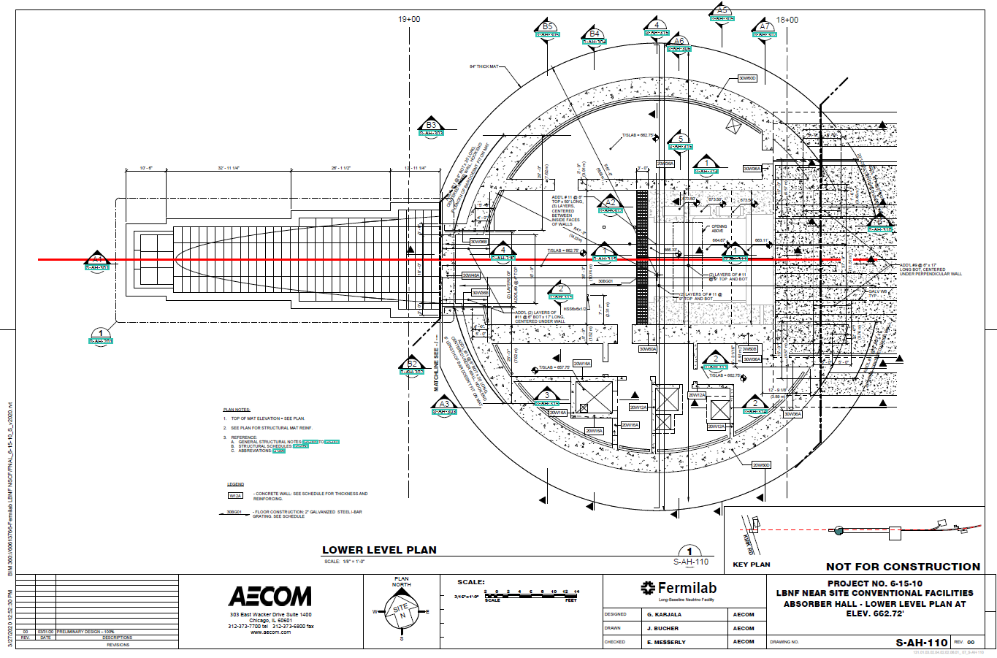
Absorber lower level plan view
Loading
zone

Slide 14
Absorber concrete bunker
693.33
18”
288”
90”
96”
367”
367.48”
41.25
36”
662.75
18.23”
4x4 angle

Slide 15
Bottom Steel shielding Layers 1 and 2 installation
The absorber steel shielding is welded from 9.11” steel plates, 48.75” width.
The structure inside the yellow dashed square is the Decay Pipe downstream nitrogen turnaround and window. This will be installed before the absorber installation begins.
B1
74,350lb
B2
74,350lb
Steel plates

Slide 16
Steel shielding Layers 3 and 4, weight 235,670lb each
B3
235,670lb
B4
235,670lb
162.25
48.75
195

Slide 17
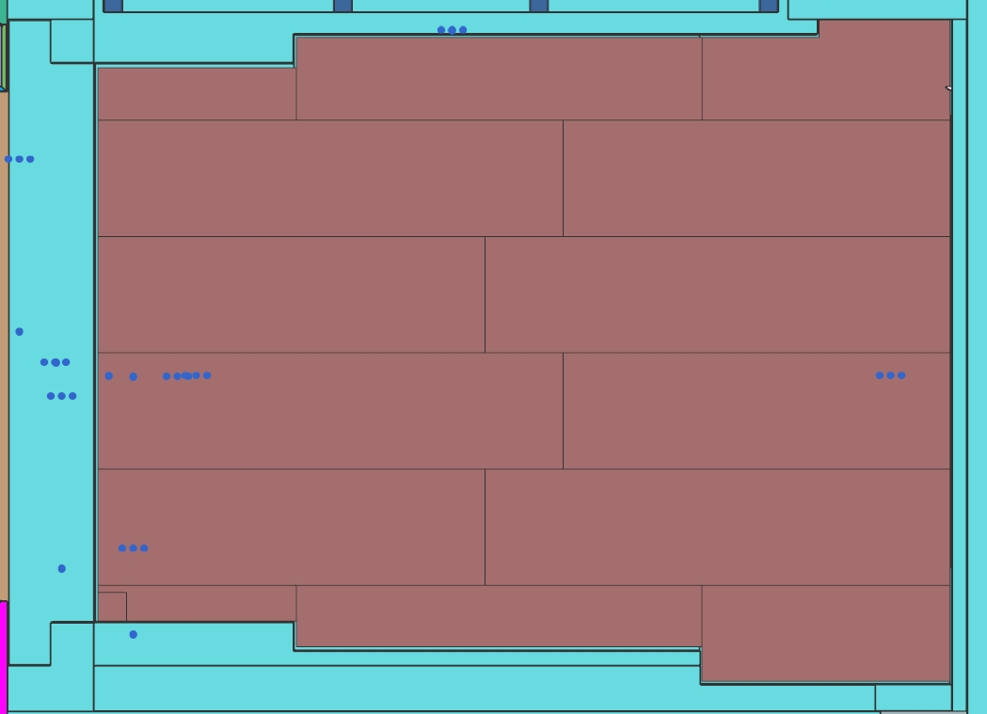
Layers 3 and 4 are installed

Slide 18
Radioactive water collecting pan
The pan is welded from the 48”x120”x ¼” stainless steel base plates and side plates 24 “ height and 1/8” thickness. The final weld of the pan is made in the absorber hall.

Slide 19
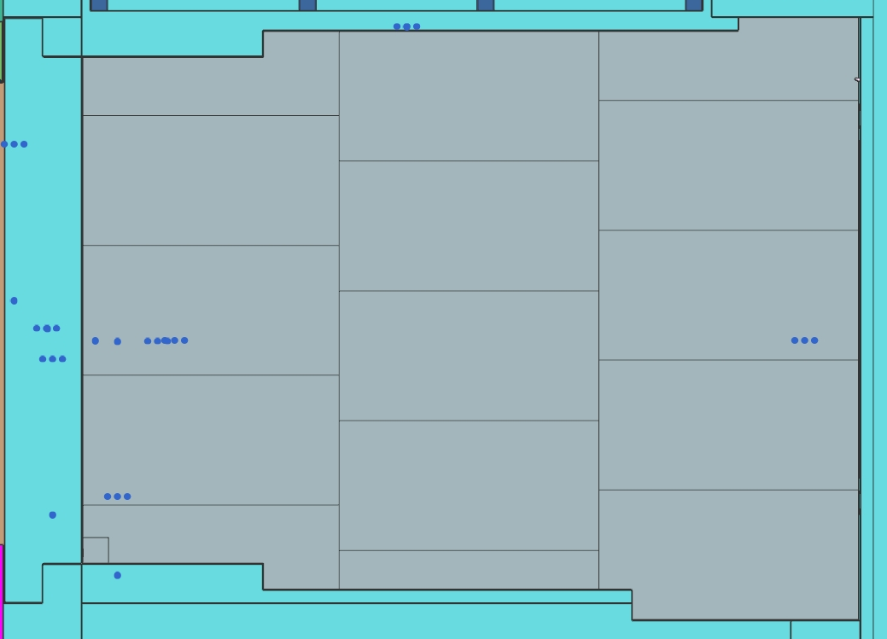
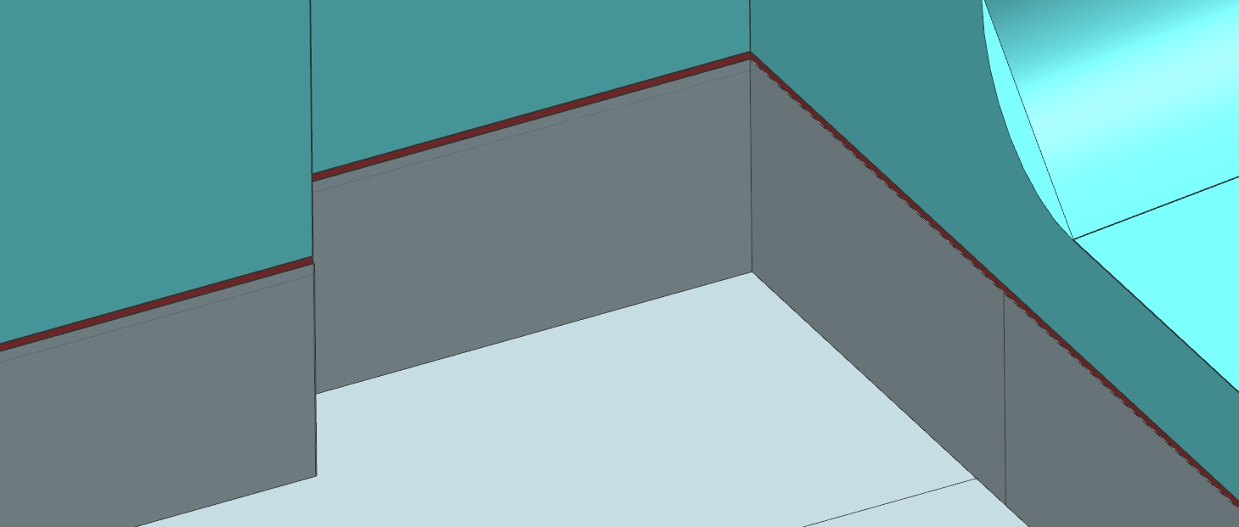
Side plates are welded to the penetrated into the concrete stainless steel strip.
Weld
Stainless Steel
strip

Slide 20
Vertical Right-1 and Left-1 Layers installation
Layers are welded from 9.11” steel plates 48.75” wide. The Right layer isn’t covered by crane.
L-1
36,680lb
R-1
65,860lb

Slide 21
Two front layers installation
Front layers are welded from 9.11” steel. Only top plates are 12” and 6” thick.
Two layers weight -224,123lb
12” steel
6” steel
9.11” steel

Slide 22
Right vertical layers-2 and -3 installation
The Layer-2 is has 7” and 2.5” thickness and can be combined from different thickness plates.
7” plate
9.11” steel
2.5” plate
R2
66,573lb
R3
151,811lb

Slide 23
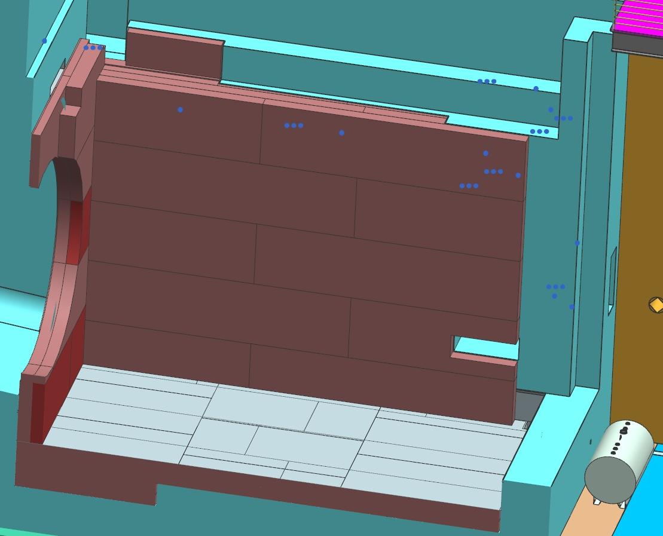
Vertical Right layer-4 installation
9.11” steel
R4
187,090lb
123”
195”

Slide 24
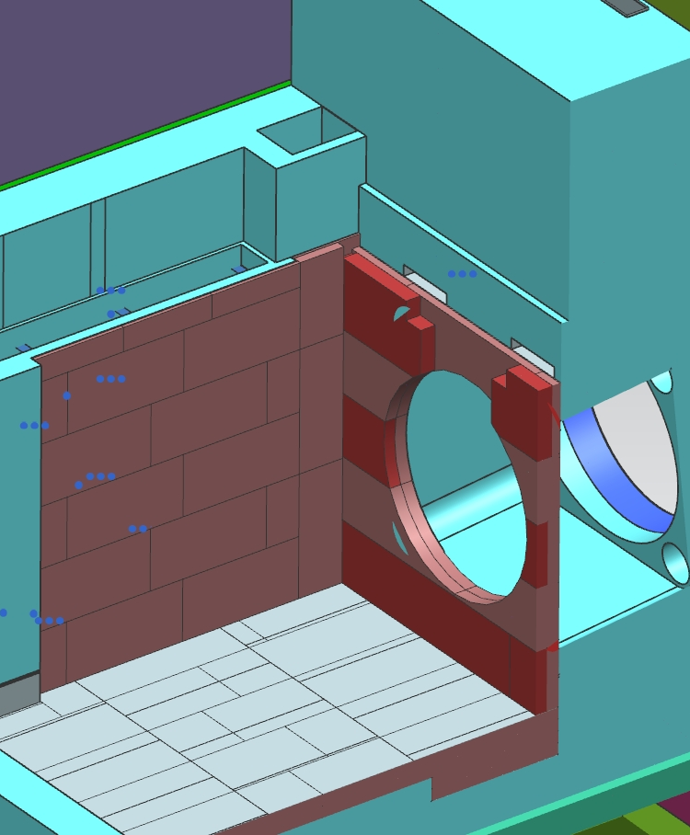
Left vertical layers-2 and -3 installation
2.5” steel
7” steel
9.11” steel
L2
58,524lb
L3
170,048lb

Slide 25
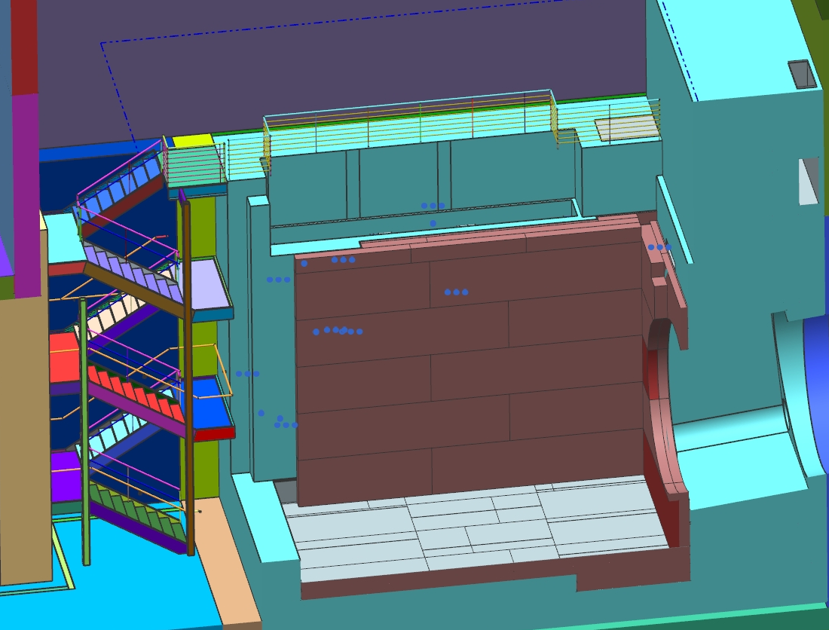
Left vertical layer-4 installation
9.11” steel
L4
212,060lb

Slide 26
Support blocks installation
Steel 12”x12” blocks 10-113.5” long are installed on the stainless steel pan and joined together with steel rods. Blocks are not welded to the pan. The distance between block is eight inches.
Support blocks
Air channels
Rods
Air channels

Slide 27
Mask support structure and steel shielding are welded together layer by layer.
The bottom block is installed, aligned and welded to support bottom blocks first, then U-shape module support structure with aluminum inserts.
Masks support weldment
U-shape welded blocks
552,500lb
Bottom block

Slide 28
Aluminum core blocks support structure and shielding installation
Aluminum core blocks support blocks and surrounded shielding are installed layer by layer.
Spacer
Vertical
plates
U-shape
weldment
Bottom block
1,668640lb

Slide 29
Steel core blocks support structure and surrounded shielding installation
Steel core blocks support structure is located under the service building hatch
and can be installed by service building crane.
Hatch projection-before
Steel core blocks support structure
Hatch projection-after

Slide 30
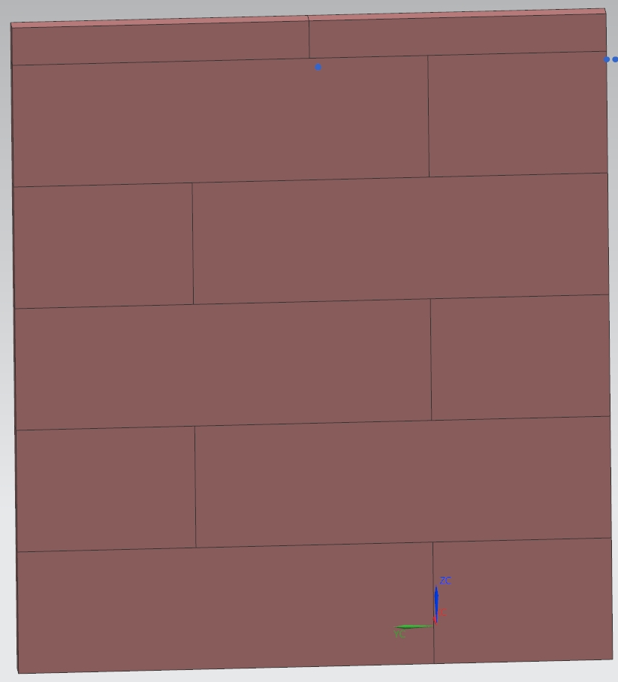
Downstream end steel shielding installation
Four layers 213.25”x237.5” x 9.11” and two layers 232”x258.75” x 9.11”steel are installed
in the downstream end of the absorber. Layers are welded from plates 48.75” width.
L1-4
130,528lb
L5-6
154710lb
51”
162.25”
69.75”
162.25”
237.5”
258.75”

Slide 31
Downstream steel shielding installation
The temporary platform is installed before downstream shielding installation.
Temporary platform
Downstream shielding
831532lb

Slide 32
Concrete T-blocks installation
Fourteen concrete T- blocks are installed in the downstream end of the absorber.
Concrete T-blocks
144”

Slide 33
Absorber mask-module installation
For the mask-module delivery to the absorber one steel core block support structure cell
has to be made wider.
Mask-module
Module
83.5”
Removable
block
164max
77”
Mask
86”
Disk
77-79”

Slide 34
Absorber Al core block –module installation
AL core block-
module
Module
176” max
Tubes
shielding
Water line
67”
67-69”
Core Block

Slide 35
Steel core block-module installation
All steel core block-module can be installed by service building crane.
Module
Service
building
hatch
177.75”
67”
67-69”

Slide 36
Water lines connection
After masks and core blocks modules installation core blocks and masks tubes are
connected to the manifolds.
Water tubes
connection
Manifold

Slide 37
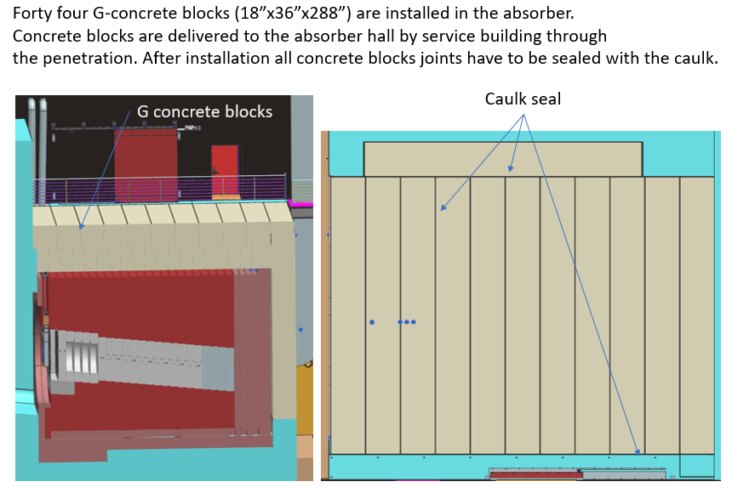
Top concrete blocks installation

Slide 38
Conclusions
1. The final design of the absorber is planned to be started when the Absorber Complex MARS
calculations, the core blocks and steel shielding thermo and stress analyses,
the absorber-decay pipe, the absorber-water cooling system , the absorber- air cooling
system, the absorber –Hadron monitor interface will be completed.
2. The procurement plan and procurement specification is planned to be developed after the final
design of the absorber completion.
3. The absorber installation procedure based on the final design and assembly scheme is planned to
be developed with the Fermilab quality standards.

Slide 39
Back up slides

Slide 40
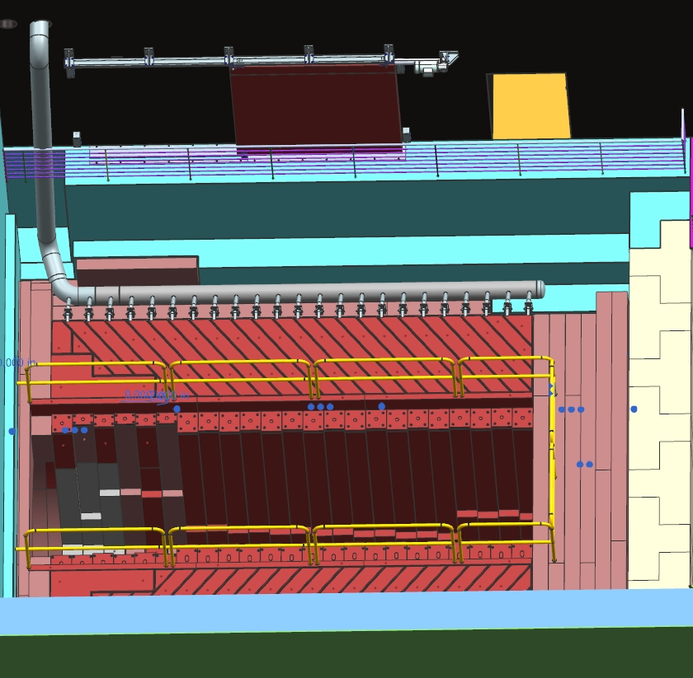
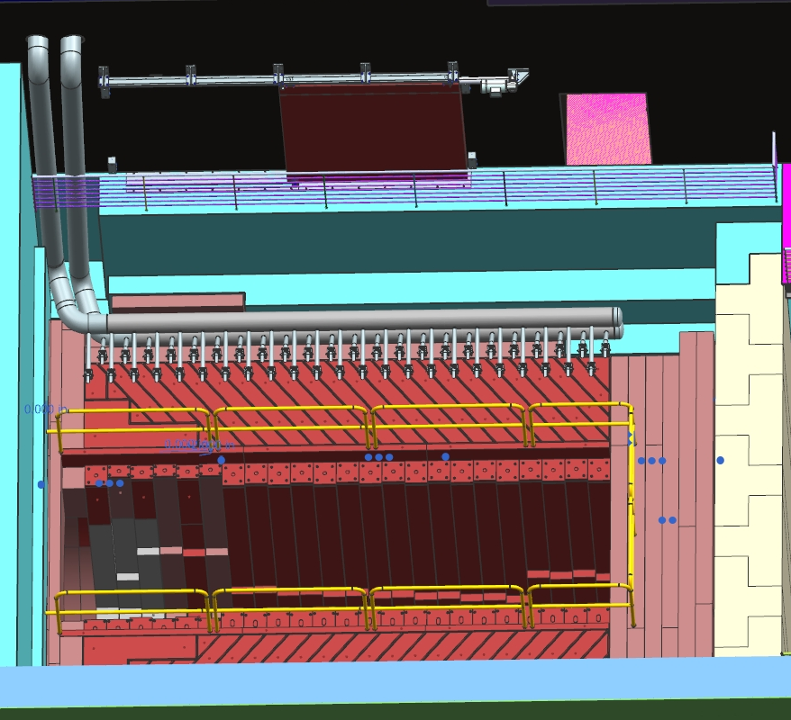
Water cooling manifolds installation
The water cooling supply and return manifolds are delivered to the absorber in several pieces and final weld can be done in the place.
Return
manifold
Supply
manifold
RAW room door
Temporary
hand rails

