Slide 1
LBNF Hadron Absorber Preliminary Design Review LBNF Hadron Absorber Interfaces
Abhishek Deshpande
June 26 , 2020

Slide 2
Overview
Introduction
Interfaces
Interfaces with CF
Interfaces with other beamline systems
Discussion

Slide 3
Introduction
The Absorber needs to work with other beamline systems.
Interfaces are defined as boundaries where the Absorber connects to other supporting systems.
There are hard and soft interfaces. Hard interfaces are where the Absorber physically interacts with other systems.
A soft interfaces describe how design changes in upstream or downstream systems affect the Absorber design; example how Target design affects the Absorber.

Slide 4
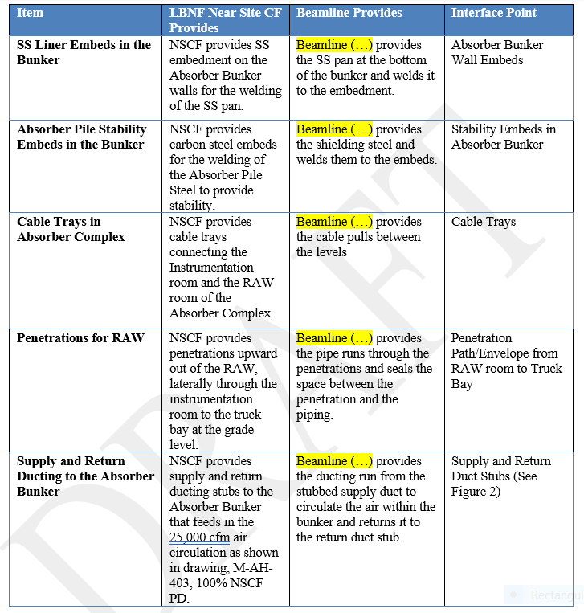
Interfaces: CF
Broadly, the physical interfaces may be categorized into:
Interfaces with CF systems (Conventional Facilities)
Interfaces with beamline systems
The interfaces with CF are highlighted in: https://edms.cern.ch/project/CERN-0000206753
Relevant ones are circled.

Slide 5
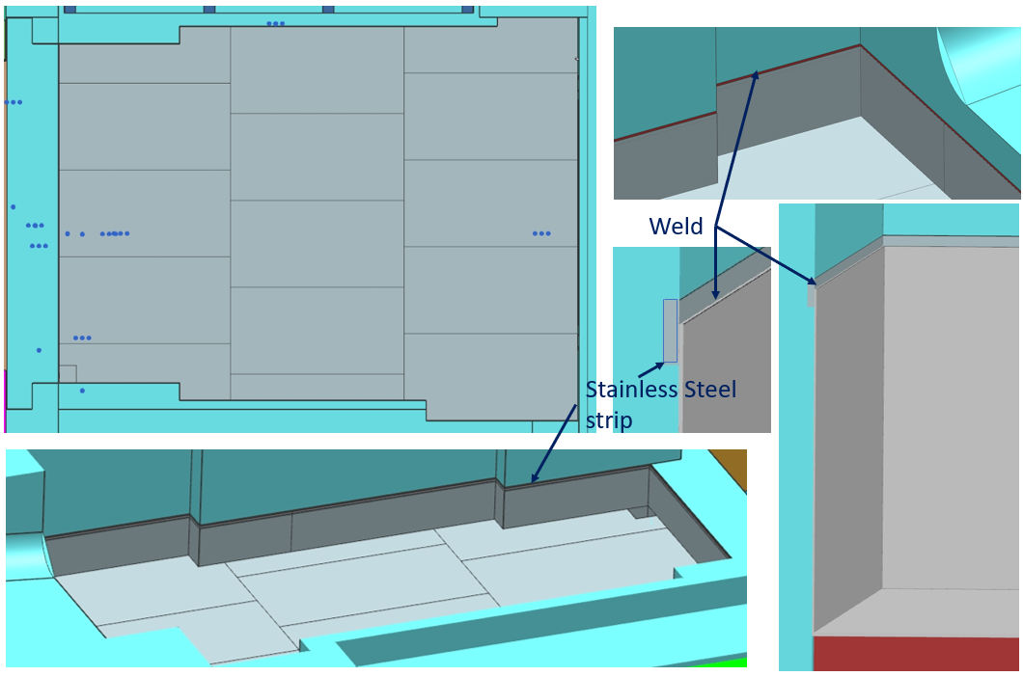
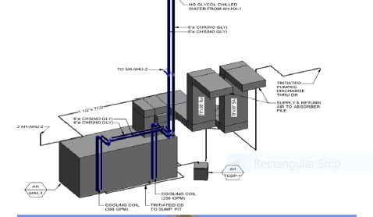
Interfaces: CF
Top view of SS pan
Vladimir Sidorov, Dune-doc-14314
Supply and return ducts
CF 100% design review, Dune-doc-18427

Slide 6
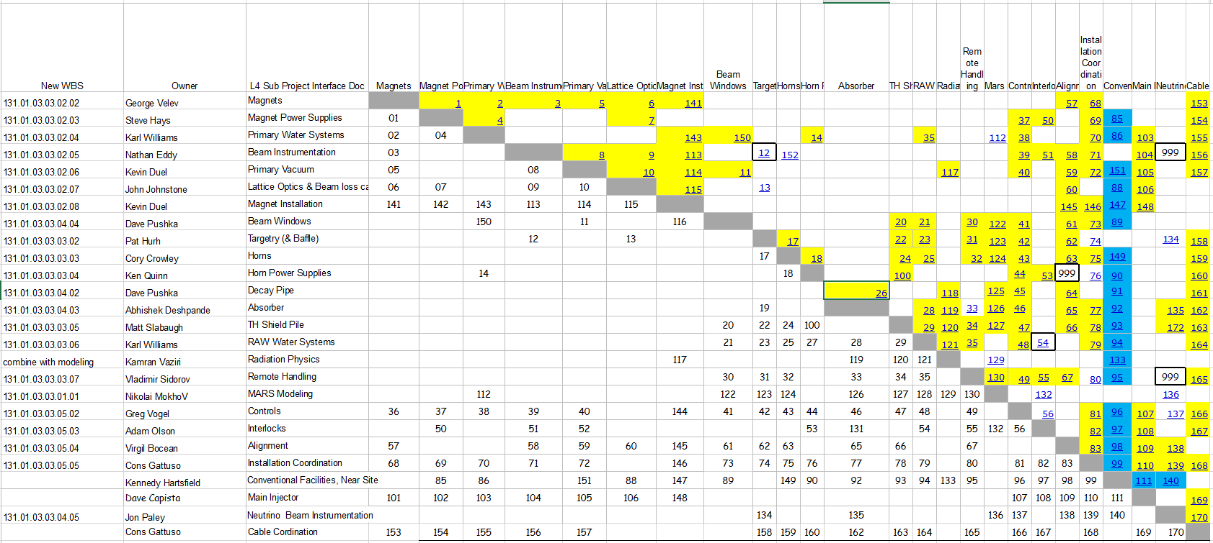
Interfaces: With beamline systems
Hard interfaces are highlighted below:
Salman Tariq, Dune-doc-301
Interface ID
https://fermipoint.fnal.gov/project/LBNF/Near%20Site/Beamline/Shared%20Documents/Forms/AllItems.aspx

Slide 7
Interfaces: With beamline systems
Interface ID definitions:
Interface ID #28. RAW system and Absorber
https://fermipoint.fnal.gov/project/LBNF/Near%20Site/Beamline/Shared%20Documents/Forms/AllItems.aspx

Slide 8
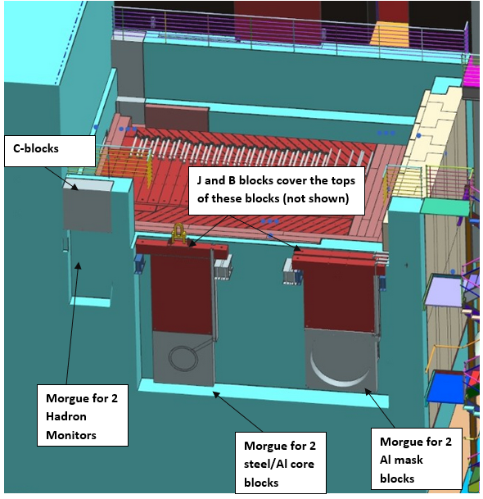
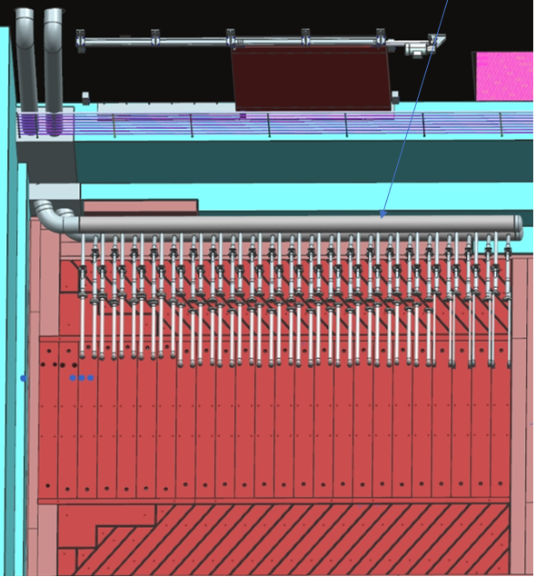
Interfaces: Beamline systems
Some interfaces with non-CF systems are well defined, such as those with RAW systems, remote handling, controls, interlocks, and neutrino beam instrumentations (Muon monitors).
However, interfaces with other systems such as the Decay Pipe are still under development due to scope reevaluation by CF.
Absorber side
RAW system side
Muon monitor side
Interface
Interface
Absorber side
Remote handling side

Slide 9
Discussion

