Slide 1
LBNF Hadron Absorber Preliminary Design Review LBNF Hadron Absorber Costs, Schedule, and Overall Summary
Abhishek Deshpande
June 26 , 2020

Slide 2
Overview
Absorber costs
Absorber schedule
Overall summary wrap-up

Slide 3
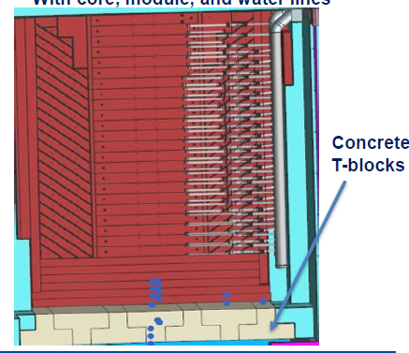
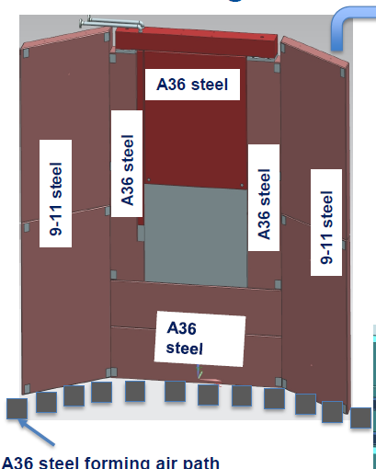
Absorber costs
With the help of a professional estimator, large component drawings were sent to several manufacturers for a quote.
Have quotes for items included in yellow boxes.
Compared quotes received with original cost estimates.

Slide 4
Absorber costs
Quotes are present in Absorber section of Dune-doc-15809.
Comparison between estimated and vendor costs is shown below:
Cost Breakdown Summary for the LBNF Absorber Compared to Estimates from Vendors
 | Major components | Estimated cost (2018) | Vendor cost (2019-20) | Difference between vendor cost (2019-20) and estimated cost (2018) | Fermi hours estimated (2018) | Hours absorbed by the vendor (2019-20) | Notes/comments
 | Absorber core | $1,014,233.06 | $975,339.00 | -$38,894.06 | 1746 | 0 | Spoiler (1), Mask (4), Core-Aluminum (13), Sore-Steel (4)
 | Absorber core support and surrounding steel | $1,250,569.88 | $2,643,045.00 | $1,392,475.12 | 0 | 0 | This includes the core support modules and the steel immediately surrounding the absorber core. This is all the A36 steel
 | Water cooling infrastructure | $94,885.35 | $78,108.00 | -$16,777.35 | 520 | 520
 | Steel shielding 9-11 steel | $1,847,582.16 | $1,283,043.17 | -$564,538.99 | 3264 | 0 | Assuming cost per pound is $0.25
 | Steel for the air channels | NA | $279,811.00 | $279,811.00 | 0 | 0 | Air channels at the bottom of the absorber pile were never costed in the original (2015) and the later version (2018) schedule.
 | Misc. items | $60,482.10 | Not available | -$60,482.10 | 0 | 0 | SS water collection pan, material handling hardware, and thermocouple array
 | Total-----------> | $4,287,752.55 | $5,259,346.17 | $991,593.62 | 5530 | 520

Slide 5
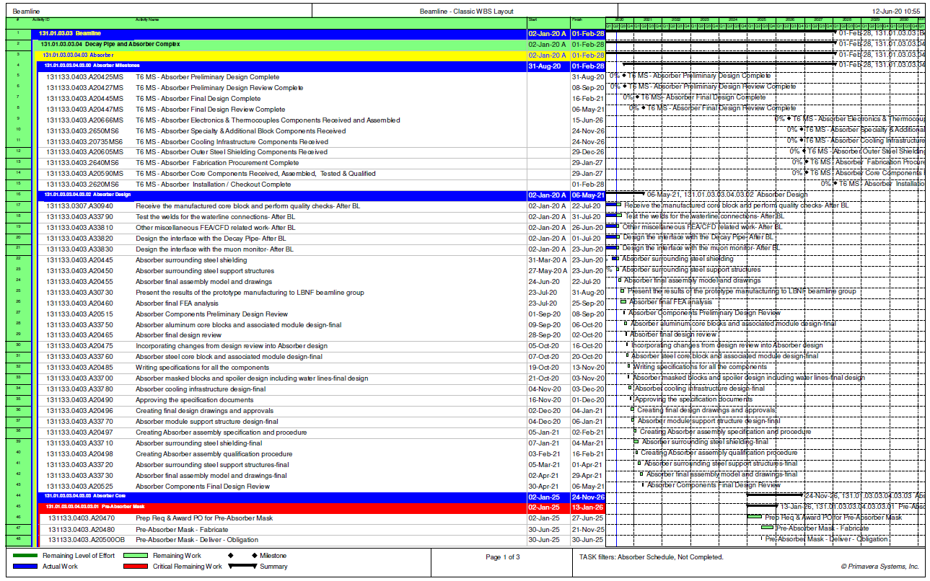
Absorber schedule
Procurement projected to start in Jan 2025

Slide 6
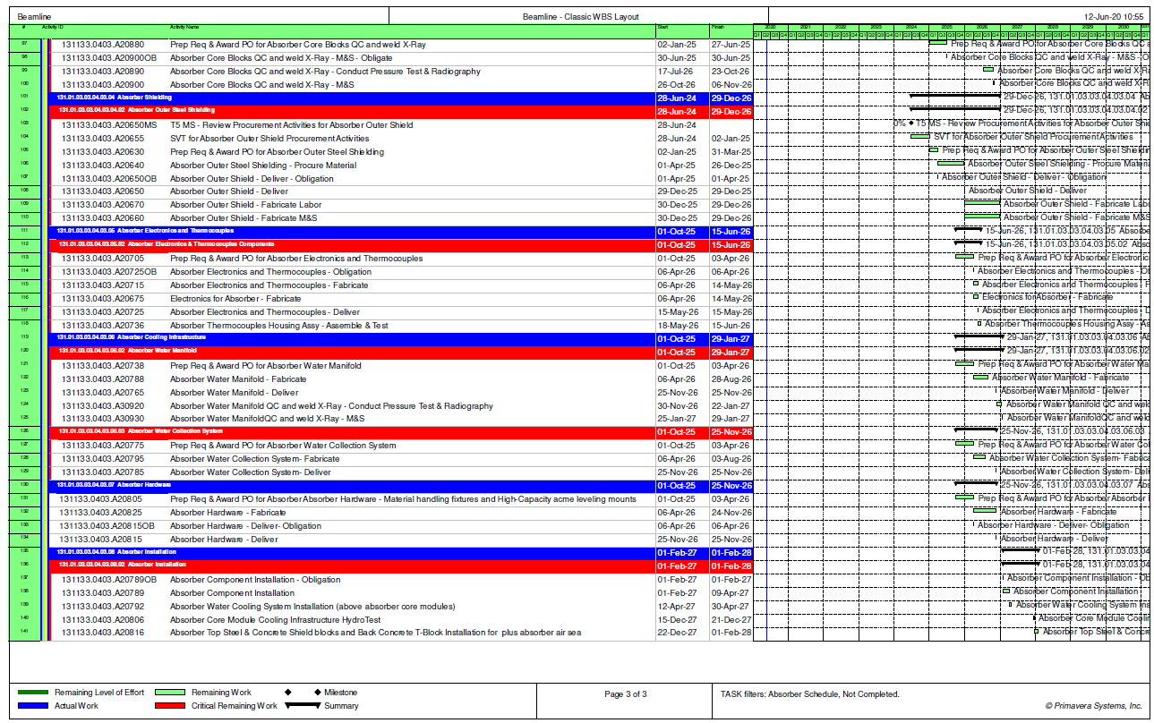
Absorber schedule
Installation projected to start in Feb 2027
Procurement projected to start in Jan 2025

Slide 7
Overall summary wrap-up
Requirement | Description | Comment
Absorber - radiation protection | The absorber shall provide radiation protection to people, in compliance with the FRCM. | This has been addressed.
Absorber - energy absorption | The absorber shall absorb the energy of the particles exiting the decay pipe and transfer this energy away using an active cooling system. | It was shown during the review that energy deposited in the Absorber was effectively transferred to the core water cooling system and the shielding air cooling system.
Absorber - lifetime | The absorber shall keep its operational ability for the life of the LBNF experiment. Near Site Conventional Facility (NSCF or CF) life is 30-years. And, the LBNF/DUNE experiment life is 20-years. | Fatigue loading and effects of creep on Aluminum were addressed. Prototyping of critical component has been done. A remote handling system facilitates quick turn around in case of component failures.
Absorber - accident conditions | The absorber shall sustain the beam energy deposition under all accident situations that may occur with some reasonable probability. | It was shown that all core components can survive after 2- accident pulses. In addition to this, a beam interlock system was described that will prevent more than 1 accident pulse.
AC - Absorber Bunker Liner | Beamline shall provide a 24 inch high, leak tight stainless steel pan liner at the bottom of the Absorber bunker | A pan design was described. Its interface with CF infrastructure has also been captured.

Slide 8
Overall summary wrap-up
Specification | Description | Comment
Absorber - accident pulses | The absorber shall include an Interlock system that limits the accident pulses to 2. | It was shown that all core components can survive after 2- accident pulses. In addition to this, a beam interlock system will prevent more than 1 accident pulse.
Absorber - dose rate | The absorber shall have a residual dose at 1 foot (measured from outside the absorber shielding) after 100 day irradiation and 4 hr. cooling that does not exceed 20 mrem/hr. | This was addressed in the energy deposition presentation. It was shown that shielding is appropriate to prevent dose rates from exceeding allowable values.
Cooling System - heat removal | The cooling system shall remove 473 kW of dissipated heat during normal operation. 233 kW using water cooling and 240 kW using forced air/gas ventilation system. This assumes a 1.5-m RAL Target at 2.4-MW beam operations. | The RAW cooling system has gone through its own preliminary design review. It is oversized for the 1.5-m RAL target case. There is room for value engineering here.
Absorber - accident pulses | The absorber shall sustain at least 2 successive accident beam pulses without damage to components or loss of functional ability. | Engineering analysis shows that 2-accident pulses will not have a detrimental effect on Absorber operations.

Slide 9
Thank you!

