Slide 1
Special Cooling Systems Design
Maurice Ball/Jerzy (Yurick) Czajkowski
PIP-II LINAC Complex Mechanical Fluid Systems PDR
April 21, 2021

Slide 2
Table of Contents
Scope Cartoon
Cooling Systems
RFQ Three Skid LCW System (Intermediate, Vane, Wall)
Beam Absorber RAW Skid
RFQ Circulator Chiller
Ion Source Chiller
Requirements (TRS)
Screen shots (where applicable)
P&ID
Preliminary analysis of piping loads (where applicable)
Installation Plan

Slide 3
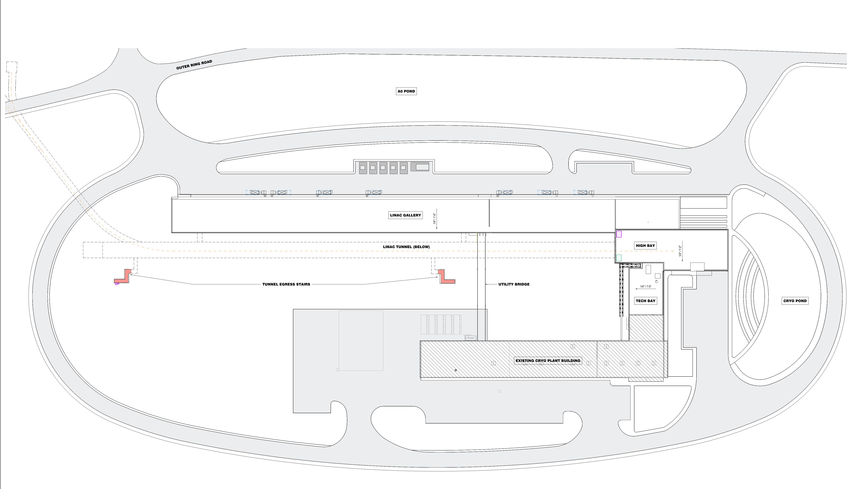
Four Specialized Cooling Systems - Locations
RFQ Cooling Skids (3)
Absorber RAW Skid
RFQ Circulator Chiller
Ion Source Chiller
To Booster
F-37
Linac Complex
HB650
LB650
SSR2
SSR1
WARM FRONT END
Cooling Towers
Utility Bridge
Ion Source Chiller
RFQ Cooling Skids (3)
RFQ Circulator Chiller
Absorber RAW Skid
Process Clean Cooling Water (PCW)
Utility Plant
Low Conductivity Water (LCW)

Slide 4
RFQ 3 Skid System Design
Maurice Ball/Jerzy (Yurick) Czajkowski
PIP-II LINAC Complex Mechanical Fluid Systems PDR
April 21, 2021

Slide 5
RFQ 3 Skid System - Highlights
Three Separate cooling skids work together as one system
304 Stainless Steel and Copper piping material
Vane and Wall Skids
Used during PIP2IT operations. Will be reused for PIP-II operations
Recirculate cooling water through Vane and Wall areas of the RFQ
Heat exchange with Intermediate skid
Intermediate Skid heat exchanges with 45°F Facility Chilled Water
Special flow control valve and flow meter under PLC program to provide tight +/- 0.5 °F tolerance requirement

Slide 6
Technical Requirements for RFQ Intermediate Skid
Building Infrastructure shall provide the RFQ Intermediate cooling water skid according to the following specifications:
Discharge Pressure = 100 PSIG
Suction Pressure = 15 PSIG
Supply Temperature = 70°F +/- 1.0 ⁰F
Delta T (ΔT) = 21.0 F⁰
Total Heat Load = 71 KW
Nominal Flow Required = 49 GPM
Resistivity = 2 MOhm-CM
Full flow Particulate filtration at 1 micron

Slide 7
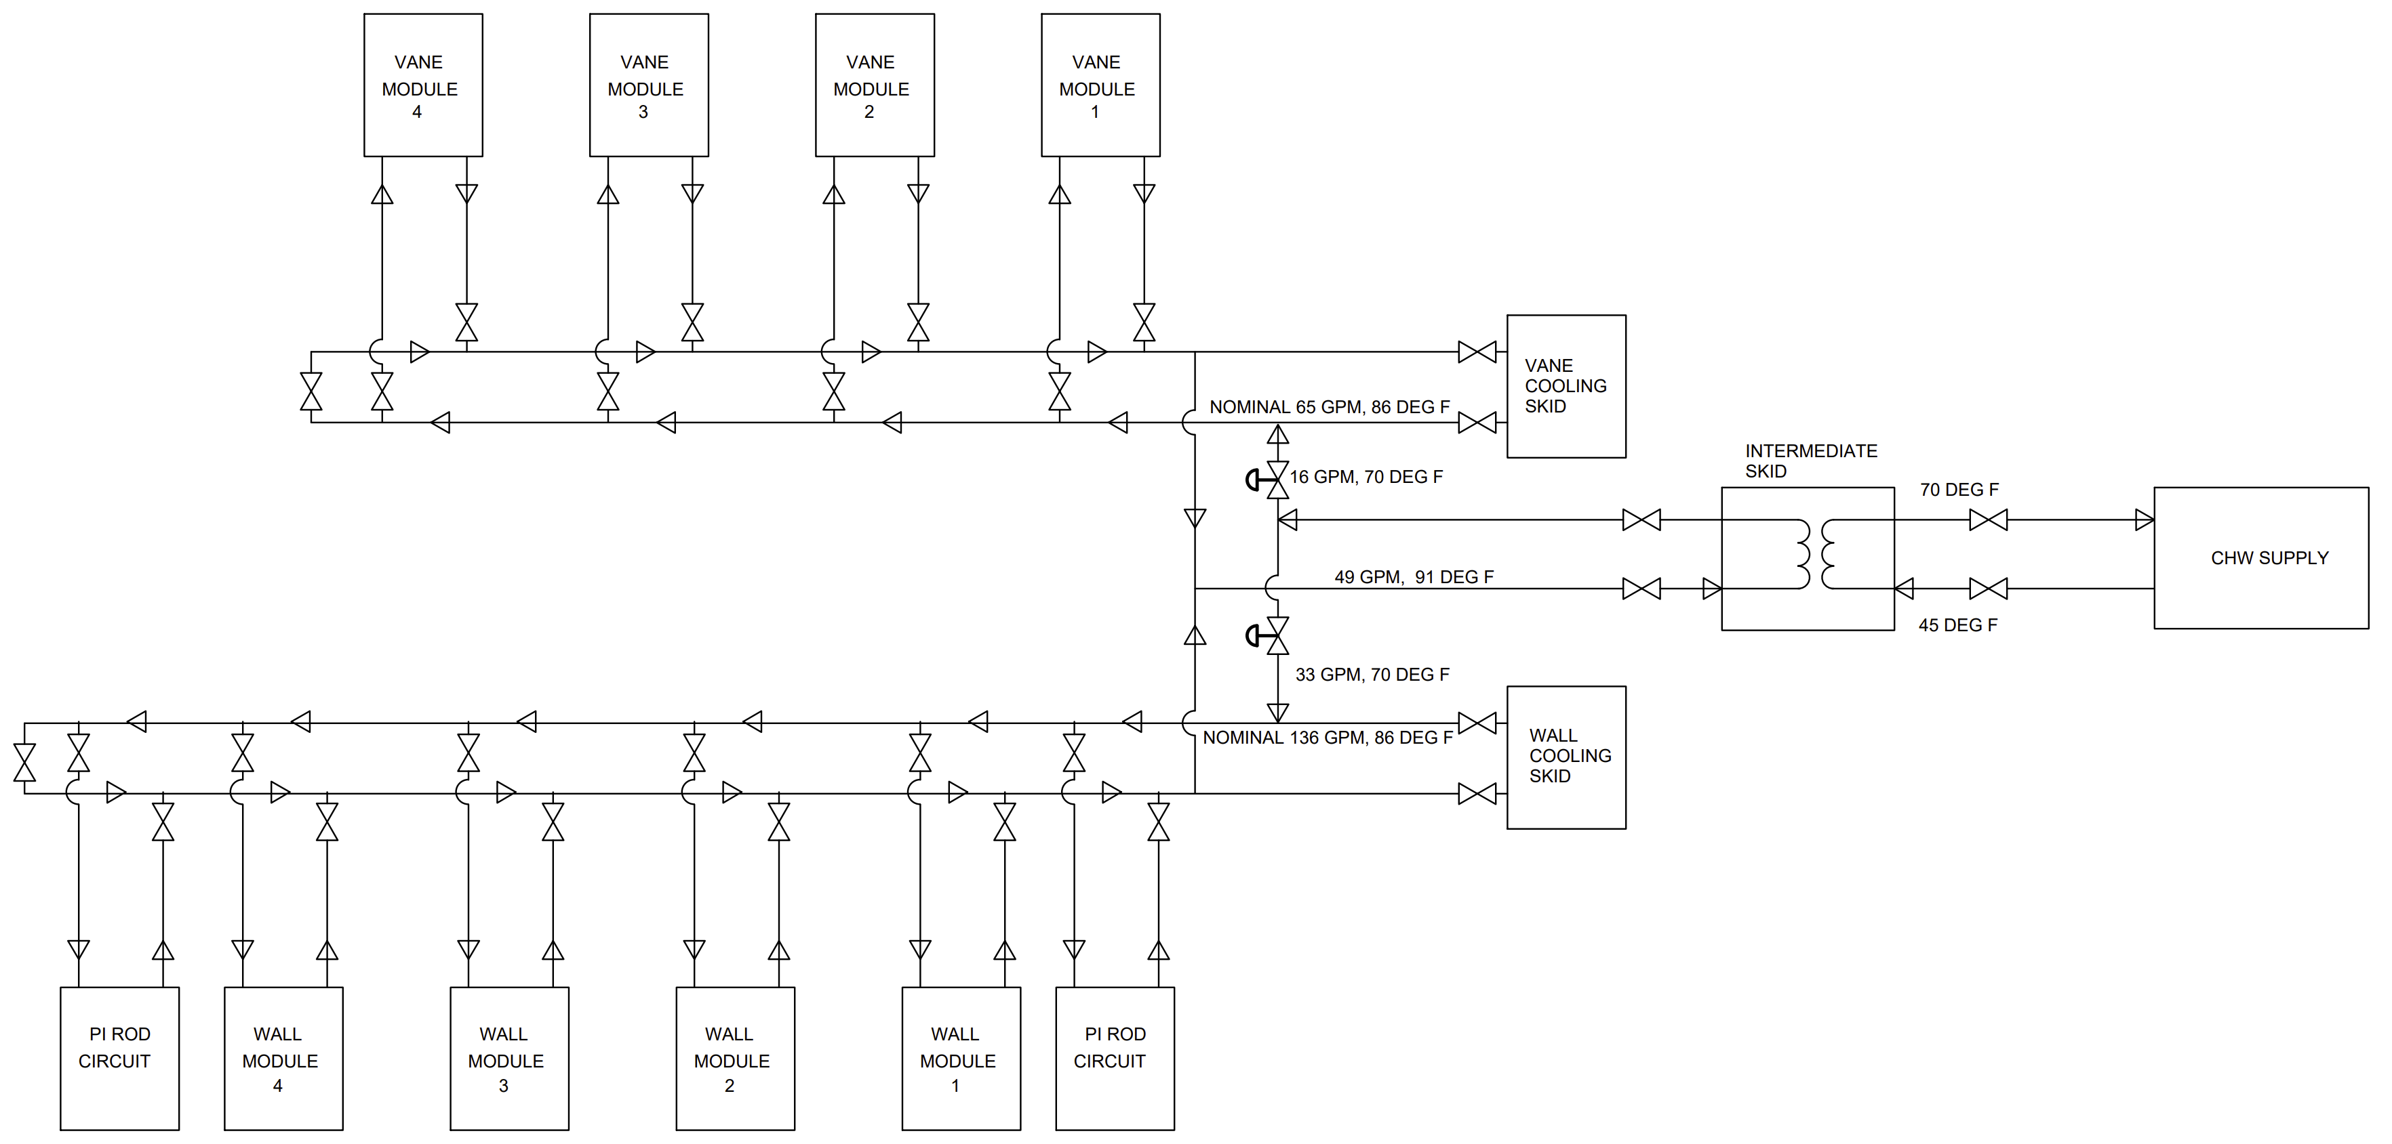
RFQ 3 Skid LCW System Block Diagram

Slide 8
Technical Requirements for RFQ Vane Skid
Building Infrastructure shall provide the RFQ Vane cooling water skid according to the following specifications:
Discharge Pressure = 100 PSIG
Suction Pressure = 15 PSIG
Supply Temperature = 86°F +/- 0.5 ⁰F
Delta T (ΔT) = 5.0 F⁰
Nominal Heat Load = 29 KW
Nominal Flow Required = 65 GPM
Resistivity = 2 MOhm-CM
Full flow Particulate filtration at 1 micron

Slide 9
Technical Requirements for RFQ Wall Skid
Building Infrastructure shall provide the RFQ Wall cooling water skid according to the following specifications:
Discharge Pressure = 100 PSIG
Suction Pressure = 15 PSIG
Supply Temperature = 86°F +/- 0.5 ⁰F
Delta T (ΔT) = 5.0 F⁰
Nominal Heat Load = 50 KW
Nominal Flow Required = 136 GPM
Resistivity = 2 MOhm-CM
Full flow Particulate filtration at 1 micron

Slide 10
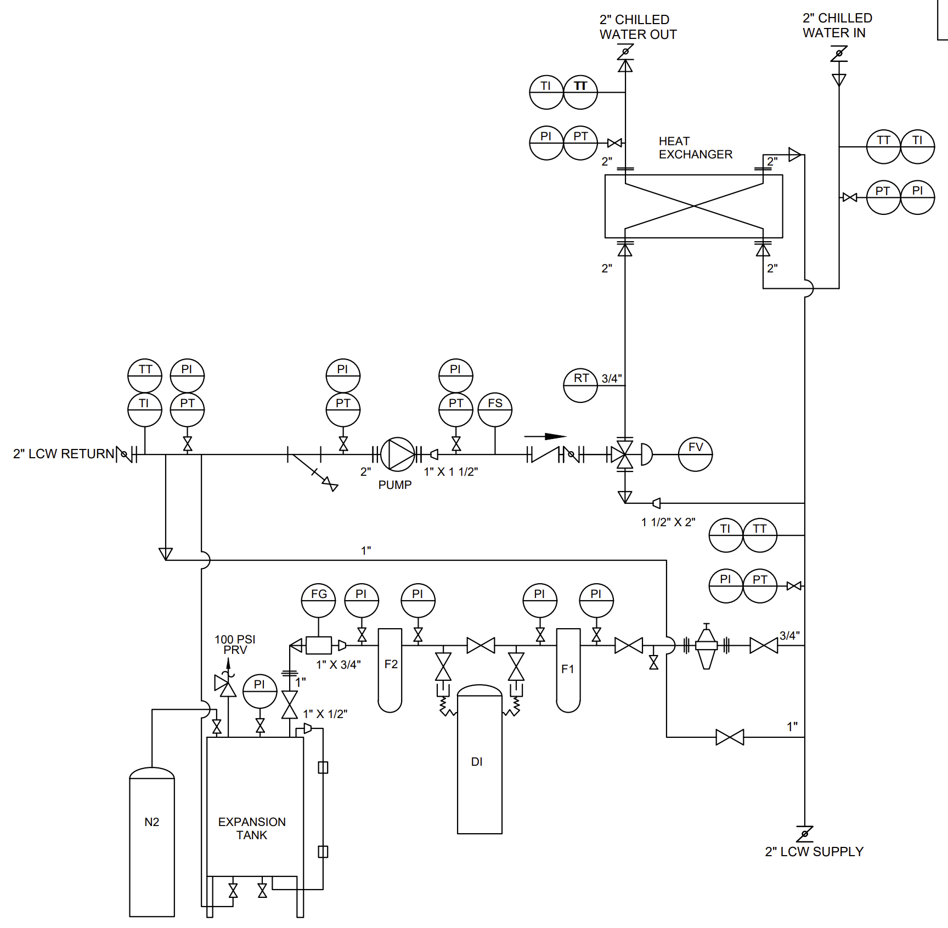
Intermediate RFQ LCW Skid P&ID
Legend:
PT – Pressure Transmitter
PI – Pressure Indicator
TT – Temperature Transmitter
TI – Temperature Indicator
RT – Resistivity Transmitter
DI – DI Bottle
F1 – Pre-Filter
F2 – After-Filter
FG – Flow Indicator
PRV – Pressure Relief Valve

Slide 11
RFQ WALL LCW Skid & Intermediate Skid
Legend:
PT – Pressure Transmitter
TT – RTD Temperature Transmitter
FT – Flow Meter/Transmitter
FV – Flow/Temperature Control Valve
RT – Resistivity Transmitter

Slide 12
RFQ VANE LCW Cooling Skid
Legend:
PT – Pressure Transmitter
TT – RTD Temperature Transmitter
FT – Flow Meter/Transmitter
FV – Flow/Temperature Control Valve
RT – Resistivity Transmitter

Slide 13
Installation Plan
Reusing the Vane and Wall skids from PIP2IT
After RFQ testing completed, Vane and Wall skids disconnected and moved to storage
For PIP-II installation, Vane and Wall skids brought out of storage and installed in High Bay ground floor in cooling skid alcove
Piping manifolds and hose assemblies from PIP2IT operation reused
New Intermediate Skid will be built to replace existing skid.
Once cooling skids, piping manifolds, and hose assemblies are installed and connected, perform pneumatic and hydrostatic pressure tests
Notes:
Transfer from P2IT to the storage
When ready transfer to PIP-II and install.
Manifold piping from PIP2IT will be reused.
We will reuse hose and manifold piping.
A lot work involved in this procurement and installation.
Hose was field fit.

Slide 14
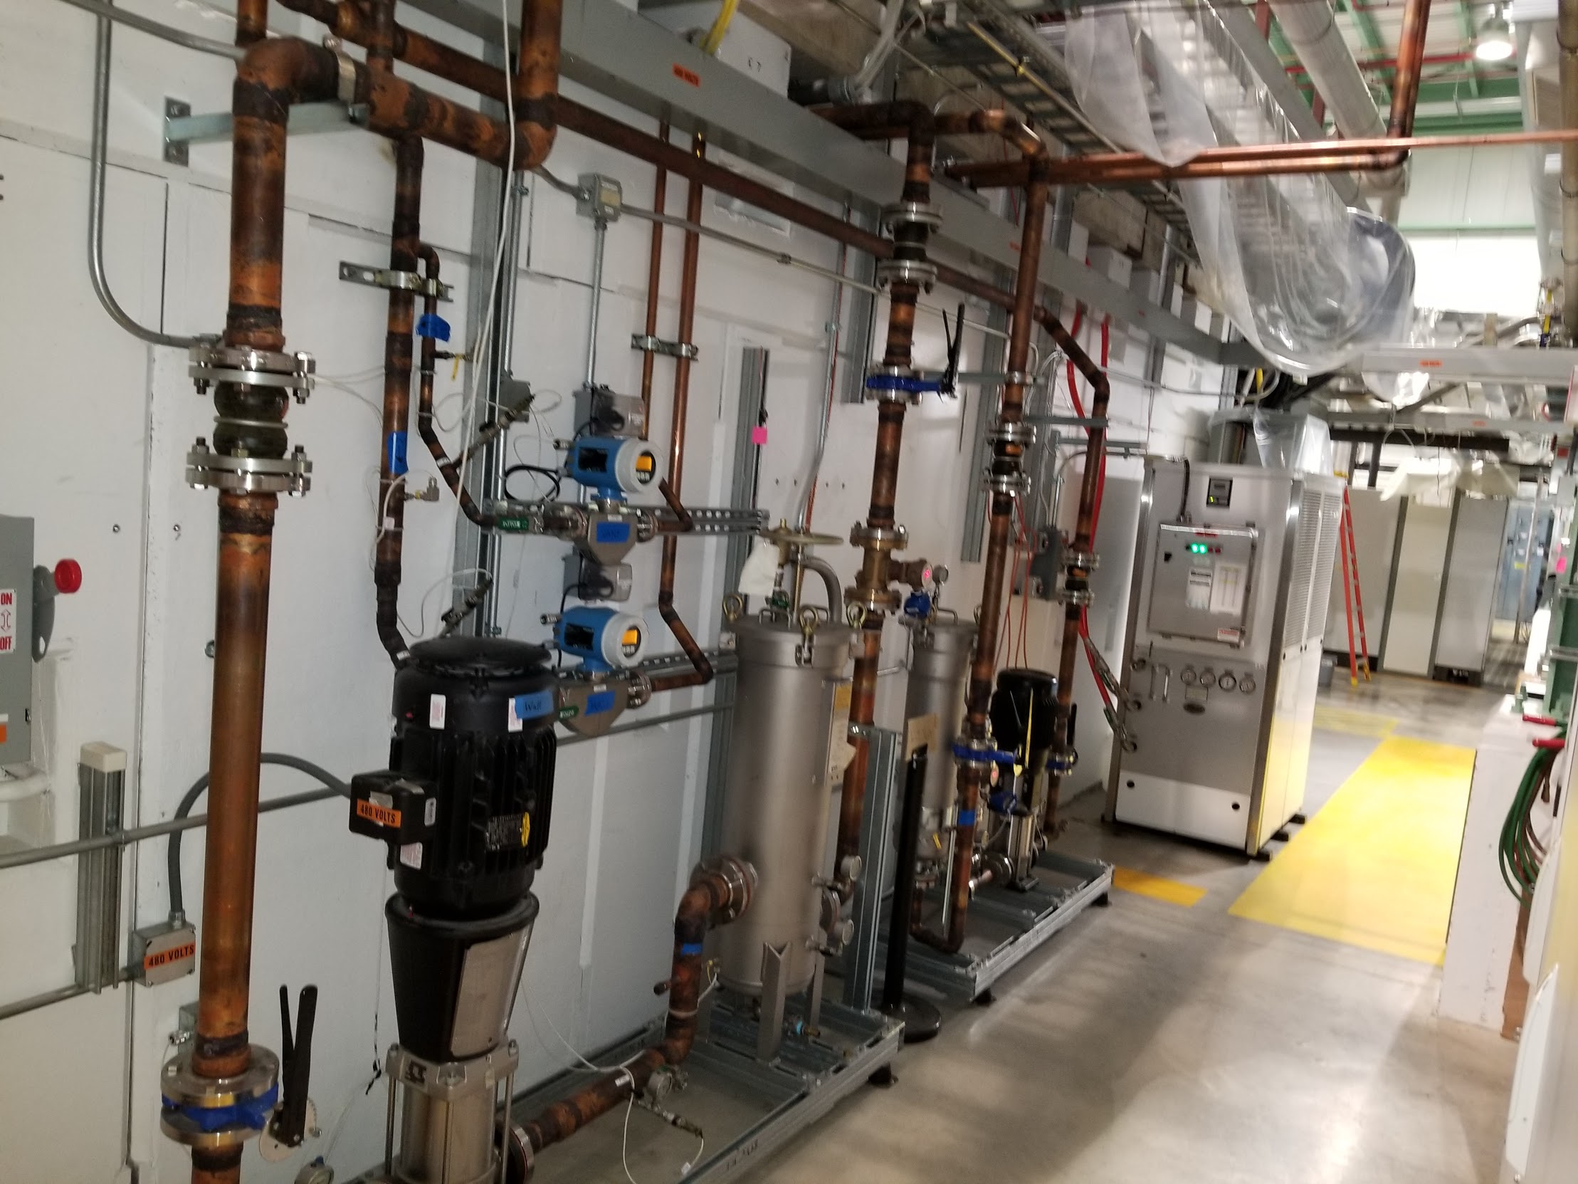
Photo Image - RFQ Vane Wall Skids at CMTF

Slide 15
Photo Image - RFQ Wall skid at CMTF

Slide 16
Photo Image - RFQ Vane skid at CMTF

Slide 17
Photo Image - RFQ Vane Wall Flowmeters at CMTF

Slide 18
Photo Image - RFQ Intermediate skid at CMTF

Slide 19
Photo Image - RFQ Intermediate skid at CMTF

Slide 20
RFQ Circulator/Loads Chiller System Design
Maurice Ball/Jerzy (Yurick) Czajkowski
PIP-II LINAC Complex Mechanical Fluid Systems PDR
April 21, 2021

Slide 21
RFQ Circulator Chiller Highlights
Off the shelf portable chiller
Self-contained
Air-cooled chiller
Special supply temperature control needs (83°F)
RFQ amplifiers cooled separately using PCW System

Slide 22
Technical Requirements for RFQ Circulator Chiller
Building Infrastructure shall provide the cooling water system, including supply and return piping, valves, and instrumentation, for the RFQ circulator and loads according to the following specifications:
Discharge Pressure = 100 PSIG
Suction Pressure = 15 PSIG
Supply Temperature = 83°F +/- 1.0 ⁰F
Delta T (ΔT) = 10 F⁰
Total Heat Load = 29 KW
Total Flow Required = 20 GPM
Resistivity = n/a

Slide 23
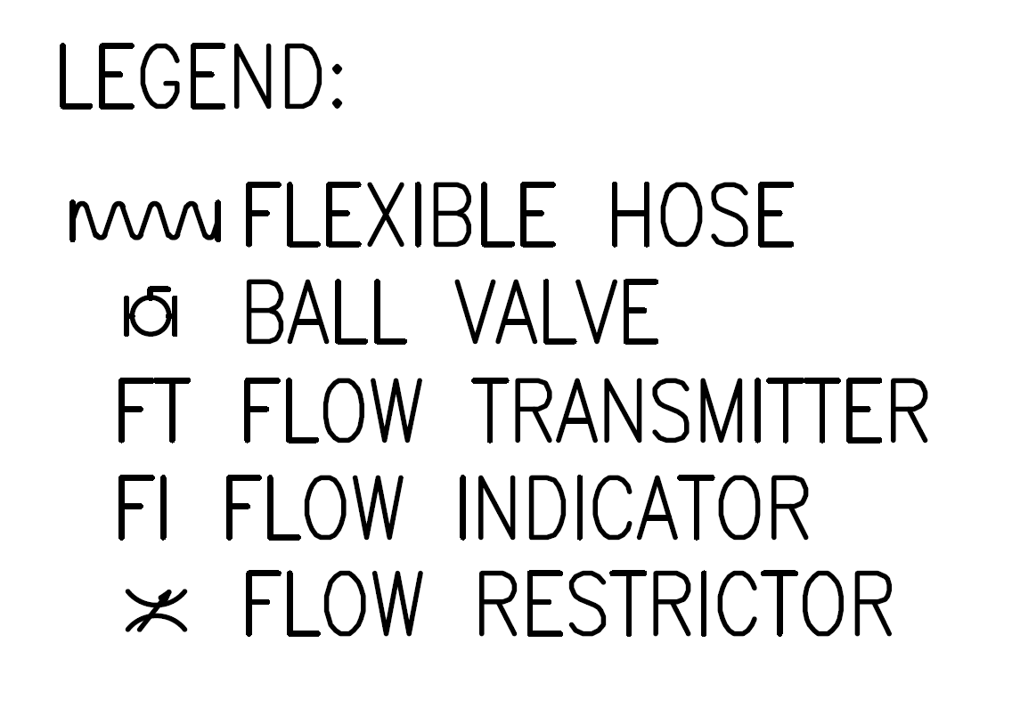
PIP-II RFQ Circulator/Loads Chiller P&ID

Slide 24
Installation Plan
Procure and install portable chiller
Connect flexible hose assemblies to manifolds and then to Circulators and Loads
Once chiller and hose assemblies are installed and connected
Pneumatic and hydrostatic pressure tests will be performed
Notes:
Transfer from P2IT to the storage
When ready transfer to PIP-II and install.
Manifold piping from PIP2IT will be reused.
We will reuse hose and manifold piping.
A lot work involved in this procurement and installation.
Hose was field fit.

Slide 25
Beam Absorber Skid and Piping System Design
Maurice Ball/Jerzy (Yurick) Czajkowski
PIP-II LINAC Complex Mechanical Fluid Systems PDR
April 21, 2021

Slide 26
Beam Absorber RAW Skid - Highlights
Radioactive Water system
Cools the Beam Absorber located in the Beam Transfer Line (BTL)
Normal Fluid Service
Nitrogen gas used as tank blanket and to purge Hydrogen gas from system
Magnetically driven circulating pump, no leaky seals
Containment basin located under RAW skid, sized to contain entire RAW system volume

Slide 27
Technical Requirements for Beam Absorber RAW Skid
Building Infrastructure shall design the Absorber RAW cooling system, including supply and return piping, valves, and instrumentation for the Absorber according to the following specifications:
Discharge Pressure = 100 PSIG
Suction Pressure = 15 PSIG
Supply Temperature = 100°F +/- 1 ⁰F
Delta T (ΔT) = 23.5 F⁰
Total Heat Load = 25 KW
Total Flow Required = 20 GPM
Resistivity = n/a
Full flow particulate filtration at 5 micron

Slide 28
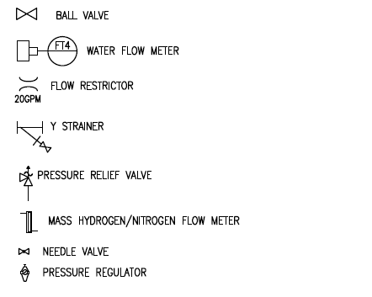
Beam Absorber Skid and System P&ID
Legend:
PI – Pressure Indicator
TI – Temperature Indicator
LT – Level Transmitter
PT – Pressure Transmitter
TT – Temperature Transmitter
FT - Flow Meter/Transmitter
1 ½” RAW RETURN 123.5 degF
1 ½” RAW SUPPLY 100 degF

Slide 29
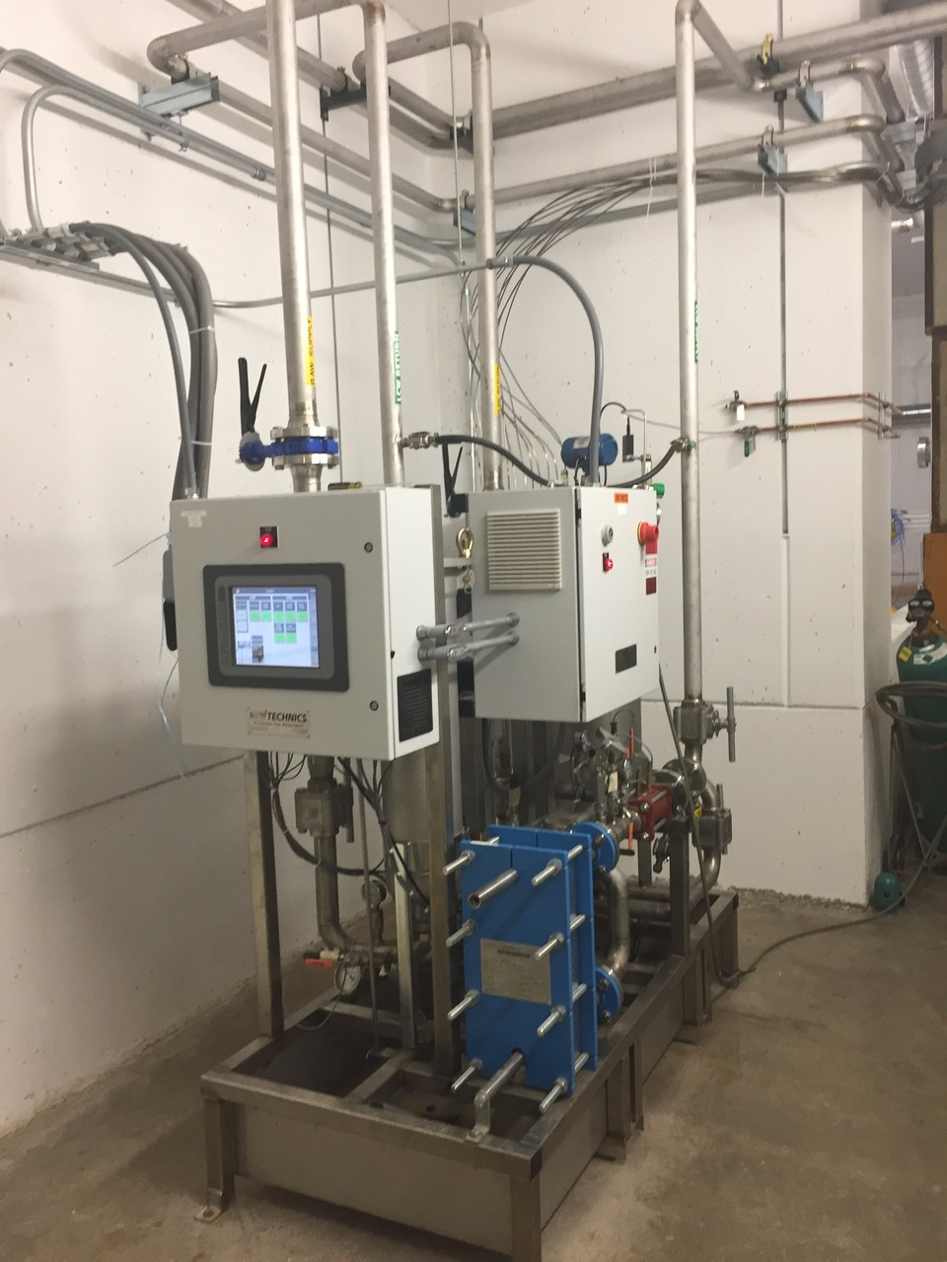
Beam Absorber RAW Skid – Highlights (Continued)
Example of a similarly designed Absorber RAW Skid at NML
Notes:
Yurick, what is the heat load of the CMTF skid?

Slide 30
Preliminary Analysis Of Designed Absorber RAW Piping

Slide 31
Preliminary Analysis Of Designed Absorber RAW Piping (Continued)
Primary piping wall thickness (T) exceeds minimum wall thickness (t_{m}) requirements

Slide 32
Installation Plan
Coordinate delivery of RAW skid to Absorber RAW Room
Supply stainless steel piping interconnecting Absorber to RAW cooling skid
Once both skid and piping system are installed and connected, pneumatic and hydrostatic pressure tests will be performed.
Notes:
Transfer from P2IT to the storage
When ready transfer to PIP-II and install.
Manifold piping from PIP2IT will be reused.
We will reuse hose and manifold piping.
A lot work involved in this procurement and installation.
Hose was field fit.

Slide 33
Ion Source Chiller and Piping System Design
Maurice Ball/Jerzy (Yurick) Czajkowski
PIP-II LINAC Complex Mechanical Fluid Systems PDR
April 21, 2021

Slide 34
Ion Source Chiller Highlights
Used during PIP2IT
Will be reused in PIP-II
Self-contained
Air-cooled chiller
Piping manifold will be reused in PIP
Special supply temperature control needs (70°F)

Slide 35
Technical Requirements for Ion Source Chiller
Building Infrastructure shall provide the Ion Source LCW System according to the following specifications:
Discharge Pressure ≥ 70 PSIG
Suction Pressure = 15 PSIG
Supply Temperature = 70⁰F +/- 1.0⁰F
Delta T (ΔT) = 7.2 F⁰
Total Heat Load = 12 KW
Total Flow Required = 14 GPM
Resistivity = 4 MOhm-CM
Built-in particulate filtration at 5 micron

Slide 36
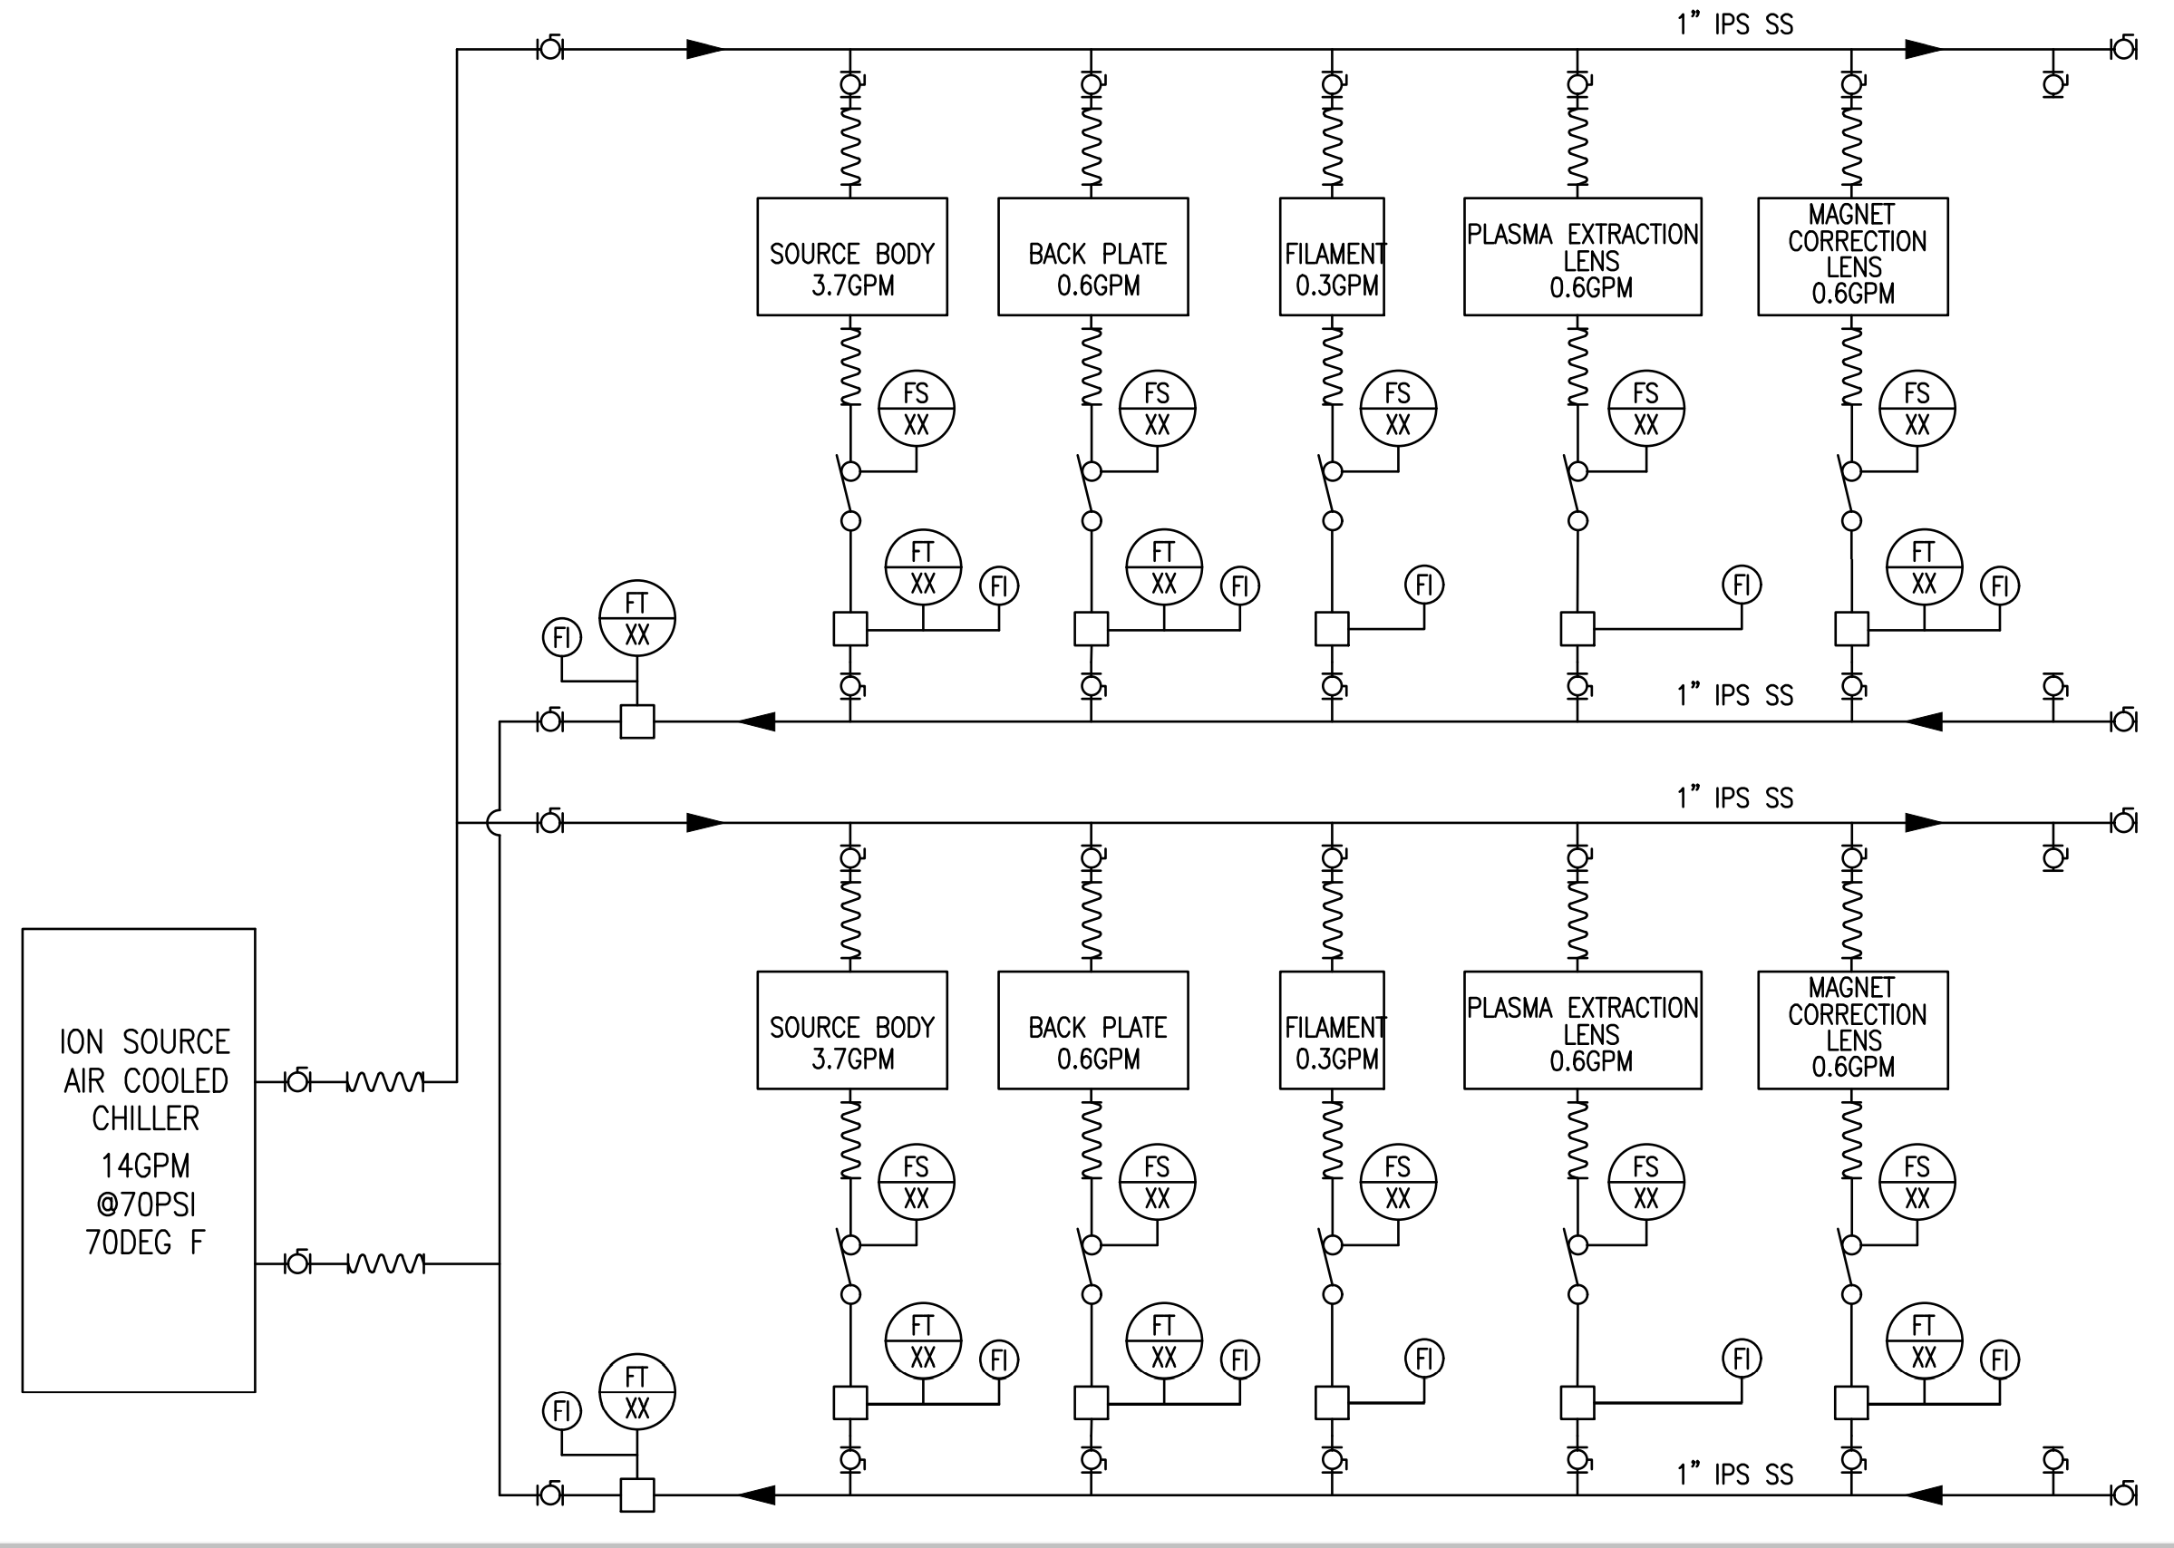
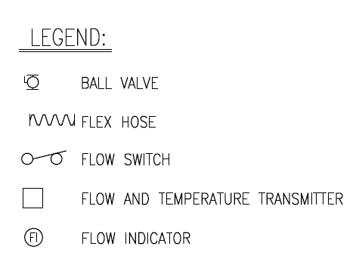
PIP-II Ion Source Skid and System P&ID

Slide 37
Installation Plan
Reusing the Ion Source Chiller from PIP2IT
After Ion Source testing completed, chiller disconnected and moved to storage
For PIP-II installation, chiller brought out of storage and installed in High Bay ground floor in cooling skid alcove
Piping manifolds from PIP2IT operation reused.
New hose assemblies created
Once chiller, piping manifolds, and hose assemblies are installed and connected, pneumatic and hydrostatic pressure tests will be performed
Notes:
Transfer from P2IT to the storage
When ready transfer to PIP-II and install.
Manifold piping from PIP2IT will be reused.
We will reuse hose and manifold piping.
A lot work involved in this procurement and installation.
Hose was field fit.

Slide 38
Photo Image - Ion Source Skid at CMTF

Slide 39
Photo Image - – Ion Source to LEBT Transition at CMTF

Slide 40
Photo Image – LEBT to RFQ Transition at CMTF

Slide 41
Photo Image – RFQ at CMTF

Slide 42
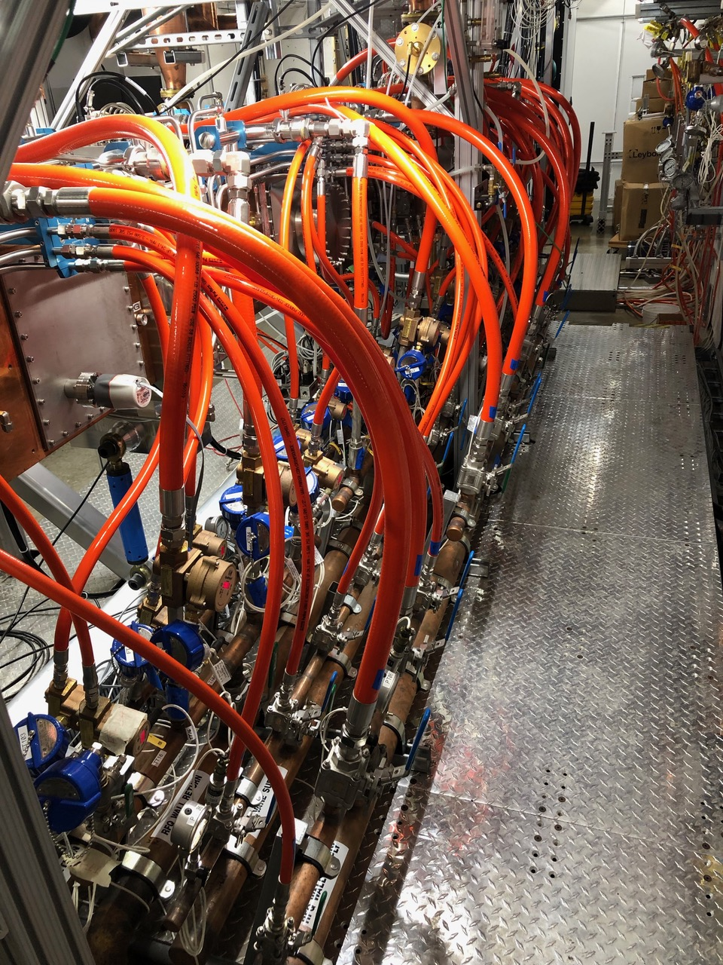
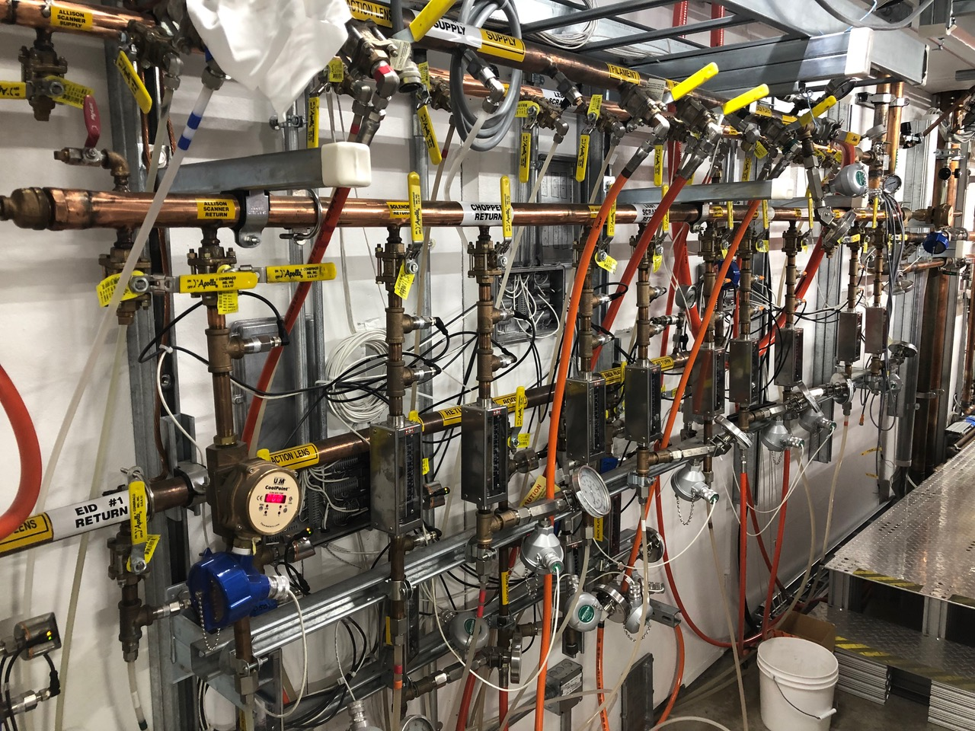
Photo Image – East Wall CMTF Cave
RFQ Cooling (Right image)
LEBT Cooling (Bottom image)

Slide 43
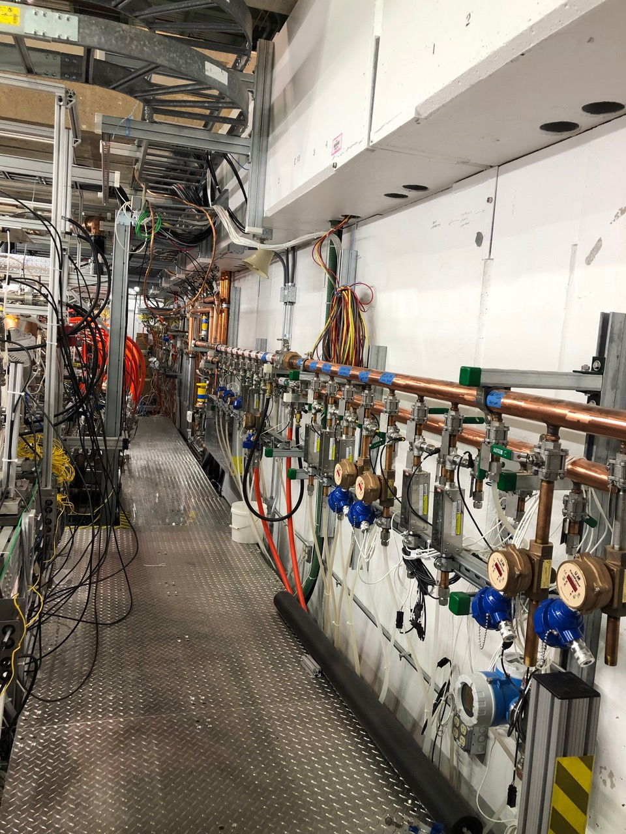
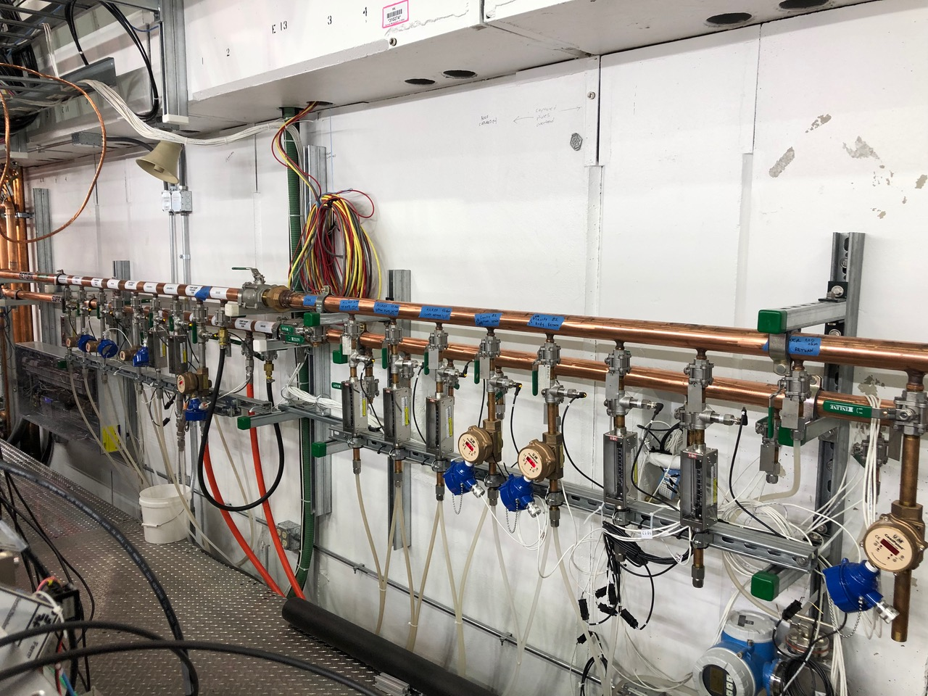
Photo Image - Warm Front End Process Fluids Cooling at CMTF
MEBT Cooling (Right and Bottom)

